Slide 1
Zoominar II on innovative success stories in the NENA region: Tool to support smallholders under COVID-19 disruptive impact?
30 April 2020
ICARDA-APRP using soilless culture techniques in greenhouses
Azaiez Ouled Belgacem & Jacques Wery
ICARDA

Slide 2
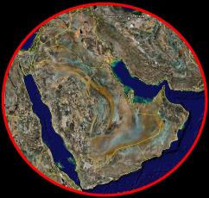
Challenges Facing Agriculture & Vegetable Production in particular in the Arabian Peninsula (General)
Harsh environment with extreme aridity;
Limited arable land;
Water scarcity & limited renewable water resource;
Rapid increase in population that requires more nutritious food.
The Arabian Peninsula (AP) is considered one of the most vulnerable regions to CC impacts
Kuwait
Bahrain
Qatar
Emirates
Saudi Arabia
Oman
Yemen
The Lowest
Water Resource
Per Capita
in the World
1.1%
4.25%
To meet food security goals there was a need for a perishable and cash crop production system with high water use efficiency.
World Water Resources
World Population

Slide 3
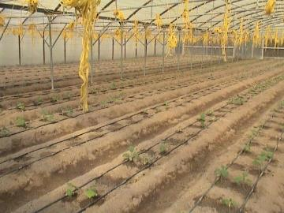
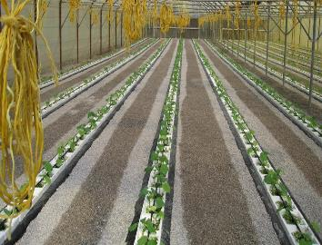
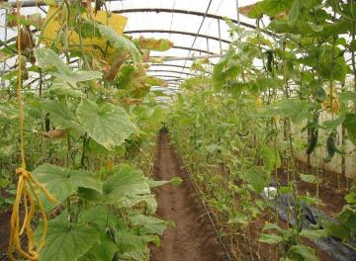
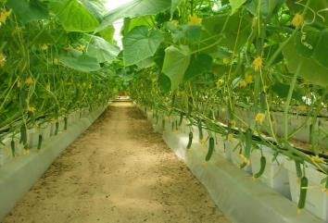
ICARDA along with NARS introduced Protected Agriculture with its Associated techniques: IPPM and Soilless Production System
Soilless culture techniques under greenhouse offer
supply of water and nutrients optimum for plant growth;
minimal water loss by evaporation; and
elimination of drainage water loss, since water is returned to the tank for recycling.
excluding the issue of soil infection and hence the danger of disinfectant residues
Before
After
50%
increase yield and water productivity as a result adoption of Soilless production system
in all AP countries
More than 2000 GH with soilless in GCC in 2018

Slide 4
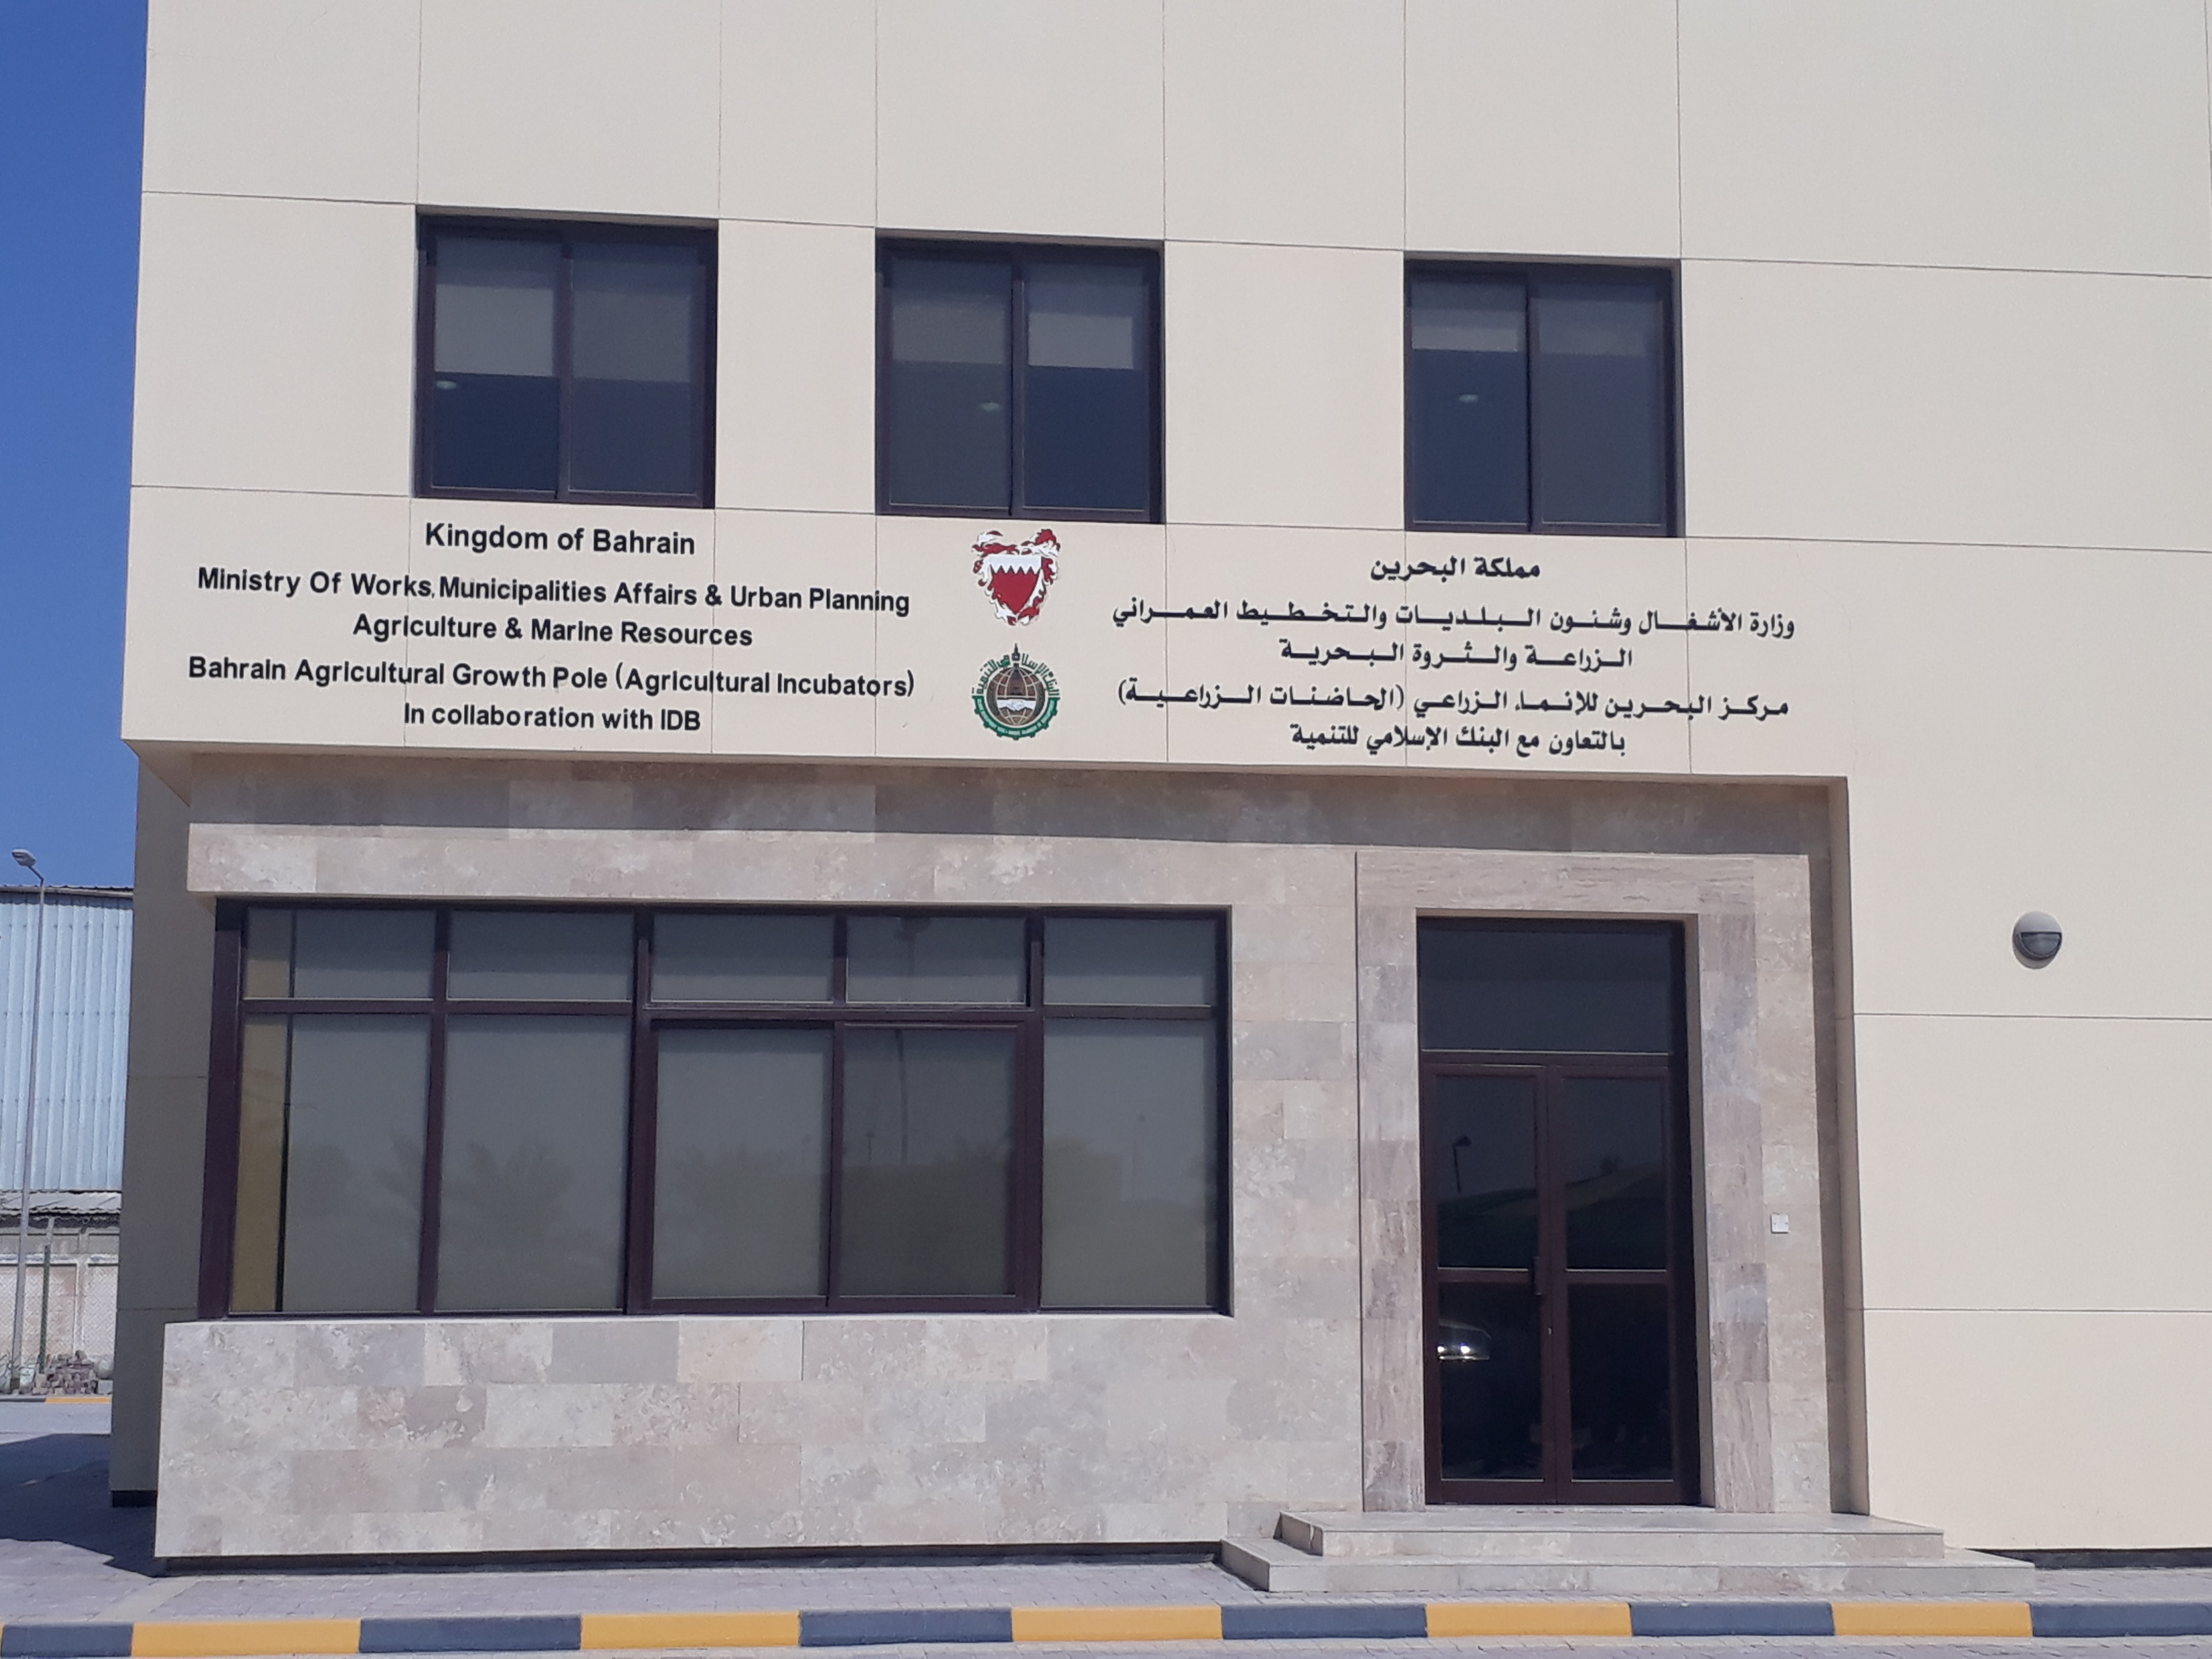
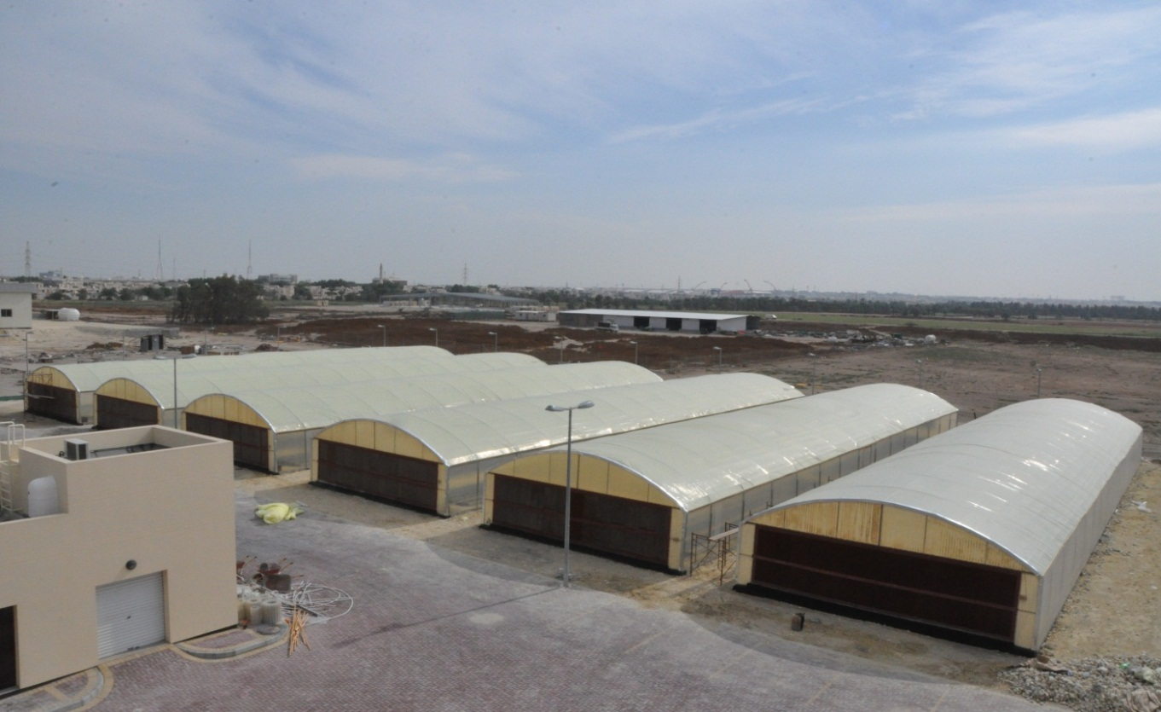
Opportunities and challenges under the COVID-19 circumstances
Opportunities
Awareness of AP Governments on the importance of PA in their food security and nutrition
Under confinement, in most countries, farmers are considered crucial. They can continue to work while maintaining proper social distancing rules.
Subsidies of GH establishment costs in most GCC countries
All stakeholders including extension agents, farmers and farm managers are well familiar with ICT technologies and easy to reach them
Existence of extension platform (KSA), Incubator (Bahrain) and NAWA company (Oman)

Slide 5
Main challenges Facing GH Production in the AP
Food supply shortages: the coronavirus is affecting the harvesting of various crops.
Most of PA crops ripe in few days such as strawberry and need large number of labors for harvesting (impossible task during social distancing).
Post-harvest: Lack of Vegetable Collection & Processing Centers (Cleaning, grading, packaging, storage and transportation) resulting in huge postharvest losses.
Supply and demand affect farmers in two ways:
- meeting the needs of customers
- their own requirements for materials, parts and supplies
Small farmers are not able to handle the temporary dip in sales and production

Slide 6
How could PA culture help farmers and or consumers face its disruptive impacts
Protected agriculture is very important for food security in the AP
Better nutrition through improved food diversification (mainly under aquaponic system)
Small units could help farmer households or communities to produce their own fresh crops
The use of renewable energy will have a considerable impact on the environment and on the economy at the farm level

Slide 7
What role could FAO and partners play to facilitate the implementation and/or scaling of these innovation in the region
Support on R4D activities specially:
Develop PA systems adapted to smallholder farmers (including home gardening and vertical farming in and around cities)
Necessity to include PA (under hydroponics and aquaponics) in more diversified farming systems adapted to the desert environment of the AP (oasis microclimate: date palm, vegetable, cereals and legumes, forage)
Introduce digital agriculture with focus on extension system (smart extension diary, Open Data Kit (ICARDA is already implementing in collaboration with NARS in the AP))
Improving cooling (renewable energy) and production system for less energy and water consumption
Utilizing locally available materials mainly in soilless media and fertilizers
Value chain and marketing
Continue on greenhouse structure and production systems subsidies
Governments should develop facilities to purchase and buffer stuck of greenhouse production at each province. This is insured the market for the production and can be used in emergency cases such as coronavirus break out.
Training and capacity building of all stakeholders (mainly in smart extension)

Slide 8
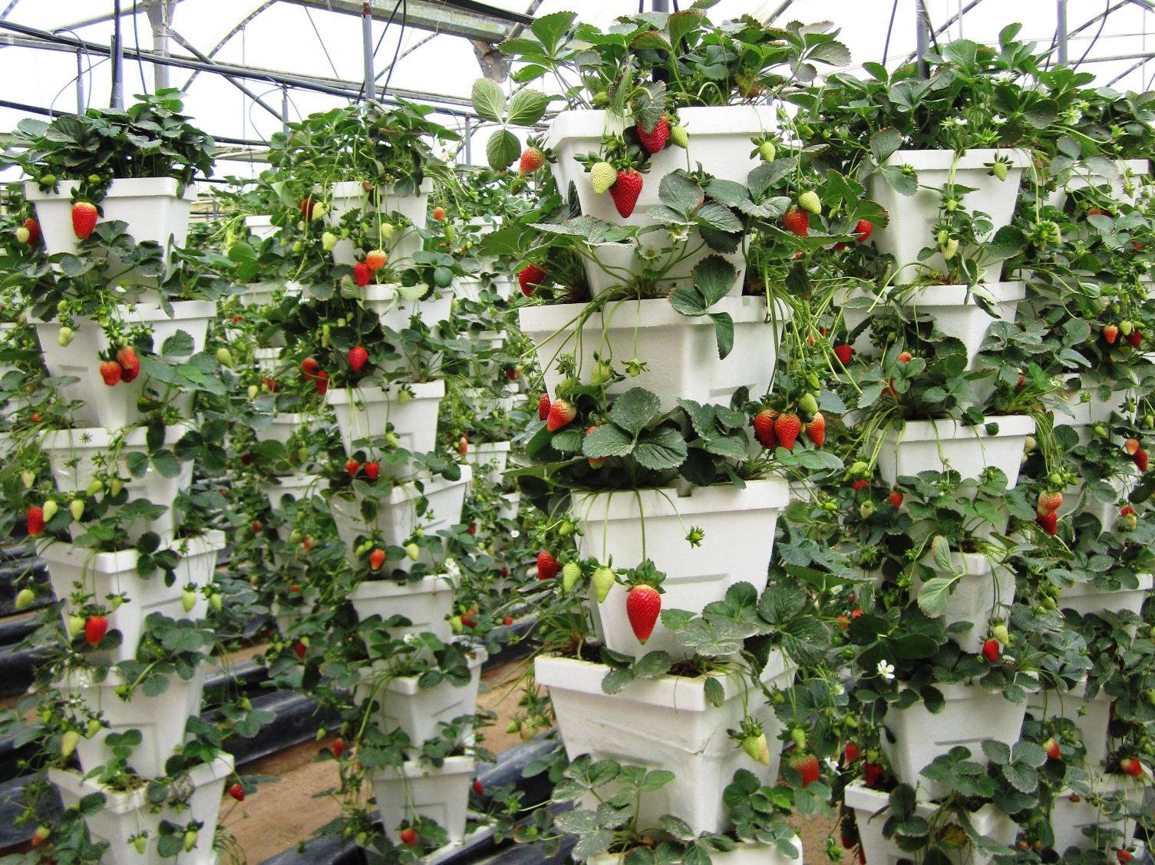
Thank You

Slide 9
ICARDA R4D in GCC
Started in 1997 where Representatives of GCC & Yemen identified Protected Agriculture as a priority for the Arabian Peninsula Region;
Teams were formed in the 7 countries and Problems were identified;
Research plans were develop to work on the following techniques:
  Hydroponics Production Systems
  Integrated Production & Protection Management (IPPM)
  GH Cooling and ventilation
  Net Greenhouse
  GH management & control
  Solar power for GH operation
  Growing Rooms
2002, introduced the proven techniques directly to growers;
The proven techniques developed by ICARDA teams in the AP were extended to Afghanistan, Baluchistan and Yemen (terraces) through funded projects from different donors

Slide 10
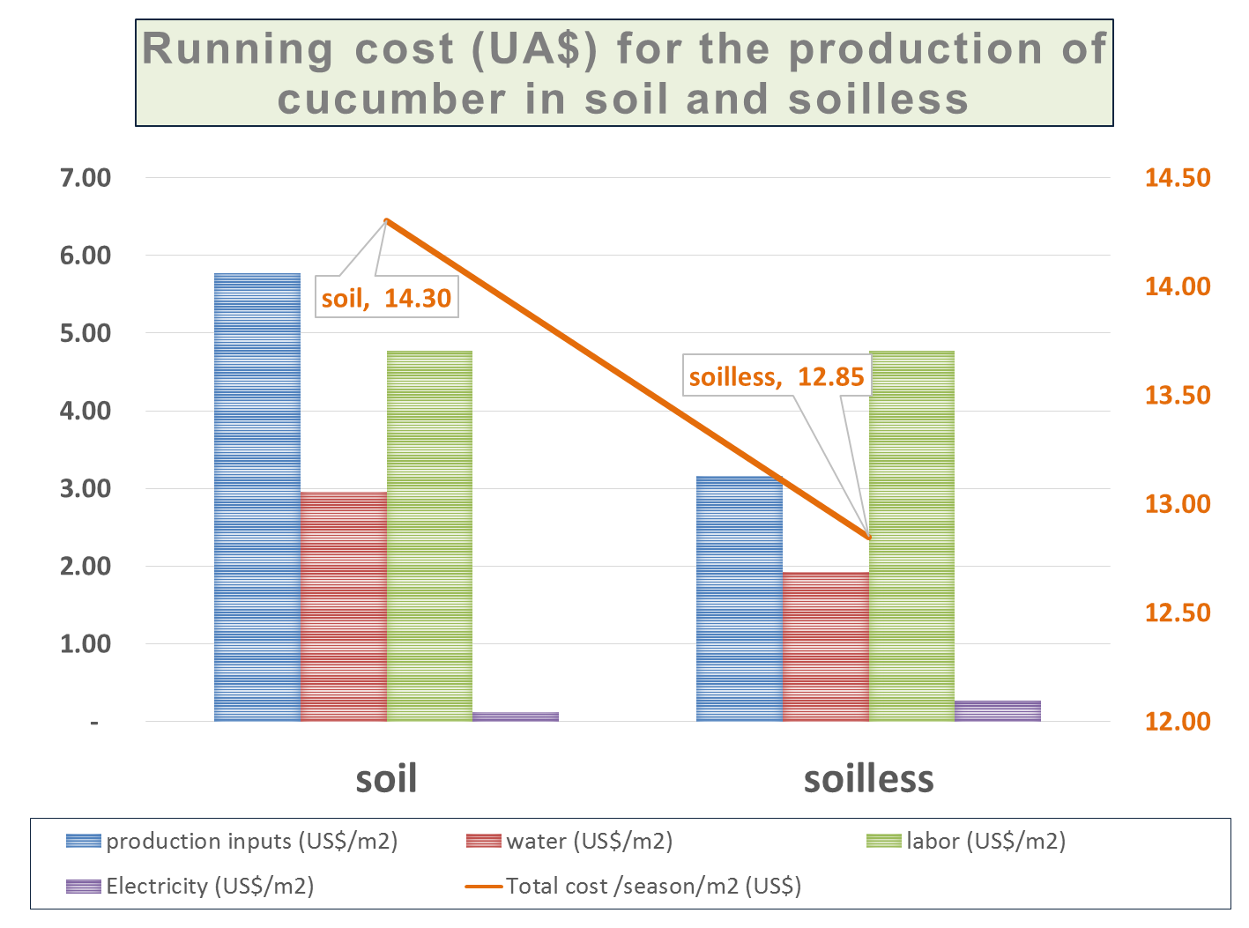
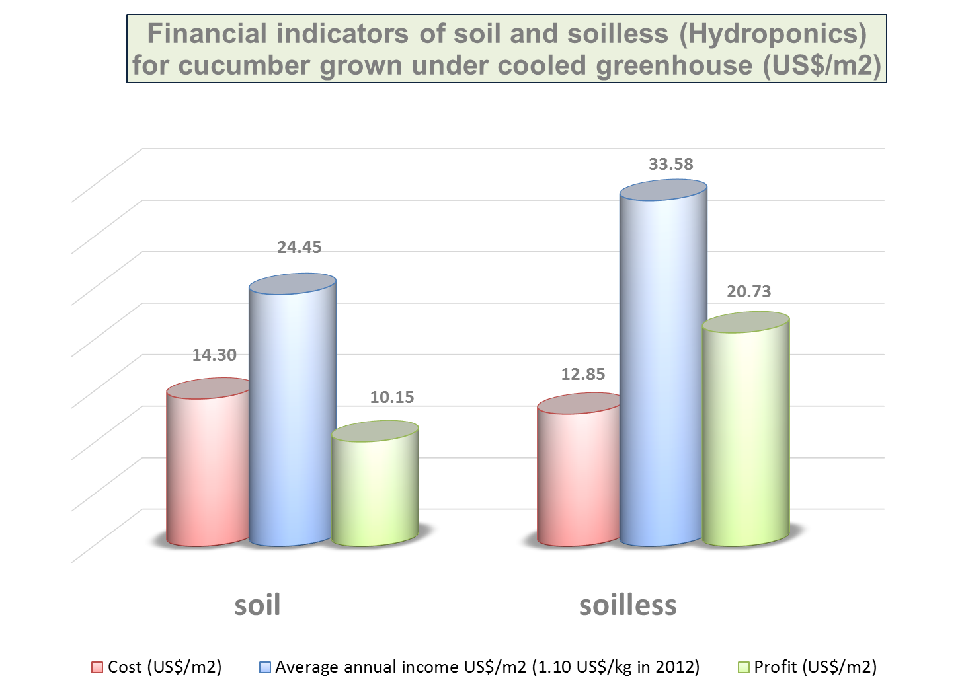
Multi-criteria Assessment of technologies
Reference; ICARDA 2008 – Challenges facing agriculture sector in Qatar

Slide 11
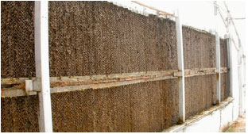
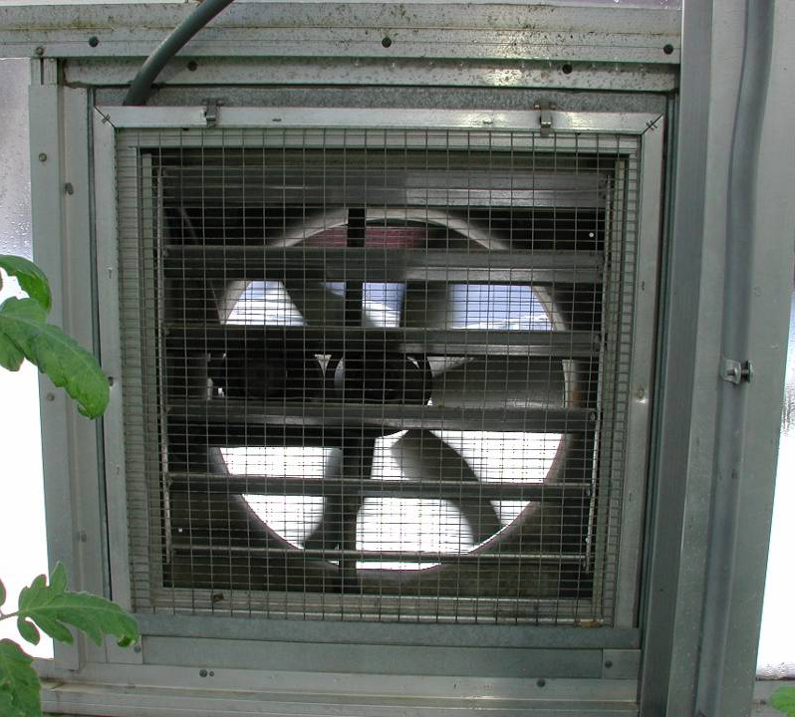
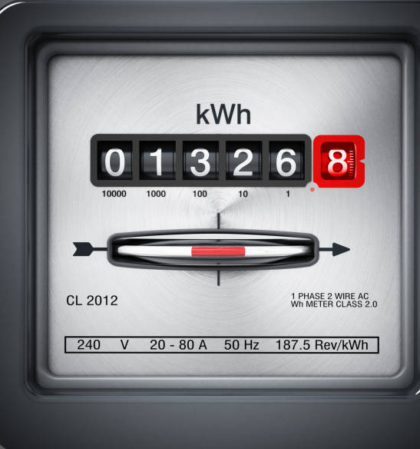
1
Expensive and required maintenance and replacement
Net House vs Cooled Greenhouse
Pad and fan challenges and constrains
2
High water consumption: Average in GCC countries 8 liter/day/m2 of greenhouse (collected from different ICARDA studies)
greenhouse cooling systems use large amounts of fresh water, which in most cases is more than what is required for plants under irrigation, especially during the humid season, leading to low efficiency.
3
Electricity: More than 20,000 kWh for a single 8x40m GH per year(collected from different ICARDA studies)
Notes:
Dirty cooloing pads lose efficiencey

Slide 12
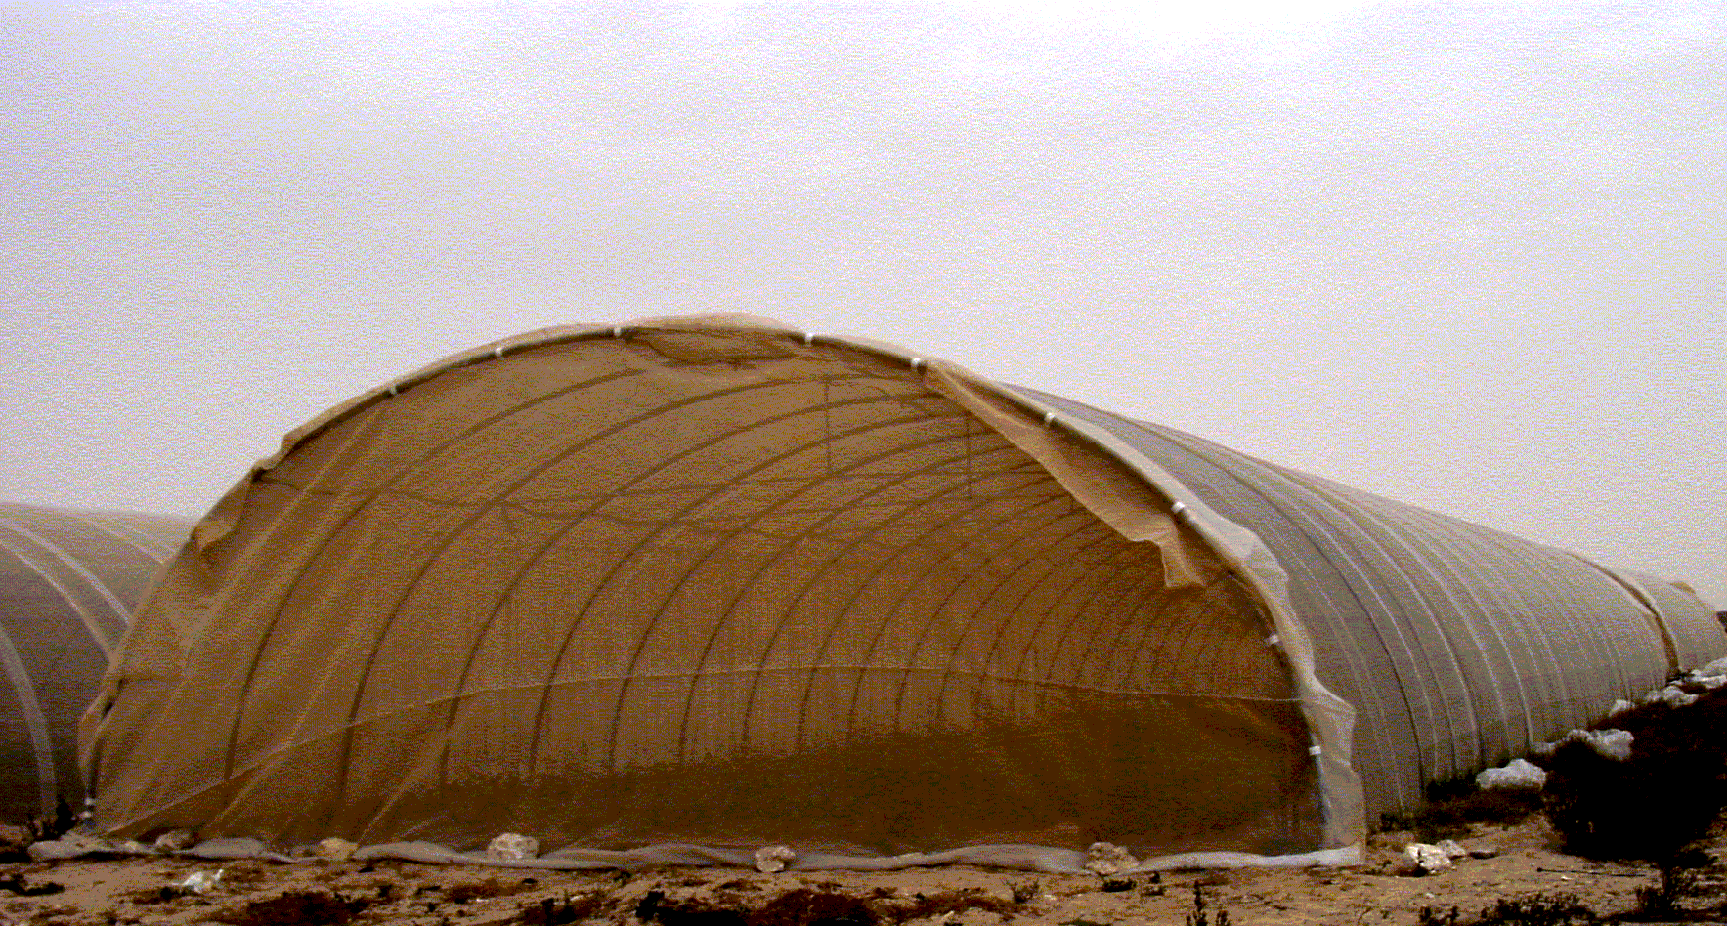
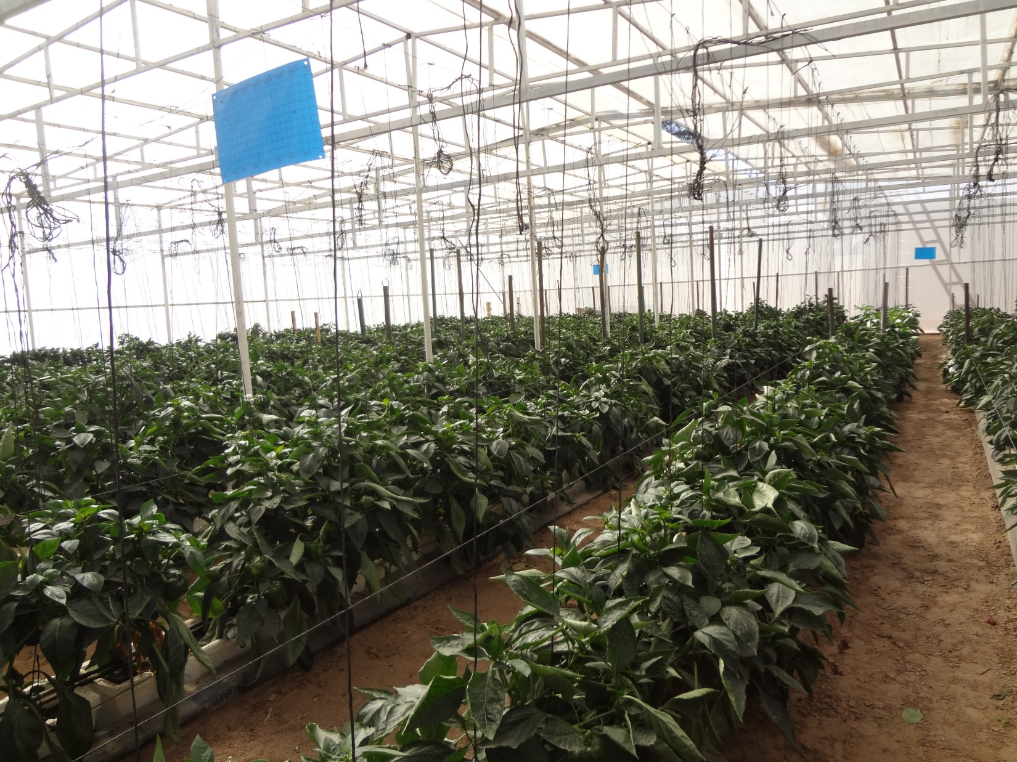
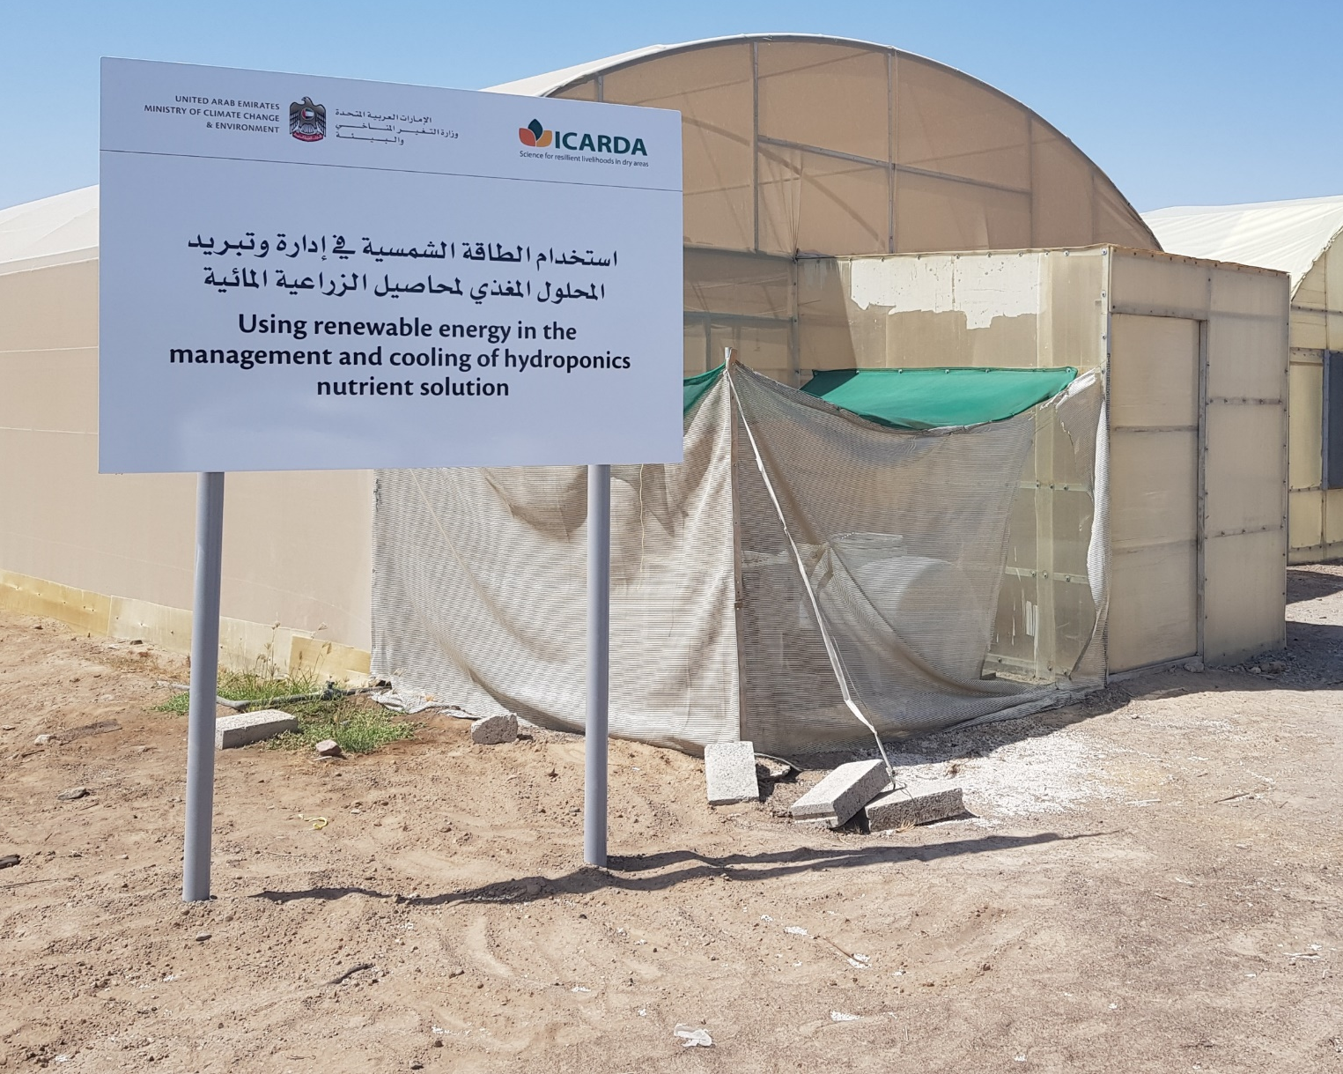
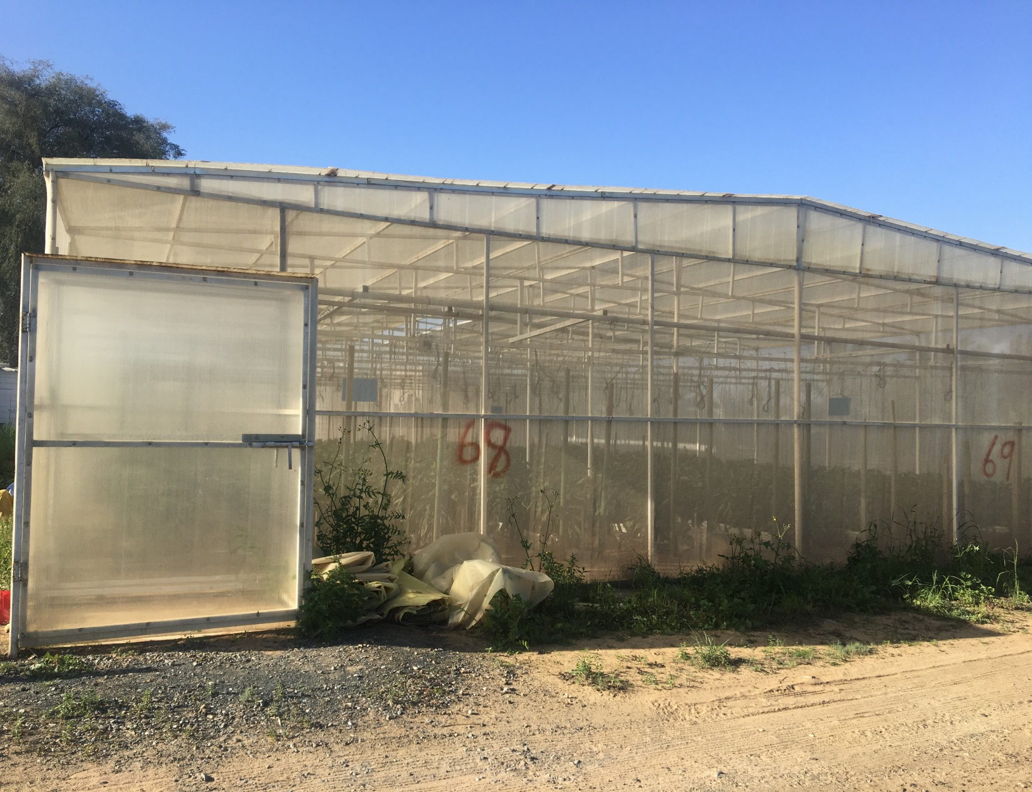
Net-house
To address the constrains of greenhouse cooling, ICARDA and NARS have introduced net-houses to the region since 2008. This is a greenhouse structure covered by an insect proof net which can allow vegetable production in desert conditions 8-9 months of the year. This leads to high yields due to water and electricity savings and obtains the same net benefit of a cooled greenhouse for 12 months.

Slide 13
Cooled GH Vs. Net House
Cost of Production, Productivity and Profits
of Cucumber in Cooled GH and Net GH in AQVPCo. - Qatar
46% less investment cost
> Cost including GH depreciation
Source: AQAPC
Notes:
No significant different in net benefit (only 2.13 QR/m2 or 6.5%)

Slide 14
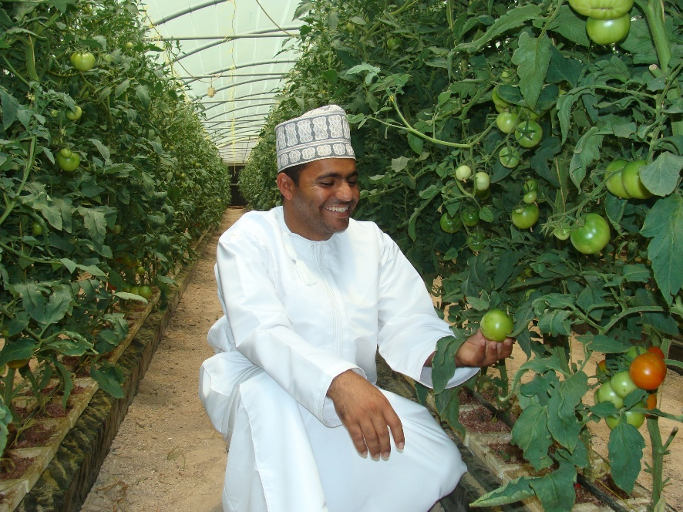
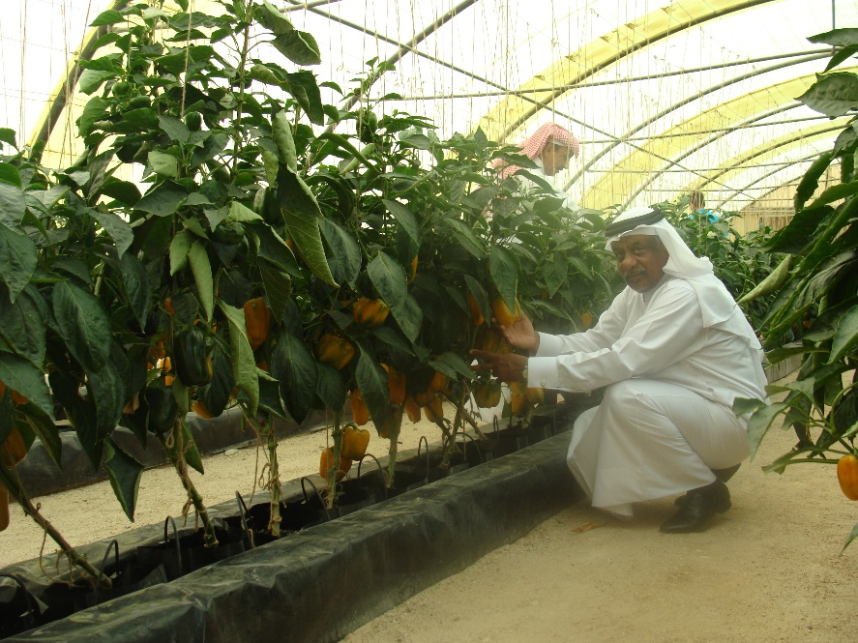
Economical Comparison between Cooled GH and Net GH for the Production of Cucumber at Rumais Research Station, Oman
 | Cooled GH |  | Net GH
Input cost | Quantity | Cost (OMR) | Quantity | Cost (OMR)
Seeds | 1000 | 50 | 1000 | 50
Fertilizers |  | 56.86 |  | 56.86
Crop protection |  | 26 |  | 26
Irrigation water | 30 m3 | 15.8 | 31 m3 | 16.4
Cooling water | 106.5m3 | 56.1 | 0 | 0
Electricity |  | 33 |  | 3
Total Input Cost |  | 238 |  | 152
Production kg |  | 5800 |  | 5300
Income |  | 580 |  | 530
Net Profit |  | 342 |  | 378

Slide 15
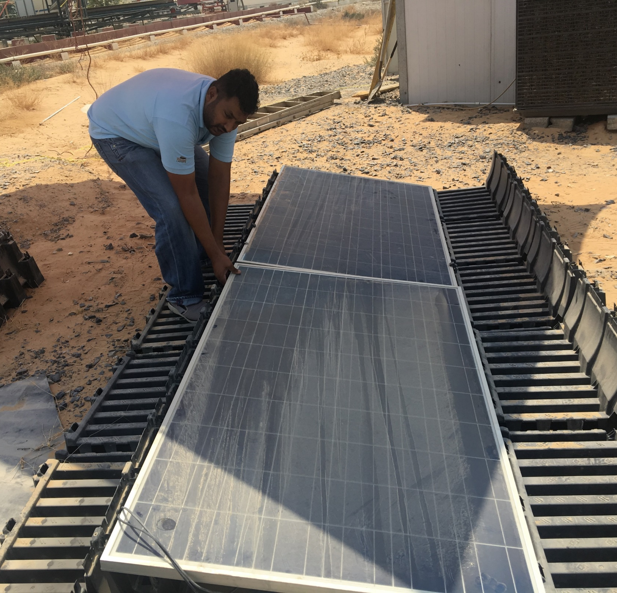
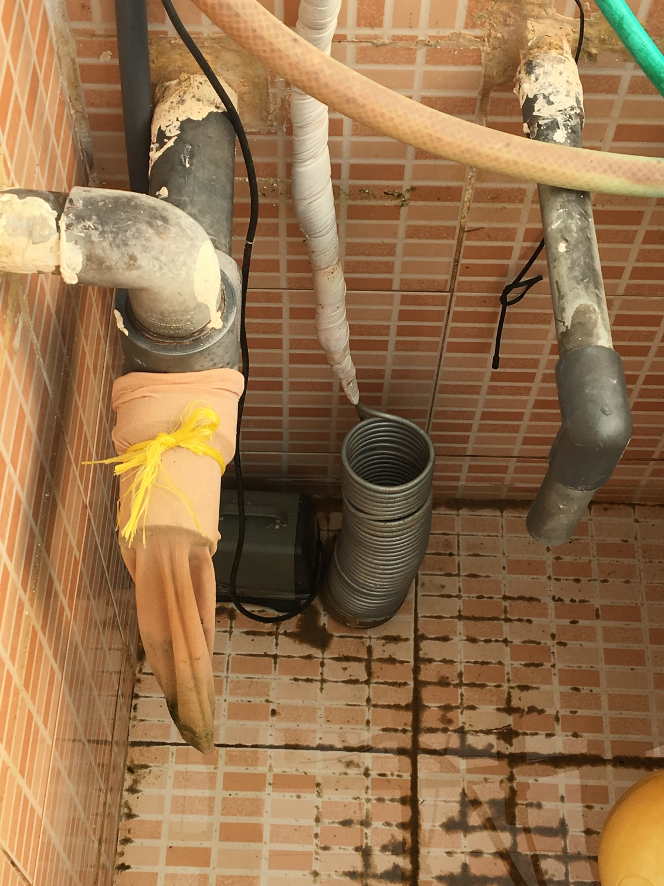
Next Step: expand the net-house production period
innovative solutions including root zone cooling (RZC) combined with utilizing solar energy to expand the production period.

Slide 16
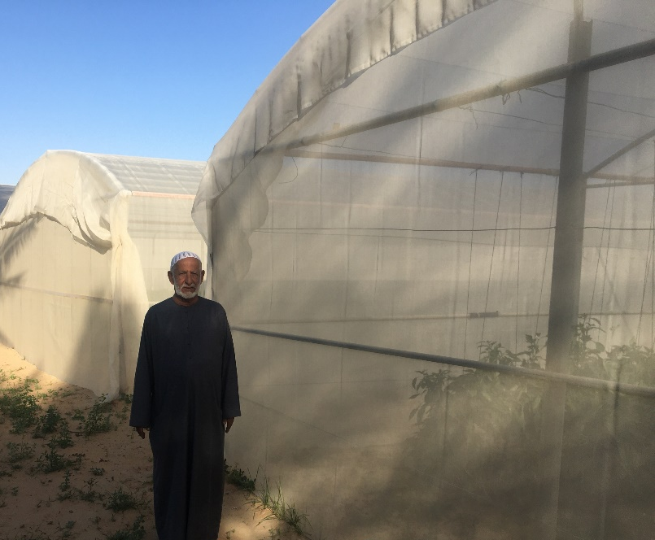
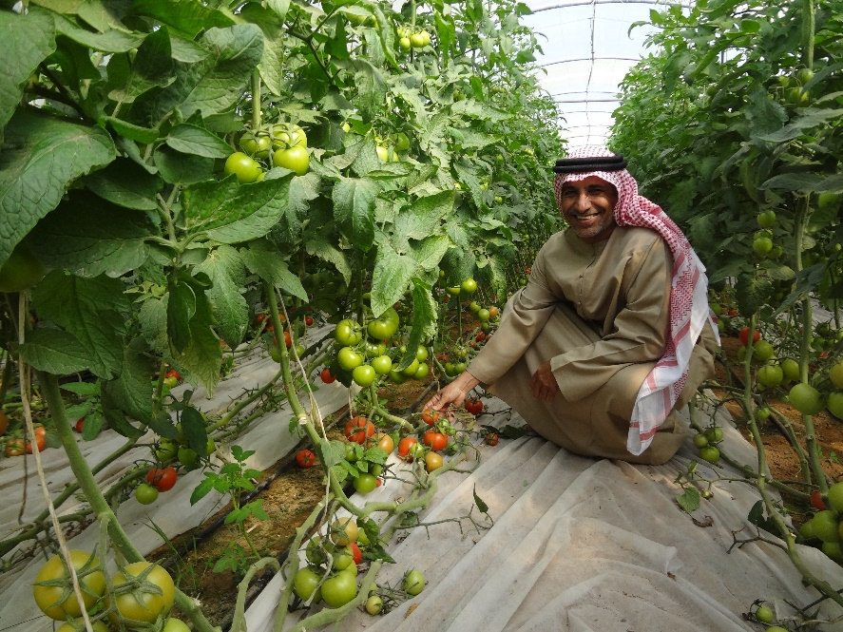
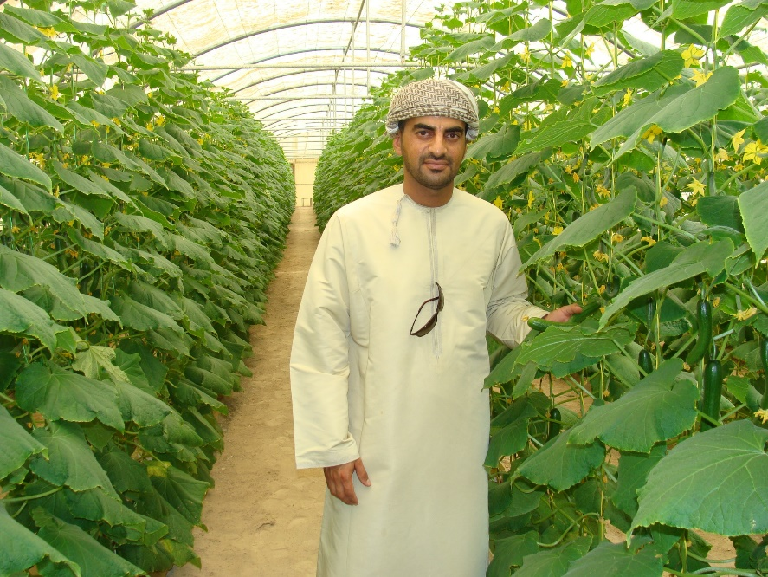
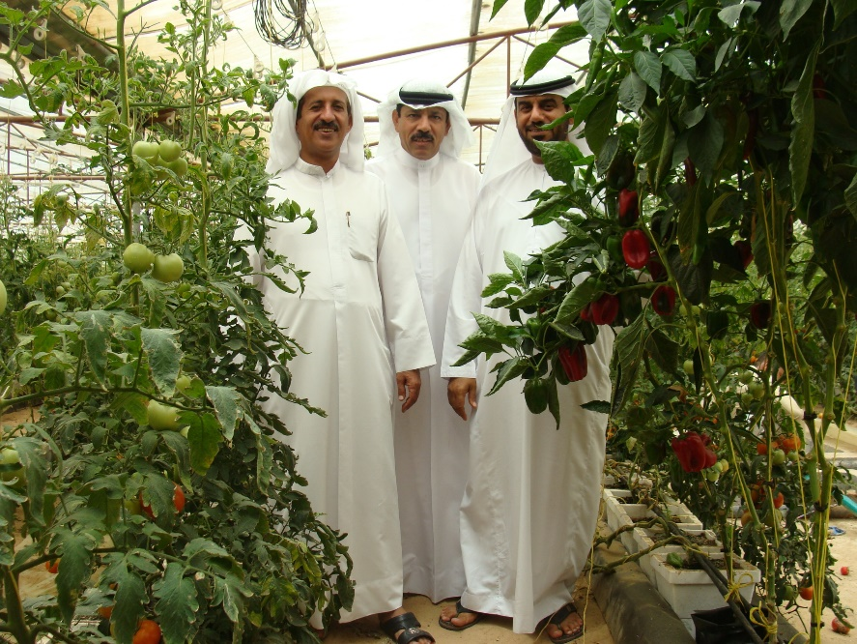
Net income of small folder farmers in soilless is 150-240% higher than soil production system as a result of higher yield with better quality.
Water productivity in soilless culture is higher by more than three times that of soil culture.
Soilless Agriculture earns more income from less water and less land.
Net-houses saved about 77% of water with a 10% increase of profitability compared to the cooled greenhouse in Oman during November-February, and, March-May 2017.
The net-houses also saved 28.5m3 of water per ton of cucumbers produced compared to cooled greenhouse.
The Net-house save about 150 kWh electricity per year per m2 of GH

Slide 17
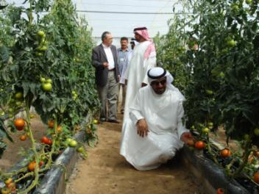
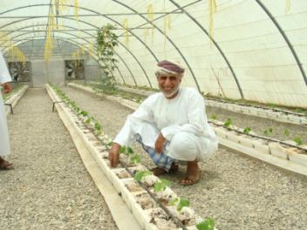
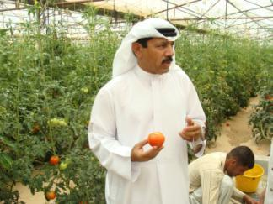
Growers reactions during Field Visits
“Mr. Mohamed Al Naeemi, Ajman, UAE
With Hydroponics, Water consumption is far less
for cucumber and tomato production comparing
to soil”.
Mr. Salim Bin Khamis Al Gadae, Al Sowaiq, Oman
“This is my second year experience with Hydroponics. I can say Hydroponics compared to soil use 80% less water meanwhile the production is about 80% higher”.
Mr. Mohamed Alwan, Ajman, UAE
“With Hydroponics, I am using far less fertilizer comparing to soil”.

