Slide 1
Training of the enumerators for collection of data on gender preferred dual purpose crops
A presentation
Sapna Jarial
IICRISAT
Scientist
Niamey, Niger| 09 06 2014

Slide 2
Training of the enumerators for collection of data on gender preferred dual purpose crops
Data collection
Please collect basic secondary information as suggested in protocol-
collect information from-statistics and reports from government departments and ministries,
programme and project documents from agencies and NGOs,
studies and surveys from universities and research institutions, and
documentation from service organisations in the local area.

Slide 3
Team Contract
The team contract is a list of rules and norms that the whole team has discussed and agreed upon for team behaviour and for dealing with crises during their fieldwork.
During the preparatory workshop ask the participants to: brainstorm on possible problems that may occur in the field and list them, e.g. conflicts, accidents, death.

Slide 4
Team contract
What do we do if.............
.….. a member of the team is late again for the morning session?
.….. a member of the team is over-enthusiastic and keeps interrupting the farmers when they are speaking?
.….. in a review meeting with farmers, the local leader tries to control the choice of research priorities?
.….. part way through a small group interview some farmers say they must leave to attend to other matters?
discuss and reach consensus about solutions or behavioural norms expected of the team members for each possible problem
decide on a strategy for dealing with unforeseen circumstances and elect responsible team members ?
write up and duplicate the team contract ensuring that everyone has a copy.

Slide 5
Therefore make a team contract.
& make a work plan…..
Workplan
The Workplan includes a description of objectives, expectations, process and an overall action plan
The Workplan is accompanied by a series of Activity Sheets -- one for each and every step in the PRA process indicating the issues, tools, facilitators, recorders and materials needed .
By completing these two types of worksheets, everyone knows what they are doing and why.

Slide 6
Before Starting the exercise…….Contact local authorities
In many cases permission from local authorities (provincial-, district- and village-level) is necessary before excercise can take place. it is essential that they be involved from the beginning. They should be contacted in ample time before the activity is scheduled to take place.
Upon arrival in the area, visits with the local authorities are not only important as a matter of courtesy, but also as sources of information.
Make logistical arrangements
An initial visit to the selected village(s) is necessary to explain the purpose and methods of the excercise and to find out whether people are interested. Then logistical arrangements can be discussed.
The team should strive to integrate as fully as possible into the life of the villagers but not impose on them. This might mean asking someone to prepare local foods for the team but contributing foodstuffs sufficient to amply cover the needs of the team and people who may join it for its meals.
To create a friendly and open atmosphere conducive to participatory planning, and to facilitate efficient time-use during the fieldwork, it is best if the team stays overnight in the village for the duration of the work.

Slide 7
Please do not forget …..
maps
flip chart paper geometry set scissors paper clips
plain paper A3 cards
files to keep drawings in
video camera and film note books pens,
markers tape string rulers coloured sticky paper
Camera
Banner for ground work

Slide 8
Field Equipment:
tents sleeping bags or bedding
mosquito nets flashlights and batteries kerosene
food supplies water supplies, if necessary cooking stoves and utensils washing utensils and soap
And: personal effects medications against malaria, diarrhoea, etc. as necessary
copy of Team Contract
copy of Workplan
copy of Rapid Appraisal Activity Sheets

Slide 9
Now… work plan
Objectives
Why is this exercise being carried out? Include the objectives of the community as well as those of the Research team or sponsoring agency. Make sure the objectives are specific, time-bound and measurable.
Expectations
Who is the team for? What will happen to the information collected and analysed? How will it be used and by whom?
Process
Decide what information needs to be collected. Review the three toolkits and decide which tools are needed at each stage in the process.
Action Plan
Design a tentative time table of events. Which activities can be done at the same time, which have to be done in sequence? Identify the possible participants for each activity, e.g. women/men, young/old, rich/poor, etc.

Slide 10
Attach accompanying Activity Sheets for each tool.
RAPID APPRAISAL ACTIVITY SHEET
Activity Sheet #_____ Date:
Village:
Place:
Time:
Facilitator: (responsible for leading the discussion with the participants, asking questions, introducing the tools, etc.)
Recorder: (responsible for taking notes about what is said and drawing pictures of what is designed, mapped, or modelled)
Translator: (if needed)
Step: (development context, livelihood analysis, stakeholders priorities for development)
Tool: (trend lines, village map, seasonal calendar, etc.) Participants: (by gender, age, wealth, ethnicity, etc. ) Triangulation with:
activity #__ activity #__ participants:
Process: (a step-by-step description of what will happen)
Materials: (materials needed to be prepared, taken with you or found when you get there)

Slide 11
Risks of rapid appraisal
1. Raising expectations
It is essential that the team be honest and clear, from the beginning and throughout the process, about whether or not resources from outside development institutions will be made available.
This might involve collaborating with another agency that can respond to local concerns or passing on the request to the appropriate government agency.
2. Agency domination
If the participatory process is constrained by agency expectations it is important to either:
educate the agency by inviting some of its key people to participate in exercise so that they can understand the importance of the process and its implications for sustainable, equitable and effective development; or
avoid using participatory RA so as to avoid falsely raising local people’s expectations.

Slide 12
3. Revealing failure or need for change
When the RA is carried out where development activities are already being implemented, the findings may reveal negative impacts, failure or needs for improvement. In such cases, the RA team has two responsibilities:
to communicate the bad news to the supporting institutions, and
to explore together with the community various options for solutions and improvements.
4. Learning about illegal activities
The right way to handle such information depends on the openness and responsiveness of the government. In no case should such information be used in any way that might result in serious sanctions on the village that participated in the RA

Slide 13
5. Stirring up conflicts
It is not always the case that the participatory RA process leads to consensus; indeed it may expose deep differences and conflict among various groups. The process can also be seen as a challenge and threat by the more powerful groups because of its emphasis on ensuring that women and disadvantaged groups participate fully. When such conflicts become apparent, or are very likely to occur, the RA team has only two options, either:
to stop the RA, or
to use negotiation and conflict resolution methods to explicitly acknowledge and work with the conflicts.
The second option requires highly specialised skills and expertise and should never be attempted by inexperienced facilitators. It also requires a much longer time frame. In any case, issues of conflict must be handled very carefully as they can lead to violence.

Slide 14
Now……Working in the field
During the field work itself the team lives in the selected village(s) and uses the toolkits and RA Workplan and Activity Sheets to guide its work.
On a daily basis the team uses the RA tools to collect and analyse information. Also on a daily basis the team gets together to review how things are going in terms of interactions with local women and men, team work, logistical problems, and so on.
The team also spends time each day on a preliminary discussion of the information gathered to see if adjustments to the Workplan are needed.
It is important to recognise that carrying out the field work requires skills . The tools cannot stand alone. In all cases they must be accompanied by skilled facilitation, and in many cases, additional field methods, such as semi-structured interviews, will be needed to further explore and verify the learning gained from using the RA tools.

Slide 15
How to be a good facilitator
Be an active listener
Good facilitators show interest in what people have to say. They listen closely enough to summarise or paraphrase what is said, to pick up on the direction of discussions and to detect underlying attitudes or judgements. Active listening is key to all facilitation skills.
Be observant
Good facilitators notice group dynamics, including who is speaking and who is not, and how various groups of people interact, e.g. women and men or different ethnic groups. They use observation to understand how and when different methods must be used to ensure that everyone has the opportunity to participate.
Ask questions
Good facilitators use questions to start, focus and deepen the learning of the participants. A simple "Why?" is often enough to move a discussion to a deeper level. Who? What? When? Where? and How? are all good questions for bringing out details.
Be flexible
Good facilitators respond to the needs of the participants and are willing to adapt or change methods, tools and questions in order to do so.
Be organised
Good facilitators are well organised. All necessary materials and logistics are prepared so that people do not lose time and become frustrated. The facilitator keeps the overall RA objectives in mind throughout the entire process.
Be knowledgeable but clear
Good facilitators are knowledgeable about development, but they are also able to communicate in simple statements and to ask focused questions. Good facilitators speak in plain language and do not use fancy words or jargon.
Be assertive but not controlling

Slide 16
What is Your Role?
For every tool or method, and for every group of participants, at least two Team Members must work together, one as the facilitator and one as the recorder:
Facilitators-
introduce purpose of tool,
organise/divide groups of participants,
ensure active participation by all groups, and
listen and ask questions.
Recorders-
make a copy of the maps, graphs, calendars, etc. in a notebook for future reference
(photographs or a videotape may be desirable too),
take detailed notes on the issues presented and discussed by the participants,
make notes about group dynamics (including who is participating and who is not), and the comments people make while participating or observing.

Slide 17
How to use additional field methods? Please use the questions for facilitation that I shared with you!
Direct observation
For every observation made, remember to write down two things:
what was observed, and
your interpretation of what it means. It is important to cross-check your interpretations with the findings from other methods and with other participants.
Semi-structured interviews
The semi-structured interview is a method that can be used at any time in an RA. It is useful to probe key questions and follow up on topics raised by other tools. Semi-structured interviews can be done with individuals or with groups.

Slide 18
Key informant interviews
For example, to learn more about resource use, key informants who may prove particularly useful may include:
an old person who knows about the history of resource use in the village
a headman who has decision-making power about land and water allocations
a poor person who depends on tree products during the hungry season
a woman who participates in the new livestock project
Informal group discussions
Unexpected learning opportunities often arise during an RA, and informal group discussions is a good method for responding to such opportunities. It requires only a keen interest in listening to people, and some flexibility.
Brainstorming
all ideas are welcome;
no criticism of ideas is allowed, and
the more ideas the better.

Slide 19
Gather together all relevant information that has been collected.
Sort the information into key categories which belong together, especially
  key Development Context findings,
  key Livelihood Analysis findings, and
  key Stakeholders’ Priorities for Development findings.
Within each of the three key categories for analysis, take note of
  similarities
  contrasts, and
  relationships and linkages.
Further sort the information into sub-categories which belong together, including
  environmental issues
  economic issues
  social issues
  institutional issues
  major issues for women
  major issues for men and
  major issues for each socio-economic group.

Slide 20
Across the sub-categories for analysis, take note of
  similarities
  contrasts, and
  relationships and linkages, including those to intermediate- and macro-level structures and patterns.
Be sure to highlight the pieces of information that, when put together, will answer the SEAGA questions.
Put the analysed pieces together in a way that tells a complete story.
Build up the case for the Best Bets Action Plans.
Add concrete recommendations for follow-up.
Across the sub-categories for analysis, take note of
  similarities
  contrasts, and
  relationships and linkages,
Be sure to highlight the pieces of information that, when put together, will answer the SEAGA questions.
Put the analysed pieces together in a way that tells a complete story.
Build up the case for the Best Bets Action Plans.
Add concrete recommendations for follow-up.

Slide 21
Analyse the process:
Many make the mistake of focusing only on the ‘data’, rather than reflecting also on the RA process as a whole. The process of discussion, selecting priorities and making decisions is just as important in the development of an action plan as the information itself. It must be recognised that empowerment will not emerge from the information or ‘data’, but from the process around the generation and analysis of the information. Critical reflection on the process, therefore, allows for an understanding of whether local knowledge and capacities were enhanced. The extent of community participation, the behaviour of the RA Team and the strengths and weaknesses of the selected tools are only some of the process issues important to reflect upon.
Participation: What percentage of the community’s total population participated in the RA? How many were women? men? What was the break-down for each of the socio-economic groups (e.g. richer, poorer, high caste, low caste)? What strategies or methods were used to reach as many different groups as possible?
What worked best? What did not work? Were certain groups under-represented? If so, why?
RA Team: How did the participants respond to the RA Team? Were there any problems with rapport? Were Team members respectful, patient and interested? Was the RA well organised? Was the Team flexible enough to meet new needs as they became apparent? Was enough time allowed? What were Team members best at? What could Team members improve next time?
Tools: How did the participants respond to each tool? Did they actively participate? Did some contribute more than others? Who? Why? Did the tools elicit useful information? What sort? What were the drawbacks or limitations of the tools? How the tools could be improved?

Slide 22
Outline for a Village Profile
Name of village:
Township or district:
Date:
Prepared by:
Village History
Development Context
Environmental patterns Economic patterns social patterns institutional patterns key inter-linkages among the patterns key constraints for development key supports for development
Livelihood Strategies
Occupations (by gender, by socio-economic group) labour patterns for meeting basic needs (by gender, by socio-economic group) use and control of resources and benefits (by gender; by socio-economic group) income and expenditure patterns (by gender, by socio-economic group) , crop preference, breed preference, fodder preference – collect the samples of seeds.- 100 gram
Development Priorities key problems (by gender, by socio-economic group)
implications for stakeholders (both insiders and outsiders) Best Bets Action Plans (by gender; by socio-economic group)

Slide 23
How to do work-
The following types of groups of participants are included at various points in the SEAGA toolkits:
Community: the entire community, women and men, children and elderly, rich and poor.
Gender focus groups: separate groups of women and men (including a mix of socioeconomic groups).
Socio-economic focus groups: separate groups of people from different socio-economic categories, e.g. by wealth, ethnicity, caste or other differences, as defined by the participants in the Village Social Map (including both women and men).
Age focus groups: separate groups of elderly and young (including both female and male).
Households: all households members, women and men, children and elderly (at least two households from each socio-economic category).
Note 1: In situations where it is not culturally appropriate to work with women and men in the same groups, separate groups must be formed and the results compared and discussed.
Note 2: Focus groups should have about 3 to 10 people. If a focus group is too large, divide it into two groups. Upon completing their analyses, have them present their findings to one another for comparison and discussion

Slide 24
Tools to use –please refer the protocol
2nd thing
Participatory methodology tools Inside the production system-
2.1Contextual analysis
2.1.1 Problem identification technique
2.1.2 Social Map
2.1.3 Transect
2.1.4 Resource Map
2.1.5 Trend lines
2.1.6 Venn diagram
2.1.7 Geographical Information System
2.1.8. Institutional Profiles
1st thing- Village information requirement-
Secondary Sources:
For technology assessment and refinement

Slide 25
3rd thing
2.2 Livelihood analysis tools
2.2.1 . Seasonal Calendars
2.2.2 Resources Picture Cards
2.2.3 Income & Expenditures Matrices
2.2.4 Farming Systems Diagram
2.2.5 Benefits Analysis Flow Chart
2.2.6 Daily Activity Clocks
2.2.7 Four Square analysis-
2.2.8 Spider diagram for crop activities
2.2.9 Spider diagram for livestock activities
2.2.10 Breed preference for animals -Matrix Pairing tool
2.2.11 Crop preference -Matrix Pairing tool
2.2.12 Fodder Crop preference -Matrix Pairing tool
2.2.13 Feed Processing TECHNOLOGY PREFERENCE -Matrix Pairing tool

Slide 26
4th thing
5th Thing
4 Tools outside the production system
4.1……….. Market
4.2 ……….STRUCTURED INTERVIEW- Fodder value Chain Survey: Case traders forage and animal feed
4.3 Fodder value chain survey: Case of producers of forage and crop residues
3. Stakeholders Analysis
3.1 Flow Diagram
3.2 Attach accompanying Activity Sheets for each tool.
6th Thing- Samples and data for grain and fodder quality analysis

Slide 27
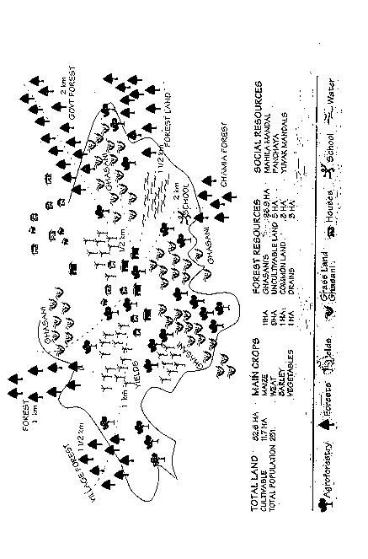
Example: Village Map

Slide 28
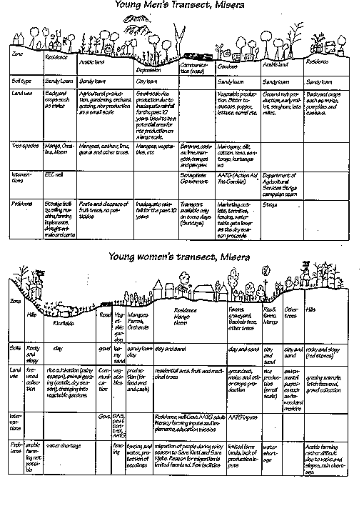

Slide 29
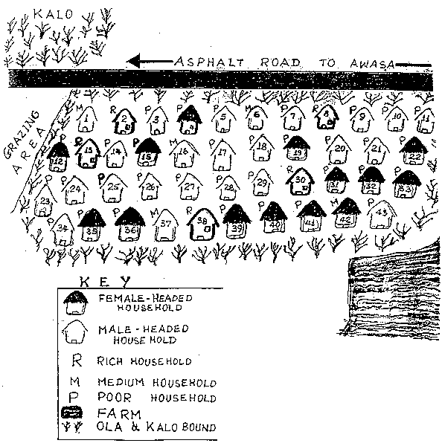
Social Map

Slide 30
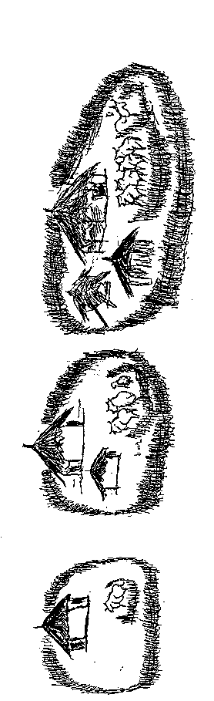
Village social map- wealth ranking
Note: please write the name of the village, date, participants, facilitators and legend

Slide 31
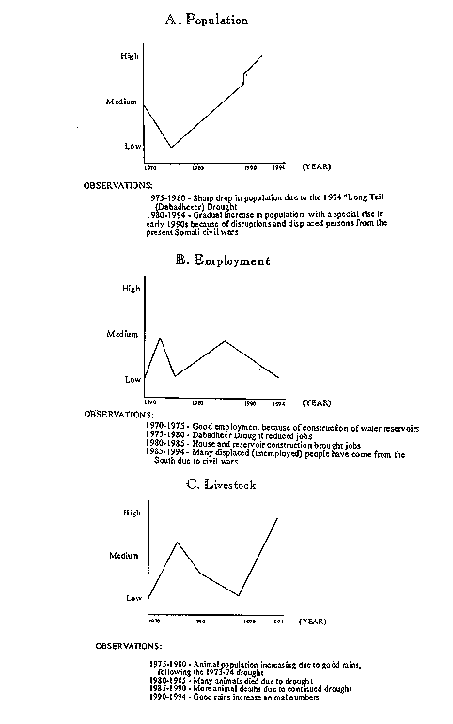
Trend lines

Slide 32
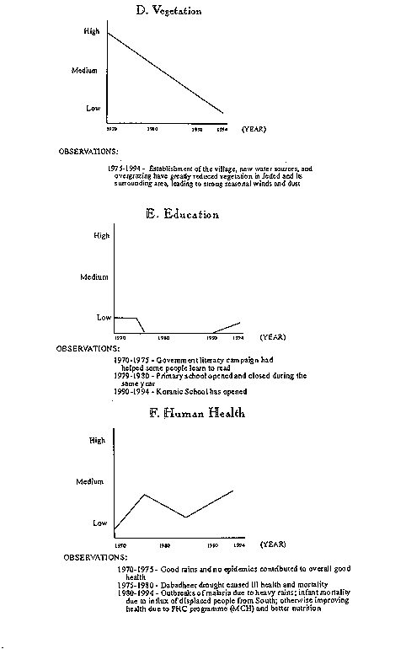
Trend line

Slide 33
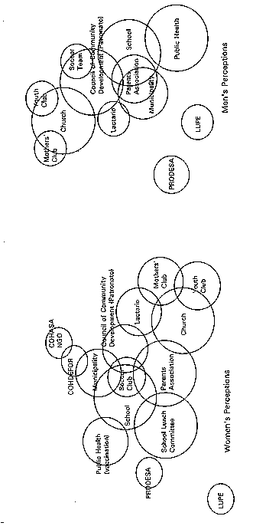
Venn diagram

Slide 34
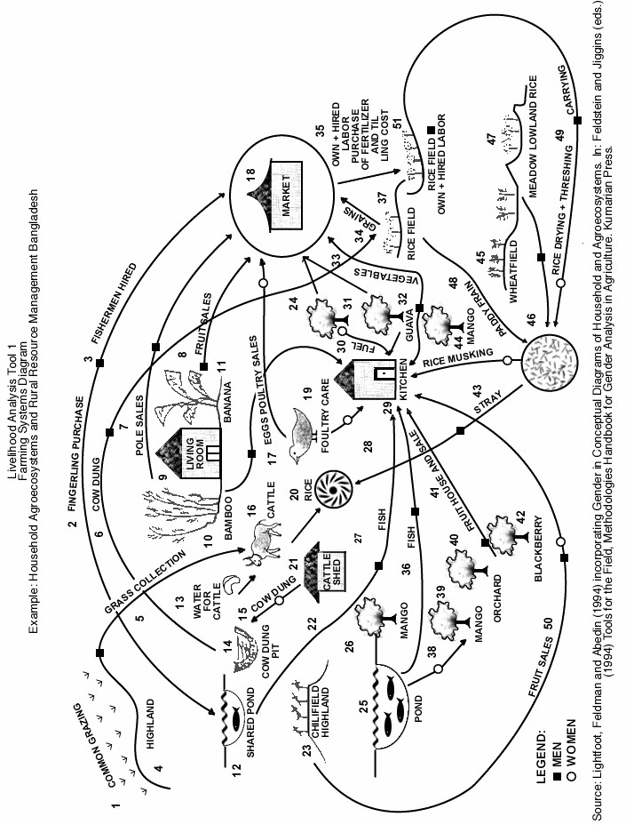

Slide 35
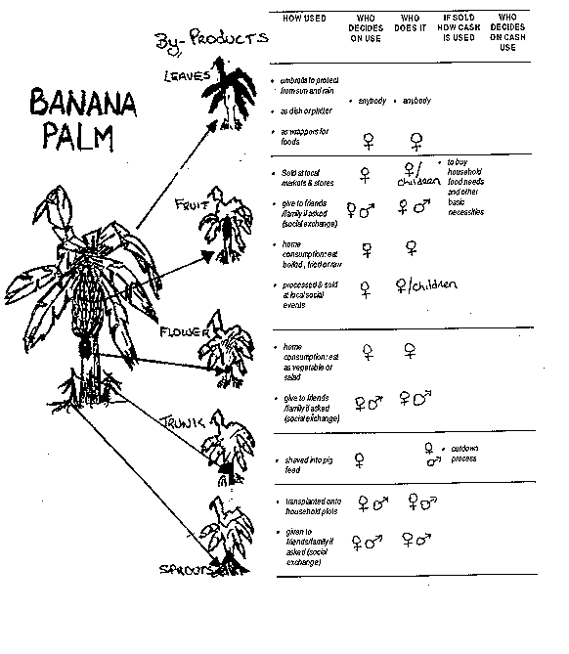
Benefit analysis flow chart tool
Example: Agbanga Leyte, The Philippines

Slide 36
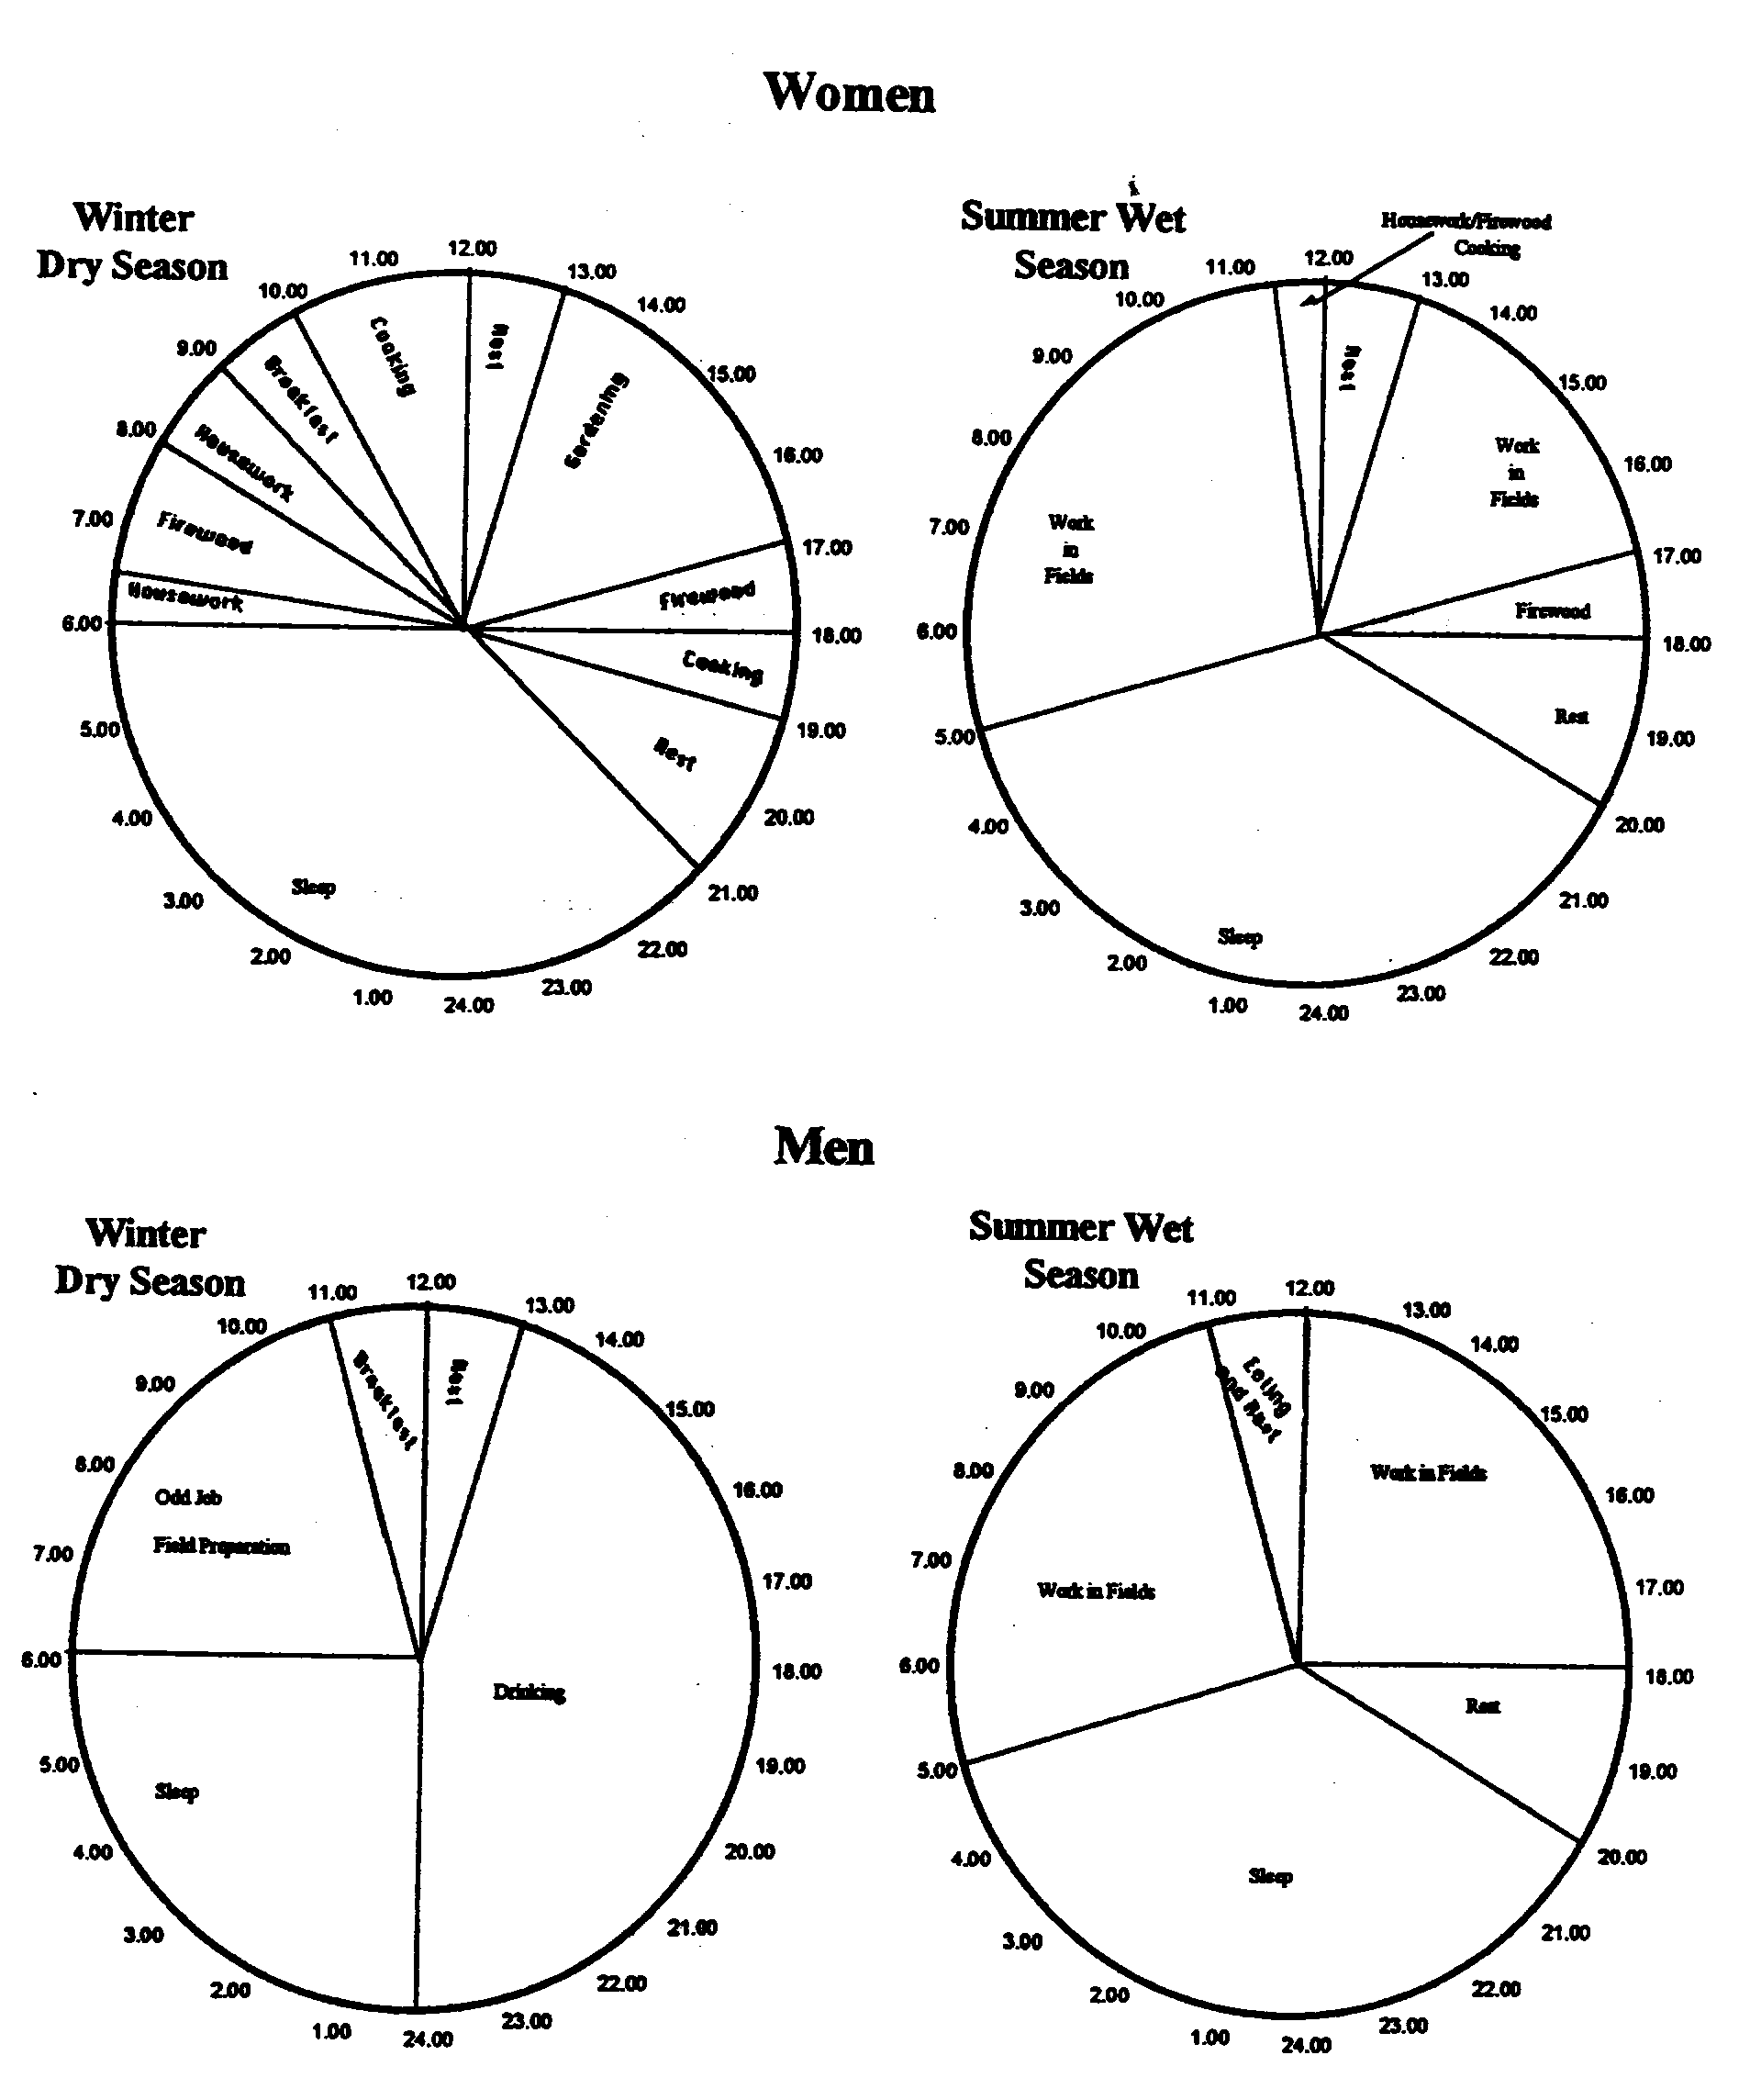
Daily activity clocks

Slide 37
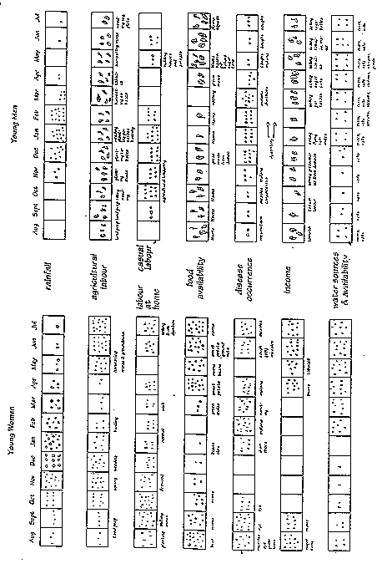
Seasonal calendar

Slide 38
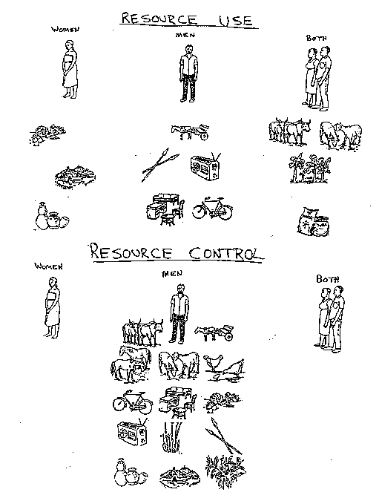
Resource picture card
)

Slide 41
Income and Expenditure
Matrix

Slide 42
Further readings-
Hilary Sims Feldstein and Janice Jiggins (eds). 1994 Tools for the field – Methodologies handbook for gender analysis in Agriculture. Kumarian Press Library of management for development.
Anja Christnick and Martina Padmanabhan (eds). Cultivate diversity. 2013 Margraf Publishers GmbH.
Field Level Handbook SEGA FAO 2001. http://www.fao.org/sd/seaga/downloads/Eng/Field_Engl.2002.pdf
Neela Mukherjee. 2009. Speaking to Power 27 voice tools. Building bridges for participatory learning action and policy making. Foreworded by Robert Chambers. Concept Publishing Company
Somesh Kumar. 2012. Methods of Community participation .A complete guide for practitioners. Vistar Publications.
Dr V E Sabarathnam 2002. R/R/PRA (PLA) For Agriculture. Rapid , Relaxed and Participatory Rural Appraisal ( Participatory Learning and Action) For Research and Extension in Agriculture (For crops and livestock). Vamsarvath Publishers Hyderabad.

