Slide 1
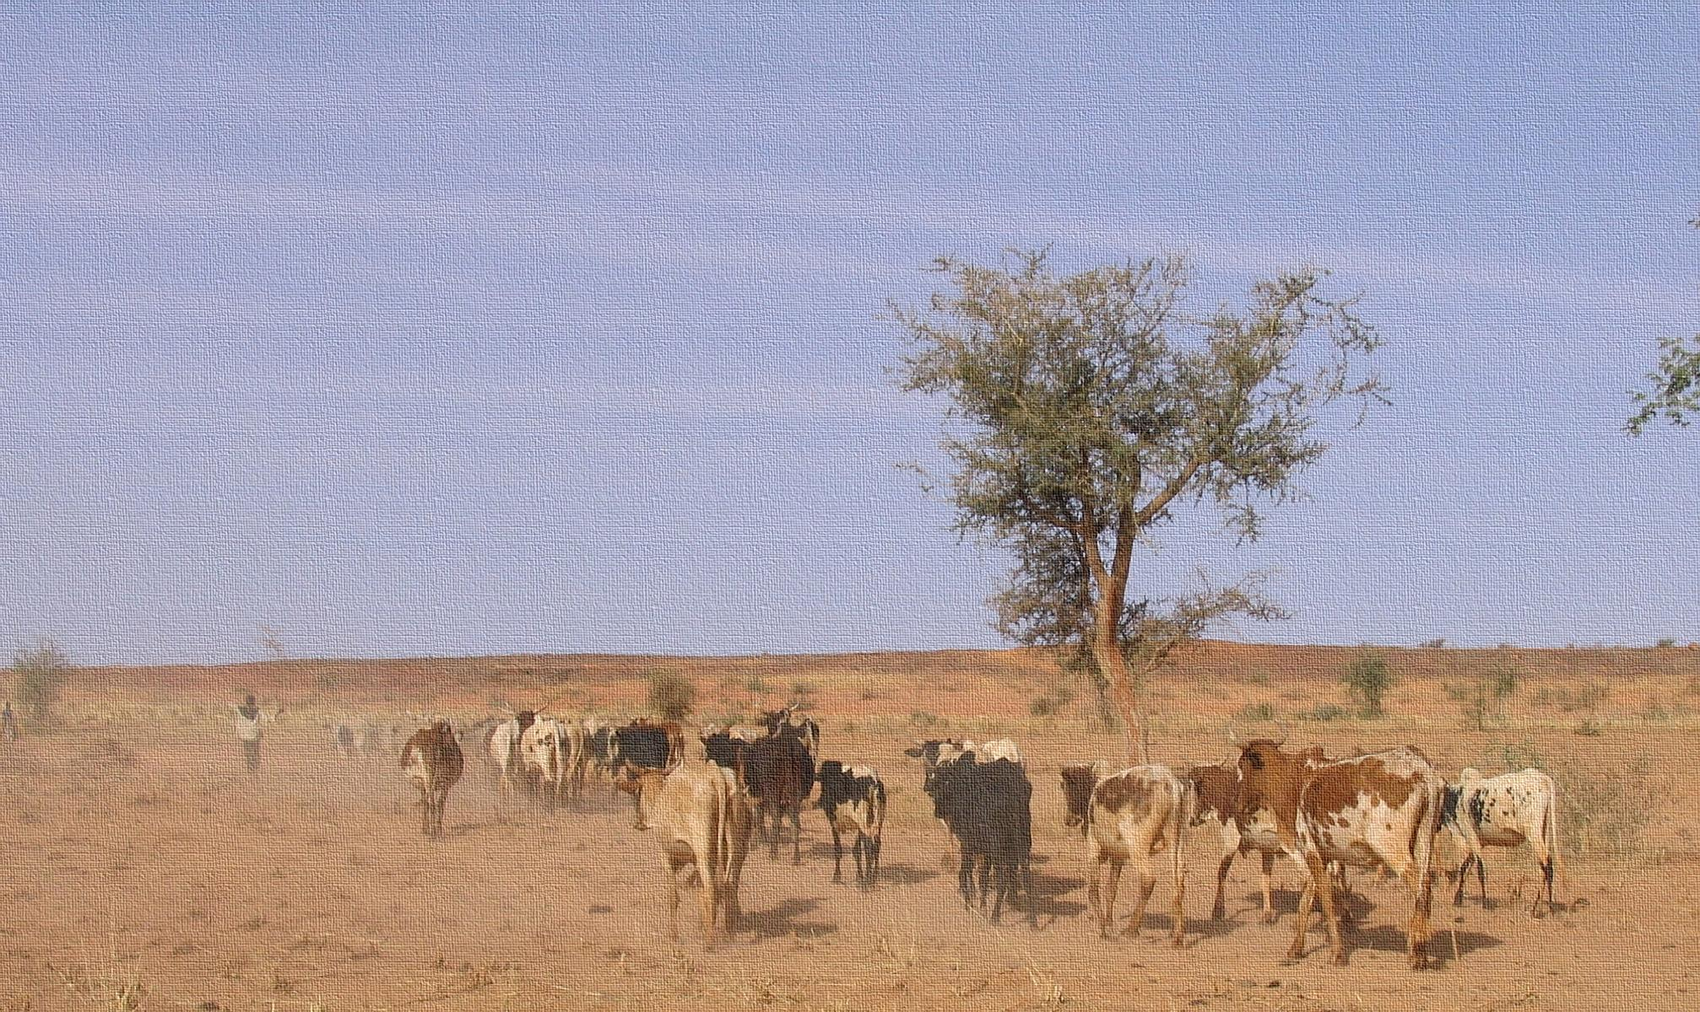




An Applied Information Economics Approach to Assessing Resilience in the Horn of Africa
Eike Luedeling
Katie Downie
Jan De Leeuw
Keith Shepherd

Slide 2

Research for Impact
Research for development only has impact if it leads to better decisions
In supporting decisions, how can we effectively consider resilience?
Image: http://www.mynamesnotmommy.com

Slide 3
Challenges for resilience decisions
Various complex and dynamic definitions: response to shocks and stressors
Rarely directly observable
Most resilience models are complex, data-demanding and error-prone
Data is scarce in most places of interest

Slide 4
Opportunities in resilience decisions
If resilience matters, it should have measurable impacts
Among several systems, the most resilient should do best in the long run most of the time, when exposed to shocks and stressors
We have to find out which one this is – quickly, cheaply, with imperfect information and yet accurately to meet demands of decision-makers…

Slide 5
Applied Information Economics
Well-established business decision analysis approach
Participatory development of a business-case model
Highly aggregated variables, but comprehensive; costs, benefits, risks
Stakeholders define the current state of uncertainty
Probability distributions for all variables
Simulate decision outcomes, considering all relevant risks
Monte Carlo analysis
Identify high-value variables
Take measurements if and where they have value for the decision
Make recommendations for optimizing decision
Based on expected gains and opportunity losses
Hubbard 2014. How to measure anything – the value of intangibles in business. Wiley.

Slide 6
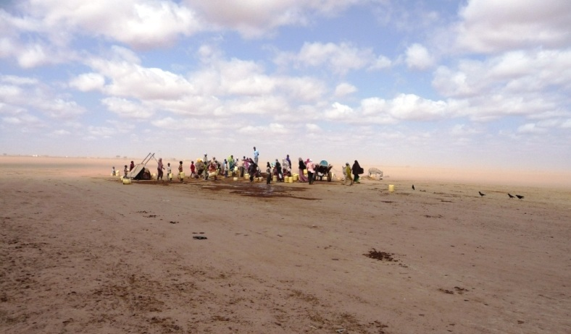

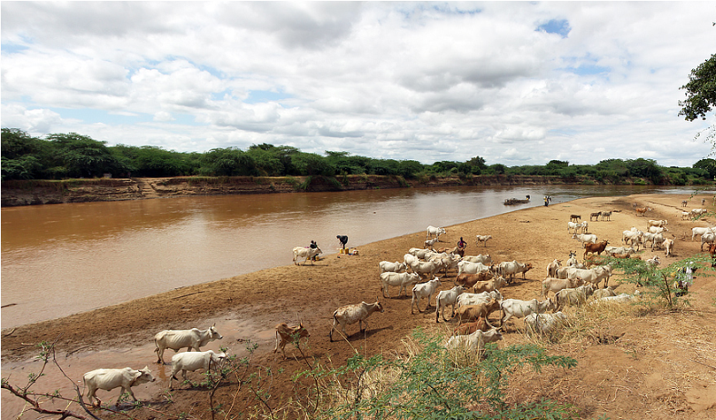
3 examples from Kenya
Water pipeline
Borehole management
Rainfed agriculture interventions

Slide 7

Water pipeline for Wajir
100-km pipeline for fresh water supply to rapidly growing dryland city
Taps a politically sensitive aquifer
Intensive discussions with stakeholders
Model-building with group of experts
Image: http://www.mercycorps.org

Slide 8
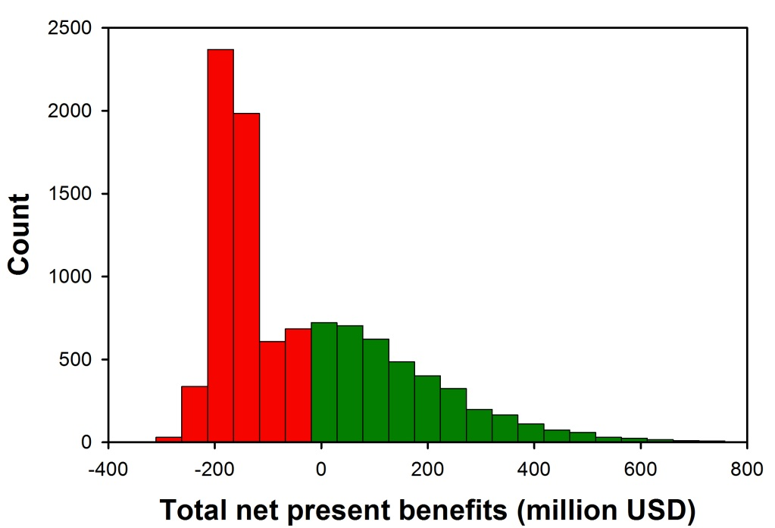
Water pipeline for Wajir
Key uncertainties
Number and value of a surviving infants
Value of disease treatment
Reduced performance due to poor design
Risk of political interference
Very risky project, when considering potential shocks
High chance of failure
Key uncertainties related to limited stakeholder inclusion, investor priorities and values
Image: http://www.mercycorps.org

Slide 9

Better borehole management to protect livestock from drought
High livestock mortality (up to 80%) during drought
Better managed boreholes could alleviate this problem
Model built based on literature and expert knowledge

Slide 10
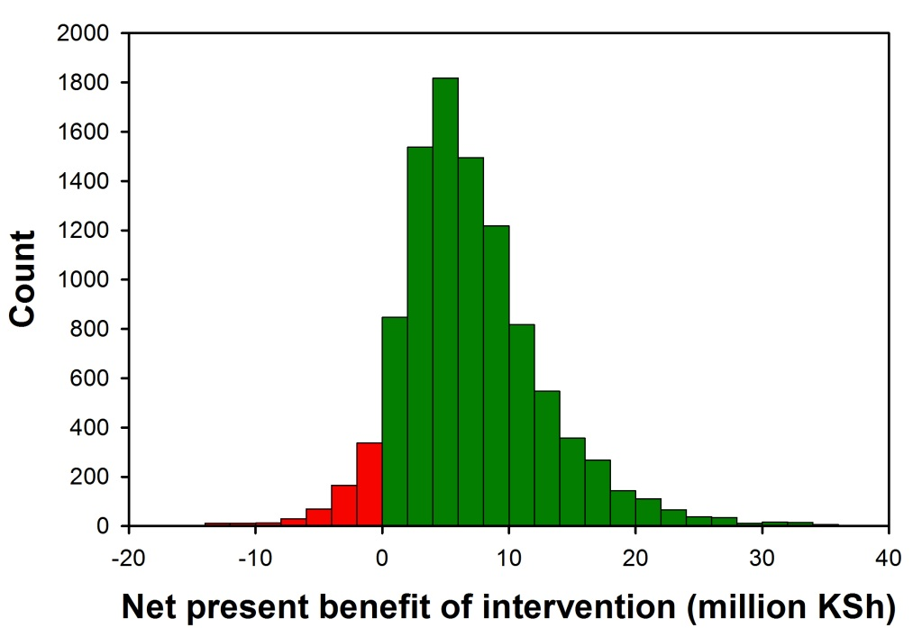
Better borehole management to protect livestock from drought
Key uncertainties
Discount rate
Milk price
Livestock mortality reduction
Herd growth rate
Milk yield per cow in non-drought years
Fairly safe bet, low chance of losses
Key uncertainties could be reduced through socioeconomic and market surveys

Slide 11

Rainfed agriculture interventions in the Tana River Basin
Portfolio of large-scale interventions
Improved soil management, water resource management, intensification of trees, mixed livestock and grazing
Model built based on stakeholder consultation and expert workshops
Image: http://www.rspb.org.uk/

Slide 12
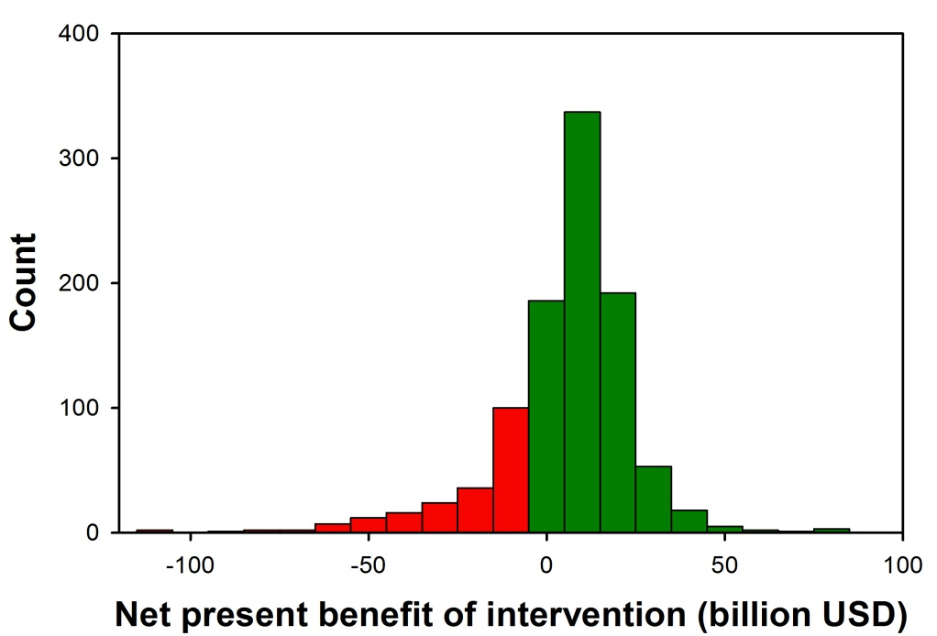
Rainfed agriculture interventions in the Tana River Basin
Key uncertainties
Cost per ton of CO2
Profits from land in semi-arid zone
Profits from land in sub-humid zone
Additional CO2 from intensive farms
Number of people who won’t migrate
Substantial gains and losses possible
High information values (100s of millions USD)
Farming profitability studies and migration studies
Image: http://www.rspb.org.uk/

Slide 13
Lessons learnt
High-level models can often provide sufficient information to guide decision-making for specific decisions
Comprehensiveness is more important than high mechanistic detail
Long-term stochastic model runs allow direct simulation of outcomes
High-value variables are often not the ones typically measured
Engagement with decision-makers increases likelihood that results will be used

Slide 14
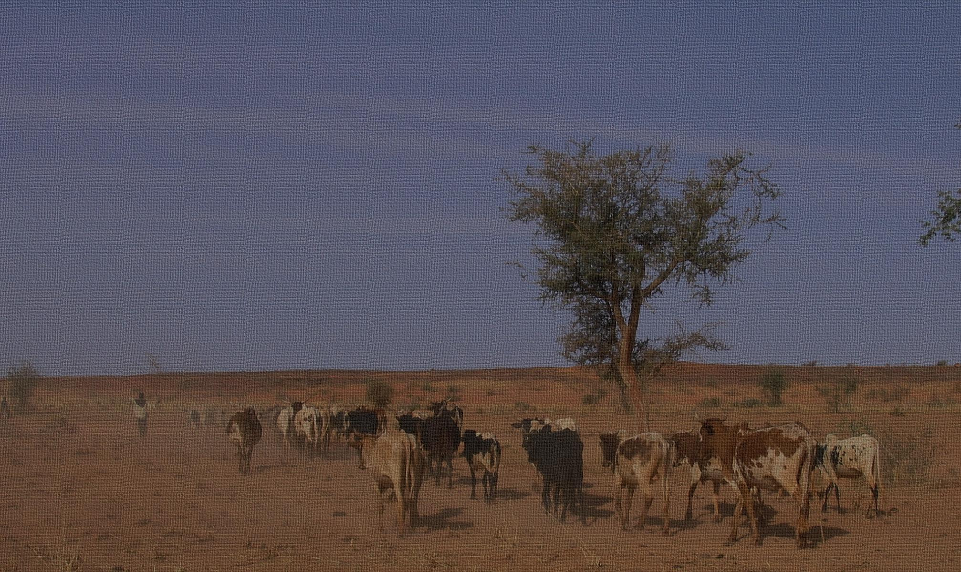
Thanks for your attention!
Eike Luedeling
Katie Downie
Jan De Leeuw
Keith Shepherd
e.luedeling@cgiar.org

