Slide 1


Institut Agronomique et Vétérinaire
Hassan II (IAV)
Hassan II Agronomic and veterinary institution
Mme Sanaa Zebakh
Deputy Director of cooperation, Partnership and Development dcpd@iav.ac.ma Sanaa.zebakh@yahoo.com
1
Notes:
1

Slide 2
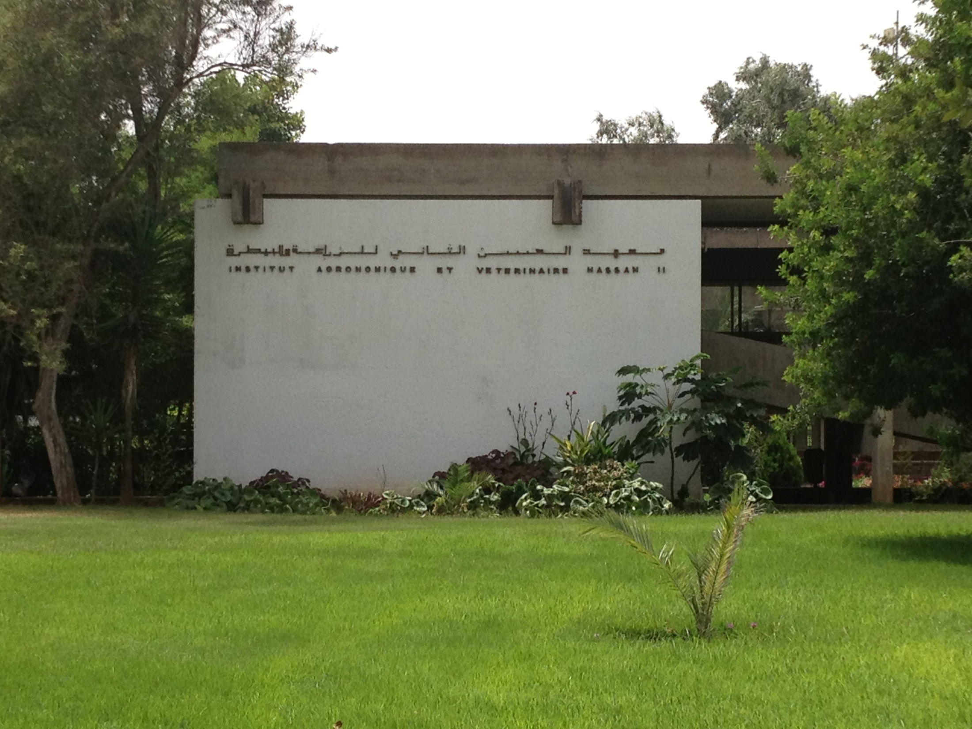
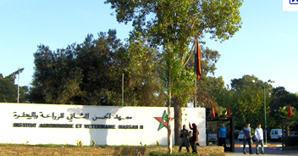
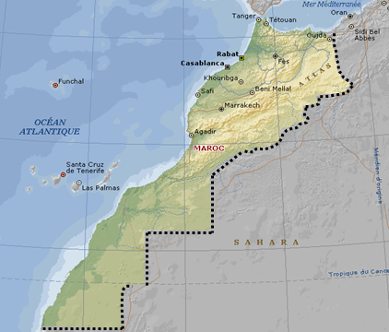
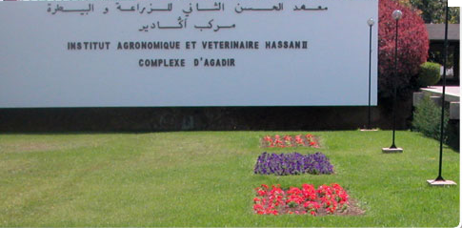
IAV general presentation
1966 (52nd anniversary)
Ministry of Agriculture (direct)
Ministry of Higher Education (accreditation of curriculea)
Rabat : 38 ha
Agadir : 80 ha
Missions : training, research and development

Slide 3

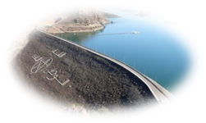
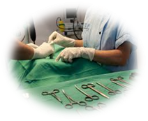

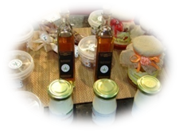

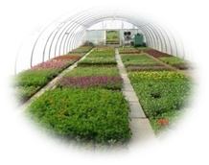
IAV general presentation
Ressources
2000 students ( 10% from African C.)
230 researchers
22 multidisciplinary research units
Specific PHD school
Certified Laboratoires , greenhouses, Clinics
Veterinary hospital, research facilities
6 schools
International Cooperation
Agronomy
Veterinary
medecine
Rural
Engineering
Total: 210 MOU
140
15
22
30
Horticulture
Food agro
industry
2
Topography
African countries : 30 MOU and 136 specific contracts for continous training, research and expertise carried with african countries during 2006-2015
www.iav.ac.ma

Slide 4





Projects et contracts
(2006-2017)
379 Contracts
49% national , 51% international
Budget : 20 millions euros

Slide 5
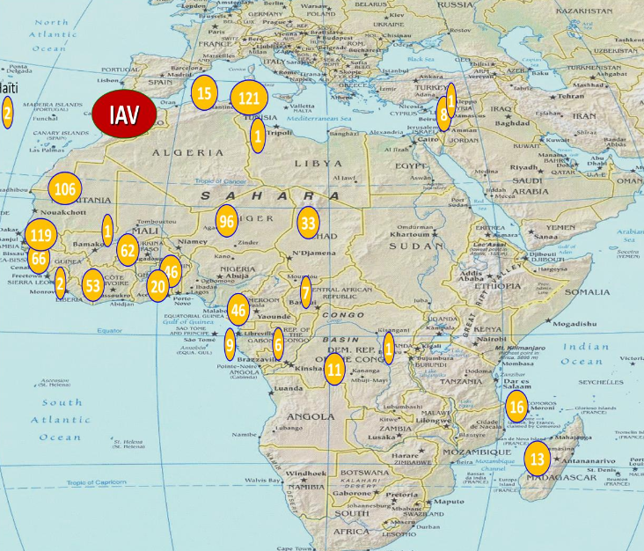
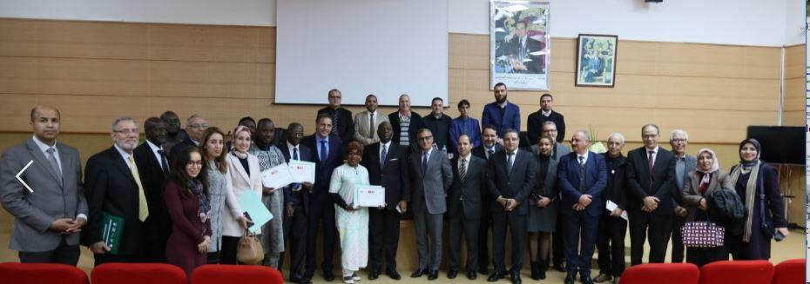
South-South and triangle cooperation
IAV contributes to the initial training of around 14 000 national Engineers and veterinarian doctors.
10 % of enroleld students each year are originary from african partner countries
900 graduates
IAV – NELGA Northern Africa Node (2017) : Network of Excellence on Land Governance in Africa. Leading training and research institutions in land governance in Northern Africa through the School of Geomatics Sciences and Topographic Engineering
Master in sciences & space technologies /2016-2017
( African Regional Center for Space Science and Technology(CRASTE-LF), United Nation.
Statistics 1972-2017

Slide 6
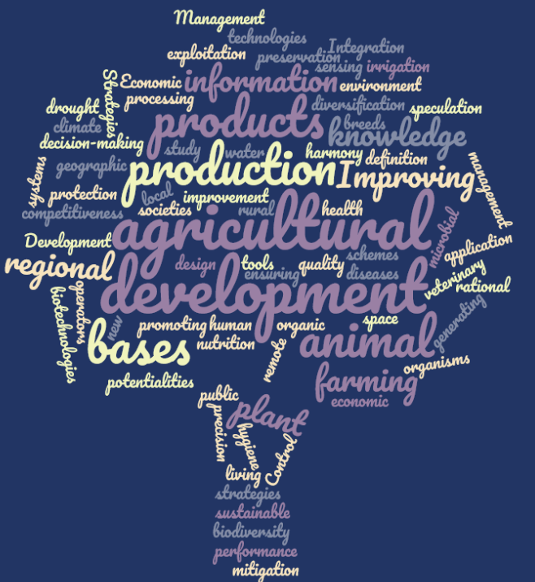
Research : sustainable agricultural development
Research priorities
In connexion with national priorities
Research : 55% of funded projects
First national institution in terms of participation to EU FPs H2020: 72 projects since 1er FP (1984) , FP7 : 17 projects
Participation to national calls ( Ministry, OCP, private sector , etc)
Others funding agencies : MCA, USAID , ACDI , and at bilateral level : CIRAD, IRD, etc

Slide 7

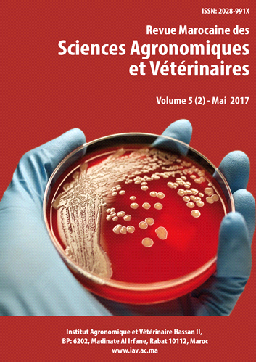
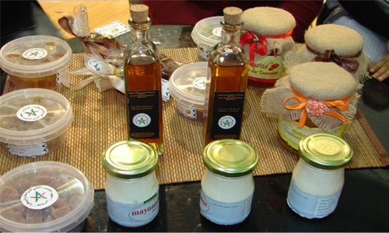
Tools in support to Research at IAV
22 multidisciplinary Research units
Experimental Stations
Fields & green houses
Laboratories
                Moroccan Journal of Agriculture and Veterninary sciences
Specific PHD school :
8th Class
325 PHD students since 2010
http://agrimaroc.org/
Contribution by author’s origin
60 % Morocco
10 % Europe
10% Maghreb
10 % Africa

Slide 8
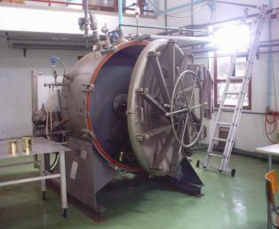
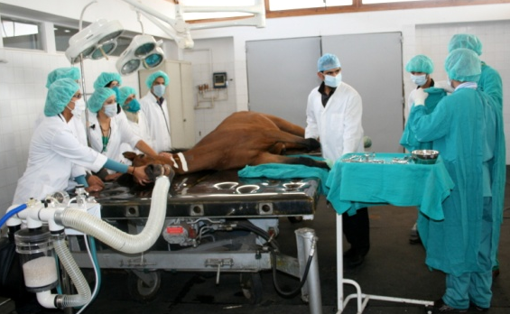
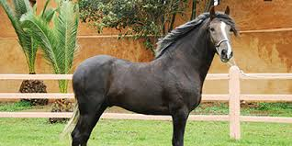
Services and expertise
Veterinary University Hospital Agricultural
Mechanization Training Center
Center for Food Technology and Engineering
Horse Clinic
Elharka Riding club
Certified laboratories :
Genetic afficilation: 4500 analyses /year
Anti-doping : 2700 analyses / year
Notes:
Horce racing

Slide 9

IAV knowledge management
IAV Hassan II 2011 new organisation
G. Director
Com. office
research
academic
cooperation
Adm & financ
School &Lab responsibles
Researchers
Students , PHD
Adm staff
(Basic management of K, tools , meetings, emails, website )
No intranet

Slide 10
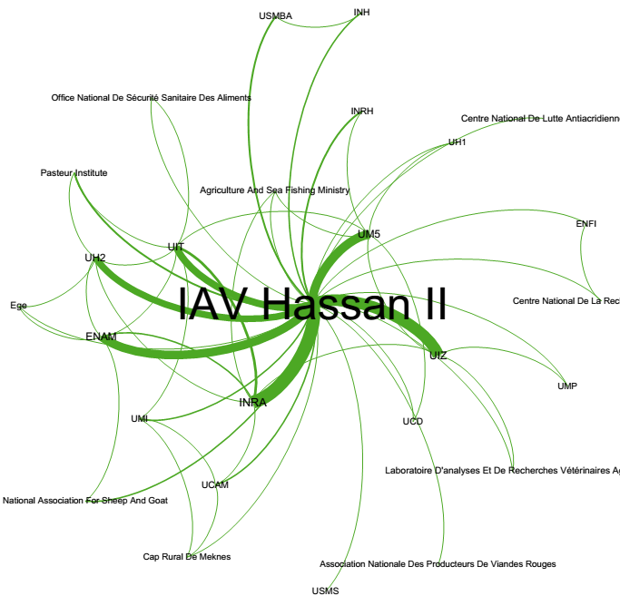
End Users :
Continous training, master and expertise to end users
Scientific journal , conference
visits
Bibliometric study scopus 2005-2015
Website, socila media
Knowledge creation : researchers
Publications
Reports
Students and PHD
Documentary center
Obstacles : vision/strategy/action plan/efficient tools and evaluation
Management of content, IP management, innovation
Researchers retirement : -33% last 12 years
turnover directors (4 last 8 years)

Slide 11

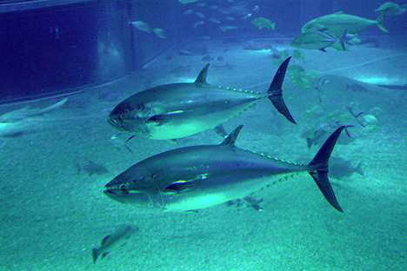
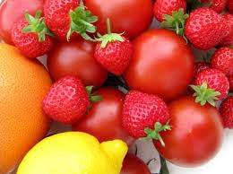
Thank you

