Slide 1
Women’s contributions to climate change adaptation in Egypt’s Mubarak
Resettlement Scheme through cactus cultivation and adjusted irrigation
Presented at the Annual Association of American Geographers, April 23, 2015, Chicago, Illinois

Slide 2
Introducing the Study
Environmental impacts differ along gender lines and therefore women must be involved in any efforts to remedy them.
The Middle East remains one of the most unequal gender regions in the world most notably evident through increased violence against women during the Revolution.
Adaptation approaches at national levels are focused for the most part on finding new water sources (the region is one of the most water stressed regions in the world).
The Revolution highlighted the urgent need to tap onto engaging social actors for adapting to climate change.
Due to the general lack of focus on gender inequalities and alternative methods to adaptation in current approaches the study adopts a FPE approach to:
  Focus on practices (local innovations) and policies that enable women to adapt to climate change
  Focus on integrating social and ecological aspects in adapting to climate change
This study draws on research conducted over a 14-month fieldwork period in 2010–2011 with follow-up research in 2012 and 2013 in two desert settlements: Sa’yda, a settlement in Upper Egypt, and Intilaq in Lower Egypt, which are part of the Massive Mubarak Resettlement Scheme
  The two sites differ in socio-economic and biophysical dynamics whereby Sa’yda comprises of women heads of household settlers, is very conservative in gender norms, focuses on feed production and livestock rearing, while Intilaq comprises of women graduate settlers, is relatively liberal in gender norms, and focuses on profitable in fruit production
The study uses ethnographic methods that offer valuable tools to uncover impacts of climate change and related adaptation strategies which are inherently local and specific with a focus on:
  Identifying local innovations in adaptation to climate change, particularly those related to women, and what enables or impedes their adaptation capacities

Slide 3
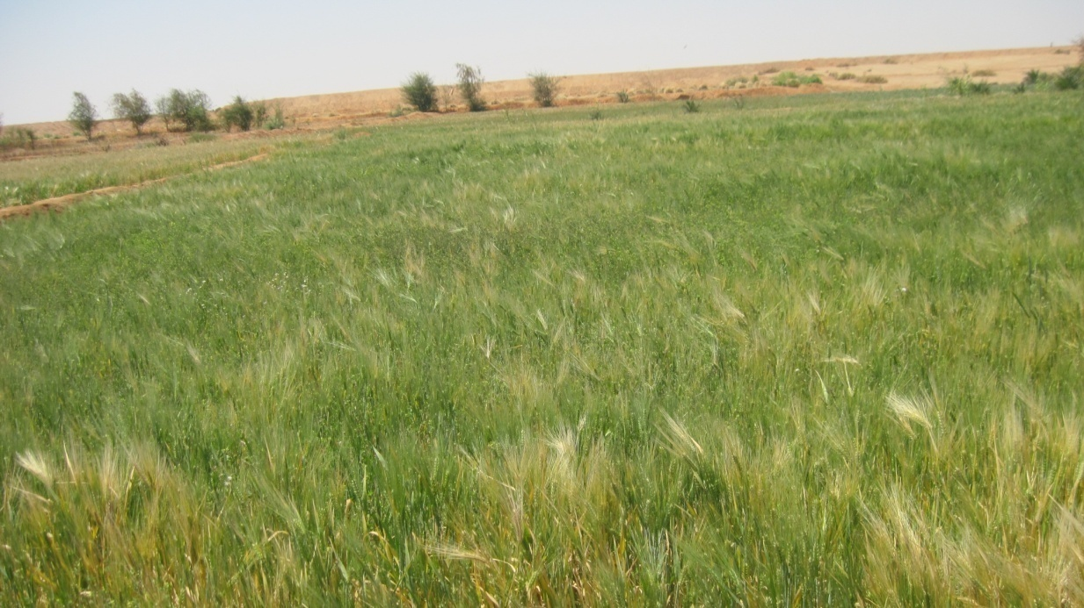
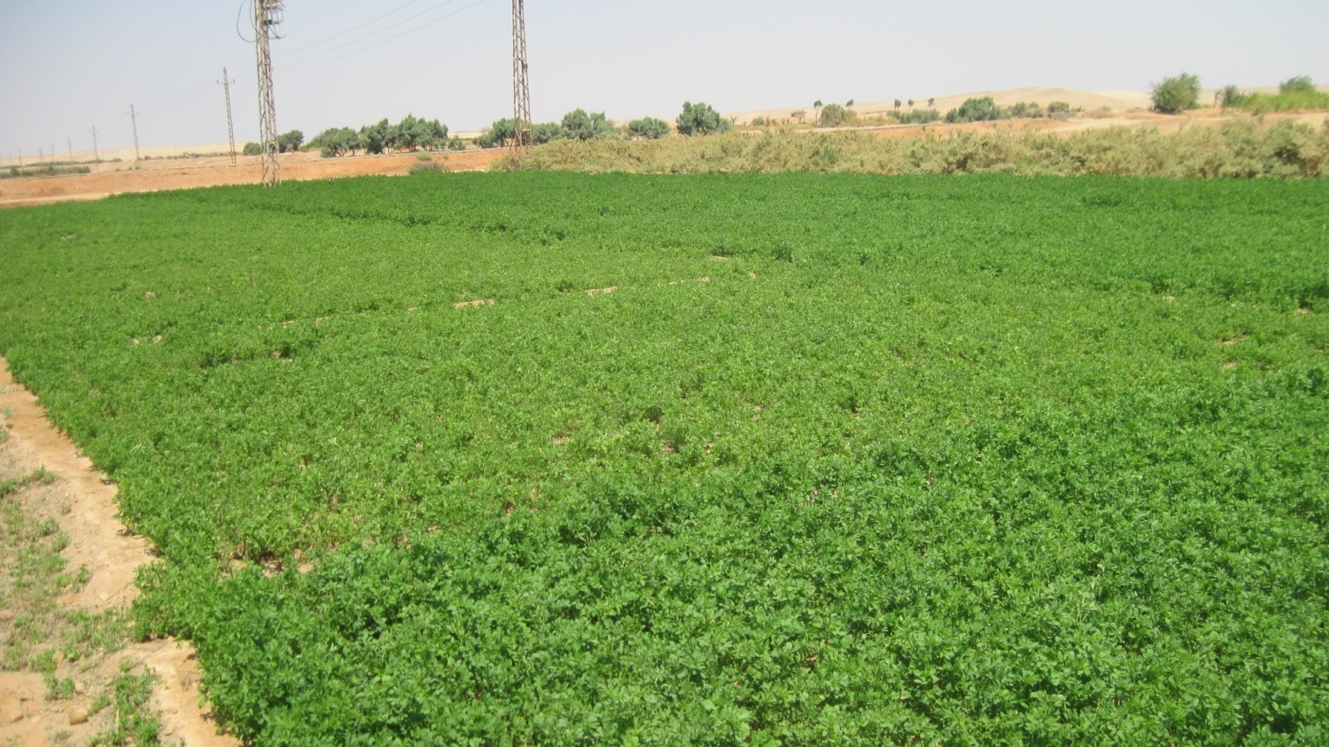
Sa’yda
Notes:
Barley and berseem (Alfa Alfa). Focused on animal production.

Slide 4
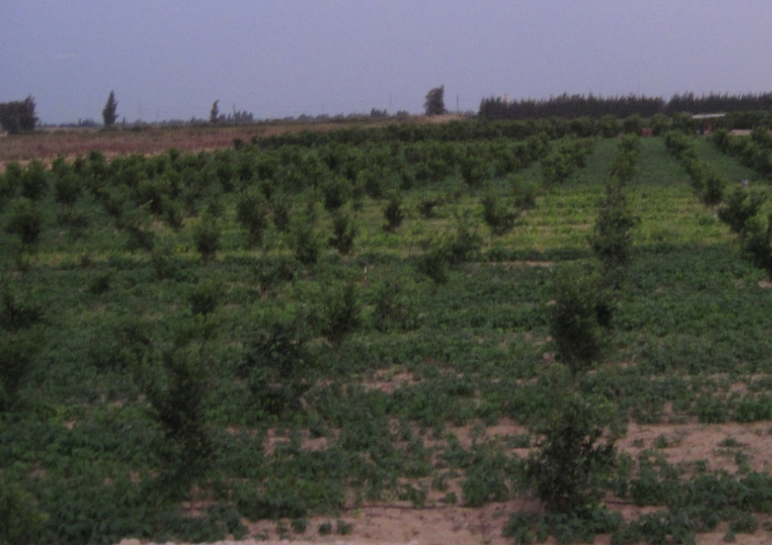
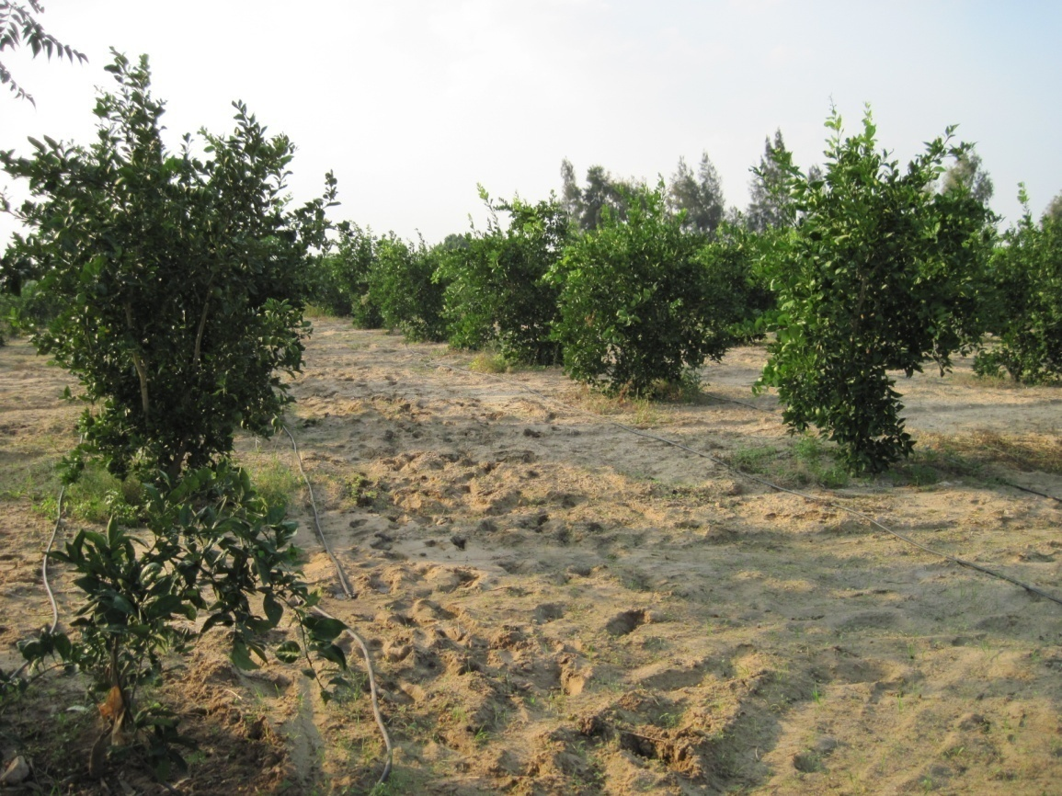
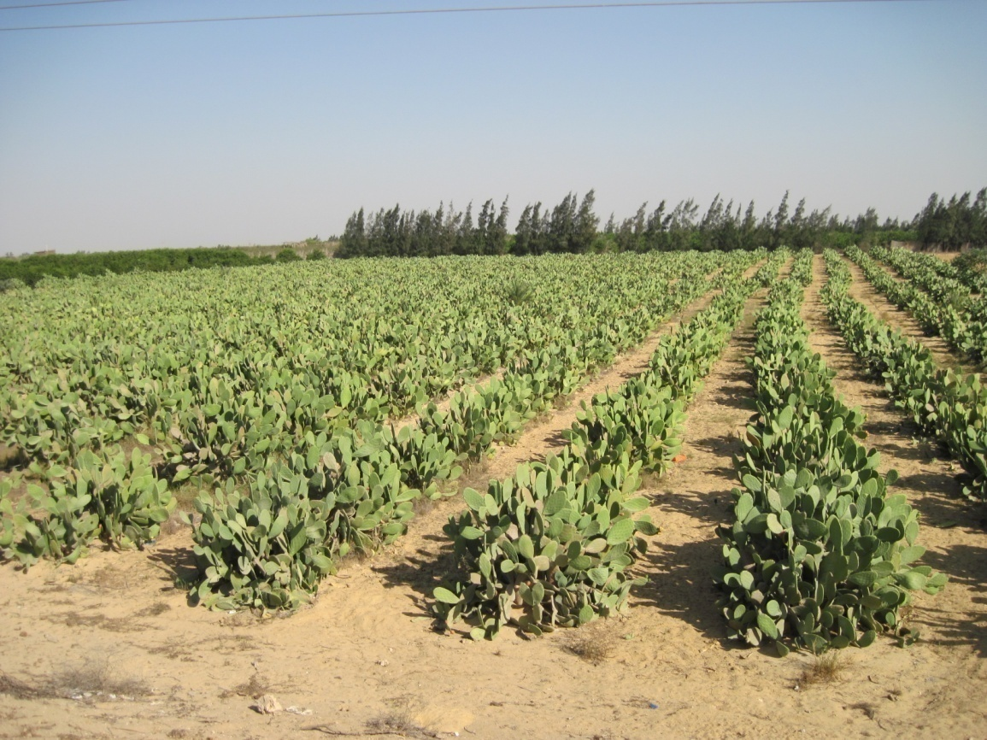
Intilaq

Slide 5
Findings on Adaptation Strategies and Implications
  In Intilaq, women graduate settlers are planting cactus, which requires less water, fertilization, and labour, as a means to avoid eviction in hostile reclaimed desert lands (limited schooling, potable water)
  In Sa’yda, women heads of household settlers are more likely to cultivate barley (which is tolerant to salts) due to a lack of adequate labour and finances to fertilize and irrigate wheat
  Participation on water user associations in both settlements was limited and more so in Sa’yda due to local norms and ineffective roles for water user associations more generally
  Government policies did not encourage cactus or barley crops in its extension or marketing support
  More focus is needed on approaches that consider the local biophysical conditions and capitalize on women’s innovations, whom are largely disadvantaged by local norms and government policies

Slide 6
Acknowledgements
Funding for this research was provided by the CGIAR Research Program on Dryland Systems, the International Development Research Center, and the Ford Foundation.

