Slide 1



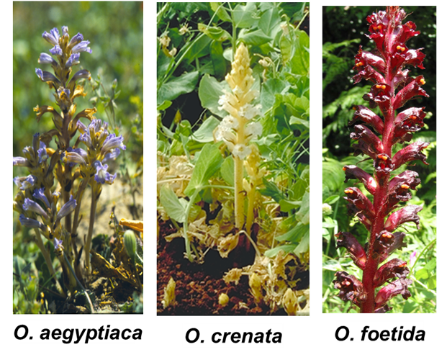
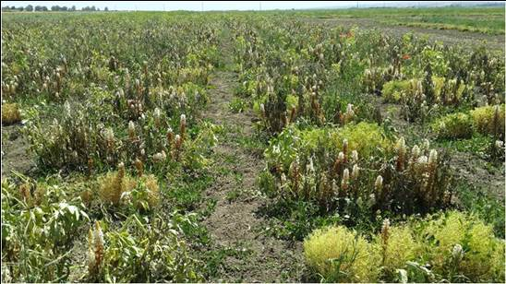
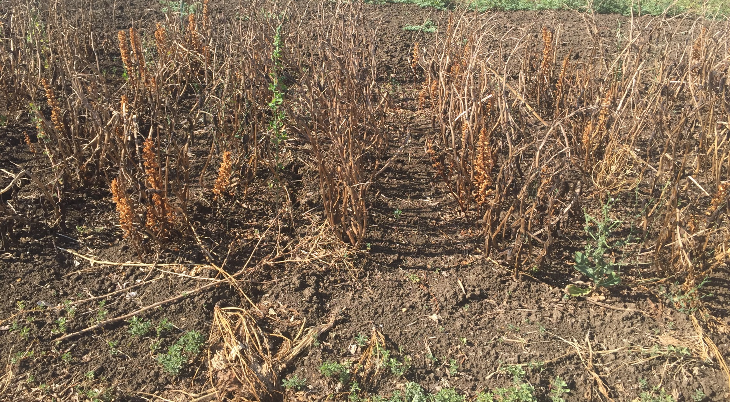


Orobanche resistance in faba bean and lentil
ABSTRACT
In order to identify resistance sources, 216 lentil and 194 faba bean elite lines and 280 recombinant inbred lines (RILs) of a faba bean cross (BPL710 x ILB4347) were screened against Orobanche crenata in a sick plot at Douyet experimental station, Morocco during 2013/14 and 2014/15. Of the total tested lines, 40 lines each of lentil and faba bean lines showed resistance with no emergence of Orobanche heads. Four lentil and nine faba bean lines are being utilized in breeding program to combine Orobanche resistance with desired agronomic background. Recently, two faba bean varieties have been released with resistance to Orobanche: Hashbenge in Ethiopia and Misr3 in Egypt.
INTRODUCTION
Faba bean (Vicia faba L.) and lentil (Lens culinaris Medik) are important crops grown worldwide as a source of protein both for human food and animal feed. However, their cultivation is strongly hampered by the occurrence of broomrape (Orobanche spp.) in Mediterranean and Middle East farming systems (Parker 2009). Faba bean and lentil are infested by various broomrape types (Orobanche spp), among the most deleterious species, Orobanche crenata Forsk. is considered indigenous in the Mediterranean basin.
This study was aimed to identify potential sources of resistance to Orobanche in lentil and faba bean and evaluate a RIL population (280 lines) for mapping and tagging genes associated with Orobanche resistance.
T
RESULTS
Two-year results indicated a wide range of responses from 1 (immune to no infection) to 9 (susceptible) for Orobanche infestation.
Significant variation for number of emerged Orobanche heads per host plant was observed.
Forty lines each of lentil (Table 1) and faba bean (Table 2) showed high tolerance with no emergence of Orobanche heads.
Four resistant lines of lentil (ILL4164, ILL7701, ILL6783, ILL10952) and nine of faba bean (F402, ILB4338, ILB4357, ILB4358, Giza843, Najah, Amcor, Hend, SelF5/3382/2003-4) are being utilized to combine Orobanche resistance with desired agronomic background.
Two faba bean varieties, Hashbenge in Ethiopia and Misr3 in Egypt released for cultivation in Orobanche infested lands.
Table 1: Orobanche resistant lines in lentil
Table 2: Faba bean lines selected for Orobanche resistance
Sl.No. | Genotype | Sl.No. | Genotype | Sl.No. | Genotype | Sl.No. | Genotype
1 | ILL5645 | 11 | ILL705 | 21 | ILL5418 | 31 | ILL7668
2 | ILL5653 | 12 | ILL840 | 22 | ILL5626 | 32 | ILL7685
3 | ILL304 | 13 | ILL1861 | 23 | ILL213 | 33 | ILL7701
4 | ILWL212 | 14 | ILL4164 | 24 | ILL5562 | 34 | ILL7723
5 | ILWL330 | 15 | ILL4606 | 25 | ILL5628 | 35 | ILL7982
6 | ILL6848 | 16 | ILL4778 | 26 | ILL6015 | 36 | ILL8009
7 | ILL490 | 17 | ILL4781 | 27 | ILL6025 | 37 | ILL8195
8 | ILL502 | 18 | ILL4819 | 28 | ILL6778 | 38 | ILL10952
9 | ILL71 | 19 | ILL4881 | 29 | ILL6783 | 39 | LIRL21-187
10 | ILL619 | 20 | ILL5384 | 30 | ILL7532 | 40 | LIRL-22-109
Number | Pedigree | Number | Pedigree | Number | Pedigree | Number | Pedigree
11A15OFS-1 | WRB 1-5 X F7/8983/05 | 11248-3 | 10901-1/2010/Giza - 4 | 11418-2 | 10456-1/2010/HBP/ESO/2000 | 11543-7 | 10919-1/2010/Giza - 429
11A15OFS-2 | Fam 2-1-1 X F7/8984/05 | 11248-4 | 10901-1/2010/Giza - 4 | 11419-2 | 9883-3/2010/HBP/DSO/2000 | 11544-1 | 9303-2/2010/HBP/DSO/2000
10931-2 | 10170-2/2010/HBP/DSO/2000 | 11248-6 | 10901-1/2010/Giza - 4 | 11420-3 | 9845-4/2010/HBP/DSO/2000 | 11544-4 | 9303-2/2010/HBP/DSO/2000
10931-3 | 10170-2/2010/HBP/DSO/2000 | 11248-7 | 10901-1/2010/Giza - 4 | 11426-1 | 9029-2/2010/HBP/DSO/2000 | 11549-1 | 9738-1/2010/HBP/DSO/2000
10931-5 | 10170-2/2010/HBP/DSO/2000 | 11256-3 | 10170-2/2010/HBP/DSO/2000 | 11432-2 | 10130-4/2010/HBP/DSO/2000 | 11549-2 | 9738-1/2010/HBP/DSO/2000
10931-7 | 10170-2/2010/HBP/DSO/2000 | 11268-2 | 10338-2/2010/HBP/ESO/2000 | 11432-3 | 10130-4/2010/HBP/DSO/2000 | 11555-4 | 10170-2/2010/HBP/DSO/2000
10945-4 | 9883-3/2010/HBP/DSO/2000 | 11314-2 | 10591-3/2010/HBP/ESO/2000 | 11510-4 | 9608-1/2010/HBP/DSO/2000 | 11567-3 | 9160-10/2010/HBP/DSO/2000
10953-3 | 10706-3/2010/S 98013 ( DC ) | 11389-4 | 10158-1/2010/HBP/DSO/2000 | 11535-1 | 10129-4/2010/HBP/DSO/2000 | 11599-1 | 9402-1/2010/HBP/DSO/2000
11072-1 | 9151-1/2010/HBP/DSO/2000 | 11392-2 | 9019-6/2010/HBP/DSO/2000 | 11539-5 | 10559-3/2010/HBP/ESO/2000 | 11626-1 | 9414-2/2010/HBP/DSO/2000
11248-1 | 10901-1/2010/Giza - 4 | 11414-2 | 9289-6/2010/HBP/DSO/2000 | 11543-3 | 10919-1/2010/Giza - 429 | 11719-3 | 9411-3/2010/HBP/DSO/2000
MATERIALS AND METHODS
A set of 216 lentil and 194 faba bean elite lines and 280 RILs of a faba bean cross (BPL710 x ILB4347) were screened against O. crenata in a sick plot at Douyet experimental station, Morocco during 2013/14 and 2014/15.
Faba bean elite lines were planted in alpha design with two replications and with repetitive susceptible check every 10 entries, while RILs were planted in augmented design with repetitive resistant and susceptible check after every 8 entries.
Lentil lines were planted in an augmented design. In order to confirm the uniformity of field infection, each lentil line was surrounded by the rows of faba bean susceptible check ‘Aguadulce’.
Data were recorded on number of emerged heads and underground tubercles per host plant, Orobanche dry weight, and per cent infestation. Based on these parameters, a severity score on a 1-9 scale was worked out.
DISCUSSION
Heavy and uniform O. crenata infestation levels occurred during the years of experimentation. A wide range of responses were obtained from these genotypes. Negative correlation between yield and number of Orobanche heads observed indicating the yield reduction due to infestation of Orobanche.
The selected lines were used as sources Orobanche resistance in the breeding program and some for further testing and validation in different locations in North and East Africa.
In faba bean, the varieties released in Egypt and Ethiopia will target the infested area by Orobanche in both countries.
Fig1: Field screening of lentil germplasm
S
R
S
REFERENCE
Parker C. (2009), Observations on the current status of Orobanche and Striga problems worldwide. Pest Management Science, 65: 453–459.
Fig 2: Variation for Orobanche infestation in faba bean.
Fouad Maalouf¹, Somanagouda Patil², Karthika Rajendran² and Shiv Kumar²
¹International Center for Agricultural Research in the Dry Areas (ICARDA), Terbol, Lebanon.
²ICARDA, Rabat Morocco
Leveraging legumes to combat poverty, hunger, malnutrition and environmental degradation

