Slide 1

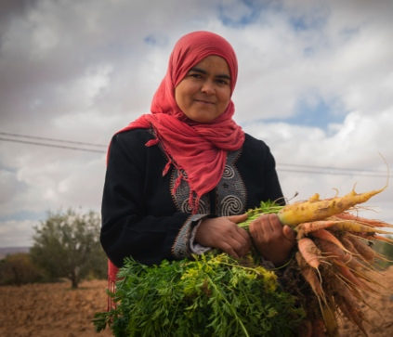
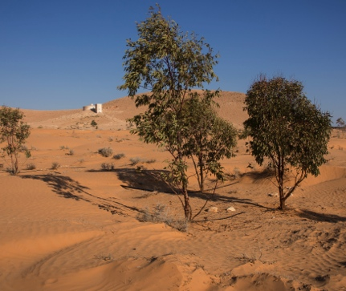
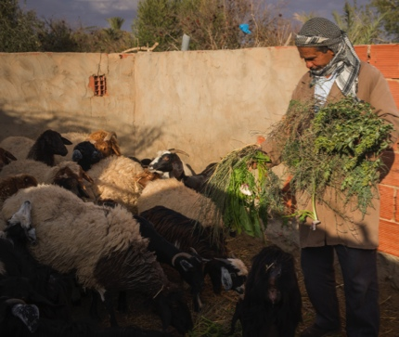
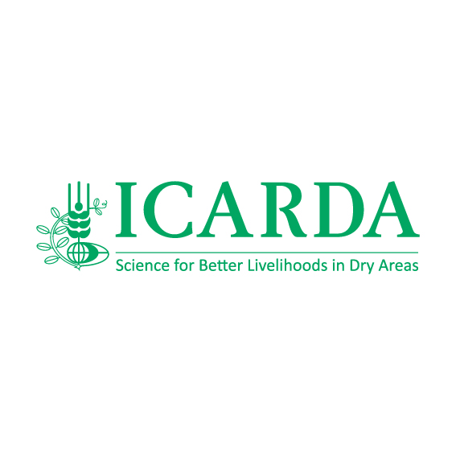
Overview of Information Management Activities
Progress of ‘Open Access’ for Dryland Systems and ICARDA
Jack Durrell
Dubai, UAE
September 29, 2014
Notes:
I am going to provide a brief overview on the progress of the information management strategies put in place for both ICARDA and Dryland Systems – which can feed into the discussions we will have regarding data management for the Program.

Slide 2
Discussion
Overview: Demonstrating ‘where we are’ in terms of Open Access implementation for Dryland Systems and ICARDA
Strategies defined to take forward the collection and organization of documents and publications
Potential obstacles that could prevent/undermine the effective implementation of an information management ‘Action Plan’
  Strategies, best practices to avoid or limit these obstacles?
Notes:
The presentation will focus on three main elements:
It will demonstrate where we are in terms of implementing the CGIAR ‘Open Access’ Strategy and what CGIAR requirements we have already met
I will talk about the different strategies currently being defined to ensure the effective collection and organization of documents and publications
And finally, I will discuss potential challenges and obstacles that may threaten to undermine or delay the information management strategy we are putting in place.
And one of my hopes for this workshop is to learn from your experiences and think through some of the best practices that could help to avoid, or at least limit, these obstacles.

Slide 3
Defining work flows
Three main workflows have been identified:
Peer-reviewed Journals, Chapters etc.
ICARDA/Dryland Systems Publications and information products – Published research reports, documents, factsheets, posters, brochures, images etc.
Unpublished material generated by research programs, centers etc. – Donor reports, technical reports, surveys, questionnaires, trip reports, images etc.
Notes:
An initial stage of the ‘on-going’ information management plan was to define relevant work flows.
Three main work flows were defined:
One for peer-reviewed journal articles and publications – the collection of this material is already organized
ICARDA and Dryland Systems publications and other information products, for instance brochures, research reports, factsheets – which are already being processed and managed by ICARDA Communications
And the third workflow, which I will be mostly discussing today, I have termed ‘unpublished material’ – referring to donor or technical reports, for instance, or research materials such as surveys, questionnaires, and literature reviews.

Slide 4
Organizing collection of information products
‘Focal points’ designated within each program, center to have responsibility over the collection, processing of information products
  Initial inventory of the information products generated – what types of products exist, quantity etc.
  Working with researchers to define key words, tags etc.
  Uploading information products into a central repository.
  Acting as a point of contact to follow-up on enquiries
Notes:
In thinking through the best strategy for organizing this material we have opted for one that involves a clearly defined ‘focal point’ – individuals designated by Programs, Departments, and Centers to oversee the collection and initial processing of relevant information products.
Their specific responsibilities would include:
An initial inventory of the information products generated by a Research Program or Department – what types of products exist, and in what quantity etc.
Working alongside researchers to define key words and tags to describe the information products
Uploading these products into a central repository
And, finally, acting as a point of contact to follow-up on enquires from the information management team overseeing the processing of ICARDA and Dryland Systems’ publications and documents.

Slide 5
Role of ICARDA Communications
The main roles and responsibilities of ICARDA Communications:
Overseeing implementation – defining strategies, communicating requirements and deadlines.
Developing an information management infrastructure – building an information repository, strengthening capacity, defining categories.
Ensuring information is properly harvested – applying correct metadata
Offering support – technical support, general advice regarding information management processes.
Notes:
This way of working would be preferable to an alternative scenario in which the ICARDA Communication Department is solely responsible for the collection of material generated by research programs – simply because research programs and researchers are best-placed to define accurate key words and descriptions for the information they generate.
However, ICARDA Communications will still play a key role:
- We will, for instance, oversee the implementation of the Information Management strategy for ICARDA and Dryland Systems – defining strategies and communicating important requirements and deadlines.
We will be responsible for developing an infrastructure – so actually building the information repository or strengthening capacity through the hiring of relevant personnel or training seminars.
Defining and applying the correct metadata to information products uploaded to the repository – so they can be properly harvested.
And, finally, being on-hand to offer technical support and general advice regarding information management processes.

Slide 6
Next steps: Implementing an IM ‘Action Plan’
In the coming weeks/months we intend to have the following:
A working information repository
Defined metadata schema
Clearly-defined workflows: main roles, responsibilities, focal points
Strengthened capacity – additional team members to take information management ‘action plan’ forward
Report submitted to CGIAR (To be submitted Dec. 15) – setting out steps taken, plans, and a timeline for future targets.
Notes:
So, what are the next steps for implementing an information management ‘Action Plan?’
Over the coming weeks and months we will be working with consultants from FAO to finalize the following:
We will create a working information repository using CG Space where documents can be collected and uploaded
A clearly-defined metadata schema that meets international standards
Strengthened capacity – hiring additional team members to take forward an effective information management strategy
And a report submitted to the CGIAR by December 15 which clearly outlines plans and a timeline for reaching future targets.

Slide 7
Potential problems:
A new way of working – may take time for systems, processes to be implemented
Perceived as an additional burden by researchers already facing significant work loads
Limited capacity – within programs, centers to effectively carry-out the information management ‘action plan.’
How can these problems best be avoided?
Incentives? Proven strategies? Mistakes to avoid?
Notes:
Finally, what are the potential problems that we can foresee in implementing an information management plan for Dryland Systems?
There are a number and I have listed three here:
Firstly, for some researchers this may be an entirely new way of working and thus it may take some time for systems and processes to be implemented
Information management could be perceived as an additional burden by researchers already facing significant workloads. Hence they may be reluctant to participate.
Finally, there could be limited capacity within programs and centers to effectively carry-out an information management strategy.
As I mentioned in the introduction to this presentation, I would be interested over the next two days to discuss ways in which these challenges could be overcome – whether incentives, proven strategies or mistakes to avoid.

Slide 8
Thank you

