Slide 1
Learning alliances in Jordan: understanding challenges to, and opportunities for enhancing quality of life in rural areas
NCARE: M. El Hiary, A. Bawalize
ICARDA: S. Kassam, B. Dheibi, M. El Dine Hilali, M. Rekik
ICARDA-NCARE technical meeting
September 21 – 22, 2014
Ayass Hotel, Amman

Slide 2
Conductive-Line activities
across countries & sites
FRAMEWORK
Preference for a “White sheet approach”
Three part process:
i) Identify ‘challenges’ to livelihoods;
ii) Assemble evidence and validate knowledge;
iii) Uncover opportunities for partnerships in addressing ‘challenges’
Many elements are common with traditional participatory approaches and rapid rural appraisals;
May not necessarily lead (solely) to ‘technological’ solutions;
Possesses elements of an innovation system, underpinned by knowledge sharing and joint learning;
In line with both area based development approaches, as well as value chain (strengthening) approaches

Slide 3
Conductive-Line activities
across countries & sites
MOTIVATION
Why do technologies fail to reach the poor
(or have low adoption rates)?
AND
How can the poor participate in the process of innovation?

Slide 4
RESEARCH AGENDA
Testing proof of concept (for the “approach”);
Assembling evidence throughout the process;
Evaluating BOTH process and outcomes;
Understanding whether the approach is able to soften cultural and social norms, in order to more effectively promote gender inclusivity within (development) initiatives aimed at enhancing livelihoods and quality of life;

Slide 5
Conductive-Line activities
across countries & sites
OUTCOMES ENVISIONED
Grassroots level:
Partners jointly develop a methodology, approaches and tools for tackling an identified development ‘challenge’ as well as in addressing barriers and constraints to productivity and profitability for commodities that are of priority to household livelihoods (linked to post-harvest and market access activity);
National and Regional/Governorate level:
Through proof of concept, governments in collaboration with donors, international research and development organizations, NGO’s, farmer groups, and civil society organizations invest in initiatives that aim (in the long run) to mainstream approaches espoused by the learning alliance framework and in line with more effective processes for innovation (‘enabling environment’) and area based development.

Slide 6
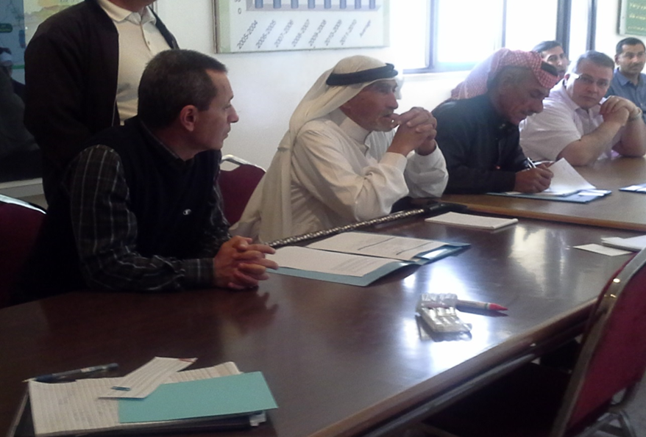
Conductive-Line activities
across countries & sites
AL ERAK LEARNING ALLIANCE
Limited access to public extension, poor productivity, issues related to participation within cooperatives
Opportunity identified:
Partnership between NCARE, ICARDA and Mutah University in the delivery of training for improved olive production practices and disease management
Research:
“Outcome mapping”- olive training programme & lessons for public extension services
Mapping social networks within the community, in order to uncover more effective opportunities for enhancing knowledge dissemination
Value chain and market access study on olives, in collaboration with the post-harvest market access initiative

Slide 7
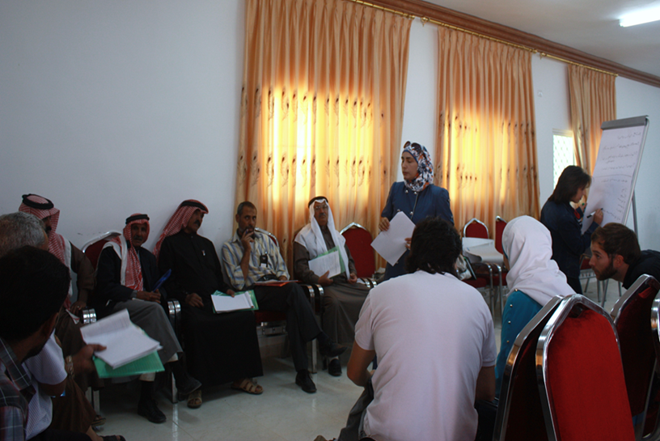
Conductive-Line activities
across countries & sites
AL KRESHA LEARNING ALLIANCE
Disgruntled community, and evidence of discord between tribal clans. History of failed attempts at social and economic organization.
Opportunities identified:
Partnership opportunities with existing welfare societies and private NGO’s aimed at expanding the range of access to technical, economic and social services
Research:
Understanding the potential role of welfare societies within NAWA, in enhancing approaches for knowledge dissemination and uptake of agricultural technologies and best practices

Slide 8
NEXT STEPS:
INNOVATION PLATFORM

