Slide 1

Training Course 2
Adopting Climate Change with Sustainable Natural Resource Management
4-8 November, 2018 - Damascus - Syria
Business Plan Project
“Feed Block Manufacturing Unit”
Boubaker Dhehibi - RALSP - ICARDA
(b.dhehibi@cigar.org)

Slide 2
WHY THIS PROJECT?
The lack of forage resources in several regions of the country.
Shortage of local animal feed sources and high prices of imported feed
The abundance and diversification of by-products that can be valorized for feeding livestock
The very advantageous cost of the forage units produced
Removing some agricultural wastes
Provide inexpensive and quality feed in times of shortage of fodder resources or when they are very costly or interrupted in the local market.
The urgent need to provide complementary feed, especially during the winter and autumn months, where the state of natural grazing is weak / fragile

Slide 3
PROJECT OBJECTIVES
To upgrade the agricultural by-products and their recycling in a well-studied system.
Transform the by-product into feed block units for livestock in the appropriate proportions.
Collecting all the vegetable matter and using it, based on a nutritive combination conceived a priori, and transforming it into feed block units.

Slide 4
TYPES OF BY-PRODUCTS
Olive cake
Tomato pulp
Spoilt apple
Molasses
Wheat bran
NOTES:
The elaborated products are feed blocks based on several combinations of by-products.
These products will be served directly after a period of adaptation to the animals as a supplement feeding.
Depending on the availability of by-products in the promoter region, the following four formulas will be used along the year

Slide 5
POSSIBLE EXISTING FORMULAS
Formula Composition | FORMULA 1 | FORMULA 2 | FORMULA 3 | FORMULA 4
By Product / Period | July – September | July - September | October-December | January-March
Urea | 1 | 1 | 1 | 4
Molasses | 5 | 5 | 5 | 0
Wheat bran | 10 | 10 | 12 | 30
Grinded barely | 0 | 0 | 0 | 0
Wheat flour residues | 10 | 5 | 0 | 0
Straw | 0 | 0 | 0 | 0
Olive cakes | 0 | 0 | 15 | 15
Cactus fruits | 0 | 0 | 64 | 35
Spoilt apple | 0 | 0 | 0 | 0
Tomato pulp | 68 | 75 | 0 | 0
Beetroot pulp | 0 | 0 | 0 | 0
Lime | 4 | 2 | 2 | 10
Salt | 1 | 1 | 1 | 5
Minerals/vitamins | 1 | 1 | 1 | 1
TOTAL | 100 | 100 | 100 | 100

Slide 6
DESCRIPTION OF PRODUCTION PROCEDURE
Collection/ Transportation of by-products
Grinding: Products like cactus fruits need to be grounded before the blocks are produced. Need a cactus crusher.
Feed block manufacturing: The crushed by-products are mixed with the additives in the appropriate proportions (depending on the formulas of the most nutrient blocks) and pressed with a hydraulic press to blocks. The blocks are dried on pallets in the hall.

Slide 7
PRODUCTION CAPACITY / MONTHLY PRODUCTION
The machine has a production capacity of about 10 tons per day. It is planned to convert 750 tons of primary materials into about 405 tons of feed blocks per year.
 | J | F | M | A | M | J | Ju | Ag | Se | Oc | N | D | Total
FR1, FR2 | 0 | 0 | 0 | 0 | 0 | 0 | 100 | 100 | 100 | 0 | 0 | 0 | 300
FR3 | 0 | 0 | 0 | 0 | 0 | 0 | 0 | 0 | 0 | 100 | 100 | 100 | 300
FR4 | 50 | 50 | 50 | 0 | 0 | 0 | 0 | 0 | 0 | 0 | 0 |  | 150
TOTAL | 50 | 50 | 50 | 0 | 0 | 0 | 100 | 100 | 100 | 100 | 100 | 100 | 750

Slide 8
HYDRAULIC PRESS TO BLOKS
Local constructed hydraulic machine
Cost of the machine: USD 16000
Local constructed crusher: 1000-1500 USD
Machine/ region/Promoter

Slide 9
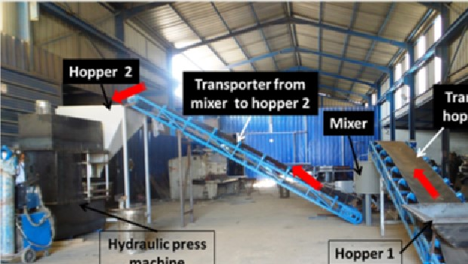
HYDRAULIC PRESS TO BLOKS

Slide 10
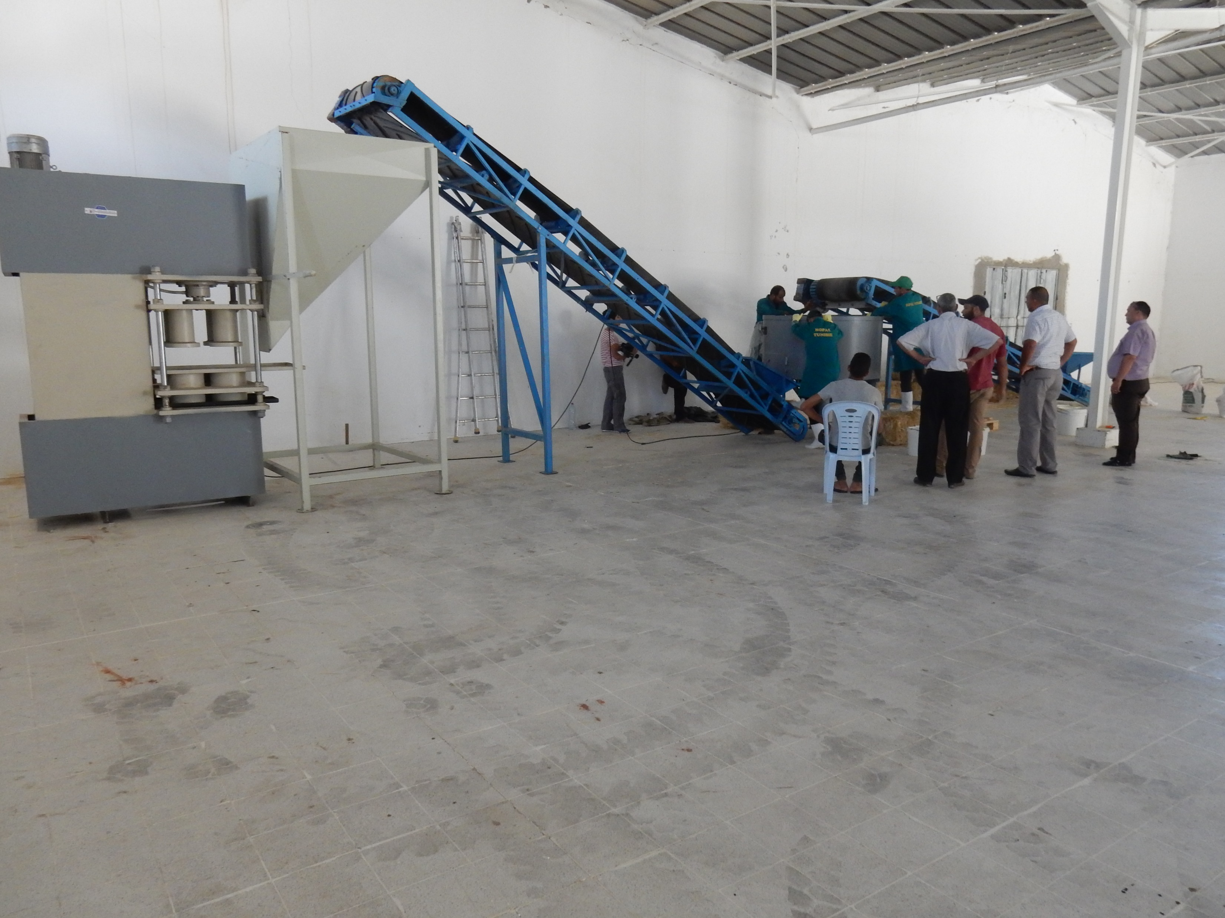
HYDRAULIC PRESS TO BLOKS

Slide 11
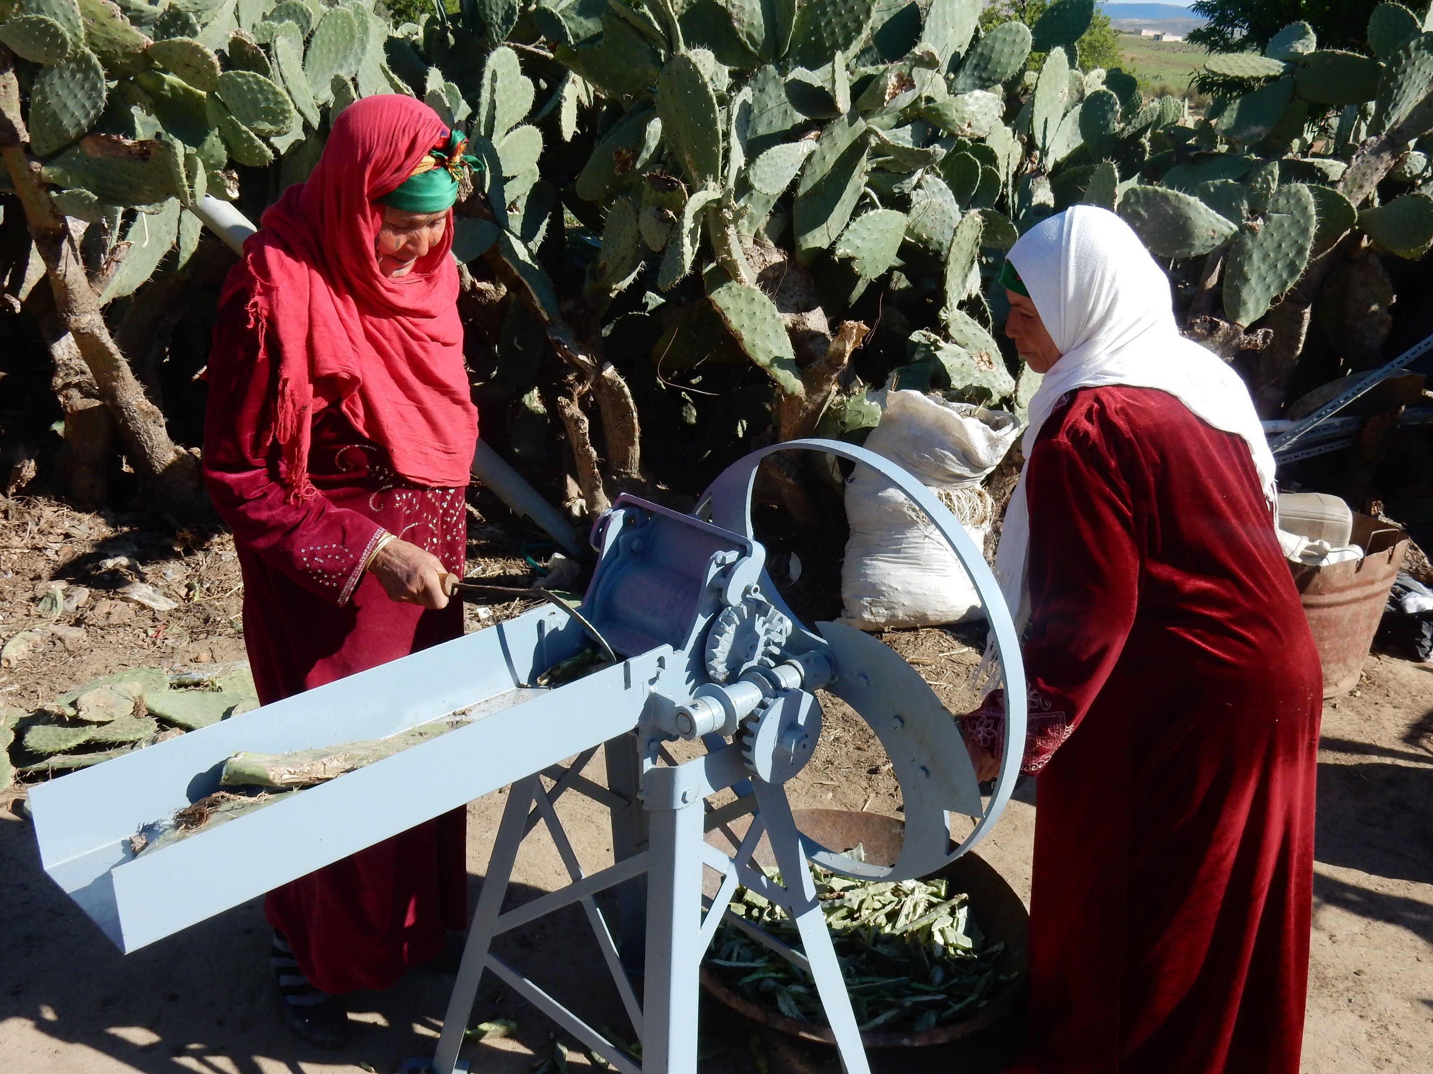
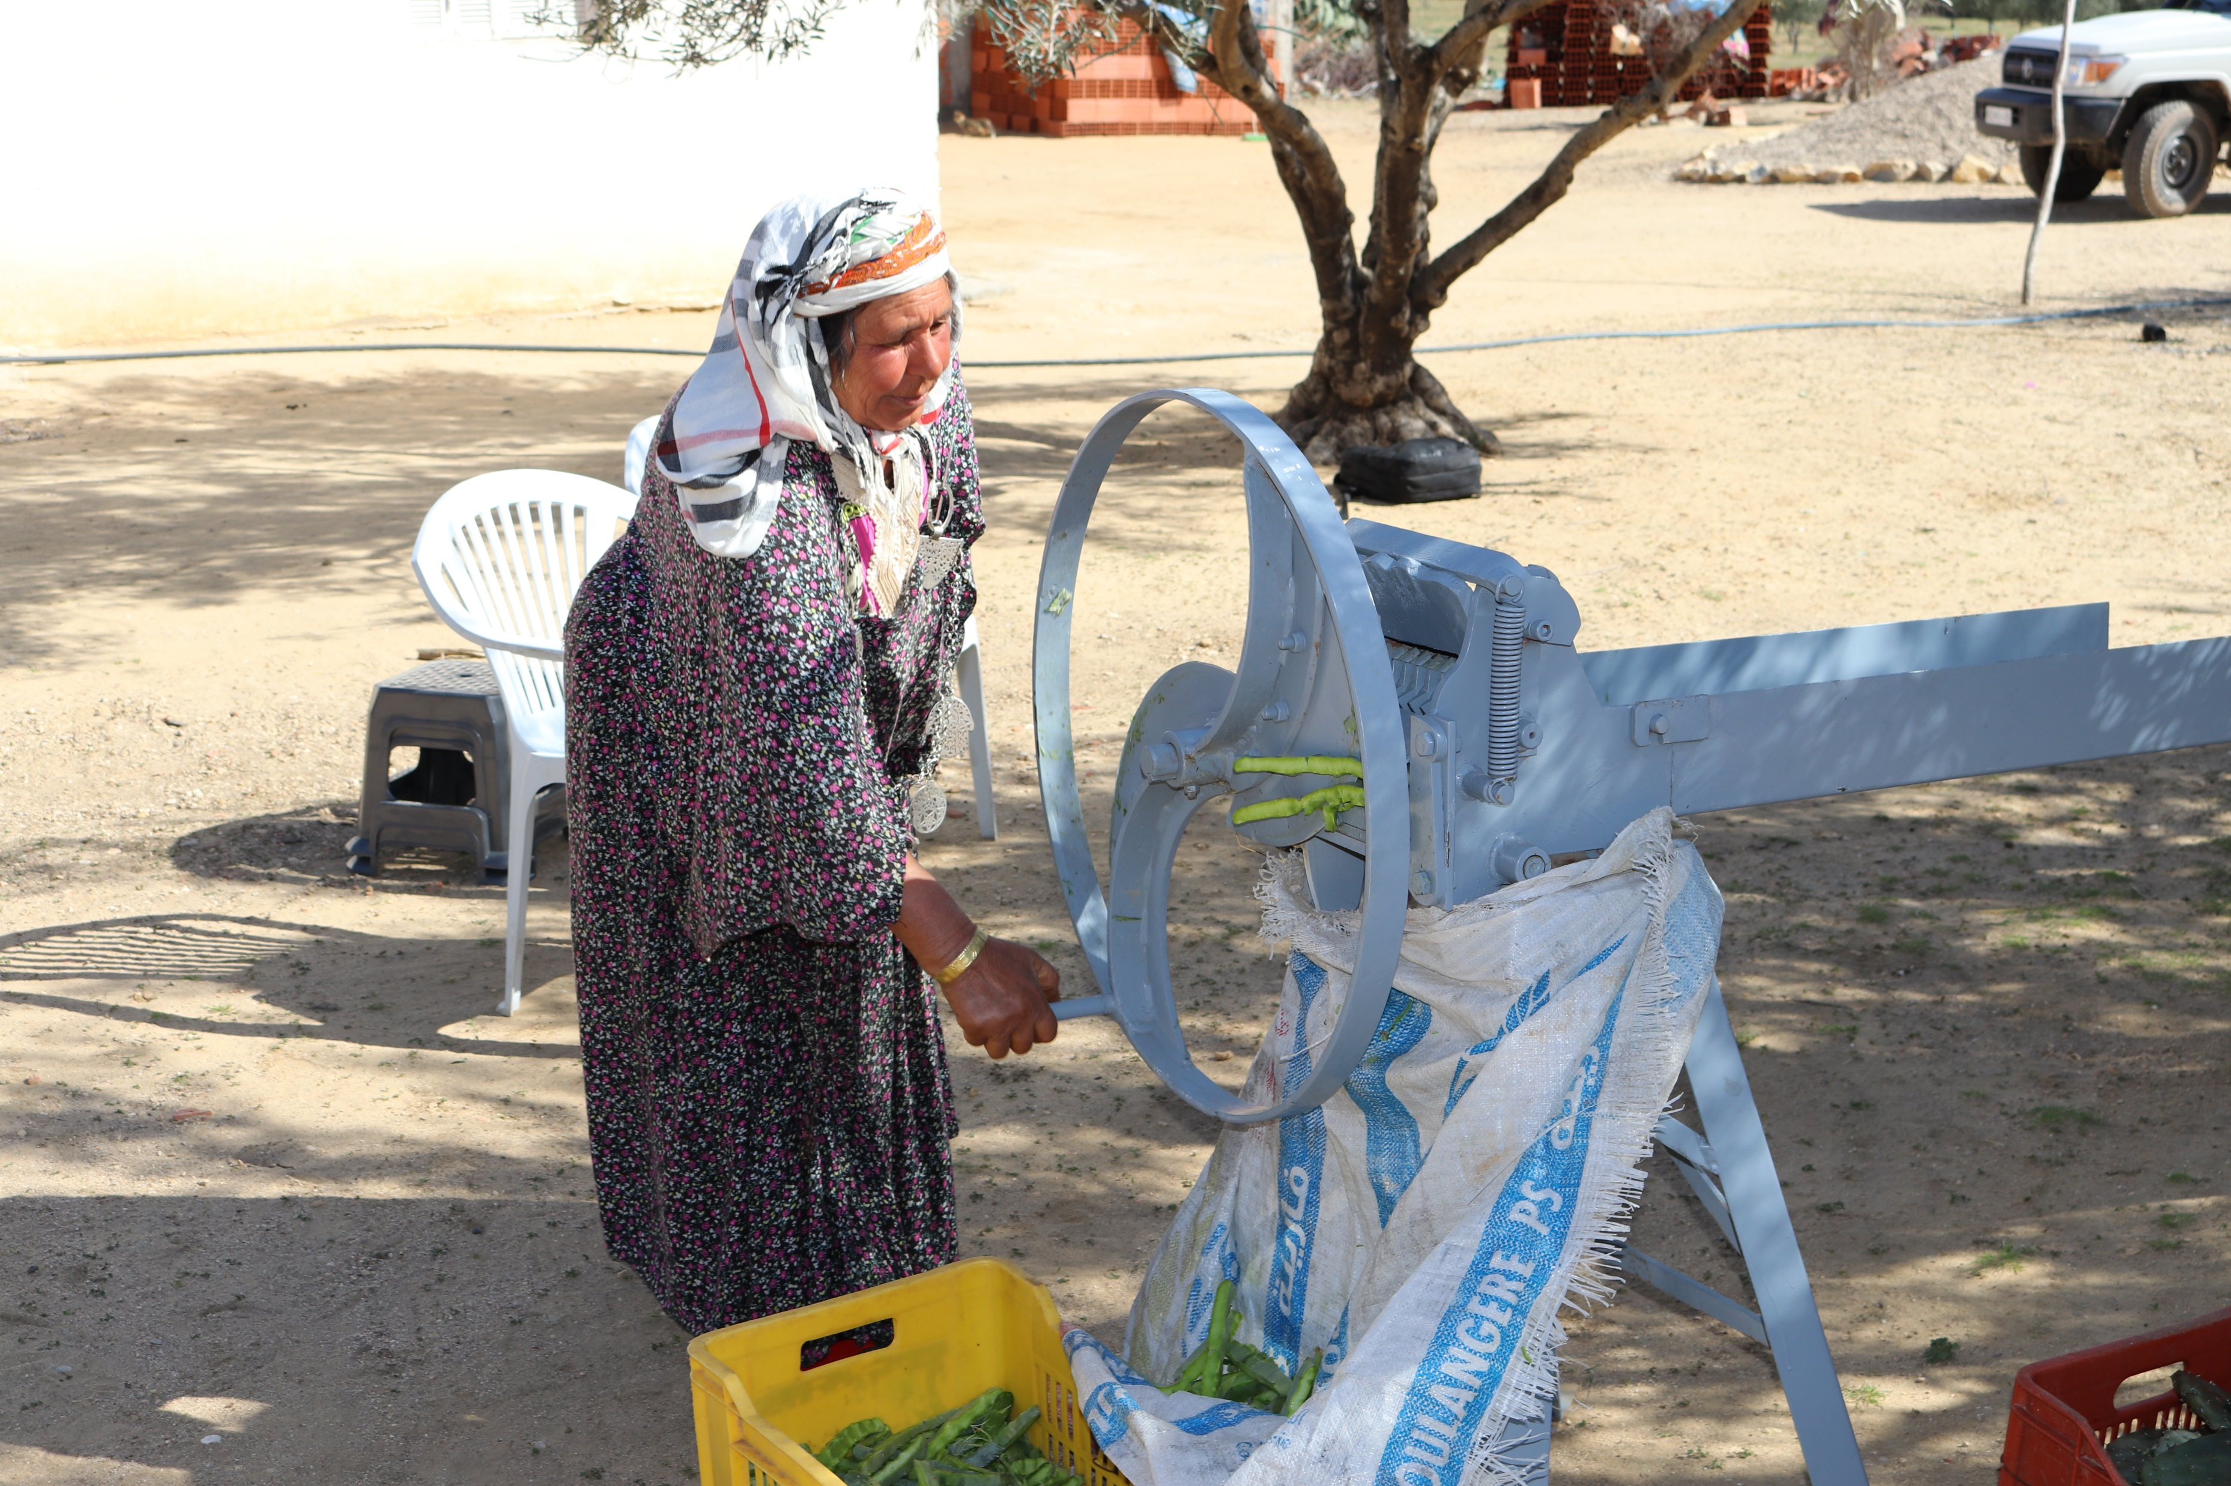
CACTUS SHOPPER

Slide 12
DESCRIPTION OF EQUIPEMENT
At least 200 m2 covered with a height of 6 m (metal frame) for storage of raw materials (wheat bran, barley, salt, etc.) and for installation of the machine.
Covered shelter very well ventilated for the drying of blocks of at least an area of 120 m2 on 5 shelves (metal framework)
A space of at least 100 m2 for storage of olive cakes and tomatoes pulp
The promoter leases a hangar of 380 m2 with 3.5 meters of height in his region.
The feed block processing machine consists of two conveyor belts, a mixer and a hydraulic press.
A crusher machine (placed with the press in the hall).

Slide 13
ECONOMIC ANALYSIS
Purchase of raw materials: The supply of raw materials is summarized in its collection and transport. Depending on each technical formula (appropriate proportions of each type of block), raw materials will be bought from farmers or on the market (bran, urea, salt, mineral and vitamin supplements, barley, olive cake, tomato pulp, etc.)
Sale of feed blocks (including marketing strategy, demand, distribution channels) The reference prices of sales of feed blocks is estimated at 210 USD/ ton. This price is lower than the price of industrial concentrate in Tunisia which currently the ton fluctuates between USD 280 – 320
Points of sale are:
  Outlets in the region (other vendors of agricultural inputs-input providers)
  Local/weekly markets
  Deliver directly to large livestock keepers

Slide 14
ECONOMIC ANALYSIS
Marketing strategy
  Free of cost distribution of the feed blocks (of a limited quantity) to the large livestock keepers at the start to make known and appreciate the new product in the region
  Prepare and distribute the technical sheets about the different categories of feed blocks
  Advertising in local radio and other local Medias
  Organize information days to raise awareness campaigns in the farmer’s communities

Slide 15
ECONOMIC ANALYSIS – OPERATING COSTS
Designation | Unit | Quantity | Unit Price TND | Total TND
Labor cost
Grinding by-products, producing and stocking blocks (# workers and months), including social costs (CNSS | Manpower / month | 27 (3 man x 9 month) | 500 | 13.500 (6000 $)
Purchase of primary materiel
FORMULAS 1&2 (average) | Ton | 300 | 102 | 30.600 (14000 $)
FORMULA 3 | Ton | 300 | 158 | 47.400 (21550$)
FORMULA 4 | Ton | 150 | 192 | 28.800 (13100 $)
Other costs
Maintenance of Equipment (machine, etc.) | Flat rate |  |  | 700 (320 $)
Water | M3 | 150 | 0.6 | 90 (41 $)
Energy (electricity) | KWh | 25000 | 0.1 | 2500 (1150$)
Management costs (stationery, etc) | Flat rate |  | 700 | 700 (320$)
Transport of by-products and final feed blocks, rent a lorry | Lorry/day | 80 | 150 | 12000 (5460 $)
Marketing and communication (flyer) | Flat rate |  |  | 3000 (1370$)
Rent a warehouse / store | Month | 12 | 550 | 6600 (3000 $)
Total |  |  |  | 66411 $

Slide 16
ECONOMIC ANALYSIS – PROFITABILITY OF THE PROJECT
Working Capital Fund
  For this project, working capital is estimated at 30% of operating costs. FR = 0.3 * FE (66411$) = 19924$
Investment (InV)
  In addition to working capital, some investments like construction of a store and office, acquisition of means of transport and equipment, and approach costs might be necessary.
  The promoter has already all necessary investments except a grinder, shelf, scale and small equipment.
Designation | Unit | Quantity | Unit Price TND | Total TND
Equipment
Machine (grinder) | 1 | 1 | 4000 | 4000 (1820 $)
3000 Liter water tank | 1 | 1
Scale | 1 | 1 | 600 | 600 (273$)
Small material | Flat rate |  | 200 | 200 (91$)
Shelve to stock blocks for drying | 1 | 1 | 800 | 800 (364$)
Total |  |  |  | 2548 $

Slide 17
ECONOMIC ANALYSIS – PROFITABILITY OF THE PROJECT
Investment (INV)
Designation | Unit | Quantity | Unit Price TND | Total TND
Approach costs
Study fees | 0 | 0 | 0 | 0
Incorporation expenses | 1 | 1 | 1400 | 1400 (637$)
Transport and installation of feed block machine | 1 | 1 | 1400 | 1400 (637$)
Total |  |  | 2800 | 1274 $
Total Investment |  |  |  | 3822 $

Slide 18
ECONOMIC ANALYSIS – PROFITABILITY OF THE PROJECT
Depreciation
Financing / Funding: This is the total investment including working capital.
Designation | Amount | Depreciation rate
Civil engineering | 0 | 5%
Equipment (including machine block) | 3500 – 1591$ (machine) 560 – 255$ (rest) | 10%
Means of transport | 0 | 20%
Approach costs | 600 – 273$ | 25%
Total | 2119 $
Designation | Amount
Own funds | 25000 (11364$)
Short term loaning | 15000 (6820$)
Medium term loaning | 10000 (4545$)
Long term loaning | 0
Total | 50000 (22728 $)

Slide 19
ECONOMIC ANALYSIS – PROFITABILITY OF THE PROJECT
Cost-Effectiveness of the project
Designation | Amount
COSTS
Operating costs | 66411 $
Financial costs | 3822 $
Depreciations | 2119$
TOTAL COSTS | 72352 $
TURNOVER
Feed blocks : 405 tons final product x (205$ / ton) | 83025
TOTAL SALES | 83025$
Net income before tax (RNAI) | 10673 $

Slide 20
ECONOMIC ANALYSIS – PROFITABILITY OF THE PROJECT
NOTE 1: The margin is (RNAI/(P1))*100 of the turnover: The Margin is 13 %.
NOTE 2: The study of the gross margin allows the monitoring of the profitability of the project and therefore of its performance. It is a benchmark indicator. The greater the margin, the more profitable is the project
NOTE 3: PROFITABILY INDICATORS
  Economic Profitability Ratio= (Total Sales - Income Taxes) / (Own Funds + Financial Debt) = 3.65
  Financial Profitability Ratio= (Total sales - Income Taxes - Interest Paid to Financial Debts) / (Own funds) = 7.01
  Profitability Threshold = (Fixed Costs) / [(Turnover - Variable Expenses) / Turnover] = 10591 $
  Break-even (in days) = (Profitability Threshold) / (Annual Turnover / 365) = 46.66 days
    The entrepreneur begins making profits from the 47th day onwards

Slide 21
THANK YOU
Questions / Comments!!!

