Slide 1
How to report deliverables
Learn how to report deliverables in MEL
in 1 minute

Slide 2
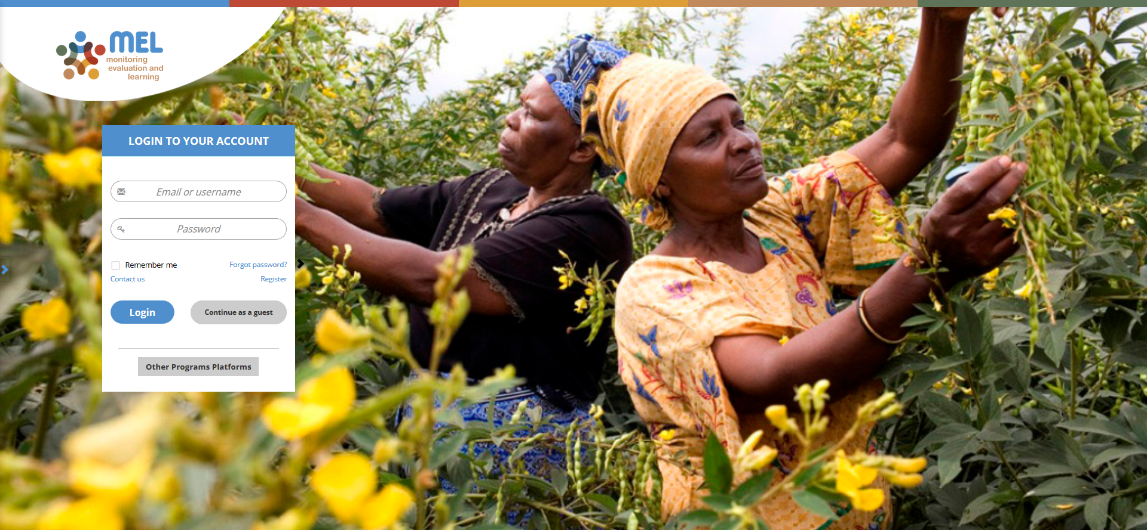
Go to mel.cgiar.org and login to your account
Use your email and password to login
Click on «Forgot password?» if you need to change your credentials

Slide 3
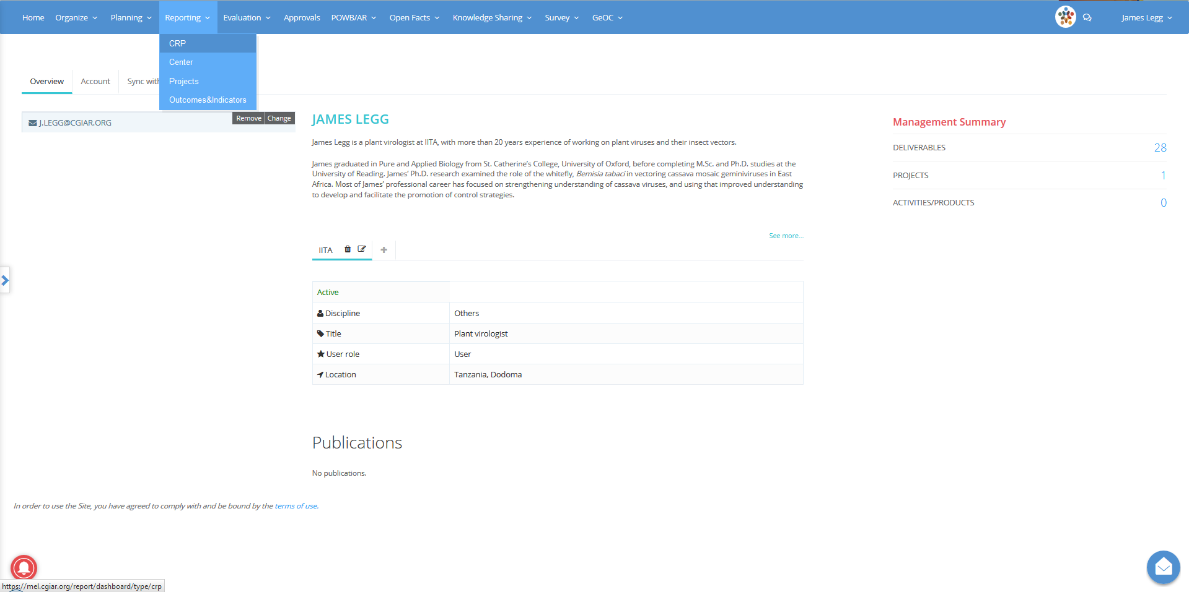
Click on the Reporting menu and select the reporting framework
You may select CRP, Center or Projects depending on the framework under which your deliverable has been planned

Slide 4
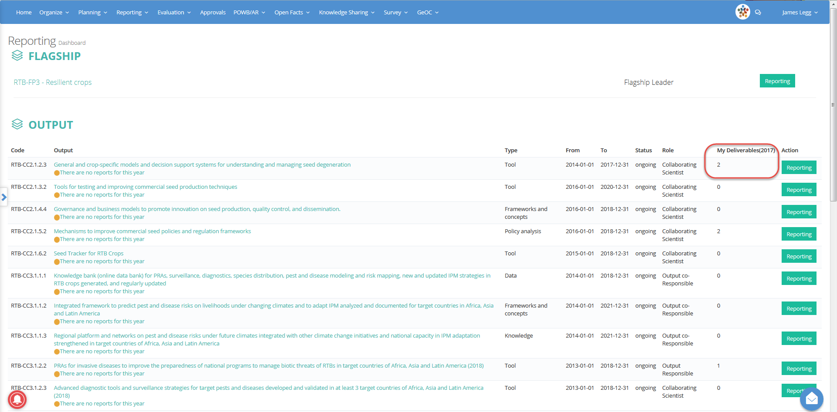
In the reporting dashboard identify the output under which your deliverable is mapped
Click on «Reporting» to open the Output page

Slide 5
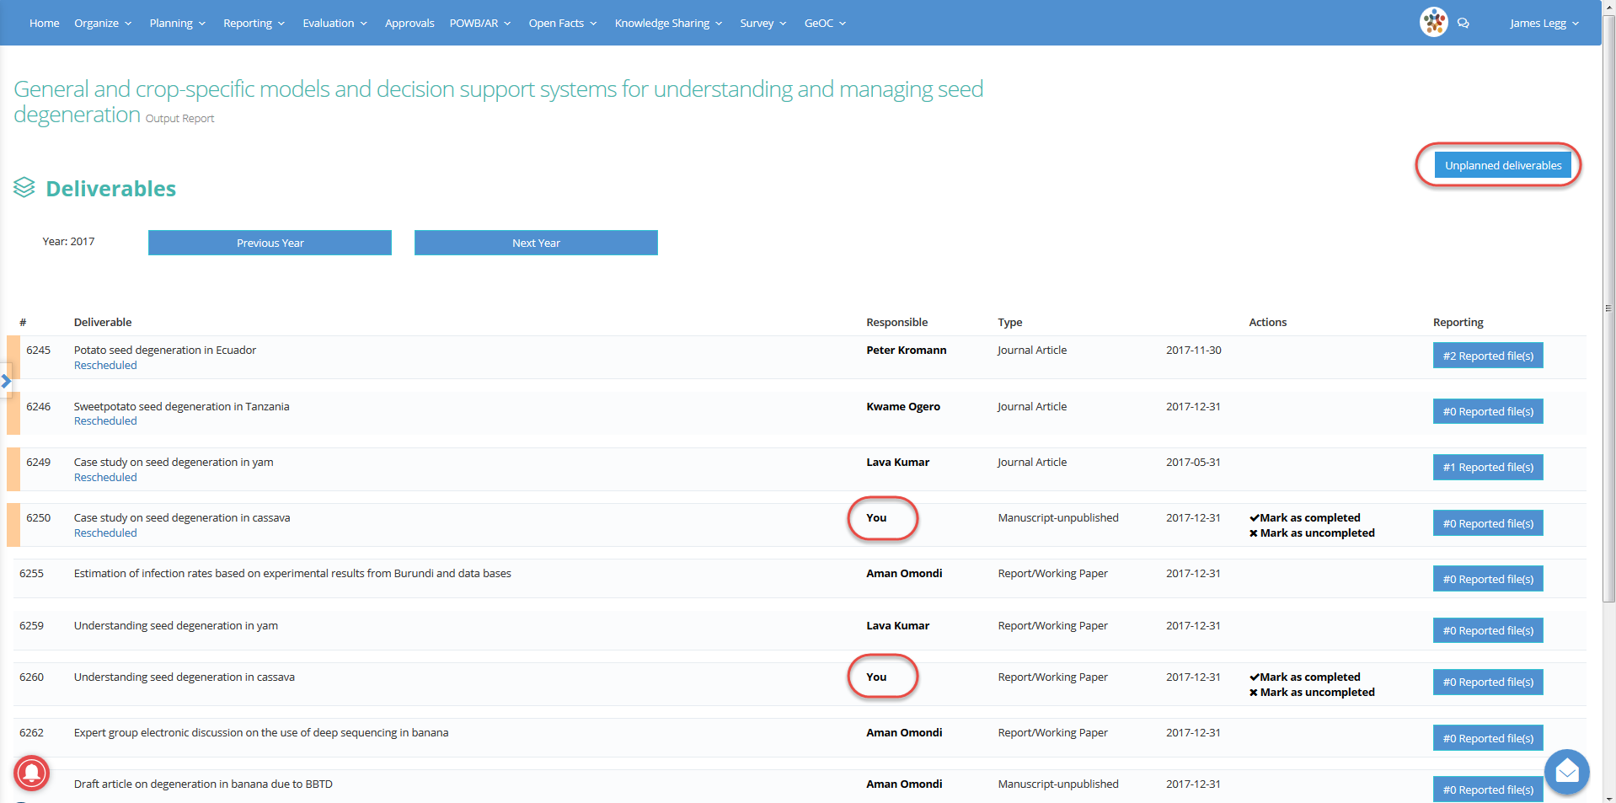
Identify the deliverables under your responsibility or create an «Unplanned deliverable»
Remember that you are also allowed to report against all the other deliverables that appear in the Output report page
Click on the button «# Reported file(s)» to upload a new file

Slide 6
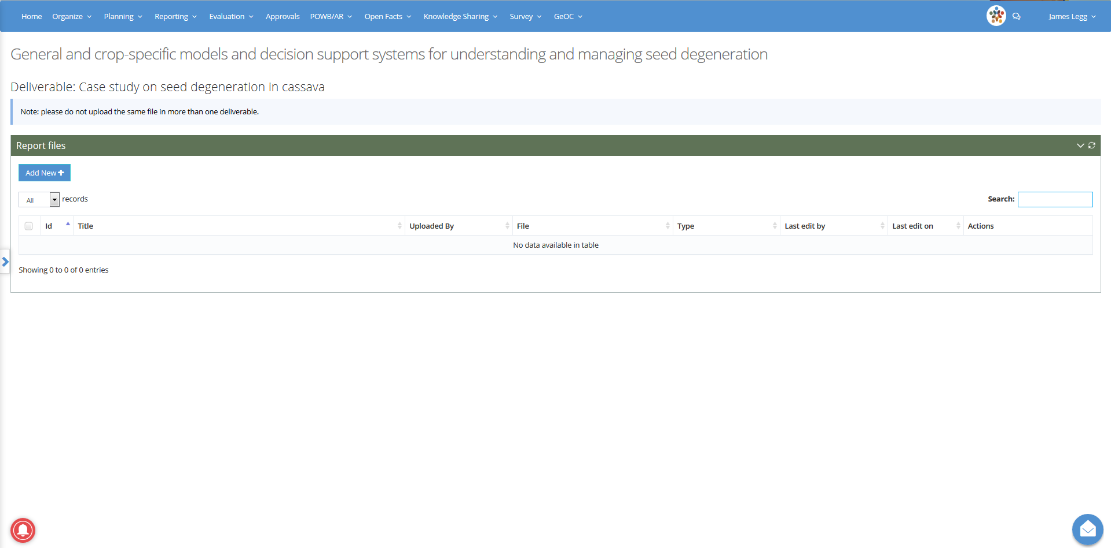
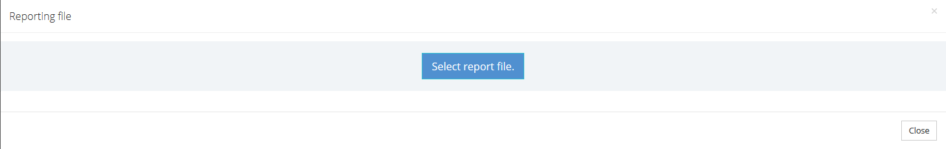
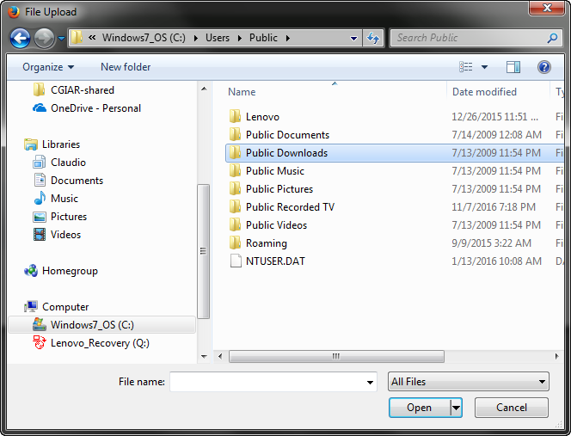
Click on Add New, Select and Upload the file

Slide 7
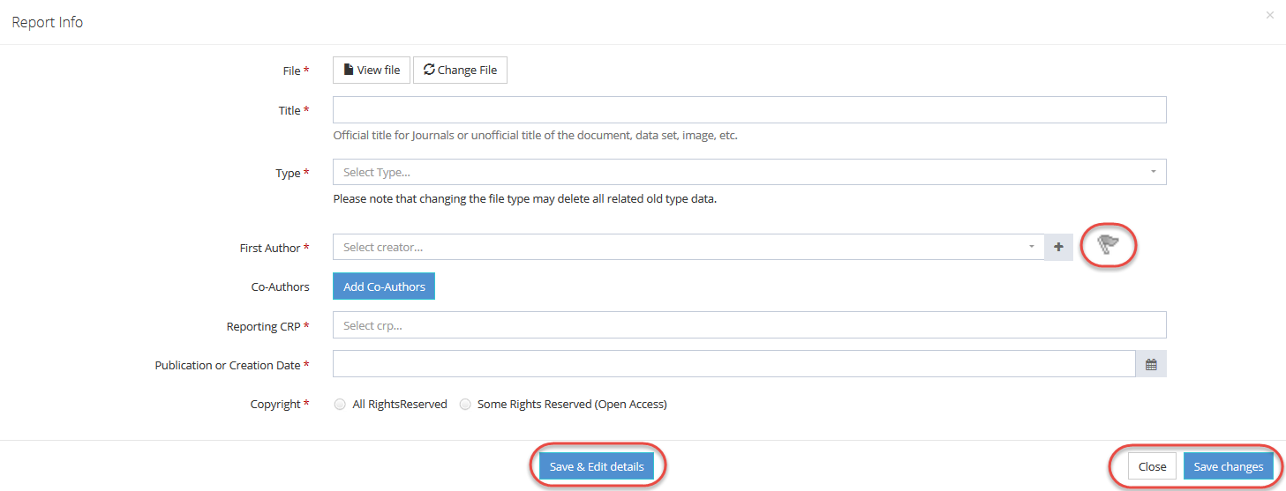
Provide basic report information and save
Remember that you have to flag one of the authors as «Corresponding author»
If you want to fill all the metada fields, click on «Save and Edit details», if not click on «Save changes»

Slide 8
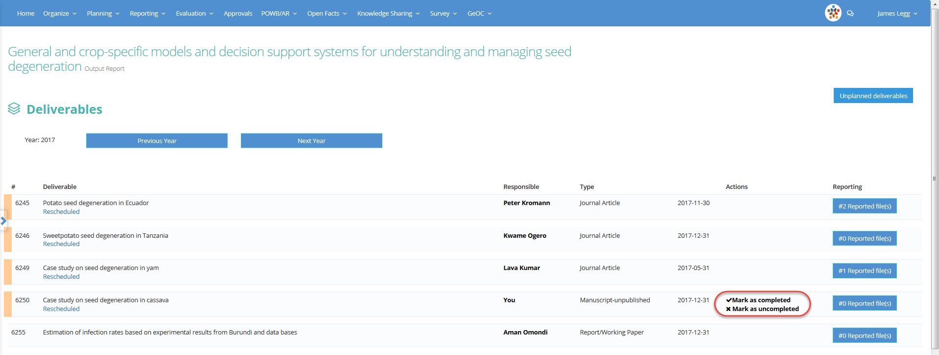
Go back to the Output report page to mark the deliverable as completed / uncompleted
When at least one file is reported under the deliverable, you may mark it as completed
If the deliverable is not completed, mark it as uncompleted and define if its delivery is postponed or canceled
Please remember: if at the end of the annual reporting cycle a deliverable is not marked as completed it will automatically marked as postponed

Slide 9



For more detailed information on how to use MEL please use the online guide
You need support?
Chat with us or send us and email
Thanks for using MEL

