Slide 1

Participatory Community development plans vs IP - ICARDA experience
Ali Nefzaoui
CRP-DS Coordinator of NA&WA Flagship
a.nefzaoui@cgiar.org

Slide 2
CRP-DS Program Management Office Notice No.3/11 September 2014
An integrated systems approach at all sites that uses innovative science and inter-disciplinary teams.
Shift from descriptive to systems analysis & modeling
Development of innovation platforms
Clear linkages of research hypotheses to outputs, outcomes and IDO’s
Value chain focus complements on-farm focus
Increasing recognition of need for enabling institutions & governance
Contested paradigms hard vs soft sciences; researcher vs farmer knowledge, what is the balance needed for the research questions asked
Greater social equity and gender considerations
Fit for purpose participatory approaches
More emphasis on SRT 1 & 4 (better functioning innovation systems, measuring impacts and cross-regional synthesis)
Etc…….

Slide 3
CRP-DS ISAC, July 2014
Systems innovation platforms will be fostered that add to value chains by encouraging diversification and local income generation by harnessing local and ‘scientific’ knowledge that, when combined with responsible private sector investment, will result in local clusters of economic activity incorporating other livelihood options such as renewable energy, ecotourism, artisanal goods and biodiversity for pharmaceuticals.

Slide 4
CRP-DS “The inception phase”
Bringing together the foremost scientists from a multitude of disciplines in order to assess needs and formulate hypothesis, outcomes and activities
Inception Regional Workshops
Regional Launch Meeting & Kick-off meetings by site
Plan of Work and Budget
2011
2013
ICARDA scientists & management
NARS scientists & decision makers
Assumption: Communities/farmers “opinion” is reflected through ICARDA and NARS scientists and other resource persons

Slide 5
Institutional and policy issues: the Bottle neck
Technical options easy to develop and implement, and are not sufficient.
Institutional and policy options are crucial for Natural resources management
Need for full integration of the TIPOs

Slide 6
The Participatory Approaches (PA) … “Old concept” but still needed in NA&WA
Definition:
Restitute to population the right of initiative and the decision making process to define, plan and implement activities and programs related to their proper future and the management of the resources available in their territories.
Slow adoption process (3 decades…)
Actions can be considered participatory only if it results from explicit negotiated compromise between all stakeholders.

Slide 7
Where we stand today ?
From participation, to local development, to self-reliance and empowerment of agropastoral communities
Self-reliance of CBOs (empowerment)
Co-management: Emergence of CBOs
Negotiation: active participation
Consultation: Participation “at a second degree »
Financial contribution
In kind contribution (labor force)
Passive participation: people are not against…
1970

Slide 8
ICARDA/M&M – IFAD working together…
Develop methodologies and tools for participatory management of natural resources in arid agropastoral areas
Empower agro communities through the creation of community-based organizations (CBO)
Getting policymakers at the local and national level to realize that technical, policy, and institutional options (TIPOs) must be strongly linked and integrated for a successful and sustainable rural development
Enhance on-going research and development initiatives using community participatory tools through a sound training program targeting all stakeholders.

Slide 9
The Methodology: Steps and tools
Step 1. Participatory characterization of the Community (territory and users): knowledge/learning phase
Step 2. Participatory diagnosis & planning
Step 3. Participatory programming
Step 4. Promotion of community-based organizations
Step 5. Implementation and Monitoring and Evaluation
Process based on group animation and multi-disciplinary team work

Slide 10
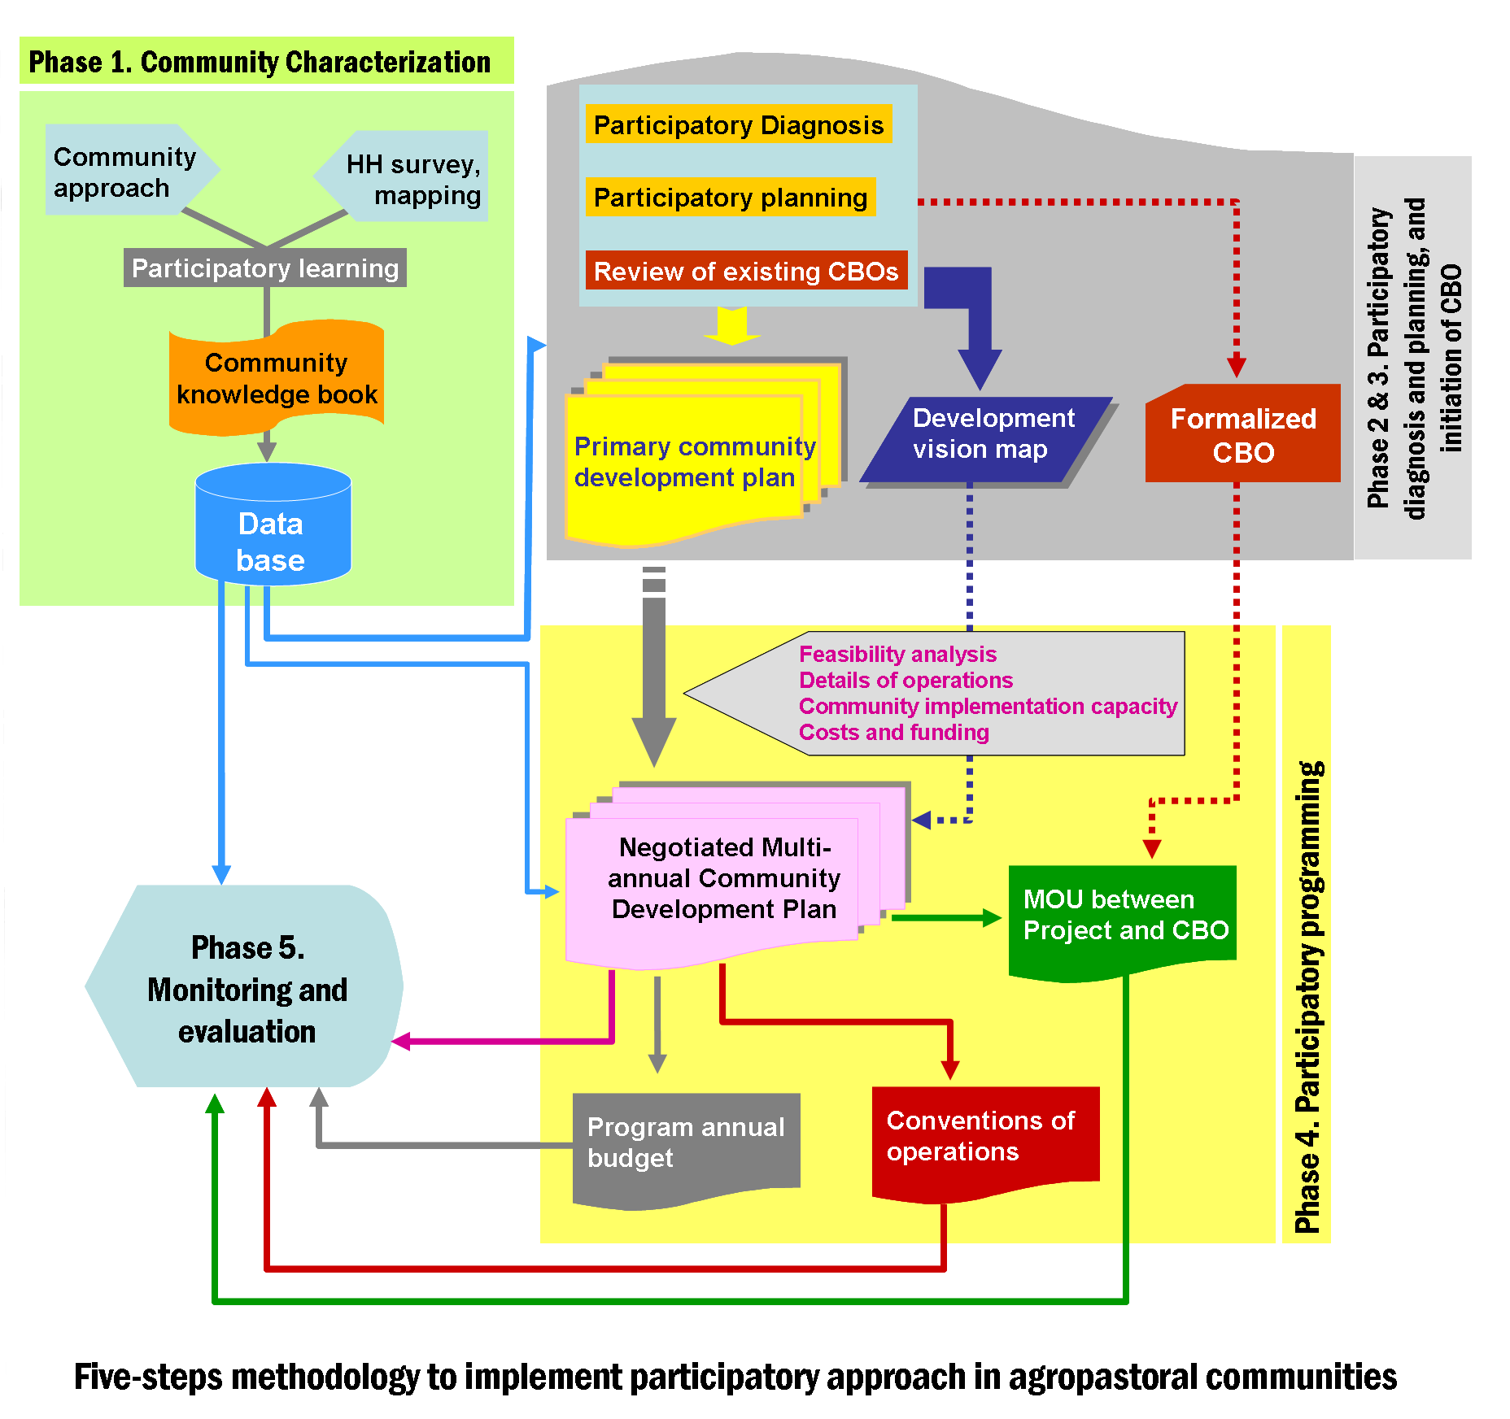
A. Nefzaoui et al. 2006

Slide 11
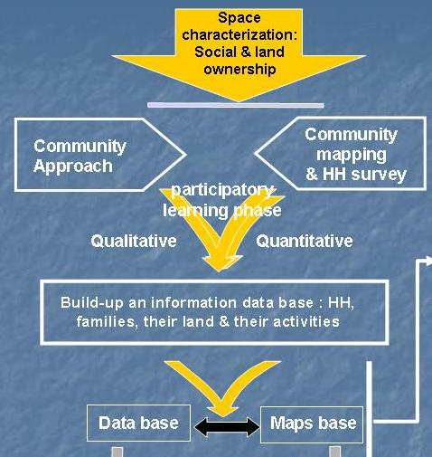
Phase I: Community characterization
D ?
Improved knowledge of the communities to better work together
M&E

Slide 12
Phase I: Community characterization
Sequences | Products/outputs
Preparatory tasks | List of HH, identification and training of surveyors
Sensitizing the population & introduction of the project | Agreement to work with the community, Organization of the working sessions
Participatory mapping of the community | Mental map with boundary and toponymic districts (TD).
GPS plotting of the community and its toponymic areas | Geo-referenced boundary of the community and of TD
Social and land survey | X surveys implemented
Typology of the community | Description and typology of TD

Slide 13
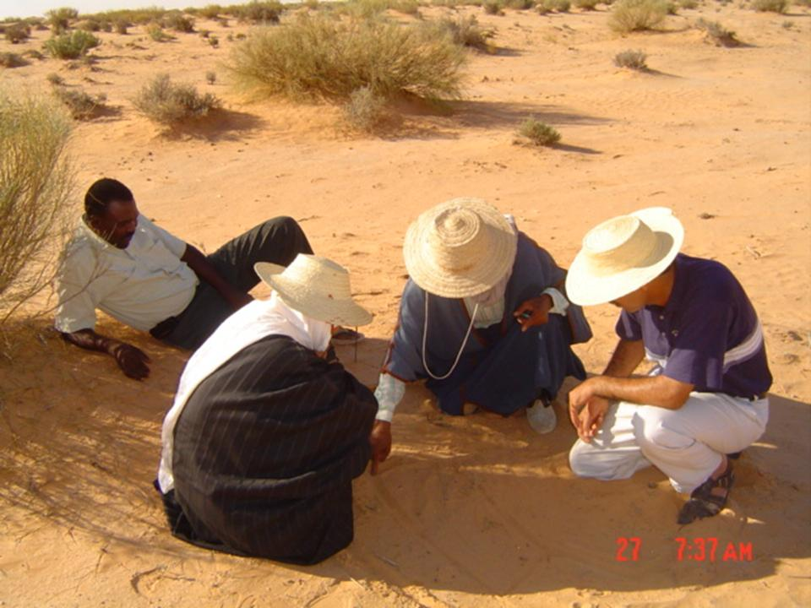
Sequence 1. Preliminary tasks
Collecting information
Organization & synthesis of information
Exploratory visit (transect)
Contacting local actors
List of HH
Available maps
Selecting and training surveyors

Slide 14
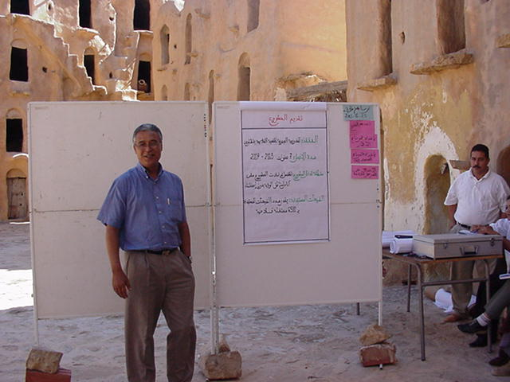
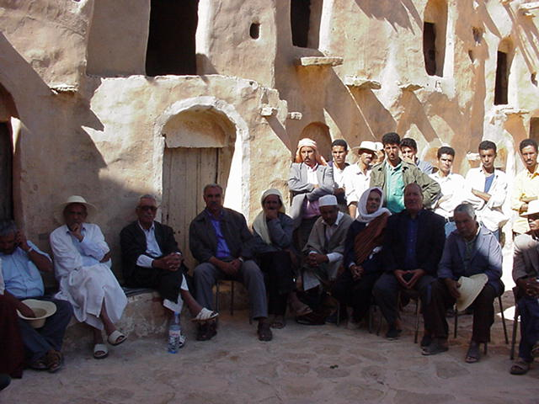
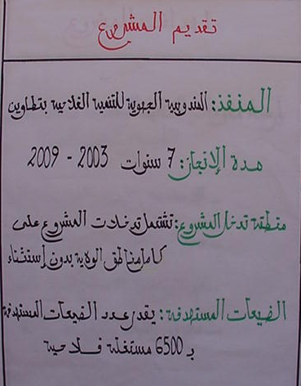
Sequence 2. Sensitizing population & introduction of the project
Introducing the project
Agreement with community members
Organization of working sessions

Slide 15
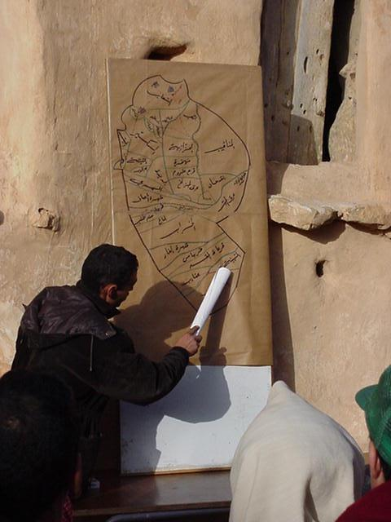
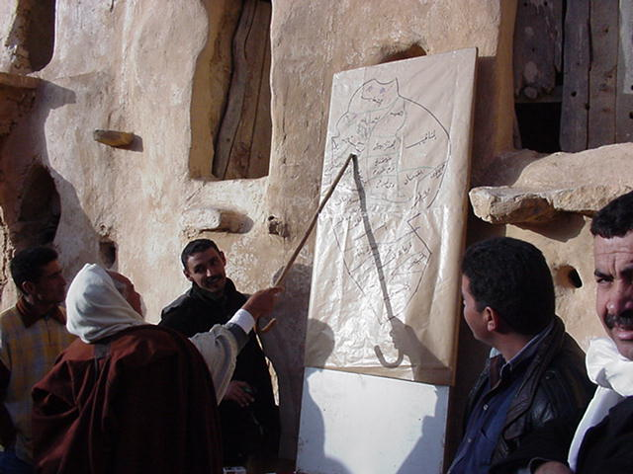
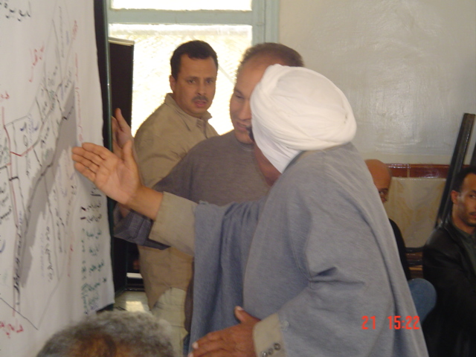
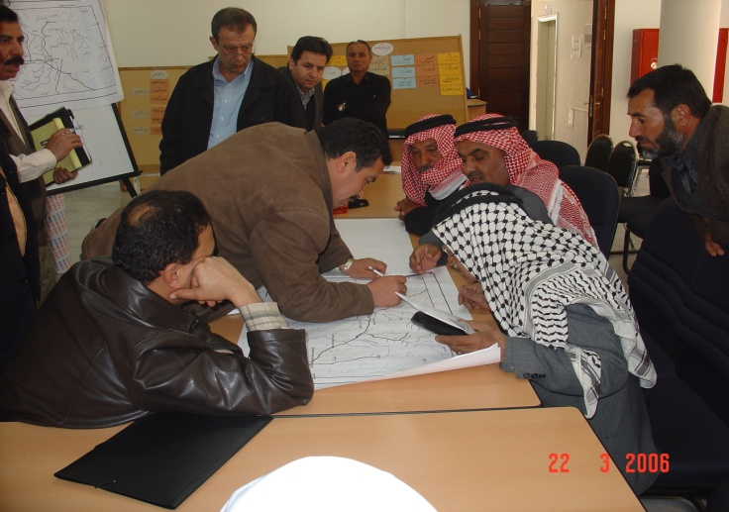
Sequence 3. Participatory development of the community mental map

Slide 16
Sequence 3. Participatory development of the community mental map
  Common understanding of the territory
  Create a link between mental map and conventional maps and GIS.
  To have a comprehensive map to negotiate locations of activities agreed upon.
  Define with the population of their history, social composition, localization of resources, etc.
  Toponymic districts (TD)
  Work to be implemented in small group (elders) designated by the population.

Slide 17
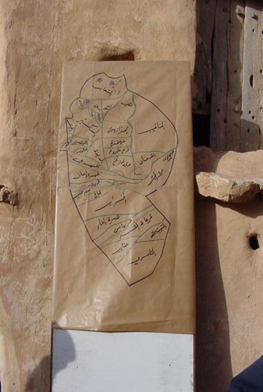
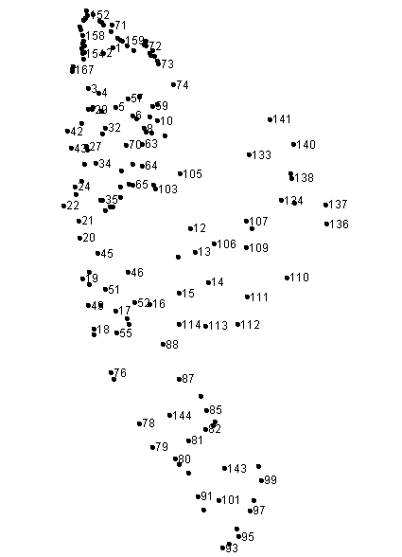
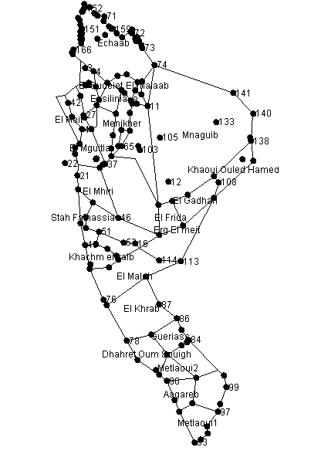
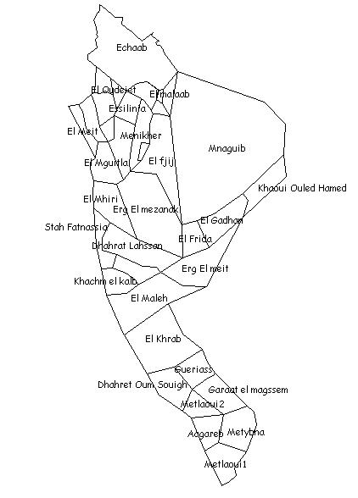
Mapping the community using GPS/ Map Info/ GIS
GPS plots (x,y)
EXCEL
MapInfo: drawing TD

Slide 18
Phase I: Community characterization (ctd.)
Sequences | Products/outputs
Capture of survey data and GPS plotting | Social and land tenure data base Maps data base
Data Analysis | Results (Tables), Thematic maps Community identity card
Production of the “community knowledge book” | Community knowledge book
Restitution and validation of the “community nowledge book” | Validated Community knowledge book

Slide 19
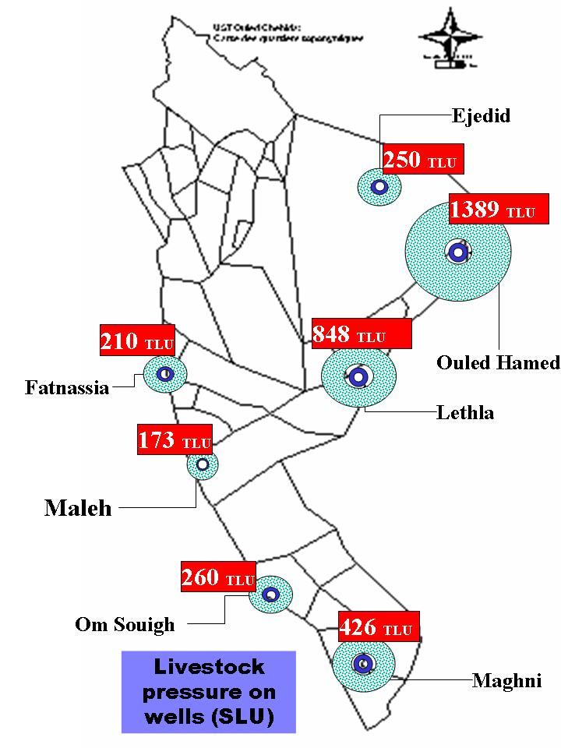
Example of thematic maps

Slide 20
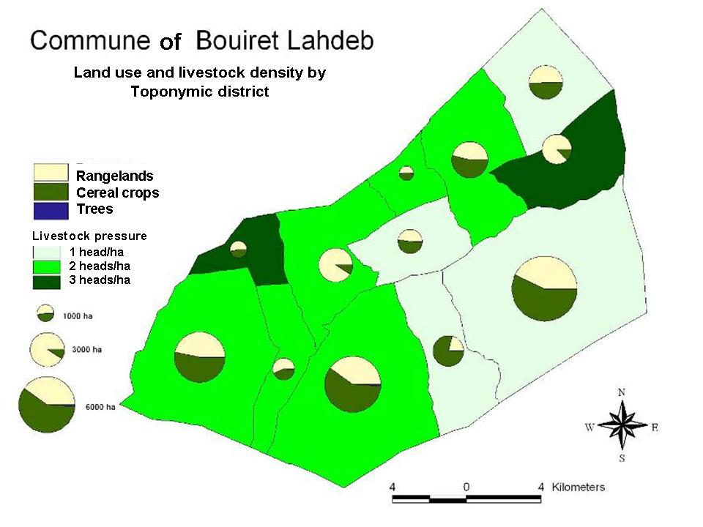
Example of thematic maps

Slide 21
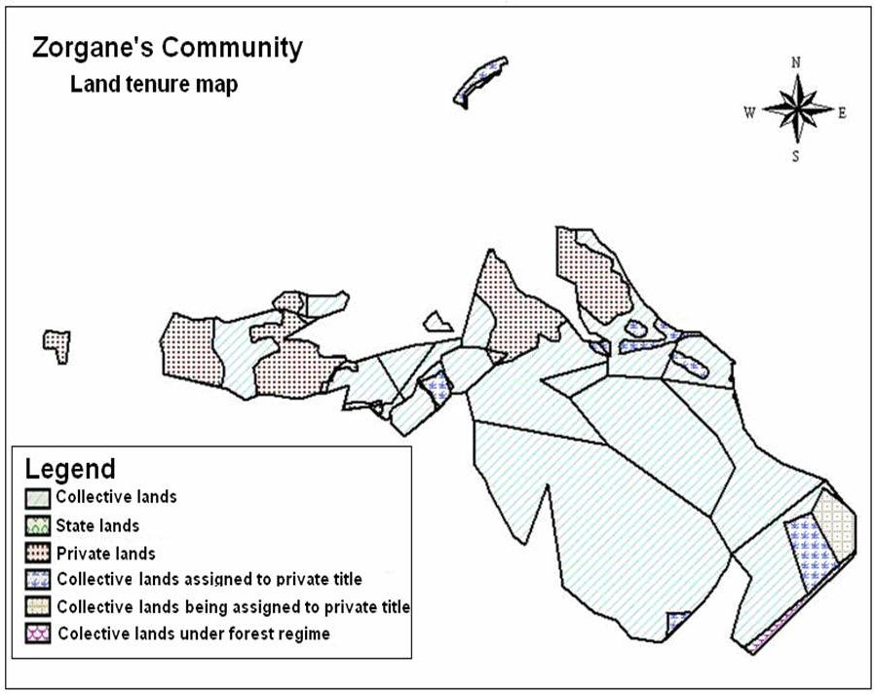
Example of thematic maps

Slide 22
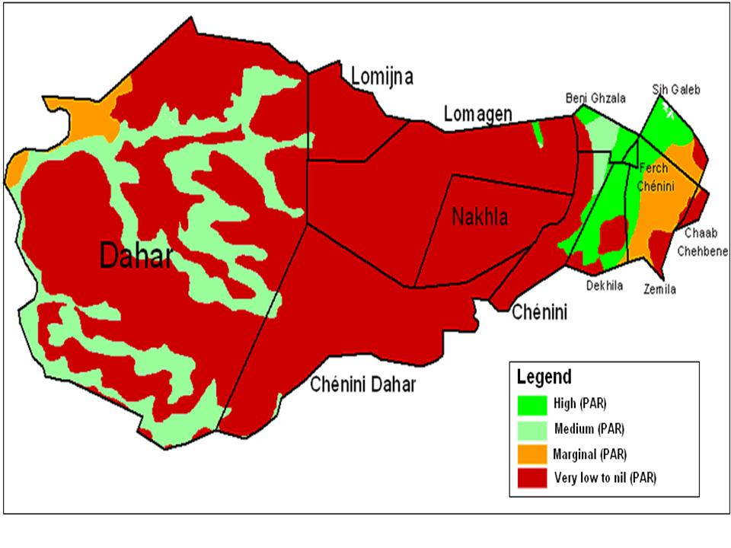
Example of thematic maps

Slide 23
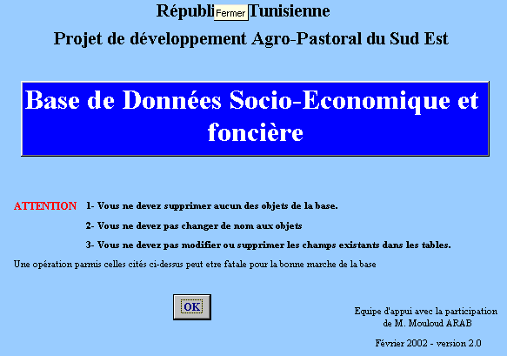
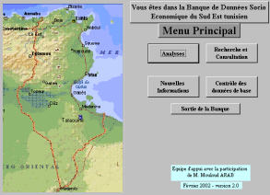
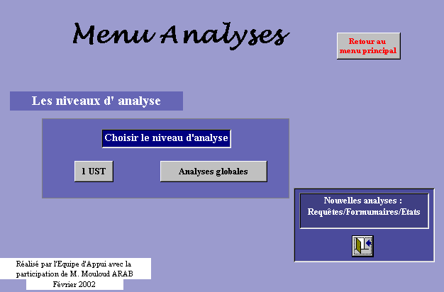
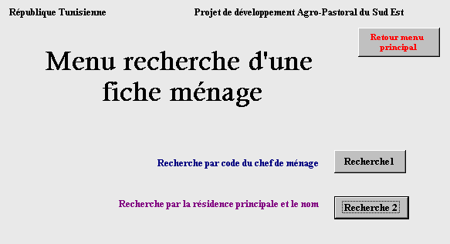
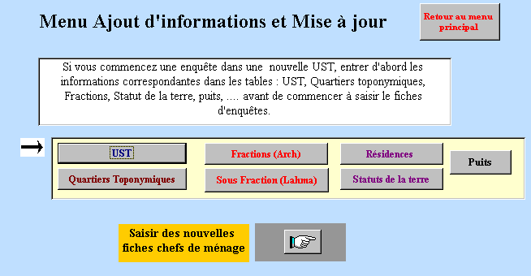
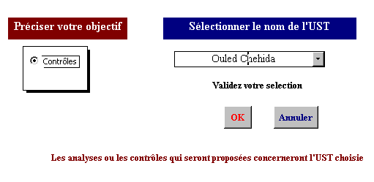
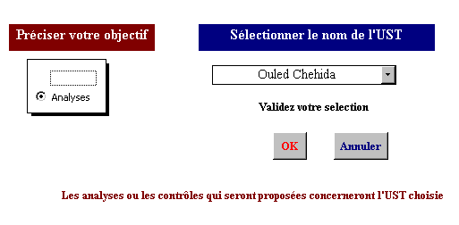
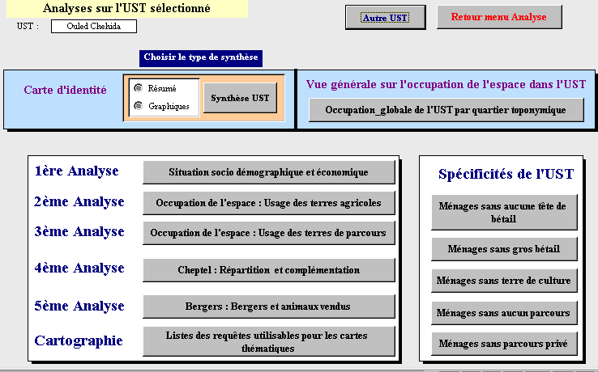
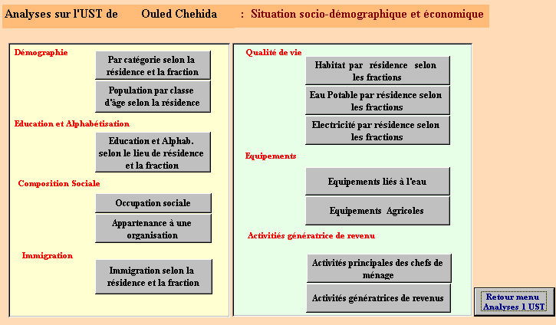
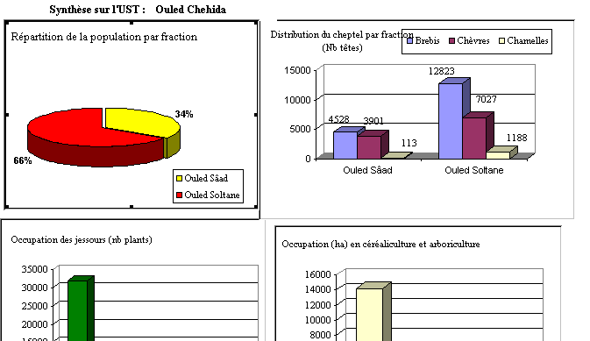
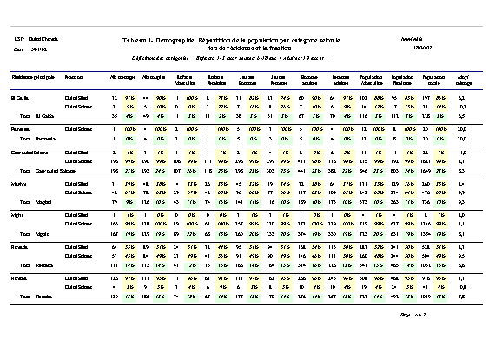

Slide 24
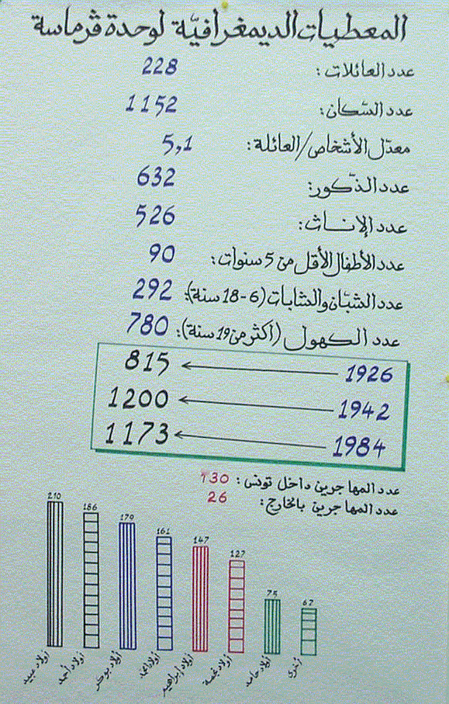
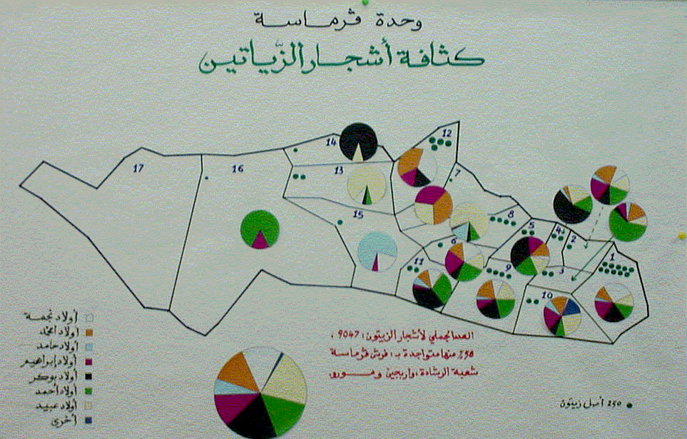
Validation of the knowledge book by community

Slide 25
Phase I & II: Participatory diagnosis and planning, and initiation of CBO

Slide 26
Participatory Diagnosis/
10 sequences
Validation of « knowledge book »
Spontaneous diagnosis
Problems classification
Restitution/validation of problems
Introduction of « local institution » issue .
Alternative solutions analysis.
Solutions priority setting.
Restitution and validation
Development of « long term vision » map.
Selection of local institution type (important step).

Slide 27
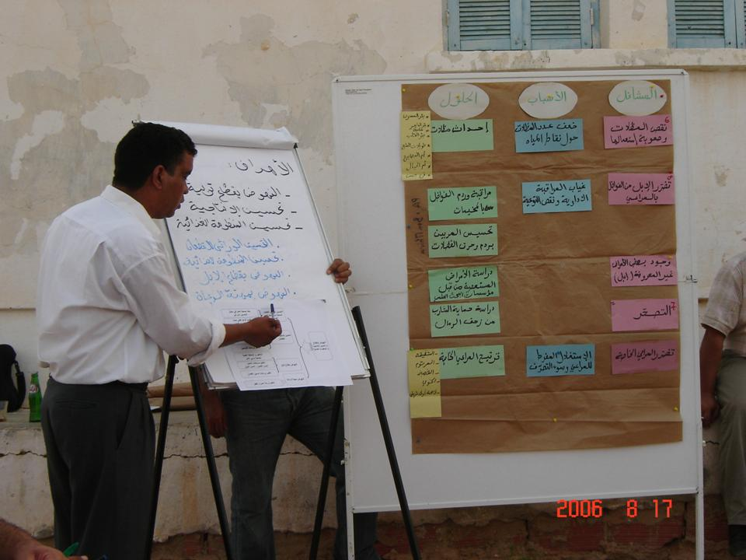
Participatory diagnosis : “cloud” of problems

Slide 28
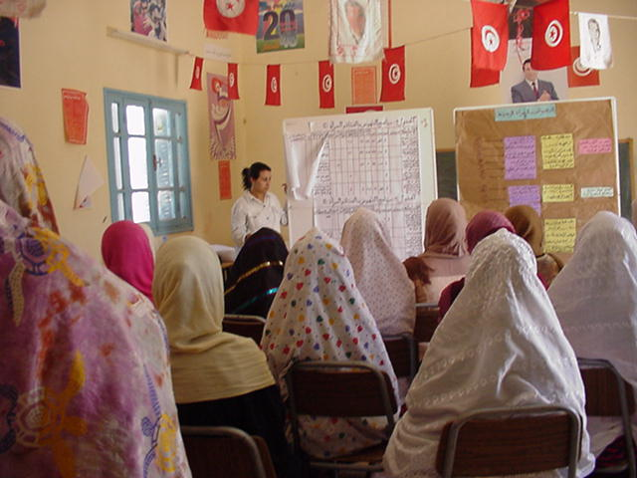
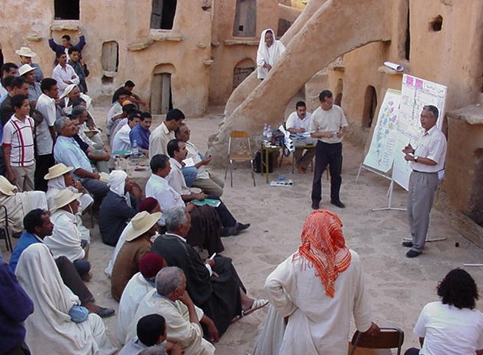
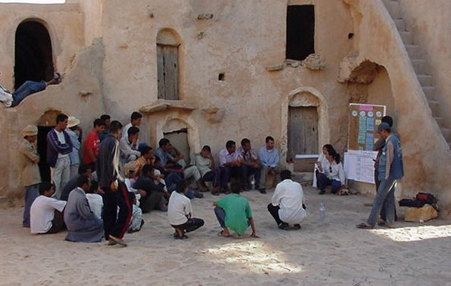
Need to work with focus groups

Slide 29
Problems’ classification to thematic areas

Slide 30
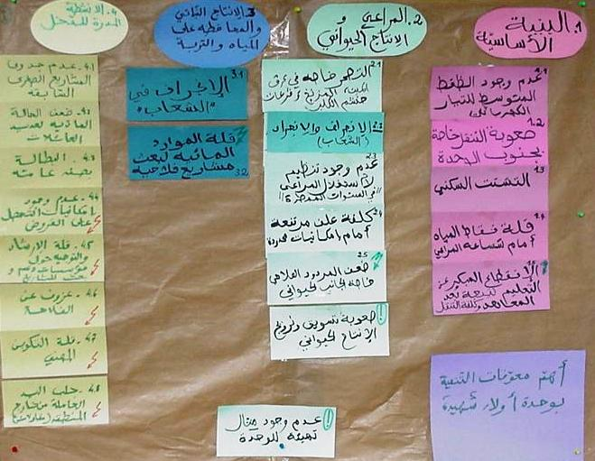
Problems’ classification to thematic areas

Slide 31
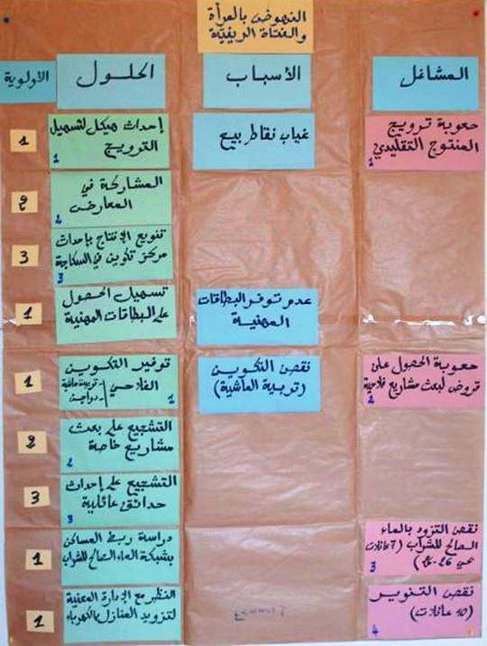

Slide 32
Identification of solutions
Problems | Causes | Potential solutions | Constraints | Setting solutions | Priorities
1. | A | A1 | If you know the constraint why it has not been done | S1 S2
 |  | A2
 |  | A3
 | B

Slide 33
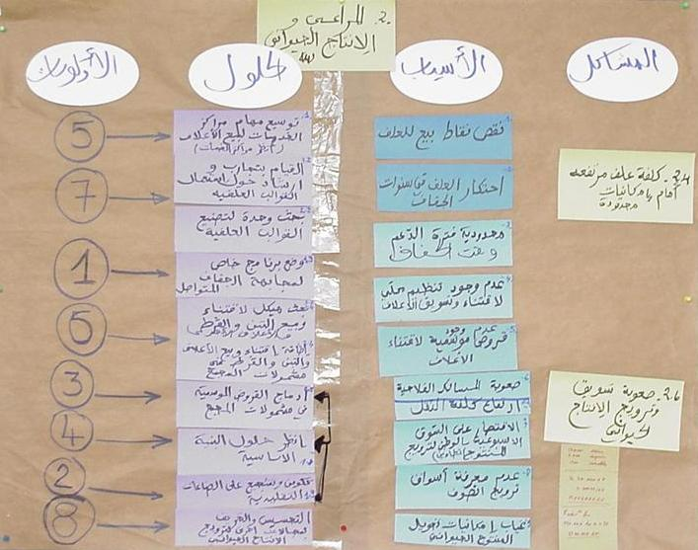
Priority setting

Slide 34
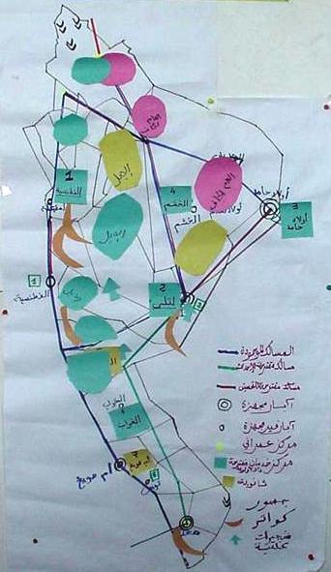
Long-term vision development map

Slide 35
Phase I & II: Participatory diagnosis and planning, and initiation of CBO

Slide 36
Step IV. Community-based Organizations
Inventory of existing local institutions
Analysis of the mandate and roles of each institution
Analysis of the decision-making process
Identification of improvements needed to the current decision making process
Development of methodologies to formalize local institutions

Slide 37
Step IV. Community-based Organisation

Slide 38
Example of Primary CDP
Activity code | Activities | Location | Priority | Unit | Qua.
1.1.5.1 | Water Harvesting - Earth dams | Tala'a Beda Ahmar | 5 | No. | 7
 | - Maintaining the Romans wells | Zabda Abo esba' | 5 | No. | 8
 | - Constructing contour ridges | Cooperative land | 5 | Dunum | 2000
 | - check dams | Cooperative land & private land | 5 | M³ | 2000
 | - Cisterns | El-Eas community | 7 | No. | 200

Slide 39
Phase IV: Participatory programming

Slide 40
Community
Community
Community
Phase I: Community characterization
Community
Participatory diagnosis and planning
knowledge book
knowledge book
knowledge book
knowledge book
Community
Community
Community
Community
Community
Community
Community
Data base
Data base
Data base
Data base
Data base
Data base
Development vision map
Development
Development
Technical feasibility analysis
(technical itinerary, details of operation, implementing capacity, costs, ect)
Formalizing CBO
Development
vision map
vision map
vision map
Output 1
MOU between project & CBO
Primary CDP
Multiannual CDP
Output 3
Implementation agreement (project & CBO)
Output 2
Annual budget program

Slide 41
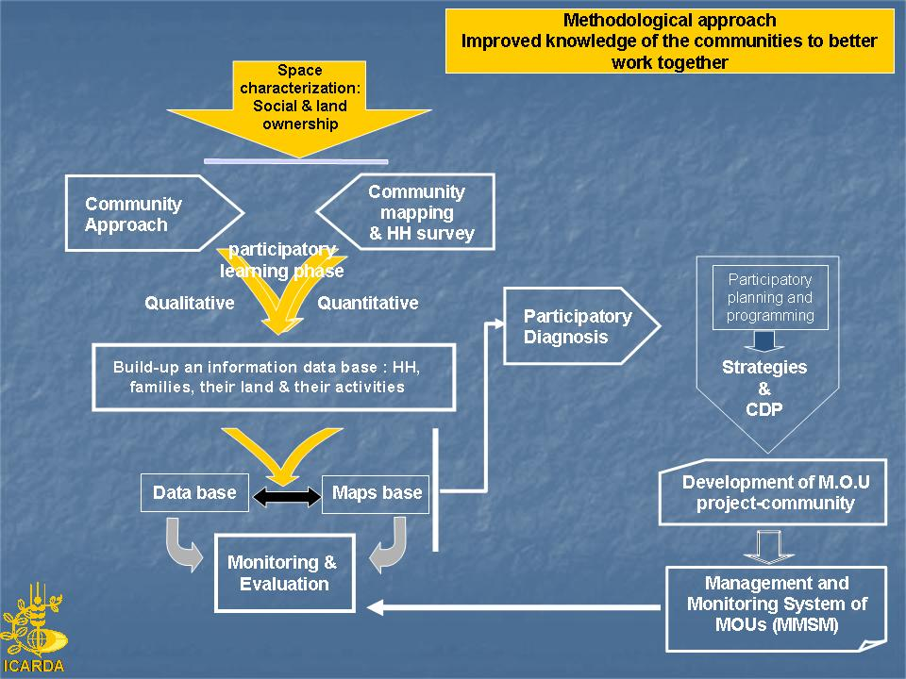

Slide 42
Example of multiannual development plan

Slide 43
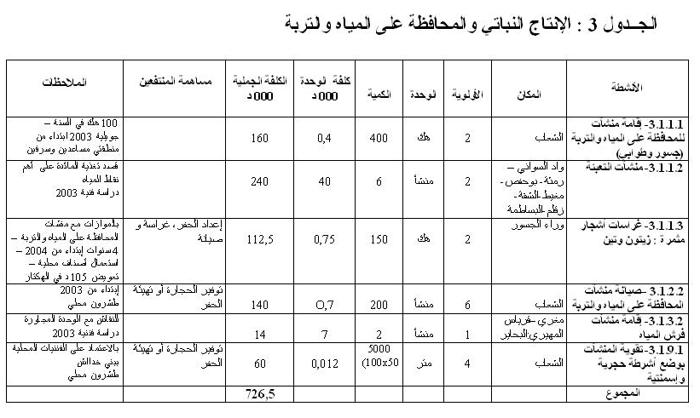
Example of annual budget program

Slide 44
On-going validation using ICARDA community participatory approach within IPs

Slide 45
Establishing IPs through Community development plan
Fostering integration between different disciplines, actors, etc.
Stimulating farmers and communities participation in steering their own development process.
Facilitating technology transfer through a participatory technology development.
Promoting collective action on the basis of a shared consensus.
Sound “open access” mega database

Slide 46
Establishing IPs through Community development plan
  The population through the participatory process determines the activities to be implemented, the amount, the location, the beneficiaries, and the implementing entity.
  The population contributes effectively in monitoring and endorsement of the work implemented.
  The power given to the community is a part of the MOU signed between the community and the Project management unit.
  Small businesses are currently emerging from the community (soil and water conservation, planting, nurseries, etc.),
  The President of the CBO is acting equal to equal with the project director, and approves and co-sign with him any deal/bargain related to their community

Slide 47
Establishing IPs through Community development plan
  The project served as a bridge between communities, government services, and NGOs to promote the development of the selected communities.
  National teams worked with their communities to develop proposals and get funding for priority actions.
  The linkages with new partners provided important social capital that facilitated the implementation of the negotiated action plans and the elaboration of community development plans.

Slide 48
Key learning
Annual and long-term development plan approved by communities is an efficient tool to mobilize resources and ease project implementation
Do not underestimate the ability of communities to identify appropriate technical solutions, to solve internal conflicts particularly relating to property rights
The success and the sustainability of the process depends on the promotion of elected community-based organizations that play a key interface role between communities and other actors (government agencies and decision makers, non government agencies, donors, and other communities).

Slide 49


