Slide 1
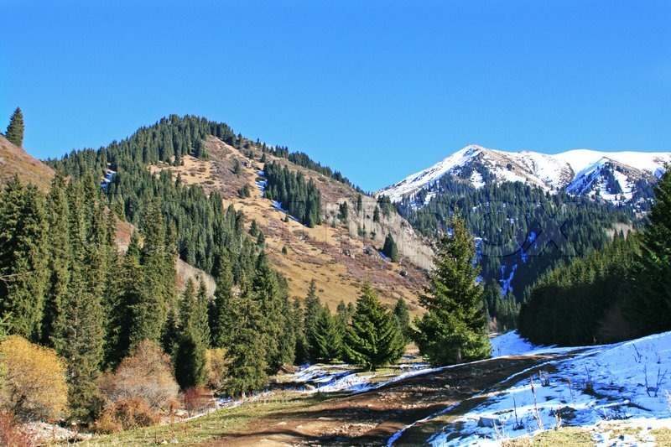
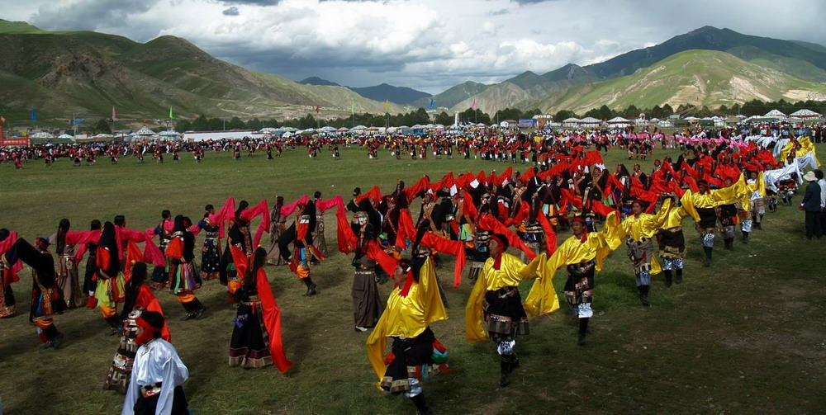
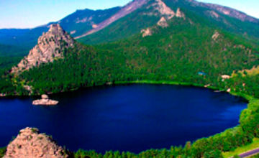
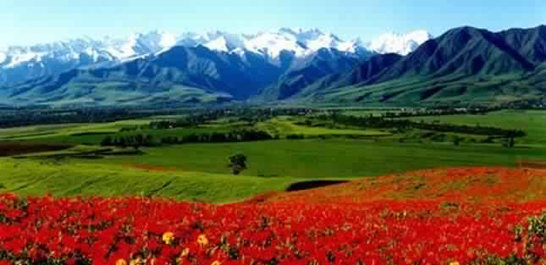
What is the value of these beautiful Central Asian
natural landscapes?

Slide 2
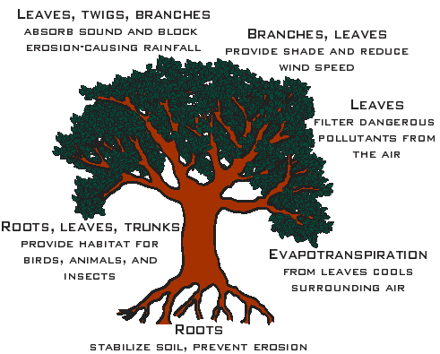
What are all these functions worth in terms of money?

Slide 3

Ecosystem Services: What they are, why they are important and how do we value and manage them
Vinay Nangia, Ph.D.
Senior International Scientist, ICARDA-Morocco

Slide 4


Ecosystem Goods
Raw materials provided by
nature
Essential inputs into all economic production
We can use them up as fast as we like
If I use it, you can't
  Competition for use
Market goods

Slide 5
Ecosystem Services-Definition
Our health and wellbeing depends upon the services provided by ecosystems and their components: water, soil, nutrients and organisms
Ecosystem services are the processes by which the environment produces resources utilized by humans such as clean air, water, food and materials
Ecosystem services can be defined in various ways. The Millennium Ecosystem Assessment (MEA) classified ecosystem services as follows:

Slide 6
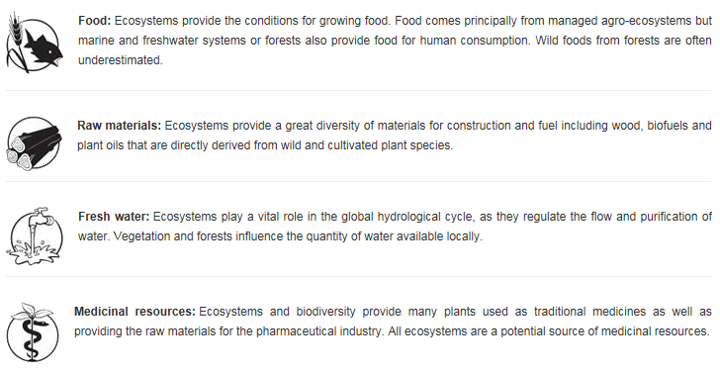
Provisioning Services

Slide 7
Regulating Services
Local climate and air quality
Carbon sequestration and storage
Moderation of extreme events
Wastewater treatment
Erosion prevention and maintenance of soil quality
Pollination
Biological control

Slide 8
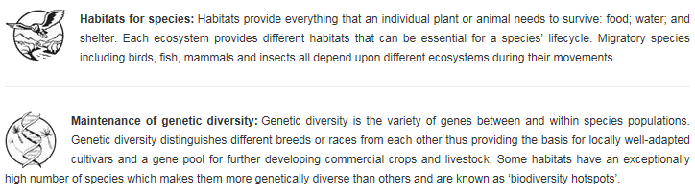
Habitat or Supporting Services

Slide 9
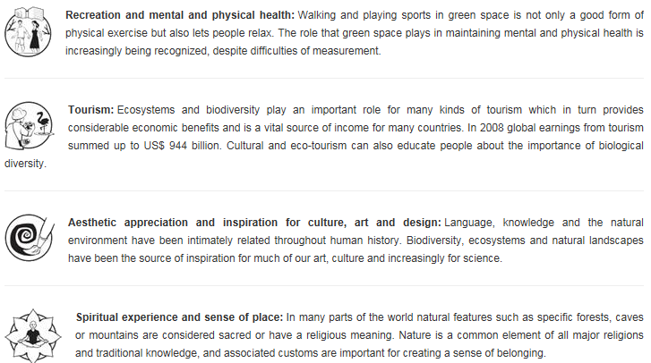
Cultural Services

Slide 10
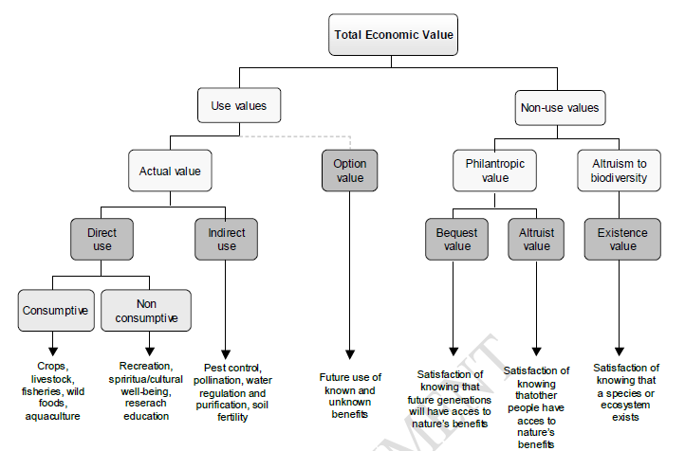
Total Economic Value (TEV) Approach
Notes:
This is typology that economists have used
Rationale for a typology of this kind is that if we do not categorize all the types of benefits that nature and ecosystems provide then we end up systematically under-estimating value (if we omit some categories)
3. We can conceive of Total Economic Value as consisting of a number of elements relating to both our use of ecosystem services either directly or indirectly, and importantly also the potential benefits from non-use of the resource.
Emphasize that TEV is considered from a purely human perspective. Whilst we might value the existence of say a habitat or species we cannot know its own intrinsic value.
Explain that use values are considered to be either direct or indirect. Direct use values include both consumptive uses such as food and raw materials and non-consumptive uses such as recreation, cultural heritage and well-being. This distinction is clear in that consumptive uses either permanently deplete non-renewable resources or temporarily prevent others from consuming renewable resources. Non-consumptive uses do not deplete the resource, but may temporarily prevent others from enjoying it, for example through crowding at recreational sites.
Indirect use values relate to the benefits we receive from regulating ecosystem services, for example pest control, pollination, water regulation and purification, and climate regulation.
Explain that option values relate to the potential future availability of ecosystem services, as such although we are not currently using those services they are often categorised as being linked to use values rather than non-use values.
Explain that non-use values can be considered as either philanthropic towards other people or altruistic towards nature.
Bequest values arise from knowing that future generations will have access to a particular natural resource, whilst altruistic value is the satisfaction of knowing that others in the current generation will have access to a resource. These types of value can therefore be used to consider issues of intergenerational and intragenerational equity. There is also an important distinction here with option value. Option value relates to the potential use of the resource by the person(s) expressing the value, bequest and altruistic values relate to potential use by others.
Existence value is the satisfaction from knowing a species, ecosystem or resource exists.
Note that whilst we can conceive of these types of value, in reality when undertaking valuation these may be inseparable motivations for value rather than individually identifiable elements of value. That is we may be unable to observe or elicit a value for either purely use or non-use elements of TEV.

Slide 11
Approaches to VES
Direct market valuation approaches: use data from actual markets
Revealed preference approaches: economic agents “reveal” their preferences through their choices
Stated preferences approaches: simulated markets where values are sought for changes in provision or policy
Notes:
Explain that there are three broad categories of valuation approaches.
Outline the types of methods used in each and where they can be applied.
Direct market valuation uses data on values that we can observe in actual markets. There are three main types of market valuation data:
Market prices – we observe these for goods and services that are traded in markets (cost of fish or forestry stock)
Cost-based approaches – where we equate the value of an ecosystem service to either the cost of provision for the service, the costs of alternatives to that service (e.g. man-made infrastructure in place of a regulating service), or the cost of damage where a service is not provided or fails (e.g. flood damage costs).
Production functions – using data on the quantity or quality of ecosystem services together with other goods or services to produce a final good with a related price or cost.
Market valuation approaches are typically used for provisioning goods (prices), regulating services (costs, production functions) and potentially supporting services (production functions)
In revealed preference methods we infer the value of ecosystem services from observing people’s behavior. There are two common methods:
Travel cost method – used for valuing recreational sites and assumes that the value that someone places on a site or activity is related to the amount of time and money they spend travelling to undertake the activity at a particular site.
Hedonic pricing – uses the assumption that the quality or quantity of ecosystem services in an area are reflected in local property prices, along with a range of other property and neighborhood attributes (beach view, lake in the backyard)
Travel cost are used for particular types of cultural services, hedonic pricing can be used for a variety of services including regulating, cultural (amenity) and commonly applied to negative impacts such as noise (road, aircraft), odours, dust etc.
Stated preference approaches use hypothetical markets to elicit willingness to pay or willingness to accept compensation for a change in provision of an ecosystem service. There are a number of variations of this approach including contingent valuation, choice modeling group valuation. The hypothetical nature of these methods mean that they are very versatile in terms of the types of ecosystem services they can value and whether their provision is existing or proposed.

Slide 12
VES Application Approach
Step 1: Identify and assess the full range of ecosystem services affected and the implications for different groups in society
Step 2: Estimate and demonstrate the value of ecosystem services using appropriate methods, including linkages over time and scale, local versus global, current use versus future use
Step 3: Capture the value of ecosystem services and seek solutions to overcome their under-valuation through economic policy instruments (subsidies, fiscal incentives, charges for access and use, payments for ecosystem services, property rights, eco-labelling and certification etc.)

Slide 13


Case study: Valuation of Ecosystem Services for Improved Agricultural Water Management in Kazakhstan

Slide 14
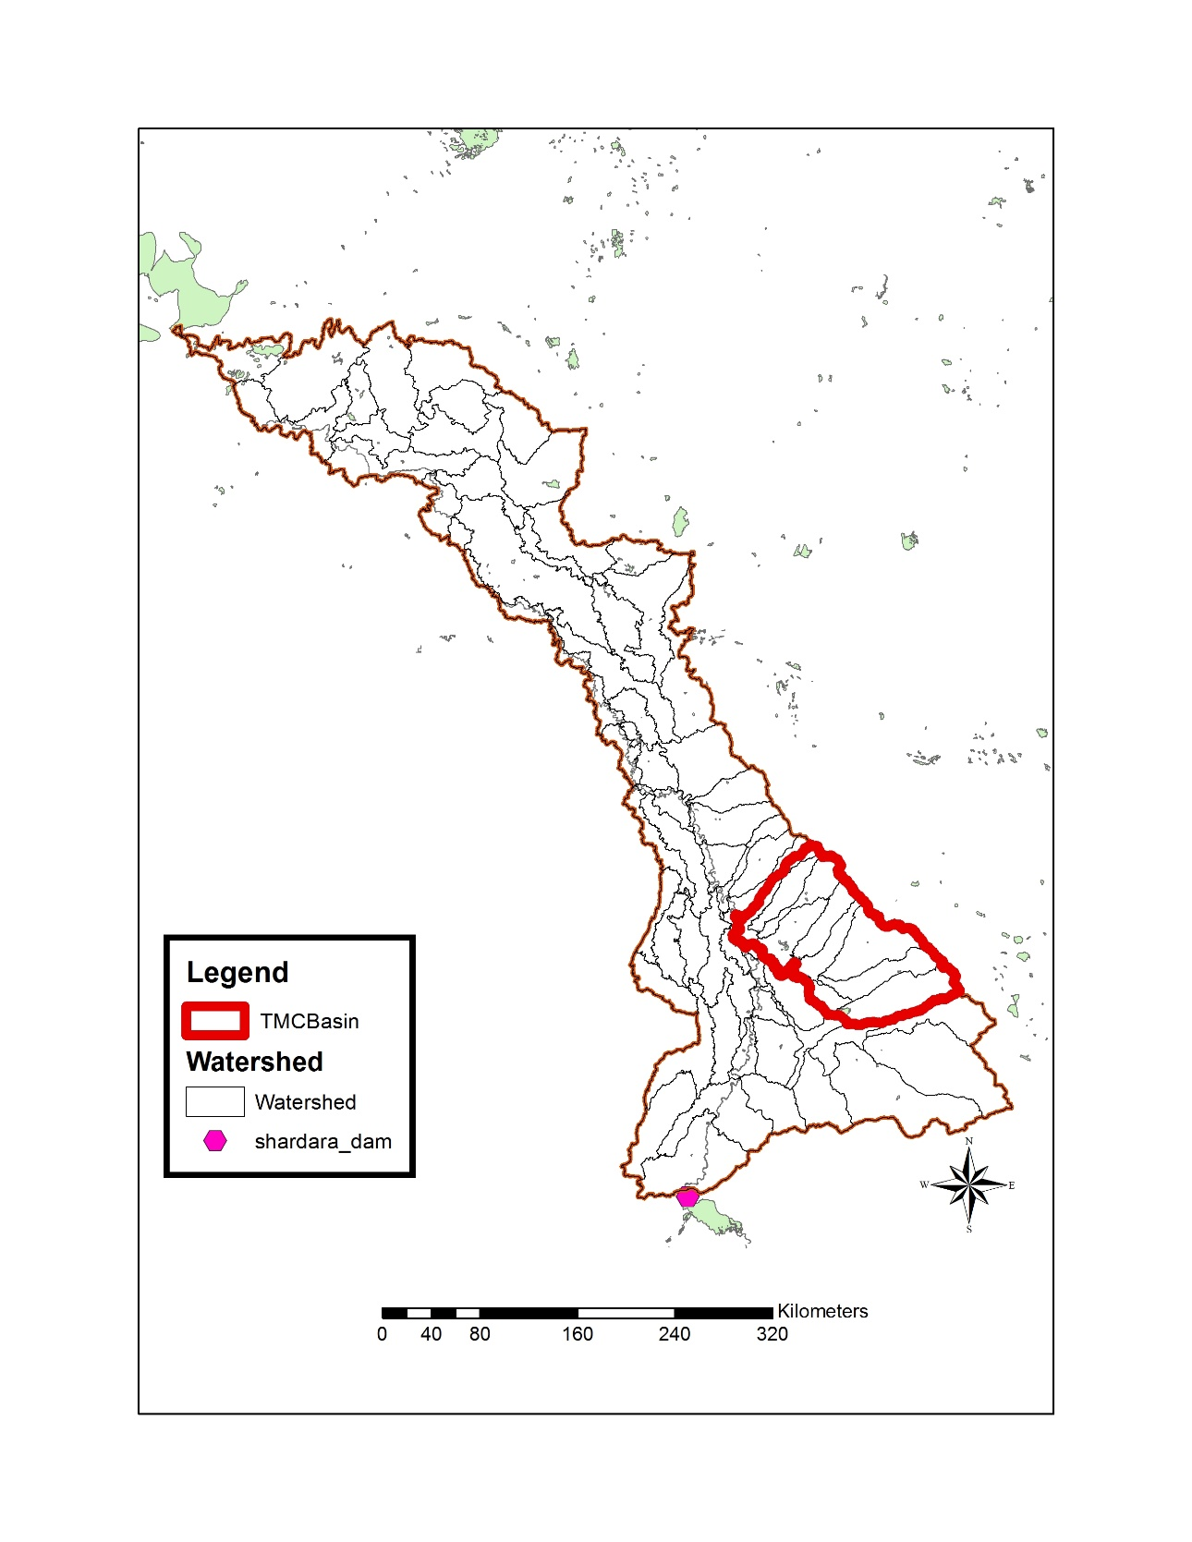
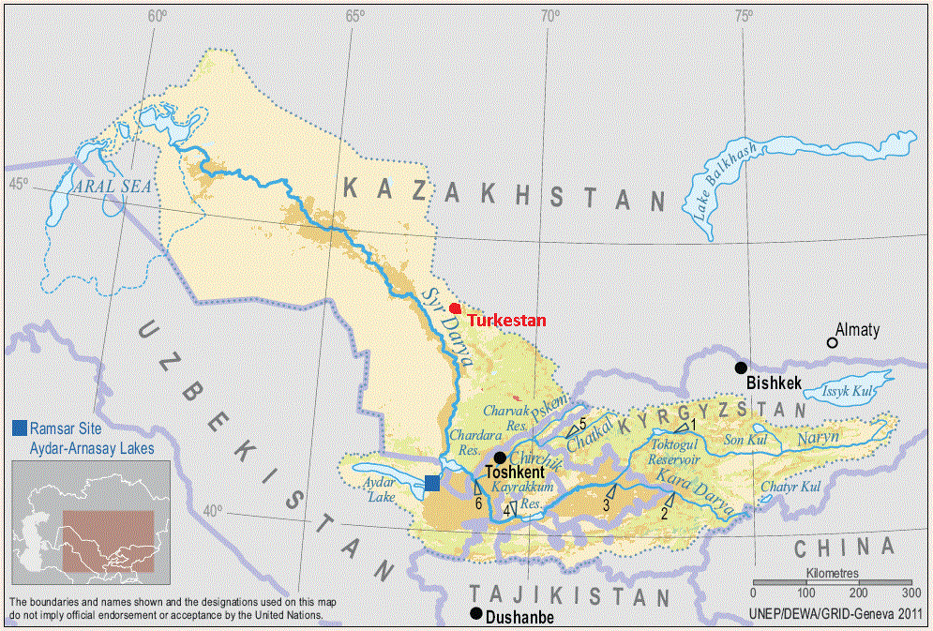
Study Location

Slide 15
Background
The Aral Sea is declining in area, water quality and habitat, as are large wetland complexes that receive irrigation return flows from farming villages in the Syr Darya River Basin
Agriculture consumes large amounts of water for irrigation of cotton, corn, alfalfa, cucumber, potatoes and grapes
Irrigation is inefficient, primarily flood irrigation is practiced - canals lose 30% of their water supply, while field level irrigation efficiency is only 50%
Farmers over irrigate due to an unreliable supply of water

Slide 16
Methodology –Soil Water Assessment Tool (SWAT) Modeling
A GIS database of information about the study area includes information on elevation, land use, soil properties, agricultural management practices, reservoir inputs and outputs, water intake and supply
These data were used with the Soil Water Assessment Tool (SWAT) to conduct detailed evaluation of water usage and other agricultural management practices and their impacts on crop yields and return flows

Slide 17


Methodology –Resource Investment Optimization System (RIOS)
The objective of this component of study is to identify a suite of ecosystem services that are affected by the alternative agricultural practices modeled with SWAT, and then to evaluate changes in provision of these ecosystem services using the Resource Investment Optimization System (RIOS) model

Slide 18
Alternative Practices Evaluated
Better fertilizer management
Better irrigation water management
Substitution of existing crops with more water efficient crops
Retirement or alternative uses for marginal crop land
Improved or targeted policies and subsidies

Slide 19
Ecosystem Services Modeled
Agricultural crop production
Baseline water discharge from agricultural lands
Water quality (nitrogen and phosphorus) in return flows

Slide 20
Value of Water
We assess the value of water by evaluating how agricultural crop production differ for the village closest to the Chardara Reservoir relative to production in the village farthest from the Reservoir as water supply decreases
Decreases in water supply may cause decreased household income, decreased land rental rates, increased use of fertilizer and/or increased costs to buy electricity for pumping of supplemental groundwater irrigation

Slide 21
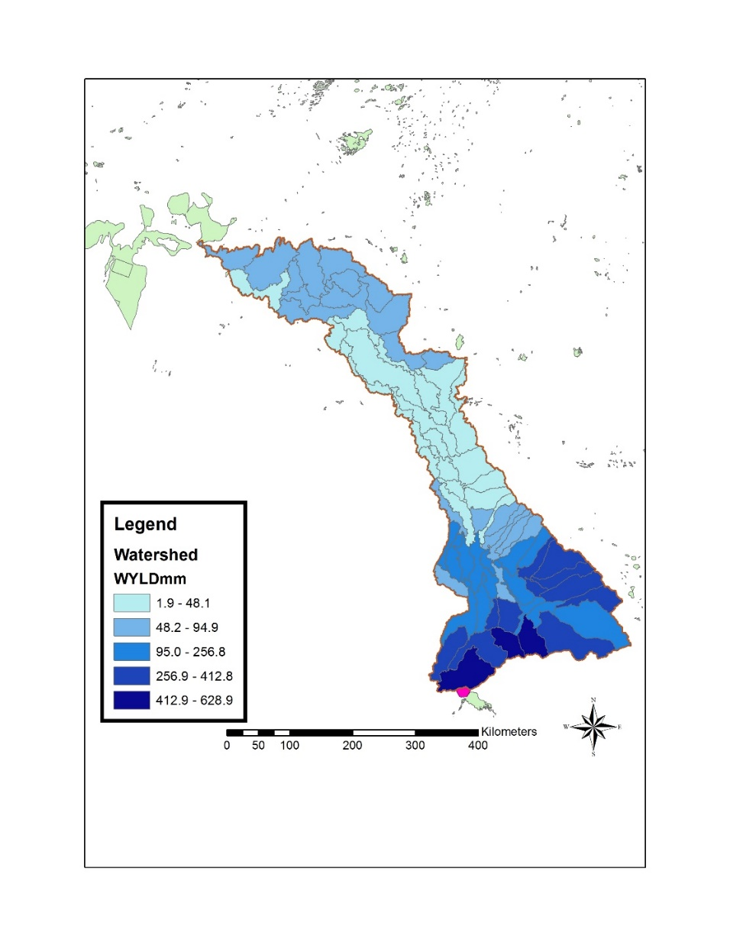
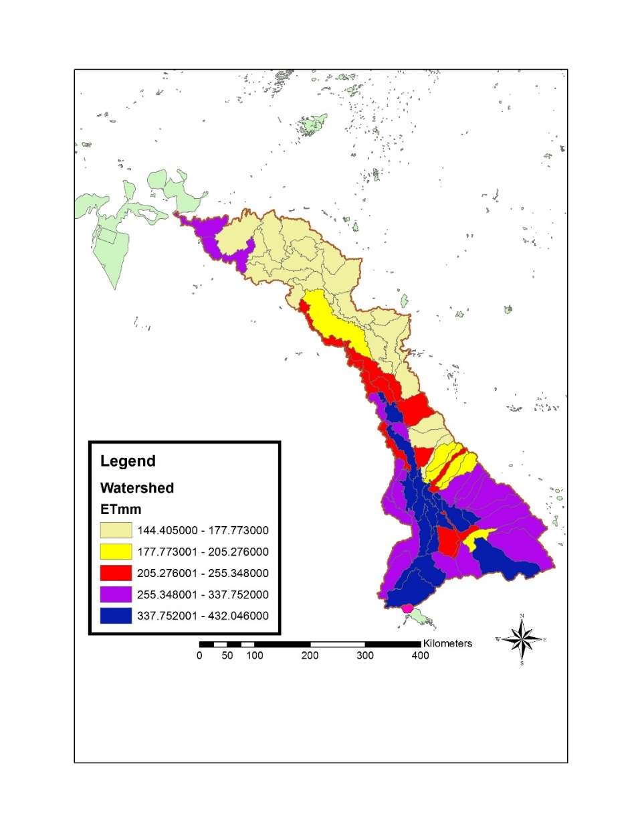
Results – SWAT modeling
Water Yield mm (2007-2013)
ET mm (2007-2013)

Slide 22
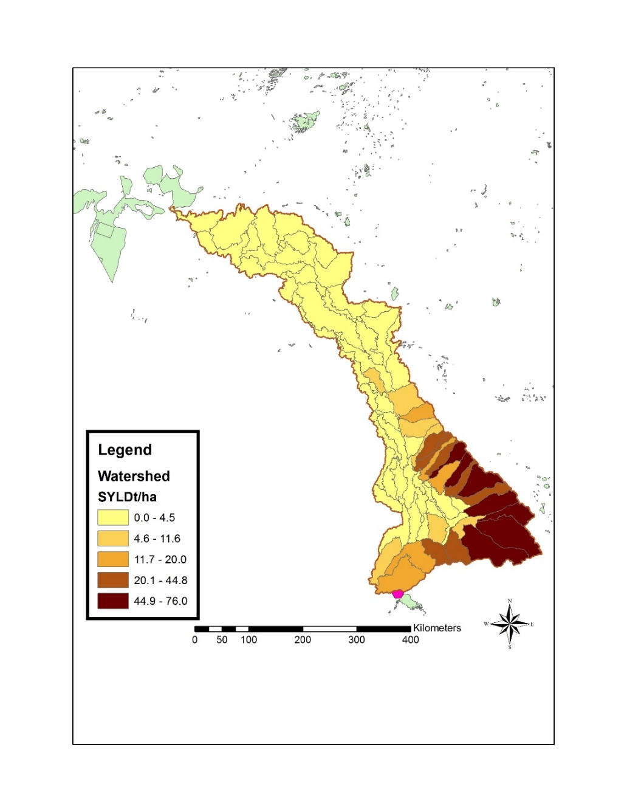
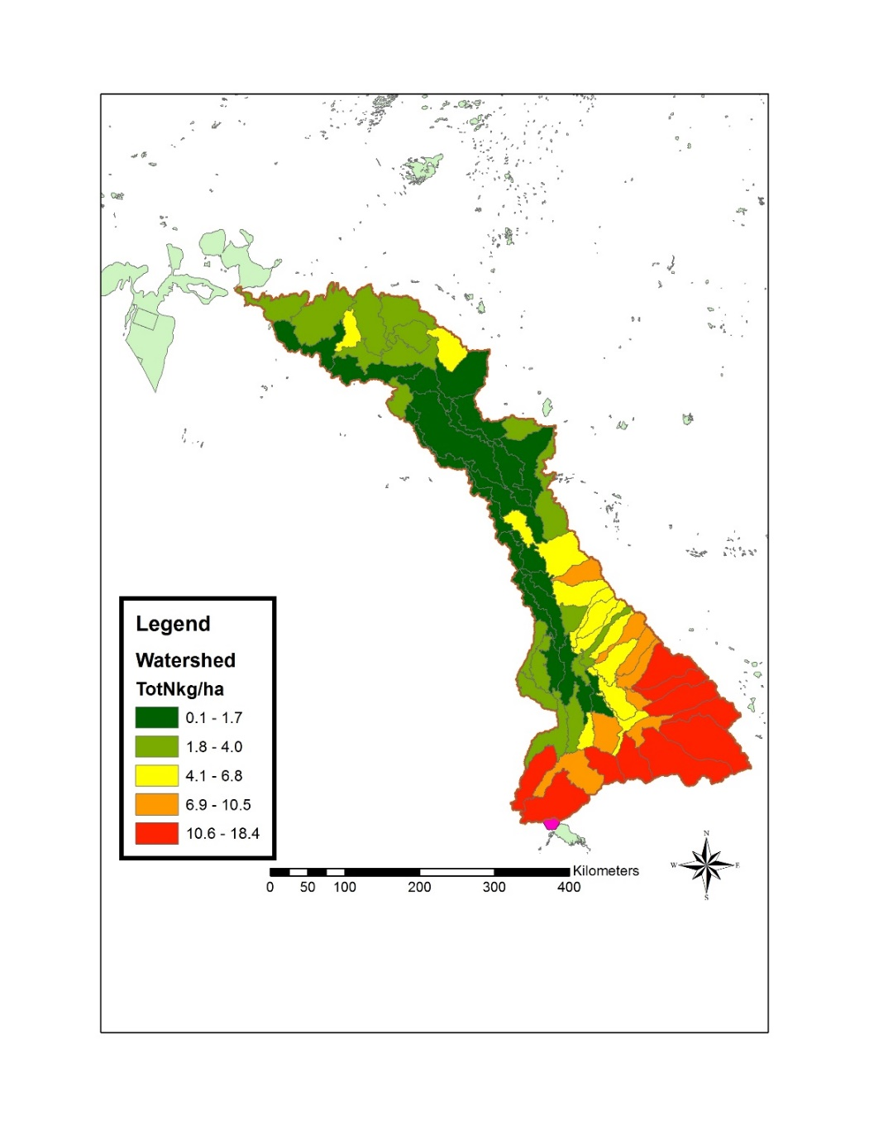
Results- SWAT modeling
Sediment Yield t/ha (2007-2013)
Total N kg/ha (2007-2013)

Slide 23
Results - RIOS modeling
 | Net cost (Cost - Income gained)
 | Without Subsidies | With Subsidies
Cotton (flood)
Cotton (drip) | 2475.2 | 2293
Alfalfa (flood)
Alfalfa (sprinkler) | 2798.4 | 2596.4
Orchards (flood)
Orchards (drip) | 336

Slide 24
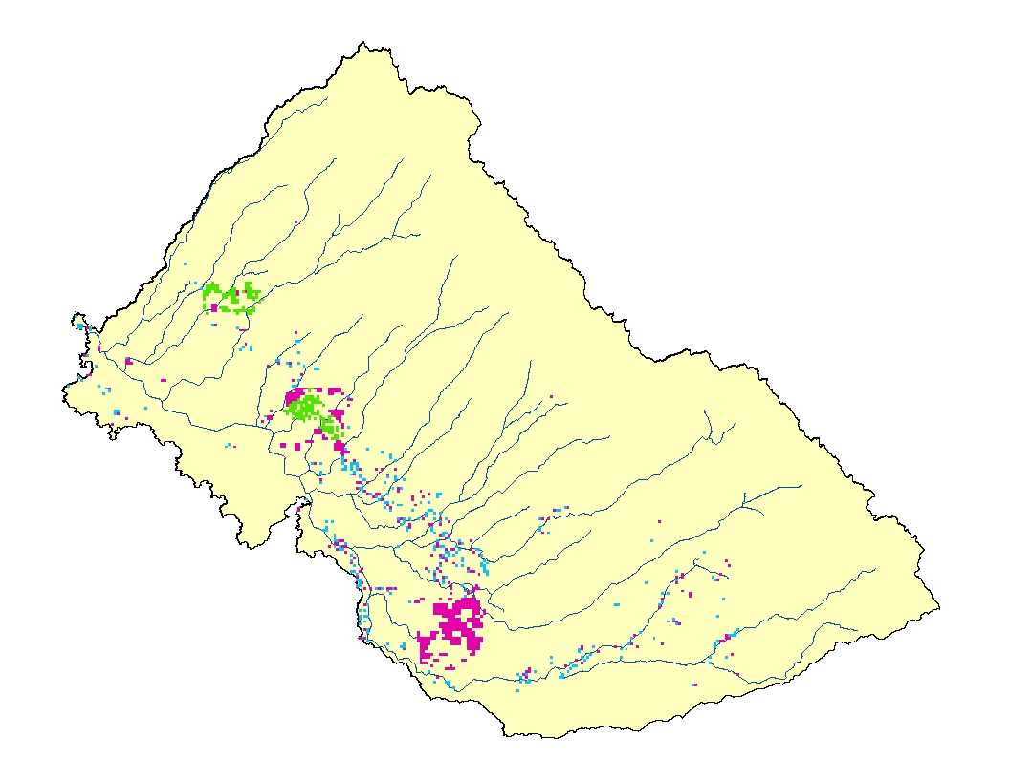
Results – RIOS modeling
Scenario A, $100M
50% to Drip Orchards (20,000 ha)
30% to Drip Cotton (11,000 ha)
20% to Sprinkler Alfalfa (7,000 ha)
Total Water Savings: 200,000,000 m³
Drip Irrigated Orchards
Drip Irrigated Cotton
Sprinkler Irrigated Alfalfa

Slide 25
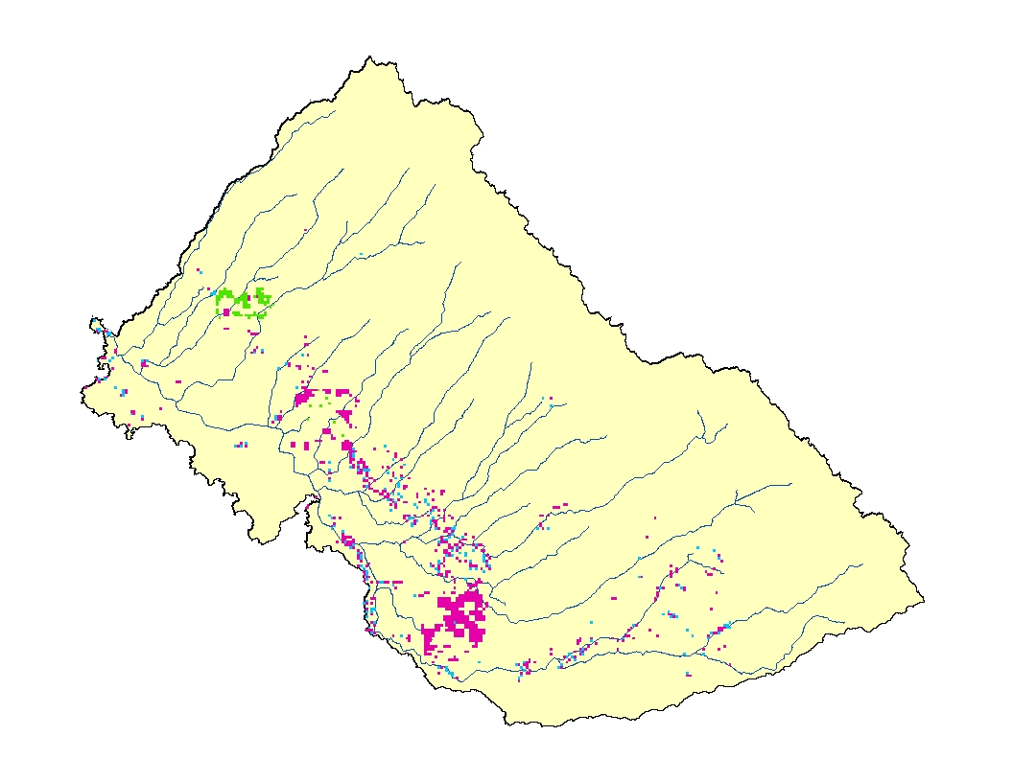
Results
Scenario B, $100M
70% to Drip Orchards (28,000 ha)
20% to Drip Cotton (7,000 ha)
10% to Sprinkler Alfalfa (3,000 ha)
Total Water Savings: 230,000,000 m³
Drip Irrigated Orchards
Drip Irrigated Cotton
Sprinkler Irrigated Alfalfa

Slide 26
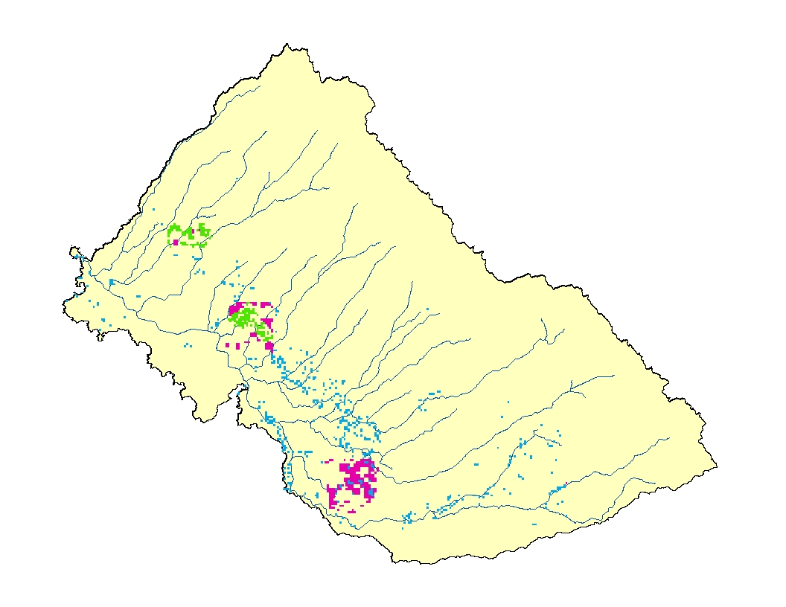
Results
Scenario C, $100M
30% to Drip Orchards (12,000 ha)
50% to Drip Cotton (18,000 ha)
20% to Sprinkler Alfalfa (7,000 ha)
Total Water Savings: 180,000,000 m³
Drip Irrigated Orchards
Drip Irrigated Cotton
Sprinkler Irrigated Alfalfa

Slide 27
Example RIOS modeling
 |  |  | $13,000,000 Budget
Conversion | Net Cost - $USD/ha | Water Reduction (mm/yr) | Land Converted (ha) | Percent of Current Landuse | Water Savings (m³/yr)
Drip Cotton (no subsidies) | 2475.2 | 485 | 5252.10 | 4.10% | 25,472,689
Sprinkler Alfalfa (no subsidies) | 2798.4 | 210 | 4645.51 | 3.63% | 9,755,575
Drip Cotton (with subsidies) | 2293 | 485 | 5669.43 | 4.43% | 27,496,729
Sprinkler Alfalfa (with subsidies) | 2596.4 | 210 | 5006.93 | 3.91% | 10,514,559
Drip Orchards | 336 | 670 | 38690.48 | 30.23% | 259,226,190
An investment of $13 million would convert 38,690 ha (30%) of flood irrigated cotton into drip irrigated orchards (e.g. pomegranates). This results in a water savings of 259 million m³/yr. (a 21% reduction relative to water used to flood irrigate cotton)

Slide 28
Conclusions
Ecosystems services are important but often neglected part of the analysis. It’s not easy to estimate value/price of benefits drawn from nature
Agriculture cannot be managed in isolation from rest of the landscape
The more we appreciate the value of nature and benefits we draw from it, the more we will be able to manage the natural resources sustainably
There is an urgent need to understand the linkage between ecosystem management and human health, effects of producing biomass for biofuels and impact on ecosystem services and ecosystem resilience

Slide 29
Thank you

