Slide 1

Gender, Tenurial niches in the Kandeu informal irrigation scheme of Malawi and their implications for drought mitigation
African Drought Conference, 15-19 August 2016
Everisto Mapedza, E. Tagutanazvo, C. Manyamba and B. van Koppen
Windhoek| Namibia

Slide 2
Organization
Introduction
Where?
How we did it?
Research Findings
Implications for Drought
Conclusion

Slide 3
Introduction
“Drought is not about lack of rainfall (moisture, water,….). It is about women, men and children. It is only about lack of rainfall (moisture, water,….). in as far as the lack of rainfall affects men, women, children and other gendered dimensions”
Drought is a multifaceted issue/phenomenon which is often conveniently de-humanized, de-genderized.
Implications on mitigation solutions.

Slide 4
Where?
Kaziputa Irrigation Scheme (Kandeu EPA)
75 irrigators (22 men and 53 women)
Clubs: Gobeke, Chikamba, Chimwalira, Namichimba and Lithethe
Ntcheu District in Malawi
Central Region
155-184 people/sqkm
70-90% poverty levels – 52% at national level

Slide 5
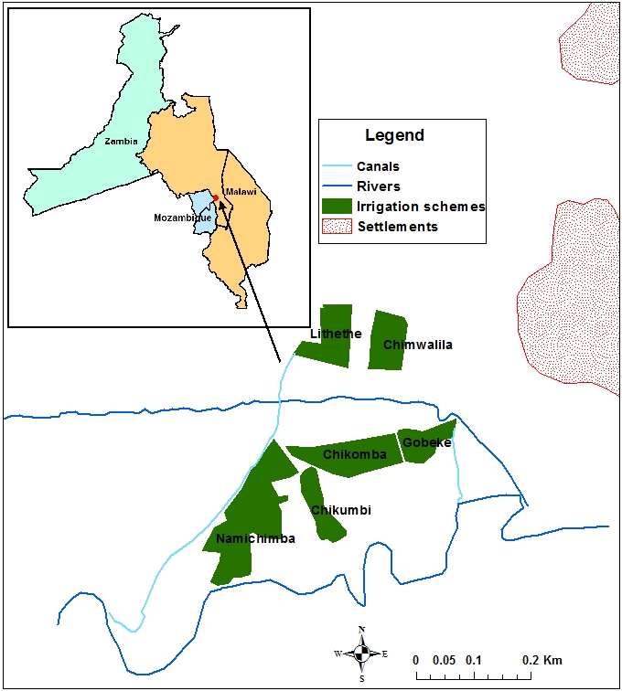

Slide 6
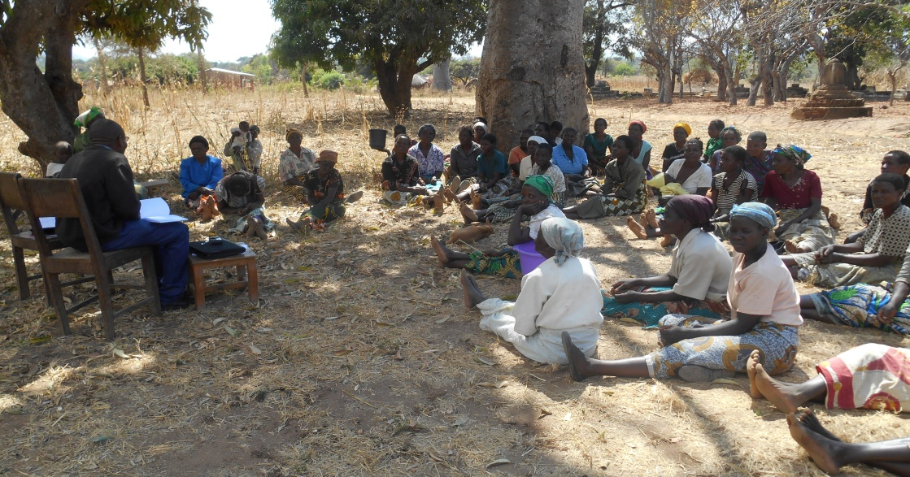
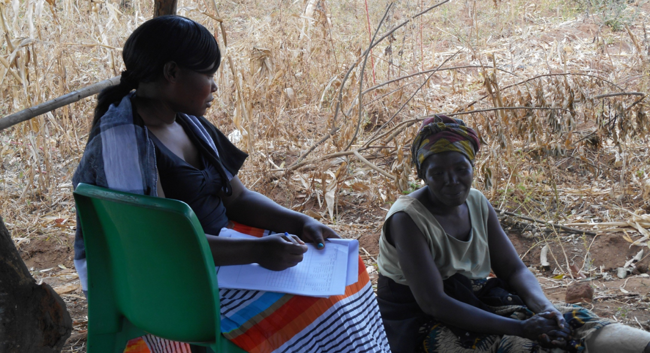
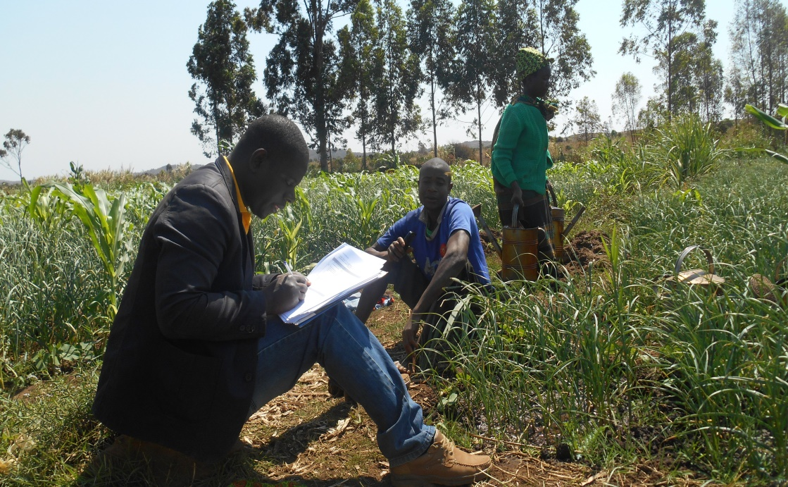
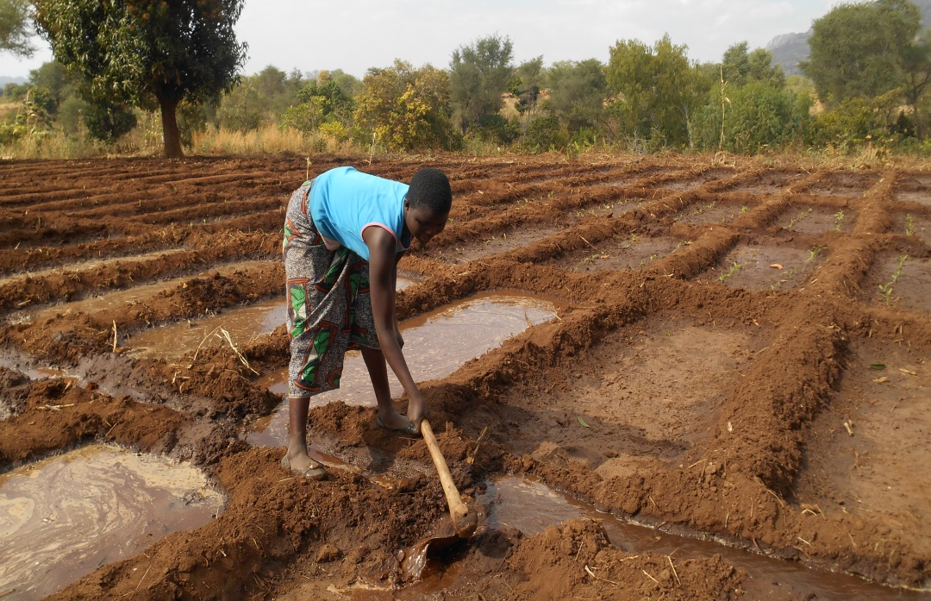
How we did it?

Slide 7
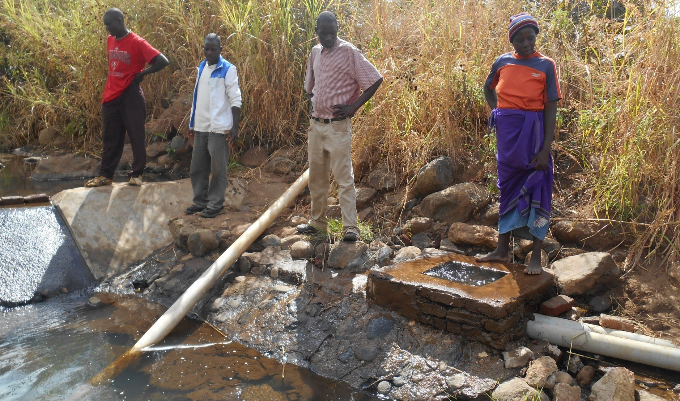
How we did it? (continued)

Slide 8
Research Findings
Matrlineal and matri-local society (75-80%) – Ngoni (70%)!
Land inherited through women
Tenure – tenurial niches (Fortmann 1992; 1996 – going beyond De Soto security of tenure through titling
Avoid simple binary of male and female ownership – gradient from female to male – multiple stories “I was given a piece of land by my grandparents from my father’s side since I had come to stay with my father after I separated with my wife long ago”.

Slide 9
Research Findings (continued)
Access – distributional equity, who gets what – going beyond neat bureaucracy to look at the social, economic and political dimensions of land tenure
There is need to monitor the dynamics, processes and sub-processes of the tenurial niches within the Kandeu area
Paradox of land ownership - not translating into control of benefits

Slide 10
Research Findings (continued)
Access and control of income - gendered
Markets – gender roles – its not safe for women to travel overnight across the mountain range to the market – land tenure within the broader cultural spectrum
Men are involved in marketing – some say prices were ‘not good’ most of the time

Slide 11
Research Findings (continued)
Divorce your husband – torch
Role of uncles in decision making – men in key decision making
Irrigation – ‘seasonal and mobile fences’

Slide 12
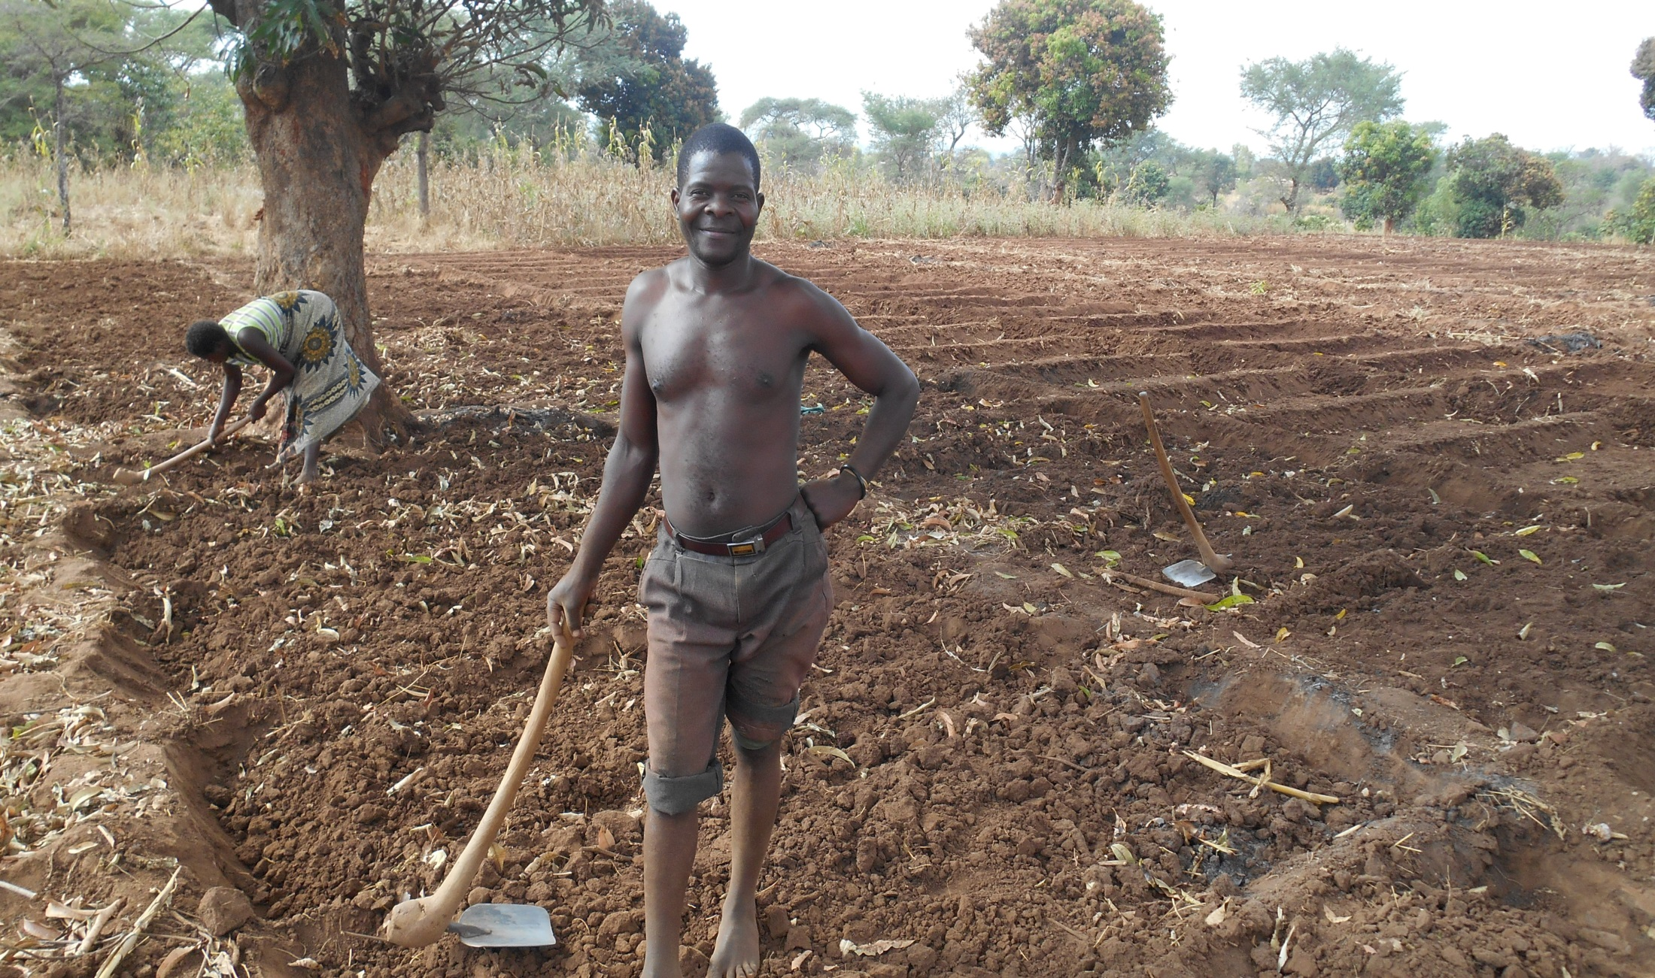
Whose labour?

Slide 13
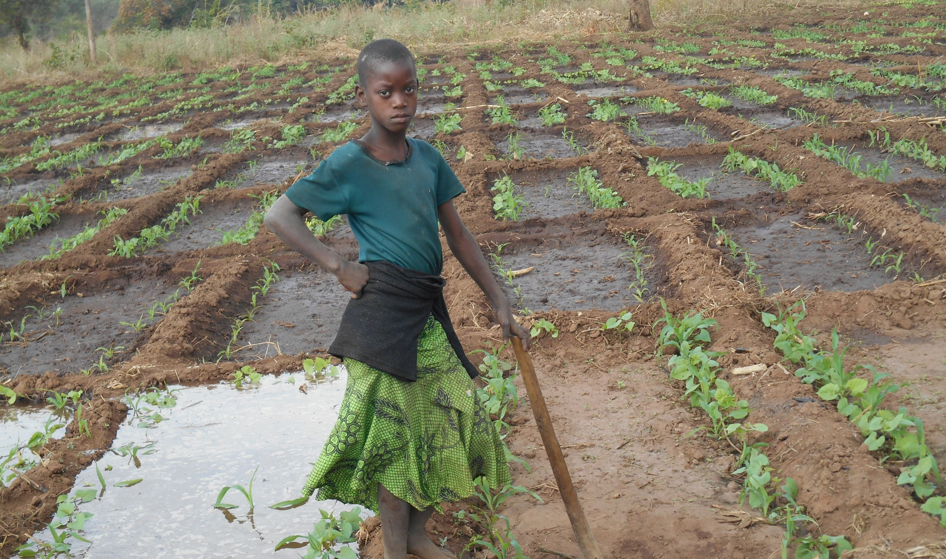
Whose labour (cont’d)

Slide 14
Access to Credit
By gender
Who obtained | Irrigating |  | Non irrigating
 | Freq | % | Freq | %
male | 19 | 41,3 | 18 | 58,1
female | 27 | 58,7 | 13 | 41,9
All | 46 | 100,0 | 31 | 100,0

Slide 15
Access to Agric Extension
Access to an agric extension worker | Irrigating (n=75) |  |  | Non irrigating (n=62) |  | All respondents (n=137)
 | Freq | % | Freq |  | % | Freq | %
male | 19 | 25.3 | 10 |  | 16.1 | 29 | 21.2
female | 49 | 65.3 | 13 |  | 21.0 | 62 | 45.3
All-yes | 68 | 90.7 | 23 |  | 37.1 | 91 | 66.4
All-no | 7 | 9.3 | 39 |  | 62.9 | 46 | 33.6

Slide 16
Social Capital
 |  | Irrigating |  | Non irrigating |  | Total
 |  | Freq | % | Freq | % | Freq | %
male | Average | 2 | 2.9 | 2 | 3.8 | 4 | 4.3
 | Excellent | 2 | 2.9 | 2 | 3.8 | 4 | 4.3
 | Good | 11 | 16.2 | 5 | 9.4 | 16 | 17.2
female | Average | 5 | 7.4 | 13 | 24.5 | 18 | 19.4
 | Excellent | 6 | 8.8 | 3 | 5.7 | 9 | 9.7
 | Good | 31 | 45.6 | 8 | 15.1 | 39 | 41.9
 | Low | 0 | - | 3 | 5.7 | 3 | 3.2
Total |  | 57 | 83.8 | 36 | 67.9 | 93 | 100.0

Slide 17
Implications for Drought
Vulnerability is gendered
Sex Disaggregated Drought Vulnerability Assessments - a necessity
Same Drought – different responses, different coping mechanism, different impacts – Female headed, HIV/Aids Orphans, old…
Institutional set up (WUA) – inclusive of gender by design - for sustainability

Slide 18
Conclusion
If you don’t know what you are looking for, you will not find it.
Sex disaggregated drought data still lacking
Suite of options – nuanced gender understanding - EWS
‘I participate. You participate. He participates. She participates. We participate. They rule’ (Whose mitigation is it anyway)

Slide 19
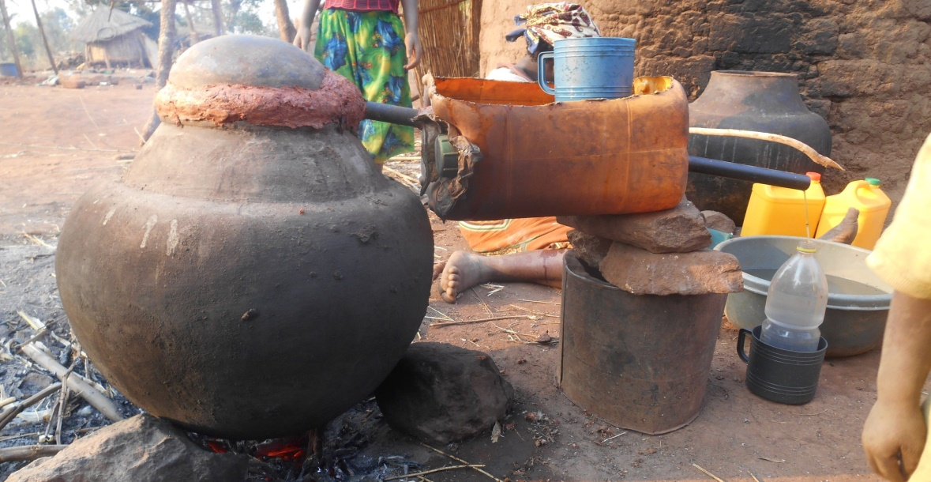
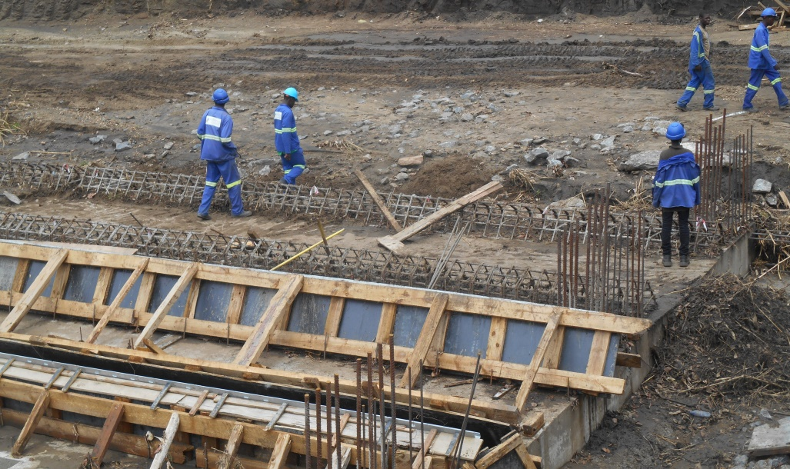
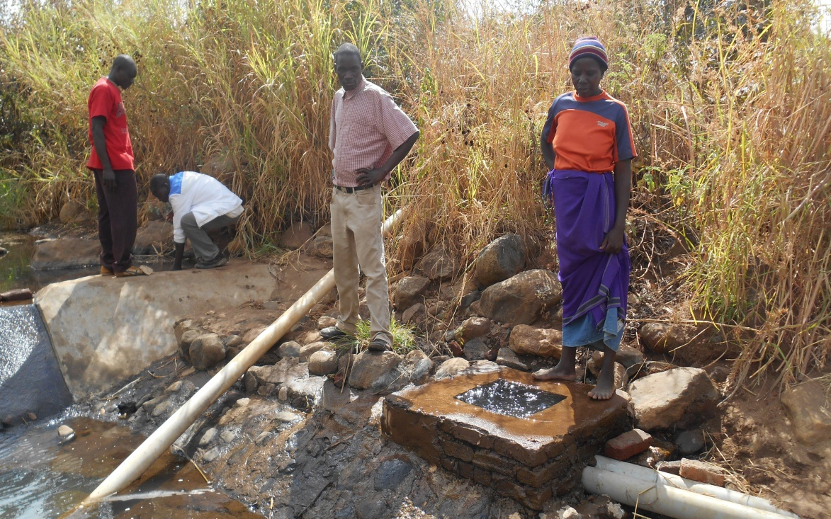
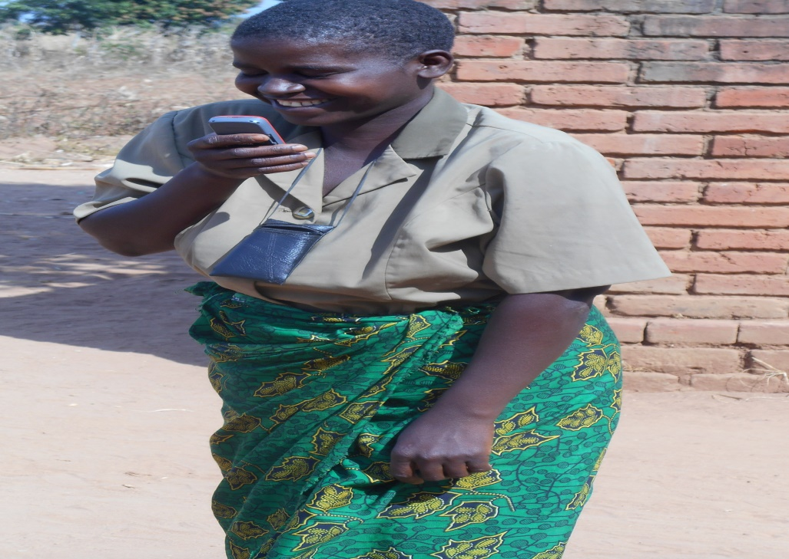
Thank You. Zikomo Kwambili.

