Slide 1

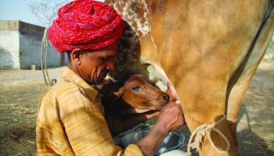
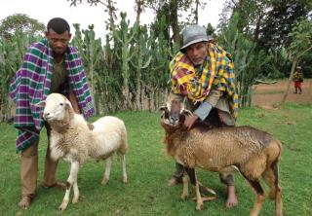


Index Based Livestock Insurance- Presenting a Challenge
Dr. Rupsha R Banerjee
Global Index Insurance Facility (GIIF) Annual Projects Workshop
26 November 2014
Relexa Hotel, Berlin
Notes:
Find a photo you like and the right size, copy and paste it in the block above.

Slide 2
The Project
Drought is the major threat to livestock
Responses to climatic shocks
  Migration, Water tracking , migration, selling livestock
  IBLI is designed using Normalized Difference Vegetation Index (NDVI) to protect pastoralist against drought-related livestock losses
  One of its kind since it promotes market based solutions
  Areas of Work: Northern Kenya, Southern Ethiopia

Slide 3
What have we been trying to do
Make IBLI a sustainable commercially viable product
Create an informed demand
Reach out in areas where markets often shy away from going
Provide additional mechanisms by which pastoralists are better prepared against climatic risks
Get the pastoral community out of the ‘freebies’ culture

Slide 4
Challenges we have faced
  Infrastructure
    Poor basic infrastructure ,low literacy levels; not to mention security issues
  Understanding and acceptance
    Most pastoralists don’t clearly understand the basic concepts of IBLI
  Lack of visibility
    Sporadic appearance during sales period and rapid disappearance after that
  Capacity Development
    Non-recurrance of information, remuneration and coordination among underwriters and agents

Slide 5
What we would do differently
WE ARE TRYING TO DO DIFFERENT THINGS….LEARNING LESSONS… and moving on ☺ ☺

Slide 6
Putting lessons to Practice
  Restructuring the current Agency Model
    Individual and group models ; community members who have retained IBLI to become agents
  Involving the community more and more
    Market studies, participatory action research, Innovation Challenge
  Evaluation of training methods
    Simplicity in language and form oral component of evaluation, communication skills
  Post sales evaluation

Slide 7
Putting lessons to Practice contd…
  Expansion of branding
    Fliers and posters in frequented places, increase visibility through mobile agents in satellite towns
    More visibility of the underwriters in the community
    Bundling of services
  Recurrence of Information
    SMS , talk shows and contact information of agents with community members, radio campaigns, financial literacy programmes , jingles

Slide 8
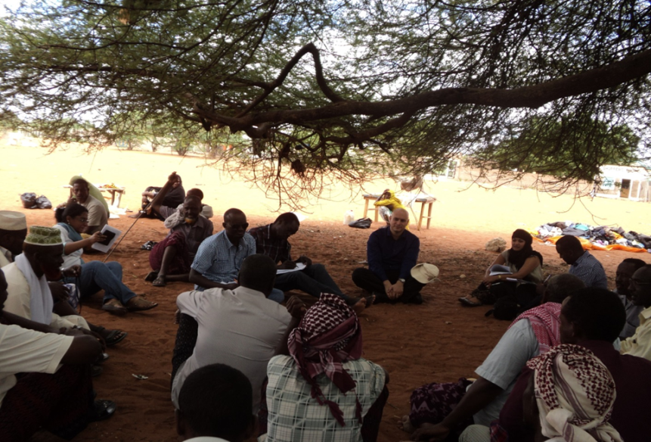
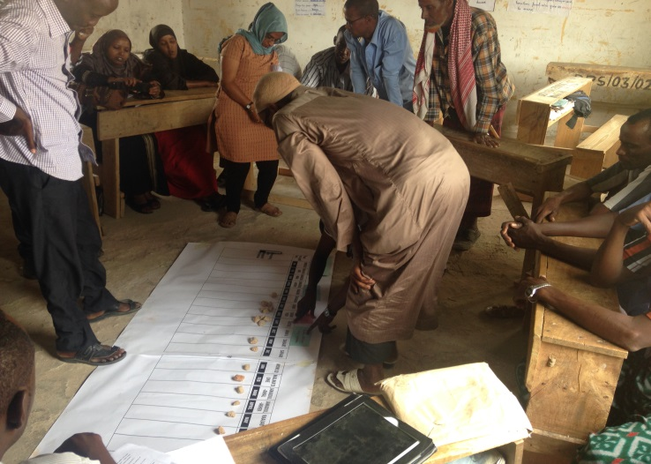
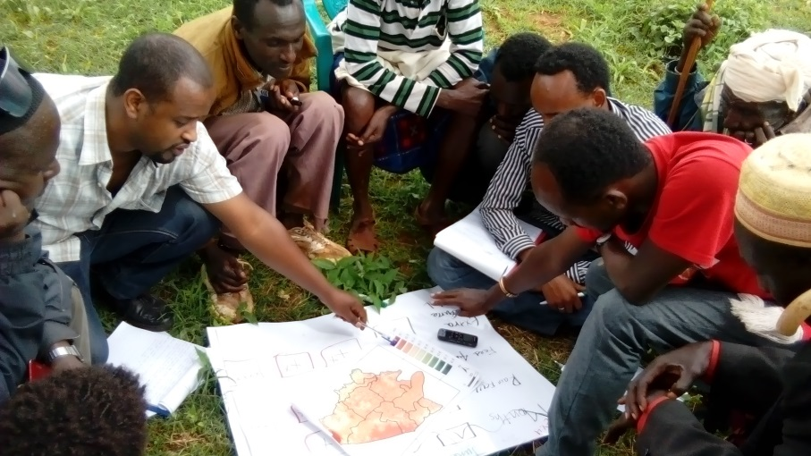

Some snap shots

Slide 9
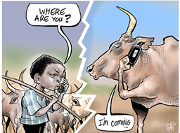
We pride ourselves in being innovation champions….each setback for us is an opportunity to do even better!!!
Thank you for your attention ☺

