Slide 1


LEARNING TO INNOVATE: ICARDA’S EXPERIENCE WITH
LEARNING ALLIANCES
IN THE NAWA REGION
Innovation Platforms
Working meeting
Dead Sea
September 15-18, 2014

Slide 2
HISTORY
IDRC funded project in 2013
Piloted learning alliances in:
  Morocco (Souss Masa Draa)
  Egypt (multiple governorates)
  Pilots undertaken in collaboration with a CIAT colleague

Slide 3
Why do technologies fail to reach the poor
(or have low adoption rates)?
AND
How can the poor participate in the process of innovation?

Slide 4
CONCEPTUAL FRAMEWORK
“White sheet approach”
Three part process:
  Identify ‘challenges’ to livelihoods;
  Assemble evidence and validating knowledge;
  Uncover opportunities for partnership in addressing ‘challenges’
  Many elements are common with traditional participatory approaches and rapid rural appraisals;
  May not necessarily lead to technological solutions;
  Possesses elements of an innovation system, underpinned by knowledge sharing and joint learning;
  In line with both area based development approaches, as well as value chain (strengthening) approaches

Slide 5
Research agenda:
Testing proof of concept (for the “approach”) in region;
Assembling evidence throughout the process;
Evaluating outcomes;
‘Spinoff’ research questions that come out of the process

Slide 6
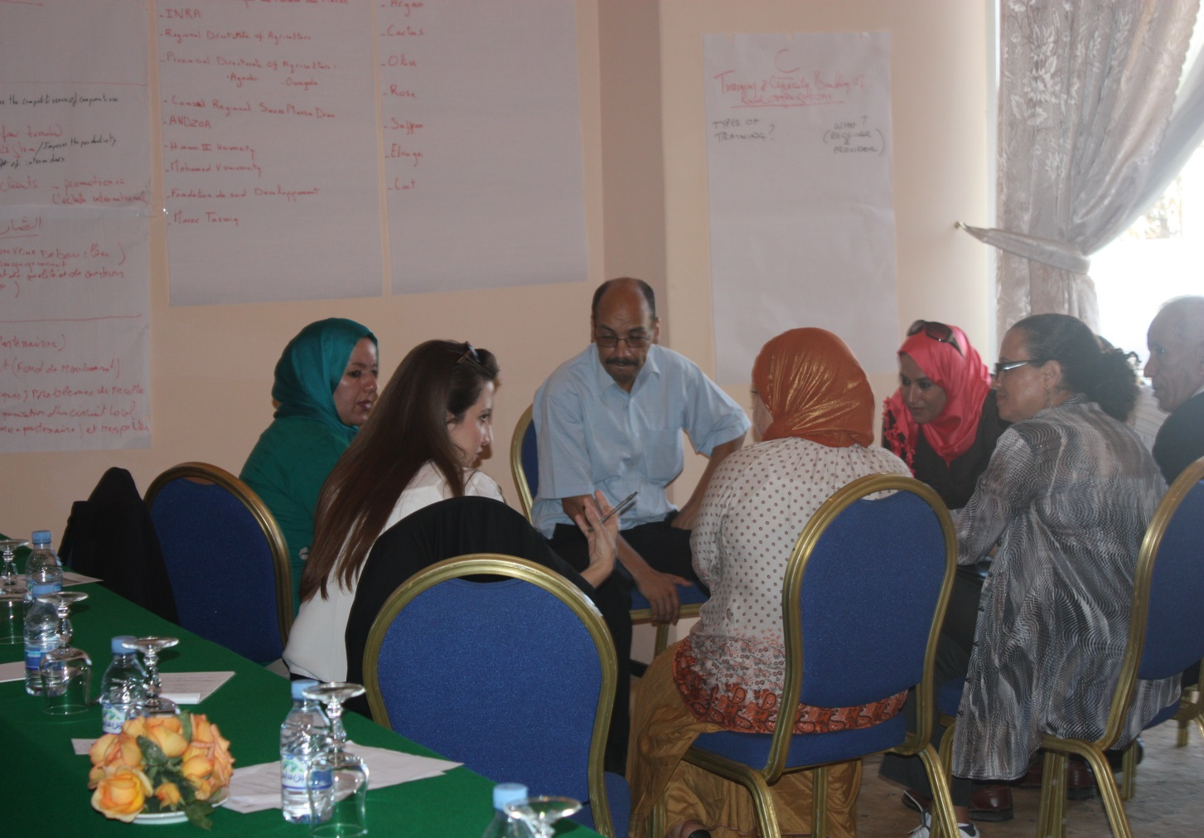
MOROCCO
Souss Massa Draa:
Initial focus on challenges of illiteracy, marketing concerns, access to credit….
Opportunities identified for partnership:
contextually relevant and effective business (and social organization) models that are applicable to diverse value chains
desire to build a common knowledge management platform that is linked to training and dissemination.

Slide 7
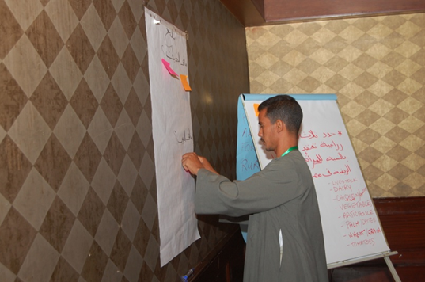
EGYPT
Challenges to public extension systems (both in terms of provision and access to service) as well as regulatory policy
Opportunities identified:
Determination of self-help initiatives inspired by knowledge gained during the two sessions and discussion of success stories in other countries

Slide 8
OUTCOMES ENVISIONED
Grassroots level:
Partners jointly develop approaches, tools and a methodology for tackling an identified development ‘challenge’, and key commodities that are of priority to household livelihoods;
National and Regional/Governorate level:
Through proof of concept, governments in collaboration with donors, international development agencies, NGO’s, farmer groups, and civil society organizations invest in initiatives that aim (in the long run) to mainstream approach espoused by the learning alliance framework

Slide 9
RESEARCH OUTPUTS FROM PILOTS
IFPRI funded study on understanding the underpinnings of women’s empowerment in the Argan sector and (intra-household, intergenerational) trade-offs made in achieving empowerment (draft journal article nearing completion for peer review)
Diagnostic study on gender based participation within value chains for four locally produced commodities in Southern Morocco (saffron, argan, cactus, rose)
Ongoing evaluation through monitoring of progress in achieving outcomes for both southwestern Morocco and Egypt learning alliances

Slide 10
2014 PROGRESS
4 learning alliances initiated through partnerships with INRA, NCARE, IRA, INRAT (scheduled for October):
    Meknes site, Morocco (Sidi Slimane – Bittit - Ain Jamaa);
    Medenine, Tunisia (Beni Khedeche);
    Karak, Jordan(Al Erak & Al Kresha)
2 learning alliances initiated by ICARDA in 2013 (Egypt, Southwestern Morocco), under an IDRC funded bilateral project, are being monitored and studied;
Each learning alliance has identified commodities of priority that are being studied by the post-harvest loss and market access initiative (value chain analysis) and identified opportunities for capacity building being undertaken;
Requests for assistance in uncovering more effective mechanisms, and institutional innovation, for social organization have been made by local members of each learning alliance. ICARDA is working with national partners, civil society and local governments to uncover avenues for facilitating access to knowledge in this area, and in assessing pathways for research and farm advisory services to effectively utilize well organized local organizations as conduits for scaling out agricultural technology and best production practices

Slide 11
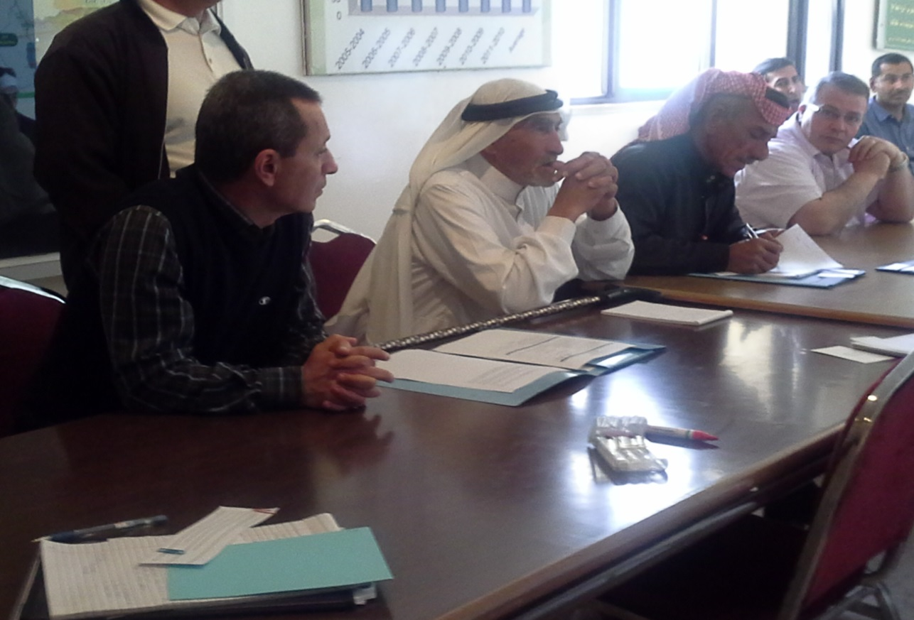
JORDAN: Al Erak
Initial focus on access to ground water and technical assistance requested for prospecting underground springs, but revised after intensive discussions and reflection by the community
Opportunities identified:
Partnership between NCARE, ICARDA and Mutah University in the delivery of training for improved olive production practices and disease management (as well in ‘youth empowerment’)
Research;
Outcome mapping process of the olive training
Mapping social networks within the community in order to uncover opportunities for enhancing knowledge uptake

Slide 12
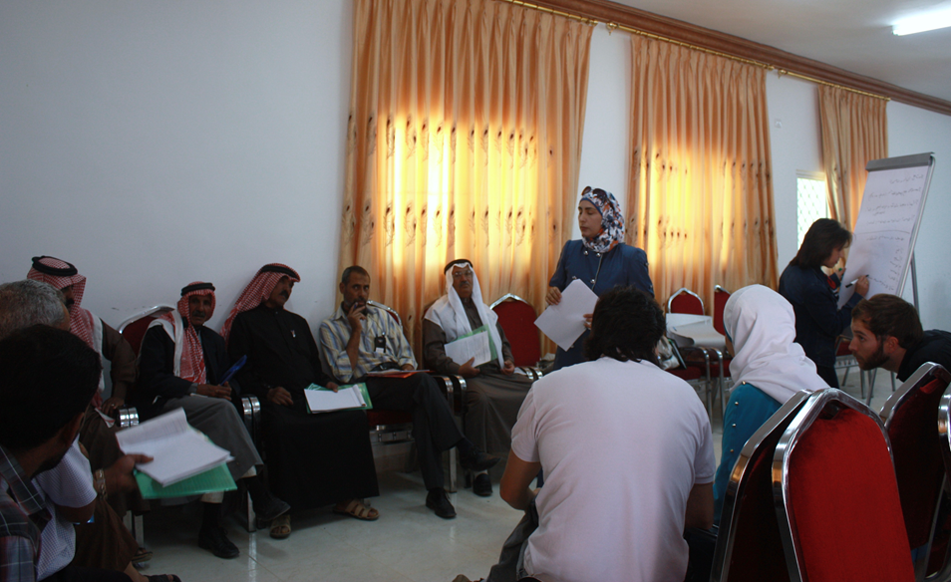
JORDAN: Al Kresha
Disgruntled community, and evidence of discord between members of the community and between tribal clans. History of failed attempts at social and economic organization
Opportunities identified:
Partnership between existing welfare societies and private NGO’s aimed at expanding the range of services (agriculture and other) offered to members and to the community in general
Research;
Understanding the potential role of welfare societies within NAWA in enhancing approaches for knowledge dissemination and uptake of agricultural technologies and best practices

Slide 13
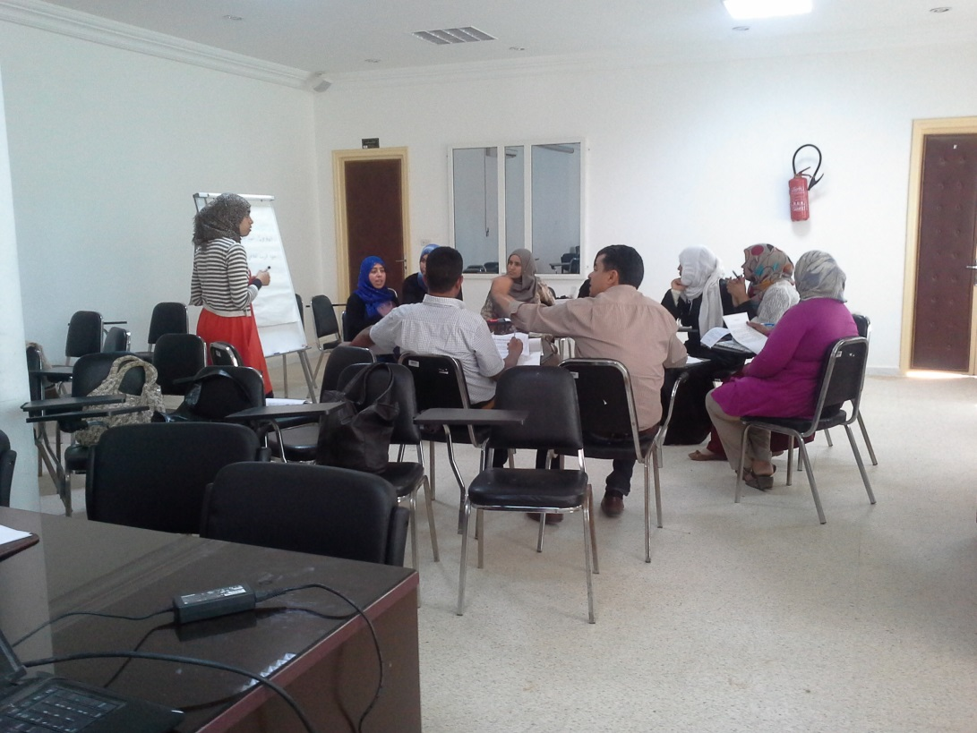
TUNISIA
Beni Khedeche
High youth unemployment and low productivity of agriculture.
Contemporary movement of self-help groups formed predominantly by young women and aimed at providing social service and access to information.
Opportunities identified:
Early identification – potential initiative related to capacity building of self-help groups, in order to enhance knowledge dissemination and extension outreach
Research;
Early stages of identification - not yet accurately defined

Slide 14
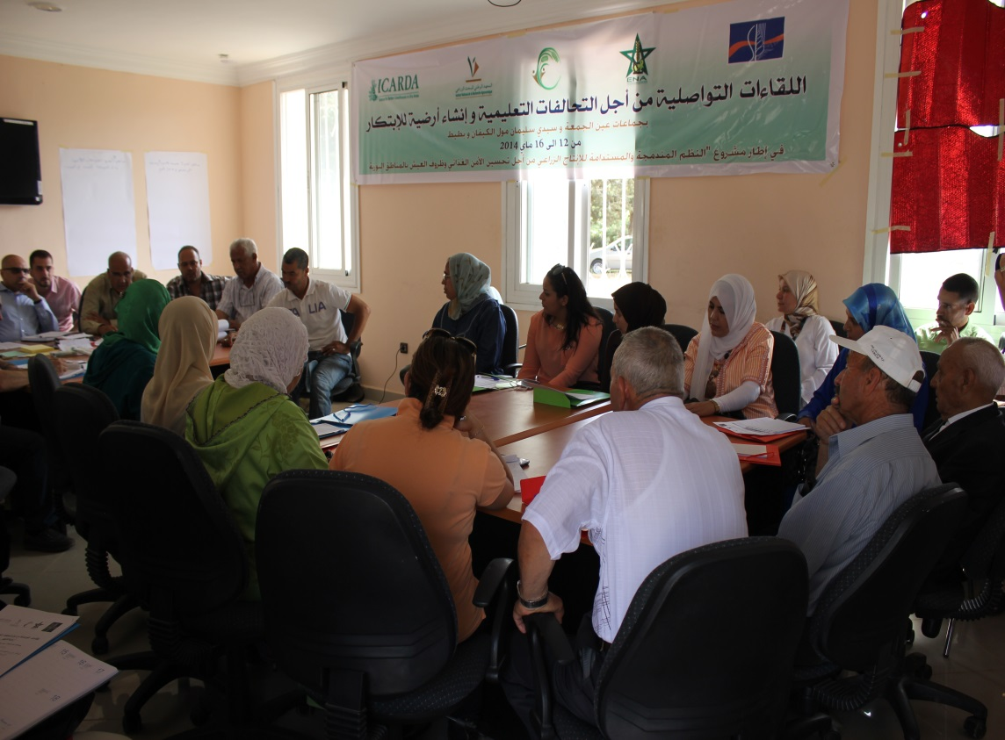
MOROCCO
Meknes
Historical experience with farm associations has negatively affected membership and participation rates within village wide (commodity based) agricultural cooperatives.
Opportunities identified:
Early identification – partnership between farming communities, INRA, ENA, ICARDA, ONCA, OCP and private seed suppliers in assessing contemporary forms of social and economic organization.
Research;
Early stages of identification - not yet accurately defined

Slide 15
Priority commodities/livelihood activity identified by the evolving alliances (CRP action sites):
Jordan: Olive oil (Al Erak), Sheep (Al Kresha)
Egypt: Buffalo milk, dates, tomatoes (from pilot)
Tunisia: Olives (integrated with livestock)
Morocco: Potatoes and Onions
Market (value chain) studies initiated in collaboration with “post-harvest and market access” activities: Morocco (potato and onion), Tunisia (olives), Jordan (olives)

Slide 16
PICTURE OF INNOVATION HERE
(what does it look like?)

Slide 17
INNOVATION PLATFORMS
Through contextually relevant approaches - which are informed by joint learning with communities, maintained through sustained support for agricultural research for development initiatives, and in line with community based development initiatives - challenges to agricultural livelihoods are identified, addressed and mitigated through mutually beneficial (public-private-civil society) partnerships that enhance quality of life for rural communities
Evidence obtained through sound research can inform both process and form of the innovation platform as well as on progress towards desired outcomes

Slide 18
Comprised of multiple layers:
Learning alliances that contextualize the undertaking of specific research which assists in uncovering avenues for addressing challenges to rural livelihoods;
Structured process for linking clusters of learning alliances, in order to inform governorate level policy and investments, and for the purpose of inducing greater investment in agricultural innovation; as well as in leveraging these investments with investments made in other sectoral innovation systems (health, education, communication…) – fostering an enabling environment for sustained innovation;
Approaches and avenues for informing national policy, and influencing policy reform through evidence based arguments
ICARDA and partners are playing a facilitative role in (i), a (future) catalytic role in (ii) and studying the tenets of (iii)

Slide 19
2014 progress
Guiding/strategic framework for contextually relevant innovation platforms, with a mutual understanding among partners documented and utilized (in process);
Analysis of farm advisory services, in order to understand potential avenues available for enhancing adoption, adaptation and broad uptake of technologies and best production practices (in process)
Development of a compendium of technologies, best production practices, approaches, social and institutional innovations for each action site and categorized by those which are:
Being adopted by a large number of farmers/over a large area
Promising for adoption but with social, cultural, regulatory challenges - and the nature of these challenges
Facing challenges in adoption - with barriers identified
Innovation Platforms

