Slide 1
Understanding the gendered tenurial niches in the informal irrigation in the Kandeu area of Malawi
Everisto Mapedza, Emelder Tagutanazvo, Christopher Manyamba and Barbara van Koppen
22 April 2015
AAG Annual Conference
Chicago, USA

Slide 2
Organization
Introduction
Where?
How we did it?
Research Findings
Conclusion

Slide 3
Introduction
“Tenure is not about land, it is about people (men and women). It is about land only as far as land can serve the needs of people (men and women)” (Westoby 1967)

Slide 4
Where?
Kaziputa Irrigation Scheme (Kandeu EPA)
75 irrigators (22 men and 53 women)
Clubs: Gobeke, Chikamba, Chimwalira, Namichimba and Lithethe
Ntcheu District in Malawi
Central Region
155-184 people/sqkm
70-90% poverty levels – 52% at national level

Slide 5
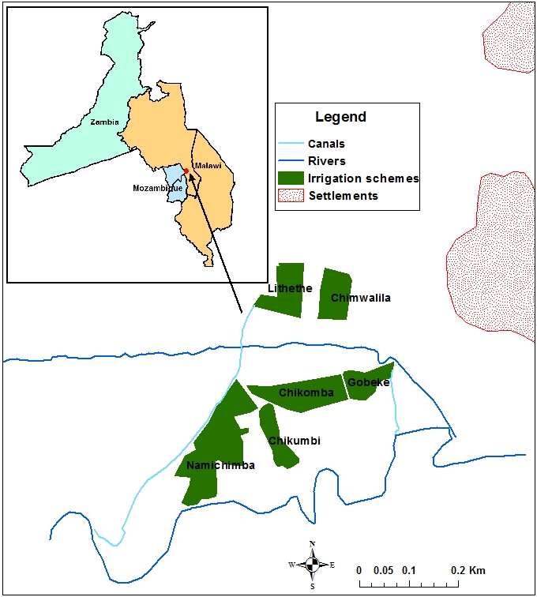

Slide 6
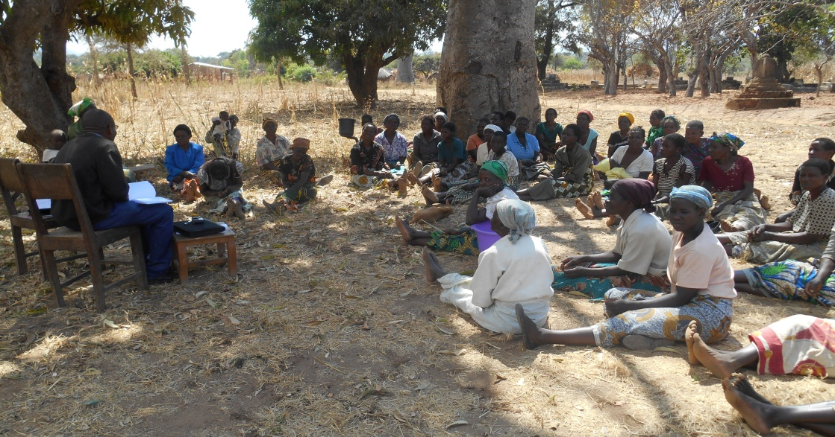
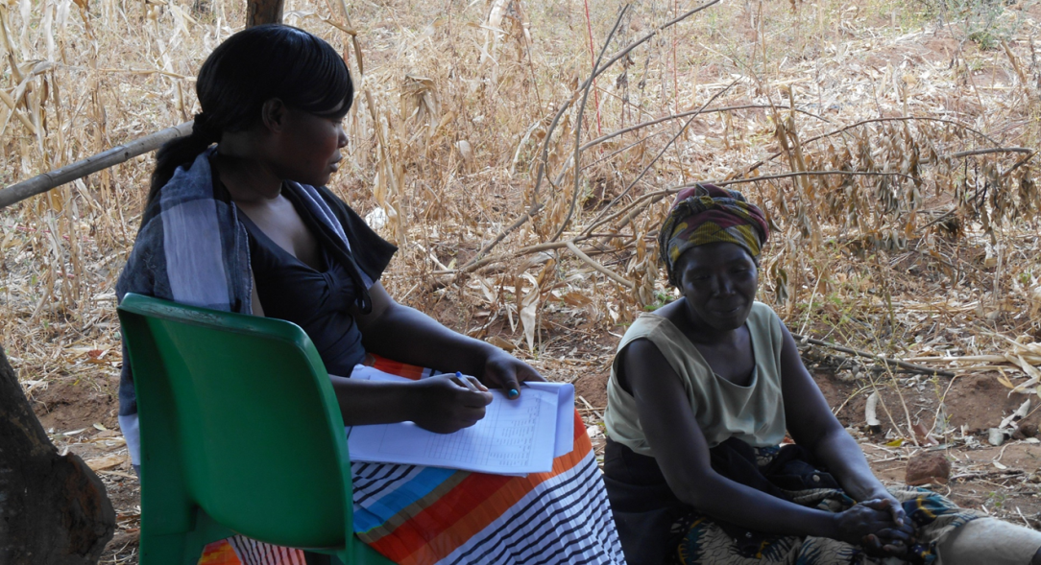
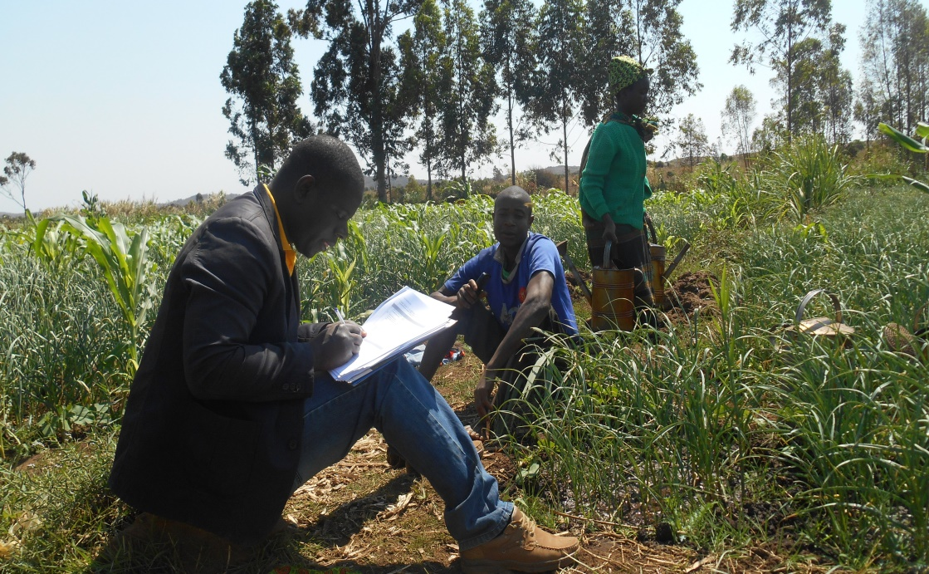
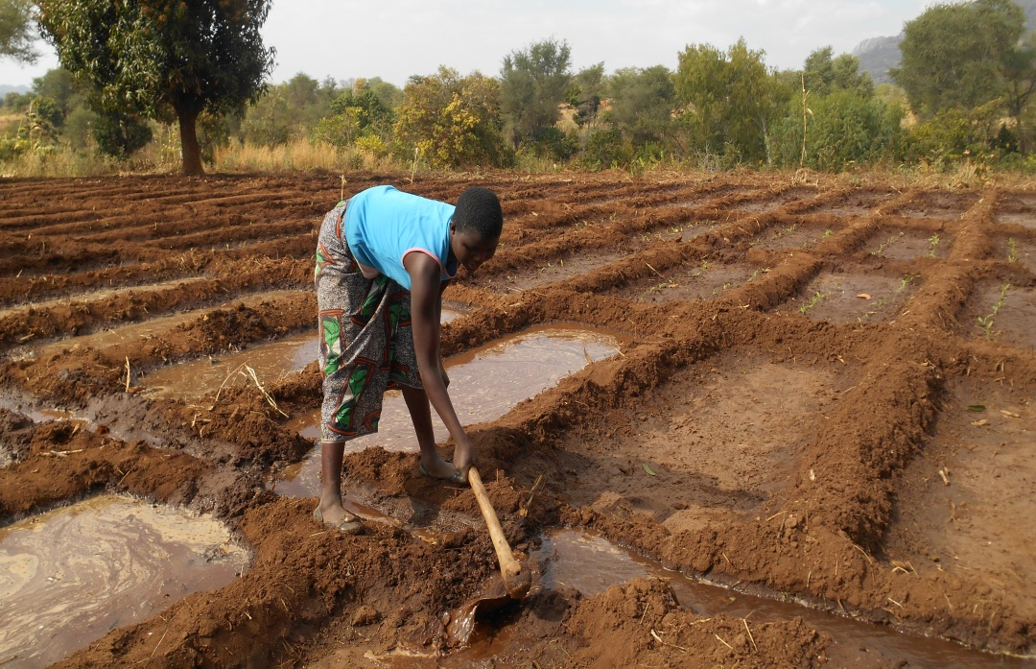
How we did it?

Slide 7
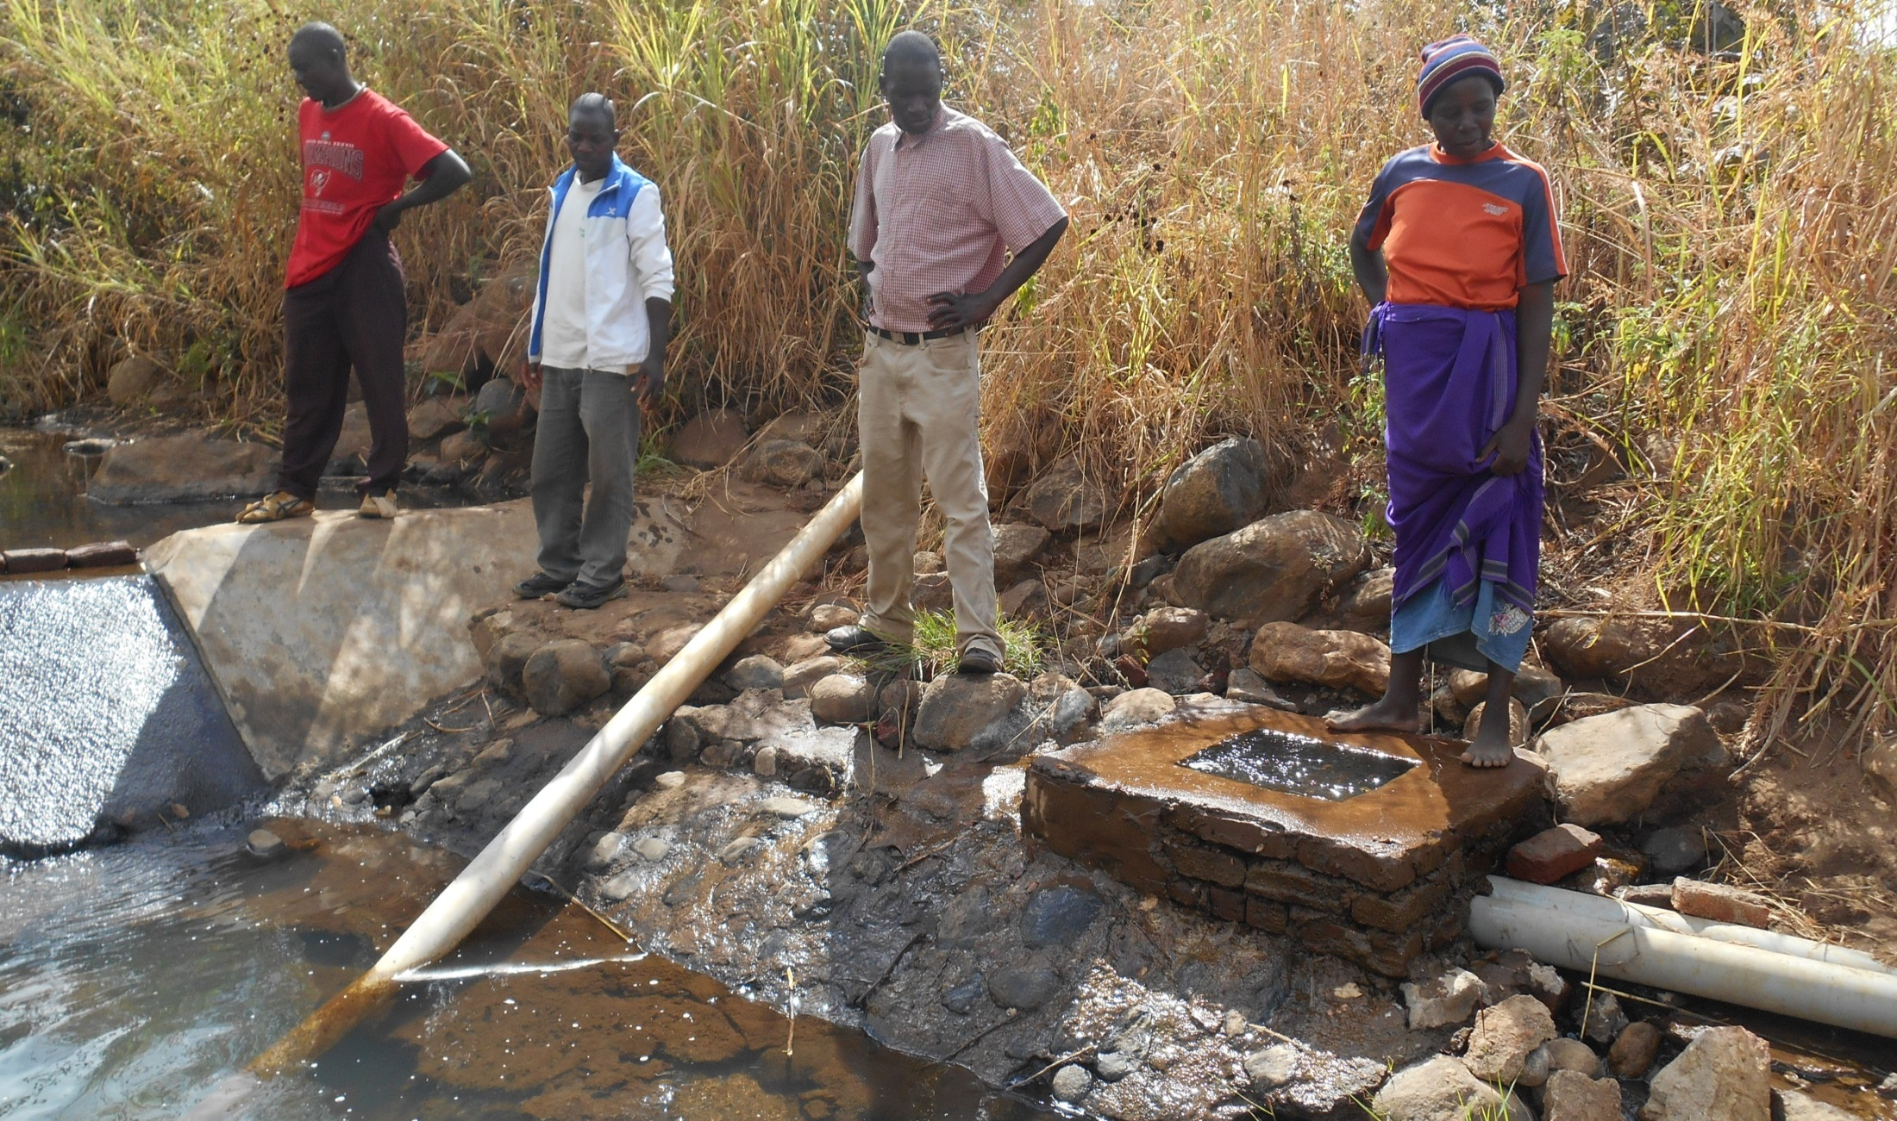
How we did it? (continued)

Slide 8
Research Findings
Matrlineal and matri-local society (75-80%)– Ngoni (70%)!
Land inherited through women
Tenure – tenurial niches (Fortmann 1992; 1996 – going beyond De Soto security of tenure through titling
Avoid binary of male and female ownership – gradient from female to male – multiple stories “I was given a piece of land by my grandparents from my father’s side since I had come to stay with my father after I separated with my wife long ago”.

Slide 9
Research Findings (continued)
Access – distributional equity, who gets what – going beyond neat bureaucracy to look at the social, economic and political dimensions of land tenure
There is need to monitor the dynamics, processes and sub-processes of the tenurial niches within the Kandeu area
Paradox of land ownership - not translating into control of benefits

Slide 10
Research Findings (continued)
Niches seem men re-negotiating their access to land through land rental arrangements.
Markets – gender roles – its not safe for women to travel overnight across the mountain range to the market – land tenure within the broader cultural spectrum
Men are involved in marketing – some say prices were ‘not good’ most of the time

Slide 11
Research Findings (continued)
Divorce your husband – torch
Role of uncles in decision making – men in key decision making

Slide 12
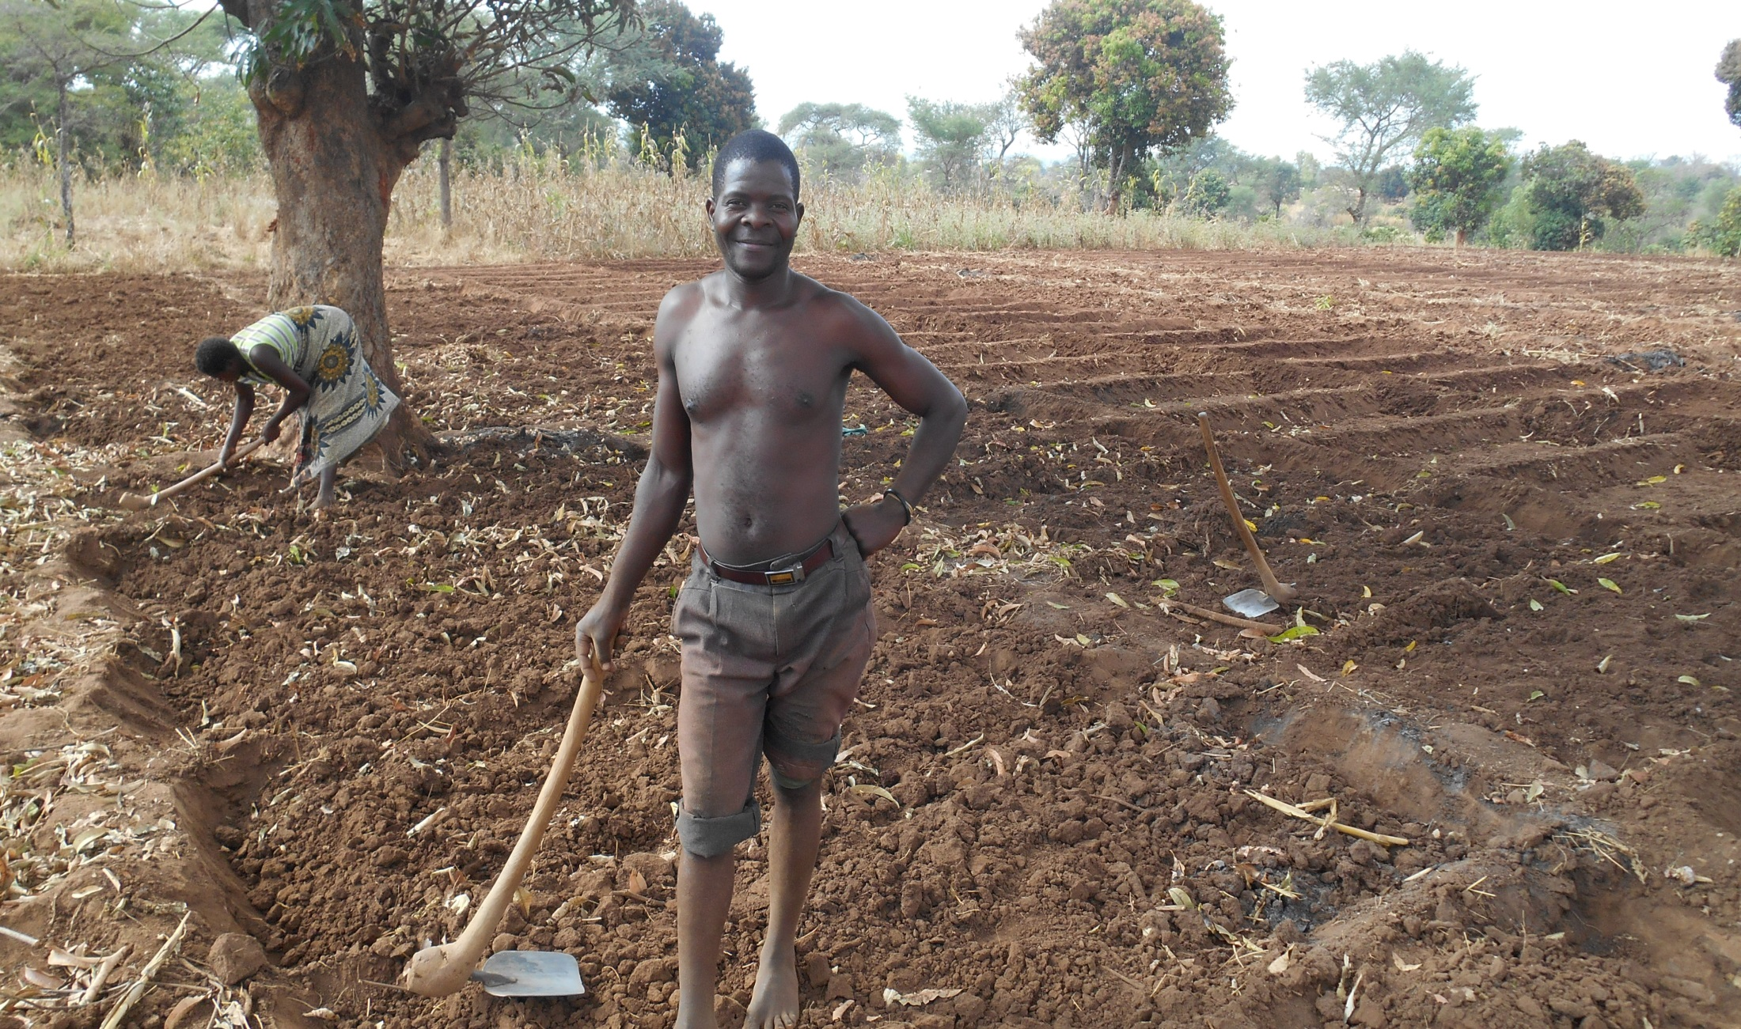
Whose labour?

Slide 13
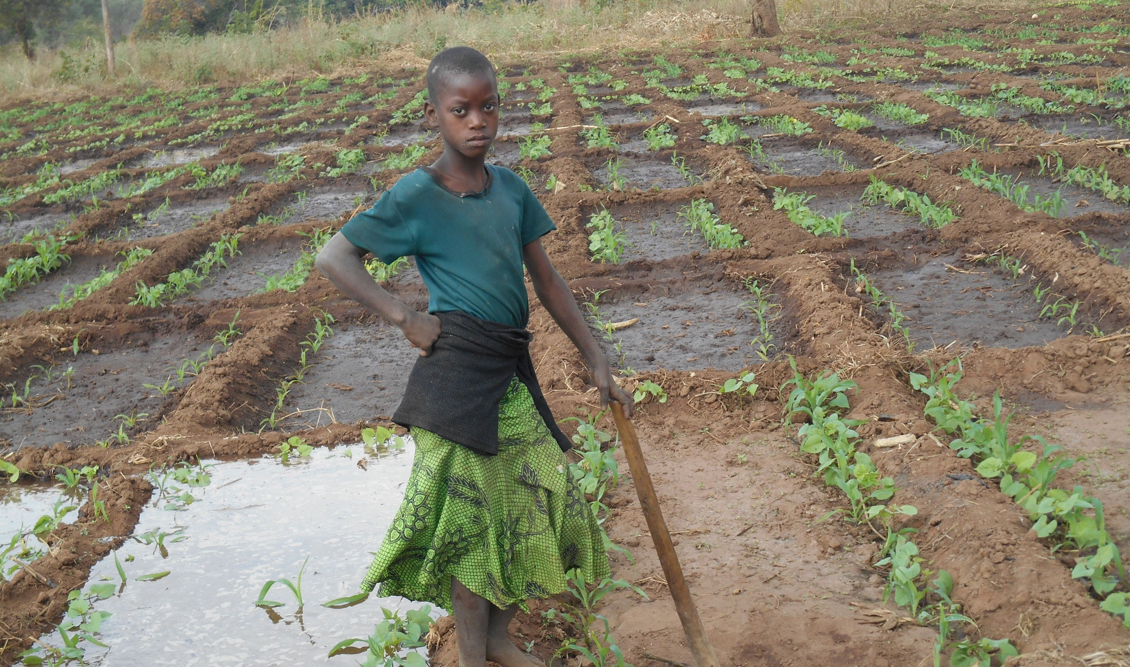
Whose labour (cont’d)

Slide 14
Access to Credit
By gender
Who obtained | Irrigating |  | Non irrigating
 | Freq | % | Freq | %
male | 19 | 41,3 | 18 | 58,1
female | 27 | 58,7 | 13 | 41,9
All | 46 | 100,0 | 31 | 100,0

Slide 15
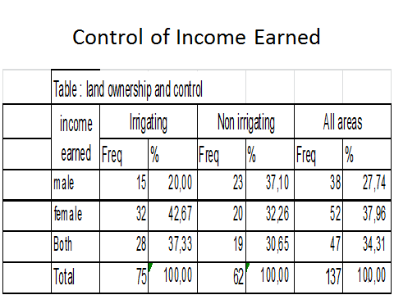

Slide 16
Access to Agric Extension
Access to an agric extension worker | Irrigating (n=75) |  |  | Non irrigating (n=62) |  | All respondents (n=137)
 | Freq | % | Freq |  | % | Freq | %
male | 19 | 25.3 | 10 |  | 16.1 | 29 | 21.2
female | 49 | 65.3 | 13 |  | 21.0 | 62 | 45.3
All-yes | 68 | 90.7 | 23 |  | 37.1 | 91 | 66.4
All-no | 7 | 9.3 | 39 |  | 62.9 | 46 | 33.6

Slide 17
Social Capital
 |  | Irrigating |  | Non irrigating |  | Total
 |  | Freq | % | Freq | % | Freq | %
male | Average | 2 | 2.9 | 2 | 3.8 | 4 | 4.3
 | Excellent | 2 | 2.9 | 2 | 3.8 | 4 | 4.3
 | Good | 11 | 16.2 | 5 | 9.4 | 16 | 17.2
female | Average | 5 | 7.4 | 13 | 24.5 | 18 | 19.4
 | Excellent | 6 | 8.8 | 3 | 5.7 | 9 | 9.7
 | Good | 31 | 45.6 | 8 | 15.1 | 39 | 41.9
 | Low | 0 | - | 3 | 5.7 | 3 | 3.2
Total |  | 57 | 83.8 | 36 | 67.9 | 93 | 100.0

Slide 18
Conclusion
Tenure is not absolute – it is fluid, created, challenged, modified, negotiated and re-configured - importance of tenurial niches
Move away from the binary - gradient
‘I own. You own. He owns. She owns. We own. They control’

Slide 19
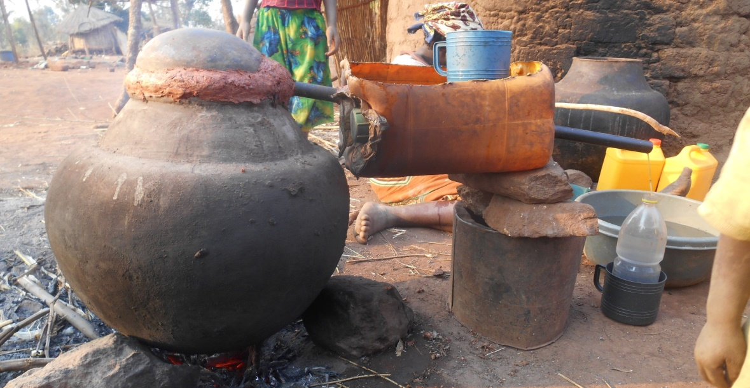
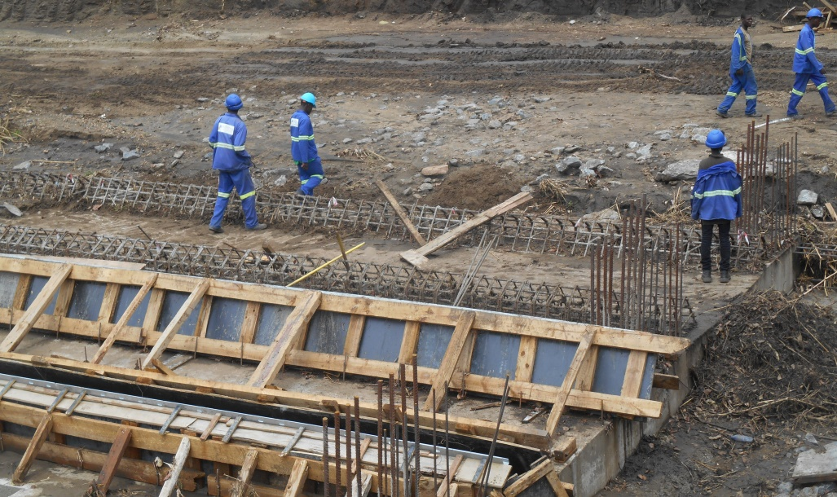
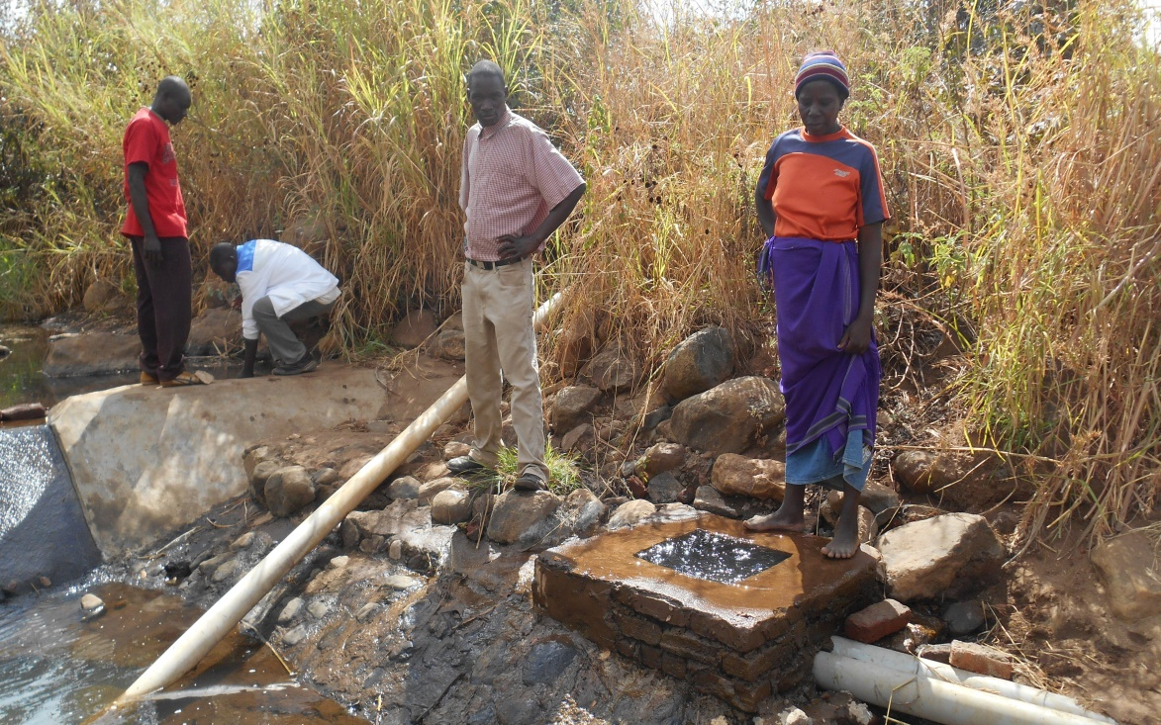
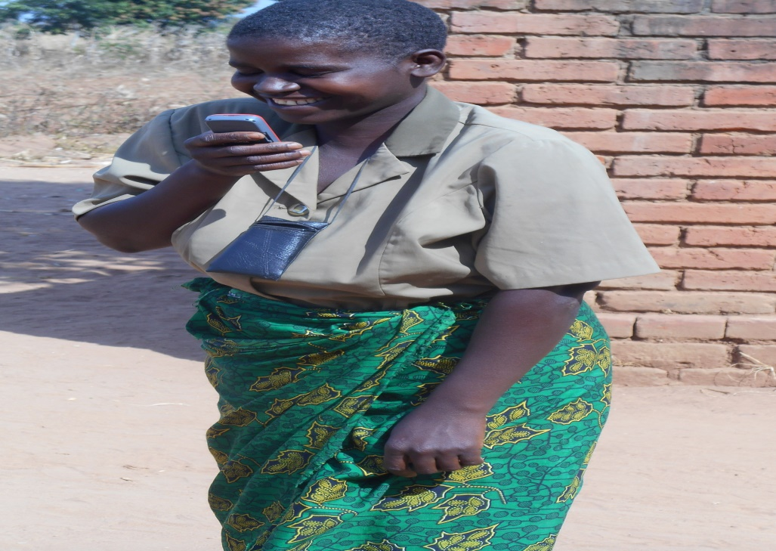
Thank You. Zikomo Kwambili

