Slide 1
Monitoring dryland agrobiodiversity and promoting its in situ/on-farm conservation and sustainable use
Promoting medicinal plants cultivation to increase income and alleviate pressure on agrobiodiversity
Maha SYOUF, Iyad MUSALLEM, Mariana YAZBEK
Consortium Research Program on Dryland Systems (CRP DS)
ICARDA – NCARE Technical Meeting for Tafilah-Salamieh Action Site (Jordan sites)
September 21-22, 2014
Ayass Hotel, Amman

Slide 2
Fertile Crescent harbors the major centers of diversity for wheat, barley, lentil, chickpea, several forage species and dryland fruit trees.
The GEF-Dryland Agrobiodiversity project implemented in Jordan, Lebanon, Palestine and Syria during the period 1999-2005 has allowed to assess the diversity of these crops and the major factors of their degradation.

Slide 3
Objectives
Assess and monitor Agrobiodiversity and its trends using ecogeographic/botanical surveys (Transects and quadrats methods for natural habitats) and farming system surveys
Use of GIS/remote sensing tools to assess the changes in landuse/landcover and to link it to results to the ecogeographic surveys
Develop and recommend management plans to promote in-situ conservation of dryland Agrobiodiversity in the selected areas;
Evaluate the effects of management options on dryland agrobiodiversity.
Promote cultivation of local and exotic medicinal and aromatic/herbal plants as a source of income to support the in situ conservation and sustainable use of Dryland Agrobiodiversity
Development of regional strategy for the conservation of indigenous medicinal and aromatic/herbal plants (MAPs) of dry areas.

Slide 4
Sites/monitoring area selection
Sites | Monitoring areas | Activity by other teams
Karak | Erak (Hleile) | Water harvesting
Karak | Khreisha (Majra) | No activity (at the time of survey)
Mwaqqar | Majidiyye | water harvesting and contour planted
Mwaqqar | Mahareb | water harvesting
Mwaqqar | University of Jordan (UoJ) | Protected / Fenced
Irbid | (JUST) Former GEF dryland agrobiodiversity site | Protected / Fenced
Mwaqqar/Irbid | Maghayer el Hana, Samta, Baoun, Wahadneh Former GEF dryland agrobiodiversity sites | No current activity

Slide 5
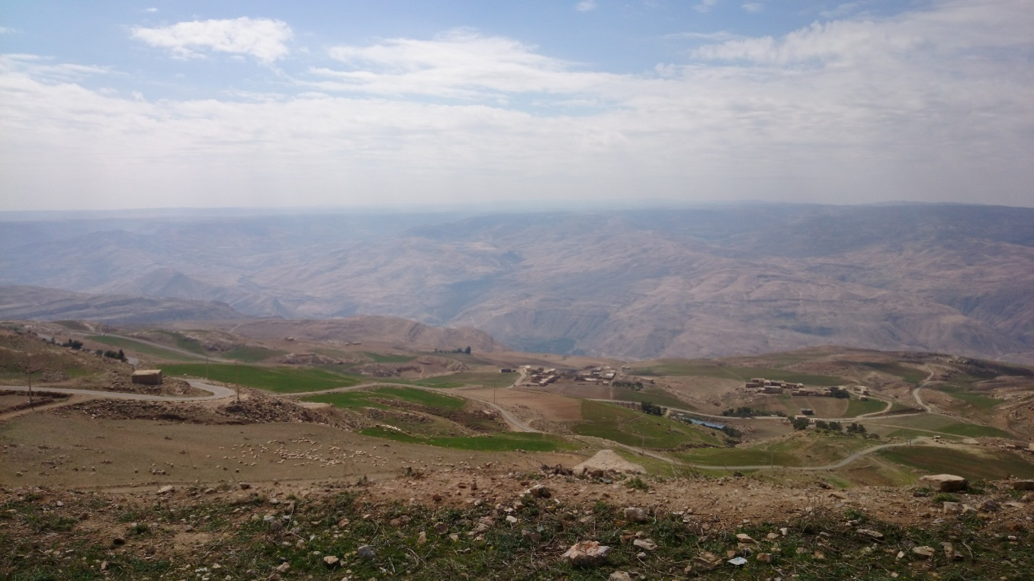
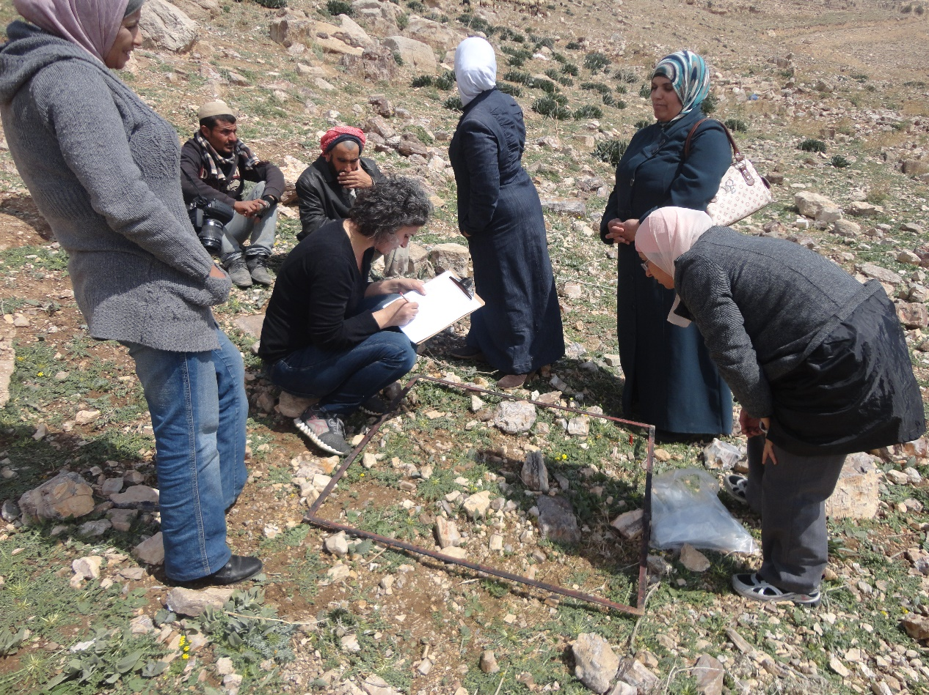
Erak

Slide 6
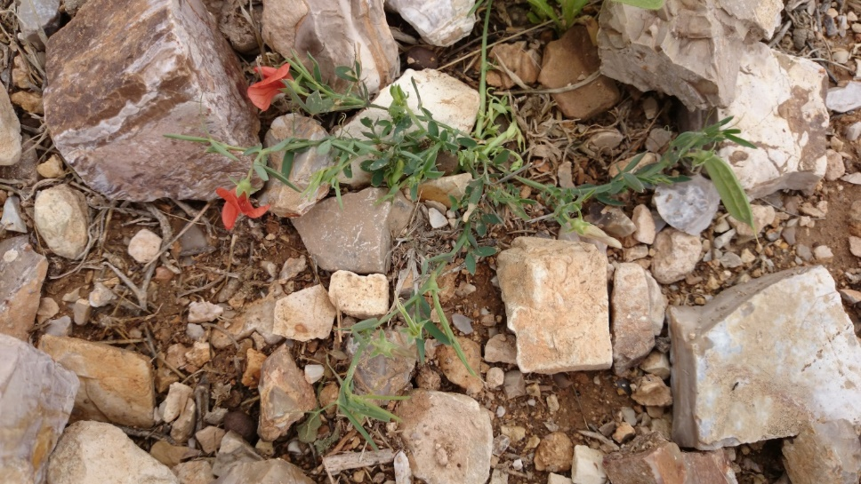
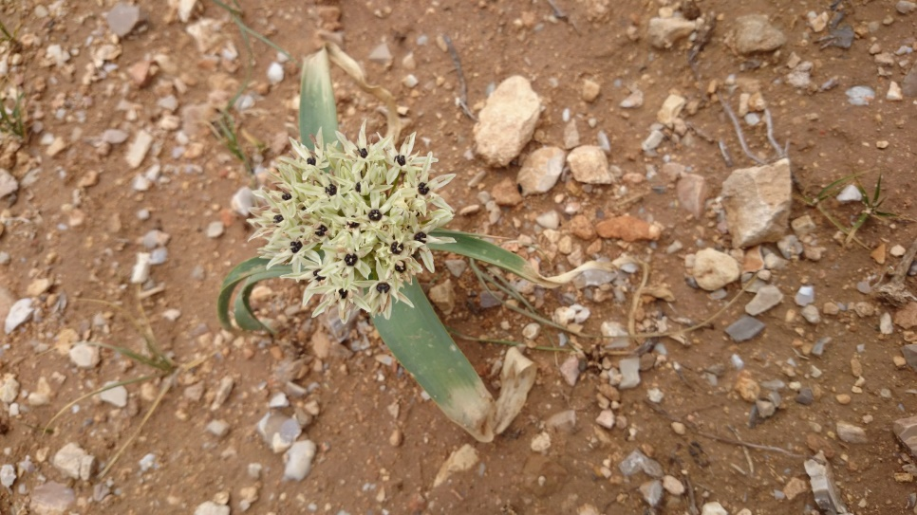
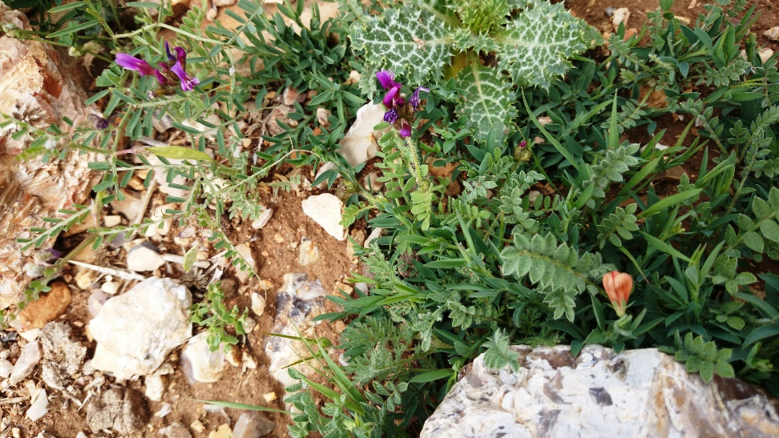
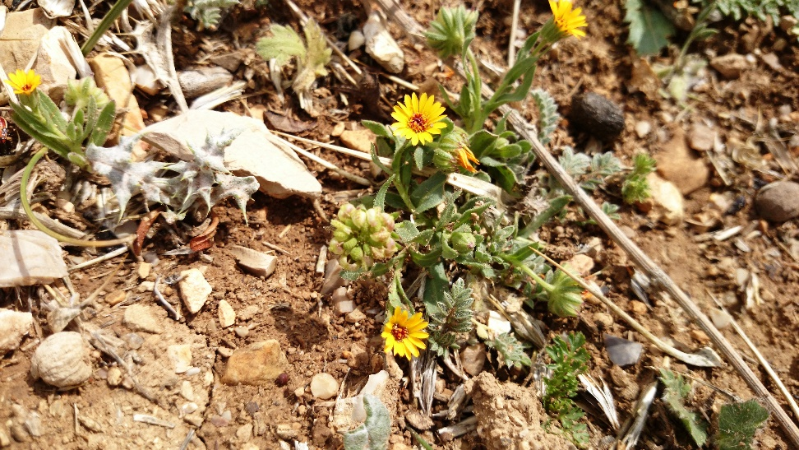

Slide 7
Ecogeographic / botanic survey conducted
spobs | country | survey_id | surveydate | species_id | cover | density
 | JOR | HLE_T1Q1_1 | 10/3/2014 | Centaurea (iberica) |  | 25
 | JOR | HLE_T1Q1_1 | 10/3/2014 | Bifora testiculata |  | 1
 | JOR | HLE_T1Q1_1 | 10/3/2014 | Hypocrepis uniceliquosa |  | 2
 | JOR | HLE_T1Q1_1 | 10/3/2014 | Crepis sp |  | 4
 | JOR | HLE_T1Q1_1 | 10/3/2014 | Carduous |  | 14
 | JOR | HLE_T1Q1_1 | 10/3/2014 | Poaceae | 10%
 | JOR | HLE_T1Q1_1 | 10/3/2014 | Coronilla scorpioides |  | 1
 | JOR | HLE_T1Q1_1 | 10/3/2014 | Astragalus (asterias) |  | 1
 | JOR | HLE_T1Q1_1 | 10/3/2014 | Trigonella (halophillus) |  | 1
 | JOR | HLE_T1Q1_1 | 10/3/2014 | Matthiola |  | 1
 | JOR | HLE_T1Q1_1 | 10/3/2014 | Anthemis sp |  | 6
 | JOR | HLE_T1Q1_1 | 10/3/2014 | Trifolium tomentosum |  | 2
 | JOR | HLE_T1Q2_1 | 10/3/2014 | Teucrium pulium | 5% | 2
 | JOR | HLE_T1Q2_1 | 10/3/2014 | Centaurea (iberica) |  | 8
 | JOR | HLE_T1Q2_1 | 10/3/2014 | Carduous |  | 6
 | JOR | HLE_T1Q2_1 | 10/3/2014 | Poaceae (Bromus) |  | 9
 | JOR | HLE_T1Q3_1 | 10/3/2014 | Onobrychis crista-galli |  | 2
 | JOR | HLE_T1Q3_1 | 10/3/2014 | Hymenocarpus cercinatus |  | 1
 | JOR | HLE_T1Q3_1 | 10/3/2014 | Trifolium sp |  | 1
 | JOR | HLE_T1Q3_1 | 10/3/2014 | Caryophyllaceae |  | 1
 | JOR | HLE_T1Q3_1 | 10/3/2014 | Trigonella (halophillus) |  | 1
 | JOR | HLE_T1Q3_1 | 10/3/2014 | Ornithopus compressus |  | 2
 | JOR | HLE_T1Q3_1 | 10/3/2014 | Centaurea (iberica) |  | 11
 | JOR | HLE_T1Q3_1 | 10/3/2014 | Hypocrepis uniceliquosa |  | 2
 | JOR | HLE_T1Q3_1 | 10/3/2014 | Fumaria parviflora |  | 1
 | JOR | HLE_T1Q3_1 | 10/3/2014 | Lathyrus pseudocicera |  | 1
 | JOR | HLE_T1Q4_1 | 10/3/2014 | Bellevalia |  | 4
 | JOR | HLE_T1Q4_1 | 10/3/2014 | Erodium |  | 20
 | JOR | HLE_T1Q4_1 | 10/3/2014 | Senecio vernalis |  | 1
 | JOR | HLE_T1Q4_1 | 10/3/2014 | Vicia sativa ssp amphicarpa |  | 4
 | JOR | HLE_T1Q4_1 | 10/3/2014 | Crepis sp |  | 11
 | JOR | HLE_T1Q5_1 | 10/3/2014 | Pisum vulvum |  | 2
 | JOR | HLE_T1Q5_1 | 10/3/2014 | Centaurea (iberica?) |  | 10
 | JOR | HLE_T1Q5_1 | 10/3/2014 | Erodium |  | 8
 | JOR | HLE_T1Q5_1 | 10/3/2014 | Calendula |  | 2
 | JOR | HLE_T1Q5_1 | 10/3/2014 | Bellevalia |  | 1
 | JOR | HLE_T1Q5_1 | 10/3/2014 | Urginea maritima |  | 2
 | JOR | HLE_T1Q5_1 | 10/3/2014 | Senecio vernalis |  | 2
 | JOR | HLE_T1Q5_1 | 10/3/2014 | Crepis sp |  | 2
 | JOR | HLE_T1Q5_1 | 10/3/2014 | Poaceae (Bromus?) | 15%
 | JOR | HLE_T1Q5_1 | 10/3/2014 | Carduous |  | 2
 | JOR | HLE_T1Q5_1 | 10/3/2014 | Hypecoum (pendulum) |  | 1
 | JOR | HLE_T1Q5_1 | 10/3/2014 | Trifolium tomentosum |  | 1
 | JOR | HLE_T2Q1_1 | 10/3/2014 | Centaurea (iberica?) |  | 13
 | JOR | HLE_T2Q1_1 | 10/3/2014 | Anthemis sp |  | 1
 | JOR | HLE_T2Q1_1 | 10/3/2014 | Urginea maritima |  | 1
 | JOR | HLE_T2Q1_1 | 10/3/2014 | Scorzonera papposa |  | 4
 | JOR | HLE_T2Q1_1 | 10/3/2014 | Carduous |  | 1
 | JOR | HLE_T2Q1_1 | 10/3/2014 | Poaceae (Bromus?) | 5% | 22
 | JOR | HLE_T2Q1_1 | 10/3/2014 | Bellevalia |  | 1
 | JOR | HLE_T2Q2_1 | 10/3/2014 | Hypocrepis uniceliquosa |  | 2
 | JOR | HLE_T2Q2_1 | 10/3/2014 | Carduous | 10% | 4
 | JOR | HLE_T2Q2_1 | 10/3/2014 | Bromus tectorum |  | 9
 | JOR | HLE_T2Q2_1 | 10/3/2014 | Anagallis arvensis |  | 1
 | JOR | HLE_T2Q2_1 | 10/3/2014 | Anthemis sp |  | 3
 | JOR | HLE_T2Q2_1 | 10/3/2014 | Calendula |  | 1
 | JOR | HLE_T2Q2_1 | 10/3/2014 | Erodium |  | 6
 | JOR | HLE_T2Q2_1 | 10/3/2014 | Astragalus (asterias) |  | 1
 | JOR | HLE_T2Q2_1 | 10/3/2014 | Iphylago |  | 2
 | JOR | HLE_T2Q3_1 | 10/3/2014 | Vicia sativa ssp amphicarpa |  | 1
 | JOR | HLE_T2Q3_1 | 10/3/2014 | Carduous | 5% | 5
 | JOR | HLE_T2Q3_1 | 10/3/2014 | Bromus tectorum |  | 11
 | JOR | HLE_T2Q3_1 | 10/3/2014 | Colchicum |  | 3
 | JOR | HLE_T2Q3_1 | 10/3/2014 | Consolida |  | 1
 | JOR | HLE_T2Q3_1 | 10/3/2014 | Onobrychis crista-galli |  | 1
 | JOR | HLE_T2Q3_1 | 10/3/2014 | Euphorbia |  | 2
 | JOR | HLE_T2Q3_1 | 10/3/2014 | Centaurea (iberica?) |  | 3
 | JOR | HLE_T2Q3_1 | 10/3/2014 | Ornithogallum |  | 1
 | JOR | HLE_T2Q3_1 | 10/3/2014 | Iris sysirinchium |  | 1
 | JOR | HLE_T2Q3_1 | 10/3/2014 | Erodium |  | 1
 | JOR | HLE_T2Q4_1 | 10/3/2014 | Carduous | 10% | 10
 | JOR | HLE_T2Q4_1 | 10/3/2014 | Bellevalia desertorum |  | 1
 | JOR | HLE_T2Q4_1 | 10/3/2014 | Erodium |  | 1
 | JOR | HLE_T2Q4_1 | 10/3/2014 | Centaurea (iberica?) |  | 8
 | JOR | HLE_T2Q4_1 | 10/3/2014 | Hypecoum (pendulum) |  | 1
 | JOR | HLE_T2Q4_1 | 10/3/2014 | Allium |  | 1
 | JOR | HLE_T2Q4_1 | 10/3/2014 | Ornithogallum |  | 2
 | JOR | HLE_T2Q4_1 | 10/3/2014 | Bromus tectorum |  | 10
 | JOR | HLE_T2Q4_1 | 10/3/2014 | Lathyrus pseudocicera |  | 1
 | JOR | HLE_T2Q4_1 | 10/3/2014 | Astragalus (asterias) |  | 1
 | JOR | HLE_T2Q5_1 | 10/3/2014 | Urginea maritima | 40% | 6
 | JOR | HLE_T2Q5_1 | 10/3/2014 | Ballota | 10% | 1
 | JOR | HLE_T2Q5_1 | 10/3/2014 | Carduous |  | 2
 | JOR | HLE_T2Q5_1 | 10/3/2014 | Ajuga chia |  | 1
marea_id | transect | quadrat | lat_dd | lon_dd | altitude | slope_dire | rocks_per
HLE | 1 | 1 | 31.1052 | 35.64298 | 1053 | SW | 50%
HLE | 1 | 2 | 31.105 | 35.64316 | 1055 | SW | 60%
HLE | 1 | 3 | 31.10489 | 35.64327 | 1053 | SW | 40%
HLE | 1 | 4 | 31.10462 | 35.64336 | 1054 | SW | 25%
HLE | 1 | 5 | 31.10443 | 35.64351 | 1058 | SW | 50%
HLE | 2 | 1 | 31.10549 | 35.64291 | 1063 | SW | 60%
HLE | 2 | 2 | 31.10577 | 35.64283 | 1076 | SW | 50%
HLE | 2 | 3 | 31.10594 | 35.64279 | 1079 | SW | 60%
HLE | 2 | 4 | 31.10619 | 35.64266 | 1083 | SW | 40%
HLE | 2 | 5 | 31.10636 | 35.64261 | 1087 | SW | 60%
MAJ1 | 2 | 1 | 31.02606 | 35.67821 | 1217 | W | 25%
MAJ1 | 2 | 2 | 31.02644 | 35.67811 | 1215 | W | 60%
MAJ1 | 2 | 3 | 31.02641 | 35.67787 | 1227 | W | 80%
MAJ1 | 2 | 4 | 31.02655 | 35.67775 | 1237 | W | 40%
MAJ1 | 2 | 5 | 31.02675 | 35.67758 | 1240 | W | 25%
MAJ2 | 1 | 1 | 31.73179 | 36.12219 | 819 | W | 25%
MAJ2 | 1 | 2 | 31.7319 | 36.12204 | 816 | W | 10%
MAJ2 | 1 | 3 | 31.73199 | 36.12187 | 815 | W | 5%
MAJ2 | 1 | 4 | 31.73216 | 36.12165 | 814 | W
MAJ2 | 1 | 5 | 31.73226 | 36.12156 | 814 | W
MAJ2 | 2 | 1 | 31.73345 | 36.12333 | 825 | W | 15%
MAJ2 | 2 | 2 | 31.73359 | 36.1232 | 822 | W | 50%
MAJ2 | 2 | 3 | 31.73374 | 36.1231 | 821 | W | 40%
MAJ2 | 2 | 4 | 31.73391 | 36.12296 | 816 | W | 20%
MAJ2 | 2 | 5 | 31.73403 | 36.12284 | 811
MAH | 1 | 1 | 31.68332 | 36.23141 | 850 | SW | 10%
MAH | 1 | 2 | 31.6832 | 36.23118 | 853 | SW | 15%
MAH | 1 | 3 | 31.68316 | 36.23105 | 848 | SW | 15%
MAH | 1 | 4 | 31.6831 | 36.23084 | 854 | SW | 10%
MAH | 1 | 5 | 31.68301 | 36.23064 | 853 | SW | 20%
MAH | 2 | 1 | 31.68346 | 36.22997 | 854 | SW | 25%
MAH | 2 | 2 | 31.68341 | 36.22977 | 855 | SW | 40%
MAH | 2 | 3 | 31.68337 | 36.22956 | 857 | SW | 25%
MAH | 2 | 4 | 31.68333 | 36.22936 | 861 | SW | 35%
MAH | 3 | 1 | 31.68057 | 36.23484 | 857 | SE | 20%
MAH | 3 | 2 | 31.6807 | 36.235 | 857 |  | 25%
MAH | 3 | 3 | 31.68079 | 36.23436 | 858 |  | 15%
MAH | 3 | 4 | 31.6809 | 36.23536 | 858 |  | 15%
MAH | 3 | 5 | 31.68098 | 36.23554 | 859 |  | 20%
JUST | 2 | 1 | 32.50466 | 35.99942 | 584 |  | 10%
JUST | 2 | 2 | 32.50473 | 35.99951 | 580
JUST | 2 | 3 | 32.50476 | 35.99954 | 582
JUST | 3 | 1 | 32.50384 | 35.99865 | 558 |  | 20%
JUST | 3 | 2 | 32.50392 | 35.99879 | 562
JUST | 3 | 3 | 32.50411 | 35.99894 | 560 |  | 10%
UOJ | 1 | 1 | 31.77892 | 36.21967 | 761
UOJ | 1 | 2 | 31.77876 | 36.21982 | 761 |  | 5%
UOJ | 1 | 3 | 31.77859 | 36.21993 | 761
UOJ | 1 | 4 | 31.77844 | 36.22002 | 761 |  | 5%
UOJ | 1 | 5 | 31.77828 | 36.22013 | 760 |  | 5%
UOJ | 2 | 1 | 31.7759 | 36.21264 | 770 | S | 5%
UOJ | 2 | 2 | 31.77582 | 36.21281 | 768 | S | 10%
UOJ | 2 | 3 | 31.77574 | 36.21301 | 767 | S | 50%
UOJ | 2 | 4 | 31.7756 | 36.21321 | 765 | S | 30%
UOJ | 2 | 5 | 31.77552 | 36.21339 | 763 | S | 10%
BAO | 1 | 1 | 32.3865 | 35.70568 | 567 | N | 5%
BAO | 1 | 2 | 32.38649 | 35.70553 | 565 | N | 30%
BAO | 1 | 3 | 32.38651 | 35.70526 | 561 | N | 5%
BAO | 1 | 4 | 32.3864 | 35.70498 | 560 |  | 10%
BAO | 1 | 5 | 32.38634 | 35.70447 | 562 |  | 2%
BAO | 2 | 1 | 32.38471 | 35.70421 | 568 |  | 5%
BAO | 2 | 2 | 32.38452 | 35.70434 | 569 |  | 70%
BAO | 2 | 3 | 32.38433 | 35.70452 | 570 |  | 5%
BAO | 2 | 4 | 32.3841 | 35.7047 | 563 |  | 20%

Slide 8
Next steps
Develop management plans and assessing their effects of on dryland agrobiodiversity.
Construct species distribution models to predict distributions of wild relatives of crops outside the surveyed sites
Use generated species distribution models in addition to GIS/remote sensing tools to predict the impacts of climate change on Agrobiodiversity distributions in dryland systems
Select biodiversity hotspots for crop wild relatives to be recommended for establishment of protected areas
Update the Agrobiodiversity database and make it open-access and user-friendly
Notes:
Extensive ecogeographic/botanical surveying for CRP-DS, necessary to advise on conservation approaches is difficult and costly, particularly because resources for agrobiodiversity conservation are limited and CRP-DS is being conducted on a large geographic scale.
2. The very valuable and thorough data collected during the Agrobiodiversity project is accessible to very few researchers. Moreover, the data is stored in the form of an outdated, non-user friendly database. This limits the data’s utility and broader impact on related research.
We therefore aim to consider the Agrobiodiversity project a pilot study for CRP-DS and use the substantial distribution/environmental data available through that project to model the distribution of agrobiodiversity in the CRP-DS area of study. We also aim at making this in addition to any newly collected data accessible through a user-friendly open-access database.

Slide 9
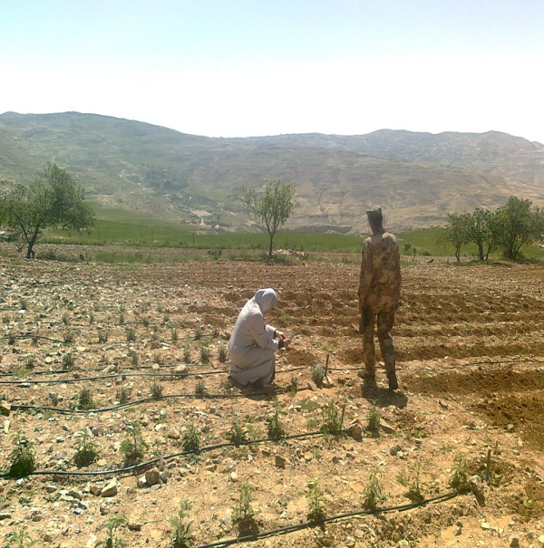
Promoting medicinal plants cultivation to increase income and alleviate pressure on agrobiodiversity
Relief pressure on wild vegetation of Medicinal plants
Provide a source of income to support the in situ conservation and sustainable use of Dry land Agro biodiversity

Slide 10
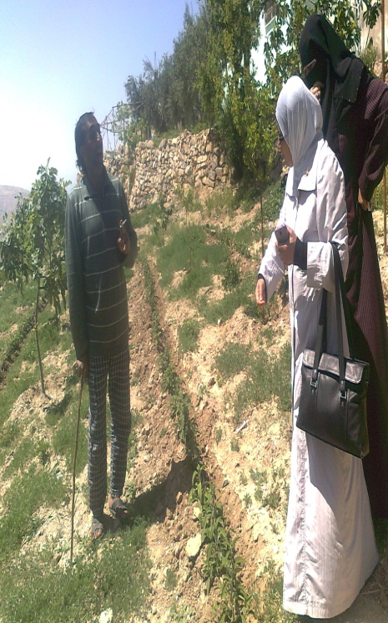
Cultivation of medicinal and aromatic/herbal plants (MAPs) in Erak
Five farmers at ERAK site were selected
women and men
Crocus sativus, Thymus spp, Salvia spp, cut herbs (Rocca, Basil, Thyme, etc..)]

Slide 11
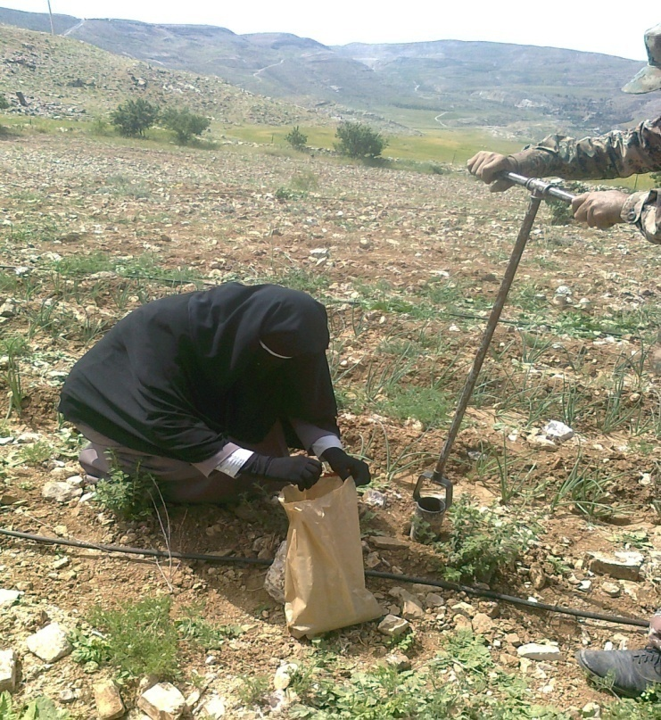
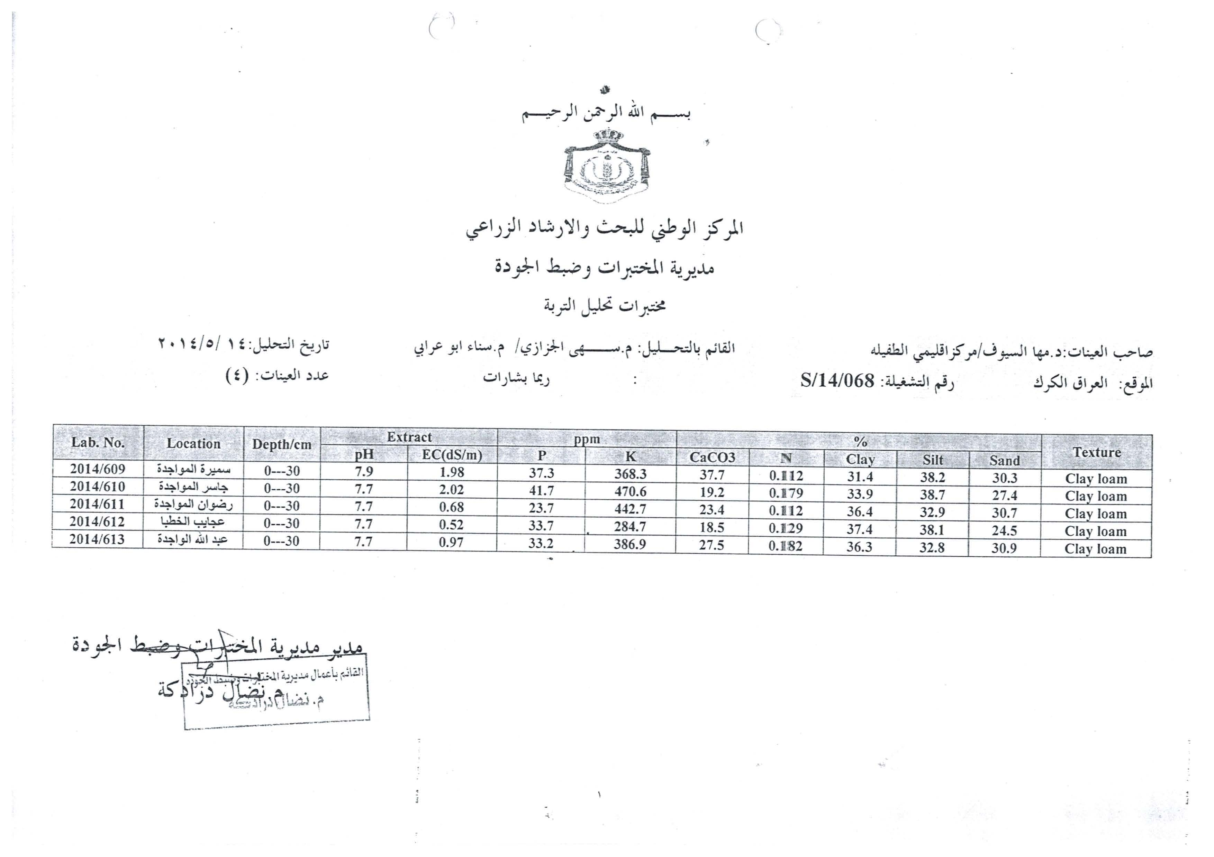
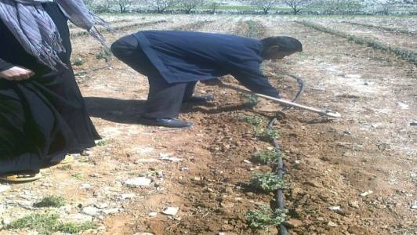

Slide 12
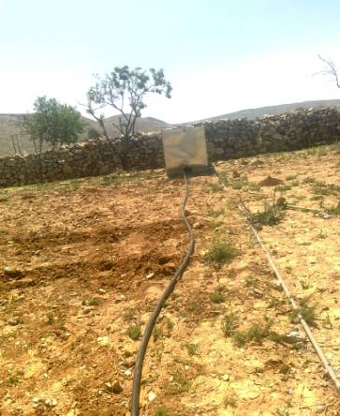
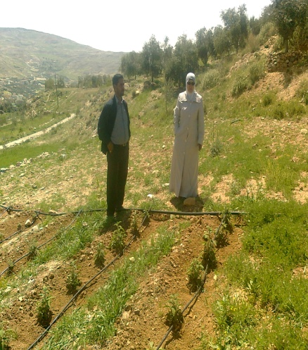
Farmers were provided with water tank and irrigation system

Slide 13
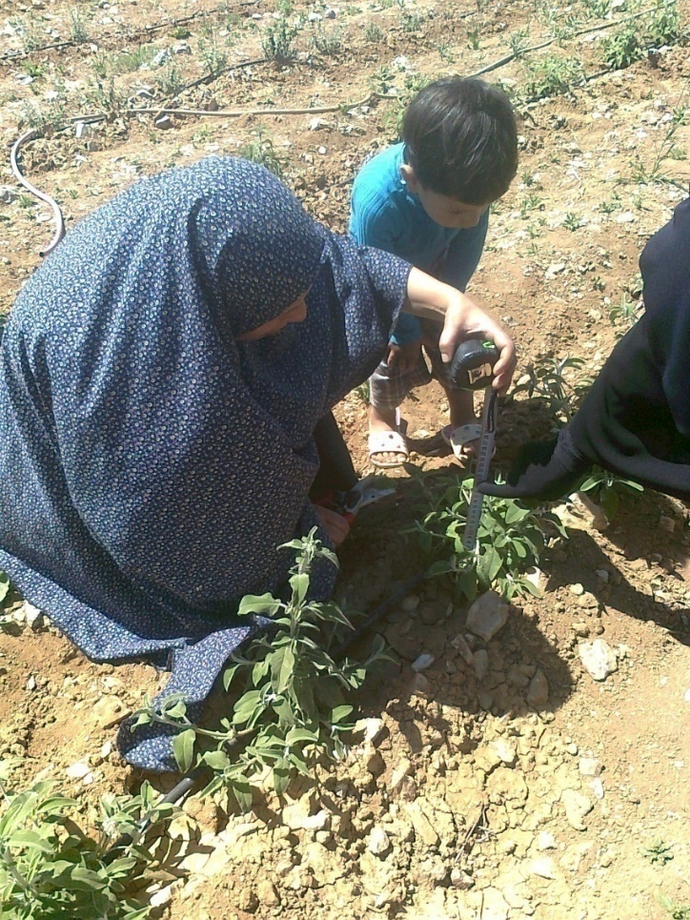
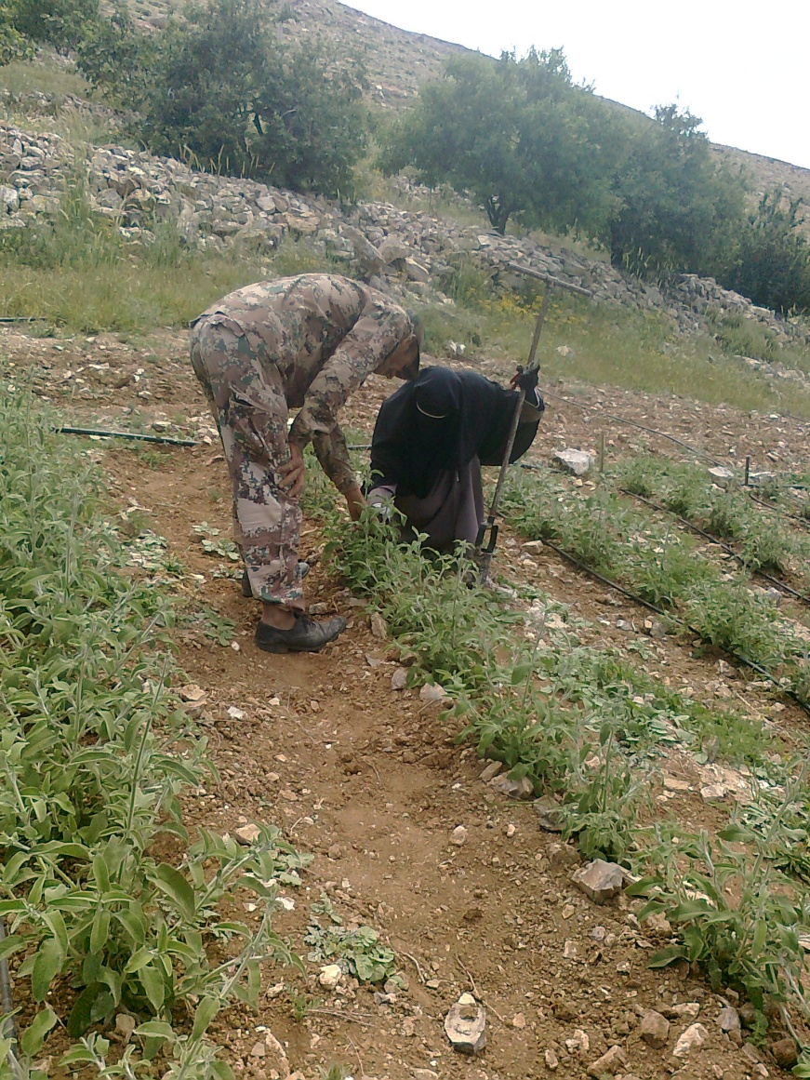
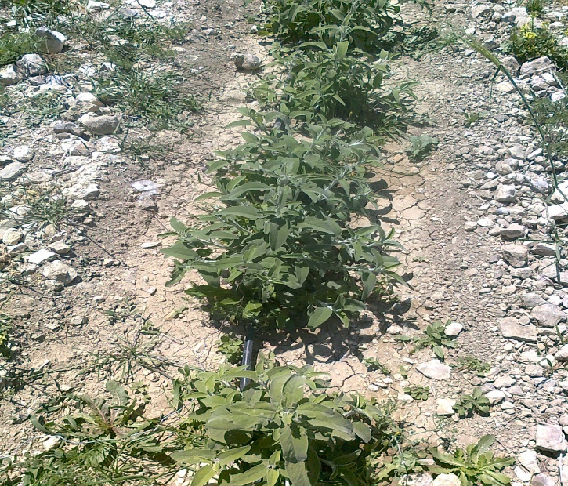
Salvia at Eraq Site

Slide 14
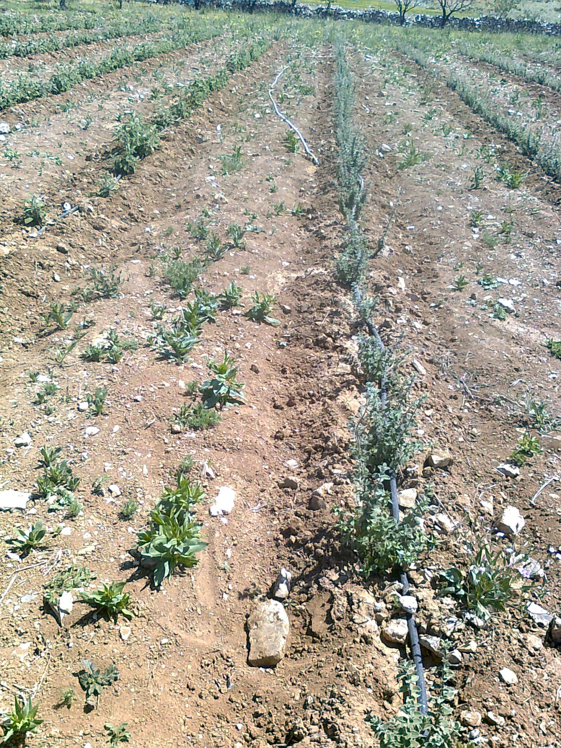
Thymus at Eraq site

Slide 15
Average Thymus and Salvia plant height at first cutting stage in April 2014
Production of both species either consumed locally or were sold to neighboring farmers

Slide 16
Ongoing
Development of Cultivation and handling protocols of medicinal species
Identification of necessary training for farmers to add value for their products at the various stages

Slide 17
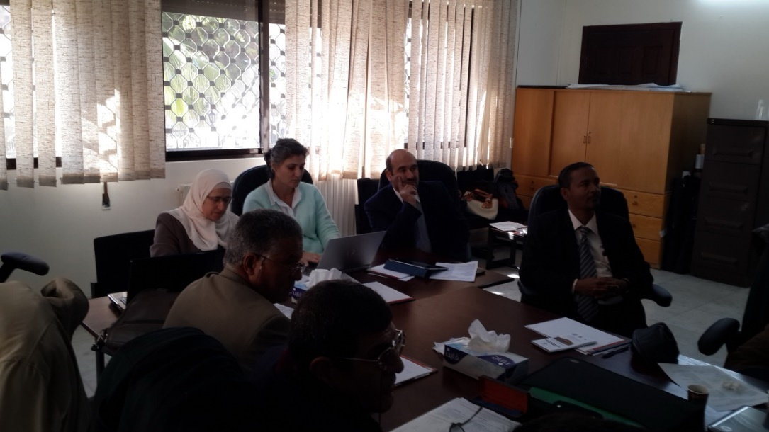
Promote Medicinal and Aromatic plants – in collaboration with AARINENA
  Establishment of Regional network for promoting the conservation and sustainable use of MHAP in NENA region
  Development of concept note of the regional strategy for conservation and use of MHAP.
  Draft ideas to implement sub-regional projects on establishing value chain on MHAPs
  Develop a mechanism for collaboration in research for utilization of MHAP genetic resources at NENA region

Slide 18


Working team
NCARE: Maha Syouf, Iyad Musalam, Ahmed Sharydeh, Ala Quran, Majeda Thnaibat
AARINENA: Mohammad Ajlouni
ICARDA: Ahmed Amri, Ali Shehadeh, Mariana Yazbek

