Slide 1
Open access as a means to produce high quality data
Anja Gassner
Head Research Method Group
Sentinel Landscape Coordinator FTA
World Agroforestry Centre (ICRAF)

Slide 2
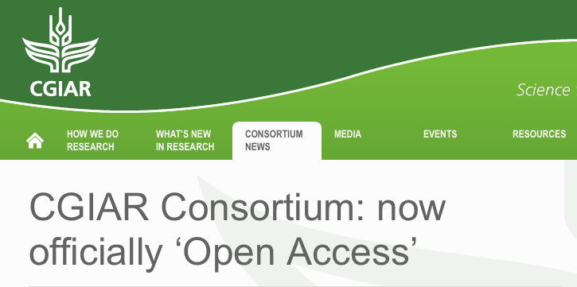
Approved by CGIAR Consortium Board October 2, 2013
The policy is applicable both to new data as well as retrospectively to legacy data:
Data shall be made open access as soon as possible and in any event within 12 month of completion of the data collection or appropriate project milestone
Existing and future databases shall be made Open access
Datasets shall be made open access after the publication the data replicates is published.
The consortium policy provides two options that allow centers to decide when and what kind of research data should be made open access
data sets that are regarded as not of value to others (draft, poor quality or incomplete) are excepted from this policy (Section 4.1.1. Openness). This option is important if data collection is done by partners and is not in our full control.
Completion of data collection is a relative term and independent of funding (unless stated otherwise in the grant contract) and project closure. Thus it is up to the center to define this on a case by case basis and allows control over the actual release date.

Slide 3
Common Misconceptions
Open Access means that I share all my data
Open Access means that I do not have time to use the data for publications
Open Access means that I will not be recognized for my work
Sharing data means I share all my data

Slide 4
The “selfish” scientist?
“Like too many publicly funded ARIs, some Centre and System-wide programs seem to treat data as proprietary”
The CGIAR at 31: An Independent Meta-evaluation of the CGIAR (2004)

Slide 5
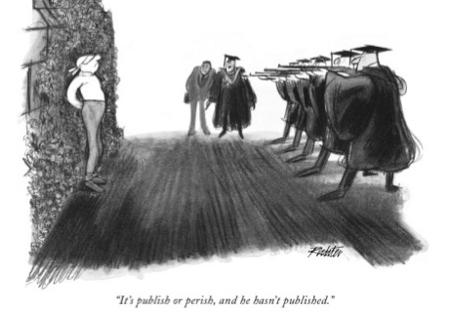
Institutional culture!

Slide 6
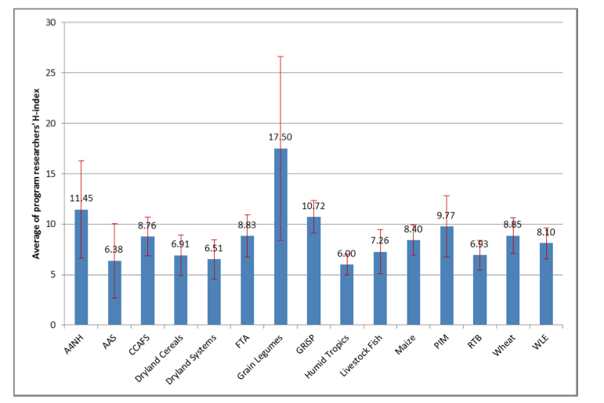
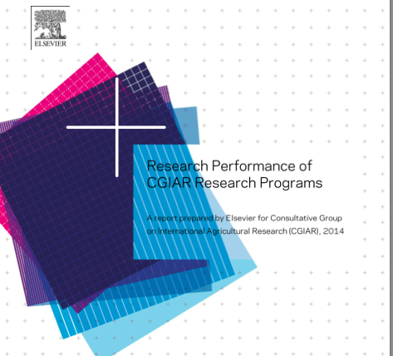
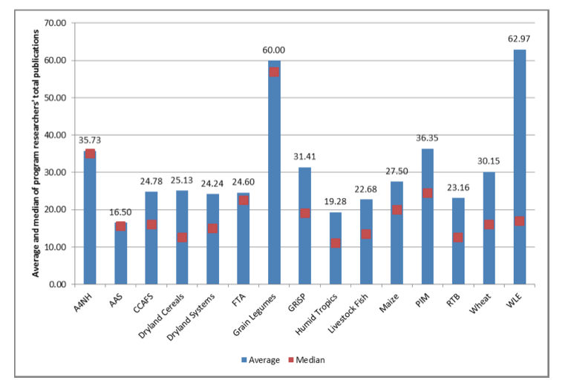

Slide 7
Research Quality
When evaluating research a clear distinction should be made between research ‘quality’ (i.e. the relative excellence of academic outputs intended for academic consumption, e.g. journal papers and books) and research ‘impact’ (i.e. the benefits that research outcomes produce for wider society)
Unfortunately this division is often confused, a prime example being when journal citation (‘quality’) metrics are incorrectly presented as measures of ‘impact’ (Donovan, 2011).

Slide 8
Publications are seldom evaluated based on the technical rigor of the data collection procedures, the completeness of the data and its description, and alignment with existing community standards.
To translate conceptual frameworks into empirical sampling designs takes significant research experience.
Thus producing a high value data set that forms the basis of a high quality scientific publication requires a high level of scientific sophistication,
Writing the paper itself requires a good grasp of language, some understanding of the science you're writing about, and an ability to "translate" technical information into plain English and write about it compellingly (Costandi, 2013).

Slide 9
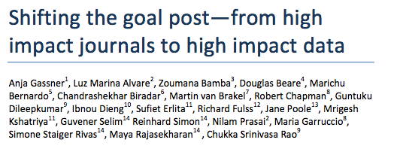
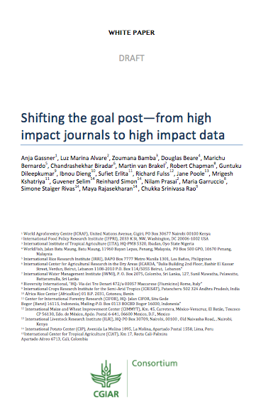

Slide 10
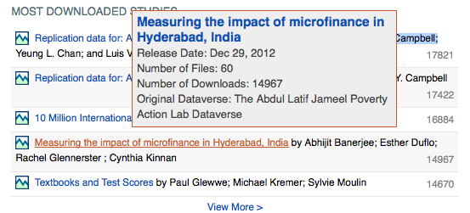
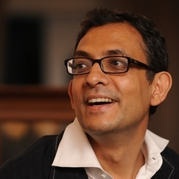
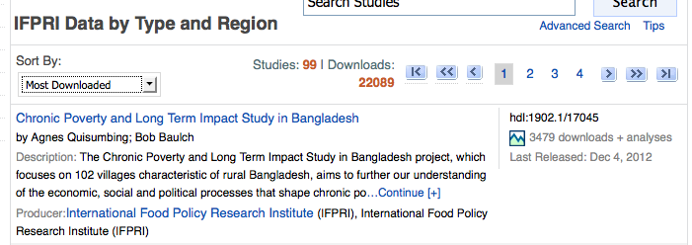
Data publishing!
Quisumbing A, Baulch B (2010) Chronic Poverty and Long Term Impact Study in Bangladesh <http://hdl.handle.net/1902.1/17045 UNF:5:8MUn92HhwQhRKF69wSTwaA== International Food Policy Research Institute [Distributor] V5 [Version]>

Slide 11
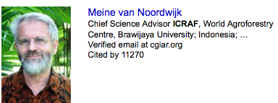

Slide 12
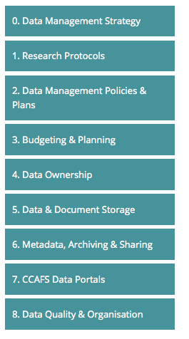
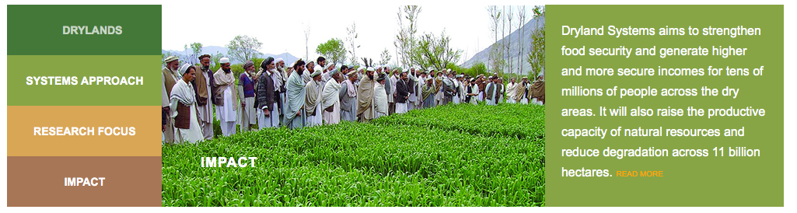
Open Access – a means to an end
Research Data Infrastructure
Impact of the Data
http://ccafs.cgiar.org/data-management-support-pack

Slide 13
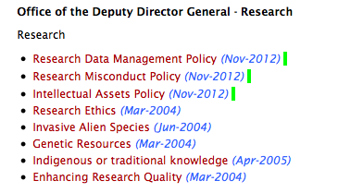
ICRAF’s Research Data
Management Policy
Projects are responsible for ensuring that research data is described by appropriated Metadata throughout their lifecycle. Metadata should be incompliance with the Simple Dublin Core requirements, or globally accepted metadata standards for specific data types
Every project shall upon closure provide a list of all data sets produced by the project to the regional coordinator and the GRP leaders, who will make recommendation regarding the identification of high value data sets, both to the Centre and our partners. These high value data sets shall be submitted to the institute repository.
To improve scientific publications, consensus with scientific peers and public trust in the quality of our research outputs the Centre will provide institutional support to ensure that all necessary raw data will be made public to reproduce or replicate every scientific publication that is based on research data. Scientists are required to submit necessary raw, verified data for every scientific publication in standard file formats.

Slide 14
Open Access?
Open Access is a means to an end
Better quality data
Better quality publications
Higher usage of data (internal & external)
Higher Recognition for “Techis”
More transparency
Better Impact

Slide 15
Use of data

Slide 16
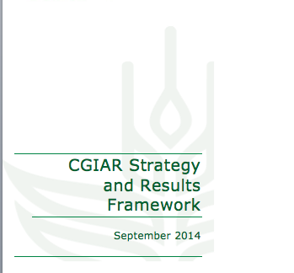
Big data and informatics: Enormous amounts of data are being rapidly generated in agri-food systems, from the lab to the field to the retailer, generating opportunities to drive innovation at various points in the value chain. Using high throughput methodologies and systems-based approaches these data can be expertly pooled, structured and mined to tackle complex research questions and identify new areas for research, development and innovation. Better models and data are crucial for developing solutions that will help increase productivity, enhance nutrition, increase resilience to the effects of climate change, and preserve/enhance natural capital.

Slide 17

Thanks

