Slide 1
Market Research
High Value Chain Cluster, Post-Harvest & Market Access Activities
CRP-DLS-Jordan Meeting
21-22 September 2014 – Amman - Jordan
Team
NCARE: Masnat El Hiary (NCARE-Jordan: masnath@yahoo.com )
ICARDA: Boubaker Dhehibi (SEPRP – ICARDA: b.dhehibi@cgiar.org)
Shinan Kassam (SEPRP- ICARDA: S.Kassam@cgiar.org )
Girma Tesfahun Kassie (SEPRP-ICARDA: g.tesfahun@cgiar.org )

Slide 2
High Value Chain Cluster – Post Harvest and Market Access
The Integration Process
Learning Alliance in Al Erak village jointly identified olives as the key commodity for household livelihoods and challenges associated with productivity and profitability;
Post-harvest and Market Access (PHMA) initiative engages in a value chain analysis and market study for olives within the Karak governorate, and linked to national and international markets and concerns;
Knowledge gained from the PHMA study will feed into an innovation platform process, of which one aim is to uncover avenues for addressing challenges and barriers to productivity and profitability of olives through effective partnerships.

Slide 3
High Value Chain Cluster – Post Harvest and Market Access
Olives and Livelihoods
Olives contribute only 10% to total household income (learning alliance participants)…..so why the importance?
      Pension income and civil service employment contribute over 50% to household income;
      Low productivity of olives (disease management concerns, ‘poor’ production practices, limited access to irrigation) lead to low marketable volumes;
      Poor quality and limited bargaining power lead to lower than expected prices for fresh olives and olive oil
      Improving productivity, market access, and thereby profitability can enhance household incomes in an area with limited opportunities for agricultural production

Slide 4
Post-Harvest and Market Access Activity
An Overview
Title of the Activity: Value chains of cash crops for enhancing market access to small holder farmers and improved harvest and post-harvest technologies
Duration: 2013 – 2014 - 2015
Objectives:
1. Assessment of the magnitude of post-harvest losses along the value chain;
2. Improving the locally appropriate postharvest handling and processing options;
3. Facilitate the development of stakeholder-driven strategies for improving the marketing efficiency, postharvest management and value addition for the selected crops/products;
4. Assist stakeholders (men, women and youth) in implementing the strategies identified in objective 3.

Slide 5
Post-Harvest and Market Access Activity
Expected Outcomes
Coordination stakeholders/value chain actors in target production areas established;
Partnerships between developmental organizations, research centres, local welfare societies, producer cooperatives, local government organs and social service providers catalyzed;
Skills of value chain actors (through awareness training programs) enhanced.
Losses on olives an olive oil chain value assessed.
A women cooperative established in Wadi Al Karak (2014-2015).

Slide 6
Post-Harvest and Market Access Activity
A Synthesis
IDOs | Country | Sub activity | Livelihood system | Indicators | Status | Partners
4 | Jordan | 2013 Value chain focus group meeting on olive and olive oil stakeholders (Al Rabeh/AL Karak on 30 December, 2013) 2014 Mapping the challenges for smallholder market access: Review of literature on institutional arrangements in collective marketing. Marketing survey, supply chain mapping and post-harvest management Awareness training programs on olives | Agro-pastoral system Intensive rainfed System | Reports (1) Reports (1) Database (1 - 150) / Reports (1) Training programs | Completed Ongoing Ongoing Ongoing (2) | NCARE-Jordan

Slide 7
Post-Harvest and Market Access Activity
Planned Activities for 2014
Data collection for Supply chain mapping:
Focus groups of farmers (RRA and PRA) and Households survey (150) in Al Erak site
Personal interviews with wholesalers; road transporters, local traders, shipping companies and institutional buyers
Focus groups of women stakeholders
Focus groups with youth (labor issues and their involvement in the agriculture sector)
Data collection for Market Analysis:
Price Analysis; Marketing cost analysis and Volume assessment
Marketing workshops for farmers and buyers (Separate workshops)
Literature review on collective action, microfinance and financial institutions
Final workshop with stakeholders, one for each crop
Data collection for Post-Harvest Status:
Data collection on post-harvest losses
Data on post-harvest infrastructure
Data on processing practices and operations
Awareness training programs on olive production and marketing

Slide 8
Post-Harvest and Market Access Activity
Ongoing Activities for 2014
Jan-Aug 2014:
1. Development of questionnaire (Marketing System for Olives and Olive Oil in Eraq -Karak) in Arabic and translating it to English
2. Pre-testing of the questionnaire
3. Implementation of the survey for the first commodity – Olive (150).
Sep-Dec 2014:
Finalizing the survey for the olive marketing questionnaire,
Data management, analysis, and reporting.
2. Focus group meeting workshop for livestock holders and milk processors at Al kresha villages.
3. Initiating a cooperative for women producers and processors.
4.Providing farmers with harvesting machine through Eraq cooperative.
5. Continue the implementation for the awareness training program.

Slide 9
Post-Harvest and Market Access Activity
Expected Outputs for 2014
1. Baseline database (on production, consumption, prices, traders, wholesalers, processing sector, and marketable surpluses in the three producing areas and markets) established;
2. Reports detailing survey results with special emphasis on factors causing losses along the supply chain written;
3. First stakeholders workshops (minutes of the workshops);
4. Awareness training program implemented on olive production and marketing.

Slide 10
Capacity Building
Short term Awareness Trainings Program
N (Females) | Activity | Month
29 (4) | Activity 1 : Pest And Disease Resistance (Integrated Pest Management). | August
19 (0) | Activity1: Irrigation Methods (Quality Of Irrigation Water, Predicting Irrigation Requirements). | September
 | Activity 2: Fertigation (Fertilizers Use, Type Of Fertilizer, Quantity, Nutrient Requirement, Application Machinery).
TBC | Activity 1: Harvesting Methods | October- December
TBC | Activity 2 : Packing And Storage Area
TBC | Activity 3: Pruninning Methods And Machineray Used
TBC | Activity 4 : Evaluation Of Olive Oil Quality ( How To Detect Adulteration Of Olive Oil, How To Save Oil Quality, Best Oil Container, Olive Oil Test , etc.)
TBC | Activity 5: Re Use Of Waste

Slide 11
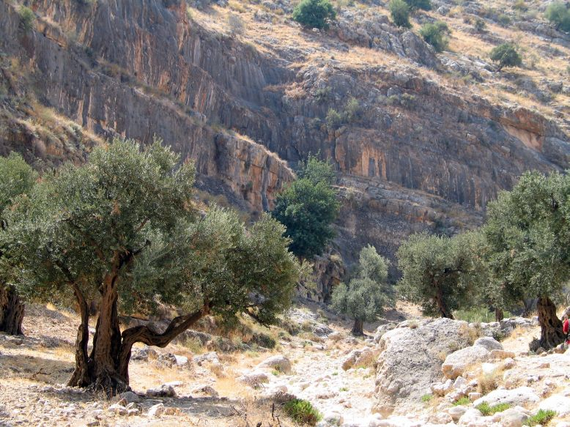
Post-Harvest and Market Access Activity
Challenges vs Opportunities
  Challenges / Constraints
  Technical constraints associated with the production of olives:
  Lack of awareness of farmers on choosing the appropriate land for planting olive, choose of the best variety which is suitable for the area and the weather;
  Lack of awareness of farmers on determining the best time for picking olive;
  Lack of awareness of farmers on the treatment of olive crop and spraying for diseases, in addition to the problem of unavailability of spraying tanks in MoA.
  2. Constraints related to the valuation of the olive products:
  No contracts with traders and some markets to market their products;
  Unstable prices from year to year.
  3. Constraints related to the professional organization of producers:
  No effective cooperative group in the region;
  Jordanian Exporters Association for Olive Oil Products (JOPEA), and Farmers Union role is absent in their region.

Slide 12
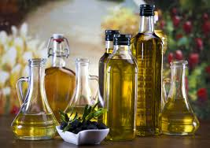

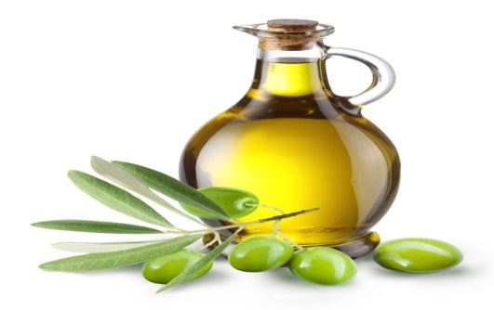
Post-Harvest and Market Access Activity
Challenges vs Opportunities
  Opportunities
  More efficient production is more income and more business and livelihood opportunities;
  Growth of national and international olive oil demand market;
  Changes in consumer preferences and increasing demand for olive oil in Jordan;
  Potentialities opened up by new information technologies.
  Olives provide seasonal work, giving potential for increasing the household income;
  Olives can be grown traditionally and without any advanced technology;
  There are large areas of suitable agricultural lands in Wadi Al Karak

Slide 13

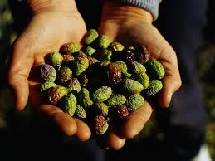
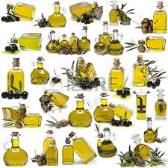
Post-Harvest and Market Access Activity
Preliminary Recommendations
Extension strategies to build local capacity;
Improving the productivity and the quality of the olive products;
Strengthen the capacity of small producers' professional organization ;
Upgrading recovery operations and marketing;
Promote the formation of production and marketing cooperatives.

Slide 14
Post-Harvest and Market Access Activity
Expected Outputs for 2015
1. Draft action plans developed and second stakeholders workshops.
2. Working group formed for the implementation of the strategies.
3. Networks established in the two production areas and Minutes of meetings and action to be taken recorded and followed up by the research team.
4. Recommendation on best-bet postharvest handling practices and bet low-tech processing options.
5. Financial and economic impacts assessed.
6. Recommendation to policymakers on best bet practices for the selected two commodities.
7. Women’s contributions, attitudes, and sense of empowerment assessed
8. Youth’s attitudes to agriculture sector employment

Slide 15
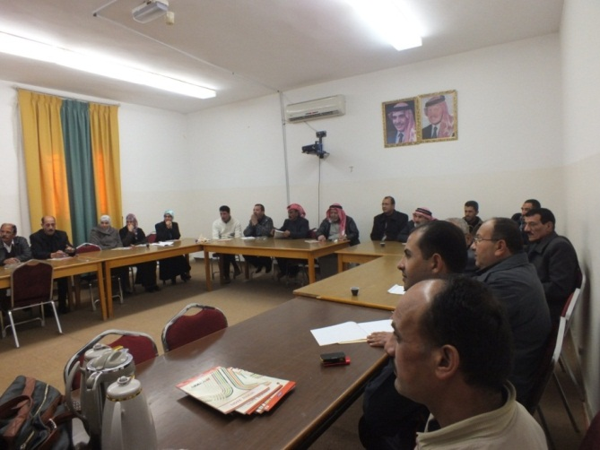
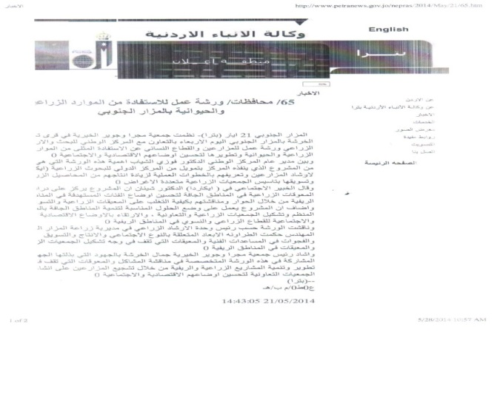
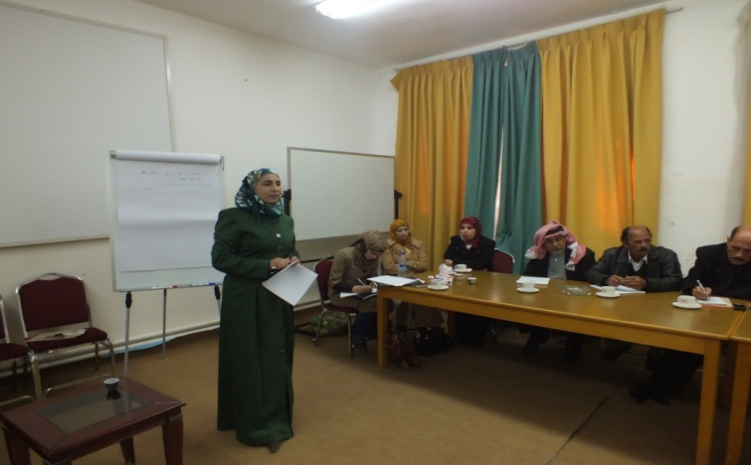
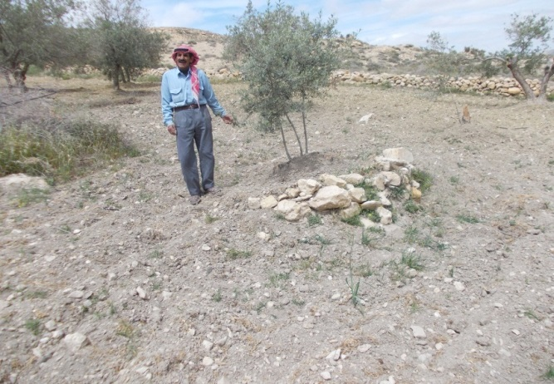
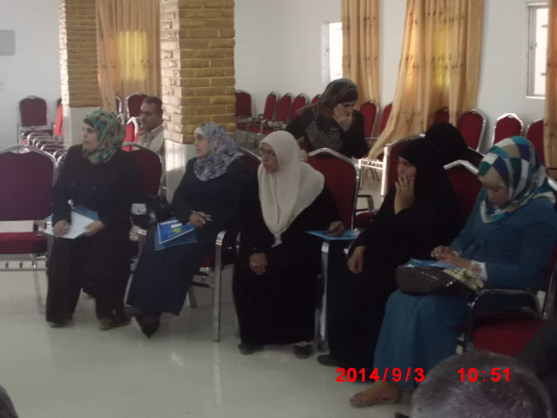
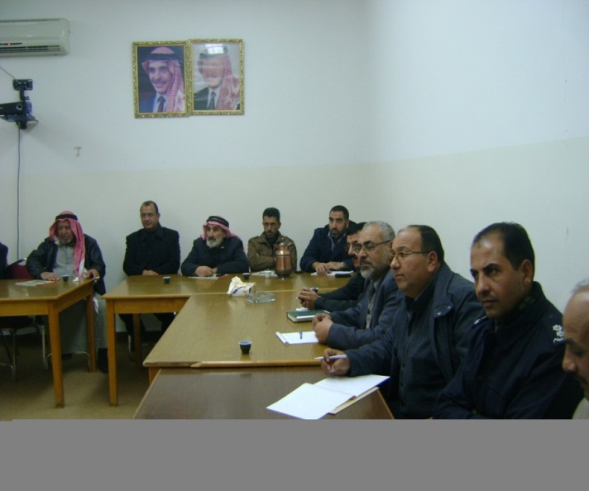
Post-Harvest and Market Access Activity
Workshops / Media

Slide 16
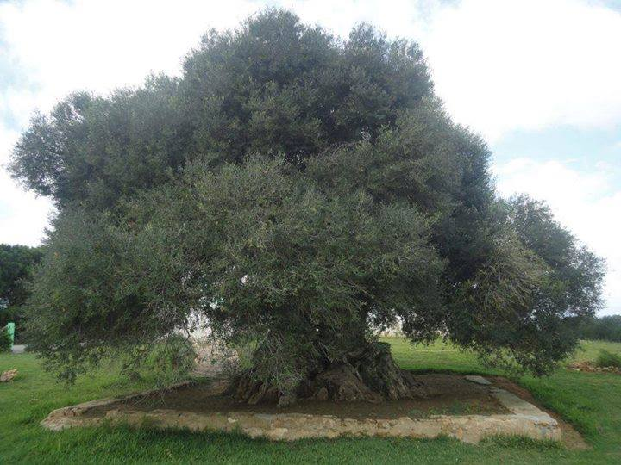
Post-Harvest and Market Access Activity
Main Message
There exists great opportunity for expanding the olive sector and use it as a vehicle for creating income, business and livelihood opportunities. A number of issues will however need to be tackled and it will take effort, initiative and cooperation from all stakeholders in and around the value chain to succeed in addressing the constraints and taking advantage of the opportunities offered (Knowledge gained from the PHMA study will feed into an innovation platform process IP).

