Slide 1



Workshop:
‘Innovation Platforms in “Dryland Systems’
15 -17 September 2014
Integrated research for development
(IRA experience, Tunisia)
Abdelaadhim M. , Fetoui M., Licheheb N., Ouessar M., Sghaier M.

Slide 2
Outline
Integrated research for development, an overview
Mechanisms to support multi-stakeholder interactions
Achievement through multi-stakeholder interactions
Multi-stakeholder interactions in practice
Constraints & opportunities
Draw lessons
Best bet technologies
Illustrations

Slide 3
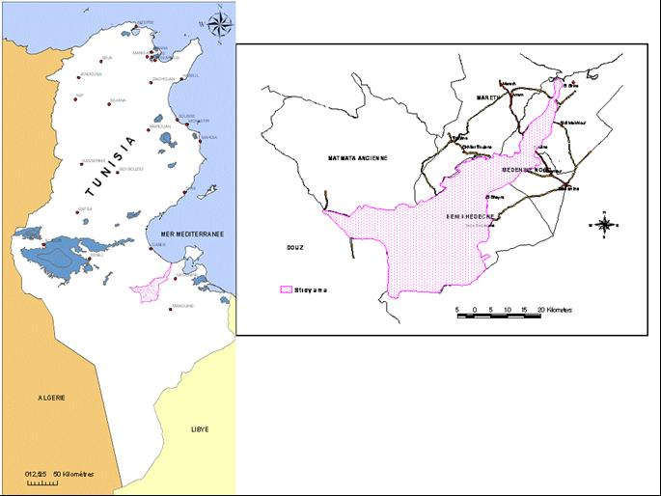
GENERAL OVERVIEW ON OUM ZESSAR WATERSHED
LACALISATION: Southern Tunisia
3 zones: BH, MN and SM

Slide 4
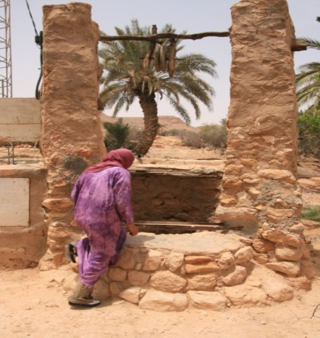
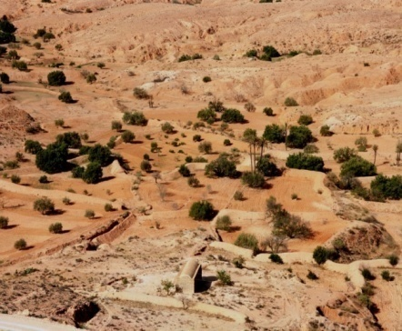
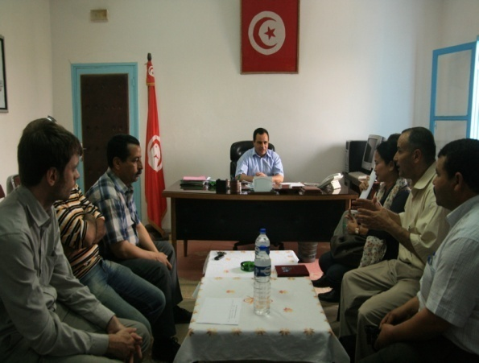

GENERAL OVERVIEW ON OUM ZESSAR WATERSHED
Oum Zessar key biophysical and socio-economic characteristics
    degraded drylands;
    low rainfall; water scarce;
    rapid population growth and urbanization
    communal and private agrarian system;
    expansion of irrigated agriculture (olive trees
    and cereals)
Water availability is therefore, a major constraint for pastoral, and domestic activities.
High diversity of stakeholders involved in Oum Zessar Watershed development and livelihood improvement
Relevance for the IP process

Slide 5
Organisation of Arid Zone Institute
05 Laboratoires de Recherche
Un Secrétariat Général chargé des affaires administratives et financières
Un Service
de Formation
Une Unité de Valorisation
des Acquis de la
Recherche
Une Unité
d’Information
et de Documentation

Slide 6
منهجية التطوير التكنولوجي لأفكار المشاريع
باعثون جدد
مخابر البحث
Laboratories
Research results and scientific findings
New promoters (private, external initiative
أفكار مشاريع
القيام بالبحوث العلمية
نتائج البحوث القابلة للتثمين
لجنة التسيير
فضاء تثمين نتائج البحوث
Selected Projects
Evaluation & selection
إختيار المشاريع
إنتقاء أفكار المشاريع
إحتضان و إيواء المشاريع
محضنة المؤسسات
فضاء التطوير التكنولوجي
Incubators
إعداد مخطط الأعمال
إعداد دراسة السوق
إعداد الدراسة المالية
تأطير الباعثين
إجراء علاقات مع المؤسسات المالية
التطوير التكنولوجي للأفكار
التأطيرالخاص
الدعم اللوجستي
مراقبة الجودة
تحاليل النتائج
Technologies adaptation and development
الفضاء الإقتصادي
تركيز المؤسسة
الإنطلاق بالإنتاج
Implementation of the project in the economic area

Slide 7
Multidisciplinairity
Partenerrship
Participation
integration
Multi spatial
Synegies & buliding on existing and previous findings
Basic principles of the framework approach adopted

Slide 8
Integration issues
Forest & rangeland
Water resource
Water and soil conservation
Agriculture production
Economic tools and incentive measures
Thematic dimensions
national
Inter-thematic
Inter-territories
inter-scale
  Temporal and spatial
Inter-actors, stakeholders and partners
Inter-economic sectors
.....
regional
Spatial dimensions
local

Slide 9
Synergies among past and ongoing projects
- Study site
- Participatory approaches
- Survey and databases
- Scenario building
- Biophysical modelling
- Socio-economic modeling
DESIRE
DESURVEY
AFROMAISON
LADA
ACCCA
LUPIS
PGRN
DNSE
CC/GIZ
WLI
CRP11

Slide 10
Needs for synergies
Donors (EU, WB, BAD, etc.) requests and encourages synergies between projects and teams
Synergies are an obligation and finality at the same time in Tunisian case :
  Integration of approaches
  Complementarities between activities
  Save time
  Save money
  Reduce overlap
  Avoid stakeholders fatigue (multi stakeholders workshops)
  Efficiency and value added

Slide 11
Mechanisms to support multi-stakeholder interactions
Consolidation of the partnership with local stakeholders (CRDA, GDA and NGOs)
The renovation of the partnership convention
Synergy within European projects
Enhance capacity and skills of the Tunisia team (many training courses, workshops have been established concerning a variety of subjects)
Call for external interventions ( facilitators, organization etc.)
Continuity and engagement to fellow up
Paying attention to details (Workshops time and location, representatively and effectiveness of stakeholders,

Slide 12
Achievement through multi-stakeholder interactions
Findings from past experiences
  Providing opportunity for stakeholders to participate in an interactive policy dialogue
  Ex-post and ex-ante policies/strategies impact assessment,
  Sharing lessons learned from experiences and improve approaches and tools;
  Watershed of Oum zessar : Elaboration of an operational integrated management plan ( OIMP) for Oum Zessar watershed
    Up-scaling of OIMP to regional and national level
  Meet different projects requirements
  Skills and capacities enhancement (share materials & tools)
  Joint learning process
  Increase social awareness
  Enhance involvement and partnership;
  Knowledge sharing
  Up taking of technologies, approaches and tools for development

Slide 13
Ongoing experience
  Identifying key commodities for livelihoods
  Strengthening farm income
  Reviving and renewing our stakeholders networks
  Be an example to fellow by an other national site, organizations, NGOs etc. for the same or for another issues
  Skills and capacities enhancement

Slide 14
Process and main findings of the implementation of Partnership framework in the case study of Tunisia : Main phases

Slide 15
Key administrations:
Main stakeholders
CRDA (regional commissary of agricultural development) :
Local administration of agricultural development of Beni Khedache
OEP (Office of livestock and pasture);
ODS (Office of development of the South;
CBOs (Communities basic organizations):
SMSA (Mutual agricultural BK services company)
GDA (Grouping of agricultural development Dhahar Rangeland)
UTAP (Tunisian union of agriculture and fishing);
NGOs
AJZ (Association of young of Zammour),
ASPAB (Boughrara),
Association of Yanabiï (Women ONGs)
Researchers
Farmers (Men, Women, Young)
D. Agricultural development & statistics
D. Water resources,
D. Forest and rangeland
Other Local NGOs
ICARDA
IRA (Arid Zones Institute)(Multidisciplinary team, 15 researchers)
Olive Institute (IO)
…
Laboratory of Eromolgy
Laboratory of socio economy
Labo of Rangeland and ecology
Labo of animal sciences
Labo of Agronomy
Breeders
Olive trees producers
Mixed farming system
National administrations (IRESA, General Directions of Production, etc.)
Irrigators
National agencies of promoting agricultural investment (APIA, API)
Banks (Credits, subsidies, BNA, SB, etc.)
Division of finance and social organization
Division of Water and soil conservation,
GDA Bhayra
Collective land Management Consult
UNF (Women union organization)
UTICA (Industrial and traders union)
ADESM (Association of development and strategic studies of Medenine);

Slide 16
Agreement
Governance of the agreement : Steering committee
Common commitment to make use of the AFM framework to produce IPNRM plan
Adaptation and validation of AFM framework (phases, etc.)
Phase 0 : design & agreement

Slide 17
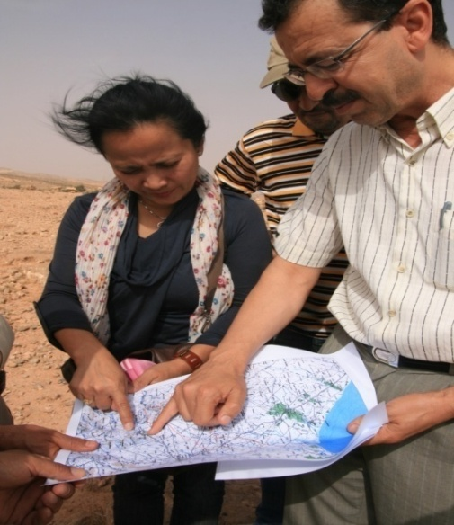
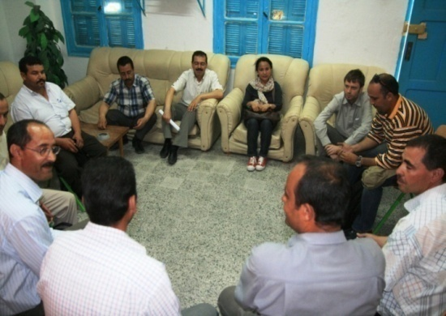
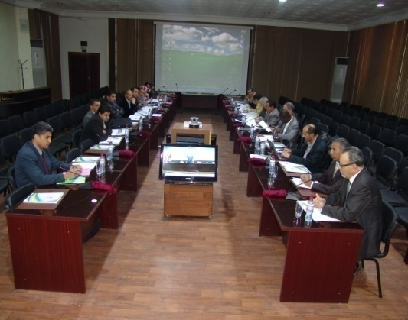
Preliminary field investigations, WP2
Organization of a SW June 2011
Elaboration of the “Rapid Assessment report, IRA-OSS-ICRAF,
Identification of main scénarios (WP 6)
Phase 1: Situation assessment & scenario’s

Slide 18
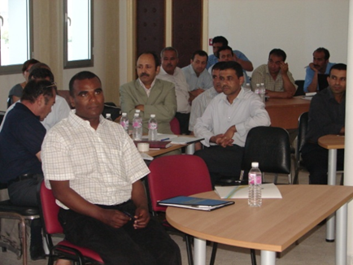
5 thematic working groups (GTT)
3 territorial working groups
Phase 2 : Option assessment & design
What options have been considered /how?
Identification of actions (INRM, management & local Development
40 action sheets

Slide 19
Elaboration of PAIP BVOZ
Phase 3 : integration of options & strategies

Slide 20
Scenarios assessment in collaboration with PIK (WP6) ;
Financial and economic assessment
(Economic Instruments) in collaboration with INR (WP4) ;
Ecosystem services assessment (ESS mapping and vulnerability) in collaboration with WPs: 1, 3 and 6 ;
Assessment of water balance (WEAP) in collaboration with IWMI (WP3) ;
Phase 4 : Testing strategy

Slide 21
Communication strategy to support local actors to uptake the INRM plan decision for funding & for its integration to the national WSC and INRM strategies
Extrapolation of the approach to other watershed in the district and in a similar contexts
Steering commitee for validation of PAIP BVOZ (3 october)
Phase 5 : Implementation procedure)

Slide 22
Main steps of AFROMAISON framework adaptation and of elaboration of integrated management plan
First Muti-stakeholders workshops14-16 December 2011
First Steering committee with Champion December 16, 2011
Scenario elaboration and second stakeholders workshop February 16, 2012 (WP6)
Second steering committee meeting January 6, 2011
AFROMAISON project meeting 5-11 March, 2012
Outcome : Charing information with AFRMAISON partners (WP, coordination, African team) & Validation of chronogram of activities
Outcome Identification of scenarios on INRM
Outcome : Validation chronogram and responsibility
Outcome : Validation of the methodological framework, approach and action plan

Slide 23
Main steps of AFROMAISON framework adaptation and of elaboration of integrated management plan
Third steering committee meeting April 4, 2011
Third Muti-stakeholders workshops April 17 2012
Fourth Muti-stakeholders workshops Mai 9 2012
Fifth Muti-stakeholders workshops Mai 17 2012
Sixth Muti-stakeholders workshops Mai 30, 2012
Outcome : Integration holistic vision, additional identified actions, validation, next steps
Outcome : 3 Territorial working groups between Stakeholders and researchers started identification actions
Outcome : 5 Thematic working groups between Stakeholders and researchers started identification actions
Outcome : Reporting to Steering committee on the regional workshop Ethiopia) & Validation of chronogram of activities

Slide 24
Main steps of AFROMAISON framework adaptation and of elaboration of integrated management plan
Outcome : application of WP3 (scoring of ESS), WP4 (Application of DS tools, WP6 (Rescoring of indicators) and WP7 tools (WAG)
Fourth steering committee meeting and stakeholders workshop July 17, 2012
Seventieth Muti-stakeholders workshops September 6 2012
Working groups (action, summary, etc) June- August 2012
Outcome : Woking groups activities, continuation of data collection, integration, interaction with partners
Outcome : Information, communication, WPs interaction, Integration, Worksheet actions, validation, next steps , adaptation etc.

Slide 25
MULTI STAKEHOLDERS WORKSHOP BENI KHEDACHE SITE (MEDENINE GOUVERNORATE)
December 14th, 2013, Beni Khedache, Tunisia
Composition of the participants by Stakeholder type and gender
Stakeholders | Man | Women | Total
NGOs | 7 | 6 | 13
Researchers (IRA) Medenine | 7 | 1 | 8
Researchers (Regional centre of agricultural research) Sidi Bouzid | 2 | 0 | 2
International researchers (ICARDA) | 2 | 0 | 2
Regional department of agricultural development CRDA Medenine | 8 | 1 | 9
Regional department of agricultural development CRDA Sidi Bouzid | 1 | 1 | 2
Development office of the south | 0 | 1 | 1
CBOs (Agricultural and development grouping) | 1 | 0 | 1
Regional union of agriculture | 3 | 0 | 3
Farmers | 2 | 0 | 2
Total | 33 | 10 | 43

Slide 26
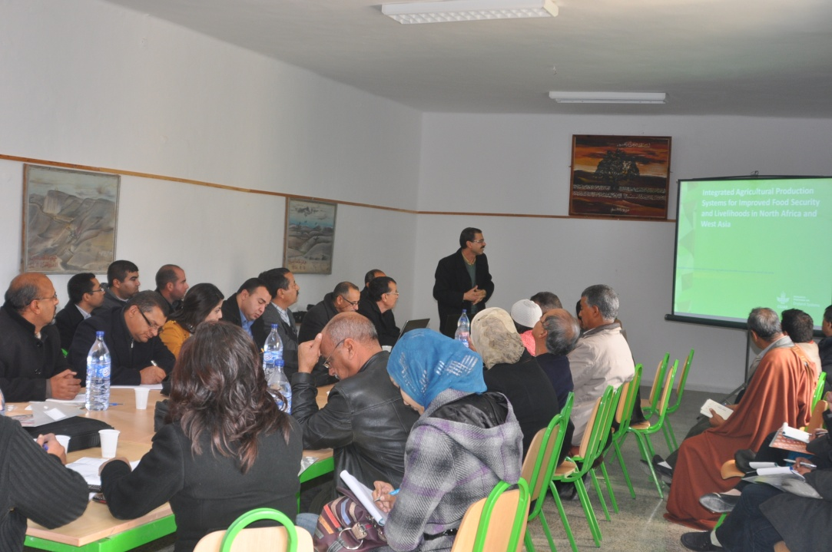
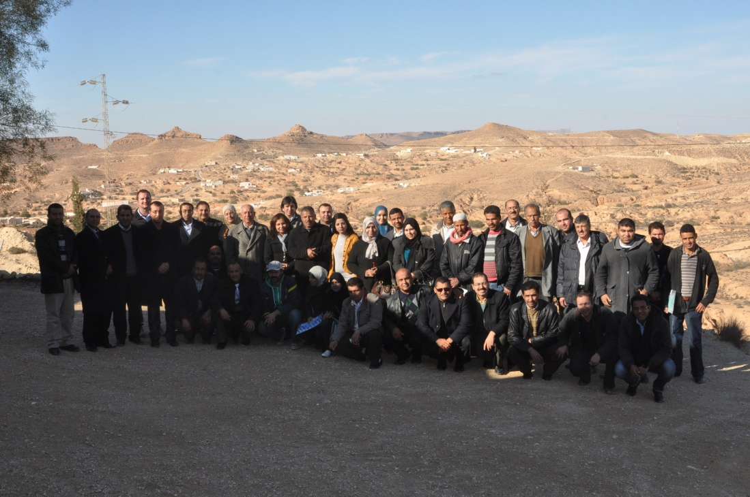
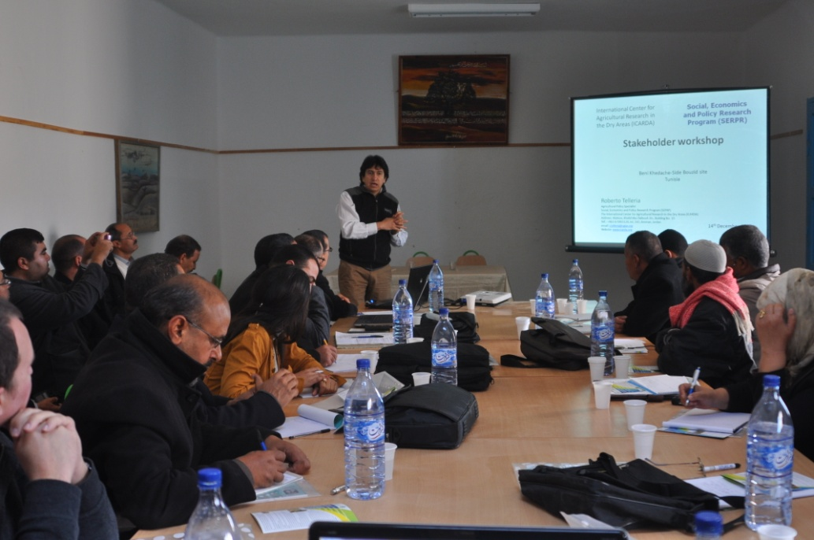
Main strategic products:
Olive oil, figs, AMP, Sheep meat ,

Slide 27
List of participants, 1st learning alliance (Beni Khedeche) June 3-4 2014
15 farmers producing different types of crops (at least 5-7 of these should be women and preferably not wives of the male farmers);
3 representatives from NGO’s working in the area of the site on social issues, women issues, or agricultural development;
3 representatives from the post-farm gate value chain (processors, input suppliers, etc.);
1 representative from a local department of the Ministry of Agriculture (should be someone who works in the field and not an administrator or director);
2 representatives from public and private extension services;
1 representative from a microcredit institution (lending officer if possible, and not a director or administrator);
2 representatives – 1 each from the local community who work in the education and health sectors (nurses, teachers, etc. and not directors or administrators – they can be retired);
5 youth from the community (between the ages of 18 and 25) and from which at least 2 should be female;
3 members from local agricultural cooperatives (if they exist);
1-2 representative from any government agencies or programmes that support social or agricultural development.

Slide 28
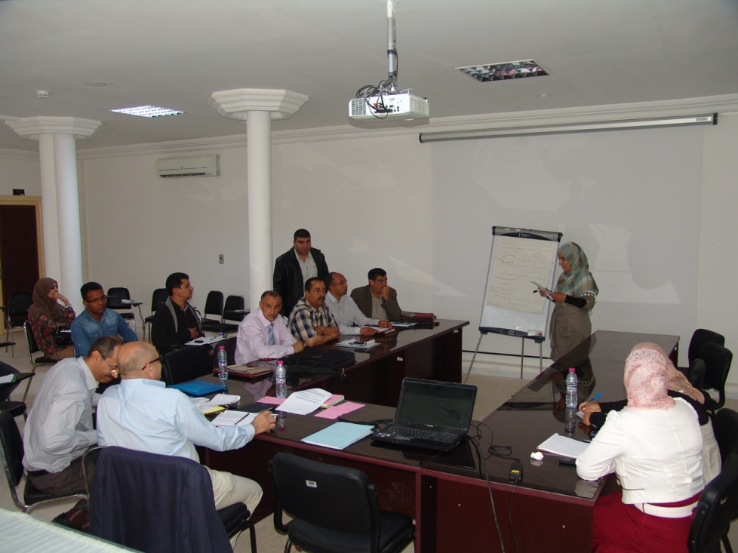
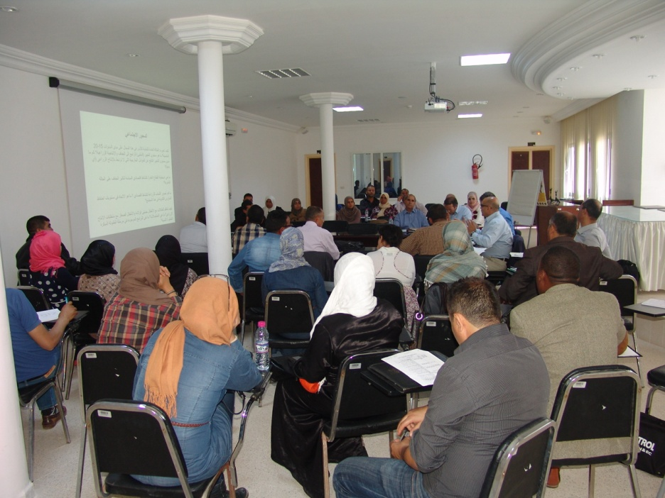
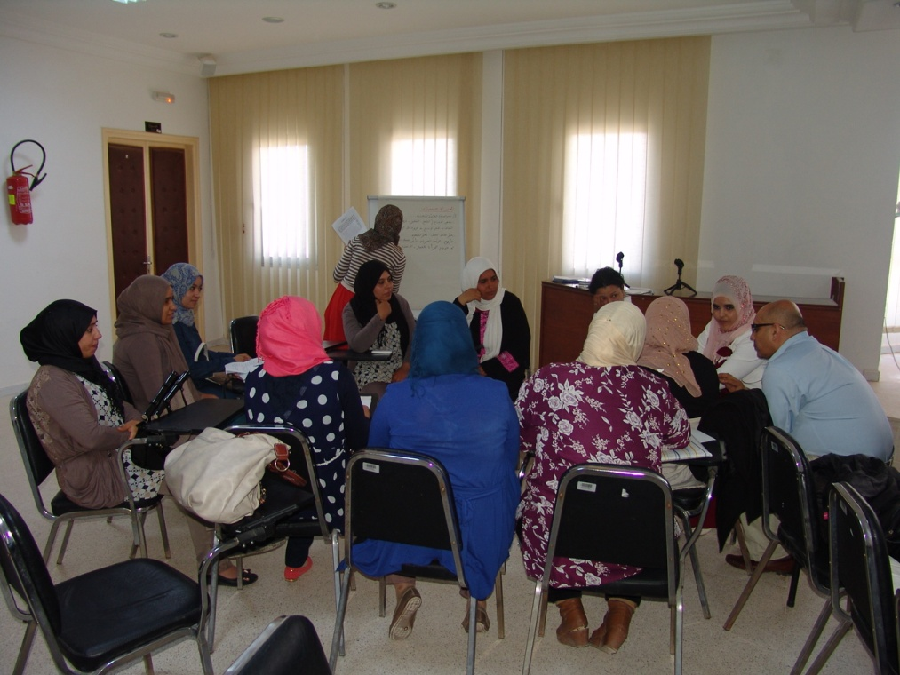
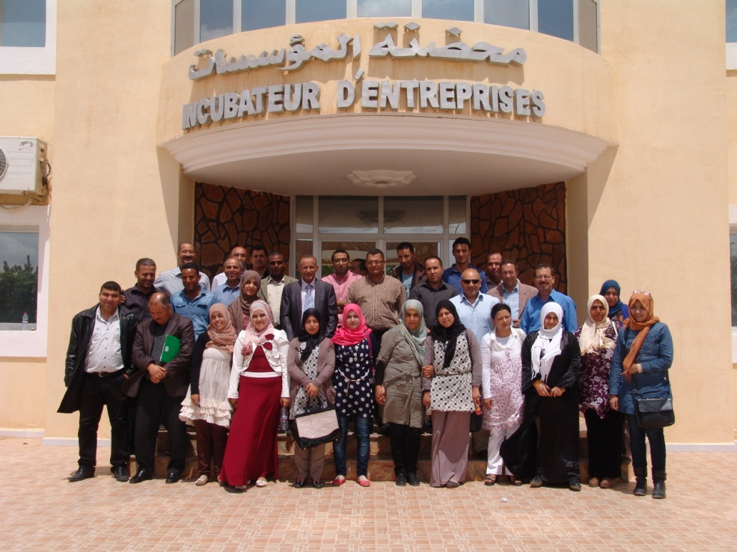
1st Learning Alliance (Beni Khedeche) June 3-4 2014

Slide 29
Planned : Second learning alliance BK, 29 sept. – 3 October 2014
Expected outcomes:
Agreement on IP to be implemented
Action plan 2014-2016
Planning

Slide 30
Best bet technologies
Water harvesting technologies to enhance olive productivity
Supplemental irrigation to stabilize and increase of productivity of olive trees
Olive Oil Producers Grouping (value chain, clustering, etc.)
Social organization (CBOs, SMSA, GDA)

Slide 31
Constraints & opportunities
Different stakeholders have different information needs because they make different types of decisions.
The information communicated to stakeholders must address their needs and concerns.
Decision makers use research findings to make decisions regarding policies, resource allocation, and strategic planning.

Slide 32
Researchers provide scientific findings & information to empower stakeholders in making evidence-based decisions.
Yet, research is frequently not available, accessible, relevant, or useful, which limits its applicability for improving rural and agricultural systems.
Developing an information dissemination strategy is likely to increase stakeholders’ research uptake.

Slide 33
Community engagement and collaboration challenges in terms of
Relationships between stakeholders in terms of trust, respect, information sharing, and improved negotiation;
Communications, demonstrated commitment, and information sharing;
Accountability of all community members involved

Slide 34
In addition, information disseminated to stakeholders should emphasize key findings for action and include recommendations that are useful.
The need for developing a communication strategy:
Objectives
which stakeholders to target for information dissemination
appropriate channels of communication
The need to adapt research findings for each stakeholder group in a user-friendly manner,
Decision makers generally prefer key messages that are concise and actionable.

Slide 35
Thank you

