Slide 1
ICRISAT 2013 activities
Dryland Systems CRP
P.S. Traore, M. Adam, H.A. Ajeigbe, F.M. Akinseye, Z. Birhanu, B. Djaby, G. Falconnier, D. Fatondji, M. Gandah, S. Jarial, M. Ollenburger, P. Savadogo, M.M. Sissoko, S.S. Traore, T. van Mourik
Africa RISING West Africa Review and Planning Meeting, Bamako, Mali, 3-4 February 2014

Slide 2


main activity clusters, Aug. 2013
target DEVELOPMENT DOMAINS & SITES
administer BASELINE HOUSEHOLD SURVEYS
organize STAKEHOLDER CONSULTATIONS
map RESOURCE FLOWS
develop PARTICIPATORY EVALUATION FRAMEWORKS
build FARM TYPOLOGIES
conduct FULL BIOMASS ASSESSMENTS
test DUAL-PURPOSE (INTER)-CROPS
establish R4D / INNOVATION PLATFORMS
systematize YIELD VARIABILITY MAPPING
test WATER HARVESTING SOLUTIONS
test INTEGRATED SOIL FERTILITY MANAGEMENT options
produce GENDER-SMART MEDIA TOOLS
model ENTRY POINTS, SCENARIOS AND TRADEOFFS
deploy TRAINING TOOLS & CURRICULA
Notes:
Set of 15 ‘activities’ identified during 1st semester 2013
5 clusters:
Blue: Targeting, baselines, typologies
Purple: Biomass assessments, yield mapping, scenarios & tradeoffs modeling
Green: Stakeholder concertations, participatory approaches, platforms
Red: Tests of intensification options
Orange: Gender smart media, training tools & capacity building
- Presented during the Kumasi regional planning meeting, August 2013
- distributed in the regional work plan by IDO and by action transect
- FBA: crop-livestock integration as an entry point for intensification

Slide 3
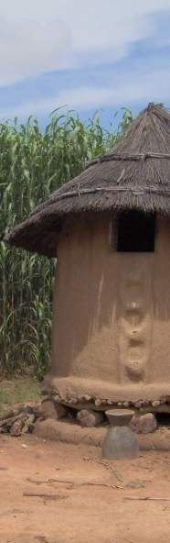
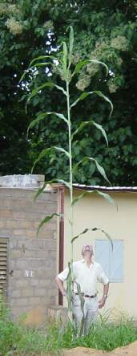
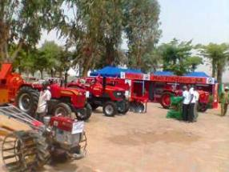
reporting on activities
1. Targeting, baselines, typologies
2. Biomass assessments, yield mapping, scenarios & tradeoffs modeling
3. Stakeholder consultations, participatory approaches, platforms
4. Tests of intensification options
5. Gender smart media, training tools & capacity building
6. Other activities, leveraging & planning for 2014
Notes:
Pictures, from left to right:
Mali-tracteurs exposition booth at the International Agriculture Fair, Bamako, Mali, 2012
6-m tall Guinea sorghum plant with Dr. Gerrit Hoogenboom (IER-Sotuba, Bamako, Mali, 2002)
Minianka granary in front of high biomass sorghum canopies (Sukumba, Koningue commune, Koutiala district, Sikasso region, Mali)

Slide 4
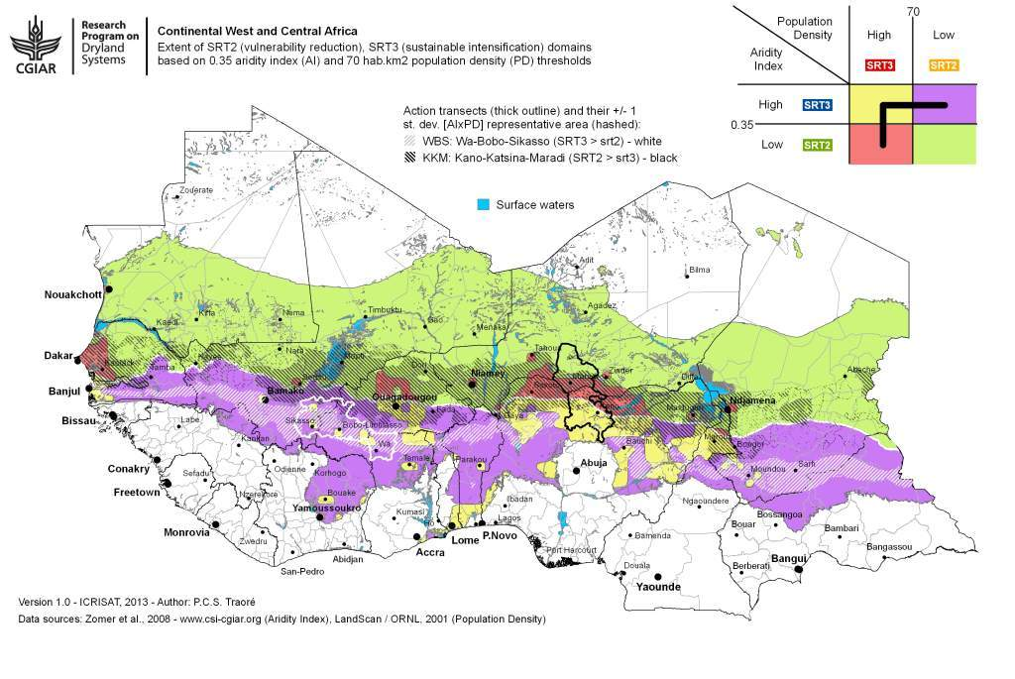
targeting

Slide 5
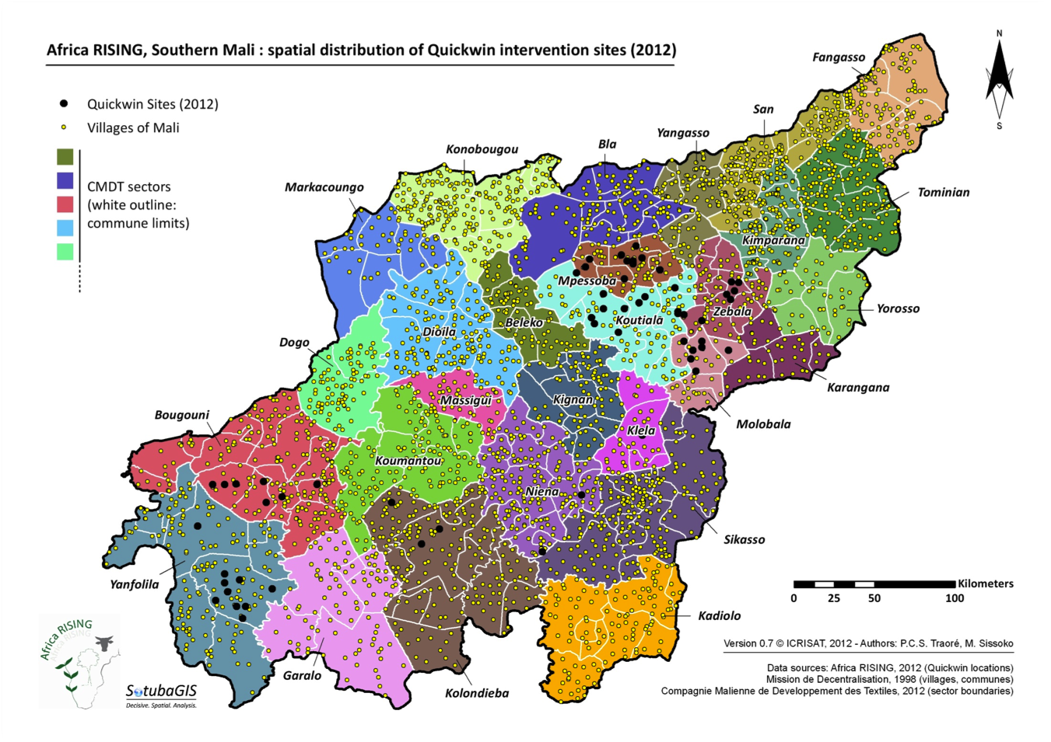
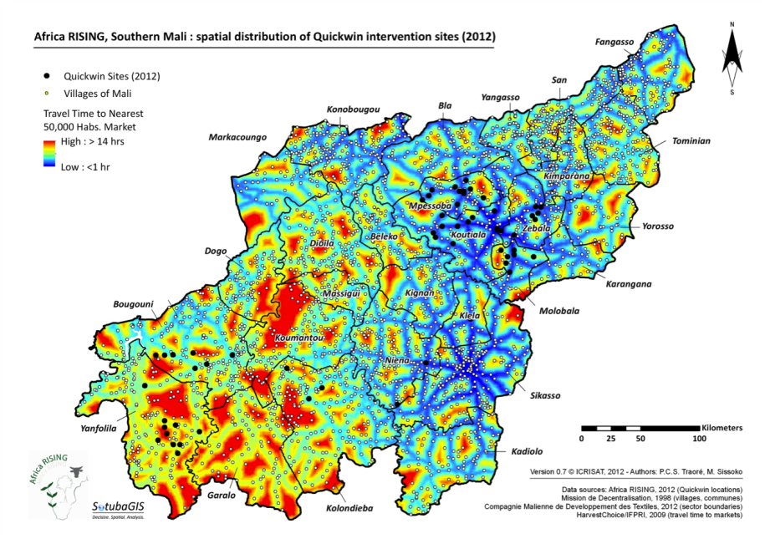
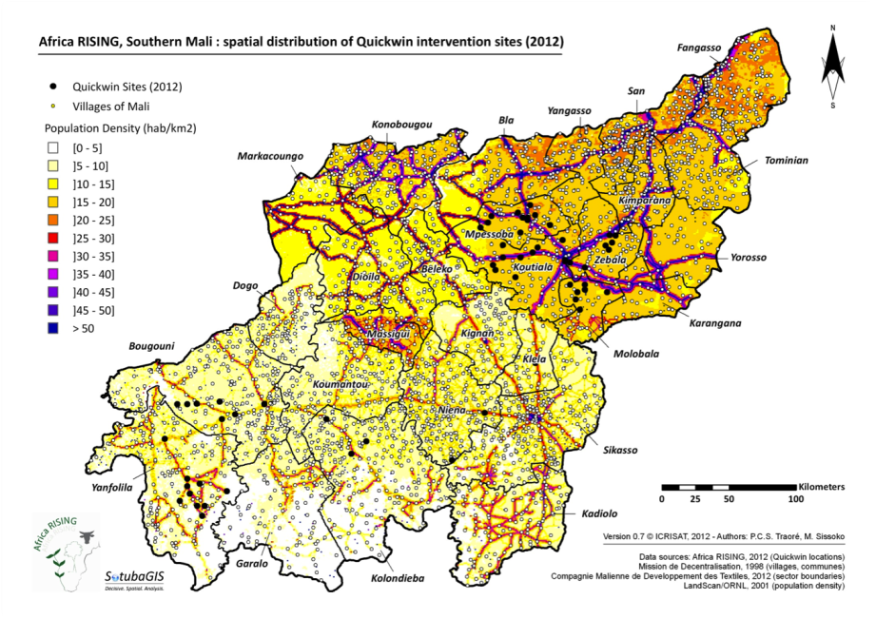
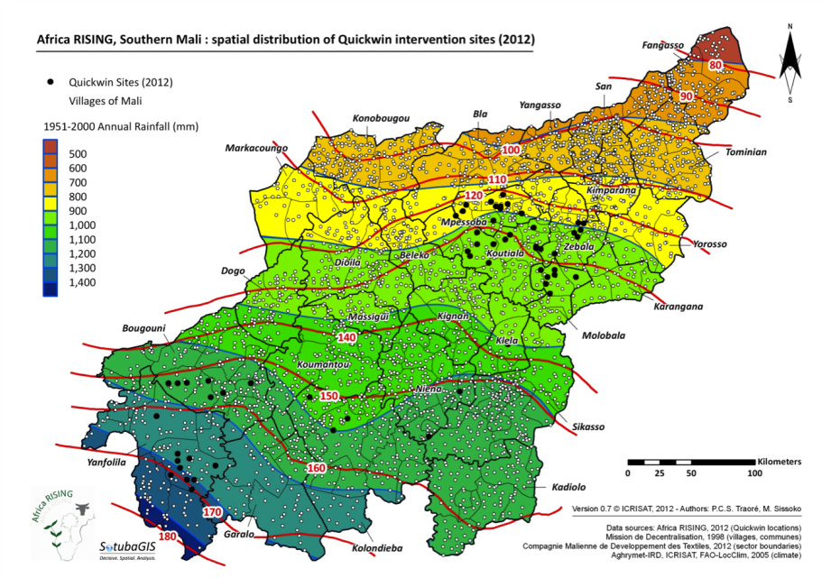
targeting
# farms
area planted
# OM
# NPK
# urea
# nat P
# herbicide
yield / prod.
livestock
equipment
prod. costs
X
cotton
maize
millet
sorghum
rice
peanut
cowpea
roselle
sesame
soyabean
forages
fonio
Notes:
Target development domains and sites
Site selection procedures that reflect main drivers of change
Scalable procedures using best available data
Development domains identified for districts in Mali (Africa RISING)
Useful to prepare recommendation domains, not so much for site selection

Slide 6
baselines – household surveys
Variable | Kani (Mali) - intervention |  | Farakoro (Mali) - control
 | Mean | std. Dev. | Mean | std. Dev.
Household Characteristics
Household size | 15.64 | 7.09 | 16.62 | 11.03
Field Size (ha) | 16.35 | 11.27 | 13.53 | 9.64
Herd Size(TLU) | 14.36 | 23.46 | 9.89 | 11.09
Age of Household Head | 54.17 | 11.31 | 52.78 | 10.99
Male headed Households (%) | 100.00 | n/a | 100.00 | n/a
Household Head Alphab. (%) | 15.00 | n/a | 17.24 | n/a
Non Agricultural Income (XOF/Yr) | 190,669.00 | 252,690.00 | 155,003.40 | 299,698.60
Notes:
10 household surveys deployed in 10 communities (5 intervention, 5 control):
Ishiyawa (A) 106, Yakubawa (C) 56 – CDA/BUK
Kofa (A) 100, Anadariya (C) 100 – CDA/BUK
Gourjia (A), Milli (C) – INRAN
Yagtuori (A) 40, Gbelinkaa (C) 30 – SARI
Kani (A) 58/139, Farakoro (C) 58/145 – IER
Data in for all 10 sites, at various levels of curating / analysis
Additionally, 2 household surveys will be deployed in 2 communities (1 intervention, 1 control) in December 2013:
Mahon (A), Sayaga (C) – INERA

Slide 7
baselines – household surveys
Variable | Kani (Mali) - intervention |  | Farakoro (Mali) - control
 | Mean | std. Dev. | Mean | std. Dev.
Farm Characteristics
Number of Family Workers | 9.88 | 4.65 | 12.70 | 8.39
Farm Net Returns (XOF/Yr) | 1,089,040.00 | 1,031,322.00 | 1,102,830.00 | 1,601,646.00
Organic fertilizer input (Kg) | 279.98 | 686.71 | 148.55 | 144.52
Chemical fertilizer input (Kg) | 1,653.62 | 2,692.41 | 1,078.90 | 1,966.21
external Labor costs (XOF) | 18,047.43 | 39,886.80 | 9,278.88 | 21,554.92
Farm Inputs expenses (XOF) | 645,529.50 | 1,467,096.00 | 464,273.30 | 972,640.20
Proportion of collective plots | 91.88 | n/a | 93.24 | n/a
Proportion of individual plots | 6.88 | n/a | 6.08 | n/a
Proportion of non-owned plots | 1.25 | n/a | 0.68 | n/a
Households Purchase Seeds (%) | 65.52 | n/a | 94.74 | n/a

Slide 8
baselines – household surveys
Variable | Kani (Mali) - intervention |  | Farakoro (Mali) - control
 | Mean | std. Dev. | Mean | std. Dev.
Household Social resources
Household access to extension (%) | 56.9 | n/a | 48.28 | n/a
Households access to credit (%) | 44.83 | n/a | 21.41 | n/a
Households belong to coop (%) | 79.31 | n/a | 67.24 | n/a
Household receive remittance (%) | 25.86 | n/a | 20.69 | n/a
Market access and integration
Distance to crops inputs market | 11 | 7.95 | 5.49 | 5.03
Dist. to livestock inputs market | 23.53 | 15.12 | 7.32 | 6.40
Dist. to crops outputs market | 11.50 | 8.19 | 5.63 | 4.97
Dist. to livestock outputs market | 17.00 | 13.39 | 7.23 | 7.98
Proport. of crops sold (% of prod.) | 38.00 | 23.00 | 38.00 | 15.00

Slide 9
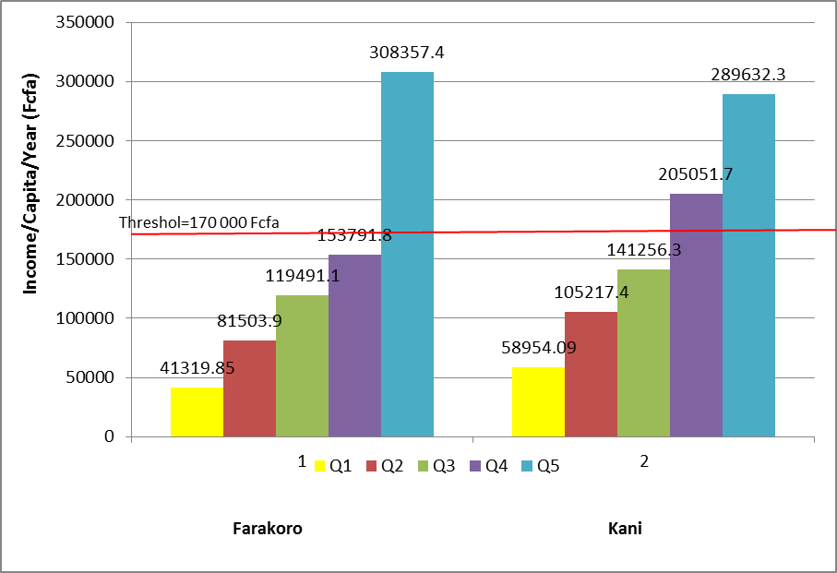
baselines – household surveys
Notes:
Poverty profile: Mean income per capita distribution between income quintiles for Farakoro and Kani.
Given a threshold of 170 000Fcfa/ capita, It appears that the proportion of poor is greater in farakoro that it is in Kani. In fact only the 5th quintile of income/capita is above the Threshold in in Farakoro whereas in Kani the 4 th and 5th quintile of income are both above the threshold. In all villages incidence of poverty is greater that 60% (4/5 of households surveyed are poor in Farakoro and in Kani 3/5 of households are)

Slide 10
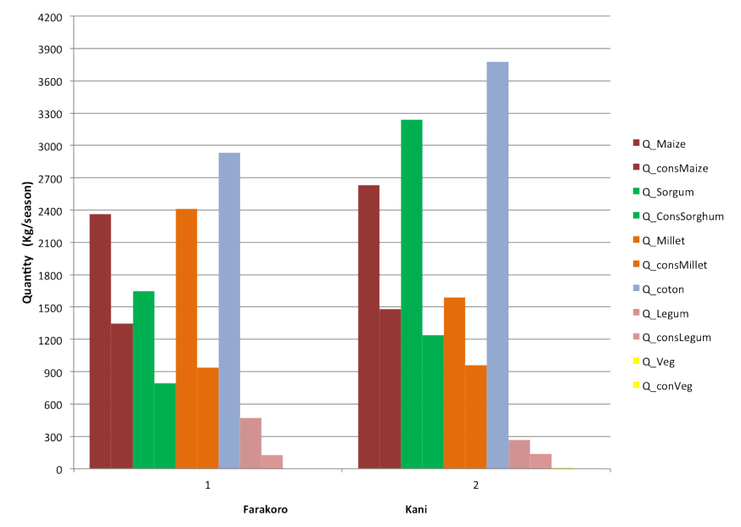
baselines – household surveys
Notes:
Food security profile: Mean Quantity of production and consumption for main crops in Farakoro and Kani per season .
For the two villages Maize is the most consumed crop. Production of vegetable is very marginal in the two villages for the population of households surveyed.
Data analyses and publications:
Forthcoming internal DSCRP report – outline currently being sketched out by Joachim and Manda
Potential publications to be generated before data is released in public domain in end 2014:
A.A. Ayantunde: first, identify research questions
A.A. Ayantunde: compare KKM and WBS transects based on the CRP Dryland hypothesis of different potential for intensification along the two transects
A.A. Ayantunde: results on external inputs use, household assets, crop-livestock integration can provide some guidance on the potential for intensification
Proposed next step: set up a task force for analysis and publication of HH survey results (I propose that A.A. Ayantunde leads that task force)

Slide 11
baselines – intensification options
Review of options and potential for intensification in West-African dryland smallholder farming (L. Woittiez)

Slide 12

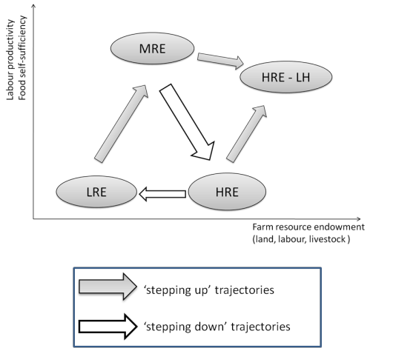
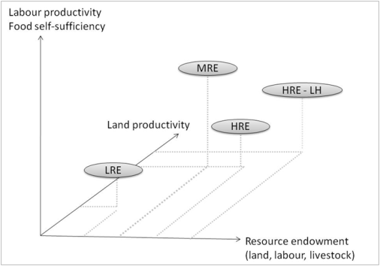
typologies – farm structures, trajectories
Notes:
Bottom-left figure: Conceptual representation of four farm types a three-dimensional space: resource endowment, land productivity, labour productivity and food self-sufficiency
Cropland > 5.8ha + TLU > 2.2 + draft tools > 2 => MRE
Actives > 9.5 persons => HRE
TLU > 21.4 => HRE-LH
Top-right figure: Overview of the possible farm trajectories
Experimental design : analysis of the monitoring of 30 farms in three villages of Koutiala region from 1994 to 2010 (IER ‘SEP’ dataset)
Cf Falconnier et al. (2013) : « Understanding farm trajectories for better targeting of agricultural technologies » to be submitted to Agricultural Systems journal.

Slide 13

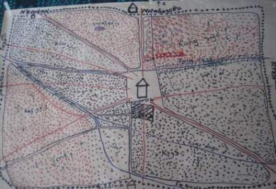
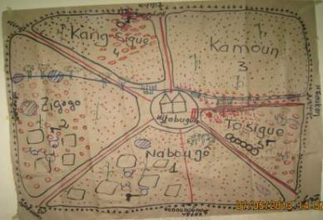
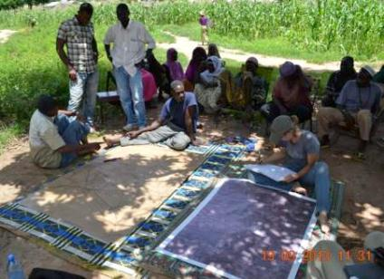
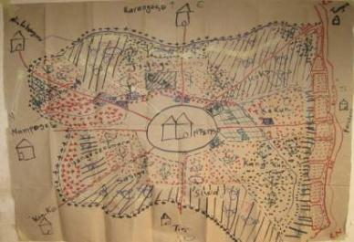
collective resource mapping – precursor to functional herd, NRM typologies
Nintabuguro
Nanposela
Sirakele,
Dieba, Sibirila
Mpereso
Notes:
Maps of collective resources, precursors of:
Functional typology (herd management)
Resource flow maps for different farm types
Both products will be established after detailed characterization of 36 farms in Nanposela, Nintabuguro, Mpereso (Jan. 2014)
Farm characterization combines biophysical assessments of cropland with socio-economic survey data
In progress in Sibirila, Dieba (Bougouni) and Sirakele (Koutiala)
Biomass assessment on non-crop areas will be combined with information regarding land use practices, including grazing itineraries and animal feeding practices to understand the contribution of non-cropped areas to farming system productivity and household livelihoods

Slide 14
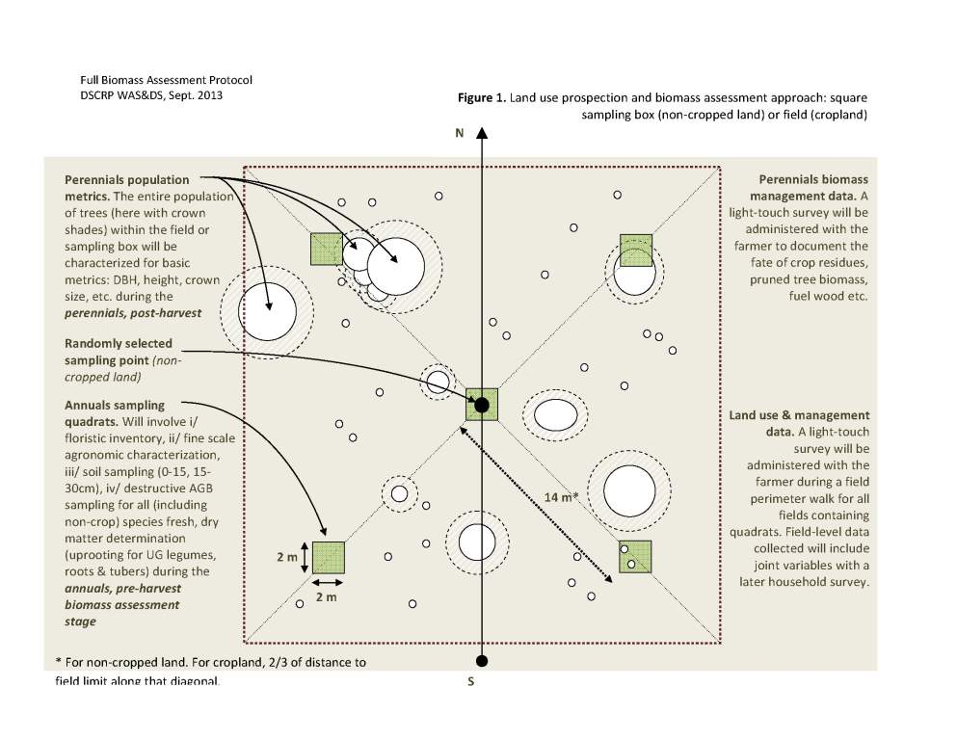
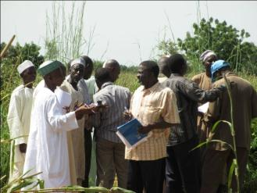
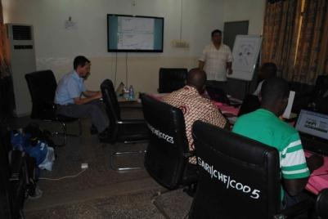
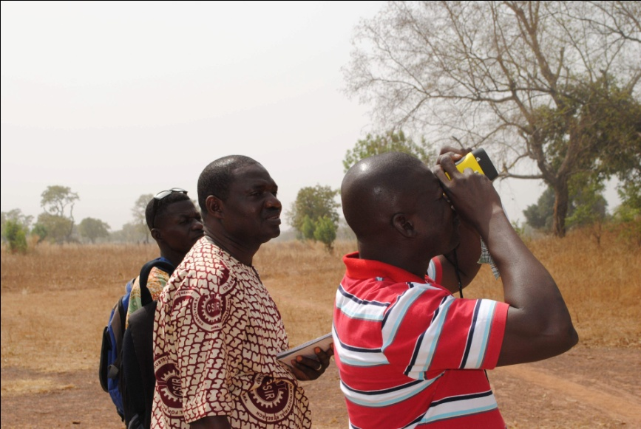

full biomass assessments
Notes:
7 annuals biomass assessments deployed in 7 communities (2 test, 5 intervention) :
Sukumba (AMEDD), Dimabi (SARI)
Gourjia (INRAN), Ishiyawa, Kofa (CDA/BUK), Yagtuori (SARI), Kani (AMEDD)
no 2013 biomass assessment in Mahon, Burkina Faso (late CRP approval + late site identification)
Protocol revised during 2013 to:
Increase sample size per species (now 7 land use types x 6 samples x 5 placelets) = 210 samples / site
Randomize sample distribution across households

Slide 15
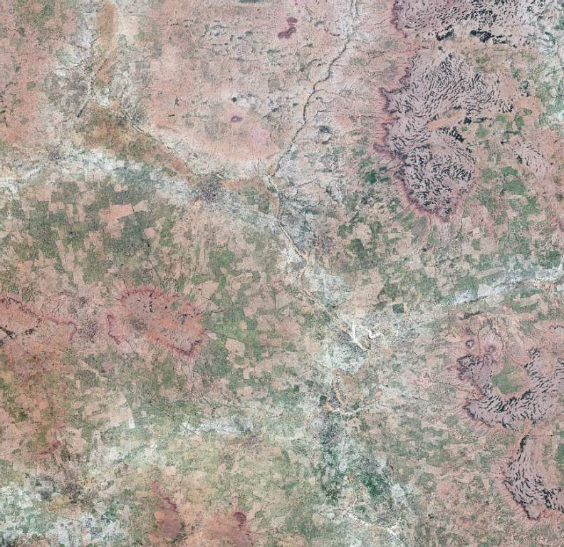
yield mapping
KKMs1
Banizoumbou
Kollo
Tillabery
Niger
28SEP13
© DigitalGlobe
WorldView2
8-band
50cm PAN
200cm MUL

Slide 16
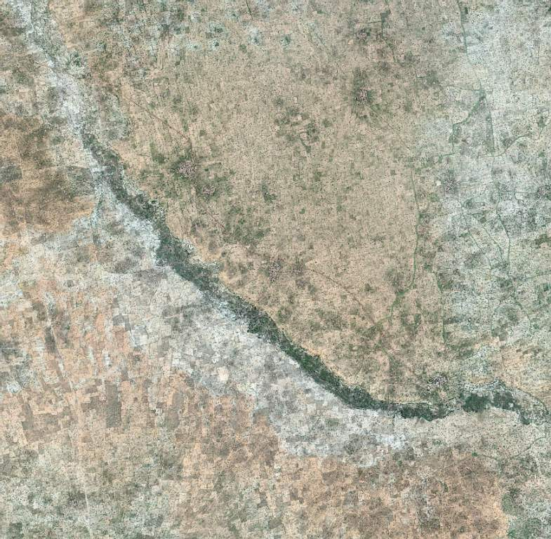
yield mapping
KKMa1
Gourjia
Aguie
Maradi
Niger
29SEP13
© DigitalGlobe
WorldView2
8-band
50cm PAN
200cm MUL

Slide 17
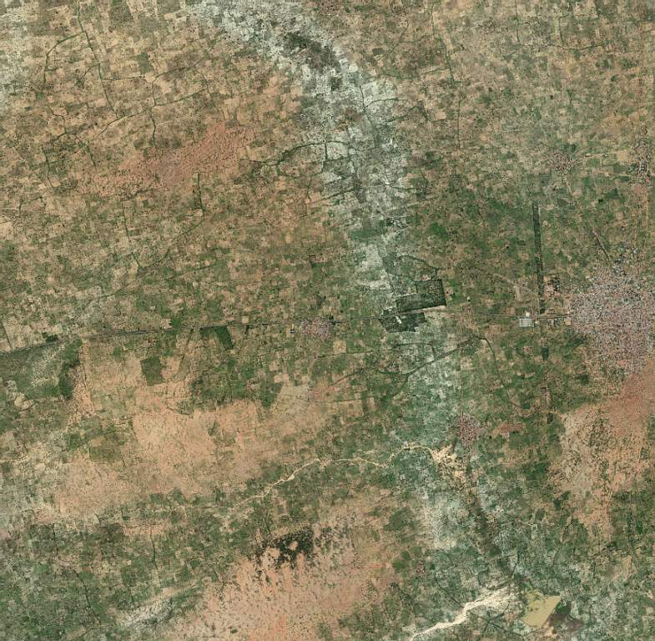
yield mapping
KKMa2
Ishiyawa
Z. Daura
Katsina
Nigeria
29SEP13
© DigitalGlobe
WorldView2
8-band
50cm PAN
200cm MUL

Slide 18
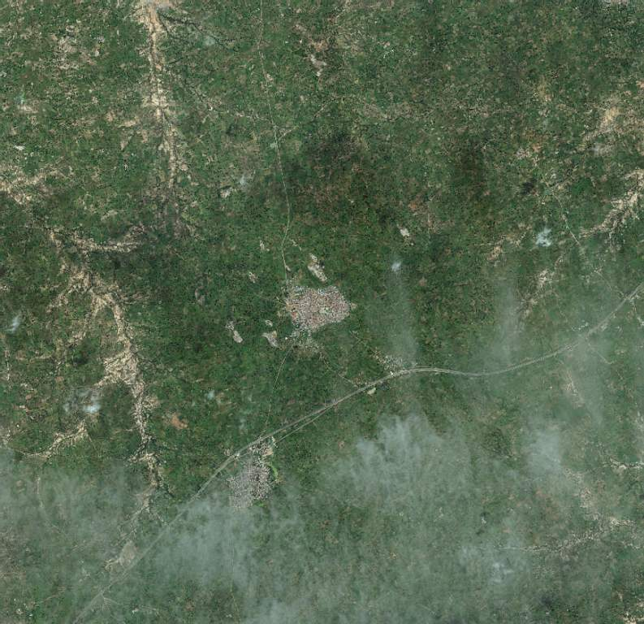
yield mapping
KKMa3
Kofa
Bebeji
Kano
Nigeria
29SEP13
© DigitalGlobe
WorldView2
8-band
50cm PAN
200cm MUL

Slide 19
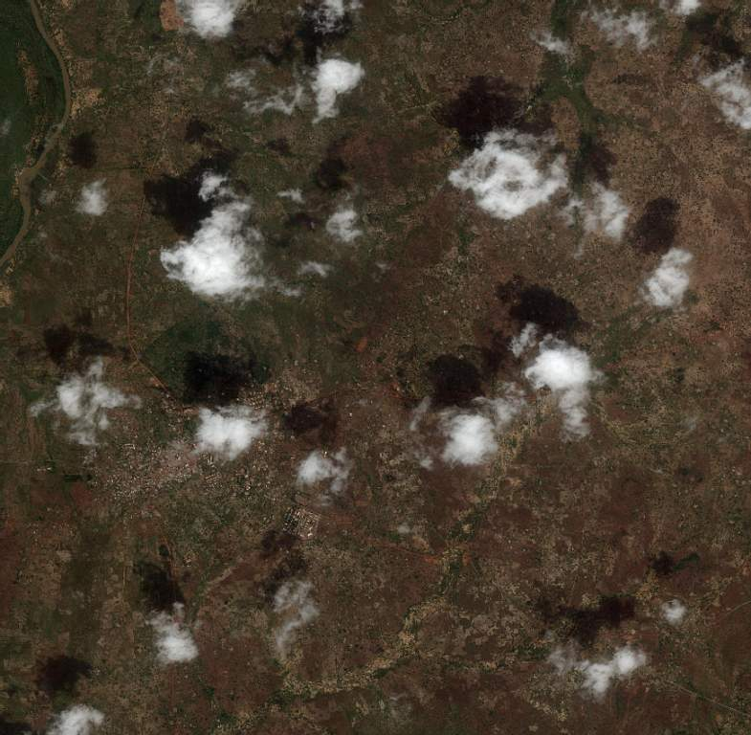
yield mapping
WBSa3
Yagtuori
Lawra
UWR
Ghana
17OCT13
© DigitalGlobe
WorldView2
8-band
50cm PAN
200cm MUL

Slide 20
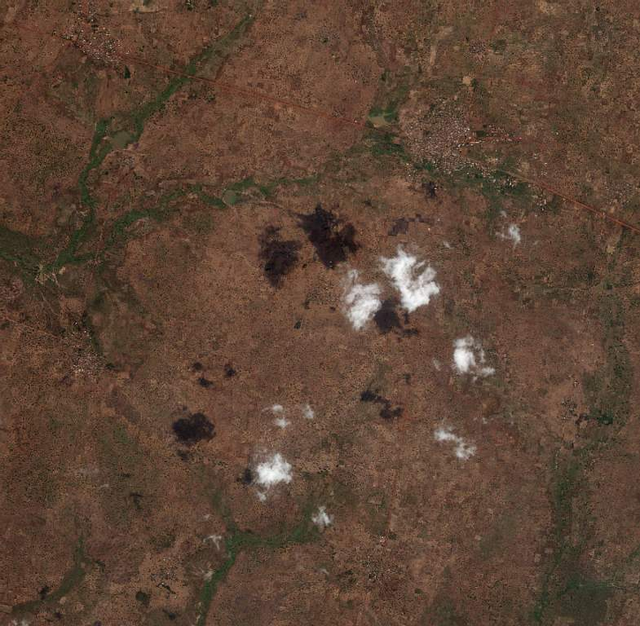
yield mapping
WBSs2
Dimabi
Tolon
NR
Ghana
25NOV12
9,081
proto-plots
extracted
(~91/km²)
© DigitalGlobe
WorldView2
8-band
50cm PAN
200cm MUL

Slide 21
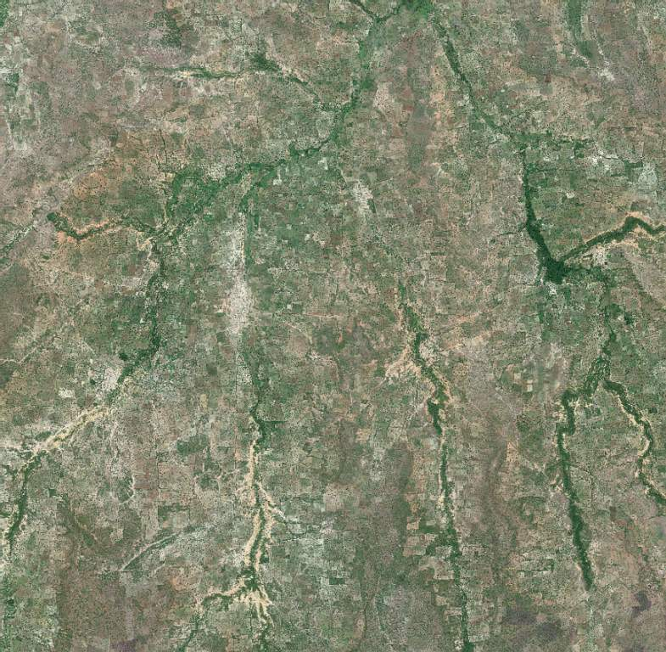
yield mapping
WBSt2
Nanposela
Koutiala
Sikasso
Mali
26OCT12
7,399
proto-plots extracted
(~38/km²)
© DigitalGlobe
WorldView2
8-band
50cm PAN
200cm MUL

Slide 22
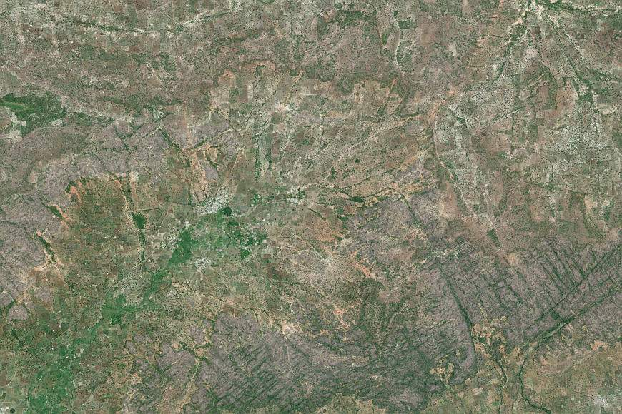
yield mapping
WBSt1
Sukumba
Koutiala
Sikasso
Mali
26OCT12
5,580
proto-plots extracted
(~38/km²)
© DigitalGlobe
WorldView2
8-band
50cm PAN
200cm MUL

Slide 23
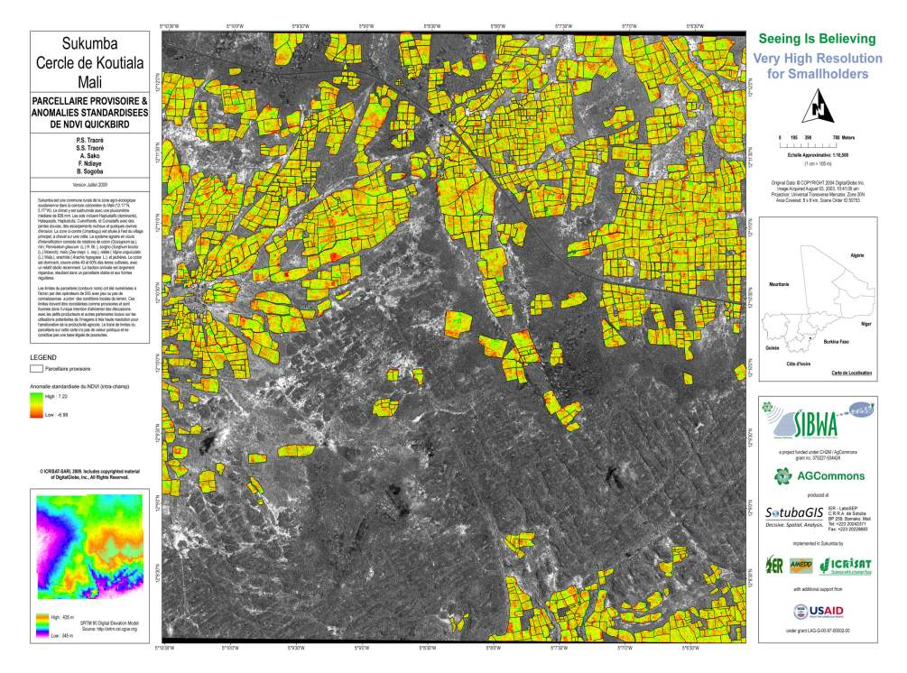
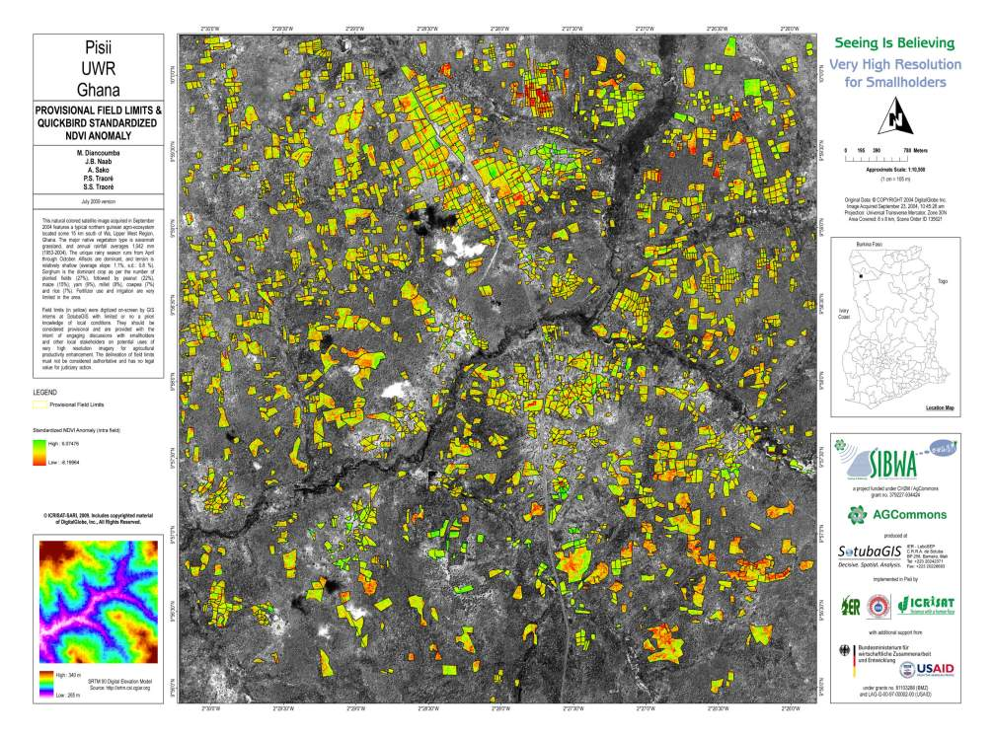
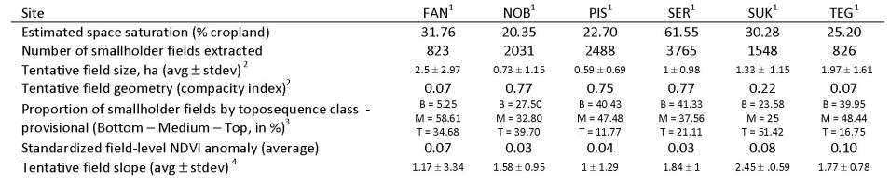
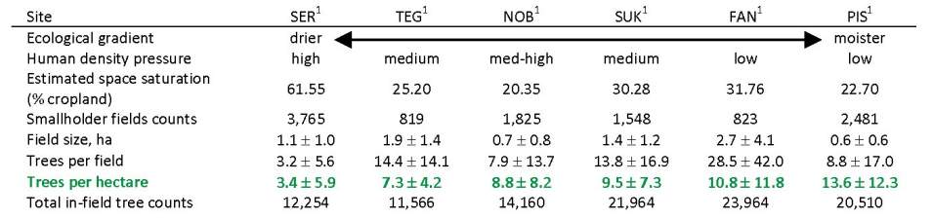
yield mapping
Notes:
Systematize yield variability mapping
Ghana, Upper West Region - High fragmentation of land tenure – still large area uncultivated (low population density, ca. 25 hab.km-2) – mixed cropping very largely dominant – little to no animal traction – irregular field geometries not amenable to mechanization unless farms coalesce – extensification still more attractive
Mali, Cotton Belt - Similar agro-ecology to previous (850mm rainfall) - regular field geometries more amenable to mechanization – animal traction everywhere – long history of intensification (cotton belt) – almost only sole crops in triennal rotations
Reference to CerLiveTrees
Linkage to Full Biomass Asssessments
Participatory research tool

Slide 24
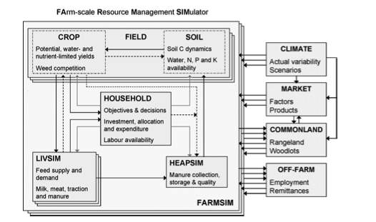
model entry points, scenarios, tradeoffs
Notes:
No results yet
The crop module of farmsim model (FIELD, cf figure) is under calibration for cotton, sorghum, maize, millet, groundnut, soybean and cowpea using data from N’Tarla long term experiment and McKinght/CRP DS trials results.
Scenarios will be established with farmers in 2014

Slide 25

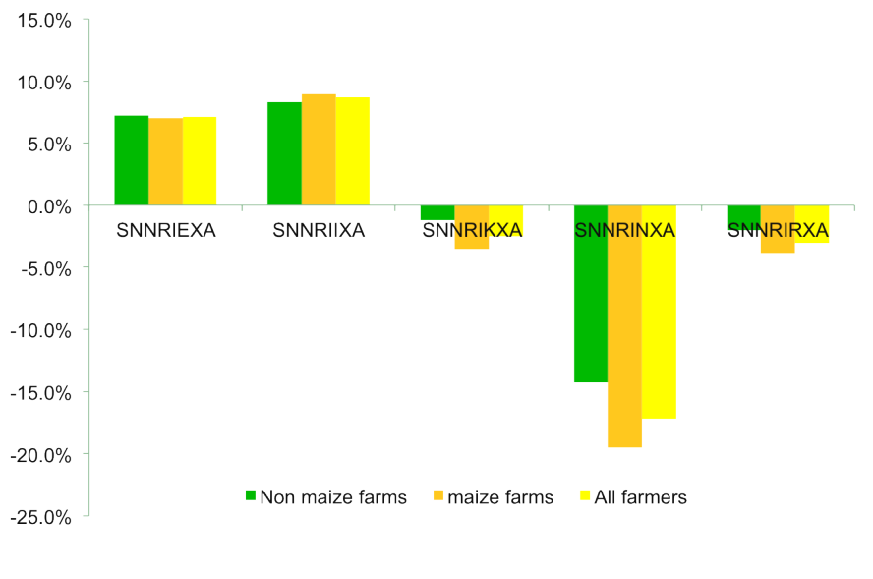
model entry points, scenarios, tradeoffs
Notes:
Millet yields: Large variability across models. Largest variability for DSSAT, smallest for SarraH. Negligible scenarios effect
Similar integrated assessment being conducted now for Koutiala (Mali), Navrongo (Ghana)
Will be scaled up to 9 other districts under proposed CCAFS-FS4 project

Slide 26


model entry points, scenarios, tradeoffs
yield
socio-economic
progress rate
impacts (2)
benefits
(3)
sensitivity
(1)
current
future
time

Slide 27




model entry points, scenarios, tradeoffs
yield
socio-economic
progress rate
impacts (2)
benefits
(3)
sensitivity
(1)
current
future
time

Slide 28
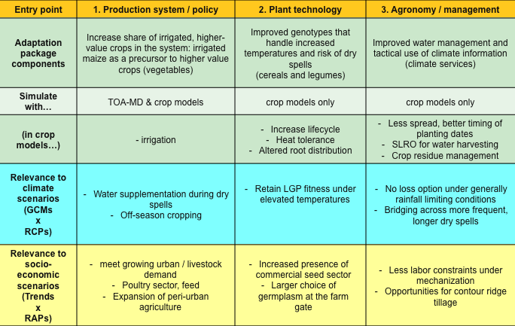
model entry points, scenarios, tradeoffs
Notes:
Model entry points, scenarios, tradeoffs
Example of adaptation package for Nioro
Similar exercise could be part of scenario visioning workshop in Orodara, Kofa

Slide 29
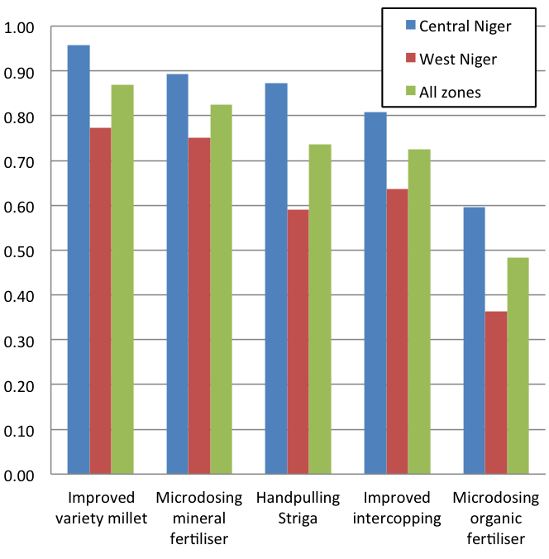
stakeholder concertations, participatory approaches, platforms
Proportion adoption (scored, not measured)
Technologies that FFS participants tested and evaluated
Notes:
Deliverable: Report on participatory evaluation of technologies, costs & benefits and adoption ranking sessions with farmer field school participants and non-participants in Mali
What do you see here: Proportions of adoption of technologies of farmer field school participants in Mali and Niger
Farmers exposed to technologies for at least 2 years
Mali, Cotton zone, Koutiala (77 men, 0 women), Non-cotton zone, Siby (47 men, 6 women)
Cotton zone in general higher adoption rates than non-cotton zone, except for microdosing mineral fertiliser.
Composting most adopted with about 50% of participants adopting.
On average FFS participants adopted 1.75 technologies per person
Niger, Central Niger (20 men, 27 women), West Niger (31 men, 13 women).
Central Niger higher adoption rates than West Niger. Men had higher adoption rates than women.
Improved variety of pearl millet, Microdosing mineral fertiliser, Handpulling Striga and improved intercropping all high rates of adoption (>70% on average)
On average FFS participants adopted 3.8 technologies per person
Adoption rates were much higher in Niger tha in Mali.
For microdosing, many farmers stated that they apply fertiliser by mixing seed with fertiliser before sowing, which is different that the microsoding technology that was tested/disseminated.

Slide 30
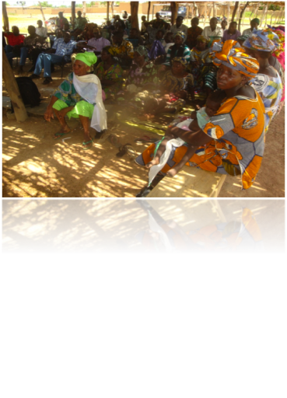
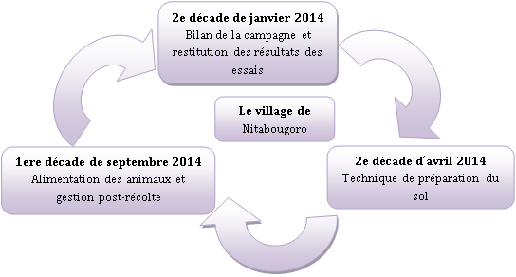
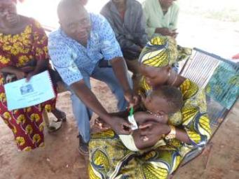
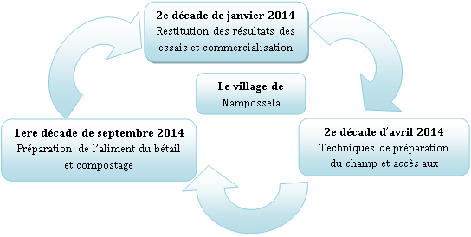
stakeholder concertations, participatory approaches, platforms
Notes:
Deliverable:
At least 4 stakeholder meetings organised in Koutiala, Bougouni, Segou district, etc.
At least 2 R4D or innovation platforms established and inception meetings reported for WBS transect districts of Mali and/or Burkina Faso, Ghana
R4D/innovation platforms established in Yorobougoula, Mpessoba and Sirakele with Africa RISING partners (AMEDD, AMASSA. MOBIOM, ICRAF, AVRDC)
Innovation platforms were initiated in Mperesso, Nintabougouro, Nampossela with McKnight partners AMEDD and IER
Themes treated in the platforms ranges from nutrition of mothers and young children, Sustainable intensification of field crops, crop-livestock interaction and options for improvement.

Slide 31
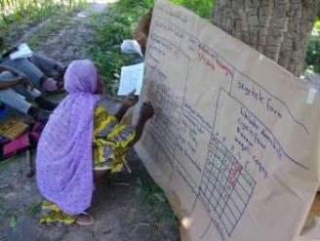
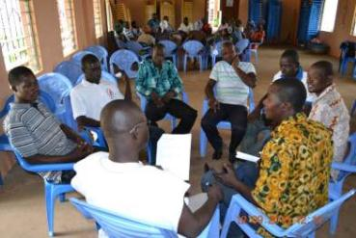
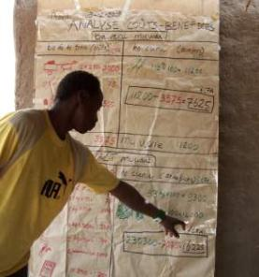
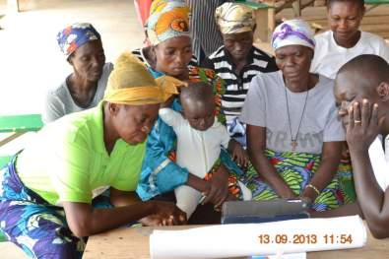
stakeholder concertations, participatory approaches, platforms – ISSFM FFS Ghana, Mali
Notes:
Deliverable: Assess Integrated Striga and Soil Fertility Management and component technologies in farmer field school setting in Mali, and Ghana
Mali:
Agro-economical analyses completed for 3 cluster base FFS in Mali (Siby, Dioila, Koutiala, 2010-2011-2012). Database and results available.
Partners have established CBFFS in Diakourouna, Niamana (World Vision), Tominian and Bankass (CRS-CARITAS) in 2013.
Ghana:
No FFS were established in Ghana in 2013, but Rapid Rural Appraisals were performed with farmer focus groups fin the 5 Africa RISING action villages in Upper East region.
An important comclusion from the RRAs was that sorghum and pearl millet have become much less important in the last 10 years, while maize and rice have become the major crops in 4 of the 5 villages. Nevertheless, farmers expressed the need to experiment with sorghum and pearl millet and learn about options to control Striga and improve yield and soil fertility.
A short report of these RRA’s is available.

Slide 32
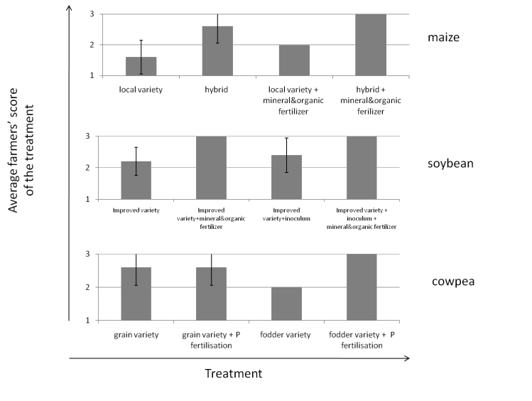
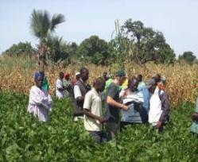
stakeholder concertations, participatory approaches, platforms
Notes:
Scoring of the treatments of the McKight on-farm trials according to farmers visualisation during field day
Scenarios (combination of crop/livestock technologies at farm level) are not established yet (we are waiting for livestock stable feeding trials during dry season to be carried out)
criterias to assess technologies were recorded during farmer field day and scoring of treatments of different trials
Segueway into testing of intensification options

Slide 33
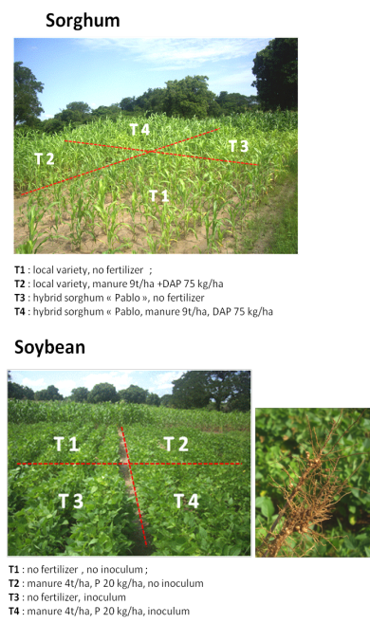
tests of intensification options – variety,
ISFM and intensification trials 2013
Country | Region | No. trials (No. villages)
Niger | Dosso, Tillaberi | 45 trials (11 villages)
Mali | Koulikoro | 73 trials (14 villages)
Mali | Sikasso | 324 trials (19 villages)
Mali | Mopti | 91 trials (27 villages)
Mali | Segou | 16 trials (8 villages)
Total |  | 516 trials (79 villages)
Notes:
Deliverables:
*At least 4 types of ISFM trials and/or intercropping trials installed in Mali (3 sites sorghum, 2 sites pearl millet)
*Agronomic data collected from ISFM and/or intercropping trials
*Agronomic and economic assessment of fertilisation, variety and ISSFM trials with sorghum and pearl millet
516 trials were established in Mali and Niger in over 79 villages.
Trials studied options such as intercropping, variety, fertilization, mechanization in a range of crops
(sorghum, pearl millet, maize, cowpea, groundnut, and soyabean)
1 Sheep fattening trial was established in Yorobougoula to test the effect of different feed rations on sheep weight gain.
Test integrated soil fertility management options (# of trials McKnight+DSCRP 2013):
Combination of 2 factors advantageous most of the time (soybean: effect of inoculation not as effective as P fertilization)
Cowpea: no clear effect of fertilization on either genotype
Sorghum (23): T1 : local variety, no fertilizer. T2 : local variety, manure 9t/ha +DAP 75 kg/ha. T3 : hybrid sorghum « Pablo », no fertilizer. T4 : hybrid sorghum « Pablo, manure 9t/ha, DAP 75 kg/ha
Maize (45): T1 : local variety, no fertilizer. T2 : local variety, manure 9t/ha +150 kg urea, 100 kg complex 15-15-15. T3 : hybrid maize « Bondofa », no fertilizer. T4 : hybrid maize « Bondofa », manure 9t/ha, 150 kg urea, 100 kg complex 15-15-15
Soybean (39): T1 : no fertilizer , no inoculum. T2 : manure 4t/ha, P 20 kg/ha, no inoculum. T3 : no fertilizer, inoculum. T4 : manure 4t/ha, P 20 kg/ha, inoculum
Cowpea (41): T1 : ‘wulibali’ cowpea, no fertilization. T2 : ‘wulibali’ cowpea, P 20kg/ha. T3 : ‘Dunanfana (dual-purpose) cowpea, no fertilization. T4 : ‘Dunanfana cowpea, P 20 kg/ha
Also Stylosanthes trials (9)
Test dual-purpose (inter)-crops:
Shown here: Maize/Cowpea intercrop: T1 : ‘wulibali’ cowpea + maize, 1 row maize, 1 row cowpea + maize. T2 : ‘wulibali’ cowpea + maize, 2 rows maize, 1 row cowpea. T3 : ‘Dunanfana cowpea + maize, 1 row maize, 1 row cowpea + maize. T4 : ‘Dunanfana cowpea + maize, 2 rows maize, 1 row cowpea
Ta, Tb : maize sole crop for Land Equivalent Ratio (LER) calculations
Tc, Td : wulubali, dunanfana sole crops for LER calculations
(# of trials McKnight+DSCRP 2013): Maize/Cowpea: 32. Sorghum/Cowpea: 5.Grand total of 110 farmers in 9 villages
(Nampossela, Nitabuguro, Mperesso, Finkoloni, Koumbri, Kani, Karangasso, Try, N’Goukan)
Diversification trials with crop-livestock focus
First feeding trials on small ruminants initiated (Africa RISING) and stable feeding trials for dairy cows planned (McKnight AEI)
Rainy season vegetable crop trials installed in collaboration with AVRDC (Africa RISING)
Perennial crop trials installed in collaboration with ICRAF for food banks, fodder banks and fruit tree establishment (Africa RISING)
Bougouni trials (Mary)
Agronomic trials
Trials include:
Sorghum-cowpea intercropping
Cowpea varieties with Neem insecticide
Soybean with organic fertilization and innoculant
Groundnut varieties with Roselle intercropping
76 total on-farm trials in 5 villages
43 men, 27 women participated
Feeding trials and Fodder production
10 women participated in feeding trials for the Tabaski holiday
13 women and 2 men produced fodder cowpea for use in dry-season feeding trials

Slide 34
tests of intensification options – ISFM & Millet
Organic manure | Mineral Fertilizer | Variety | Grain yield (kg/ha) | Total biomass
200g per hill | 2g DAP+1g urea per hill | ICMV IS 89305 | 1092 | 3368
200g per hill | 6g NPK per hill | ICMV IS 89305 | 1107 | 3909
300g per hill | 6g NPK per hill | ICMV IS 89305 | 1020 | 3565
200g per hill | 2g DAP+1g urea per hill | ICMV IS 94206 | 1038 | 3649
200g per hill | 6g NPK per hill | ICMV IS 94206 | 1023 | 3767
300g per hill | 6g NPK per hill | ICMV IS 94206 | 1089 | 4011
200g per hill | 6g NPK per hill | ICMV IS 99001 | 1154 | 3950
200g per hill | 2g DAP+1g urea per hill | Kado Nio de Mali | 1172 | 4808
200g per hill | 3g NPK per hill | Kado Nio de Mali | 1079 | 4998
300g per hill | 0g min fert | Kado Nio de Mali | 1334 | 5156
300g per hill | 6g NPK per hill | Kado Nio de Mali | 1262 | 5354
300g per hill | 3g NPK per hill | Local variety | 1002 | 4126
100g per hill | 3g NPK per hill | Mil de Siaka | 1076 | 3446
100g per hill | 6g NPK per hill | Mil de Siaka | 1007 | 3761
200g per hill | 0g min fert | Mil de Siaka | 1035 | 3246
200g per hill | 3g NPK per hill | Mil de Siaka | 1085 | 3552
300g per hill | 0g min fert | Mil de Siaka | 1003 | 3710
300g per hill | 2g DAP+1g urea per hill | Mil de Siaka | 1131 | 3889
300g per hill | 3g NPK per hill | Mil de Siaka | 1161 | 3725
300g per hill | 6g NPK per hill | Mil de Siaka | 1174 | 4390
200g per hill | 2g DAP+1g urea per hill | SOSAT-C88 | 1012 | 2957
300g per hill | 2g DAP+1g urea per hill | SOSAT-C88 | 1033 | 3114
300g per hill | 6g NPK per hill | SOSAT-C88 | 1001 | 3118
Notes:
Types of integrated soil fertility management trials and/or intercropping installed in Niger:
- During the rainy season 2013 an experiment was conducted at ICRISAT station at Sadore to evaluate the performance of millet varieties under 16 soil fertility management option
- The second trial aims as determining the long term effect of fertilizer microdosing on soil fertility, water use and millet performance under conditions of different management of millet residues
- With the third experiment we study the effect of Acacia husbandry and manure on millet and cowpea performance and water use
Table here: Data of 3 years – agronomic assessment of fertilization, variety and ISFM trials – pearl millet
Seven millet varieties produced more than one ton of grain depending in the fertility management.
Mil de Siaka performed well under a wide range of options
Mineral alone produced less than one ton of grain
Organic manure alone was a better option when compared to mineral
Kado Nio de Mali was the best variety in term of crop-livestock integration followed by mil de Siaka

Slide 35
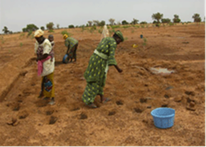
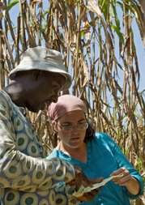
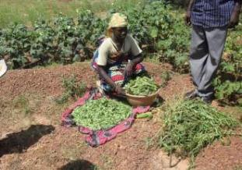


tests of intensification options – dual purpose sorghum genotypes, water management
Notes:
Akinseye’s trial
10 sorghum genotypes including dual-purpose hybrids & purified landrace parents
Measurement of stay-green characters
NIRS analysis of fodder quality
Agricultural water management technologies tested on 50 farmers' fields
In collaboration with a partner NGO, test on a system involving rain water harvesting technologies, leafy vegetables and high values trees was conducted in 97 villages in central and eastern Niger
Report on there evaluation will be provided

Slide 36





gender-smart media training tools & capacity building – farmer to farmer training videos
Notes:
Deliverable: Sowing/thinning/transplanting video tested with farmers (especially women), adapted and available online
1. Thinning and transplanting video for sorghum in editing phase (script and voice over ready, images available)
2. ICRISAT also collaborated on a two other videos for crop management of sesame and the production of enriched porridge from cereals, cowpea/soyabean and groundnut (video ready, but not yet available online)
Over 22K “Fighting Striga” DVDs distributed in WCA
Aflatoxin management video dubbed in 7 major languages (touching a linguistic customer basin of 150+ million)

Slide 37



gender-smart media training tools & capacity building – dissemination workshops
Notes:
Deliverable: At least two workshops organised with partners on the use of printed, radio, video messages and seed minipacks in WBS sites by field agents
Two workshops organised in Mali (Koutiala and Bamako) in order to train field agents and lead farmers of partners (World Food Program, NGO’s, Farmers’ organisations, NARS)
One workshop organised in Niger (Dantchiandou) for the training of field agents of farmers’ organisations
Over 70 field agents and lead farmers trained in the use of media for large scale dissemination and received copies of Figthing Striga DVDs and poster books for farmer training on improved technologies. Each partner organisation developed a strategy for the use of these tools for dissemination activities.
Important to note that many partners (World Vision, World Food Program & partners, have organized training of the use of the DVDs and other materials at lower levels (districts and communes).

Slide 38


gender-smart media training tools & capacity building – dissemination campaigns
Notes:
Deliverable: Dissemination campaign, mid-season evaluation, mass media (print and electronic) campaigns to disseminate identified relevant technologies to different classes of farmers including women and vulnerable groups
3 Fighting Striga videos were shown in French, Zerma, Haussa and Bambara on national television in Niger and Mali.
ICRISAT and partners trained at least 3000 field agents and farmers (men women and children) in Mali, Niger, Burkina Faso and Nigeria using video and printed materials in 2013 and 18000 field agents and farmers in 2012 and 2013. Of the persons trained, about 40% are men, 30% are women and 30% are children aged between 7 and 18).
Farmer organizations and NGO’s are responsible for about 85% of all trainings, while ICRISAT trained merely 7%.
For 2013, data collection is ongoing and numbers for training by partners is potentially much higher, as collecting feedback from non-contracted partners is difficult and collecting feedback from farmers in villages nearly impossible.
A study is on-going to identify potential early impact on partners’ and farmers’ training activities and farmers behaviour and experimentation in Mali. A report of this study will be available in January 2014.

Slide 39


gender-smart media training tools & capacity building – scenario visioning, VRHI for biomass

Slide 40
other activities, leveraging & planning for 2014*
1960-2010 LULC mapping (w/ ICARDA)
Follow up desk study (w/ WUR)
RS learning package (BMGF)
RS support for biomass assessments (w/ WUR)
P-aware sorghum modeling (w/ UF)
Flagship 4 – Policies & Institutions (w/ CCAFS, AgMIP)
Youth & agri-entrepreneurship workshop (w/ YPARD)
WUE, water harvesting, watersheds in basins (w/ WLE)
Other CRP interfacing
Others?
*non-exhaustive
Notes:
ICARDA: 50K for WAS&DS from GIS/RS unit – Wall-to-wall land use land cover mapping (with C. Biradar, B. Djaby) – Corona + Landsat (preparing outscaling by identifying similar target environments)
BMGF: 2 use cases – technical development: breaking the crop recognition barrier / value chain development: developing business models for agro-dealers (1.5M USD effort over 2014-2015 complemented by institutional landscaping + procurement activities) + 2 other regions
CCAFS-FS4: Capacitating science-policy exchange platforms to mainstream climate change into national agricultural and food security policy plans (2.4M USD effort over 2014-2017
YPARD: Workshop on Strengthening the Capacity of Sahelian Youth in Promoting Agribusiness Enterprises and Economic Transformation (preparing outscaling by strengthening next generation of agro-dealers)
CRPs: interfacing with DC, WLE, CCAFS, FTA, others?

Slide 41


other activities, leveraging & planning for 2014 (1)
Notes:
Critical areas in pink highlight key deficiencies in CGIAR centers for developing sustainable value chains. This business model canvas is being used to develop one of the BMGF use cases for the West Africa remote sensing learning package.

Slide 42

other activities, leveraging & planning for 2014 (2)
ENTRY POINTS
More relevant scenarios, models, projections
More granular data, information, knowledge
More connected institutions, participation, legitimacy
IMPROVE FORESIGHT INSTRUMENTS
LAY THE GROUND FOR CO-PRODUCTION
ANCHOR PLATFORMS IN CONTEXT
LEVERAGE TOWARDS SCALE
Increasing the salience, relevance and legitimacy of projections of climate change impacts on agriculture and food security using integrated assessment methods with state-of-the art climate, crop and economic models parameterized at the district scale
Wall-to-wall mapping of the institutional and socio-economic landscape for the co-production of climate-smart farm services at scale, with the gender-disaggregated village as the target granularity
Developing district-level capacity to inform the development of national climate change adaptation and mitigation, agriculture and food security policies and agendas, and to monitor the equitable implementation thereof at sub-national scales
Establishing effective monitoring and evaluation systems within national platforms for science-policy dialogue, to quantify social returns on investments, geographical and thematic gaps in funding, and to improve users' access to climate adaptation resources
ACTIVITIES
RELEVANT KNOWLEDGE IN POLICY PLANNING
STRONGER CAPACITY TO PRIORITIZE AND DECIDE
PROJECT
National science-policy exchange platforms use up-to-date, granular and relevant knowledge generated at national and local (district) levels for their sectorial adaptation and mitigation plans country-wide
National research, extension partners and policy makers are enabled to develop and utilize tools and knowledge, scenarios and decision- support mechanisms to prioritize national investments
Foresight analyses of climate change impacts on crops, agricultural enterprises and livelihoods are available for internally and externally validated agricultural development pathways and adaptation options, and are systematically disseminated across all constituencies by national platforms via policy instruments and planning
Local environments enable the co-production and targeting of climate-smart interventions, investments and services thanks to wall-to-wall, granular institutional landscaping information available in an accessible, transparent format to all stakeholders in the target countries
The national climate adaptation and food security policy planning is firmly anchored in the local development context through institutional mechanisms and formal two-way (bottom-up, top-down) consultative processes in place for all administrative (district) constituencies country-wide
FLAGSHIP
Notes:
Impact pathway in development for the CCAFS Flagship4 proposal (ICRISAT – ICRAF – ILRI – IWMI)

Slide 43
in a nutshell…
significant data production effort launched in 2013, intensifying 2014
DS intervention sites mostly untouched by trials as of yet
new complementary human and financial resources in 2014
activity set inching towards systems approaches, not there yet
suggestions:
    IRT thematic task forces to analyze and publish
    strengthened IRT communication infrastructure
    review activities against regional research questions
    empowering action transect coordinators

