Slide 1
How to report outputs
Learn how to report outputs in MEL
in 1 minute

Slide 2
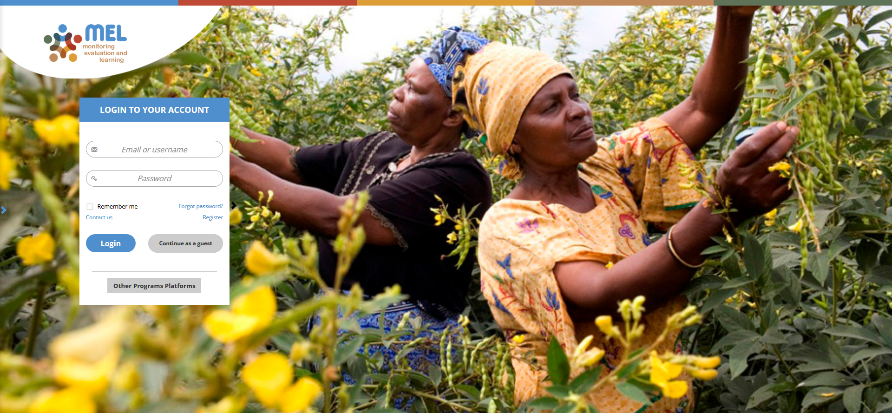
Go to mel.cgiar.org and login to your account
Use your email and password to login
Click on «Forgot password?» if you need to change your credentials

Slide 3
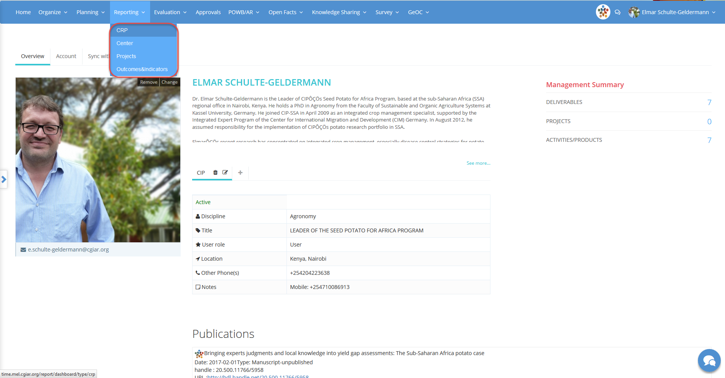
Click on the Reporting menu and select the reporting framework
You may select CRP, Center or Projects depending on the framework under which your output has been planned

Slide 4
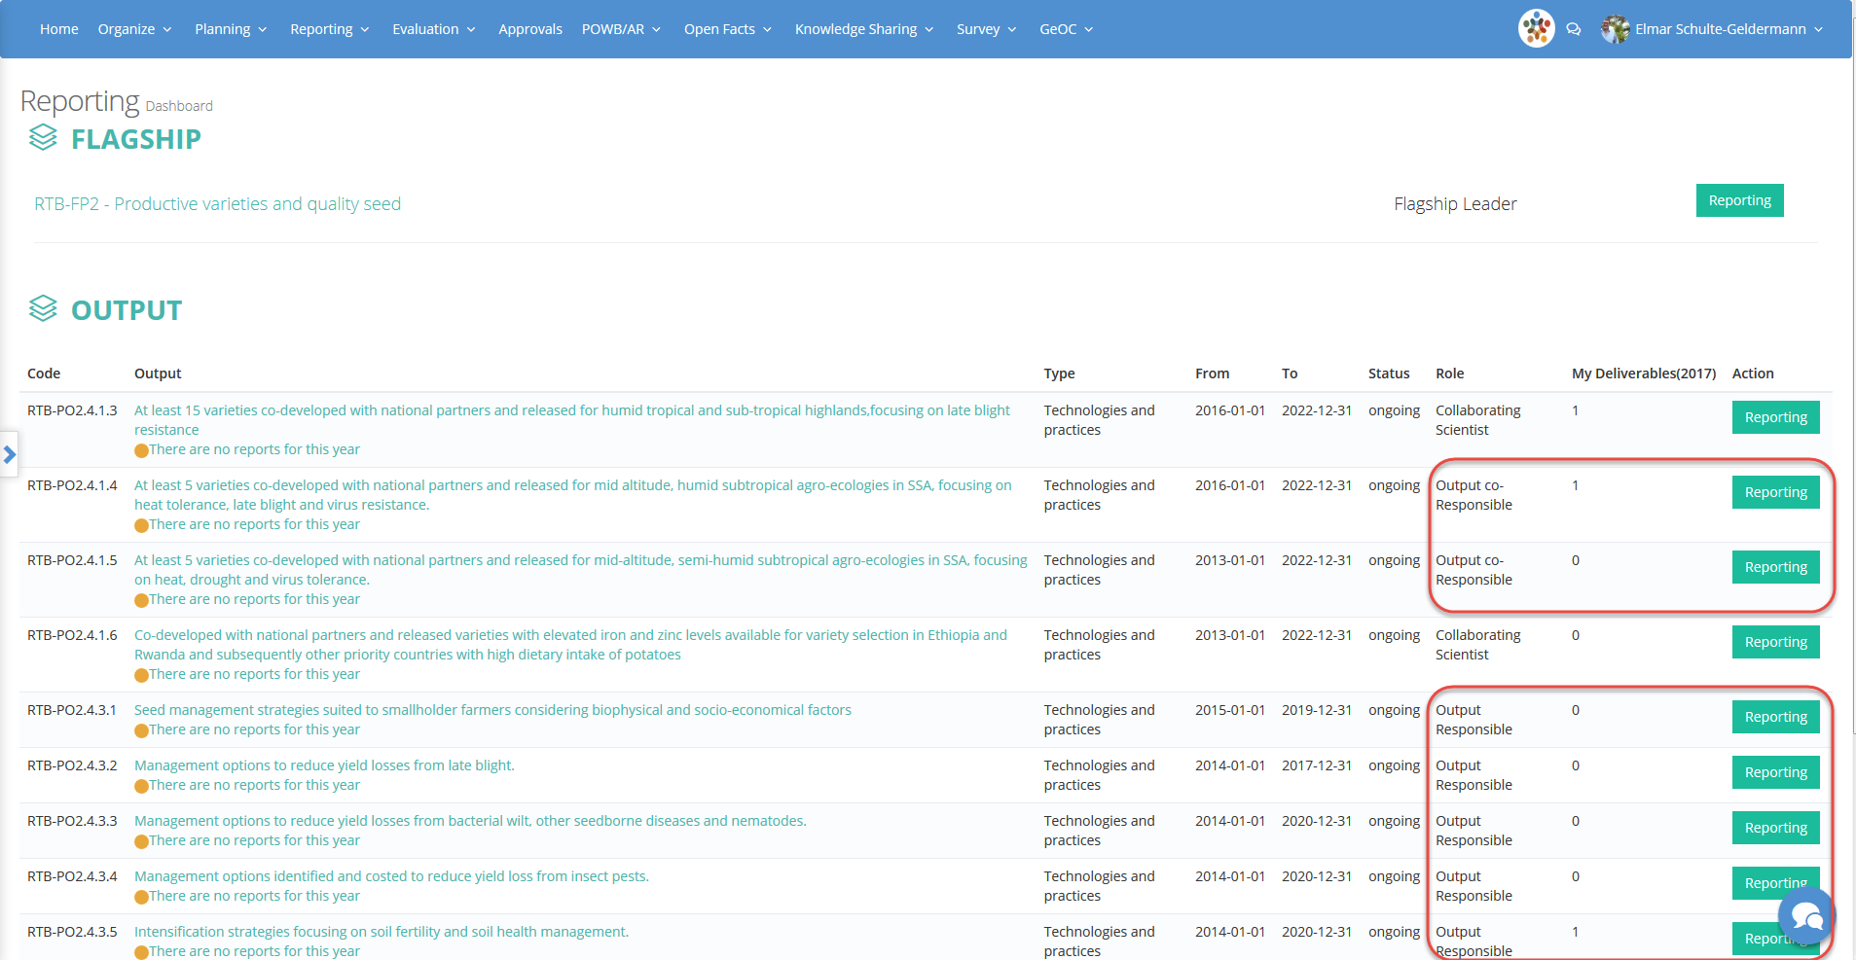
Identify the outputs that are under you responsibility or co-responsibility
Click on «Reporting» to open the Output page
Remember that the overall output reporting has to be prepared and submitted by the output responsible in collaboration with the co-responsible

Slide 5
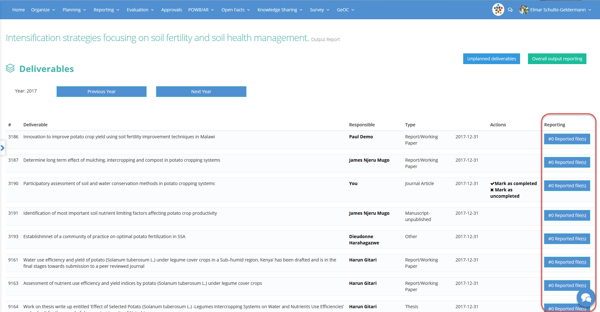
Make sure that the expected deliverables have been reported
Click on the button «# Reported file(s)» to access the information related to deliverables
Ask the reporting scientists if you have questions or if you need additional information

Slide 6
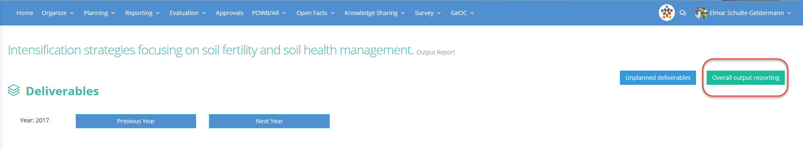
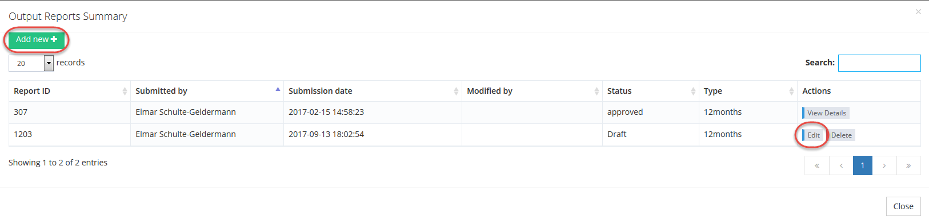
Click on the button «Overall output reporting» to work on the output report
Click on the button «Add new» if you are starting with a new report
Click on the button «Edit» if a draft report already exists

Slide 7
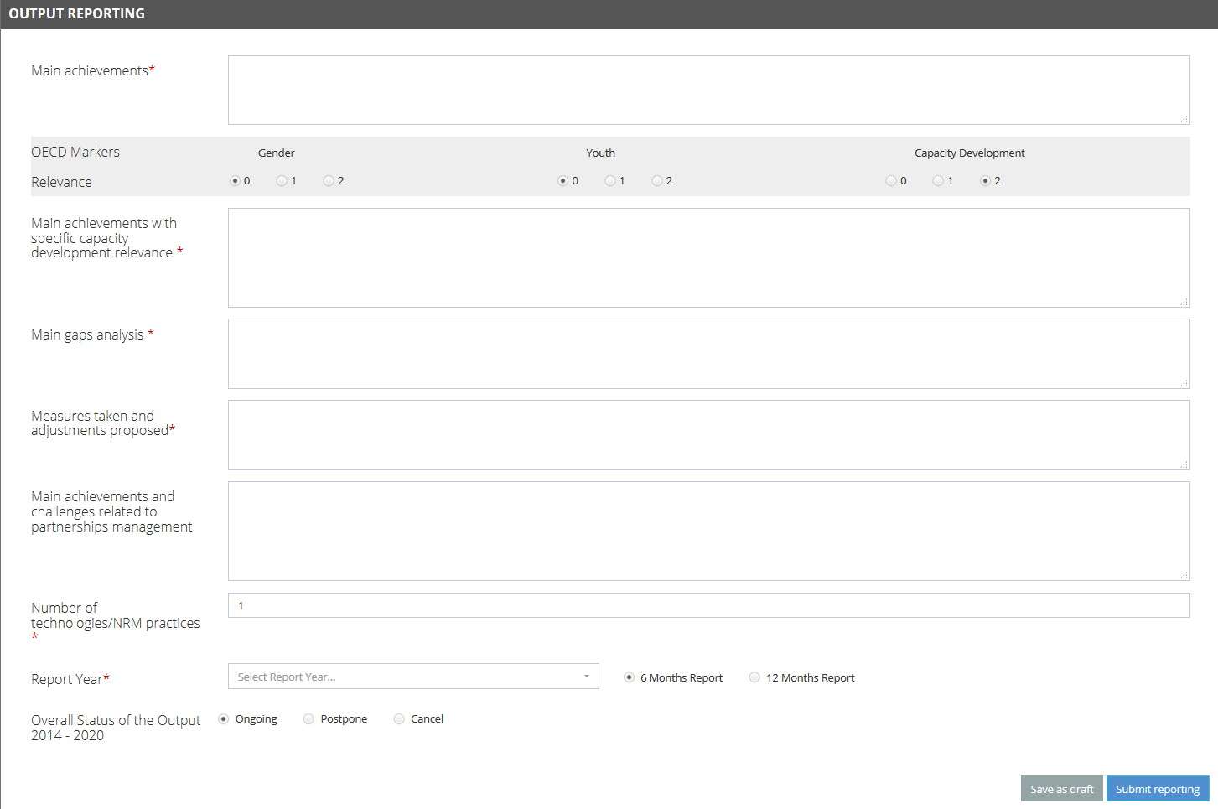
Complete the template and submit your report
When one of the dimensions is marked as relevant (1 or 2) a box for reporting on main achievements appears
If you are not ready to submit or if you want the output co-responsible to contribute, save the report as draft. You will be able to resume the reporting and finalize it later
When you select postpone or cancel you will be asked to provide additional explanations

Slide 8



For more detailed information on how to use MEL please use the online guide
You need support?
Chat with us or send us and email
Thanks for using MEL

