Slide 1
CRP Dryland Systems
Updating notes & Action points
Hichem Ben Salem
ICARDA’s Focal Point - CRP-DS
ICARDA – NCARE Technical Meeting for Tafilah-Salamieh Action Site
(Jordan sites)
21 - 22 September, 2014
Amman, Jordan

Slide 2

Outline
Title
Dynamic building of CRP DS
Performance evaluation .. us and them
Requested changes
Activities clustering
Concluding remarks

Slide 3
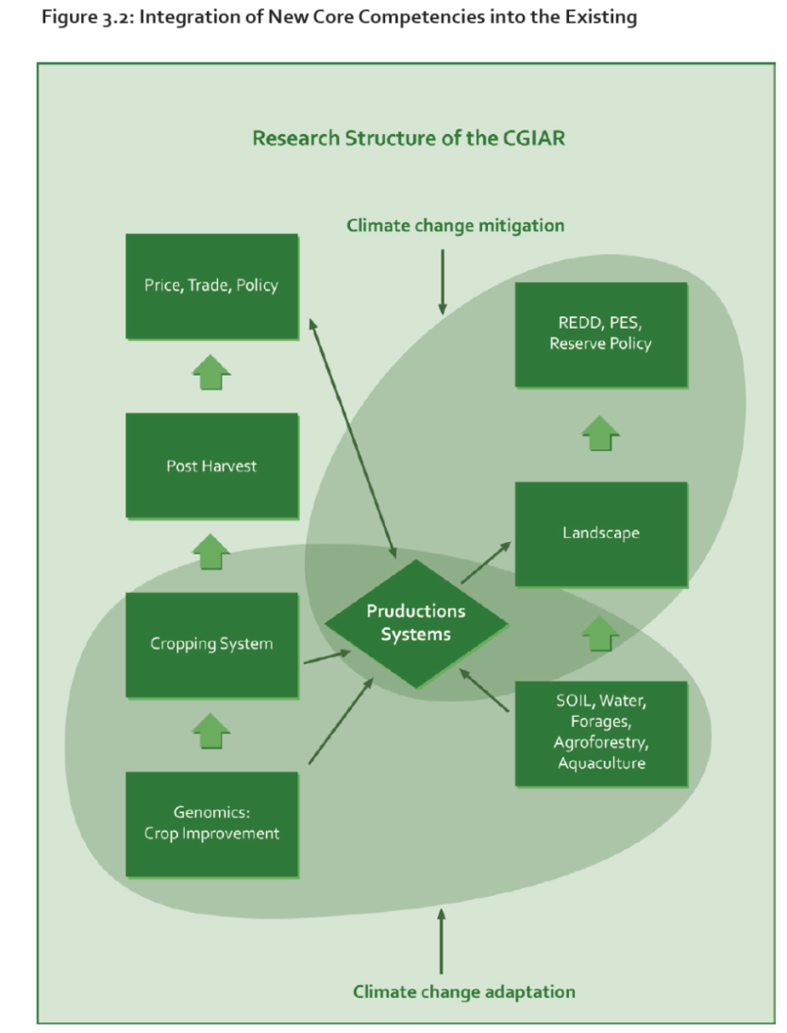
Strategic and Results Framework (SRF)
Title
The SRF (CGIAR 2011) advocates new areas of core competency to achieve impact in four SLOs
One is development of core competency in the area of “production systems”
This will test the ability of the system to undertake inter-center research
Systems research will integrate commodity, natural resource management and policy research to improve productivity and livelihoods in a sustainable manner at the national and regional level

Slide 4
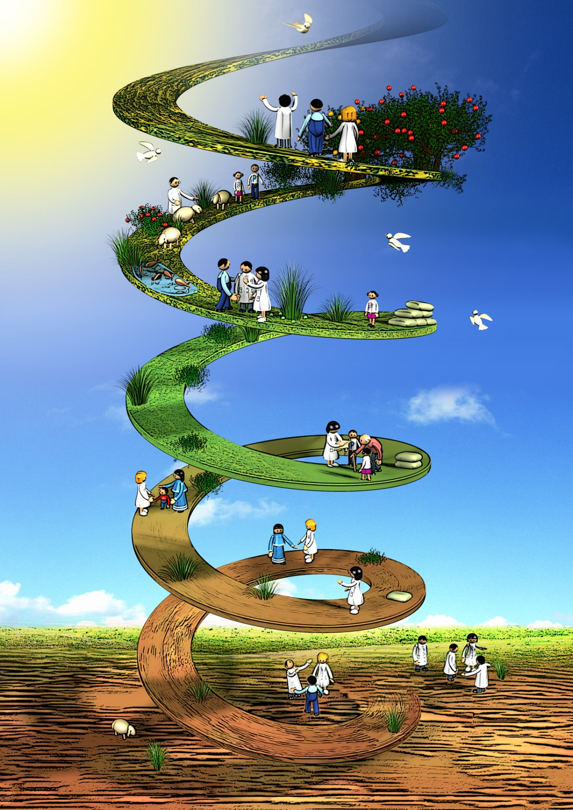
Learning, growing, spiral impact pathway
Traditional research-for-development impact pathway includes four steps: research, outputs, outcomes and impact.
CRP1.1 views these steps not as a linear sequence, but as an upward spiral of learning and growing.
This results in an iterative research cycle, with continuous improvement in technologies.
Notes:
yellow = tropical drylands
pale and dark brown = non-tropical drylands with winter and summer rainfall respectively
The dry areas of the developing world occupy about 3 billion hectares (41% of the earth’s surface) and are home to some 2.5 billion people (more than one-third of the world population) – and the majority of the world’s poor.
In these areas, agriculture and pastoralism remain the main source of rural livelihoods. They are highly vulnerable, fragile ecosystems: and economic activities are constrained by persistent water scarcity, climatic variability and frequent droughts, rapid natural resource degradation and desertification and groundwater depletion
They are furthered threatened by climate change (decline in annual precipitation and increase in mean temperatures).
Dry lands, and particularly the most marginal lands (mountains, rangelands, and marginal arable areas), have suffered from underinvestment in research and development and supporting infrastructure
To ensure the future livelihoods of dryland farming communities, it is critical to
(1) manage risk more effectively in the most vulnerable systems, by building ecosystem resilience, and
(2) enhance production growth in higher potential areas through both the diversification and the sustainable intensification of production systems.
Thus, the complexity of challenges facing the dry areas requires an integrated agro-ecosystems approach to research for development. CRP1.1 will not be involved in basic research on single components of crop improvement and genetics, and other fields, but will take an integrated systems approach.

Slide 5
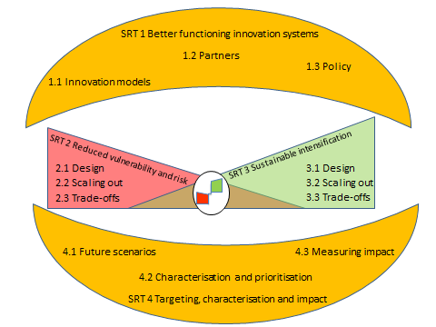
Strategic Research Themes and their outputs
SRT1: Approaches and models for strengthening innovation systems, building stakeholder innovation capacity, and linking knowledge to
policy action
SRT2: Reducing vulnerability and managing risk
SRT3: Sustainable intensification for more productive, profitable and diversified dryland agriculture with well-established linkages to markets
SRT4: Measuring impacts and cross-regional synthesis
Notes:
yellow = tropical drylands
pale and dark brown = non-tropical drylands with winter and summer rainfall respectively
The dry areas of the developing world occupy about 3 billion hectares (41% of the earth’s surface) and are home to some 2.5 billion people (more than one-third of the world population) – and the majority of the world’s poor.
In these areas, agriculture and pastoralism remain the main source of rural livelihoods. They are highly vulnerable, fragile ecosystems: and economic activities are constrained by persistent water scarcity, climatic variability and frequent droughts, rapid natural resource degradation and desertification and groundwater depletion
They are furthered threatened by climate change (decline in annual precipitation and increase in mean temperatures).
Dry lands, and particularly the most marginal lands (mountains, rangelands, and marginal arable areas), have suffered from underinvestment in research and development and supporting infrastructure
To ensure the future livelihoods of dryland farming communities, it is critical to
(1) manage risk more effectively in the most vulnerable systems, by building ecosystem resilience, and
(2) enhance production growth in higher potential areas through both the diversification and the sustainable intensification of production systems.
Thus, the complexity of challenges facing the dry areas requires an integrated agro-ecosystems approach to research for development. CRP1.1 will not be involved in basic research on single components of crop improvement and genetics, and other fields, but will take an integrated systems approach.

Slide 6
IDOs
IDO 1. More resilient livelihoods for vulnerable households in marginal areas | IDO 2. More stable and higher per capita income for intensifiable households | IDO 3. Women and children in vulnerable households have year round access to greater quantity and diversity of food sources
IDO 4. More sustainable and equitable management of land and water resources in pastoral and agropastoral | IDO 5. Better functioning markets underpinning intensification of rural livelihoods | IDO 6. More integrated, effective and connected service delivery institutions underpinning resilience and system intensification
IDO 7. Policy reform removing constraints and creating incentives for rural households to engage in more sustainable practices that improve resilience and intensify production

Slide 7
Program Objectives and
Flagships Target Regions
Title
Program objectives
Dryland Systems aims to improve livelihoods in two distinct drylands agro-ecosystem types:
Marginal, low-productivity areas: where people need support to mitigate vulnerability and solutions for resilience for food production.
Areas that have the potential to improve productivity: where people need support to engage in the sustainable intensification of their agricultural production.
Program research-for- development architecture: Flagship Target Regions
  West African Sahel & Dry Savannas
  North Africa & West Asia
  East & Southern Africa
  Central Asia
  South Asia

Slide 8
The inception phase
Bringing together the foremost scientists from a multitude of disciplines in order to assess needs and formulate hypothesis, outcomes and activities
Inception Regional Workshops
Regional Launch Meeting & Kick-off meetings by site
Plan of Work and Budget
2011
2013
ICARDA scientists & management
NARS scientists & decision makers
Assumption: Communities/farmers “opinion” is reflected through ICARDA and NARS scientists and other resource persons

Slide 9
The implementation phase
MoAs preparation
Implementation of activities
Workshop Extension proposal
Science & Implementation Meeting
Evaluation
Task Force
Late 2013
2014
ICARDA scientists & management
NARS scientists & decision makers
Assumption: Task force to improve CRP DS performance

Slide 10
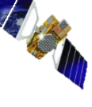

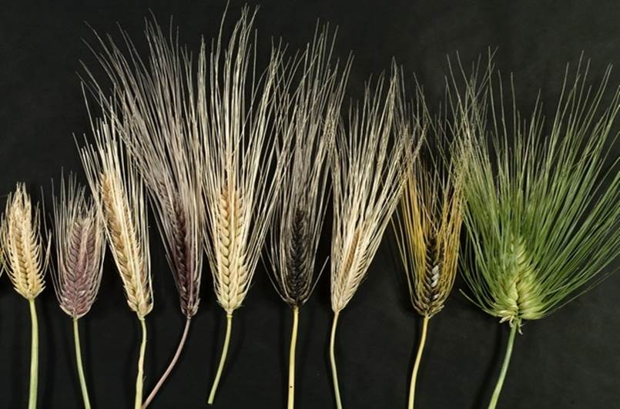
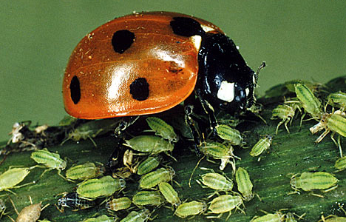

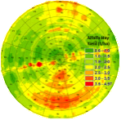

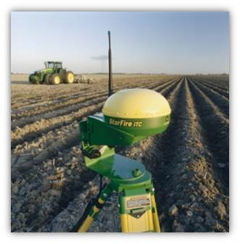
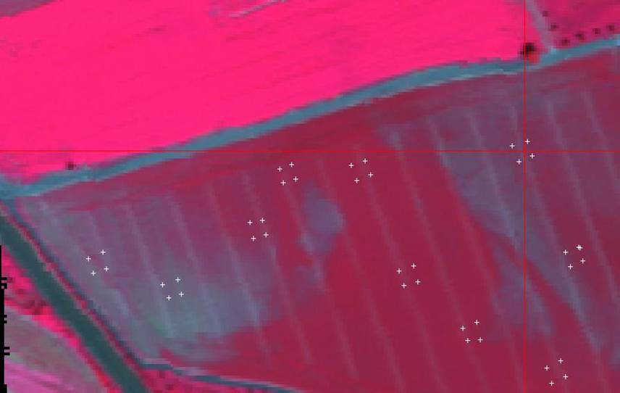
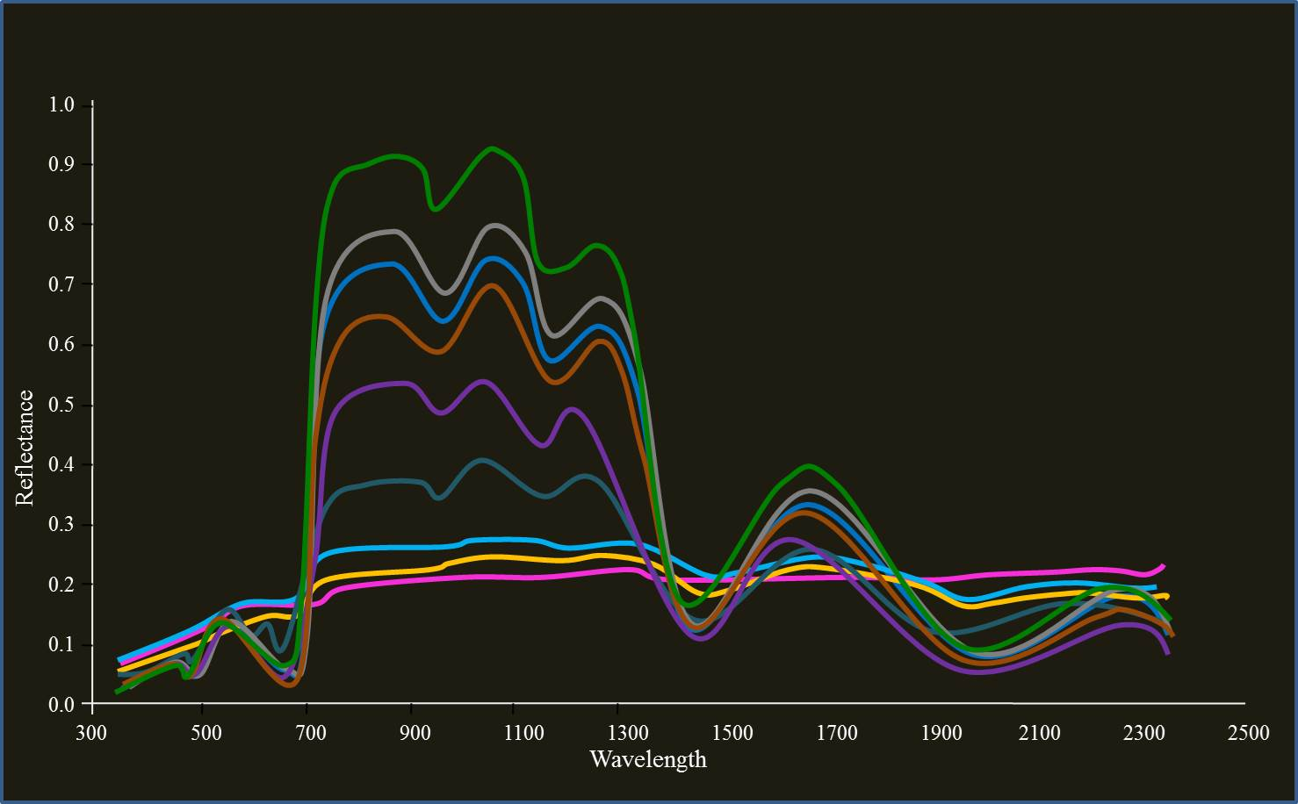
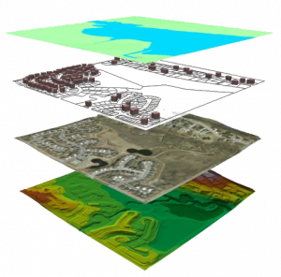
Crosscutting themes and linkages of CGIAR Research Programs* (CRPs)
Gene Banks
CRP DS
Policies, Institutions, and Markets
Managing biodiversity in agro-systems. Focused Identification of Germplasm Strategy. Characterization of genetic resources at landscape level.
Sustainable intensification, challenges and constraints, integrated crop and pest management practices, and value chain linkages
GB
CRP PIM
Hyper and ultra spectral mapping of genotypic and phenotypic variability
Dryland Systems
Integrated pests and diseases management
Enhancing productivity and managing risks
through diversification, sustainable intensification,
and integrated agro-ecosystem approaches
Climate Change
Wheat
Eco-friendly climate change adoption - strengthening approaches for better management of agricultural risks associated with increased climate variability and extreme events
Improving productivity and profitability of wheat, improved resistance to pests and diseases, climate resilient, and increasing yield while reducing inputs
CRP CCAFS
CRP
Linkages and Activities Established in 2013
WHEAT
Mapping inter and intra variability at species, field, and farm scales
Geo-referenced in situ/field photo and data collection
Water, Land and Ecosystems
Grain Legumes
Improving land and water, productivity, and ecosystem services. Assessment of land degradation, soil health and nutrition, and climate change impact
CRP WLE
CRP GL
Sustainable intensification- challenges and constraints, integrated crop and pest management practices, and value chain linkages
Livestock and Fish
Innovative tools and techniques for improved agronomic practices and management
Resilience and vulnerability of livestock production under changing climate, land use and markets, identify and address key constraints and opportunities
Quantification of trends and status of soil fertility,
salinity, and degradation,
CRP N&H
CRP DC
Nutrition and Health
Dryland Cereals
Improving synergies between agriculture, nutrition, and health. Location base services-distribution, access pattern, value chain, and control of zoonotic diseases/pests and risks
Validating high yielding varieties with better pest and disease resistance, tolerance to abiotic stresses, and improved crop management technologies
CRP L&F
Crop spectra
Bio-physical-spectral
libraries for mapping agricultural productivity
Location based
services in natural resource management
*ICARDA Led/Involved

Slide 11
Major Agricultural Livelihood Systems in NA&WA
ALS | Brief description | Major constraints | Sites
Agropastoral Systems | Agricultural livelihood based on small ruminants, barley crop, small scale irrigation | Overgrazing, feed imbalances, land degradation, water scarcity, climate variability, conflicts over resources, youth unemployment | Tafilah-Salamya, Beni Khedache-Sidi Bouzid, Karkheh River Basin
Intensive rainfed Systems | Wheat-based cropping system, land fragmentation, horticulture is intensifiable and market-oriented including for export, intensive dairy cattle production | Land degradation, nutrient deficiencies, water scarcity, climate variability, youth unemploymeent | Meknes-Saies, Karkheh River Basin

Slide 12
Major Agricultural Livelihood Systems in NA&WA
ALS | Brief description | Major constraints | Sites
Tree-based Systems | Mixed tree-crop-livestock, variant of agropastoral (Jordan & Tunisia: olive-figs - almonds-barley - sheep) & intensive rainfed; rainfed (Meknes: wheat-fruit trees-dairy cattle) | Fast degradation of natural resources, overgrazing, land degradation, climate variability, youth unemployment | Tafilah-Salamya, Beni Khedache-Sidi Bouzid, Meknes-Saies
Irrigated Crop Systems | Market-oriented vegetable and fruit; high yielding wheat and forage crops, dairy cattle. | Land constrained by groundwater depletion, salinization, heat stress, youth unemployment | Nile Delta

Slide 13
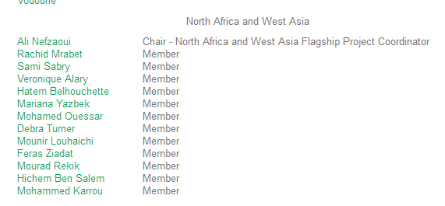
NA&WA Interdisciplinary Research Team http://drylandsystems.cgiar.org/people
TORs (in progress):
To identify research needs
Science quality control
Engage partner at field level
Support the FC for planning and reporting
Etc.

Slide 14
Self-evaluation – among the drawbacks of Phase 1
Lack of integration across activities, NARS of the same country, regions and CRPs
Different methodological approaches and tools are used across action sites, regions and CRPs
NARS still not familiar with CRP DS
Timely delivering and reporting
Heavy management of funds
Under-spending
Continuous change of CRP DS approach
14

Slide 15
ISAC’s Questions
What do you really want to achieve in your Target Region through the CRP, and HOW?
What are your main research questions (the science), and what methods and tools have you been using to address those?
What scale have you been working so far, and what is envisaged?
What collaboration frameworks and partnerships are you using, and how do they work in practice (within and across regions)?
What have you achieved so far: concrete activities and results so far?
What was successful; what did not work well, and why?
What are your biggest implementation challenges now and in the next 2-3 years?
If you had to start again, what would you do differently now?
15

Slide 16
CO/CRP DS Office … 33 points
An integrated systems approach at all sites that uses innovative science. New science: eg. How to handle/manage megadata sets, data fusion and modeling using remote sensing/GIS for integration of land use, ecosystem services; how to cope with stochasticity, non linearity, feedbacks, spatial and temporal dynamics of new components/systems; risk management approaches; trade-off-analysis; knowledge systems sciences; trans-disciplinarily how to achieve it especially economics and ecosystems; use of modern ICT to engage youth in agricultural employment; use of the Focused Identification of Germplasm Strategy (FIGS) for targeting interventions and matching genotypes to environment and management options

Slide 17
CO/CRP DS Office … 33 points
Well defined inter-disciplinary teams (these can change in composition over the lifetime of an activity depending on what is identified as the main barriers to uptake of research for example)
Clear linkages of research hypotheses to outputs, outcomes and IDO’s that could be a mixture of outputs and outcomes
Plausible outcomes identified including the identification of the barriers to outscaling of research outputs

Slide 18
CO/CRP DS Office … 33 points
Inclusive partnerships including more than 1 CGIAR center, development of innovation platforms
Explicit linkages to other CRP’s and especially those that link germplasm development to NRM within a production systems context. Shift from descriptive to systems analysis & modeling
Increasing inclusiveness in partnerships
Value chain focus complements on-farm focus

Slide 19
CO/CRP DS Office … 33 points
Increasing recognition of need for and attention to, enabling institutions & governance
Contested paradigms hard vs soft sciences; researcher vs farmer knowledge, what is the balance?
Greater social equity and gender considerations
Primary focus on agricultural livelihood system (pastoral, agro-pastoral, irrigated crop, intensive rain-fed and tree-based)
Fit for purpose participatory approaches

Slide 20
CO/CRP DS Office … 33 points
Options x context approach in research sites, research at scale of impact (see report of the S&I meeting)
Much more emphasis on SRT 1 & 4 (better functioning innovation systems, measuring impacts and cross-regional synthesis)
Capacity development needs to be built in and made explicit with perhaps as much as 10-15% of the budget for identified capacity development needs (some of these were also recommended at the S&I meeting). CD strategy under definition.

Slide 21
CO/CRP DS Office … 33 points
Decreasing budget
Activities clustering
W1&W2 funds to complement and integrate results (outputs, outcomes) from completed, ongoing and expected bilateral projects.
W1 & W2 funds could be used to fund new activities in case a specific gap is identify.
Mapping W3/Bilateral results
All results should be pointed to field sites or to global scale (dryland Systems) where the field sites are not applicable.

Slide 22
CO/CRP DS Office … 33 points
Clear reporting structure for Bilateral project in order to integrate the developed science.
At least 10% of the budget should be allocated to Gender (Integration).
At least 1% should be used for M&E activities. ICARDA as all other centers should have staff checking results at action site level.
At least 1% should be used for Risk management. ICARDA as all other centers should implement procedure for assessing possible risk for the program implementation.

Slide 23
CO/CRP DS Office … 33 points
All scientists are familiar with the S&IM recommendations (http://drylandsystems.cgiar.org/sites/default/files/DS_CRP_science_and_implementation_meeting.pdf).
Include in each activity a budget allocation for communication (i.e. for their brochure, media events, etc).
Include in each activity a budget allocation for CDU support (i.e. for collecting CD data, support in the organization).
Include in each activity a budget allocation for GU (i.e. for maps, GIS support etc).

Slide 24
CO/CRP DS Office … 33 points
ICARDA should support the flagship coordination of NAWA and CA.
Activity description should clearly state how there will be a cross fertilization among scientists working in different regions and action sites.
Organize a priority list for the activity and phase those who do not achieve the system approach. The integrated approach should be clearly stated in each activity and those ones involving interdisciplinary research team should be as first priority.

Slide 25
To consider for year 2015
Clustering and developing an impact pathway for each cluster in relation with the targeted IDO(s) with clear cause/effect for outputs/outcomes
Phasing
Harmonize
Mapping W3/bilateral projects

Slide 26
CRP-DS revised IDOs
SLOs
IDO1
Resilience
IDO2
Wealth & Wellbeing
More resilient livelihoods for vulnerable HH in marginal areas
More sustainable & higher income & well-being for sustainable HH
IDO3
Food access
IDO4
NRM
IDO5
Gender empowermt
IDO6
Capacity to innovate
Women & children have access to greater quantity & diversity of food
More sustainable & equitable mgt of land, water, energy & biodiversity
Women & youth have better access to and control over resources & market and more equitable share of income & food ..
Increased & sustainable capacity to innovate allowing to seize new opportunities ..

Slide 27
IDO 1
Newly-focused Intermediate Development Outcomes (IDOs) | Target (2025) & Data source | Indicator Name | Explanation/Metric
IDO 1 RESILIENCE: More resilient livelihoods for vulnerable households in marginal areas | 25%; Baseline survey (BLS), follow-up surveys | Household food security | Number (or %) of HH food insecure before and after dissemination and adoption of program outputs. % of HHs with more secure food (with increased and more stable per capita food access from farm sources and local markets).
 | 30% decrease avoided; BLS, follow-up surveys | Herd stability | Control livestock survival & destocking rate & replacement rate and the relevant reasons. (Livestock survival = ratio of adult survival at the end of the year to adult survival at the beginning of the year; Destocking rate = ratio of number of animals sold or slaughtered to total number of animals; replacement rate = number of yearling animals to total number of animals).
 | 20%; BLS and follow-up | Tree density and resilience benefits | Through remote sensing the change in density of trees attributable to program outputs and estimate the number of settled drylands HH who benefit from these program outputs through a higher and more even supply throughout the year and particularly during the dry season of tree based foods, goods and energy and incomes derived from this.

Slide 28
IDOs 2-3
Newly-focused Intermediate Development Outcomes (IDOs) | Target (2025) & Data source | Indicator Name | Explanation/Metric
IDO 2 WEALTH AND WELLBEING: More sustainable and higher income and well-being of per capita for intensifiable households | 20%; BLS, follow-up surveys | Income | Number (and %) of all HH who increased their income by at least 20% after dissemination and adoption of program outputs. Estimate % of low income HH who increased their income by at least 20%.
IDO 3 FOOD ACCESS: Women and children in households have year-round access to greater quantity and diversity of food sources | 30%; BLS, follow-up surveys | Women and children dietary improvement | Estimate number (and %) of HH who improved their dietary scores after dissemination and adoption of program outputs.

Slide 29
IDO 4
Newly-focused Intermediate Development Outcomes (IDOs) | Target (2025) & Data source | Indicator Name | Explanation/Metric
IDO 4 NATURAL RESOURCES MANAGEMENT: More sustainable and equitable management of land, water resources, energy and biodiversity | 25%; Assessment and modeling at field and watershed levels | Reduced land degradation | Amount of carbon sequestered will be increased by 20% over the baseline survey estimates. NARS would adopt improved management of PSs with the demonstrations at action sites. Soil erosion reduced by 25% as measured through sediment load in runoff measured. Sediment yield and runoff losses reduced as a result of implementing soil and water conservation interventions.
 | 20%; BLS, follow-up surveys | Increased water productivity of crops, trees and livestock | Economic, livelihood and/or biophysical outputs derived from use of a unit of water (e.g. $/cubic meter); $ return from marketable crops and tree and animal products per unit of water transpired or used to produce these products (e.g. total water consumed by the crop, tree or animal).Trade-offs between land and water productivity (Maximum water productivity, Optimum land productivity). Levels of natural resources (water and land), as compared to the initial situations, when best-bet management techniques/technologies are applied.

Slide 30
IDO 4
Newly-focused Intermediate Development Outcomes (IDOs) | Target (2025) & Data source | Indicator Name | Explanation/Metric
IDO 4 NATURAL RESOURCES MANAGEMENT: More sustainable and equitable management of land, water resources, energy and biodiversity | 25%; BLS and follow-up | % of reduction in ABD decrease over time | Change in levels of agricultural biodiversity (ABD) maintained by households and uses derived from it. It takes into consideration the number of crop species grown by households during the year (crop species richness at the household level)
 | 1-2% increase in soils with low or average OC contents | Enhanced soil fertility | Increased soil organic matter content that improves soil nutrient and water dynamics, soil structure and productivity. Measured as organic carbon (OC) content of soil (%).

Slide 31
IDO 4
Newly-focused Intermediate Development Outcomes (IDOs) | Target (2025) & Data source | Indicator Name | Explanation/Metric
IDO 4 NATURAL RESOURCES MANAGEMENT: More sustainable and equitable management of land, water resources, energy and biodiversity | 50% farmers using BMP | Best Management Practices adopted | Soil nutrient status and productivity improved through use of fertilizer and nutrient best management practices (BMP)
 | 25%; BLS and follow-up surveys | Use or adoption of sustainable agro-ecosystem management | Change in number of land-users applying sustainable agro-ecosystem management, and effects on natural resources; Number of land-users applying sustainable agro-ecosystem management with measurable reduction of land & water degradation, reduced depletion of soil, water & biodiversity, or increased efficiency.

Slide 32
IDO 4
Newly-focused Intermediate Development Outcomes (IDOs) | Target (2025) & Data source | Indicator Name | Explanation/Metric
IDO 4 NATURAL RESOURCES MANAGEMENT: More sustainable and equitable management of land, water resources, energy and biodiversity | 30%; BLS, recording by the project team | Increased livestock performance | Live weight gain (LWG), score of body condition, lambing rate, milk yield and litter survival (LWG = difference between final live weight (i.e. end of the control period) and initial live weight (start of the control period); Score of body condition is assessed by class using the PET method; Lambing rate = number of females giving birth to total number of females, Milk yield = amount milk produced by animal during milking period; Litter survival = ratio of litter size at weaning to litter size at birth).

Slide 33
IDO 5
Newly-focused Intermediate Development Outcomes (IDOs) | Target (2025) & Data source | Indicator Name | Explanation/Metric
IDO 5 GENDER EMPOWERMENT: Women and youth have better access to and control over productive assets, inputs, information, market opportunities and capture a more equitable share of increased income, food and other benefits | 30% of the countries; BLS and follow-up workshops | Out-scaling gender equitable development interventions by NARS and partners | Changes based on initial assessments of level of gender-sensitive options promoted by partners and methods used, determine changes; Number of NARS and other partners adopting procedures for institutionalizing out-scaling gender-equitable development interventions
 | 30% of the countries; BLS and follow-up workshops | NARS and development partners adoption of guidelines for empowering rural women and increased gender equity | Change in uptake of women-empowering actions; Number of development organizations (national, International, NGOs, etc.) applying DS guidelines for empowering rural women and gender equity.

Slide 34
IDO 6
Newly-focused Intermediate Development Outcomes (IDOs) | Target (2025) & Data source | Indicator Name | Explanation/Metric
IDO 6 CAPACITY TO INNOVATE - Increased and sustainable capacity to innovate within and among low income and vulnerable rural community systems, allowing them to seize new opportunities and meet challenges to improve livelihoods, and bring solutions to scale. | 20% of the organizations involved; BLS assessment and follow-up workshops | Organizational innovation by local communities | Change in uptake of organizational innovations; Number of community organizations or CBOs adopting innovative organizational approaches promoted.

Slide 35
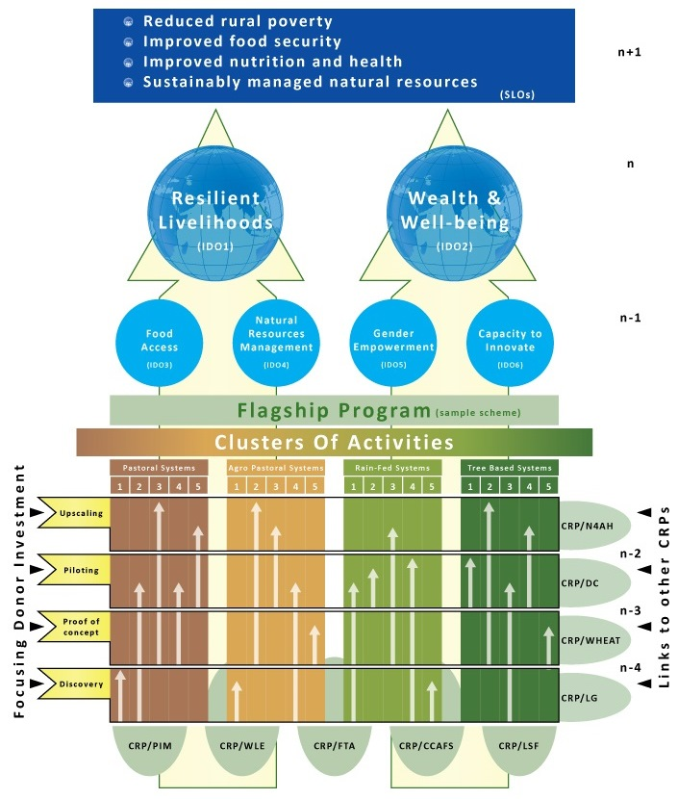
Phased Activities, ALS, Flagships, IDOs
Title
Dryland Systems Results & Management Framework
Framework integrates Activities, Outputs and Outcomes
Follows 4-phased research pathway
Leads to 6 intermediate development outcomes (IDOs)
Delivers on 4 SLOs
Entry points at activity level with other CRPs
Donors can target investments on activities at specific phases

Slide 36
Current activities for NA&WA Flagship
  Conservation agriculture
  Small ruminant productivity
  Water & land productivity in irrigated systems
  Policies on water resources
  System vulnerability
  Bio-economic farm
  Innovation platforms &scenarios
  High value chain clusters
  In situ biodiversity
  Water harvesting & soil conservation
  Water & land productivity in rainfed systems
  Managing salinity
  Seed system & dissemination
  Cereal & legume species adaptation
  Cereal and legume system IPM
  Managing agropastoral rangelands
  Post-harvest & market access
  Cereal aggregation approach
19. Gender in drylands

Slide 37
Clustering - NA&WA Flagship
Recommended Clusters | Activities under each cluster
Cluster 1 – Sustainable management of marginal ecosystems | 1.1. Conservation agriculture 1.2. Livestock productivity and Health 1.3. Water and land management 1.9. In situ biodiversity 1.10. Water harvesting and soil conservation 1.16. Managing rangelands
Cluster 2 – Sustainable intensification in favorable ecosystems | 1.2. Livestock productivity and Health 1.11. and 1.12. Sustainable water and land productivity in irrigated systems 1.13. Seed system & dissemination 1.14 Cereal & legume species adaptation 1.15. Cereal and legume system IPM New. Improving agronomic practices

Slide 38
Clustering - NA&WA Flagship
Recommended Clusters | Activities under each cluster
Cluster 3 – Developing and scaling innovation capacity | 1.5. Reducing system vulnerability and improving resilience (or System analysis) 1.6. Bio-economic modeling 1.7. Innovation platforms
Cluster 4 - Markets and Policies | 1.4. Policies 1.8. High value chains 1.17. Post-harvest & market access 1.18. Cereal aggregation approach
Cluster 5 – Gender in Drylands | 1.19. Gender in drylands

Slide 39
Coming .. Move to Flagship by ALS instead of by region
Pastoral ALS
Agropastoral ALS
Intensive rain-fed ALS
Irrigation-based ALS
Tree-Cropping ALS
Better integration among regions
Better collaboration between CG centers
Better linkage with other CRPs

Slide 40
Concluding remarks …
Integration
Harmonization
New science
Clustering
Partnership
Bring other CG-centers in the NA&WA flagship
Linkage with other CRPs
Mapping W3

Slide 41
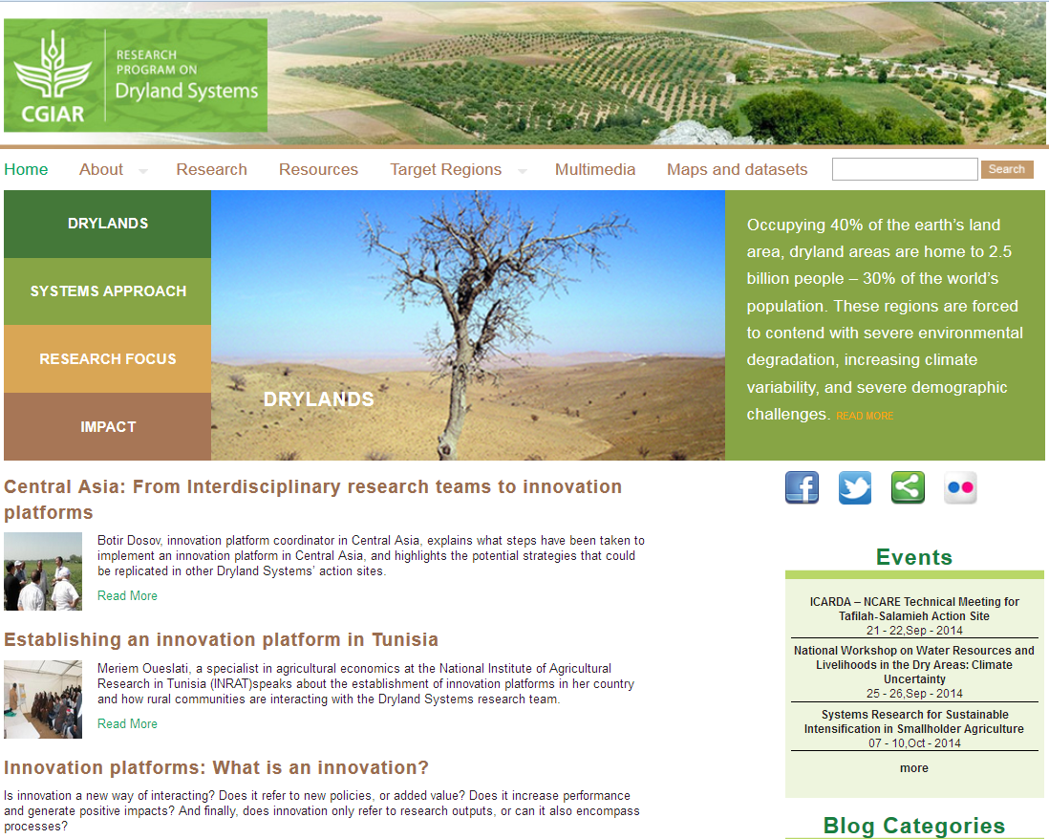
http://drylandsystems.cgiar.org/

