Slide 1
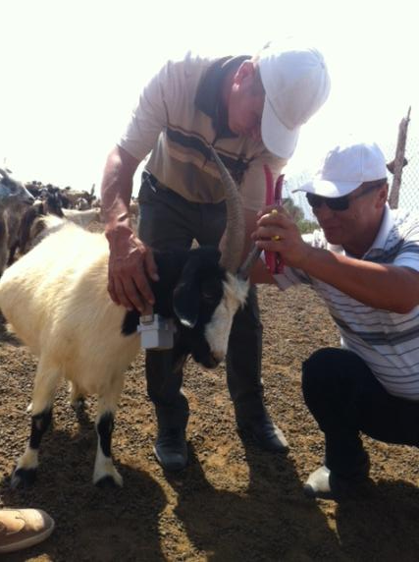
Using Animal GPS Collars
Karakalpakstan site

Slide 2
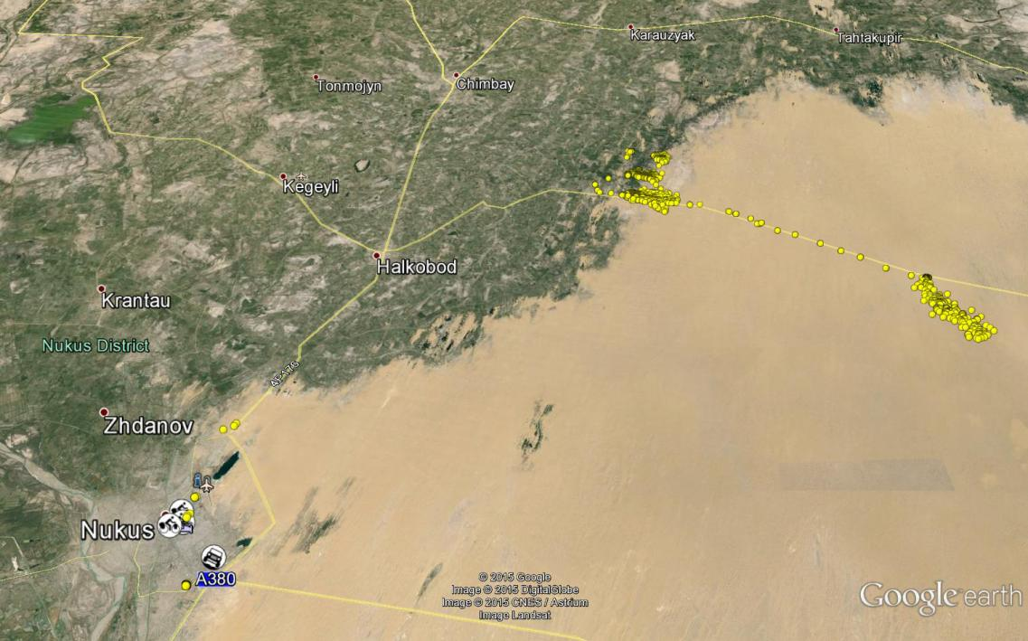
Route of herds movement in Karakalpakstan
The GPS collars were deployed on 20 August 2015

Slide 3
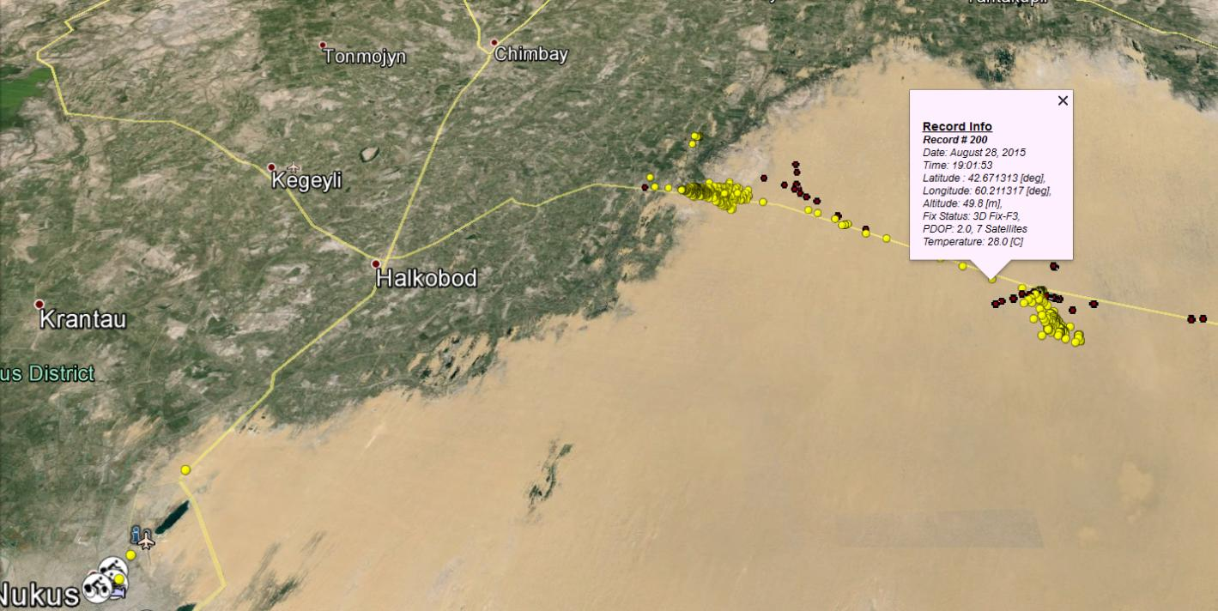
Route of herds movement in Karakalpakstan along the site where vegetation sampling took place

Slide 4
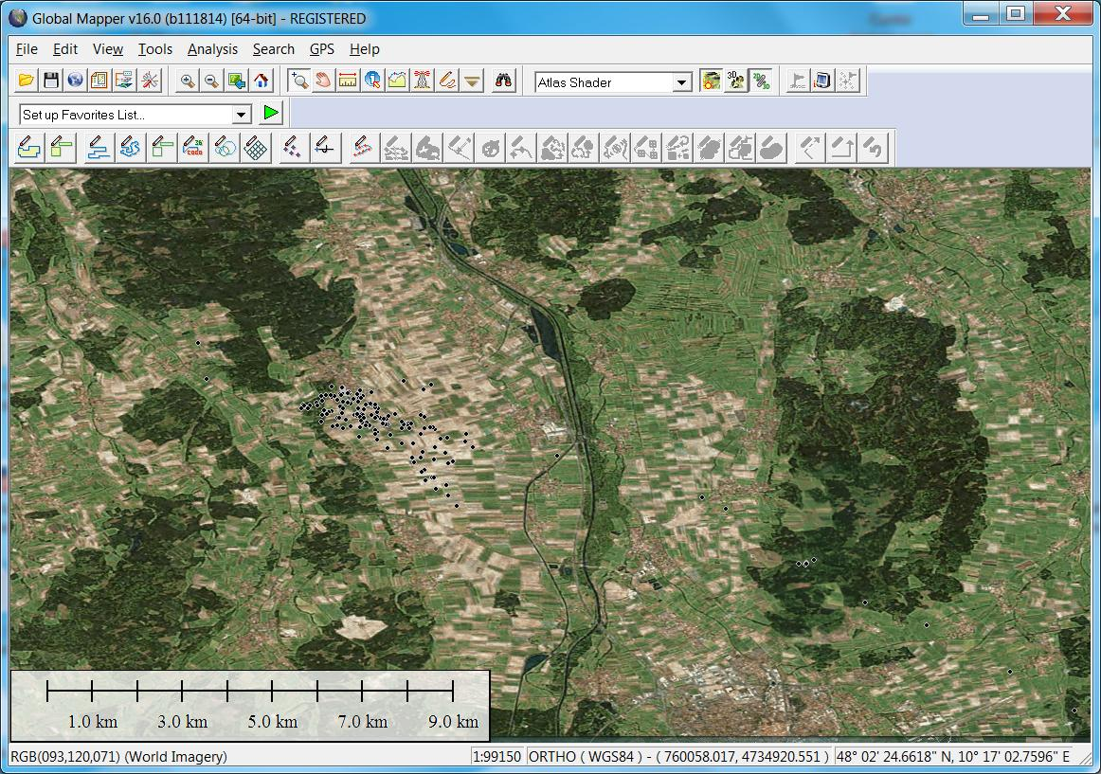
Grazing on crop fields

