Slide 1



Integrated Crop-Livestock Conservation Agriculture for Sustainable Intensification of Cereal-based Systems in North Africa and Central Asia
Presentation of Project achievements 2015: Tajikistan
3rd Coordination and Project Closing Meeting (CPCM)
04th – 06th April 2016, Hotel Ayass,
Amman, Jordan

Slide 2
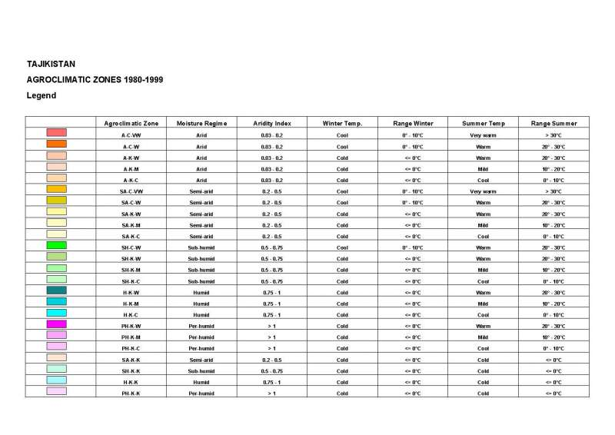
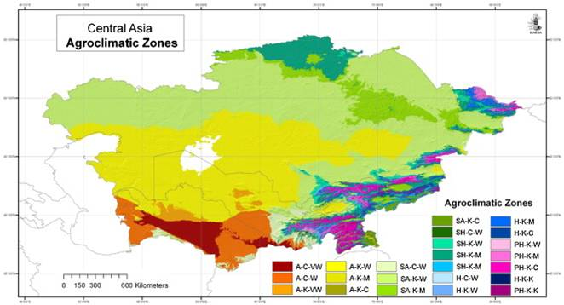
General Information: Map and climate
The climate in the region is mostly arid and semiarid, and strongly continental, with hot summers and cold winters. Average annual precipitation, which is concentrated in the winter and spring, is about 270 mm, and varies from 600 to 1000 mm in the mountainous zone, and 80-150 mm in the desert regions.

Slide 3
Goal: Enhanced sustainability of natural resource use, increased farm profitability through greater efficiencies, and improved livelihoods of resource-poor farmers through large scale adoption of CA technologies in crop-livestock production systems capitalizing on the system synergies of crops, livestock and soils.
Objective: Through integrated and participatory research with farmers, NARES will develop and test innovative approaches (i.e. reduced tillage) and management (i.e. improved cropping options) options and practices (i.e. residue management through restricted grazing) for the adoption of integrated CLCA by small holder farmers in the WANA region.
Indicator: Site and agro-ecosystems specific CA systems characterized and contribute to increased farmer income, compared to conventional systems. Sound component technologies of crop and livestock production have been integrated and adopted by farmers and disseminated by national systems partners at least in one action site in each target country.

Slide 4

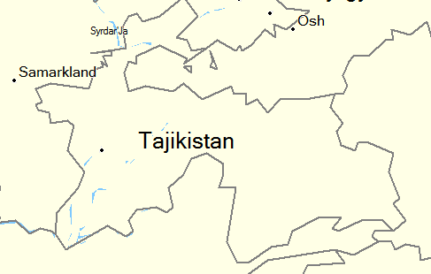


Collaborative Research Institutes:
Tajikistan Research Institute of Farming,
Tajikistan Research Institute of Soil Science,
Tajikistan Research Institute of Livestock,
Tajikistan Research Institute Economics
Fergana
Valley
  Fergana Valley
Rasht Valley
  Rasht Valley
Gissar
Valley
Dushanbe
  Gissar valley

Slide 5
Components
Understanding and responding to the trade-offs, constraints and opportunities for the adoption of the crop-livestock CA systems in project areas of CWANA.
1.1. Ex-ante evaluation for CA based technologies in CWANA.
1.2. Enhanced crop-livestock integration in CA through optimized stubble grazing strategies and increased fodder availability from forages or fodder shrubs
1.3. Site-specific conservation agriculture technology packages fine-tuned and disseminated for enhanced farm productivity, resource use efficiency and profitability.
2. Knowledge management and dissemination of the CLCA in CWANA region.

Slide 6
Ex-ante evaluation for CA based technologies in CWANA.

Slide 7
ADOPT – Adoption and Diffusion Outcome Prediction Tool
Methodology:
ADOPT is structured around four categories of influences on adoption
Characteristics of the innovation
Characteristics of the target population
Relative advantages of using the innovation
Learning of the relative advantages of the innovation
Notes:
The focus group discussion conducted a total of three focus group meetings organized for farmers across three project sites namely in Sharora settlement, Muksu village and B.Gafurov district. These meetings were held between July 12 and September 1, 2015.
Each focus group involved 15 farmers including a one or two households in order to hold a constructive dialogue on adoption of conservation agriculture. Each group discussed the important aspects of constraints for adoption of conservation agriculture their region.

Slide 8
CA Adoption: Peak of adoption and time
Prediction of adoption level according to time (Farmers)
Predicted years to peak adoption | 21.4
Predicted peak level of adoption | 59%
Predicted adoption level in 5 years from start | 13.9%
Predicted adoption level in 10 years from start | 44.2%
Factors affecting adoption are:
Triability of the innovation,
Complexity of the innovation,
Skills and knowledge of farmers to use the innovation
Size of the up-front cost of the investment

Slide 9
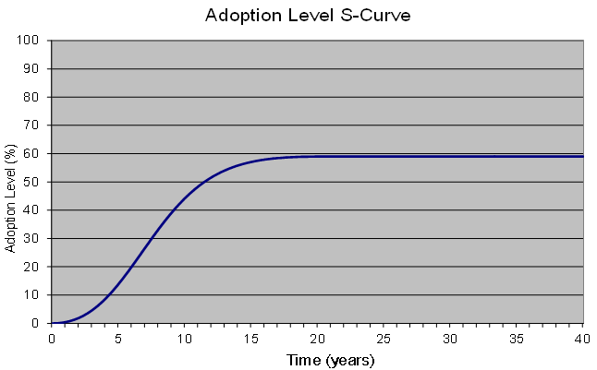
Predicted Adoption Curve of CA in Tajikistan

Slide 10
Economic evaluation of conservation agriculture technology and trade-offs of the different technology options proposed by CLCA project
Cost – Benefit Analysis Table 2014/2015
Cost-benefit variables |  | Tillage/crop
 |  | CT |  |  |  |  | NT
 |  | Maize | Mungbean |  | Soybean |  | Maize | Mungbean | Soybean
Grain yield (kg/ha) |  | 4108 | 1204 |  | 1737 |  | 3864 | 1412 | 1965
Grain yield price (USD/kg) |  | 0.3 | 1 |  | 1 |  | 0.3 | 1 | 1
Total income (USD/ha) |  | 1232 | 1204 |  | 1737 |  | 1159 | 1412 | 1965
Production cost (TC)(USD/ha) |  | 635 | 391 |  | 465 |  | 585 | 351 | 426
Net Return (USD/ha) |  | 597 | 813 |  | 1272 |  | 574 | 1061 | 1539
Indicators
 | Maize (CT vs NT) |  |  | Mungbean (CT vs NT) |  | Soybean (CT vs NT)
% Change in NR | -0.059 |  |  | 0.172 |  | 0.131
% Change in TC | -0.0784 |  |  | -0.102 |  | -0.084
IRR | 0.7525 |  |  | -1.687 |  | -1.56
Benefit/Cost Ratio | 1.94 |  |  | 3.08 |  | 3.75 | 1.98 | 4.02 | 4.61

Slide 11
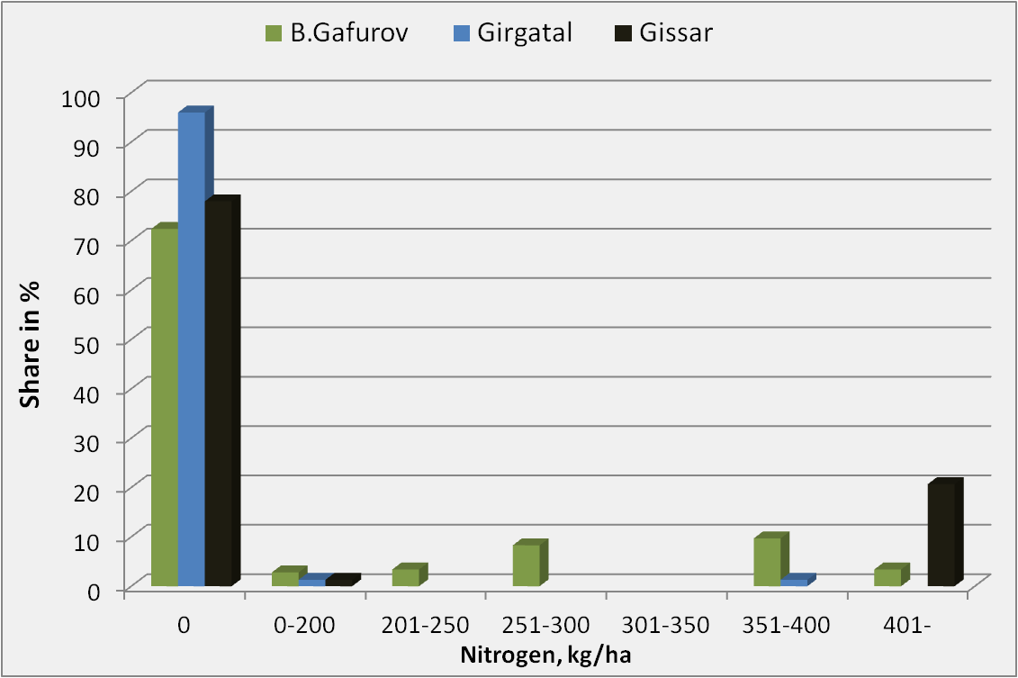
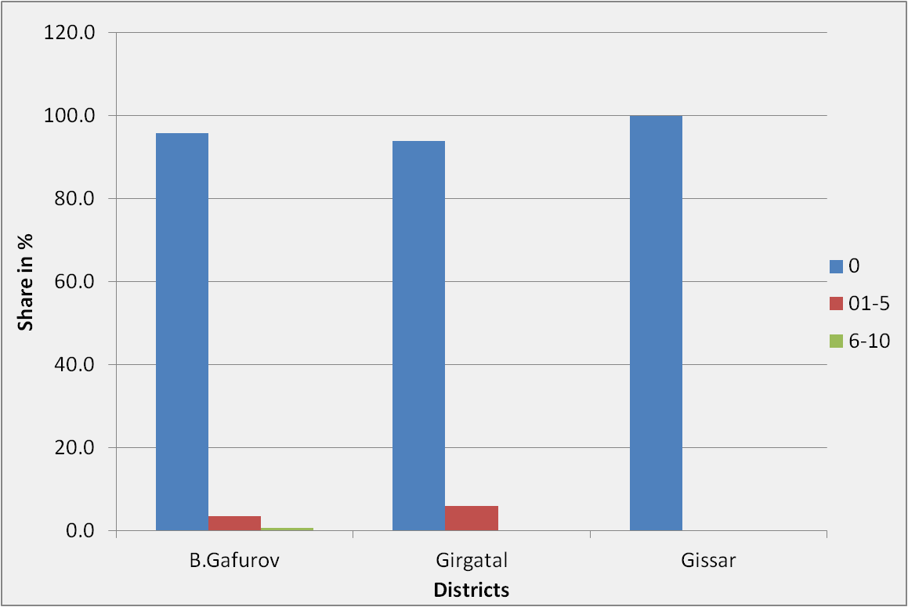
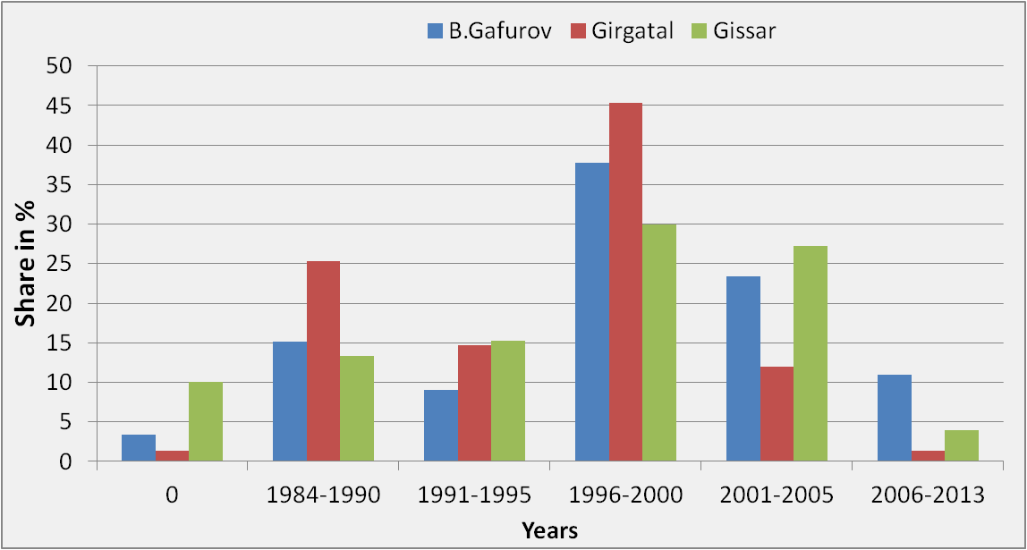
Nitrogen use in the project sites
Herbicide use at farm level in target areas
Districts | Crops | Livestock | Government jobs | Seasonal migratory works | Remittance
B.Gafurov | 31 | 19 | 13 | 15 | 22
Gissar | 30 | 19 | 17 | 14 | 20
Girgatal | 30 | 38 | 11 | 6 | 15
Current land management information
Sources of gross output returns of three
districts, %

Slide 12
Conclusion
Factors affecting in change of technology use include the access to the technical training, meeting, oral transmission, trust on technician and believe on technology introduced by scientist. High education level is one of the important constituents in the process of information and knowledge dissemination.
New crop management program, such as conservation agriculture, can be introduced to these farmers/households so that they can improve crop management practices their farming using economically effective farming practices.

Slide 13
Conclusion
Though farmers perceived technology as good thing to them, they still faced problems in application of technologies. These comprise of lacking of capital, direction of the government and extension, lack ensure of yield by compensation policy.
The main factors affecting adoption are triability of the innovation, the complexity of the innovation, the skills and knowledge of farmers to use the innovation and finally, the size of the up-front cost of the investment relative to the potential annual benefit from using the innovation.

Slide 14
Conclusion
In Tajikistan, some elements of CA can be found within several donor-funded projects implemented in the past, but their geographic coverage and number of beneficiaries (mostly farmers) are relatively small. In order to create awareness about conservation agriculture in Tajikistan to meet these challenges, three training courses organized for researchers and farmers.
All farmers emphasized that existing agricultural input prices very high because the country imports many fuel from abroad. Taking this into account conservation agriculture has a great potential and future in Tajikistan.

Slide 15
1.2. Enhanced crop-livestock integration in CA through optimized stubble grazing strategies and increased fodder availability from forages or fodder shrubs

Slide 16
Activity 1.2.1: Legume-cereal mixtures under no till and conventional tillage.
Activity 1.2.2: Triticale-forage pea-mulberry alley cropping.
Activity 1.2.3: Barley-forage pea-wild apricot alley cropping.

Slide 17
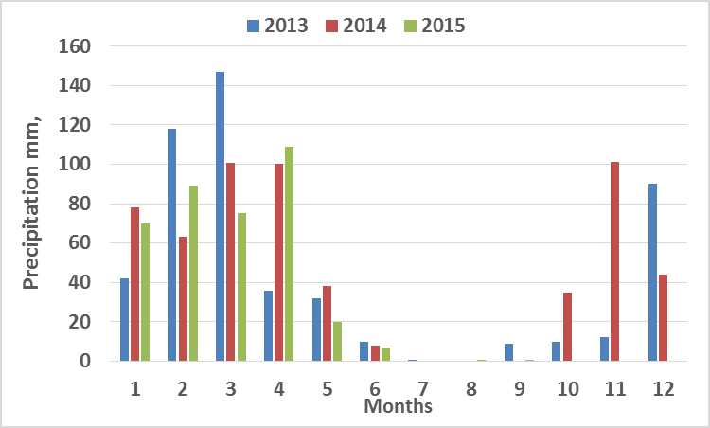
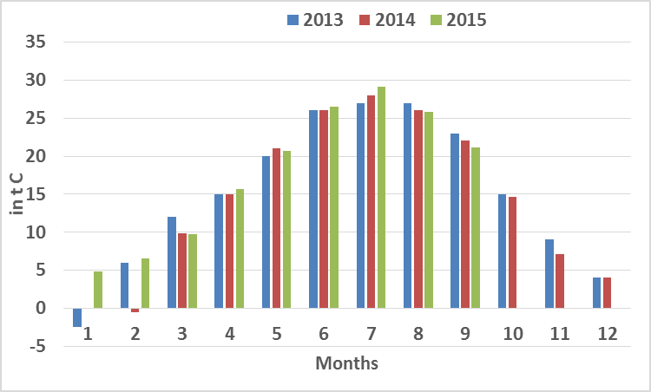
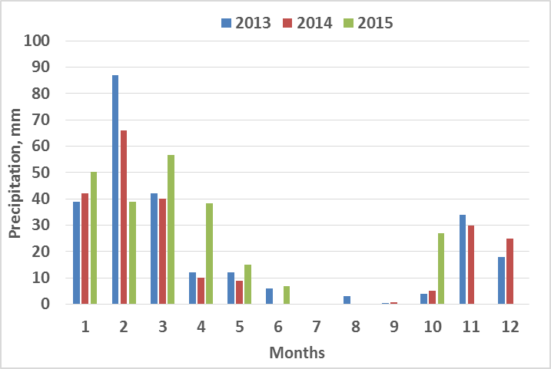
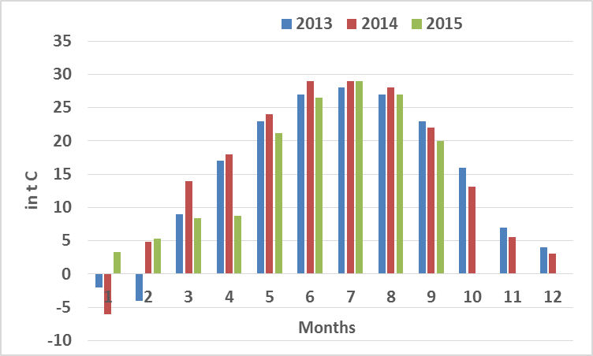
Climatic conditions of the project sites (2013-2015)
Mean annual precipitation, Gissar district
Average air temperatures in Gissar district
Mean annual precipitation, Fergana valley
Average air temperatures in Fergana valley

Slide 18
Soil parameters in rainfed conditions
Site | Soil depth | Humus content | Total elements in % |  | Available elements mg/kg
 |  |  | Nitrogen | Phosphorus | NO₃ | NH₄ | P₂O₅ | K₂O
Gissar | 0-30 | 1.12 | 0.106 | 0.160 | 6.78 | 1.78 | 11.00 | 11.5
 | 30-60 | 0.61 | 0.053 | 0.149 | 7.72 | 0.78 | 6.30 | 10.0
Fergana | 0-30 | 0.97 | 0.094 | 0.142 | 6.11 | 1.55 | 10.10 | 12.2
 | 30-60 | 0.72 | 0.066 | 0.137 | 5.45 | 0.63 | 5.38 | 09.54
Soil parameters of experimental site in irrigated site in Gissar
Soil depth | Humus content | Total elements in % |  | Available elements mg/kg |  |  |  | pH
 |  | Nitrogen | Phosphorus | NO₃ | NH₄ | P₂O₅ | K₂O
0-30 | 1.25 | 0.115 | 0.164 | 12.44 | 3.55 | 10.75 | 13.4 | 8.1
30-60 | 0.75 | 0.068 | 0.143 | 8.57 | 0.67 | 5.50 | 8.0 | 7.9

Slide 19
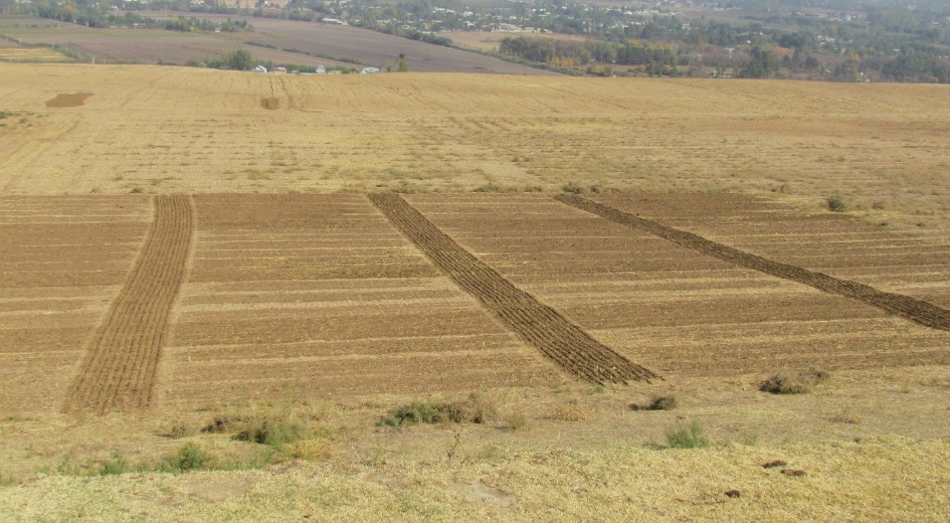
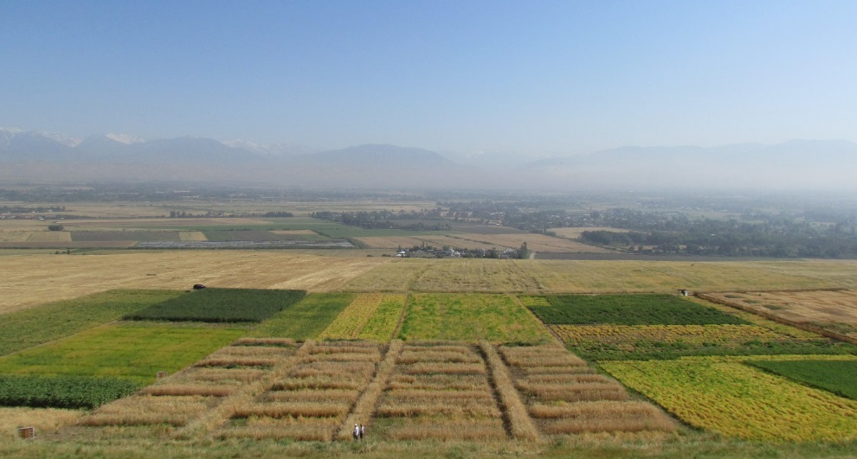
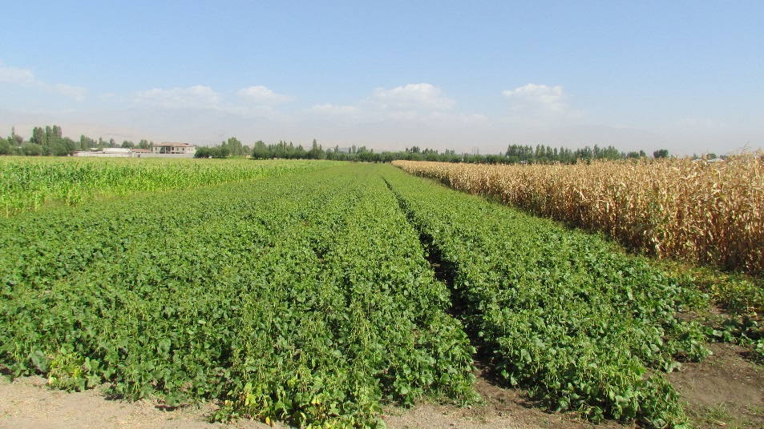
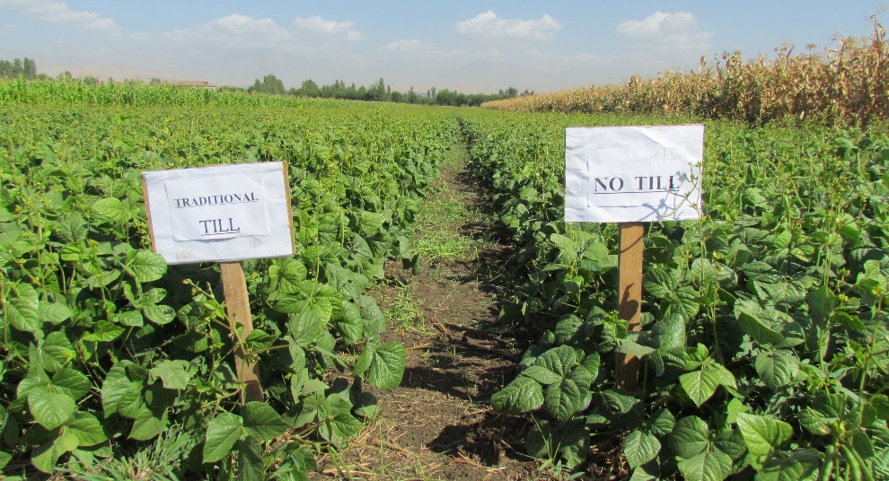
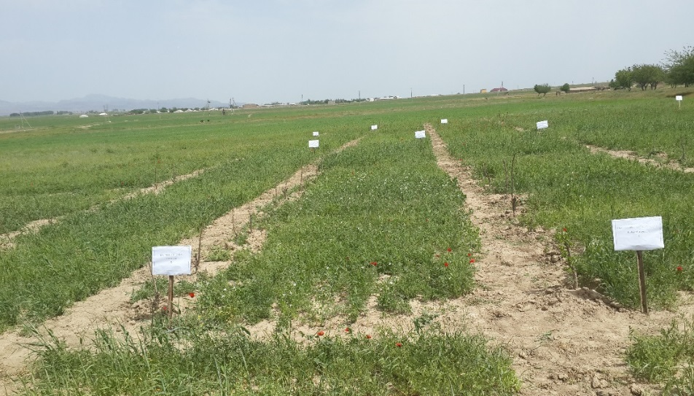
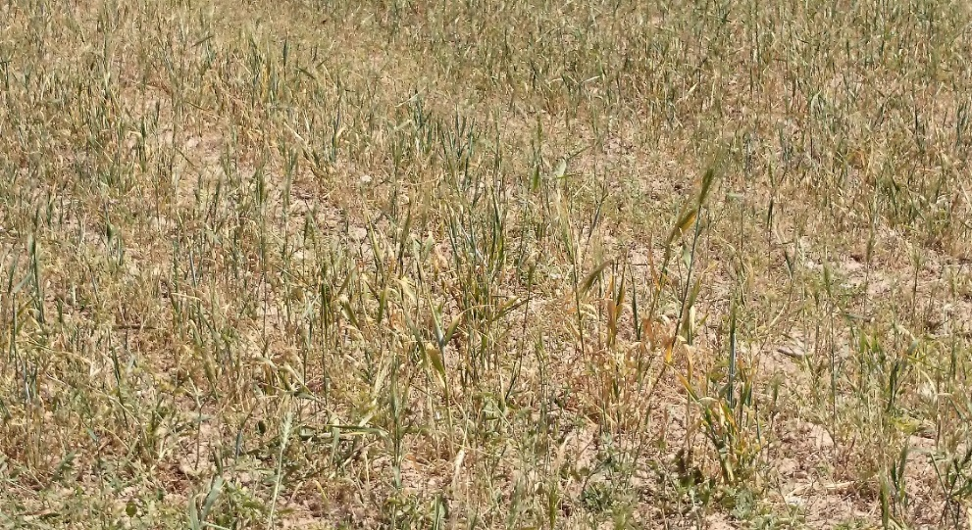

Slide 20

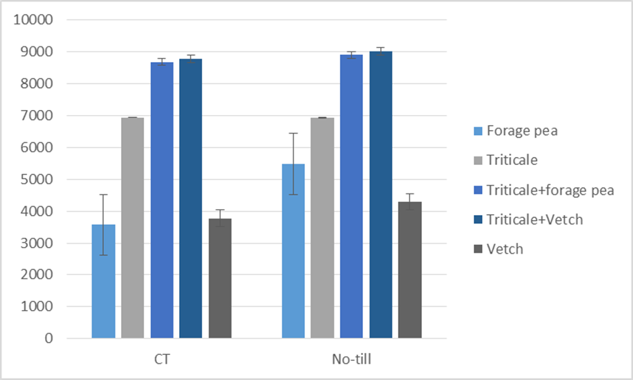
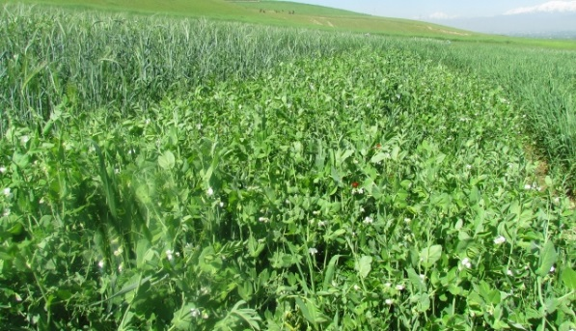
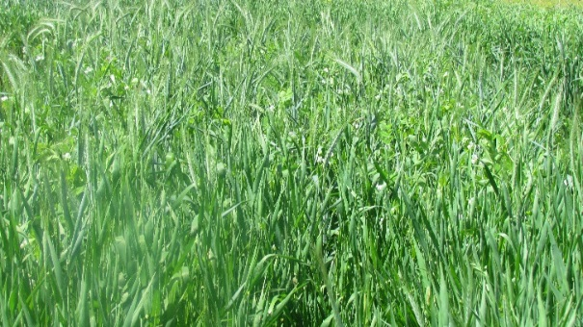
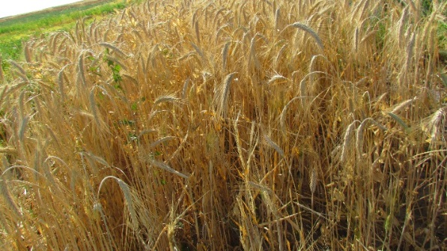
Activity 1.2.1: Legume-cereal mixtures under no till and conventional tillage.
The main objective of this study is to study effect of tillage methods on productivity of forage crops in rainfed areas of Tajikistan

Slide 21
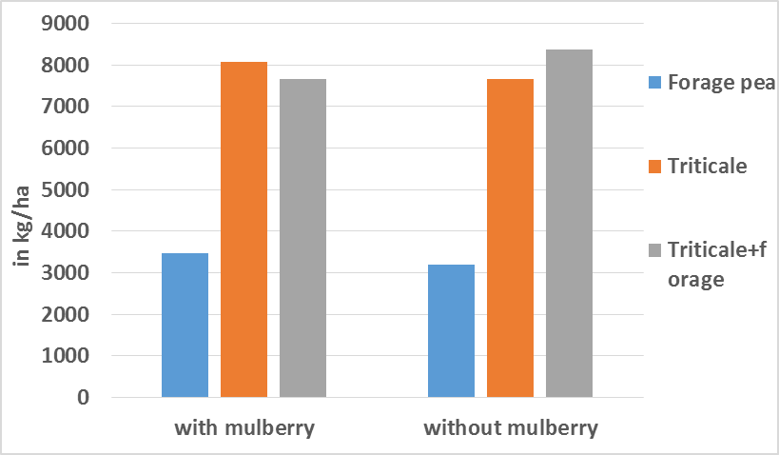

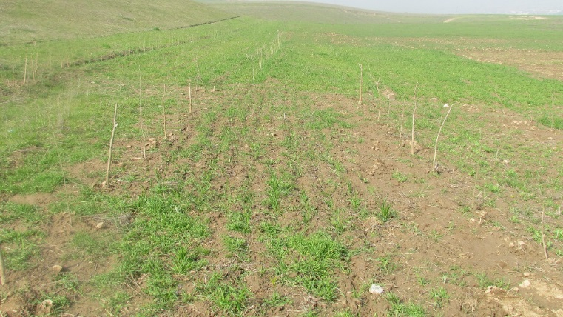
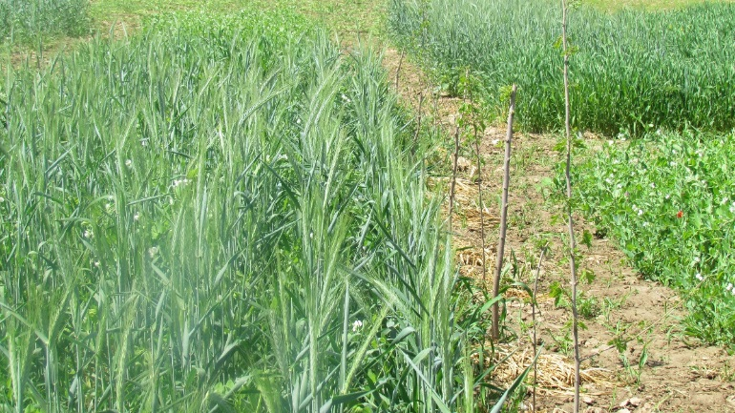
Activity 1.2.2: Triticale-forage pea-mulberry alley cropping.
The objective of this experiment was to increase forage production through alley cropping with mulberry trees.
Effect of alleys on forage yield of different agricultural crops

Slide 22
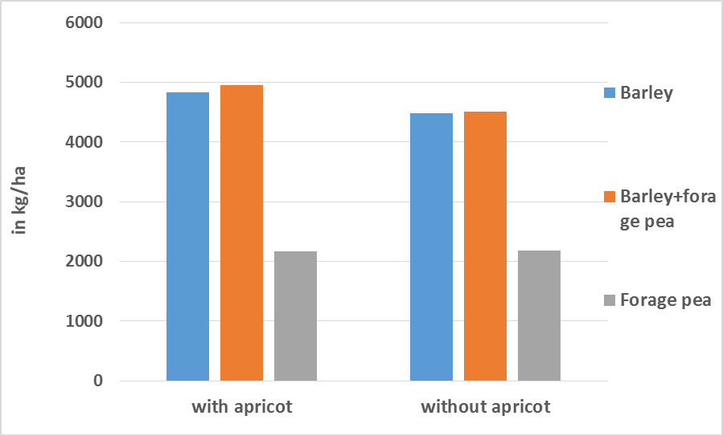
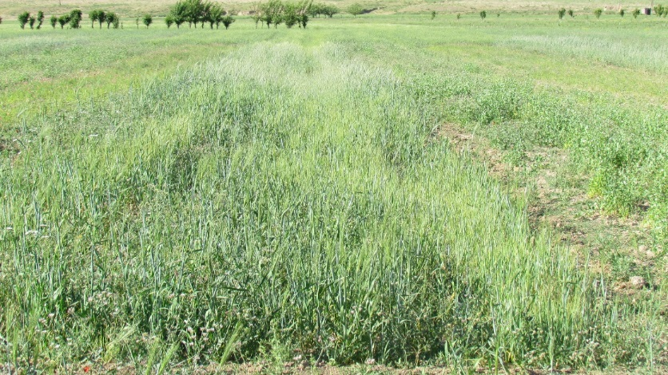
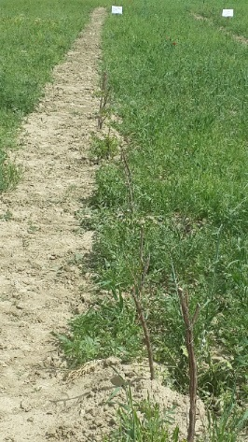

Activity 1.2.3: Barley-forage pea-wild apricot alley cropping
Effect of alleys on grain yield of different agricultural crops
Cost benefit analysis of different forage crops grain yield with and without wild apricot
Cost items | With wild apricot |  |  | No wild apricot
 | Barley | Barley+ forage pea | Forage pea | Barley | Barley+ forage pea | Forage pea
Yield kg/ha | 4833 | 4955 | 2164 | 4478 | 4515 | 2187
Crop price per kg/USD | 0.09 | 0.11 | 0.15 | 0.09 | 0.11 | 0.15
Yield USD | 435 | 545 | 325 | 403 | 497 | 328
Total variable costs USD | 160 | 150 | 130 | 160 | 150 | 130
Profit USD | 275 | 395 | 195 | 243 | 347 | 198

Slide 23
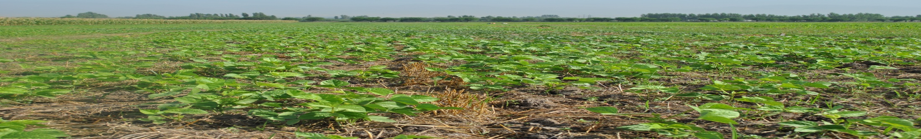
1.3. Site-specific conservation agriculture technology packages fine-tuned and disseminated for enhanced farm productivity, resource use efficiency and profitability.

Slide 24
Activity 1.3.1. Effect of tillage on productivity of winter wheat in the irrigated conditions of Gissar valley
Activity 1.3.2: Effect of planting method on productivity of winter wheat under irrigation in Gissar
Activity 1.3.3: Effect of tillage on the productivity of winter wheat under rainfed
Activity 1.3.4. Effect of tillage on the productivity of winter chickpea under rainfed
Activity 1.3.5. Effect of tillage methods on productivity of double cropped mungbean in the irrigated conditions of Gissar

Slide 25
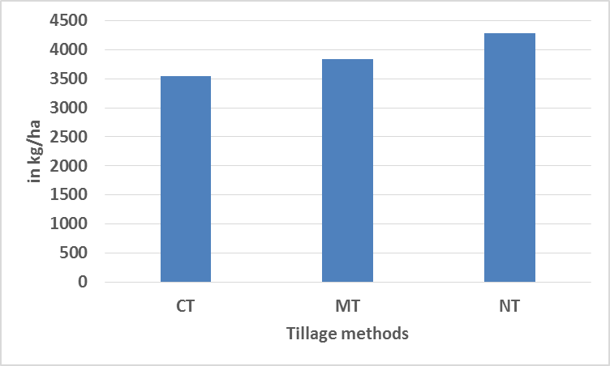
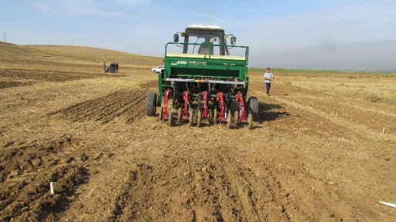
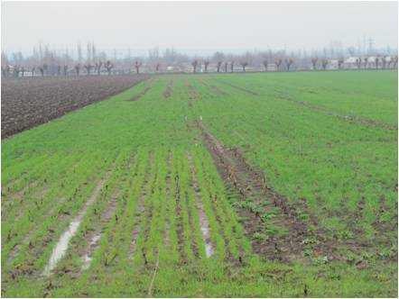
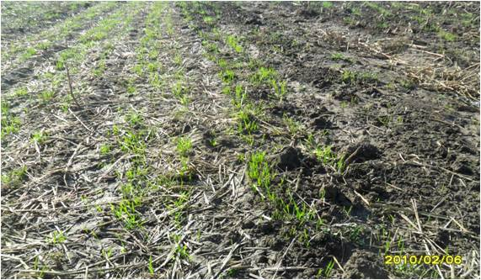
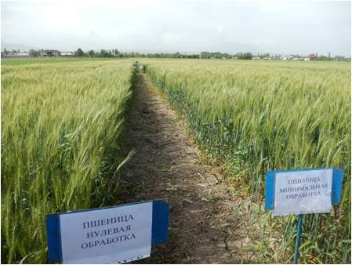
Activity 1.3.1. Effect of tillage on productivity of winter wheat in the irrigated conditions of Gissar valley
Effect of tillage method on grain yield of winter wheat in the irrigated areas (2015)
Cost benefit analysis of winter wheat under different tillage methods
Cost items | Grain yield
 | CT | MT | NT
Yield kg/ha | 3540 | 3840 | 4280
Crop price per kg/USD | 0.22 | 0.22 | 0.22
Yield USD | 779 | 845 | 942
Total variable costs USD | 470 | 410 | 291
Profit USD | 309 | 435 | 651

Slide 26
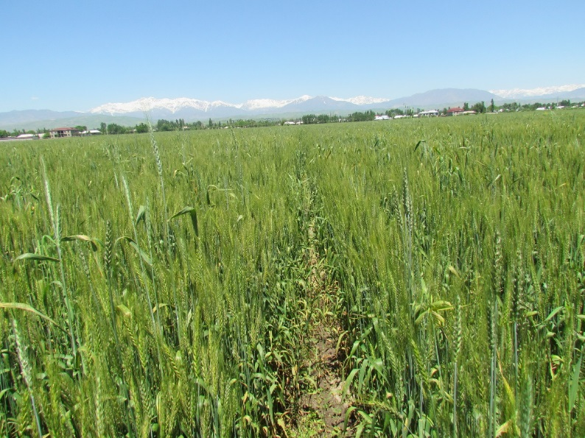
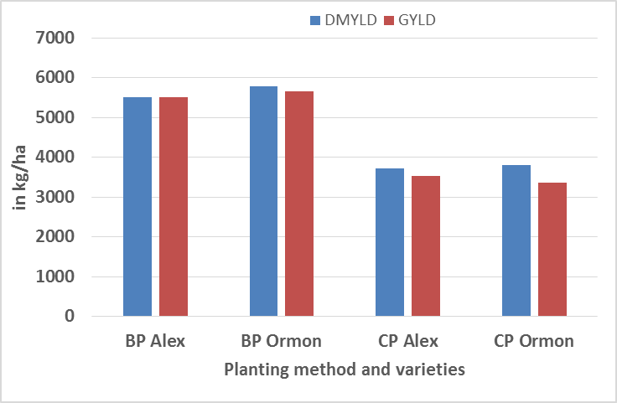
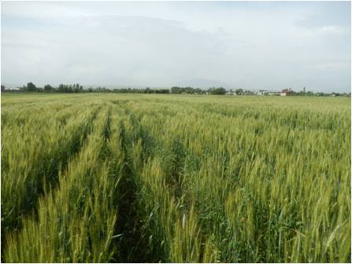
Activity 1.3.2: Effect of planting method on productivity of winter wheat under irrigation in Gissar
Effect of planting method on productivity of winter wheat
Economics of planting methods on winter wheat productivity
Cost items | BP |  | CP
 | Alex | Ormon | Alex | Ormon
Yield kg/ha | 5510 | 5650 | 3520 | 3360
Crop price per kg/USD | 0.22 | 0.22 | 0.22 | 0.22
Yield USD | 1212 | 1243 | 774 | 739
Total variable costs USD | 370 | 370 | 550 | 550
Profit USD | 842 | 873 | 224 | 189

Slide 27
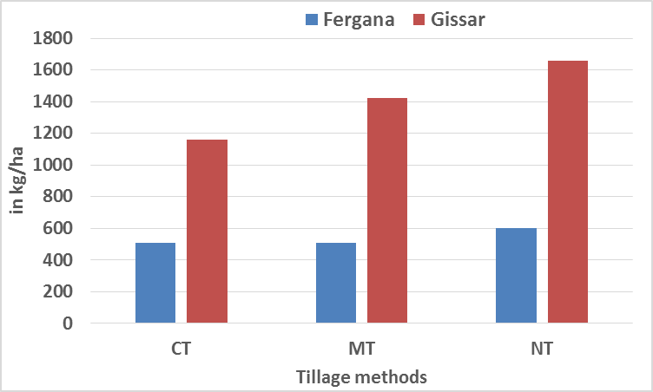
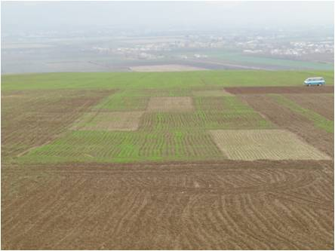
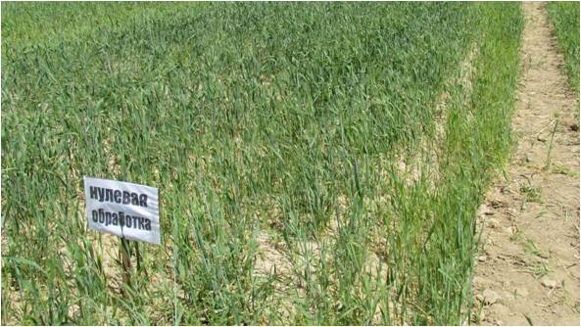
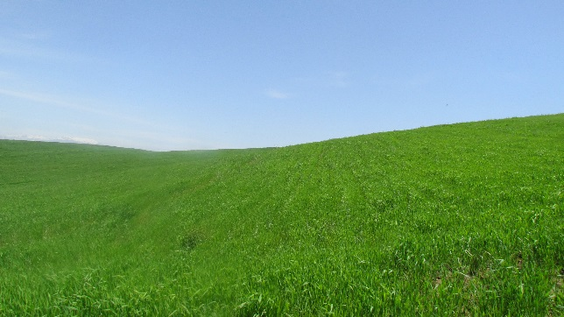
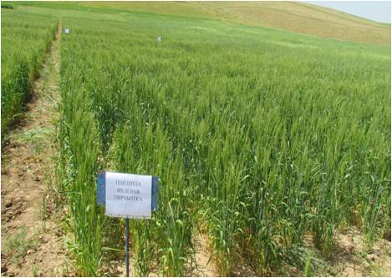
Activity 1.3.3: Effect of tillage on the productivity of winter wheat under rainfed
Effect of tillage on the productivity of winter wheat under rainfed

Slide 28
Activity 1.3.3: Effect of tillage on the productivity of winter wheat under rainfed
Cost benefit analysis of winter wheat under different tillage methods
Cost items | Fergana |  |  | Gissar
 | CT | MT | NT | CT | MT | NT
Yield kg/ha | 510 | 510 | 602 | 1160 | 1420 | 1660
Crop price per kg/usd | 0.5 | 0.5 | 0.5 | 0.5 | 0.5 | 0.5
Yield USD | 255 | 255 | 301 | 580 | 710 | 830
Total variable costs | 372 | 322 | 272 | 372 | 322 | 272
Profit | -117 | -67 | 29 | 208 | 388 | 558

Slide 29
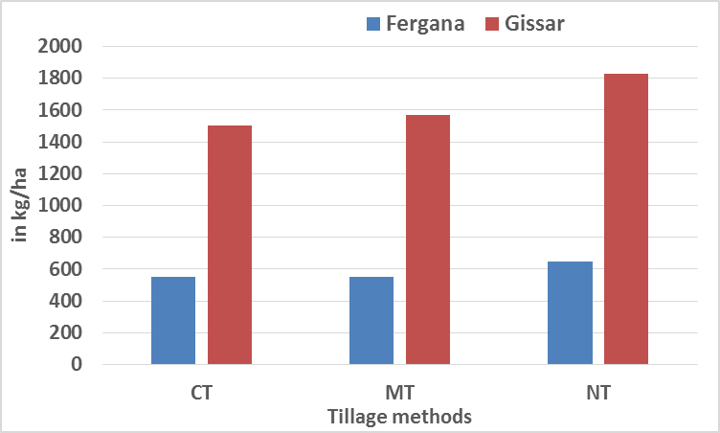
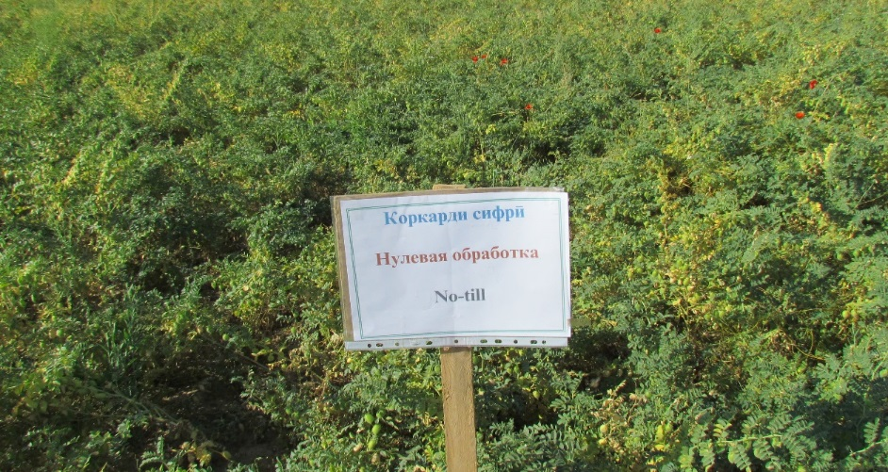
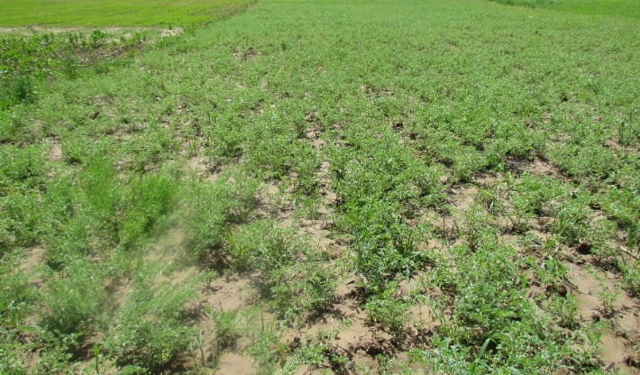
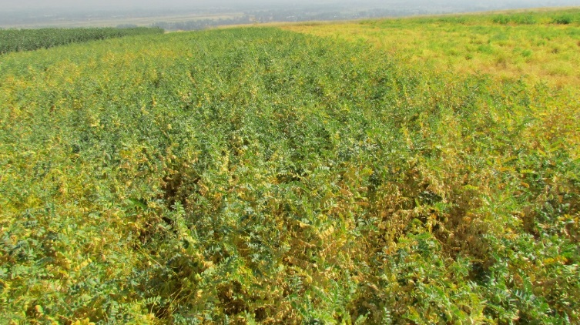
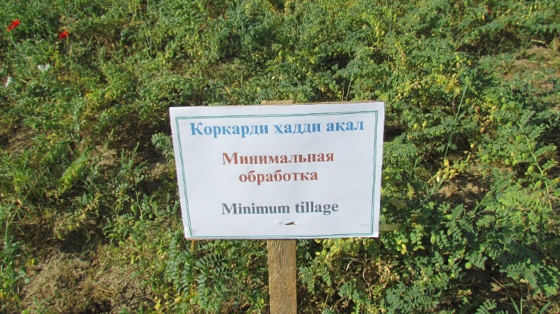
Activity 1.3.4. Effect of tillage on the productivity of winter chickpea under rainfed
Analysis of variance of grain yield
Effect of tillage on productivity of winter chickpea
Source of variation d.f. s.s. m.s. v.r. F pr.
Location 1 4.54140 4.54140 51.97 <.001
Location.tillage 4 0.53843 0.13461 1.54 0.233
Residual 18 1.57290 0.08738
Total 23 6.65273

Slide 30
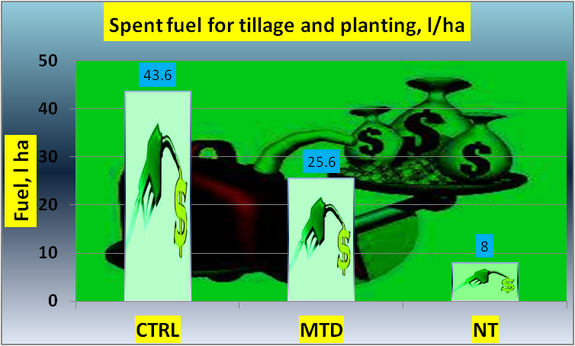
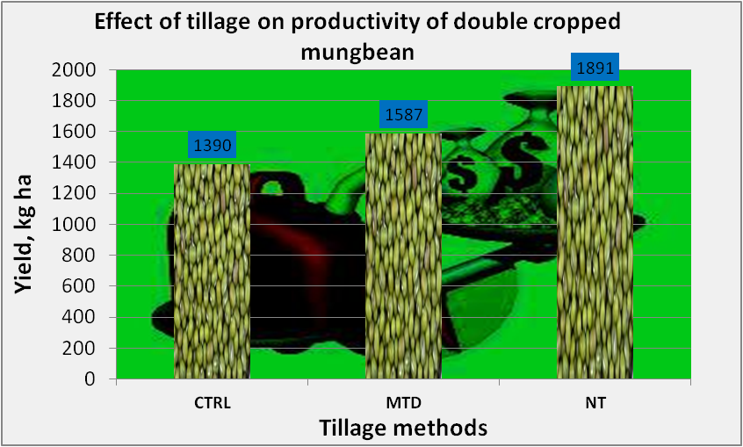
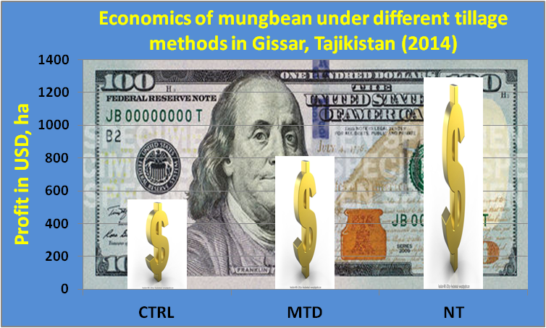
Activity 1.3.5. Effect of tillage methods on productivity of double cropped mungbean in the irrigated conditions of Gissar

Slide 31
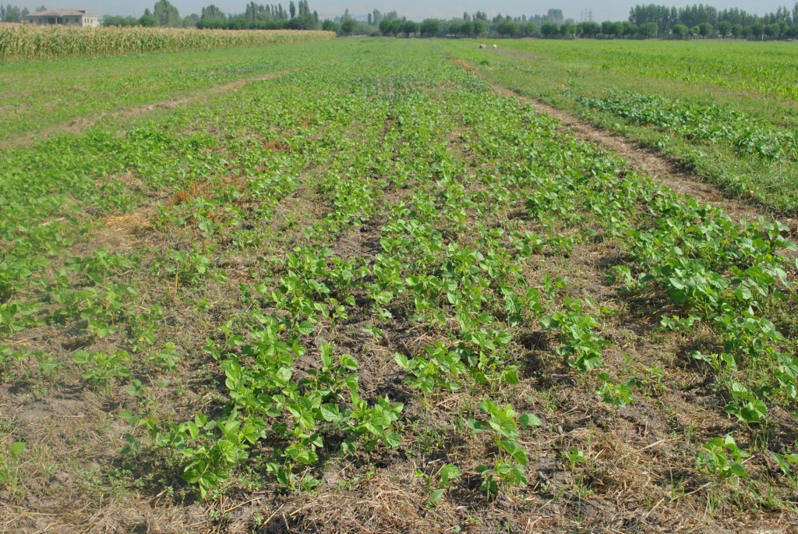






Slide 32
Component 2: Knowledge management & dissemination of the CLCA in CWANA

Slide 33
Information on PhD student in Tajikistan
Name PhD student | Title | Duration of the research | Duration of support by project | Activity involved in the project | Supervisor from Tajikistan | Supervisor from ICARDA
Yatimov Bakhrullo | Effect of tillage method on productivity of winter wheat in Tajikistan | 2013-2016 | 2013-2016 | 1.3.1. | Prof. Saidzamol Saidov | Dr. Aziz Nurbekov

Slide 34




Field days
Locations | Number of participants | Male | Female
Rasht valley | 62 | 55 | 7
Gissar valley | 112 | 98 | 14
Fergana valley | 70 | 59 | 11
Gissar valley | 90 | 72 | 18

Slide 35


Two seminars organized
44 participants including 15 female
27 participants including 2 female

Slide 36
Publications
Nurbekov Aziz, Tanzila Ergasheva, Boubaker Dhehibi, Amir Kassam and Hichem Ben Salem. Can conservation agriculture address land and water challenges in Central Asia? "Regional Economic Cooperation in Central Asia: Agricultural Production and Trade (ReCCA)". 24-26 November, 2014, Halle (Saale), Germany.
Nurbekov A., A.Kassam, A.Musaev, D.Sydyk, Z.Ziyadullaev, D.Feindel, H.Muminjanov and J.Turok. Effect of tillage methods on productivity of winter wheat in the irrigated conditions Central Asia and the Caucasus. 18th International Soil Conservation Organization Conference May 31 – June 5, 2015 El Paso, Texas, USA.
Nurbekov A., A. Kassam, A.Mirzabaev, J. Turok, D. Sydyk and Z. Ziyadullaev. Possible role for Conservation Agriculture in climate change adaptation and mitigation in Central Asia: A preliminary review. “Agriculture and climate change in transition economies”. 17-19 June 2015. Halle (Saale), Germany.
Asoev N.A., Ibragimov N.I., Nurbekov A.I., Yatimov B.N., Khomatov A., Winter wheat productivity under different tillage methods. Journal of Tajik Academy of Science.
Nurbekov Aziz, Tanzila Ergasheva, Dhehibi Boubaker, Harun Cicek and Hichem Ben Salem Attitudes towards conservation agriculture practices in Tajikistan. The role of agriculture in food security conference. 12 September 2015. Dushanbe, Tajikistan. Pp. 292. ISBN 978-99975-48-73-3.

Slide 37


Publications
Posters published in both languages in Russian and English in order to raise awareness on conservation agriculture in Tajikistan.
English: http://www.cac-program.org/news/detail/416
Russian: http://www.cac-program.org/ru/news/detail/417
In the Videos section: http://www.cac-program.org/video

Slide 38

Adoption area of conservation agriculture under IFAD/CLCA project in Tajikistan

Slide 39

Yield of agricultural crops under conservation agriculture in Tajikistan

Slide 40
Conclusions
Three seeders brought by ICARDA are the first ever no-till seeders in Tajikistan. This fact itself deserves an attention and praise.
No-till practices were found to be useful for increasing farmers’ income and improving their livelihoods which is very important in rainfed conditions of Tajikistan.
In rainfed legume-cereal based systems of Gissar valley, no-till proved to be more profitable, resource and energy saving
These results showed that alley cropping has good potential to increase forage production and increase profit ratio in Tajikistan.
Carried out awareness raising campaigns, establish and arrange demonstration sites, filed days and seminars wide adoption and promotion of CA

Slide 41
Conclusions
Two articles prepared on CA in Tajikistan with simple descriptions of CA technology
One brochure and one leaflet for each farm practice produced for each project site in Russian and Tajik languages
Two poster published in Russian and English
A journal article prepared and submitted for publication on economics of CA
Four field days organized
Two seminars conducted

Slide 42
General conclusions
It is increasingly recognized that a complete understanding is required of all the social and economic results of the CA farming system in order to guide component research into topics and techniques which will be applicable.
There is a need for special policy reforms in agriculture in order to shift from conventional agriculture into conservation agriculture.
Law on conservation agriculture is under discussion

Slide 43

Thank you for your attention

