Slide 1


Managing Scarce Water Resources in Irrigated Drylands of Central Asia
Dr. Vinay Nangia
Associate Professor, Tottori University
Senior Agricultural Hydrologist, ICARDA

Slide 2
Two Case Studies
Uzbekistan - ET-based Irrigation Scheduling to Improve WUE and build resilience
Kazakhstan – Valuation of Ecosystem Services for Improving Agricultural Water Productivity

Slide 3

ET-based Irrigation Scheduling to Improve WUE and Resilience in Uzbekistan

Slide 4
Hydromodule Zone (HMZ)
Central Asian farmers use the Soviet era-developed method of irrigation which divides the irrigated areas in Hydro Module Zones (HMZ)
Each HMZ has a set of crop-specific recommendations for irrigation based on:
  soil characteristics (thickness of soil layers, soil texture) and
  depth of groundwater table
  These recommendations have not been revised against changes in cultivars and fluctuations in groundwater table during past decades

Slide 5
How ET-based Irrigation Scheduling works?
ETc = Kc x Reference ET
Weather Data
From crop modeling of historic field trial data

Slide 6
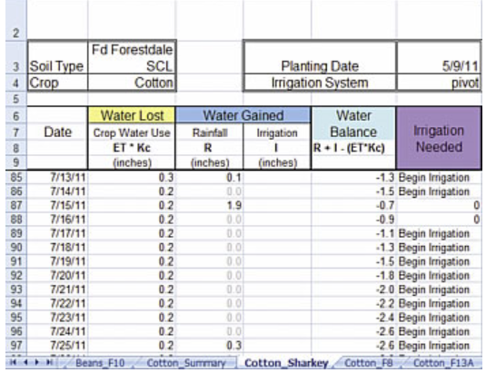

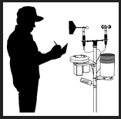
Experimental Design
Weather data
Soil moisture data
Soil moisture data
Hydro-module Zone I
Hydro-module Zone II
Hydro-module Zone VIII
Traditional
Irrigation
ET-based
Irrigation
Traditional
Irrigation
ET-based
Irrigation
Traditional
Irrigation
ET-based
Irrigation

Slide 7
Results
Site (HMZ) | Water applied (mm) |  | Yield (kg ha⁻¹) |  | Water productivity (kg m⁻³)
 | Conventional irrigation | ET-based irrigation | Conventional irrigation | ET-based irrigation | Conventional irrigation | ET-based irrigation
Khorezm (VIII) | 756 | 492 | 5700 | 5800 | 0.75 | 1.17
Fergana (I) | 542 | 359 | 4011 | 3985 | 0.74 | 1.11
Fergana (II) | 631 | 477 | 3975 | 4579 | 0.63 | 0.96
Fergana (VIII) | 620 | 407 | 3968 | 3500 | 0.64 | 0.86

Slide 8
Results
There was on average 32% saving of irrigation water and 50% increase in water productivity
There was excellent match between model-predicted and literature-reported values of Kc
The pilot area selected for research is representative of 35% of irrigated areas in Fergana Valley (241,407 ha) and Aral Sea Basin (79,566 ha)
Saved water can be used for supporting ecosystem services, expanding agriculture or for industrial and municipal purposes

Slide 9
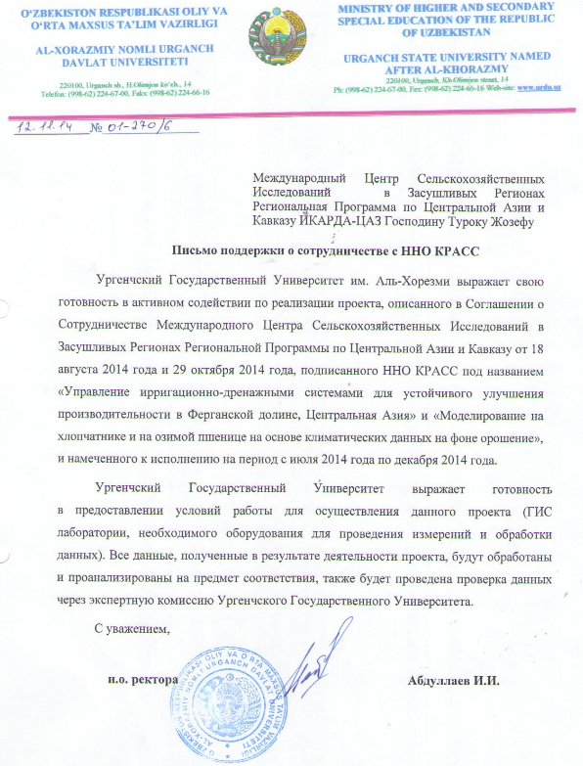
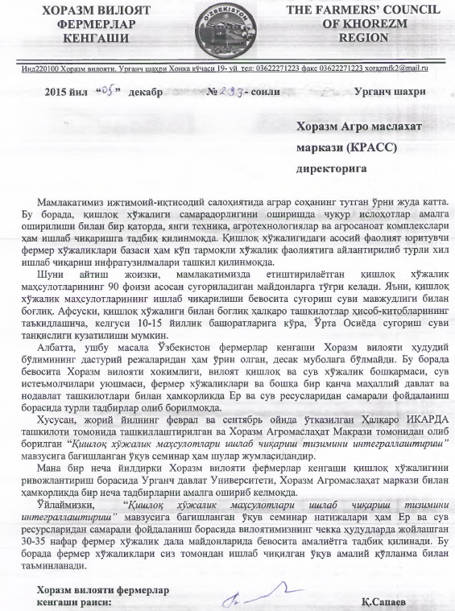
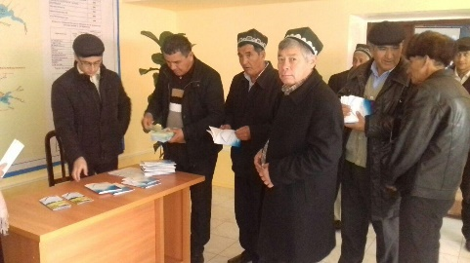
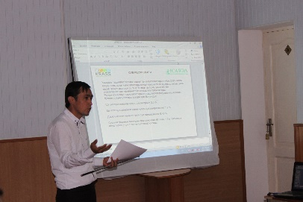
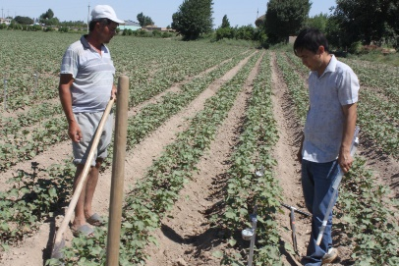
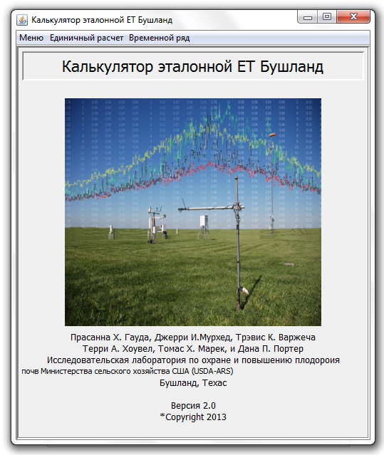
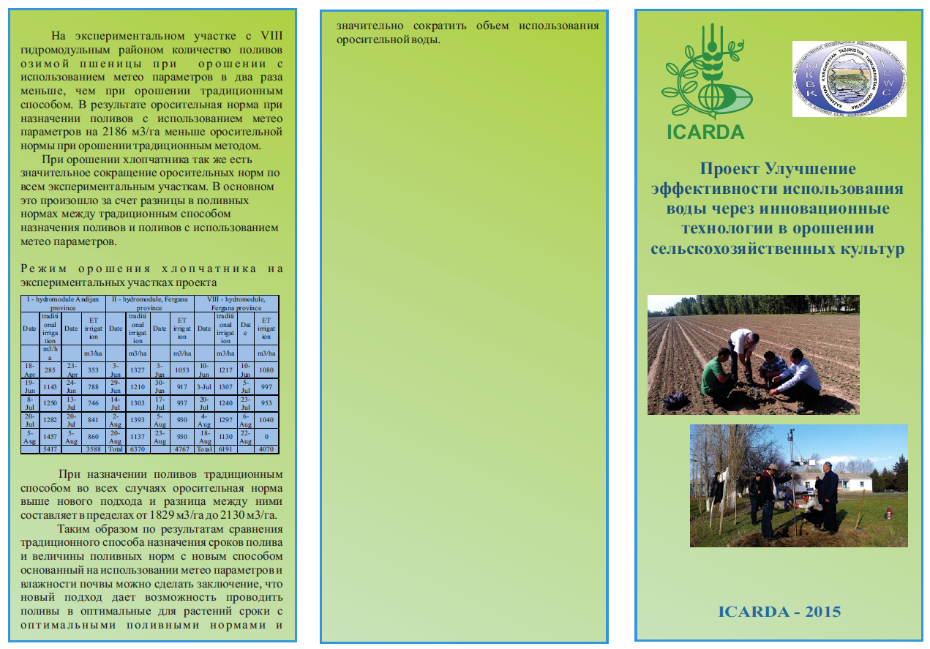
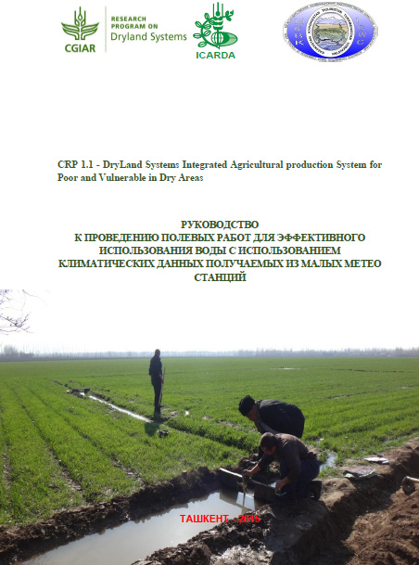
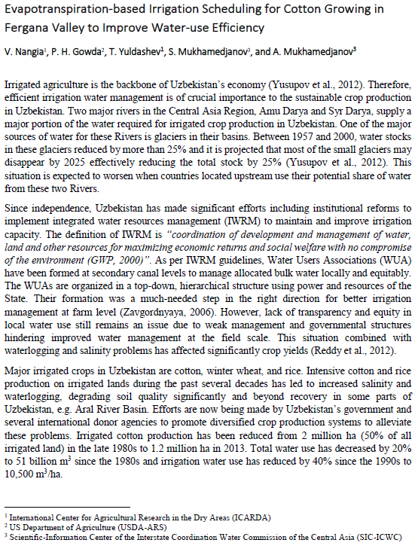
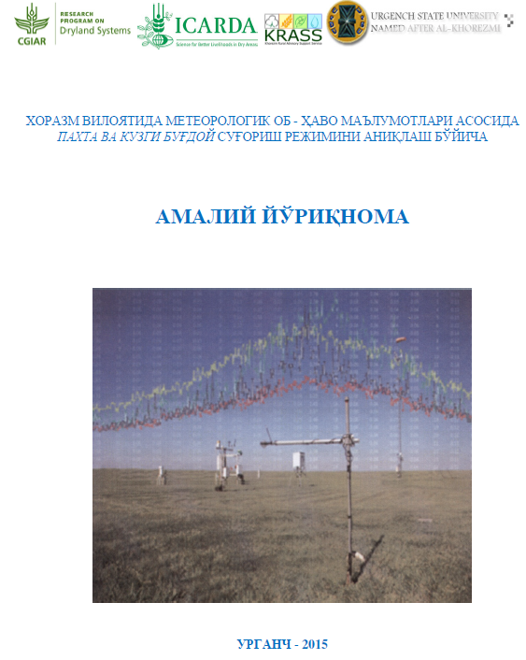
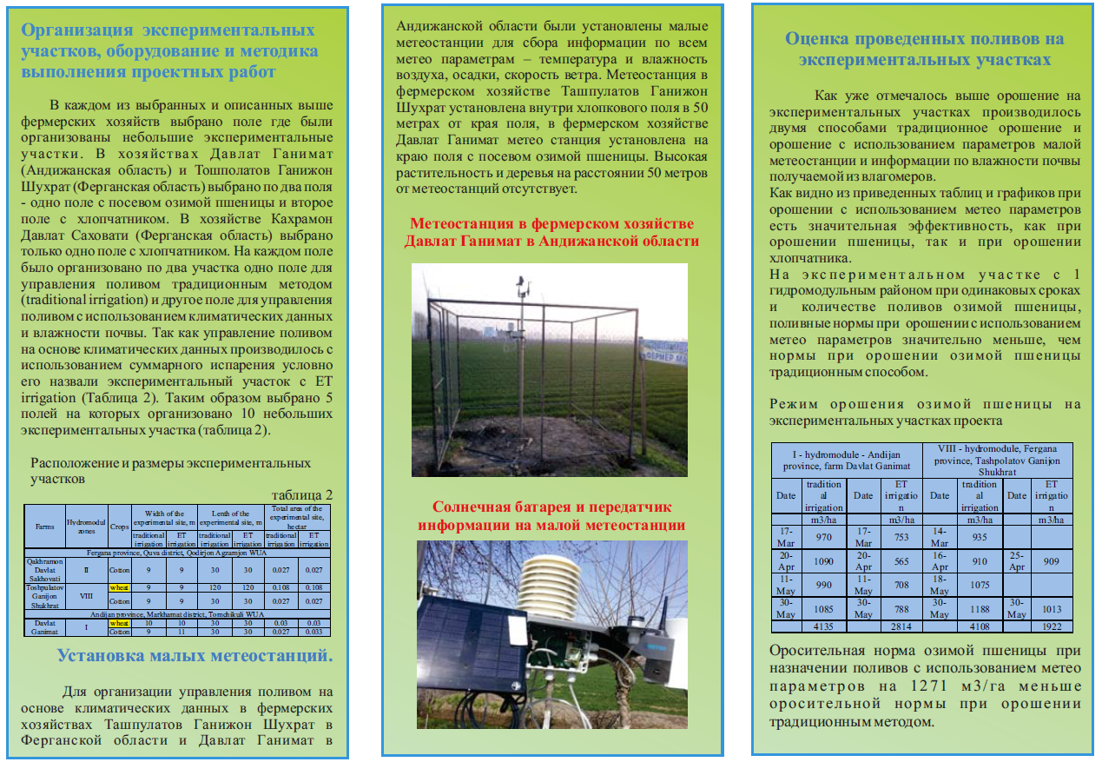
Outscaling and Succession Planning
Stakeholder training and participatory research
Testimonies from Hakimiyats and Provincial University
Russian version of Reference ET calculator
Brochures and Pamphlets
Handbooks and Policy Briefs
Publications

Slide 10


Valuation of Ecosystem Services for Improving Agricultural Water Productivity in Aral Sea Basin, Kazakhstan

Slide 11
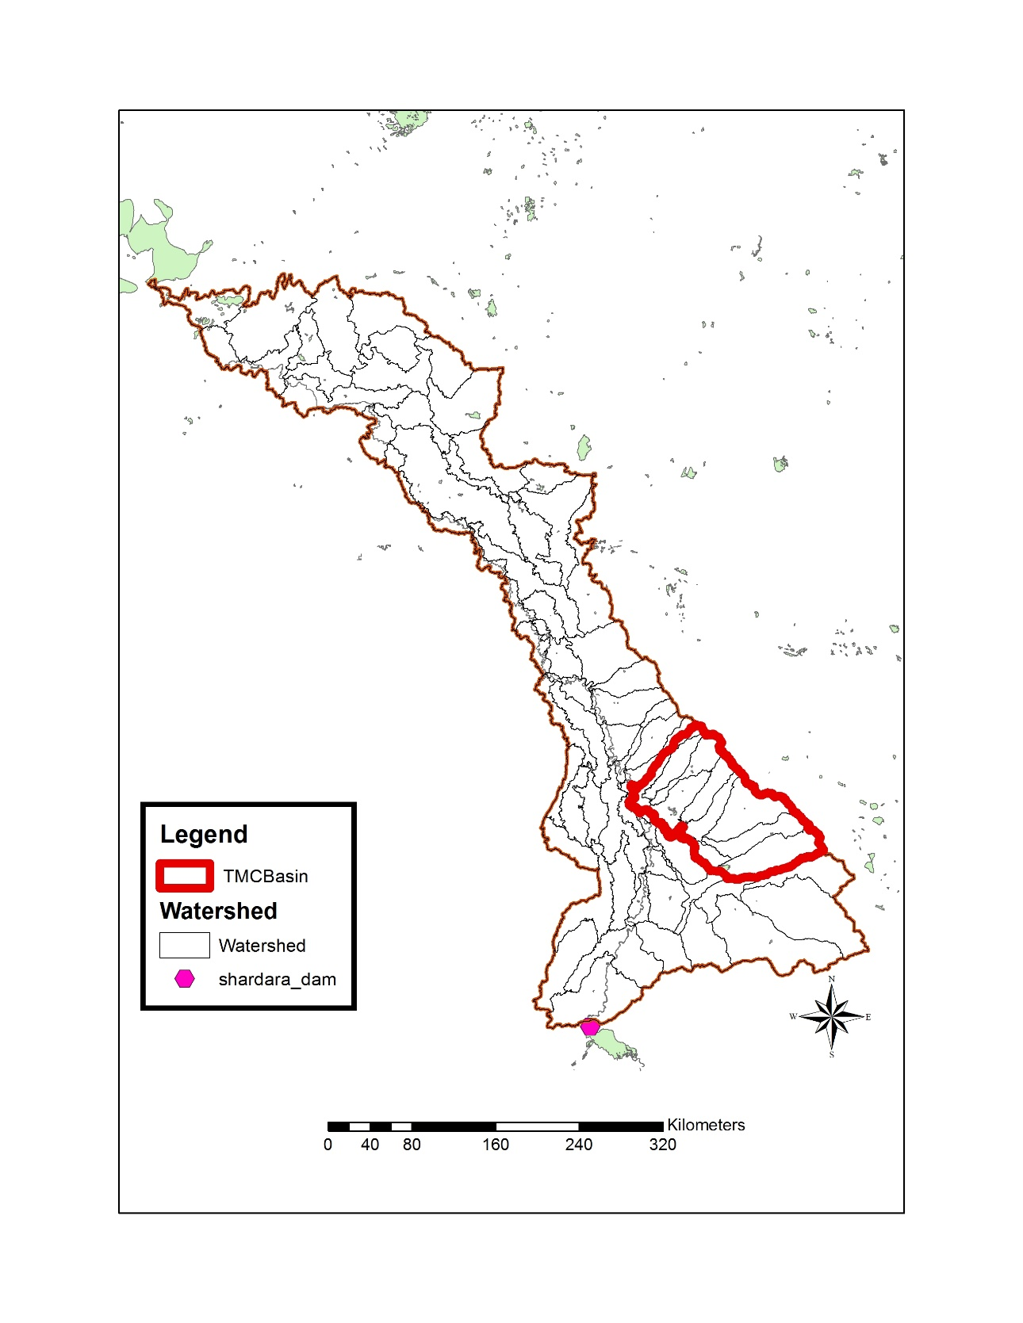
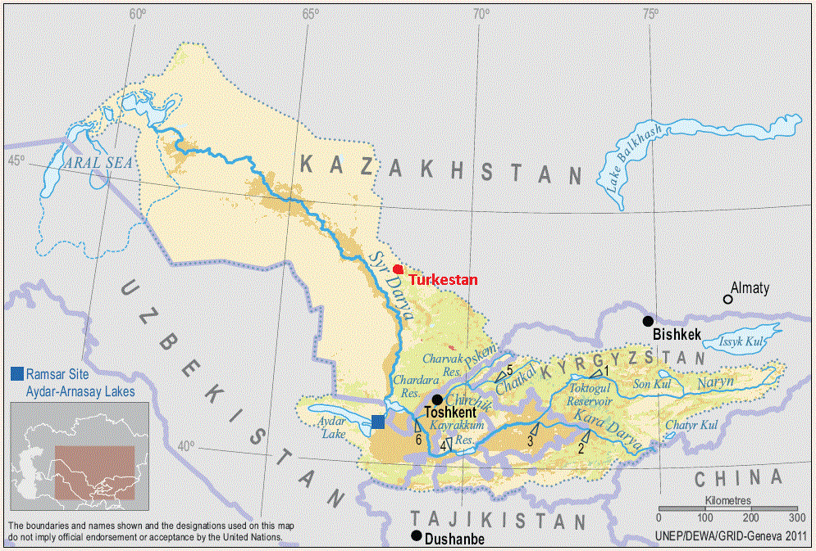
Study Location

Slide 12
Background
Chardara Reservoir was constructed:
  in southern Kazakhstan in 1965
  for irrigation and hydropower generation
  reservoir also supports many fragile ecosystems such as:
    the fishery and livestock
    riparian forests and rangelands
    human population
    tourism

Slide 13
Background (cont’d)
Agriculture consumes large amounts of water for irrigation of cotton, corn, alfalfa, cucumber, potatoes and grapes
Irrigation is inefficient, primarily flood irrigation is practiced - canals lose 30% of their water supply, while field level irrigation efficiency is only 50%
Farmers over irrigate due to an unreliable supply of water

Slide 14
Hypothesis of the study
Improving agricultural water management will lead to improvement of other downstream ecosystem services sharing same water, and
through the identification and valuation of main water-related ecosystem services, a plan can be developed for payment for improvement of agricultural water management

Slide 15

Methodology –Soil Water Assessment Tool (SWAT) Modeling
A GIS database of information about the study area includes information on elevation, land use, soil properties, agricultural management practices, reservoir inputs and outputs, water intake and supply
These data were used with the Soil Water Assessment Tool (SWAT) to conduct detailed evaluation of water usage and other agricultural management practices and their impacts on crop yields and return flows

Slide 16


Methodology –Resource Investment Optimization System (RIOS)
The objective of this component of study is to identify a suite of ecosystem services that are affected by the alternative agricultural practices modeled with SWAT, and then to evaluate changes in provision of these ecosystem services using the Resource Investment Optimization System (RIOS) model

Slide 17
RIOS Model
The RIOS model allows users to identify a set of alternative land use management practices and then identify the ecosystem services that result when these practices are allocated in different ways across the landscape
RIOS also allows users to optimize selected ecosystem services for a specified level of investment by identifying where on the landscape it is best to implement a suite of management practices

Slide 18
Alternative Practices Evaluated
Better fertilizer management
Better irrigation water management
Substitution of existing crops with more water efficient crops
Retirement or alternative uses for marginal crop land
Improved or targeted policies and subsidies

Slide 19
Ecosystem Services Modeled
Agricultural crop production
Baseline water discharge from agricultural lands

Slide 20
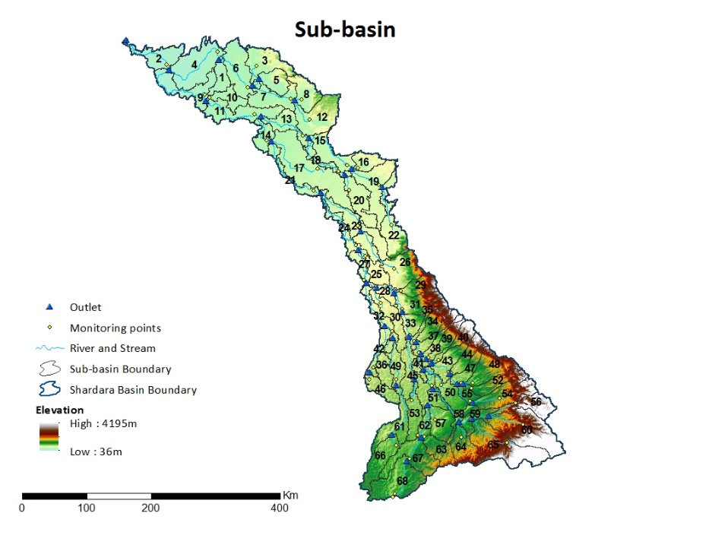
Results

Slide 21
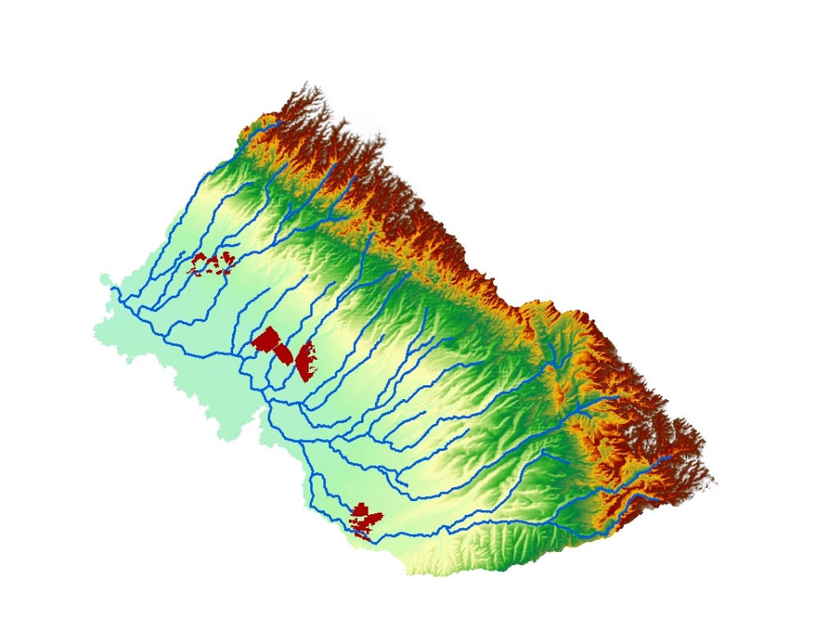
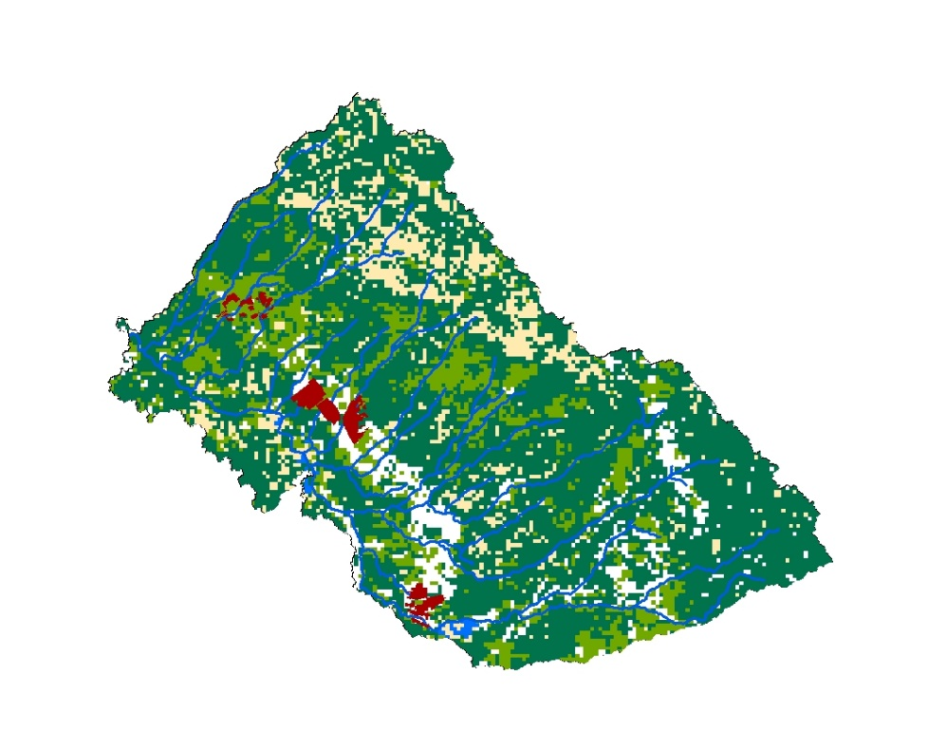
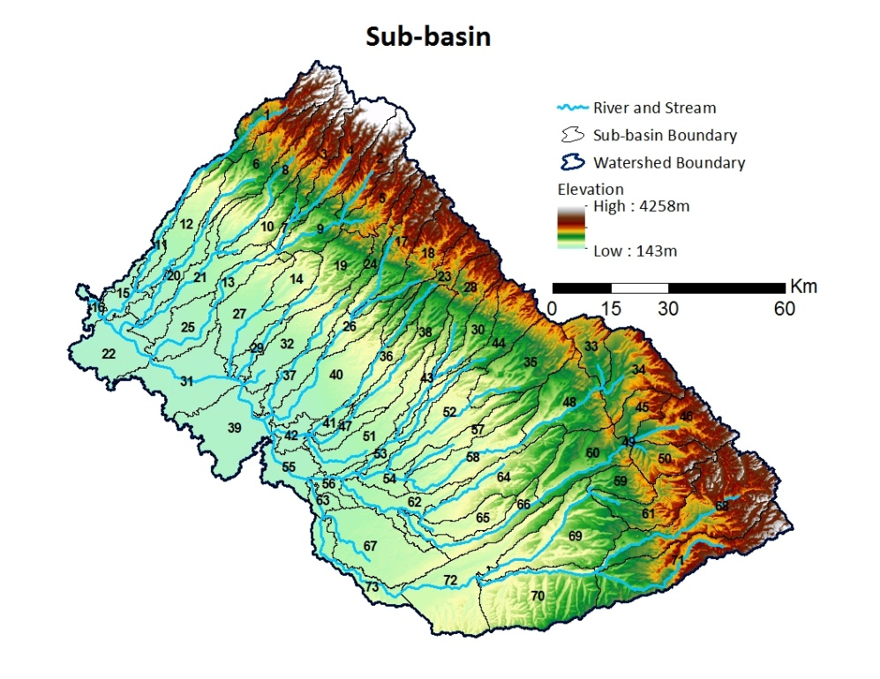
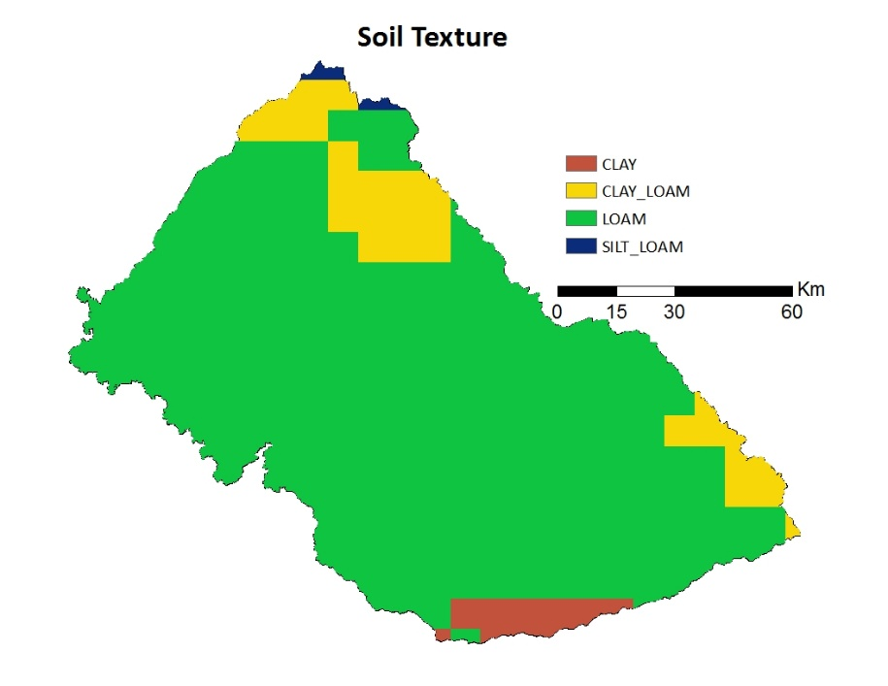
Results
Topography
Landuse

Slide 22
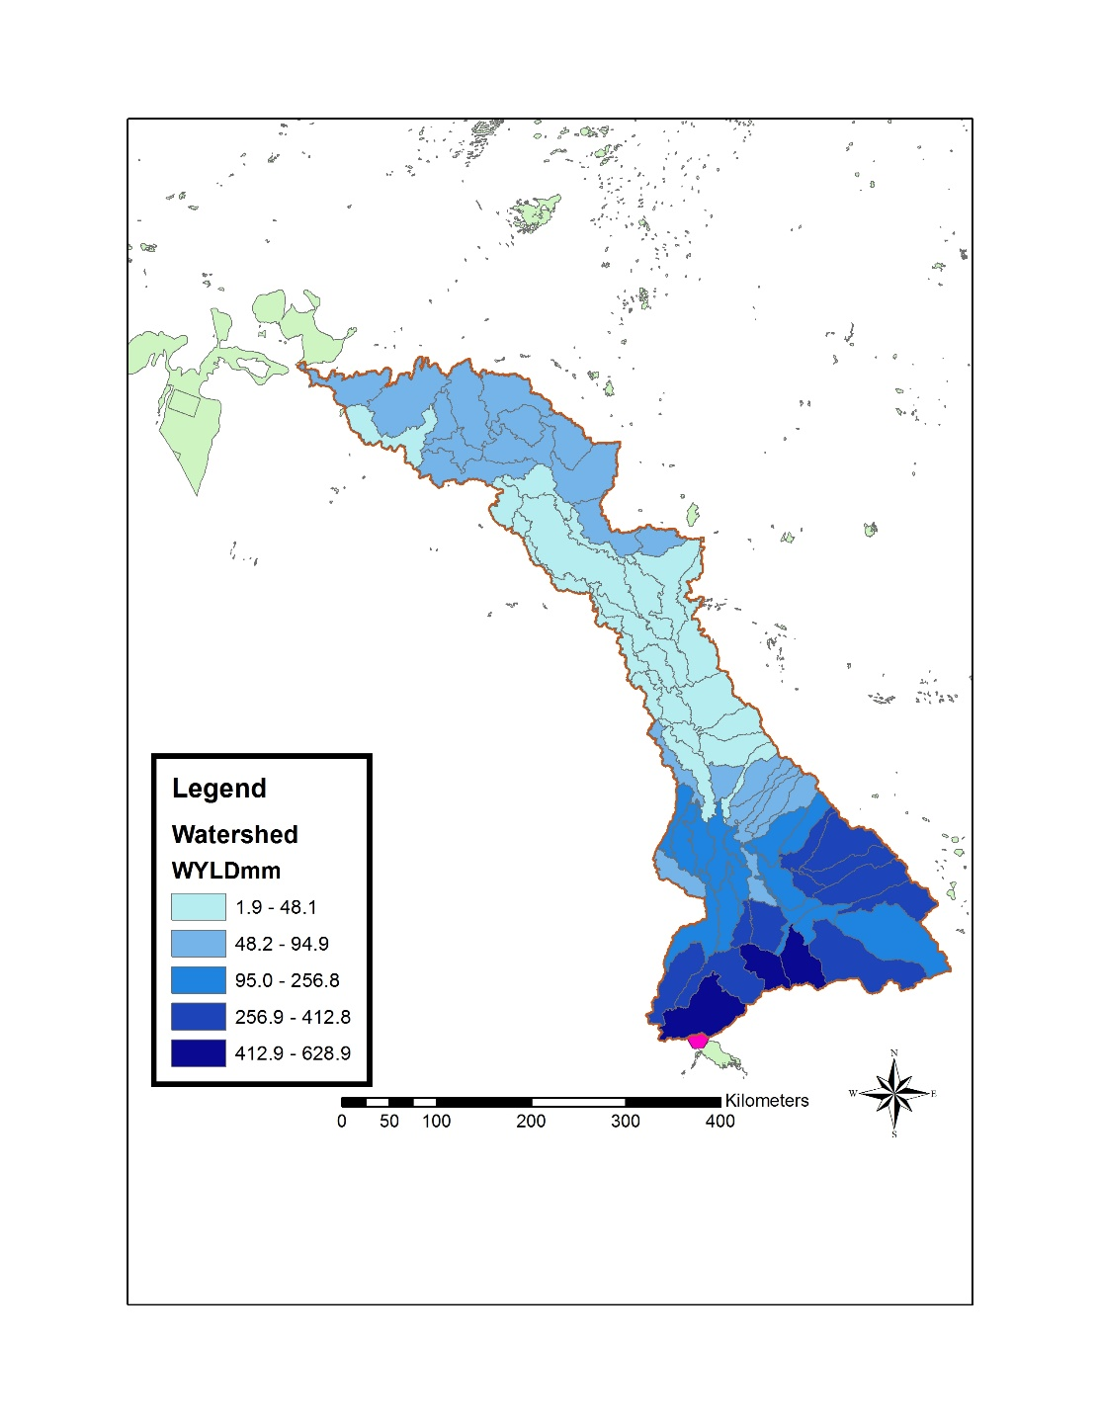
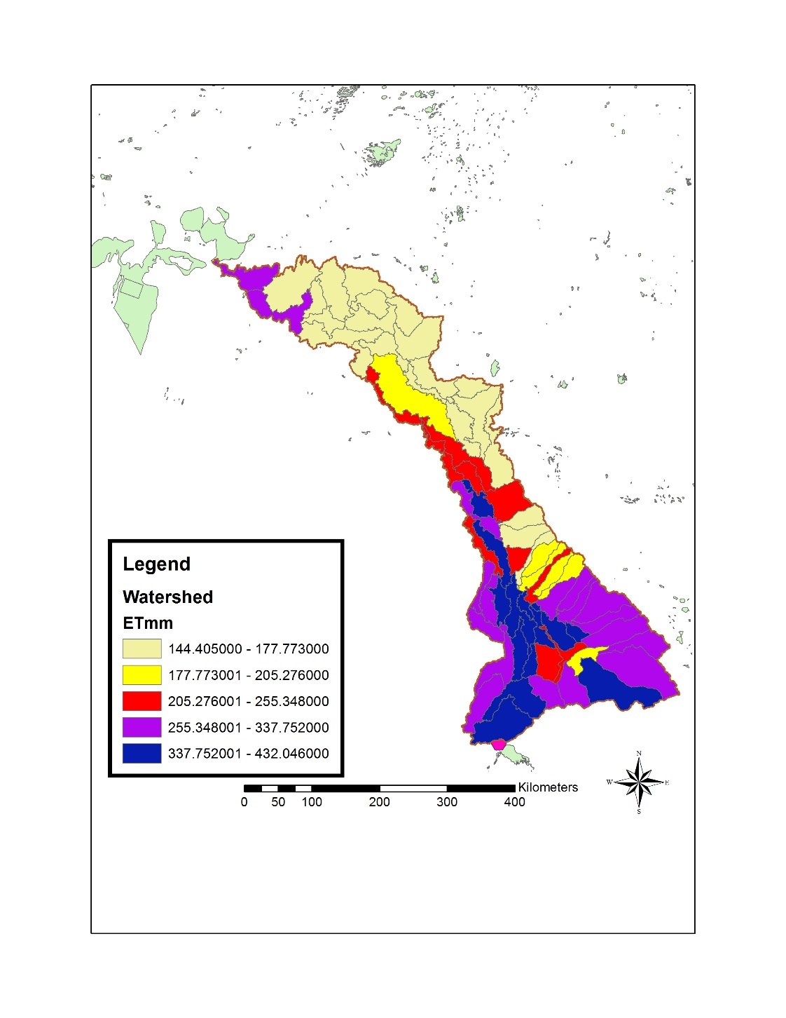
Results – SWAT modeling
Water Yield mm (2007-2013)
ET mm (2007-2013)

Slide 23
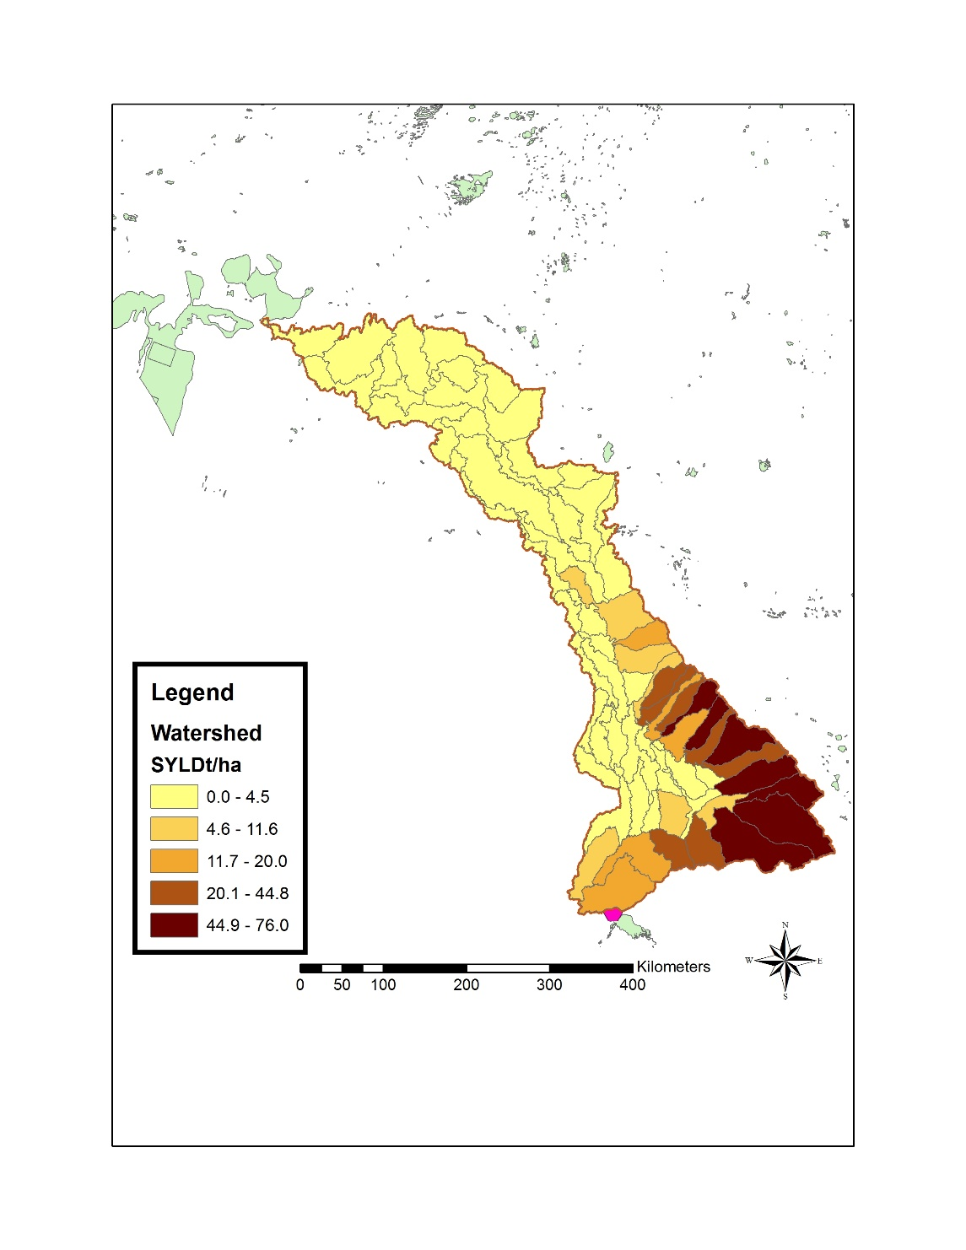
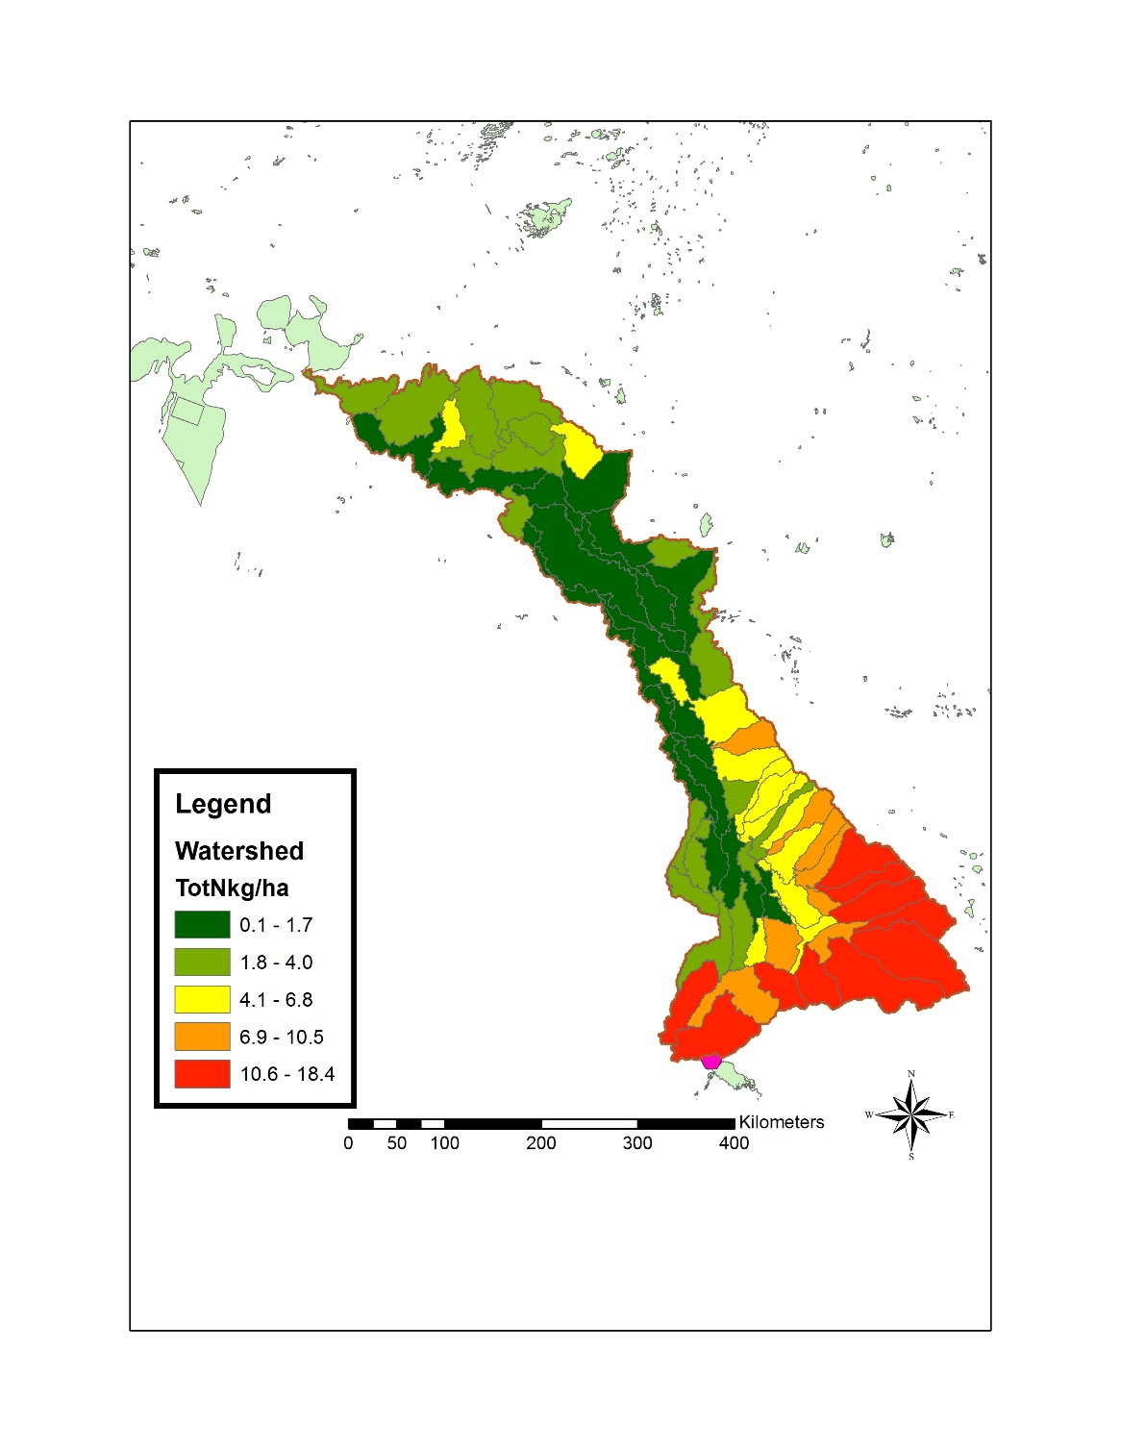
Results- SWAT modeling
Sediment Yield t/ha (2007-2013)
Total N kg/ha (2007-2013)

Slide 24
Results - RIOS modeling
 | Net cost (Cost - Income gained)
 | Without Subsidies | With Subsidies
Cotton (flood)
Cotton (drip) | 2475.2 | 2293
Alfalfa (flood)
Alfalfa (sprinkler) | 2798.4 | 2596.4
Orchards (flood)
Orchards (drip) | 336

Slide 25
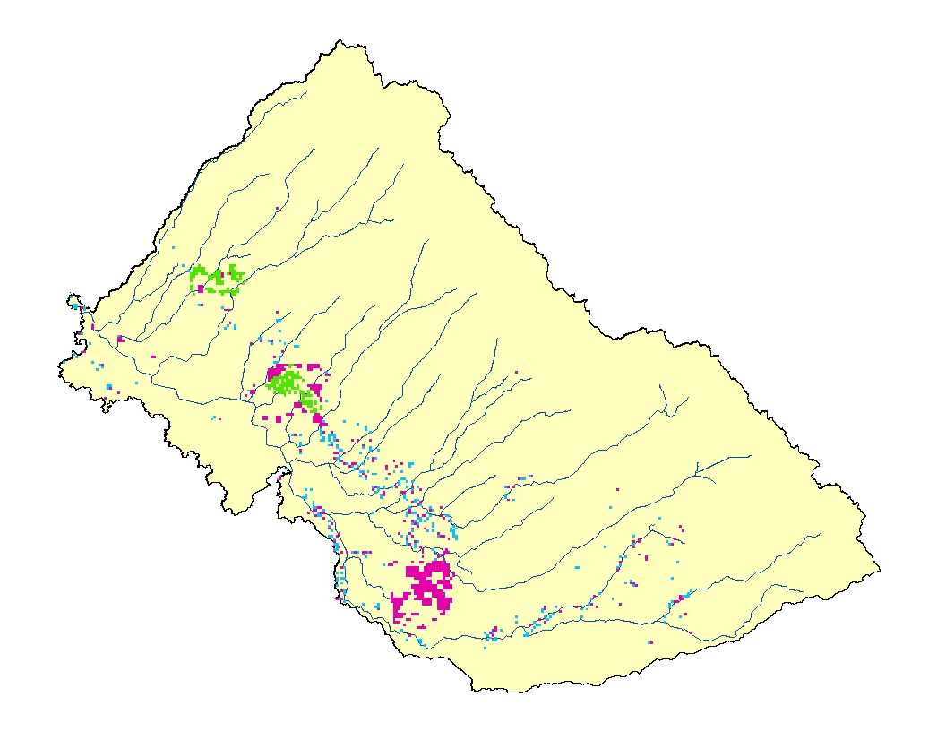
Results – RIOS modeling
Scenario A, $100M
50% to Drip Orchards (20,000 ha)
30% to Drip Cotton (11,000 ha)
20% to Sprinkler Alfalfa (7,000 ha)
Total Water Savings: 200,000,000 m³
Drip Irrigated Orchards
Drip Irrigated Cotton
Sprinkler Irrigated Alfalfa

Slide 26
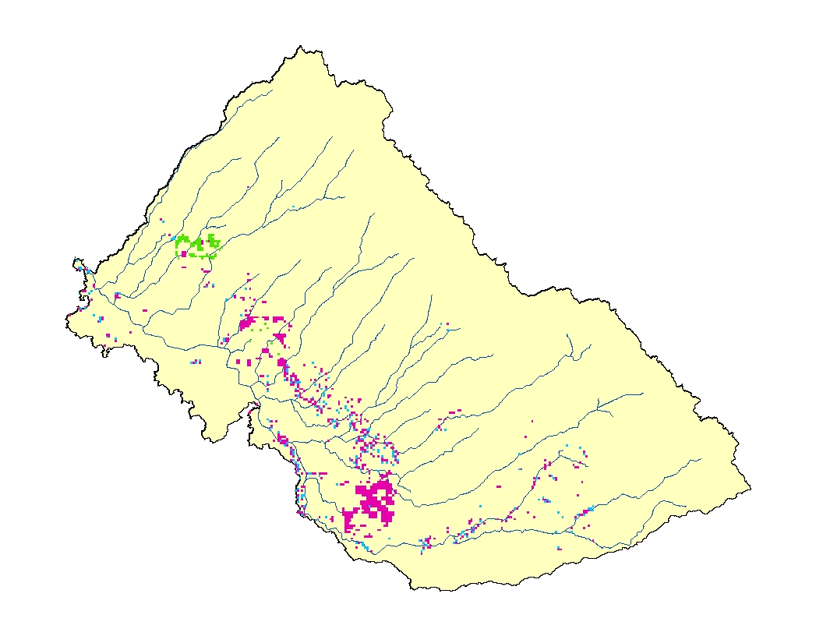
Results
Scenario B, $100M
70% to Drip Orchards (28,000 ha)
20% to Drip Cotton (7,000 ha)
10% to Sprinkler Alfalfa (3,000 ha)
Total Water Savings: 230,000,000 m³
Drip Irrigated Orchards
Drip Irrigated Cotton
Sprinkler Irrigated Alfalfa

Slide 27
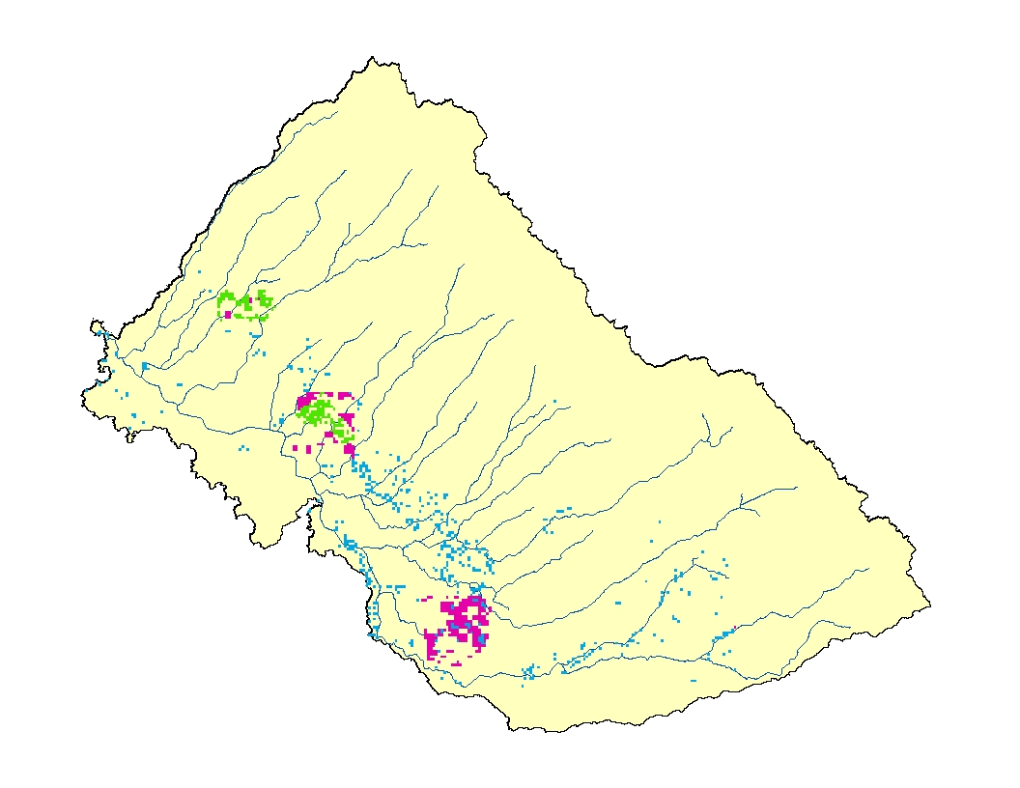
Results
Scenario C, $100M
30% to Drip Orchards (12,000 ha)
50% to Drip Cotton (18,000 ha)
20% to Sprinkler Alfalfa (7,000 ha)
Total Water Savings: 180,000,000 m³
Drip Irrigated Orchards
Drip Irrigated Cotton
Sprinkler Irrigated Alfalfa

Slide 28
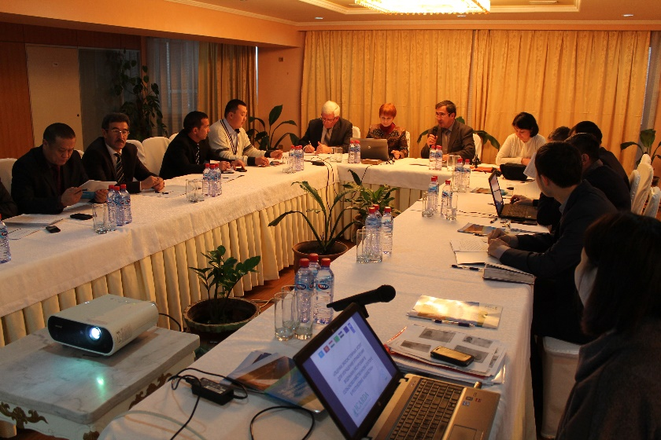
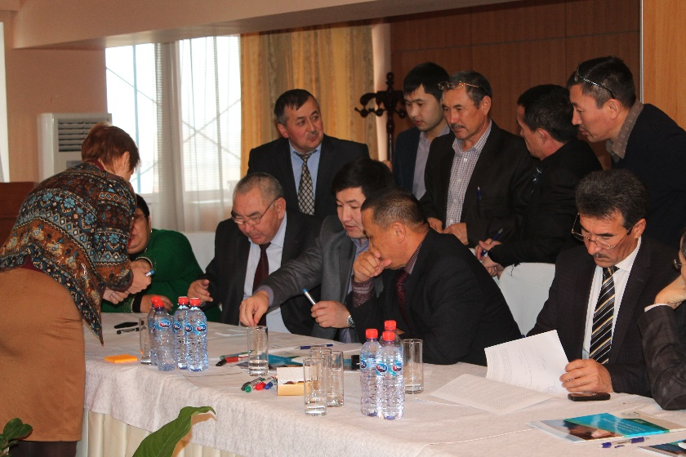
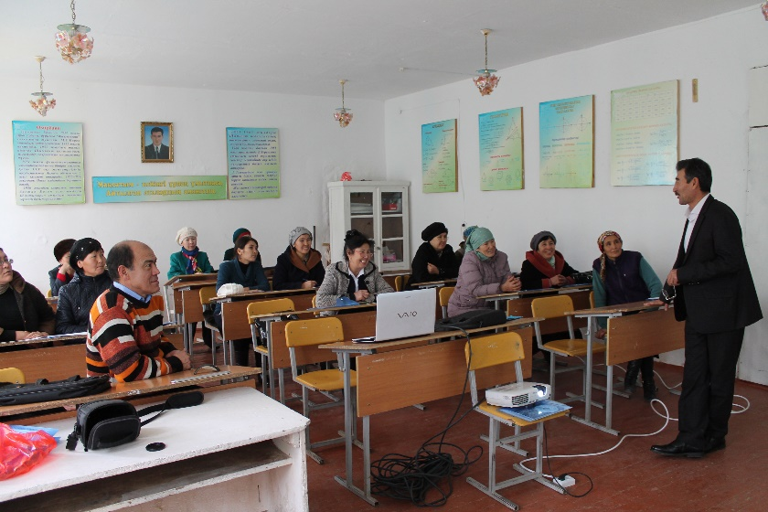
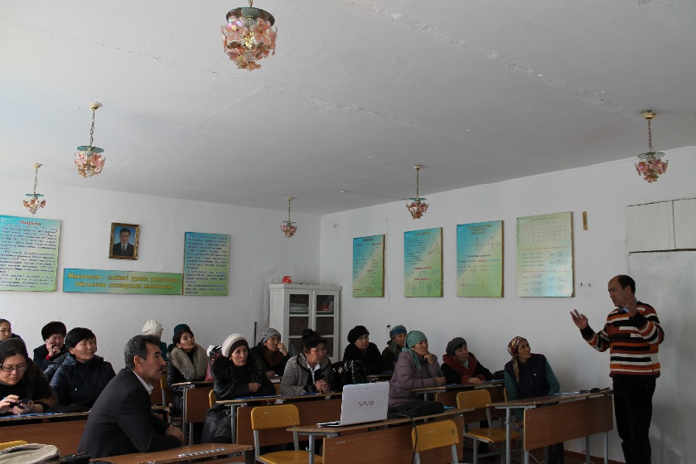
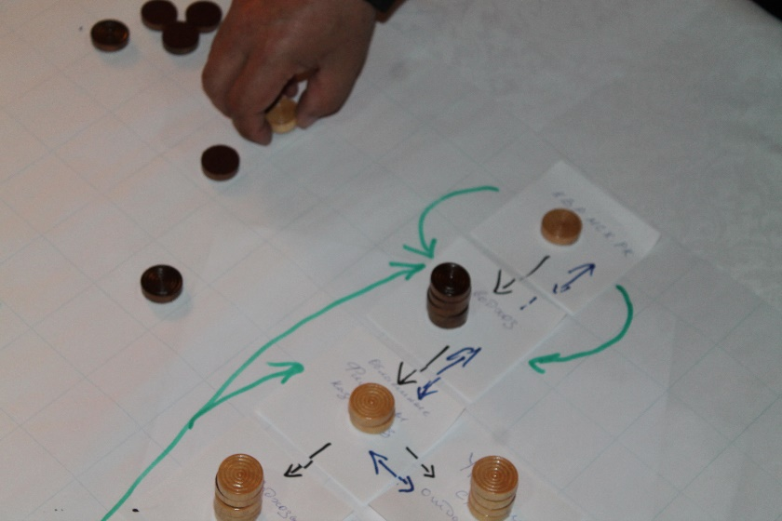
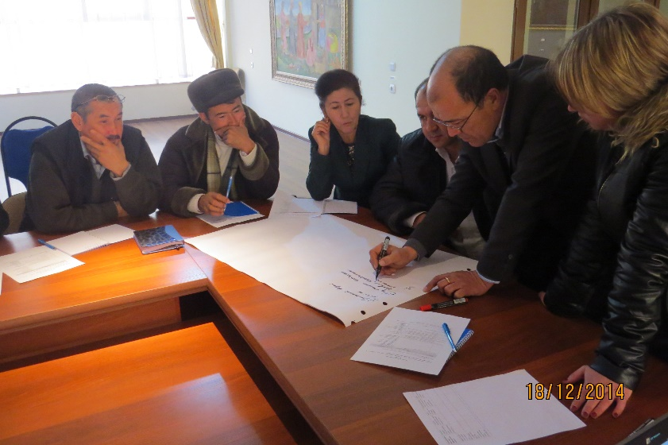
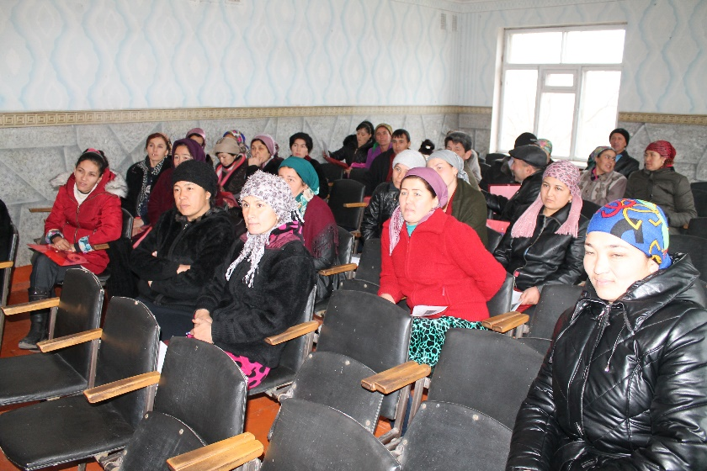
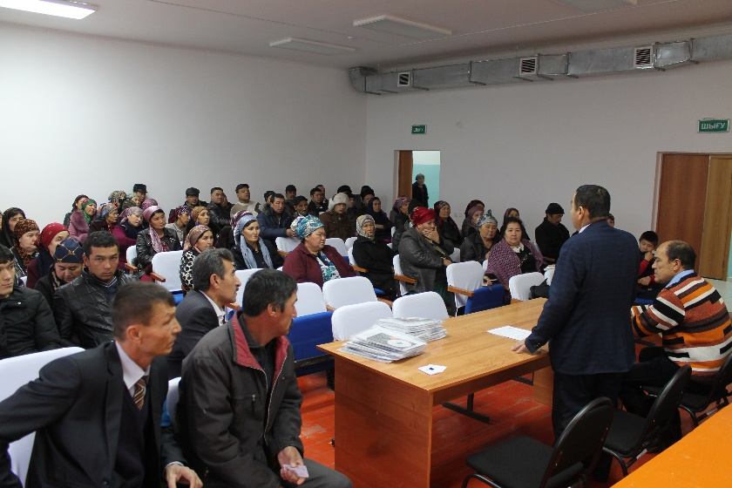
Stakeholder and Policy-maker consultation

Slide 29
Conclusions
Ecosystems services are important but often neglected part of the analysis. It’s not easy to estimate value/price of benefits drawn from nature
Agriculture cannot be managed in isolation from rest of the landscape
The more we appreciate the value of nature and benefits we draw from it, the more we will be able to manage the natural resources sustainably
There is an urgent need to understand the linkage between ecosystem management and human health, effects of producing biomass and impact on ecosystem services and ecosystem resilience

Slide 30
Thank you
V.Nangia@CGIAR.ORG

