Slide 1

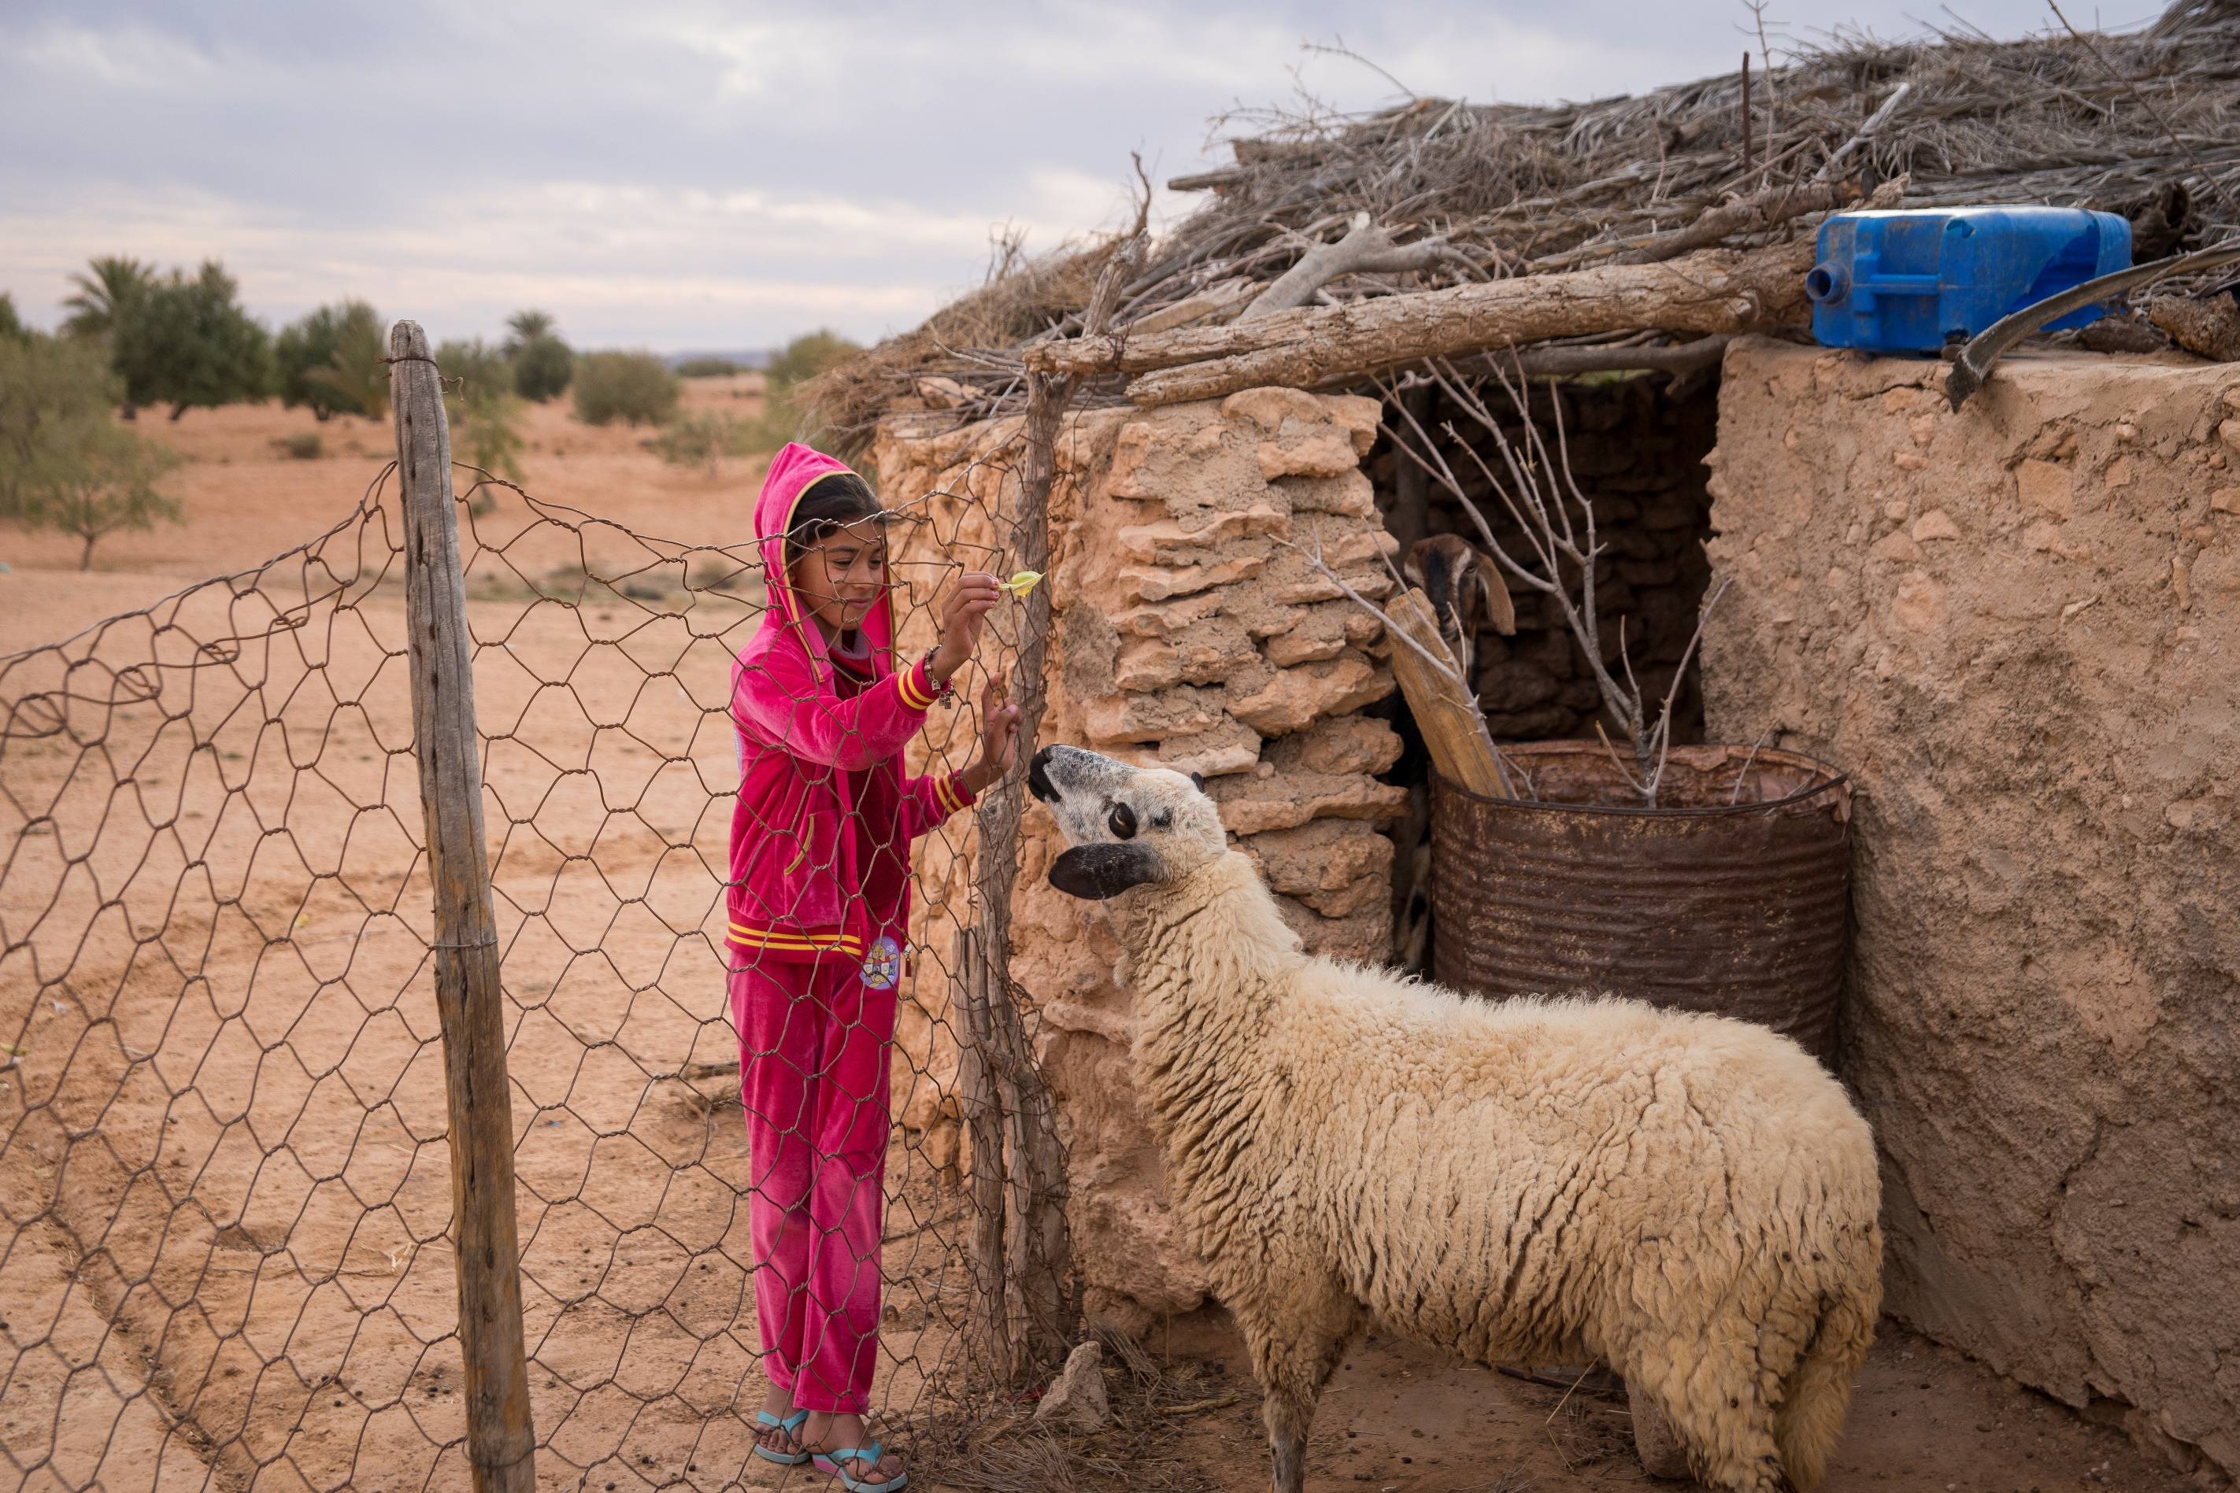
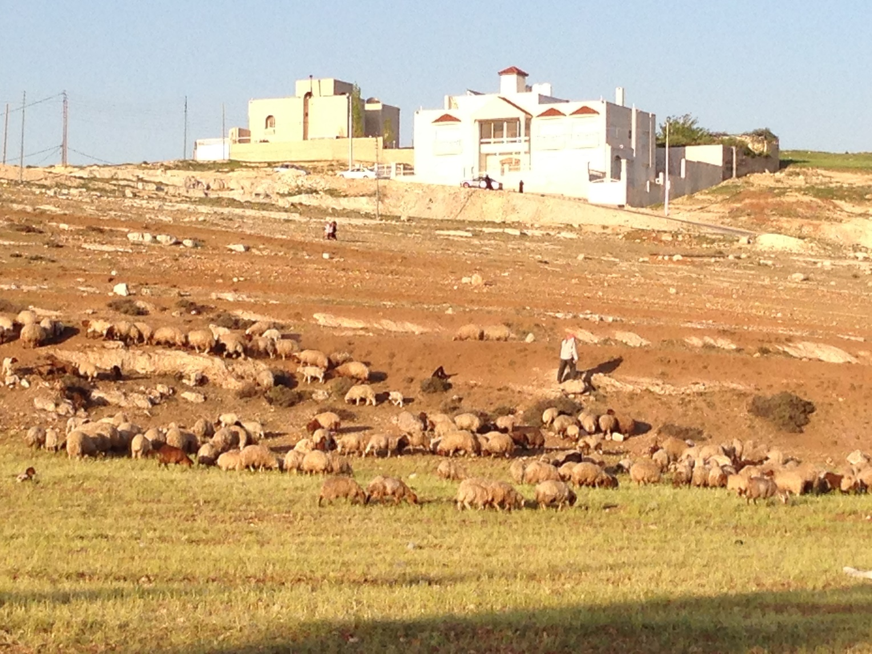







MIND THE GAP
Improving Dissemination Strategies to Increase Technology Adoption by Smallholders
Project OVERVIEW
The Challenge: Proven agricultural technologies that can improve lives often have low adoption rates due to lack of effective service delivery systems and enabling policy environment. However, little is known about which extension approaches are the most effective with farmers.
Improving Dissemination Strategies to Increase Technology Adoption by Smallholders:
Understanding which extension approaches have the greatest success rate will help improve future agricultural technology dissemination efforts. This project will compare different extension approaches and evaluate their impacts on technology adoption rates and farm household livelihoods. In addition to agricultural training, extension approaches will include business training for farmers and access to market information.
Methods: Randomized control trial of different treatment groups that receive different extension approaches.
*the control will receive extension after the household surveys are finished.
Objective: To present the most effective extension approaches to the Tunisian government with maps that identify similar socio-cultural and environmental environments.

