Slide 1
CRP DS
M&E Framework
Enrico Bonaiuti
Research Program Coordinator
CRP-DS Planning workshop for the Implementation of the Gender Strategy
26th – 27th May, 2014
Holiday Inn Hotel - Amman, Jordan

Slide 2
Agenda
Definition
Program Management Office Goals
Timeline
Framework
Impact pathway
Performance Monitoring
Reporting
FPs activities mapped to IDO 5 (gender)
CO Indicators
CO result-related definitions
Results for mapped activities

Slide 3
Timeline
2014
May: Define internal monitoring system based on specific System CRP characteristics; establish baseline data required
June: Set responsibilities at regional and FP level & revise targets
July: Define targets timeline
August: Launch beta version of web based data collection system based on other CRPs experience.
September: Visit partner or arrange a workshop with the M&E POC
November: Review web based system usage and constrains analysis
December: Extract monitoring data and re-orient the system; Share M&E strategies among partners for comments

Slide 4
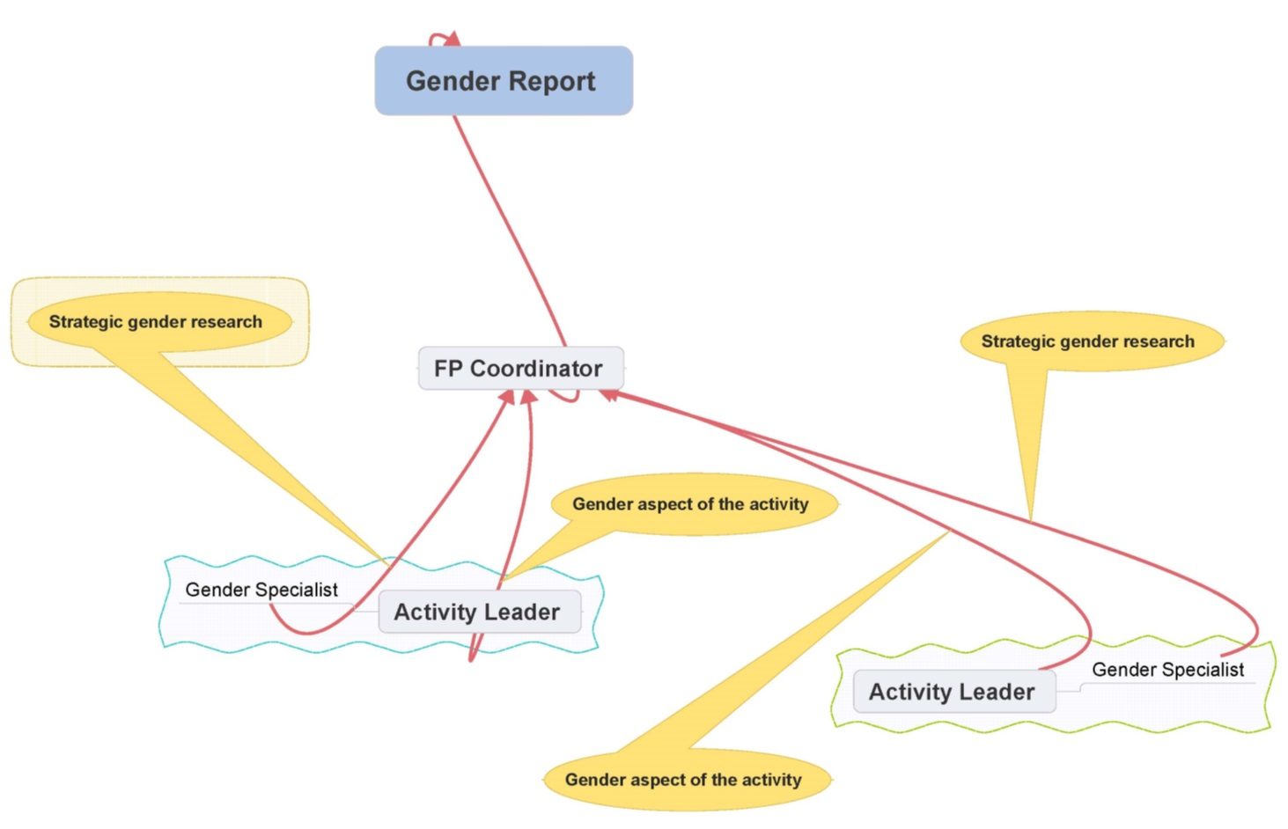
Reporting

Slide 5
Activities mapped to IDO5
WAS: 19 Activities in total - 7 Activities mapped in IDO5 (1 ALS) - 10% of FP budget allocation
NAWA: 45 Activities in total - 6 Activities mapped in IDO5 - 25% of FP budget allocation
ESA: 21 Activities in total - 9 Activities mapped in IDO5 - 11% of FP budget allocation
CA: 24 Activities in total - 19 Activities mapped in IDO5 - 9% of FP budget allocation
SA: 48 Activities in total - 1 Activities mapped in IDO5 - 0.15% of FP budget allocation

Slide 6
CGIAR Reporting
Data and successful stories
Which are our targets? (2014)
Can we identify deviations?
How do we report successful stories of outcomes?
Standard reporting for the CO. Table 1 and table 2 (Annual report)
Notes:
In the M&E the trick is not just counting the number of outputs produced against the target, it is most importantly telling successful stories of outcomes in medium to large scale. Some CRPs call this case studies and they solicit form the centers outcome stories that have substance and that can be verified. So, you need to alert FP coordinators that they must plan for reporting these outcome stories/ case studies from the start of the year and should provide the supporting document.

Slide 7
CGIAR Indicators
KNOWLEDGE, TOOLS, DATA
Flagship products: These are frameworks and concepts that are significant and complete enough to have been highlighted on web pages, publicized through blog stories, press releases and/or policy briefs. They are significant in that they should be likely to change the way stakeholders along the impact pathway allocate resources and/or implement activities. They should be products that change the way these stakeholders think and act. Tools, decision-support tools, guidelines and/or training manuals are not included in this indicator.
% having explicit target of women farmers/NRM managers
% having been assessed for likely gender-disaggregated impact
Notes:
In the M&E the trick is not just counting the number of outputs produced against the target, it is most importantly telling successful stories of outcomes in medium to large scale. Some CRPs call this case studies and they solicit form the centers outcome stories that have substance and that can be verified. So, you need to alert FP coordinators that they must plan for reporting these outcome stories/ case studies from the start of the year and should provide the supporting document.

Slide 8
CGIAR Indicators - DS annual report 2013
KNOWLEDGE, TOOLS, DATA

Slide 9
CGIAR Indicators
KNOWLEDGE, TOOLS, DATA
Tools: These are significant decision-support tools, guidelines, and/or training manuals that are significant and complete enough to have been highlighted on web pages, publicized through blog stories, press releases and/or policy briefs. They are significant in that they should be likely to change the way stakeholders along the impact pathway allocate resources and/or implement activities
% having explicit target of women farmers/NRM managers
% having been assessed for likely gender-disaggregated impact

Slide 10
CGIAR Indicators - DS annual report 2013
KNOWLEDGE, TOOLS, DATA

Slide 11
CGIAR Indicators - DS annual report 2013
CAPACITY ENHANCEMENT AND INNOVATION PLATFORMS
Trainees in short-term programs facilitated by CRP (male)
Female
Trainees in long-term programs facilitated by CRP (male)
Female

Slide 12
CGIAR Indicators - DS annual report 2013
TECHNOLOGIES/PRACTICES IN VARIOUS STAGES OF DEVELOPMENT
Technologies/NRM practices under research (Phase I) Technologies to be counted here are agriculture-related and NRM-related technologies and innovations including those that address climate change adaptation and mitigation.
% having explicit target of women farmers/NRM managers
% having been assessed for likely gender-disaggregated impact

Slide 13
CGIAR Indicators - DS annual report 2013
TECHNOLOGIES/PRACTICES IN VARIOUS STAGES OF DEVELOPMENT
Number of technologies /NRM practices field tested (phase II) - Under “field testing” means that research has moved from focused development to broader testing (pilot project phase) and this testing is underway under conditions intended to duplicate those encountered by potential users of the new technology.
% of above innovations/approaches/options that are targeted at decreasing inequality between men and women

Slide 14
CGIAR Indicators - DS annual report 2013
TECHNOLOGIES/PRACTICES IN VARIOUS STAGES OF DEVELOPMENT
Number of farmers and others who have applied new technologies or management practices as a result of CRP research (a. male, b. female)

Slide 15
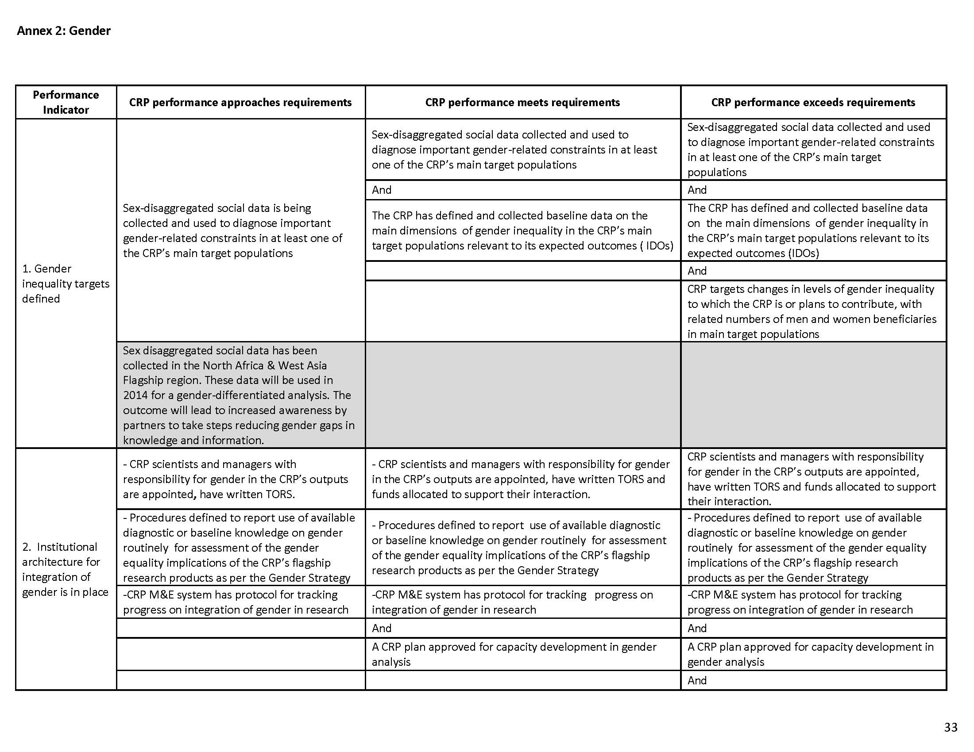
CGIAR Indicators – Table 2 Annual report

Slide 16
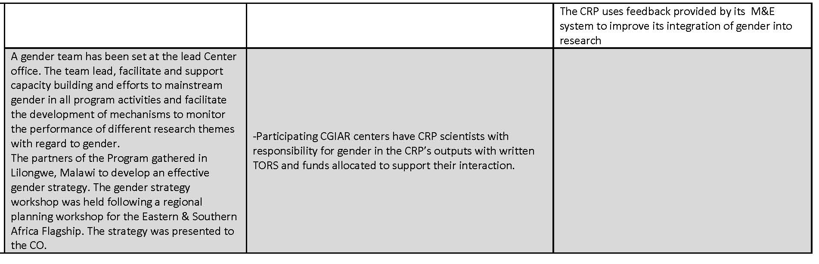

Slide 17
CO result-related definitions
Research output: are the products, services or attributes resulting from the research activities and linked to the objectives. e.g. a report, publication, DNA sequence, molecular markers, new methodology, new policy, new soil management practice,, newsletter, tool, website, conference, etc...
Research outcomes: They represent adoption or further use of research outputs by the immediate users targeted by the CRP, such as smallholder farmers, NARS researchers or national policy makers. Research outcomes are generated as a result of research, capacity building and advocacy activities by the CRP and include Capacity changes, the changes in knowledge, attitudes and/or skills, of the beneficiaries and intermediaries and Behavioral changes , in actual practices that occur in the beneficiaries and intermediaries; beneficiaries and intermediaries do things differently or use the research outputs.

Slide 18
CO results-related definitions
Intermediate development outcomes: changes that occur in the medium term that are intended to affect positively the welfare of the targeted population or environment, and which result, in part, from research carried out by the CGIAR and its partners. The IDOs are attributable to CRP-level activities and are necessary precursors and logically linked to the SLOs
Impact: The ultimate positive/negative, direct and indirect consequences of the CRPs work on the status and state of selected development variables concerning the SLOs - which are themselves related to the attainment of Millennium Development Goals and the SDGs. Impacts are the overall and long-term effects that a CRP contributes to.

