Slide 1

Dryland Systems Gender Component
Communication
Rajita Majumdar
Michael Devlin

Slide 2
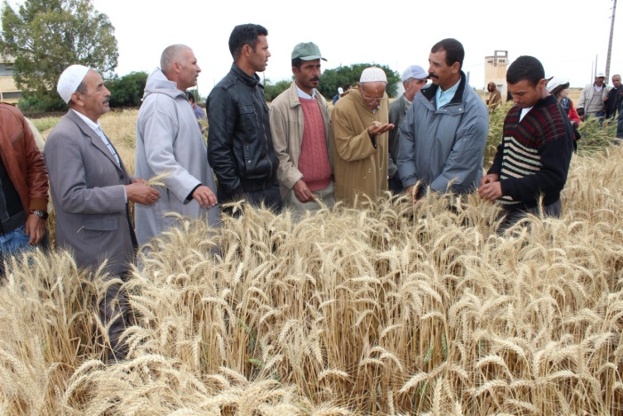
Key challenges for communicating effectively
Informing our audiences
Influencing decision makers
Delivering tools & technologies
Effective exchange and learning across regions & sites

Slide 3
Dryland Systems communication - Key action areas
Marketing communication:
Ensuring high visibility and branding of the program.
Strategic communication and advocacy:
Informing and influencing specific groups worldwide, getting the science into
use.
Website:
Provide broad access to concepts, key messages and results of Dryland
Systems.
Information management:
Processes and guidance for the capturing, organizing (cataloging) and open access to
all data, and information generated by Dryland Systems.
Knowledge sharing and learning:
Processes and techniques to capture and synthesize the learning from the research
process as it progresses.
Gender

Slide 4
Strategic Communication
‘Outcome’ thinking
What do we want to happen ?
Changing behavior among specific groups.
Who can we influence directly?
How to best achieve this?
What communications activities, products, services?

Slide 5
Dryland Systems gender communication 2014
Synthesis report (current gender activities)
Summary of current activities across the partners.
Web page
Women & youth reporters initiative.

Slide 6
Ideas to consider?
How to collect frequent news of your work?
Receiving regular information about your work and points of interest. Updates, photos, etc.
Gender learning blog?
Short updates on your work, questions and exchanges between
Action Sites/Regions (1-2 paragraphs!).

