Slide 1
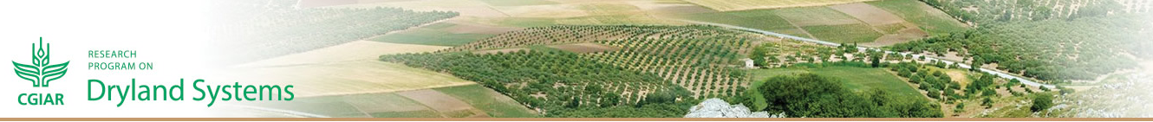

CRP - Dryland Systems: Overview and implementation at the Jordan Site
Mourad Rekik (ICARDA)
Yahya Shakhatreh (NCARE)
16th Jordan/ICARDA Biennial Coordination Meeting
14th September, 2014
NCARE, Beqa, Jordan

Slide 2
Agenda
1. Consortium Research Program on Dryland
Systems (CRP DS): shared understanding
2. Features of the Jordan site and prospects
for expanding: Obligation of results at large scale
3. On-going activities and some achievements
4. Challenges ahead

Slide 3
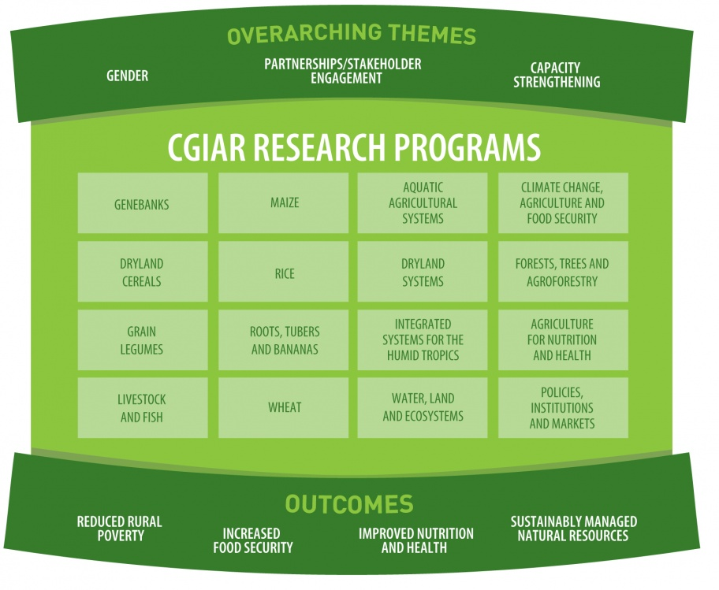
CGIAR Research Programs align the research of their 15 Research Centers and their partners into efficient, coherent, multidisciplinary programs.

Slide 4
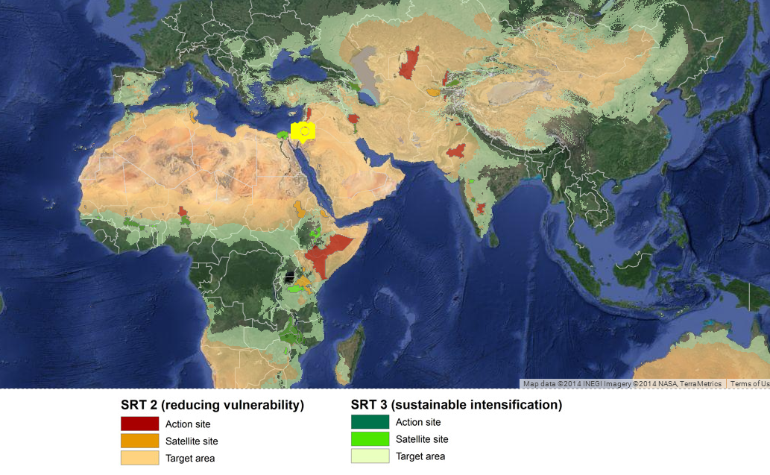
Geographical spread of CRP DS

Slide 5
Agricultural Livelihood Systems – a new, practical unit of measure for systems research
Agro-pastoral systems
Intensive rain-fed systems
Irrigated crop systems
Constrained by overgrazing, rangeland/forage feed imbalances, soil erosion, climate variability and conflicts over resources;
Prevalent in Tafilah-Salamieh and Beni Khedache-Sidi Bouzid transects;
System based on small ruminants, barley cropping and small scale irrigation.
Constrained by land degradation, nutrient deficiencies, climate variability and water scarcity;
Prevalent in Meknes-Sais Morocco and Karkheh river basin in Iran;
Wheat-based cropping systems are prevalent, horticulture is intensifiable and livestock is dairy cattle-oriented.
Land is constrained by groundwater depletion, salinization, and heat stress;
Prevalent mainly in the Nile delta site;
Market-oriented vegetable and fruit trees production, high yielding wheat and forage as well as dairy production.

Slide 6

Issue: What should be a common understanding of CRP DS ?

Slide 7
Context where CRP DS is conducted
Country
Policies
Population
needs &
aspirations
Agro-
ecological
policy
markets
National
Research
Portfolio
Existing
projects

Slide 8
CRP DS is here to improve the productivity, profitability, sustainability, and resilience of entire farming systems
Synergy, Coherence
and Partnership
Agro-
ecological
policy
markets
National
Research
Portfolio
Population
needs &
aspirations
CRP Dryland Systems
Country
Policies
Existing
projects

Slide 9
Innovative Partnerships allow for scaling up and scaling out
UP
Second Level of Influence
National Level
First level of Influence
District level
Participating Farmers
Local or village
level
Innovation Platform
Upstream Research Activities
OUT

Slide 10
Scaling Phases
Discovery phase
Proof of concept
phase
Pilot phase
Scaling up phase
Testing of proof
of concept in
real world/
controlled
conditions
(n = 1000 s)
Multi-location
release/trials
for smallholder’
benefit
(n = 100,000 s)
Release for scaling
up & adaptation
in different
locations
(n = 100,000 s)
New concept
of product,
service
or process
Food
Access
For Women
and
Children
Sustainable
and Equitable
Management
of Natural
Resources
Increased
Resilience
in Marginal
Areas
Wealth and
Wellbeing
for Intensi-
fiable HH

Slide 11
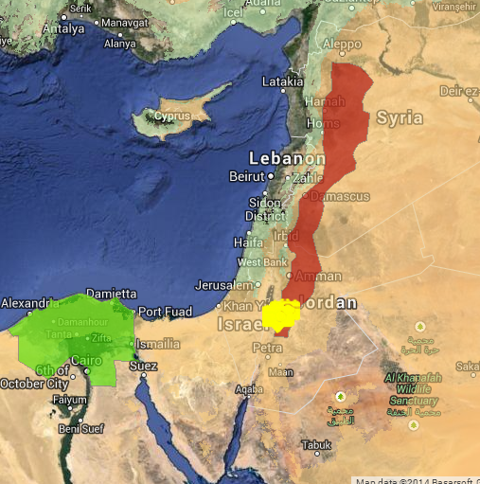
Tafilah-Salamieh Action Site (Jordan-Syria)
Area: 36,600 km² (less than 1/3 in Jordan)
Population: 8.3 10⁶
Aridity Index: 0.05-0.35
High temporal variability of precipitation: 23-60%
Important water and soil erosion
Over-pumping of underground water
Extent of rangeland: 20%
Domination of the cereal – legume cropping
High prevalence of livestock diseases and losses

Slide 12
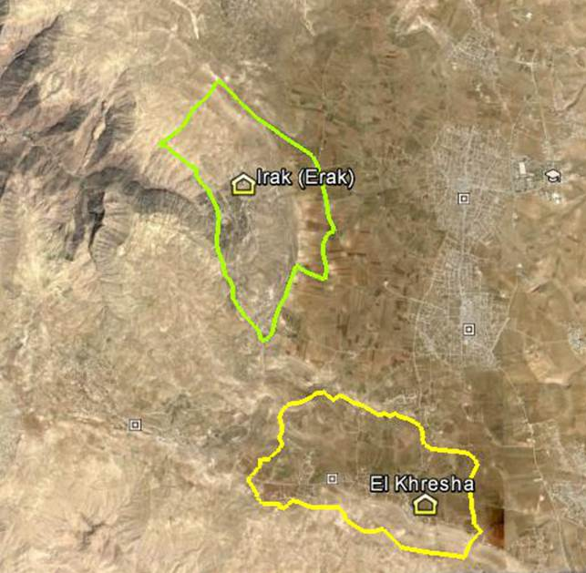
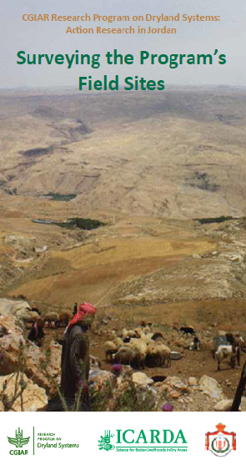
Initial Fields Site Selection
(1) Methodological, consultative process
(2) Capitalization on existing secondary data
(3) Variability in production system
(4) Active community organizations and receptiveness
http://www.icarda.org/publications-resources/drylans-systems

Slide 13
Progressive Geographical Expansion…
Eraq village covers 12 km² while El-Khrisha cluster of 13 villages stretches over more than 30 km²;
Both sites are part of a much larger water shed;
Both sites host a population of at least 28,000 people;
The immediate scaling out in Jordan (starting from 2015) would be the governorates of El-Karak and Tafilah where more than 338,000 people (200,000 rural) live representing 6% of the population in the kingdom stretching over a total area of 5,700 km²

Slide 14
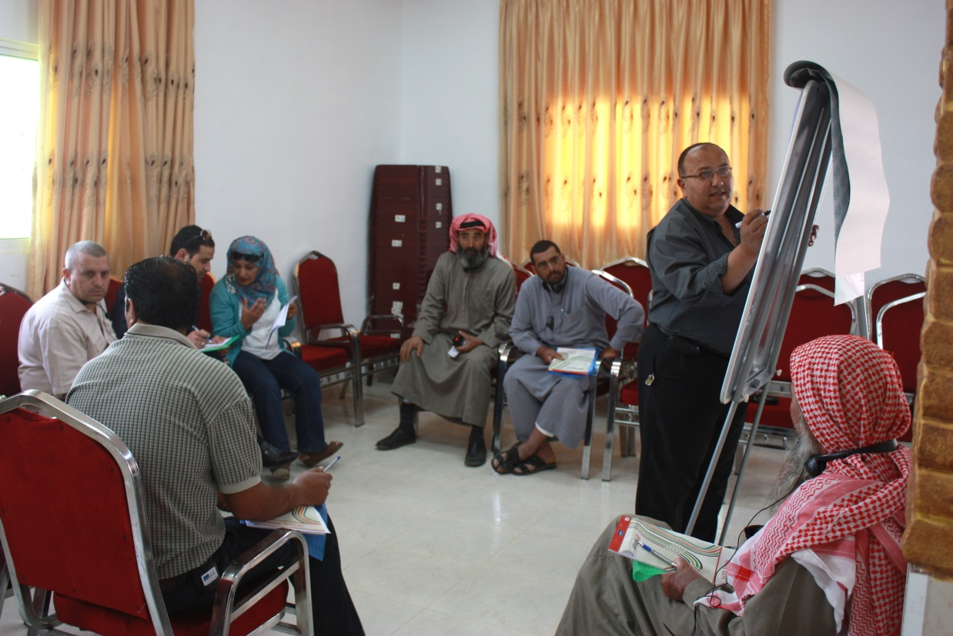
INNOVATION THROUGH JOINT LEARNING
Learning Alliances in Al-Kresha and Eraq villages;
Catalyzing partnerships between developmental organizations, research centres, local welfare societies, producer cooperatives, local government organs and social service providers;

Slide 15
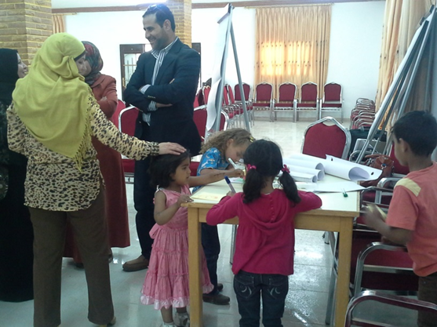
FOSTERING BROAD UPTAKE THROUGH
LOCAL ORGANIZATIONS
Eraq:
Productivity enhancement and effective marketing for olives and olive oil
Income generating activities
Al Kresha:
Improved approaches for social and economic organization
Livestock productivity and incurred losses
Uncovering new approaches for agricultural (youth) associations, in partnership with national universities, and in order to develop a new generation of professional farmers and advisory services

Slide 16
A Large Number of Activities
Activities | Status
System Vulnerability | Launched
Conservation agriculture
Livestock productivity and products safety
Managing rangelands
In-situ Biodiversity
Water Harvesting & Soil Conservation
Water & Land Productivity in Irrigated Systems
Innovation platforms & scenarios
High-Value Chain Clusters
Policies on Natural Resources
Bio-economic Farm Models
Gender in Drylands
At # stages of
progress
Co-commanded
by ICARDA
& NCARE
teams
Involving public
and private
stakeholders

Slide 17
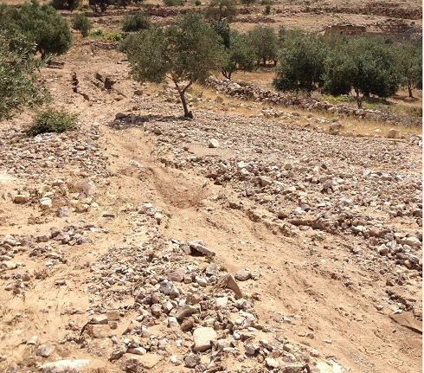
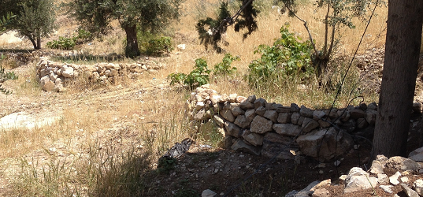
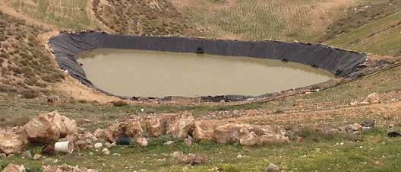
Develop, test and disseminate soil and water conservation practices to combat land degradation and improve agricultural productivity
Devastating land degradation resulting from extreme rainfall events
Participatory testing and dissemination of soil and water conservation interventions
Soil conservation: research trials in four fields in Erak and Tafila.
Water harvesting and grazing management: working with farmers to fine-tune grazing practices (field days and training).
Water harvesting and supplemental irrigation (hill lakes): testing a model in Tafila.
Watershed modeling: to assess the impact of soil and water conservation, mainstreaming and training.
Water harvesting to improve productivity and livelihoods
Overall
The adaptability of the proposed interventions and acceptability by communities are promising indicators for wider uptake and adoption

Slide 18
Conservation Agriculture
Objective
To adapt conservation agriculture for rapid adoption by smallholders in the context of produce more food/feed with less resource and input
Outcome
To generate and customise improved resilience options for vulnerable households

Slide 19
Conservation Agriculture … example of activities performed in the target action site
Technical platform | Type of
No-till vs Conventional practice | On-farm trials In El Kareq comparing yields of food/feed crops (Barley, wheat and vetch) and WUE cropped using No-till or conventional cropping.
Combined No-till and alley-cropping | Food/feed crops (barley, vetch) are planted under no-till or conventional practice between the rows of shrub species (Atriplex, cactus) in El Kareq
Demonstration plots under CA have been implemented in 18 farms in El-Karak and Madaba

Slide 20
Conservation Agriculture … example of activities performed in the target action site
On-farm trials
6 farms were identified and around 25 ha were seeded to legumes and barley using ICARDA Zero-Till seeders
Demonstration fields
10 farms in El Karek and 10 farms in Madaba hosted CA combined or not with alley cropping
On station trials
Testing the effect of sowing time and cereal/legume rotation under Zero tillage
Promising scaling opportunities starting 2015 through partnership with FAO and IFAD-ARMPII project

Slide 21
High prevalence of infectious diseases in sheep and goats flocks
Main risk factors:
  Grazing in communal rangeland
  Introduction of new animals without prior control
  Large flock size

Slide 22
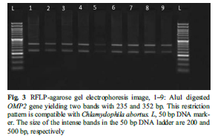
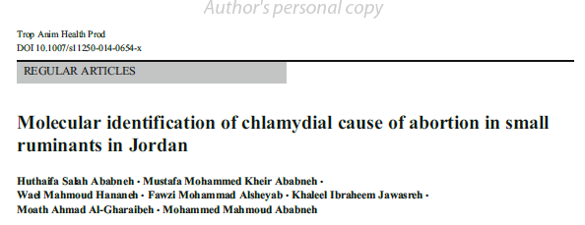
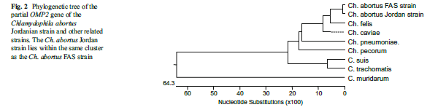
Addressing zoonosis with a major impact on the flock productivity and the household well being

Slide 23
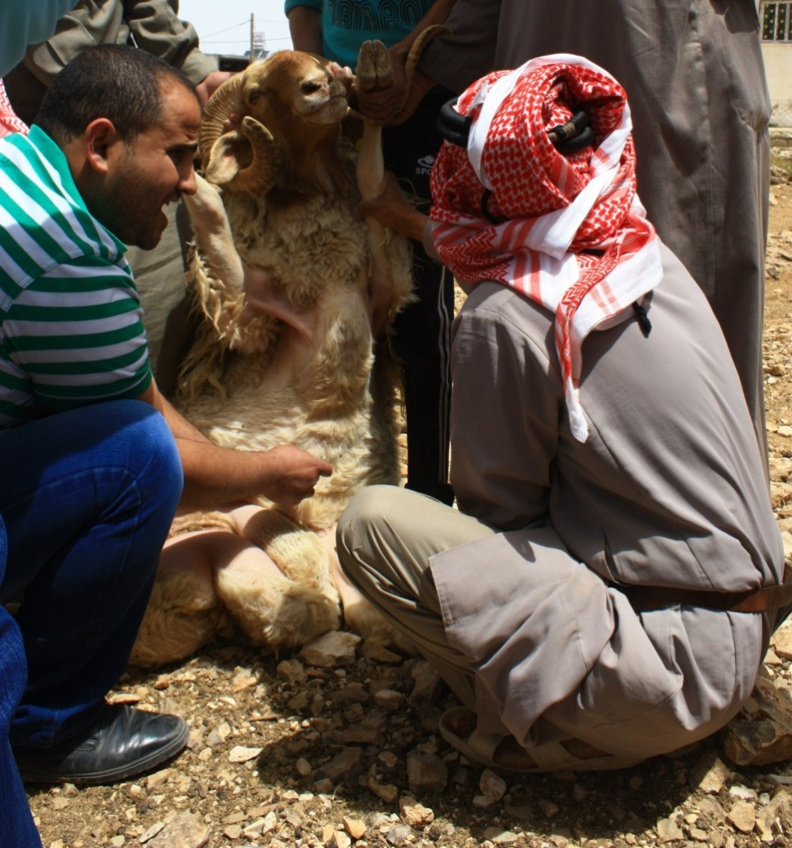
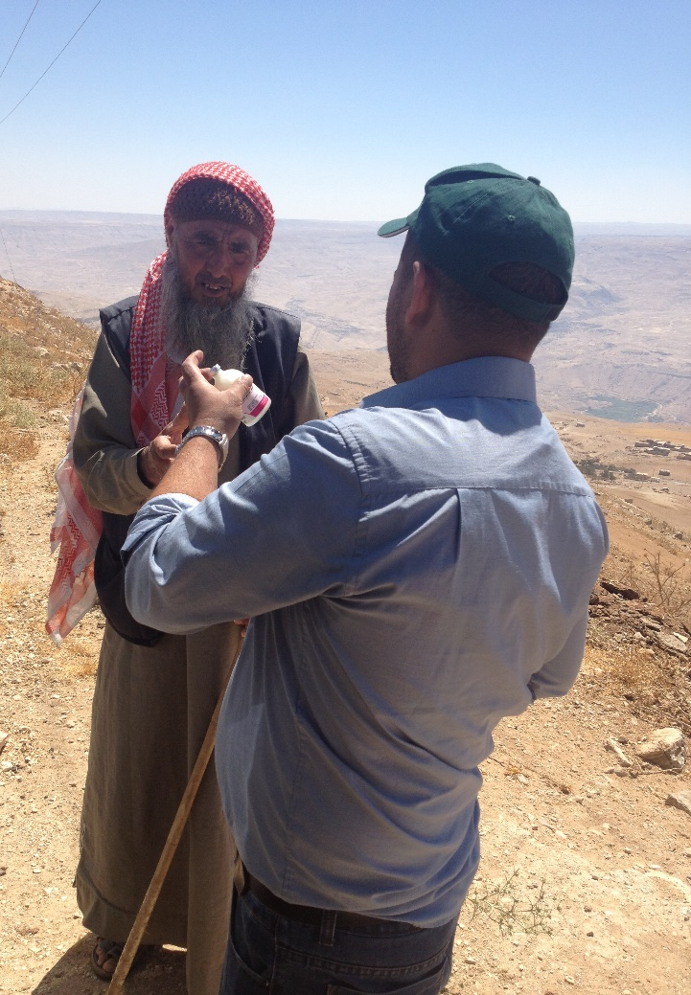
Improving flocks’ fertility: The Rams 1st
Rams’ Breeding soundness

Slide 24
Improving flocks’ fertility
Over 35% of the examined rams have a likely background of being inbred
Over 85% of the rams have a body condition score under the recommended level

Slide 25
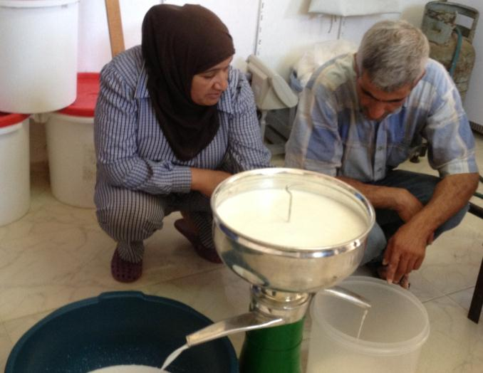
Enhancing dairy processing skills and market access of rural women in Jordan
Characterization of the socioeconomic conditions, dairy processing and marketing methods in 4 target villages in El-Karak
  Quality of Jameed improved by more hygienic processing
  Improved method of making Jameed for small-scale dairy processors developed
    Saves 60-70% of water consumed during processing
    Saves 60-70% of energy

Slide 26
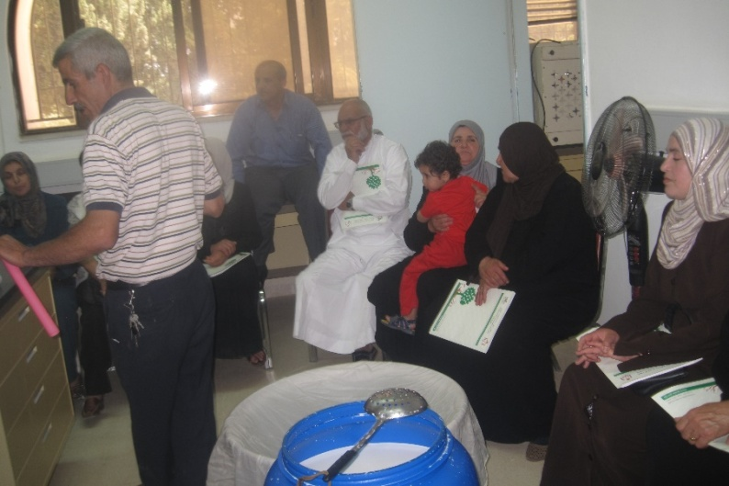
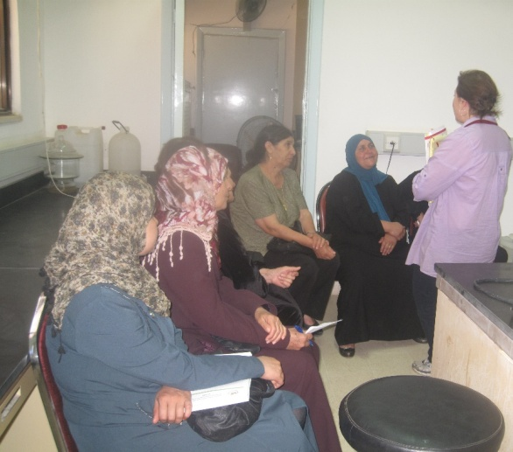
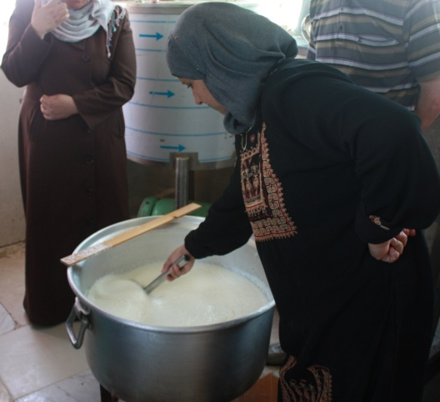
Women empowerment and scale impact
12 processing units
40 trained leading women
160 impacted women
16,000 ewes
48,000 kg Jameed + 30,000 kg Ghee
750,000 JD

Slide 27
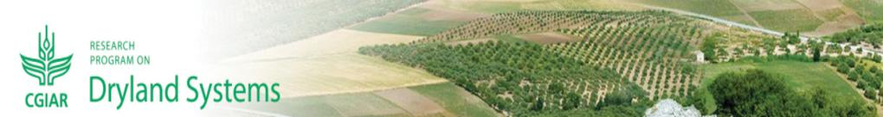
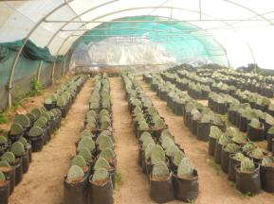
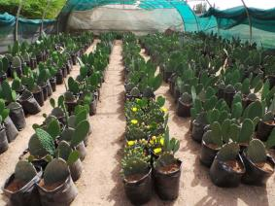
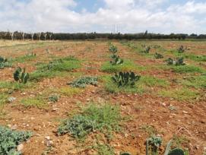
Enhancing the use of cactus (Opuntia focus indica) to promote better livelihoods in arid areas of West Asia
Over 100 accessions are planted in nursery and ready to be transplanted to the field in different sites

Slide 28
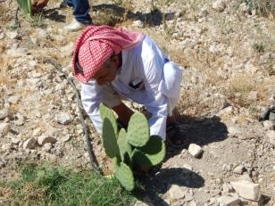
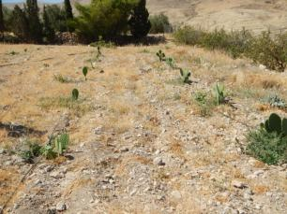
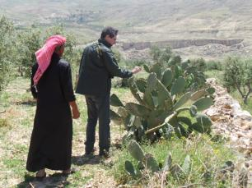
Enhancing the use of cactus (Opuntia focus indica) to promote better livelihoods in arid areas of West Asia

Slide 29
System vulnerability, Bio-economic farm models and Policies on natural resources
Secondary data collected on the action villages during the selection process of the studies villages.
Baseline questionnaire prepared to collect the needed baseline information.
Report on “An Overview and Comparison of the Production Systems in Irak and Krisha Villages been prepared.
A representative household and model has been identified.
weather data, soil data, crop production data been collected for the purpose of the model.
literature review of previous studies on barley subsidies been conducted.
on exports-imports, of Barley and wheat bran been collected from the department of statistics during the period 2005 2012.
data on livestock numbers of sheep , goats and cattle during the period 1991to 2012 been collected from the department of statistics.

Slide 30
In-situ biodiversity
Distribution of 250 plants Thymus and 250 of Salvia to each five farmers in Irak.
Assess and monitor Agrobiodiversity and its trends using ecogeographic/botanical for natural habitats of Erak, Khreisha, Majidiyya&Mahareb. Also
Flora Identification was finalized , data and reporting is in the process of finalizing .
Introduction of Crocus sativus to local farmers.

Slide 31

Challenges in the Jordan Site

Slide 32
Rethink our strategy from commodity-based (activity-wise) to system-based (community-wise);
Clustering of current activities (various approaches in discussion…e.g. Natural Resources Management, Improving Farming Productivity, Markets and Policies, Gender Mainstreaming);
Yielding measurable impacts and attainable deliverables. What is the unit of measurement? What should be measured?

Slide 33
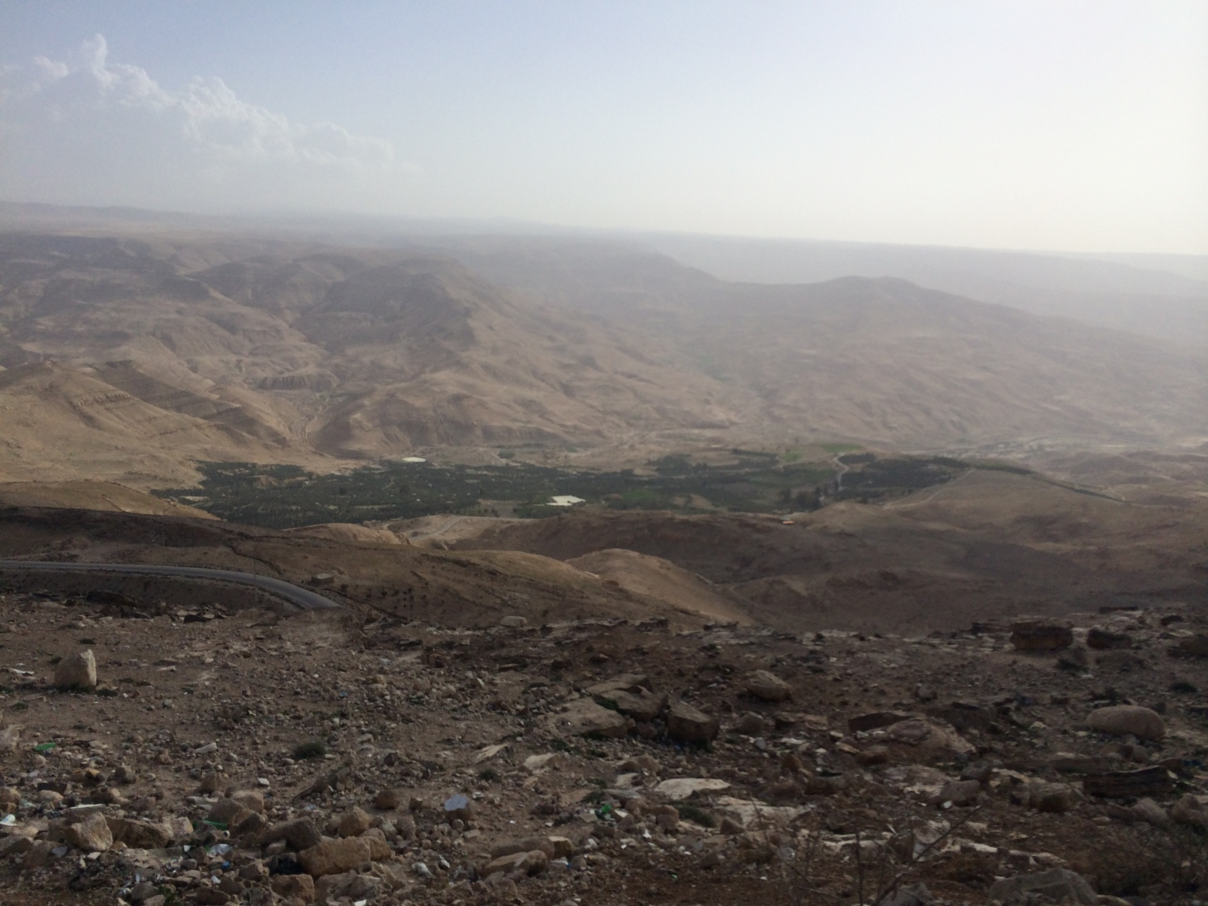
Thank you

