Slide 1
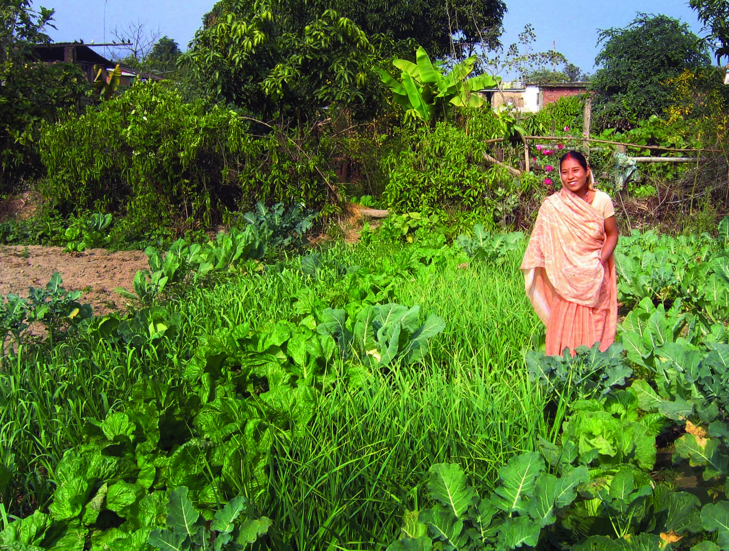


Agricultural Biodiversity Assessment in the Systems CRPS: An Introduction
Mauricio R. Bellon, Principal Scientist
28/04/2014
Notes:
COVER SLIDE
To change the picture:
Right click on the photo
Click on change picture
If you need a specific CRP logo, replace the general CGIAR logo at the upper right.

Slide 2
Conceptual framework for the assessment
Notes:
DIVIDER SLIDE
You can use it to introduce a section of your presentation.

Slide 3
individual
Nutrition & Health status
Household & individual
Food security & dietary quality
Dietary diversity
Influencing factors
Self-consumption
Purchase
Influencing factors
Influencing factors
Household & community
On-farm diversity
Market diversity
Sale
Ecosystem & Evolutionary
Services
Income
Information flow

Slide 4
General objective
to characterize these three dimensions of ABD
  the elements and relationships involved
  the exogenous factors that influence them
  as the basis for analyzing the roles of ABD in the lives and livelihoods of rural populations
  to identify entry points for designing and implementing interventions that contribute to improve their well-being

Slide 5
Specific objectives
To identify and quantify the number of all useful plant and animal species (including fish) at the household-level that are:
  grown on farm and home garden, or collected from the wild
  consumed as part of the diet by mothers and children
  purchased and sold
  Including both domesticated and wild species
  For each species the number of varieties/breeds

Slide 6
Focus of the assessment
Annual domesticated plant species
Perennial plant species, including agro-forestry species
Wild and semi-domesticated plant species
Domesticated animal species
Wild animal species
Fish
Species and products bought and sold
Foods consumed
Markets

Slide 7
Methodology
Ethno-biological survey
Focus group discussion
  Male and female groups
Questionnaire to a random sample of households in villages targeted by the CRP
Notes:
TITLE AND TEXT

Slide 8
Data analysis: Some preliminary results and examples

Slide 9
Focus Group Discussions
Notes:
DIVIDER SLIDE
You can use it to introduce a section of your presentation.

Slide 10
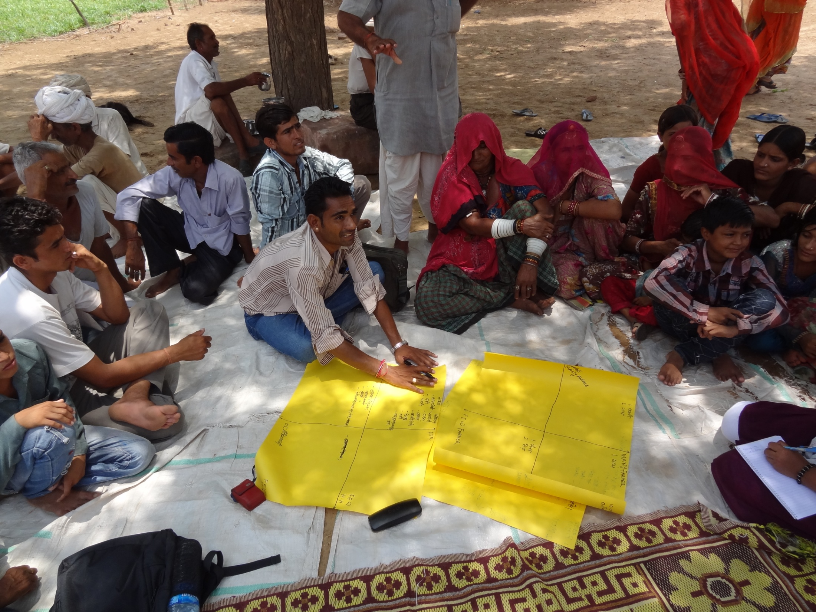

Slide 11
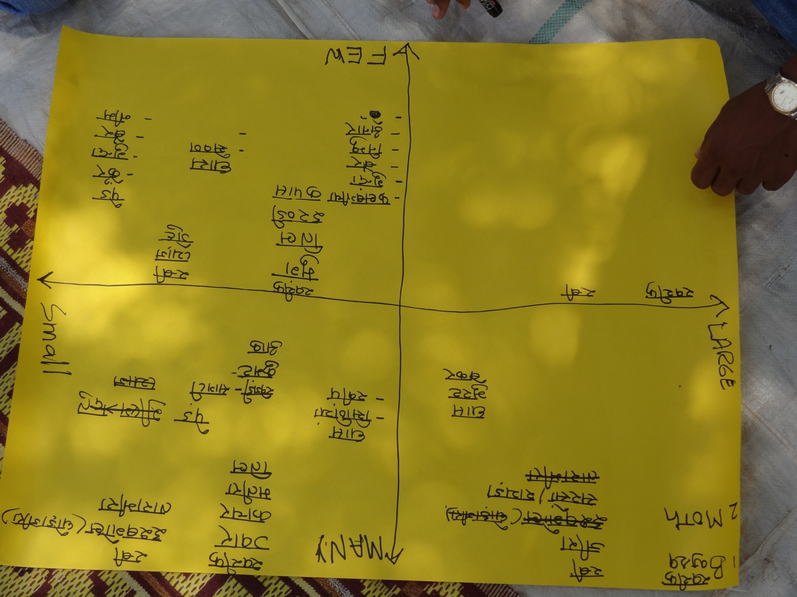

Slide 12
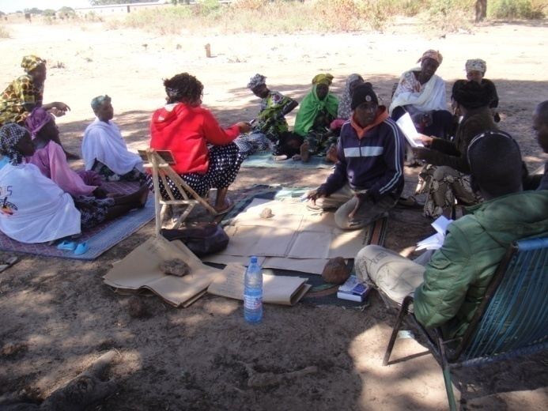
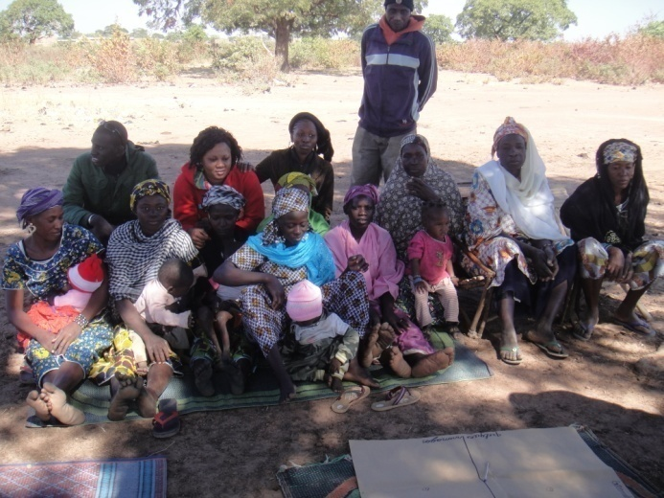
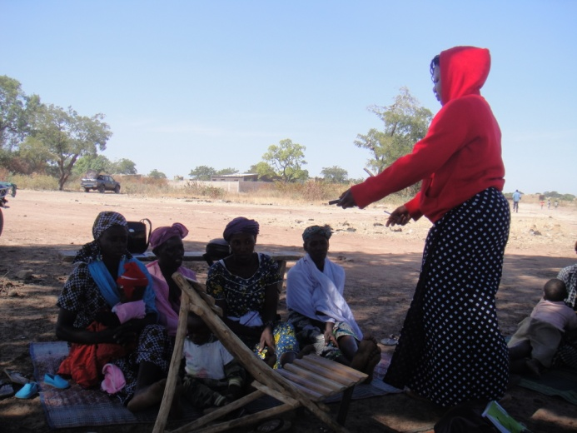
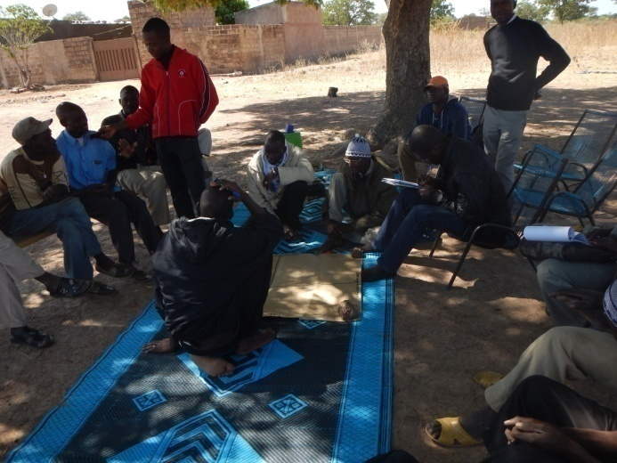

Slide 13
Preliminary results: FDG Mali-annual species
Species | Male1 | Female1 | Male2 | Female2 | Male3 | Female3 | Mean | Count
Gossypium hirsutum | 1 | 1 | 1 | 1 | 1 | 1 | 1.0 | 6
Pennisetum americanum | 1 | 1 | 1 | 1 | 1 | 1 | 1.0 | 6
Zea mays | 1 | 1 | 1 | 1 | 1 | 1 | 1.0 | 6
Sorghum bicolor | 3 | 1 | 1 | 1 | 1 | 1 | 1.3 | 6
Vigna unguiculata | 3 | 1 | 1 | 1 | 1 | 1 | 1.3 | 6
Arachis hypogea | 4 | 1 | 1 | 1 | 3 | 1 | 1.8 | 6
Oryza sativa | 1 | 1 | 3 | 1 | 4 | 2 | 2.0 | 6
Colocynthus citrillus | 2 | 1 | 4 | 4 | 3 | 1 | 2.5 | 6
Capsicum frutescens | 3 | 3 | 3 | 3 | 3 | 3 | 3.0 | 6
Vigna subterranea | 4 | 3 | 4 | 3 | 3 | 1 | 3.0 | 6
Abelmoschus esculentus | 3 | 3 | 4 | 3 | 3 | 3 | 3.2 | 6
Digitaria exilis | 1 | 4 | 4 | 4 | 4 | 2 | 3.2 | 6
Lycopersicum esculentum | 3 | 3 | 4 | 4 | 3 | 3 | 3.3 | 6
Solanum melongena | 3 | 3 | 4 | 3 | 4 | 3 | 3.3 | 6
Lactusa sativa | 3 | 3 | 4 | 3 | 4 | 4 | 3.5 | 6
Allium cepa | 4 | 4 | 3 | 3 | 4 | 4 | 3.7 | 6
Ipomea batatas | 4 | 4 | 3 | 3 | 4 | 4 | 3.7 | 6
Lagenaria sp | 2 | 4 | 4 | 4 | 4 | 4 | 3.7 | 6
Brassica oleracea var. capitatta | 4 | 4 | 4 | 4 | 4 | 4 | 4.0 | 6
Dioscorea sp | 4 | 4 | 4 | 4 | 4 | 4 | 4.0 | 6
Glycine maxima | 3 | 4 | 3 |  | 3 | 1 | 2.8 | 5
Cucumis sativus | 3 | 3 | 4 |  | 3 | 3 | 3.2 | 5
Hibiscus cannabinus |  | 4 | 3 | 3 | 3 | 3 | 3.2 | 5
Cucumis melo |  | 4 | 4 | 4 | 3 | 3 | 3.6 | 5
Sesamum indicum | 4 |  | 4 | 4 | 4 | 4 | 4.0 | 5
Cucurbita pepo | 2 | 4 | 4 | 4 |  |  | 3.5 | 4
Solanum aethiopicum | 3 | 3 |  |  | 4 | 4 | 3.5 | 4
Solanum tuberosum |  |  | 4 | 4 | 4 | 4 | 4.0 | 4
Capsicum annuum | 3 | 3 |  |  |  | 4 | 3.3 | 3
Plectranthus esculentus | 4 | 4 |  |  |  | 3 | 3.7 | 3
Manihot exculentus |  | 4 | 4 | 4 |  |  | 4.0 | 3
Cucurbita ciceraria |  |  |  |  | 4 | 3 | 3.5 | 2
Nicotiana tabacum |  |  | 4 | 3 |  |  | 3.5 | 2
Docus carota | 4 |  |  |  |  | 4 | 4.0 | 2
Phaseolus vulgaris | 4 | 4 |  |  |  |  | 4.0 | 2
Allium sativum |  |  |  | 4 |  |  | 4.0 | 1
Zingiber officinale | 4 |  |  |  |  |  | 4.0 | 1

Slide 14
Classification of annual species: male versus female groups
Kendall tau rank correlation coefficient
 |  | Village
 | 1 | 2 | 3
Kendall's tau-b | 0.5148 | 0.6742 | 0.6877
Test of Ho: males and females are independent | 0.0006 | 0.0000 | 0.0000

Slide 15
Household questionnaire:
Preliminary results from India
Notes:
DIVIDER SLIDE
You can use it to introduce a section of your presentation.

Slide 16
Koutiala, Mali: Crop species grown during the rainy season

Slide 17
Rajasthan, India: Crop species
Species | Common name | No. households | No. villages
Pennisetum glaucum | Pearl millet | 227 | 8
Cyamopsis tetragonoloba | Cluster bean | 182 | 8
Vigna aconitifolia | Moth bean | 138 | 7
Vigna radiata | Green gram | 120 | 8
Triticum aestivum | Wheat | 88 | 5
Cicer ariatinum | Chickpea | 78 | 4
Citrullus lanatus | Water melon | 50 | 4
Cucumis sativus | Cucumber | 50 | 3
Brassica spp | Mustard | 27 | 5
Sesamum indicum | Sesame | 24 | 5
Ricinus communis | Castor | 21 | 3
Cuminum cyminum | Cumin | 11 | 4
Gossypium hirsutum | Cotton | 9 | 2
Sorghum vulgare | Sorghum | 8 | 1
Arachis hypogea | Peanuts | 2 | 1
Allium cepa | Onion | 1 | 1
Plantago ovata | Psyllium | 1 | 1
Praecitrullus | Round gourd | 1 | 1

Slide 18
Rajasthan, India: Trees are important
Species | No. households | No. villages
Prosopis cineraria | 225 | 8
Azadirachta indica | 61 | 7
Acacia nilotica | 43 | 6
Ziziphus nummularia | 81 | 6
Acacia arabica | 79 | 5
Calotropis gigantia | 74 | 5
Senegalia catechu | 53 | 5
Tecomella undulata | 72 | 5
Ziziphus mauritiana | 60 | 5
Salvadora oleiodes | 43 | 4
Cordia dichotoma | 10 | 3
Areca catechu | 18 | 2
Eucalyptus citriodora | 2 | 2
Leptadenia pyrotechnica | 21 | 2
Clerodendrum multiflorum | 29 | 1
Mangifera indica | 1 | 1
Tamarindus indica | 1 | 1

Slide 19
Rajasthan, India: Domesticated animals
Species | Common name | No. households | No. villages
Capra hircus | Goat | 216 | 8
Bos dometicus | Cow | 198 | 8
Ovis aeries | Sheep | 42 | 7
Bubalus bubalis | Buffalo | 37 | 5
Camelus dromedarius | Camel | 6 | 6
Equus assinus | Donkey | 3 | 2
Gallus gallus domesticus | Hen/cock | 3 | 1
Equus equus | Horse | 1 | 1

Slide 20
Rajasthan, India: Distribution of responsibility for caring of species (number of households)
Annual crop species
Who takes care of the species: | Husband alone | Wife alone | Both | Children | Total
Number of households: | 7 | 50 | 166 | 6 | 229
Useful trees
Who takes care of the species: | Husband alone | Wife alone | Both | Children | Total
Number of households: | 21 | 43 | 161 | 4 | 229
Domesticated animals
Who takes care of the species: | Husband alone | Wife alone | Both | Children | Total
Number of households: | 8 | 61 | 166 | 3 | 238

Slide 21
Rajasthan, India: Number of decisions made by different household members about species
Decision-maker | Number of decisions |  |  |  | Total number of decisions
 | 1 | 2 | 3 | 4
Annual crop species
Husband alone | 79 | 21 | 6 | 4 | 155
Wife alone | 10 | 6 | 1 | 3 | 37
Both together | 7 | 26 | 77 | 104 | 706
Children alone | 2 | 0 | 0 | 4 | 18
Tree species
Husband alone | 56 | 35 | 6 | 7 | 172
Wife alone | 12 | 4 | 2 | 3 | 38
Both together | 12 | 39 | 53 | 110 | 689
Children alone | 1 | 0 | 0 | 4 | 17
Domesticated animal species
Husband alone | 31 | 39 | 9 | 14 | 93
Wife alone | 17 | 2 | 1 | 4 | 24
Both | 8 | 41 | 31 | 128 | 208
Children alone | 1 |  |  | 3 | 4

Slide 22
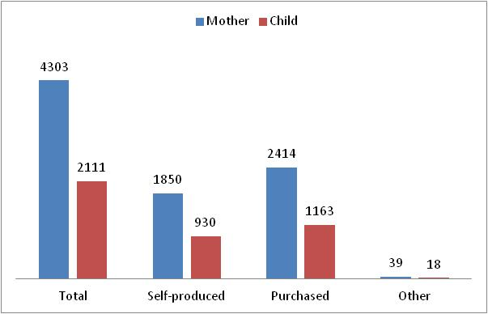
Number of food items consumed and transactions by which they were obtained by mothers and children

Slide 23
ABD Assessment: which CRPs and where
Dryland CRP
  India
  Mali
  Ghana
  Malawi
  Mozambique
Humidtropics CRP
  Vietnam
Aquatic Agricultural Systems CRP
  Bangladesh
  Philippines
  Zambia

