Slide 1
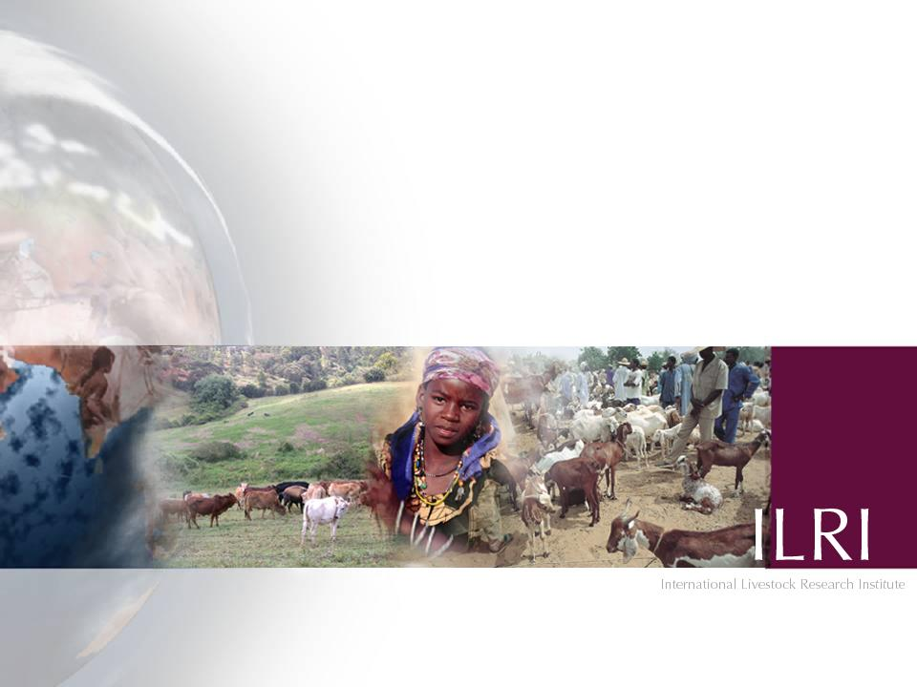
Conservation and wildlife in Kenya
Mohammed Said¹, Philip Osano^{1, 2, 3}, Shem Kifugo¹, Leah Ng'an'ga, Dickson Kaelo⁴ ,
Gordon Ojwang⁵, Patrick Wako⁵, Lucy Njino⁵ and Joseph Ogutu⁶
(1) International Livestock Research Institute; (2) Dept. of Geography, McGill University, Canada; (3) Africa Technology Policies Studies Network (ATPS); (4) University of Nairobi; (5) Department of Resource Surveys and Remote Sensing; (6) University of Hohenheim
BEST Project Policy Maker, Practitioner, Community User and Researcher Workshop, Nairobi, 13 August 2013

Slide 2
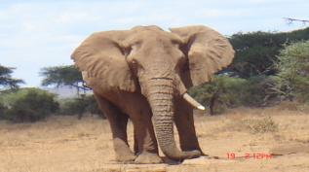
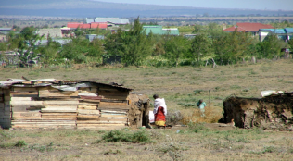
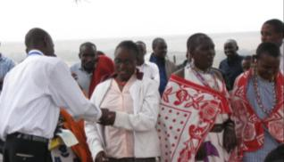
What is happening in Kenya Rangelands
Biodiversity loss – wildlife declined by 50-70% in ASALs in the period 70s-2009 (Norton-Griffiths & Said 2010; Western et al 2009)
Livestock populations – vary year to year in response to rainfall, increase 0.6% per annum, high offtake
High poverty rates in pastoral communities
Emergence of conservancies – more than 160
Initiative for communities to benefit from wildlife revenue - Payments for Wildlife Conservation (PWC)
Notes:
Biodiversity loss is increasing worldwide
Poverty is rampant in rural areas of Africa, especially among pastoral communities
How to revert trends in biodiversity loss and poverty
Is there a tipping point? I will show you an example of one case of a ‘tipping point’ in Kenyan rangeland around Maasai Mara National Reserve (MMNR)

Slide 3
Wildlife trend and Poverty

Slide 4
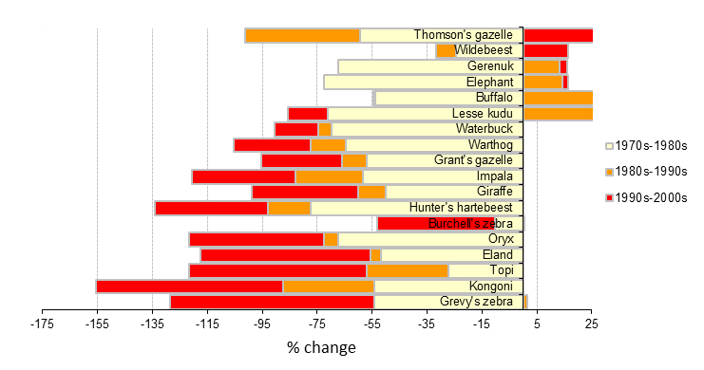
Wildlife trends in the Kenya rangelands between 1970s and 2000s
Source: Natural Capital Atlas, DRSRS

Slide 5
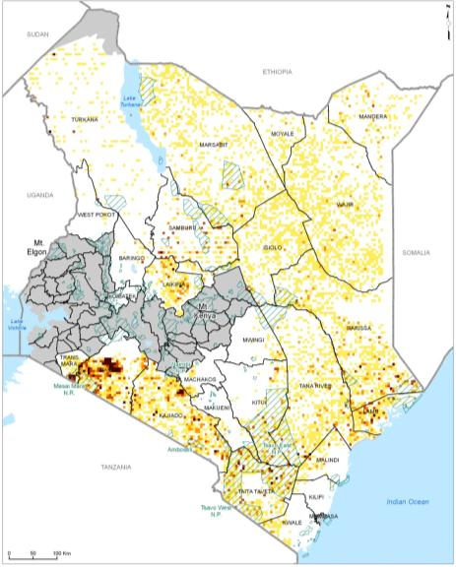
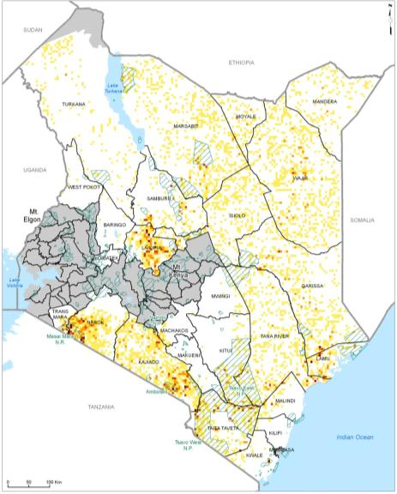
Wildlife Density1970s
Wildlife Density 1990s
Source: WRI, ILRI, DRSRS, CBS 2007

Slide 6

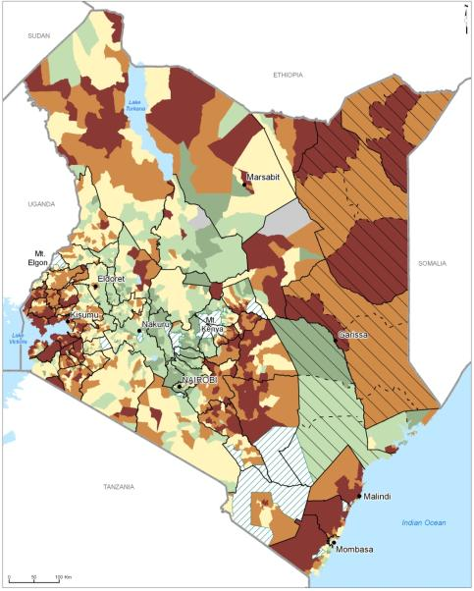
Wildlife Density in 1990s
Poverty Rate in 1999
Source: WRI, ILRI, DRSRS, CBS 2007

Slide 7
Evolution of Conservancies
Photos: Rob O’Meara, Sarah O’Meara
Source of Information: Olare Orok Conservancy Trust publication

Slide 8
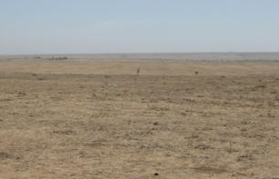
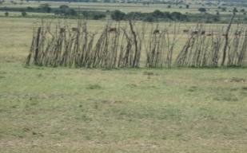
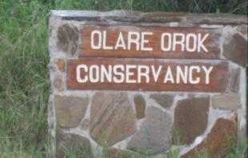
Shifts in Land Management in ASALs
Land Tenure
Mobility
Tourism Benefits
Communal
Open
Latent
Privatized
Closed
Gone
Payments for Wildlife Conservation (PWC)
Land Lease
Photo credit: Philip Osano

Slide 9
Evolution of conservancies in the Kenya Rangeland
160

Slide 10
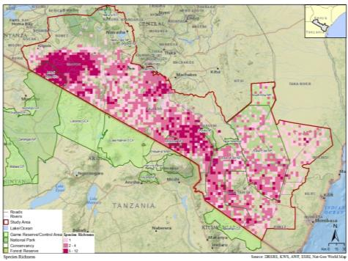
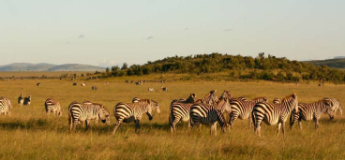
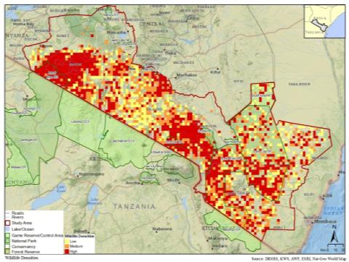
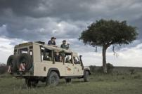
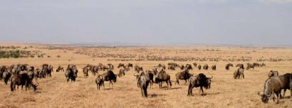
Species Richness – herbivore
Photos: Rob O’Meara, Sarah O’Meara
Source of Information: Olare Orok Conservancy Trust publication
Wildlife Density – herbivore
Photo: Ron Beaton
Source: DRSRS et al. in prep

Slide 11
Vision 2030
Securing Wildlife Corridors

Slide 12
Vision 2030
  The Vision 2030 accords a clean, secure and sustainable environment prominence under the economic and social pillars inspired by the principle of maintaining ecosystems integrity and sustainable development.

Slide 13
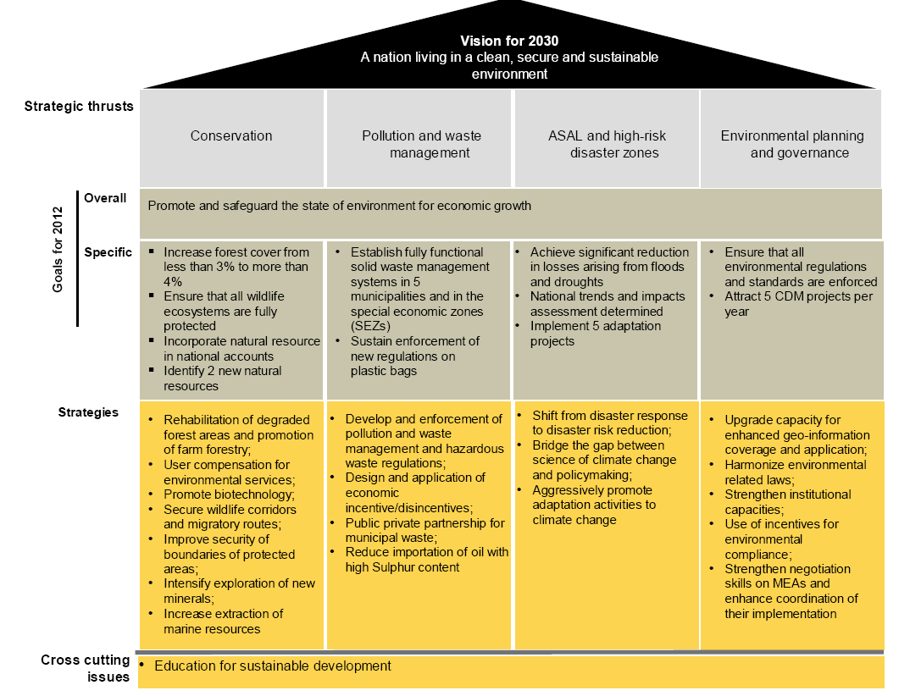

Slide 14
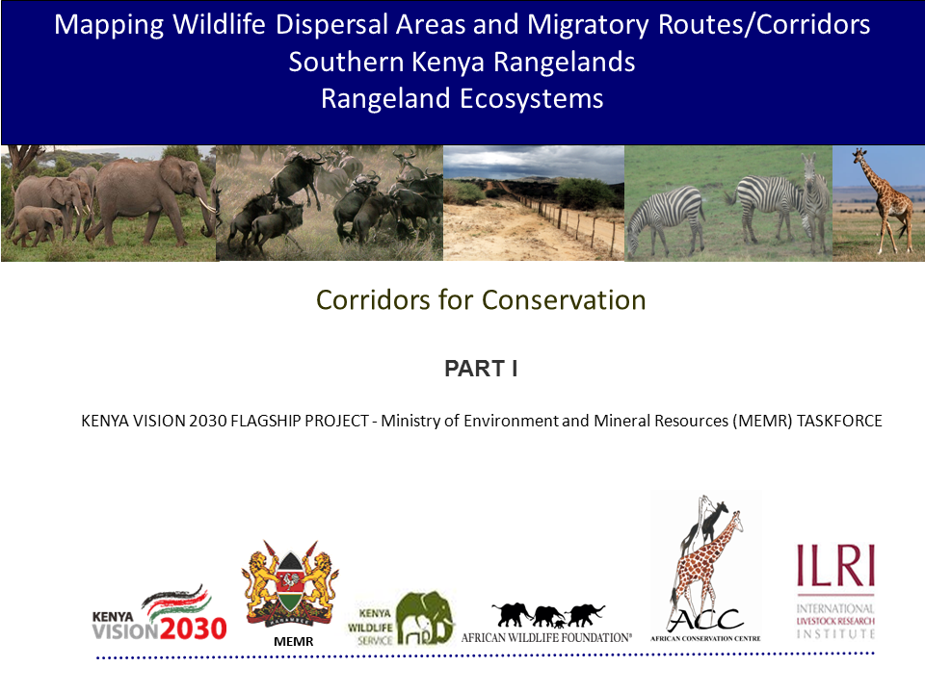

Slide 15
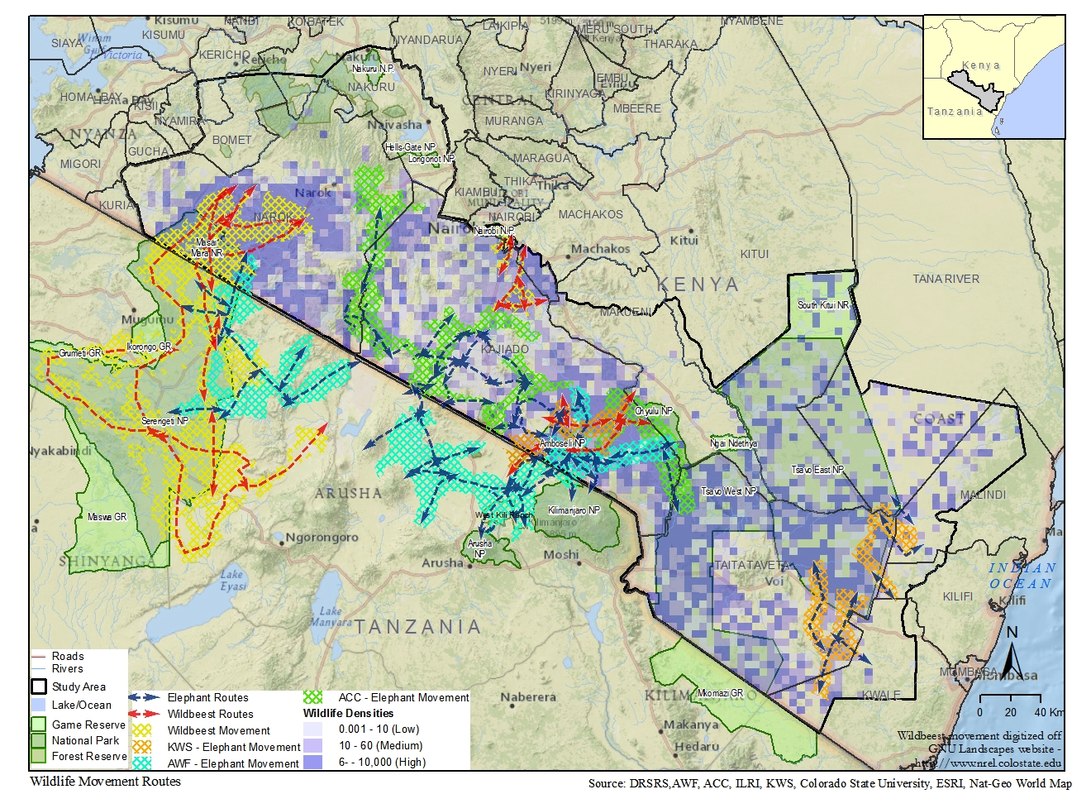

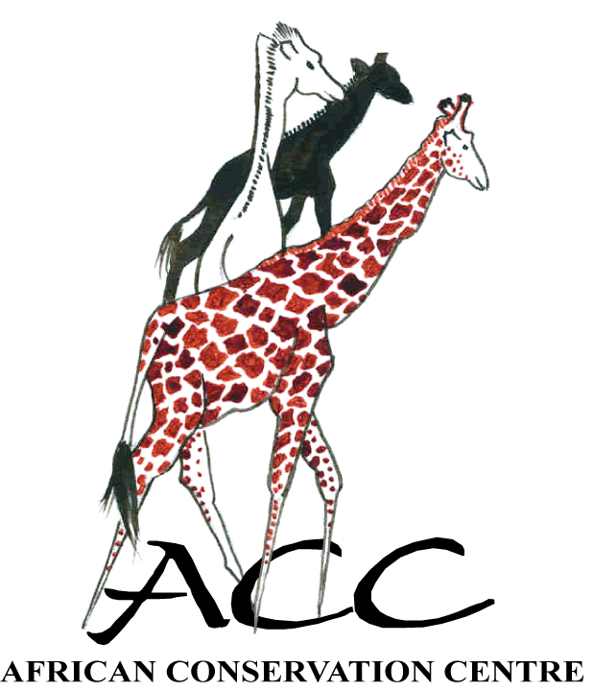



Wildlife dispersal areas and corridors
Connectivity of conservation areas both dispersal and wildlife corridors (Vision 2030)
Conservation of meta-population
Restoration of degraded lands and wildlife
MEMR

Slide 16
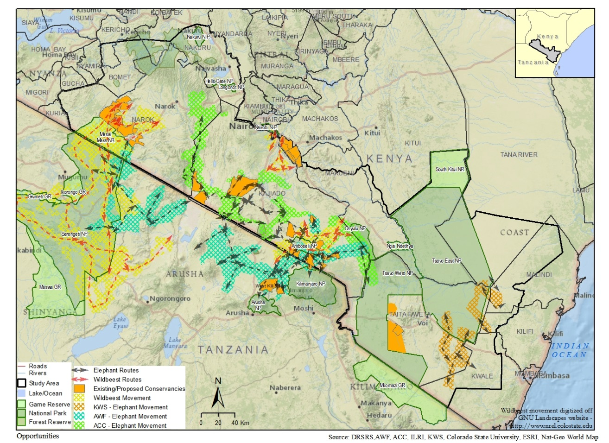
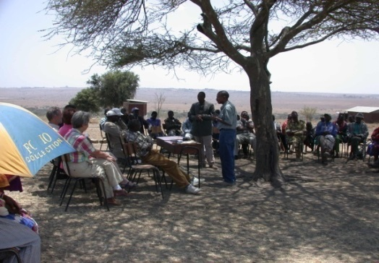
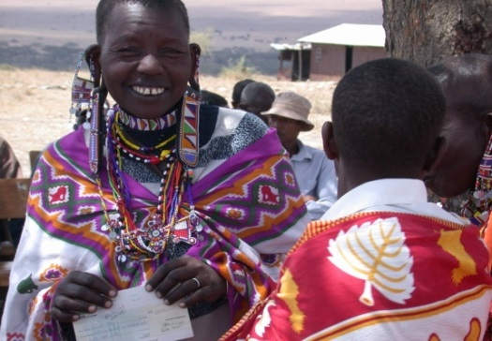
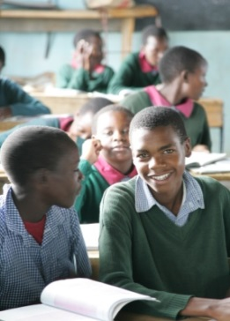
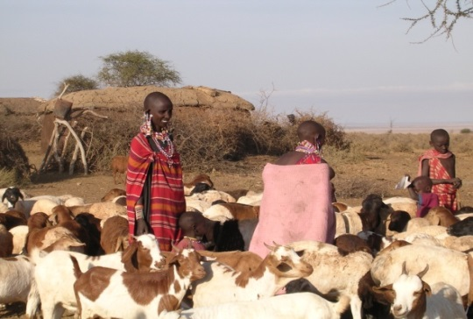

Slide 17
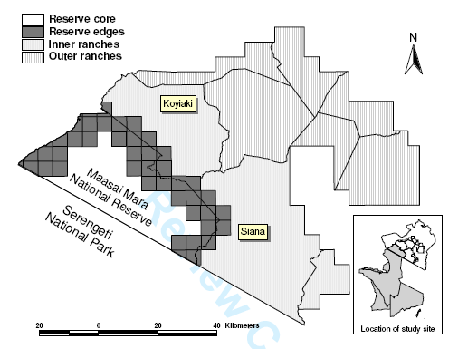
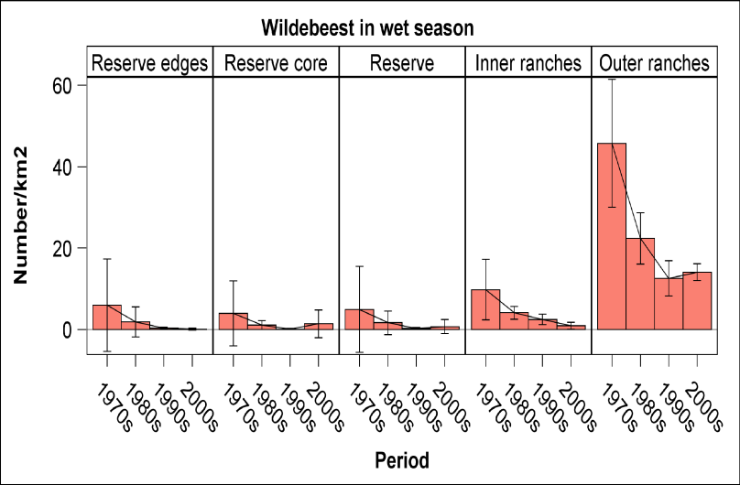
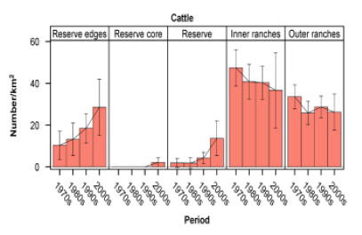
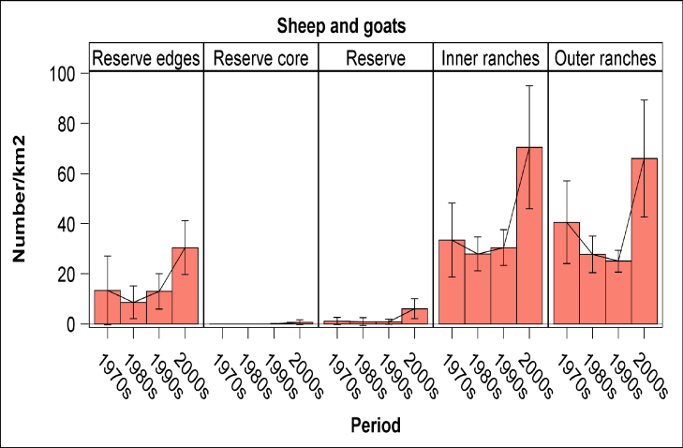
Trends of wildebeest and sheep & goats in the Mara Ecosystem
Source: Ogutu, Owen-Smith, Piepho and Said 2011

Slide 18
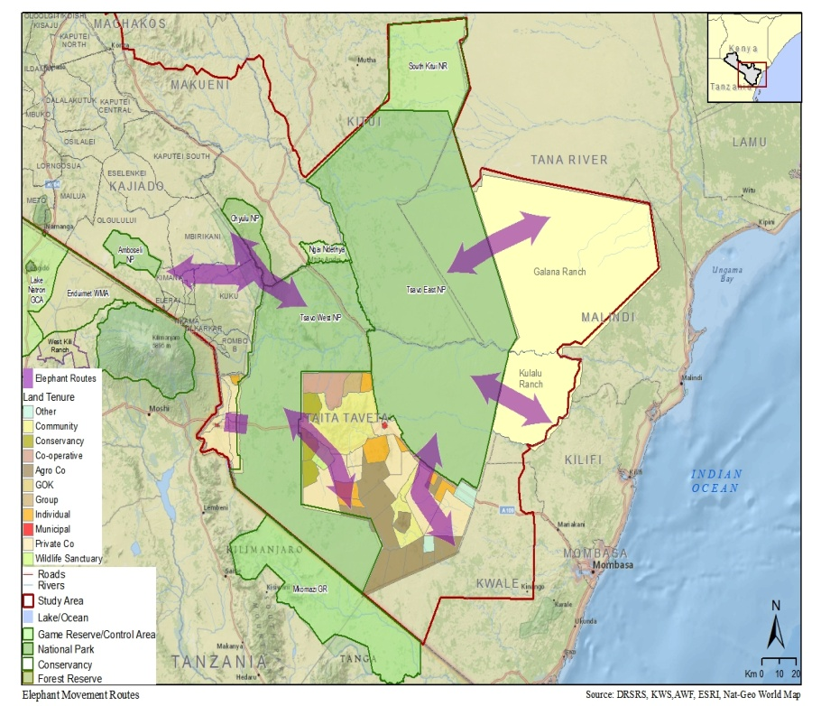
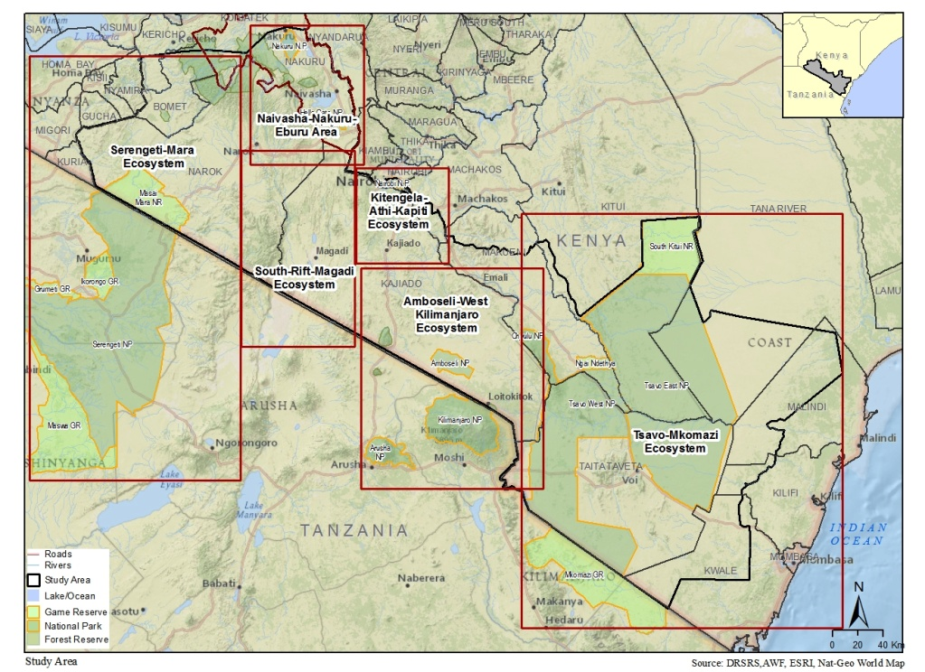
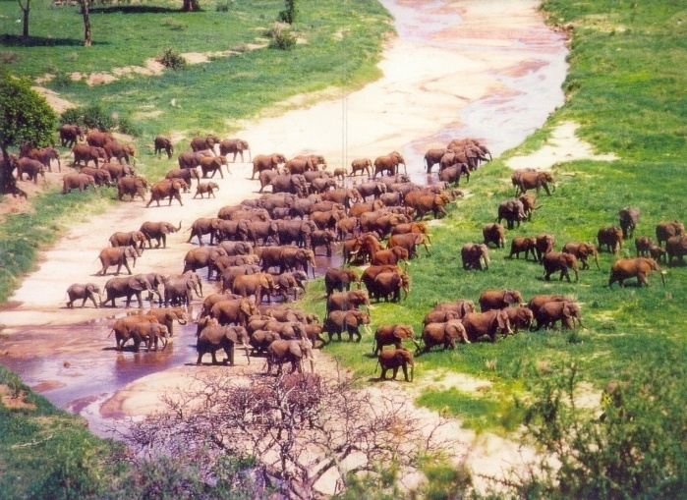


Elephant Movements in Tsavo
Source: DRSRS et al. in prep
Photo: Msoffe
MEMR

Slide 19
Drivers | Population growth; insecure land tenure; land subdivision; changing climate and rainfall patterns - scarcity of water and recurrent droughts; lack of incentives to conserve wildlife; lack of policy e.g. land use and development of conservancies.
Pressures | Land use change - conversion to settlements, subsistence farming, sisal plantations; grazing leases; fencing; sedentarisation; Human encroachment - incompatible land uses; forest destruction; charcoal burning; wild fires; poaching; precious stone mining; and Human-wildlife conflicts - crop damage, livestock predation, injury or death to humans
State | Critical elephant corridors not threatened (located in the Park) River Tiva Crossing, Yatta gaps and Ngulia to Yatta Blocked wildlife corridors Southern park area to Rukinga and Taita (fences, small scale farming); Maktau to Kasigau (heavily settled, fences, small-scale farming); Kamboyo to Chyulus (encroached); Chyulu to Amboseli (land subdivision and sale, irrigated and rain fed agriculture, fences, incompatible tourism development); and Lake Jipe (high density settlements and agriculture) Degraded wildlife corridors Tsavo East to Galana (over grazed); and Tsavo to Kulalu (over grazed)
Impacts | Loss or fragmentation of wildlife habitats; decline in wildlife populations (e.g. wild dogs);
Response | Establishing game sanctuaries and community wildlife conservation areas; Direct purchase of private lands for inclusion into the wider protected area system; Establishing legal and economic instruments (leases, easements and agreements); Establishing participatory land use planning; Strengthening the protected area management through inclusion of wildlife extensions and diversification of incentive; and Implementing transboundary conservation initiatives (TsavoWest NP and Mkomazi GR)
MEMR

Slide 20
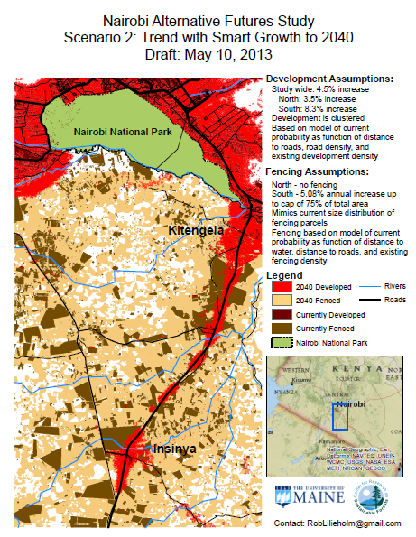
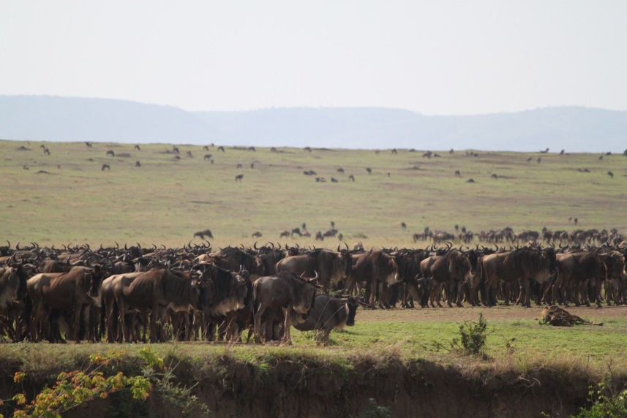
Scenario NNP
Source: Lilieholm et al. 2013; Ogutu et al. in press

Slide 21
Kenya’s Natural Capital Atlas
ACC lead agencies
Contribution from government ministries and department agencies (DRSRS, KWS, Museums of Kenya, Nature Kenya, Universities, NGOs), International Organizations (ILRI, WRI, ..)
Report ready – End of September

Slide 22
Issues – Wildlife Bill
Devolution and governance of natural resources
National and county responsibilities as it relates to conservancies – security, land use plans, coordination, …
Resource allocations, monitoring of the conservancies, …..

Slide 23
Acknowledgements
International Livestock Research Institute (ILRI) (www.ilri.org)
University College, London (UCL), Department of Anthropology
Africa Technology Policy Studies Network (ATPS) (www.atpsnet.org)
National Environment Research Council (NERC)-ESPA (NERC grant NE/1003673)
McGill University (www.mcgill.ca)
-Department of Geography and Department of Anthropology
-McGill Institute for International Development Studies (IIDS)
International Development Research Center (IDRC), Canada (www.idrc.ca)
Association for the Strengthening of Agricultural Research in Eastern and Central Africa (ASARECA grant PAAP/09/02) (http://www.asareca.org/)
Department of Resource Surveys and Remote Sensing
Various partners and collaborators in Kenya (Kenya Wildlife Services, African Conservation Centre, Kenya National Bureau of Statistics, African Wildlife Foundation)
Local community and NGOs - Local community in Mara, Northern Rangeland Trust, The Wildlife Foundation, Olare Orok Conservancy, Naiboisho Conservancy, BaseCamp Foundation, OlKiramatian Group Ranch, SORALO

