Slide 1
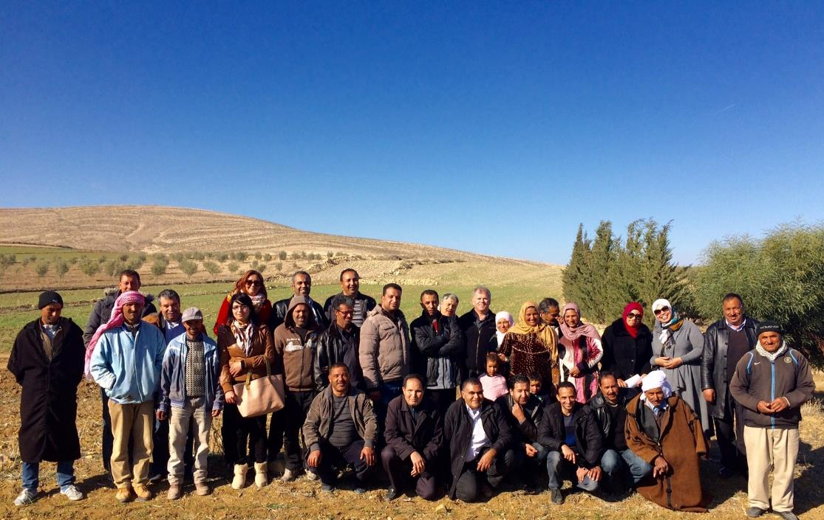
Integrated Crop-Livestock Conservation Agriculture
For Sustainable Intensification of Cereal-based Systems
In North Africa and Central Asia
Project Completion Review Mission
Dr Jay Cummins
jay@iafd.org
5

Slide 2

Mission Tasks
Review Work Plan Activities Assess Scientific Quality of Field activities Analyse impacts at farmer level Assess farmer’s perception of technologies and adoption Assess dissemination methodologies and scaling up Assess success of capacity development activities
2

Slide 3
Mission Tasks (continued)
Identify critical research gaps Identify perceptions of project achievements and impact amongst stakeholders Discuss project exit strategy approaches and sustainability Links to other IFAD projects Gender balance and engagement Prepare Mission Report
3

Slide 4
Basis of the Review
Effectiveness: Has the intervention achieved its objectives or will it be able to do so in the future? Impact: What are the overall effects of the intervention, intended and unintended, long term and short term, positive and negative? Relevance: Is the intervention consistent with the needs and priorities of its target group and the policies of the partner countries and donor agencies? Sustainability: Will the benefits produced by the intervention be maintained after the cessation of external support? Efficiency: Are the costs of the intervention justified by the results?
4

Slide 5
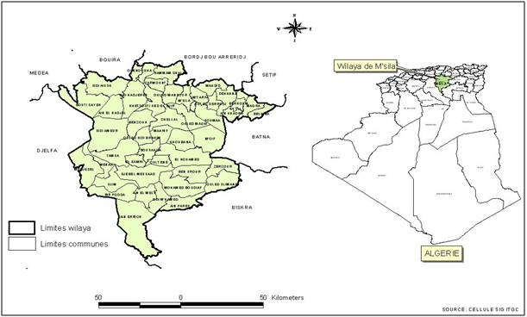
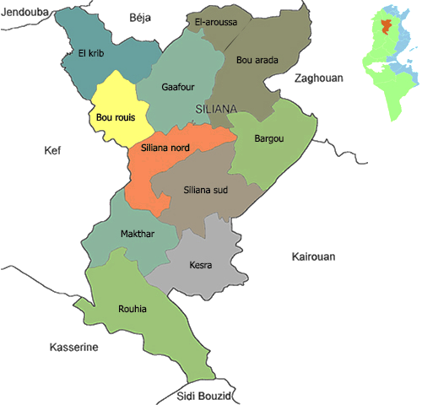
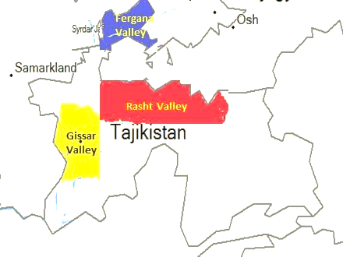
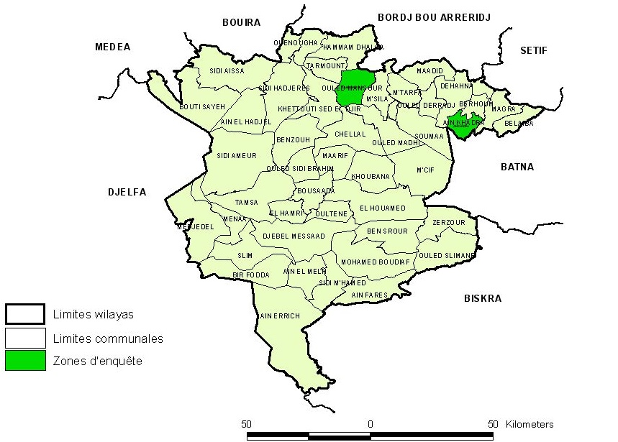
Where?
Tajikistan, Algeria and Tunisia
5
5

Slide 6

Project Scorecard
Effectiveness
The majority of objectives have been achieved, with a significant number of discoveries to date providing an extremely strong case for the support of a Phase 2 project. These include: the development of ZT seeding systems demonstrated increases in fodder production (converting to increased opportunities for livestock production) potential water savings under irrigated crop production systems improved understanding of grazing behavior and requirements of livestock | The overall effectiveness of the project is yet to be realized, due to the short period of operation of the Phase 1 project. This will only improve over time, as the momentum and synergy builds around the development and adoption of a truly integrated CLCA system.
6

Slide 7
Project Scorecard
Impact
Innovative approaches to working with farmers have resulted in the development of affordable and adaptable CLCA technologies. The adoption of CLCA systems will take place over an extended period of time, given the complexity of the system, and the need to develop regional ‘best management practices’ and benchmarks. | The full impact of the project is yet to be realized, given the complexity of the CLCA system and the need to adapt and developed improved management systems. A focus on building R, D & E capacity across all three countries (and in particular Tajikistan) will further enhance impact and project success into the future.
7

Slide 8
Project Scorecard
Relevance
The project has identified and addressed the needs of the targeted audience (small landholders), based on highly detailed ex ante farm household socio-economic analysis. Strong farmer engagement and an exhaustive number of on-farm demonstrations, coupled to regular farmer consultation & feedback has helped to ensure strong project relevance. The project addresses three critical elements, namely water and food security, and maximizing farm profitability; whereby farmers can implement practical changes having lasting benefits to all in the community. | Alley farming systems are appropriate for landscapes characterized by high soil erosion potential, and/or where subsoil constraints such as salinity limit high crop productivity. The development of low-cost, locally manufactured seed drills will help to ensure that the adoption of CLCA systems are within the financial resources of small, resource-poor landholders.
8

Slide 9
Project Scorecard
Sustainability
The project is built on a strong foundation of capacity building, both at the farmer level and also project teams comprising research and extension outreach personnel. The CLCA system presents a truly integrated production system that is based upon long term agricultural sustainability. Farmer interest and motivation is growing considerably, and present an ideal model for long term practice change. | The phase 1 project has run for two growing seasons. A long-term investment is warranted (5 years +) to properly develop and adapt CLCA systems in a practical and applicable manner at the farmer level. Further farmer engagement, largely through forming, supporting and empowering farmer groups will provide a sustainable model for the achievement of enduring impacts.
9

Slide 10
Project Scorecard
Efficiency
The work programs and activity outputs have been extensive across all three countries. The in-kind co-contribution of NARS has been significantly under-estimated, resulting in a significant amplification of project outputs and potential impacts. | A delayed commencement date for the project, and project payments to NARS resulted in the inability to deliver on all scheduled activities. Delays in the shipment and commissioning of the ZT seed drills provided additional challenges to project teams.
10

Slide 11
Opportunities
Development low-cost ZT Seed Drills
Farmers need to be able to access low-cost ZT Seed drills Currently a major barrier to adoption Local development and manufacturing is critical Local adaptation to suit local farming systems
11

Slide 12
Opportunities
Technical Capacity and Capability
Skills vary by country according to experience in CA Technical training, grounded in practical approaches is critical Priority Areas include: Development of integrated crop protection systems Integrated Crop Monitoring Systems (Agronomic based) On-farm trials and demonstrations
12

Slide 13
Opportunities
High-performance livestock systems
Phase 1 has identified the potential to intensify livestock production Oat-vetch is a profitable option to increase carrying capacity and productivity over mechanical fallow Requires the development of an integrated crop-livestock production system Development of livestock BMP
13

Slide 14
Opportunities
Market chain approaches to farmer decision-making
Farmers need to be responsive to market opportunities Optimise price-premium windows according to seasonal demand for livestock and grains Adaptation of breeding calendar according to peak demands for lambs Meeting market demand being a profit driver
14

Slide 15
Opportunities
Formation of farmer-driven CLCA Discussion groups
Importance of local farmer discussion groups can not be over-emphasised Groups need to be demand-driven, supported through formative stages Requires good local farmer leadership and motivation Need to work alongside and understand local farmer needs Complements participatory extension and ‘evidence based research
15

Slide 16
Opportunities
Achieving significant reductions in irrigated water use
Farmer evidence has identified significant reduction in water requirements for crops irrigated where ZT has been adopted Between 30-40% reductions compared with conventionally sown crops More work needs to be done to validate the full benefits and impact across basins Further advances in moving from flood to sprinkler and/or laser levelled
16

Slide 17
Opportunities
Maximising Crop WUE and Yield Potential
Under rain-fed systems significant opportunity to increase crop water use efficiency ‘The Yield Gap’ (difference between potential yield and current yields achieved’) is large Need to set clear targets to aim for, in terms of improving Crop WUE Long term benefit of enhancing both food and water security
17

Slide 18
Opportunities
Monitoring impact – measuring change
Need to monitoring the long-term impact of practice change Includes crop rotation trials, best management versus district practice Results need to be demonstrated over an extended period of time, to take into consideration changes in soil fertility, physical soil properties, farm profitability and drought resilience KASAP – measuring changes in knowledge, attitudes, skills, aspirations and practice change amongst farmers is a priority
18

Slide 19
Opportunities
Supporting market-responsive input supply chains
The CLCA system is more dependent upon agricultural inputs (fertilisers, crop protection products, machinery) Farmers need access to such inputs at critical times There needs to be greater competition in the market place to reduce the cost of such inputs It appears that farmers pay a price premium, and at times can not access various inputs at critical times ‘Local farmer buying groups’ may create greater competition in the market place; in order to develop ‘demand driven, customer focused services.
19

Slide 20
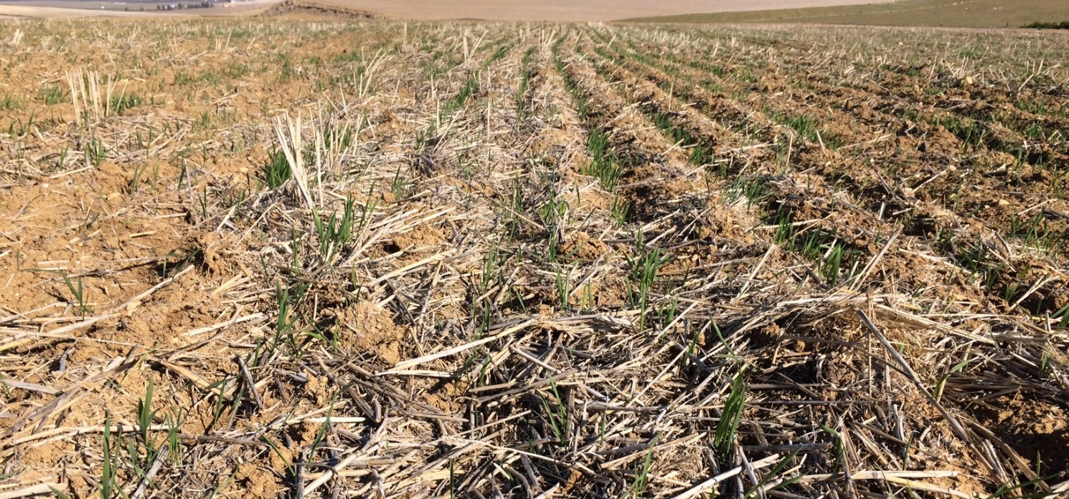
Outstanding Achievements
On-farm demonstrations of CLCA
20

Slide 21
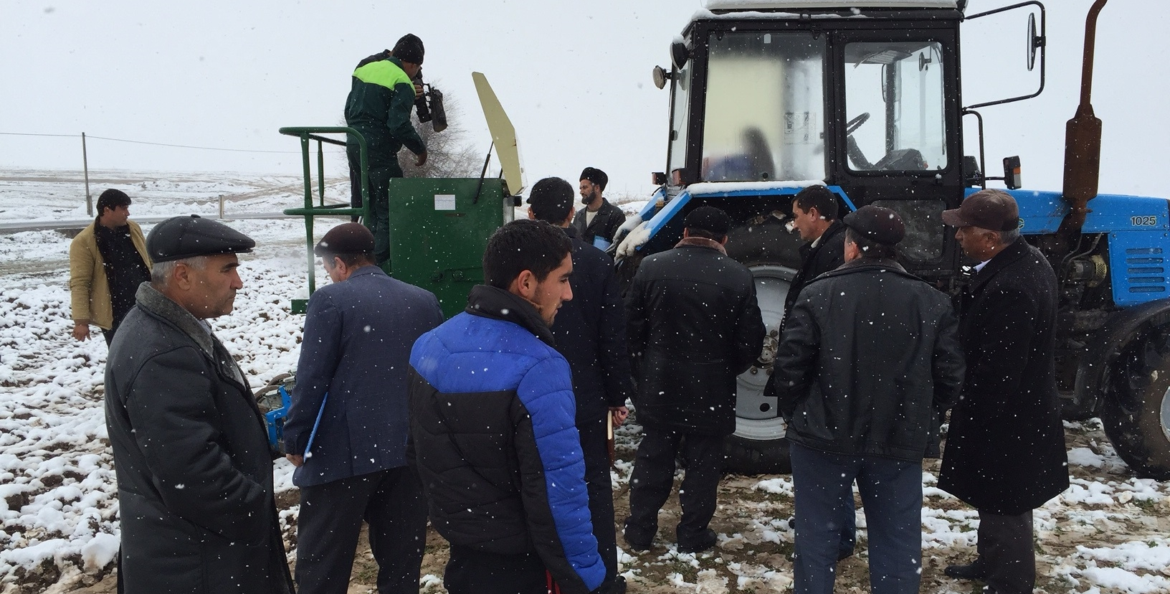
Outstanding Achievements
Farmer interest in CLCA and in particular ZT systems
21

Slide 22
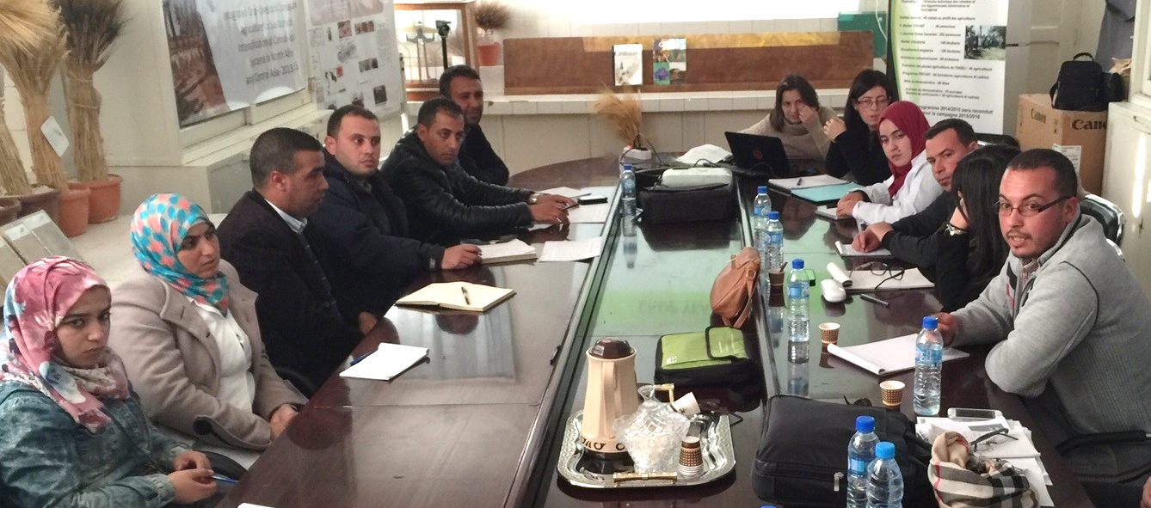
Outstanding Achievements
Enthusiasm and commitment from the teams
22

Slide 23
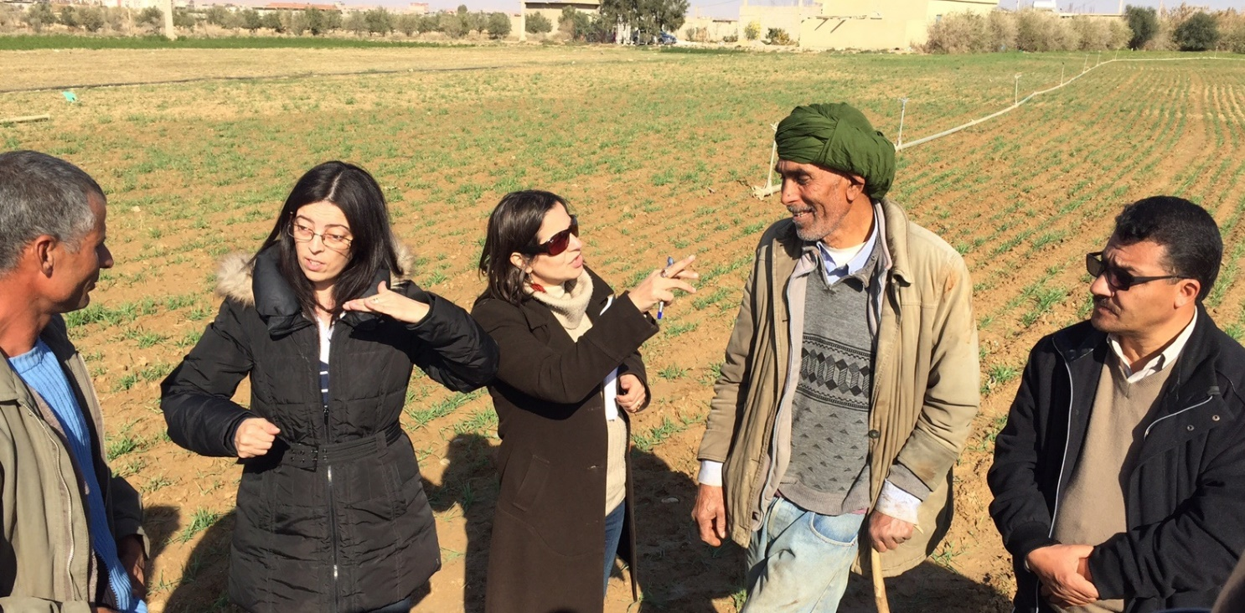
Outstanding Achievements
Ability to engage with and motivate farmers
23

Slide 24
Outstanding Achievements
On-farm demonstrations of CLCA
24

Slide 25
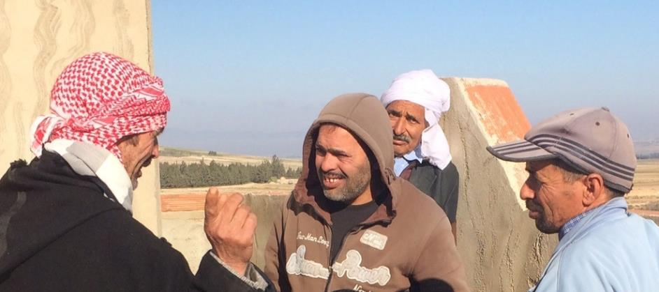
Outstanding Achievements
Support in establishing farmer groups
25

Slide 26
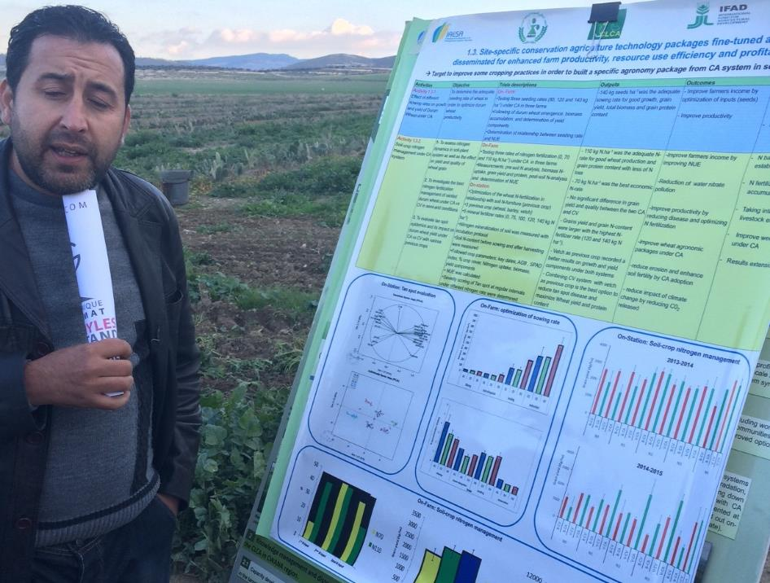
Outstanding Achievements
Quality and commitment to on-farm research
26

Slide 27
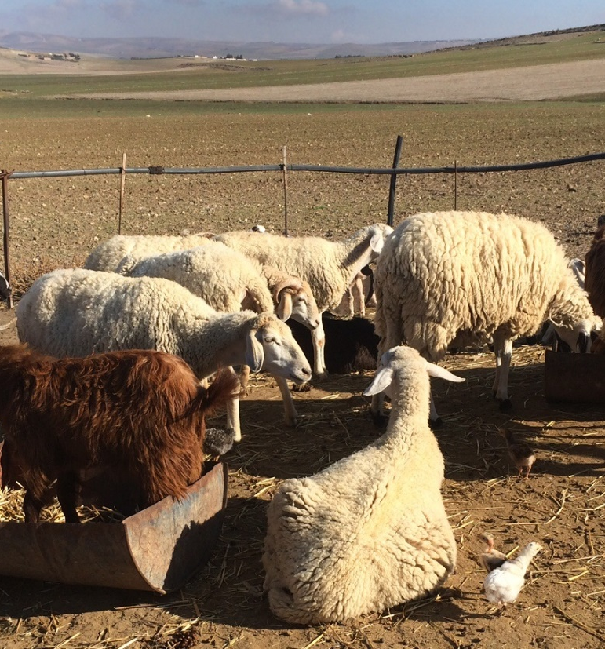
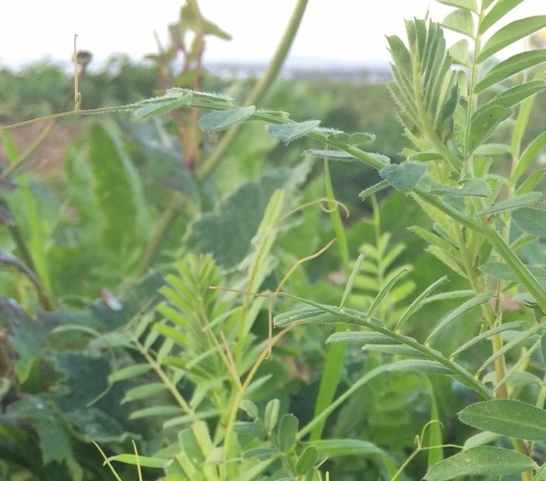
Outstanding Achievements
Integration of livestock into the CLCA system
27

Slide 28
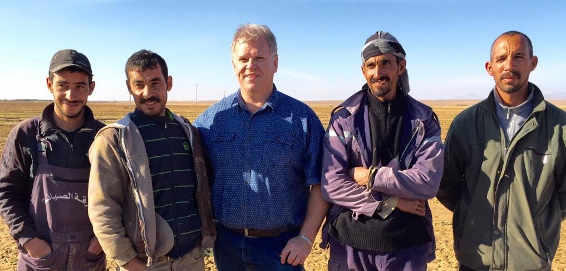
Outstanding Achievements
Genuine farmer motivation, interest and local leadership
28

Slide 29
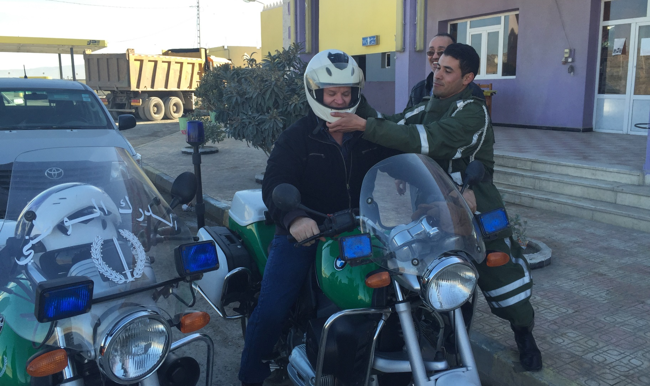
Thankyou!
5

