Slide 1
The value of data
Carlos Barahona
Statistical Services Centre, University of Reading, UK

Slide 2
Open Data Policies
We are moving in the direction of change
IT is ready and changing fast
CG ODP is in place
but I believe it is a working hypothesis and will evolve
Incentives, skills and resources requireed are probably underestimated
But we also need a change in culture

Slide 3
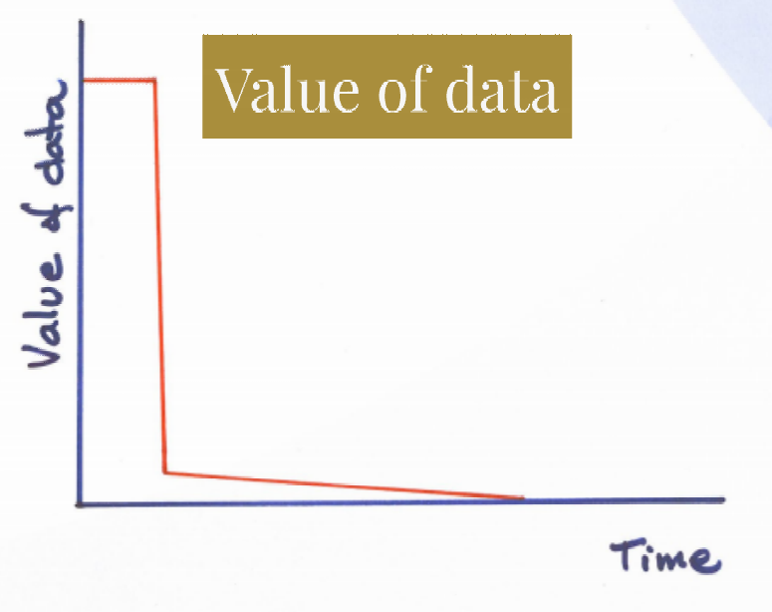

Slide 4
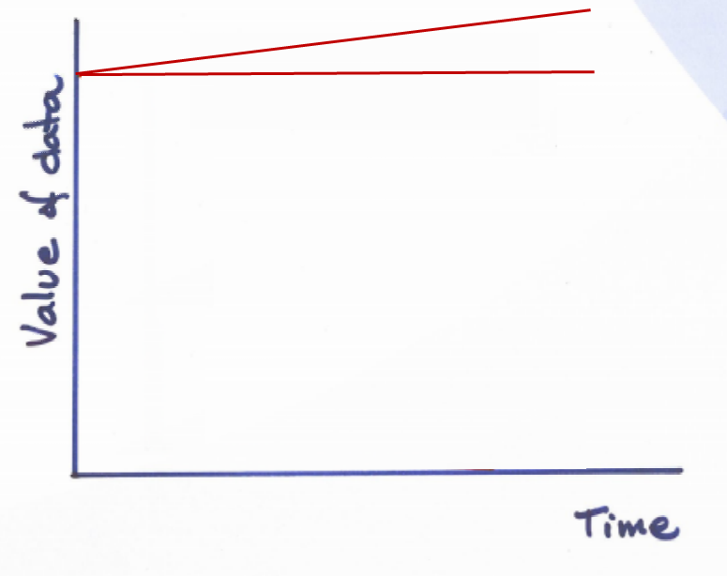

Slide 5
Risks and challenges
Re-value the data
Use accumulated data
How to provide data
Compliance and supervision
Data Standards
Data depositories
Incentives
Support
Confidentiality
Completeness
Long term management

Slide 6
An initial proposal for training resources
What is Data Quality?
Role of scientists and research methods support in relation to Data Quality
The value of data: Design-Collect-Assess-Build-Share
  Elements of sampling
  Good Data Collection
    Using paper
    Using electronic devices
  Checking consistency of data
  Metadata
  Data archiving
What is research with a Systems Approach
Options by Context – an emerging framework for research

Slide 7
What capacities/skills do we (scientists/ research methods support/institutions) need to develop to:
Comply with CG Open Data Policy
Take advantage of the Open Data Policy, i.e. what can it do for me?

Slide 8
Resources
Do you have any suggestions for
Additions
Remove some items
Contents of some of the topics

