Slide 1
Drylands Systems CRP
Gender Implementation Workshop
West African Sahel & Dryland Savanna Flagship
Amman, 26-27 May 2014
Djalal Ademonla Arinloye
Pierre S. Traore
Joachim Binam
Catherine Dembele
Antoine Kalinganire

Slide 2
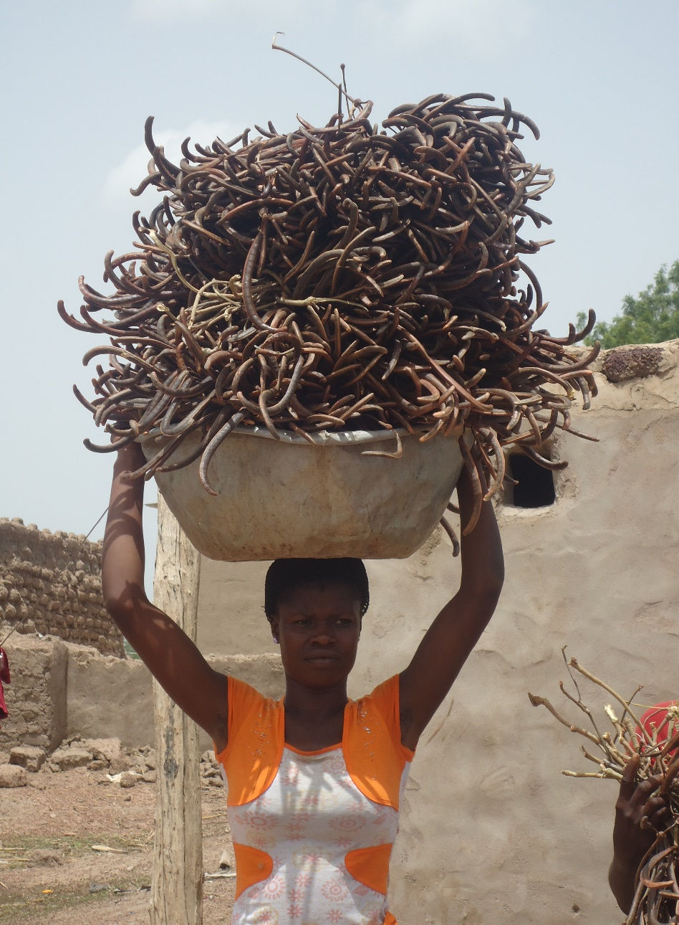

Gender mainstreaming
Mainstreaming refers to the systematic integration of gender equity issues into the WAS&DS research process: priority setting, planning, design, implementation, M&E and into the management of this process
  To ensure that poor women have enhanced access to the results of agricultural science and technology (e.g. WAS&DS research outputs), and that these results effectively contribute to increased gender equality in access to and control over productive assets, inputs and benefits

Slide 3
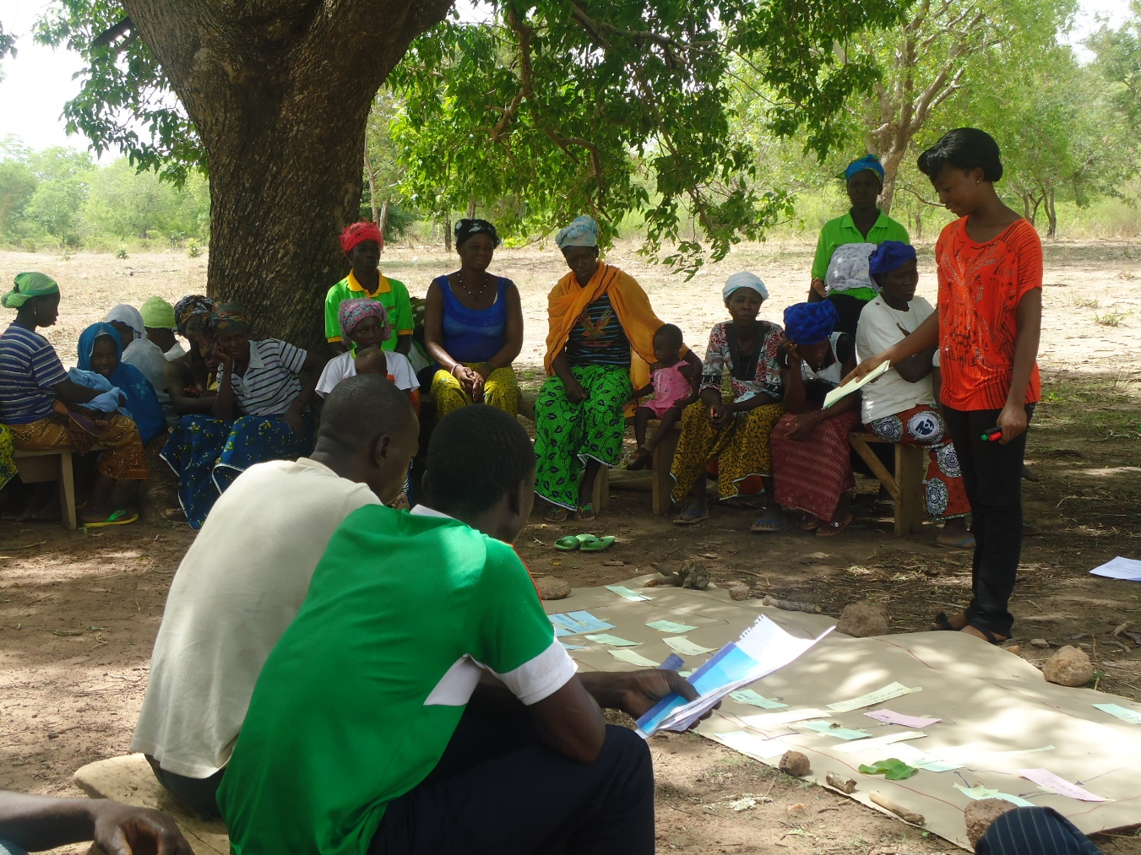
Gender in value chains
Indirect chain Actors
Direct Chain Actors
Performance indicators
Governance (Quality control, low transaction costs)
Effectiveness:
Quality (Consumer demand)
Targets (yield, benficiaries)
Markets access
Efficiency:
Profitability
Low ransport cost
Impact:
Food security
Incomes
Gender / Equity
Added value distribution
Sustainability
Partnerships PPP
Nat. Res.Conserv.
Biodiversity
Inter ( national) policies and regulations
International consumption
Consumption
Export
Resources
Extension
Marketing and trade
Distributed
Benefits
Research
Infrastructure
Processing
Added value
Financial support services
Production
Input supply
Capacity building & Empowerment of stakeholders
Gender issue cutting across all components of VC

Slide 4
WAS Flagship Activities: gender mainstreaming strategies
WAS&DS | Current Activity Clusters | New Activity Cluster Name in WAS | CRP DS Agricultural Livelihood Systems (ALS) | Ongoing gender mainstreaming strategies
1 | Review past work on dryland systems and draw lessons on successes, failures and gaps; and evaluate vulnerability and risk management strategies in the action sites | Monitoring and Evaluation: Review past work on dryland systems, coordinate and harmonize database management | -Agro-pastoral systems -Intensive rain-fed systems -Tree-based systems -Traditional subsistence system | - Collecting/analyzing sex- and age-disaggregated data by farming system, age, socioeconomic class, ethnic and religious group in survyes, value chain analysis, biodiversity assessment, vulnerability and risk assessment - Gender-focused intensification options e.g. small ruminant fattening (Ramadan) to increase income generation by women to improve household food security
2 | Coordinate and harmonize database management and research methods
6 | Establish reference situation/ Baseline for the action sites to support systems approaches
9 | Assess and monitor biomass and resource flow in the action sites

Slide 5
WAS Flagship Activities: gender mainstreaming strategies
WAS&DS | Current Activity Clusters | New Activity Cluster Name in WAS | CRP DS Agricultural Livelihood Systems (ALS) | Ongoing gender mainstreaming strategies
3 | Develop and test value adding strategies for post-harvest management, processing and use of agricultural produce and by-products including forest product | Idem | -Traditional subsistence system -Agro-pastoral systems -Tree-based systems -Intensive rain-fed systems | - Developing and testing gender-smart harvest and postharvest technologies, human nutrition, crop residue management, post-harvest management and processing of forest and crop products, and grain storage
4 | Promote local and regional knowledge generation and exchange for scaling up and out of promising intensification options and strategies | idem | -Traditional subsistence system -Tree-based systems -Agro-pastoral systems -Intensive rain-fed systems | - Gender balanced site selection, communication and dissemination of promising intensification options and strategies, and training of trainers in intensification options and strategies

Slide 6
WAS Flagship Activities: gender mainstreaming strategies
WAS&DS | Current Activity Clusters | New Activity Cluster Name in WAS | CRP DS Agricultural Livelihood Systems (ALS) | Ongoing gender mainstreaming strategies
5 | Induce intensification and improve resource use efficiency through on-farm testing and evaluation of technologies | idem | - Agro-pastoral systems - Intensive rain-fed systems - Traditional subsistence system - Agro-pastoral systems | -Testing and evaluating of gender-smart best fit options for improved livelihood, and water management → High-value market garden and fruit-tree production; improved quality and quantity of crop residue for livestock feeding and quality manure generation for women and other vulnerable groups
7 | Quantify resource use and associated tradeoffs to optimize community-level decision making to promote SI and vulnerability reduction | Effective resources management: Review, analyze, develop, test and disseminate community-based strategies for resource management and vulnerability reduction | - Traditional subsistence system | - Simulation models and foresight capacity developed considering gender representativeness to predict future systems evolution based on locally valid resources and flows, cultural issues, and strategic decision making capacity involving women and youth

Slide 7
WAS Flagship Activities: gender mainstreaming strategies
WAS&DS | Current Activity Clusters | New Activity Cluster Name in WAS | CRP DS Agricultural Livelihood Systems (ALS) | Ongoing gender mainstreaming strategies
8 | Facilitate effective linkages and knowledge exchange among different actors for improved system productivity and better market access | idem | -Agro-pastoral systems -Intensive rain-fed systems | -Gender disaggregated value chain analysis - Women participation to Farmers' field school, field diversity forum, Rural Resource Centre - Ensure inclusiveness (poor and landless farmers, women, youth); Engaging and empowering women, youth and disadvantaged groups

Slide 8
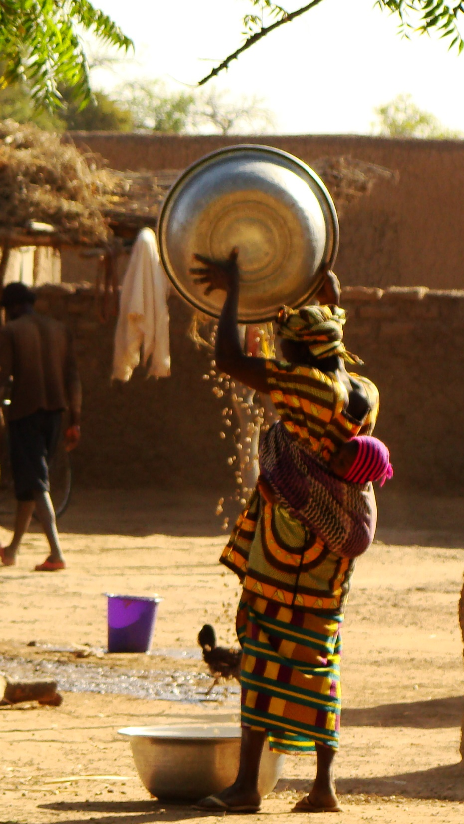
Strategic gender research
Gender specific research
  Addresses direct questions related to differential intervention results between men and women and marginalized groups
    e.g. How does household adoption of a new technology change women and men’s time use patterns, and income accrual?
  Expectation is that at least 30% of research being gender specific
Gender sensitive research
  Addresses indirect question such as :
    e.g What are the (ex-ante & ex-post) impacts of adoption of a new crop variety? where data collection is such that results can be reported for male and female plot managers?
  Target of 100% of all research that measures impact on farmers

Slide 9
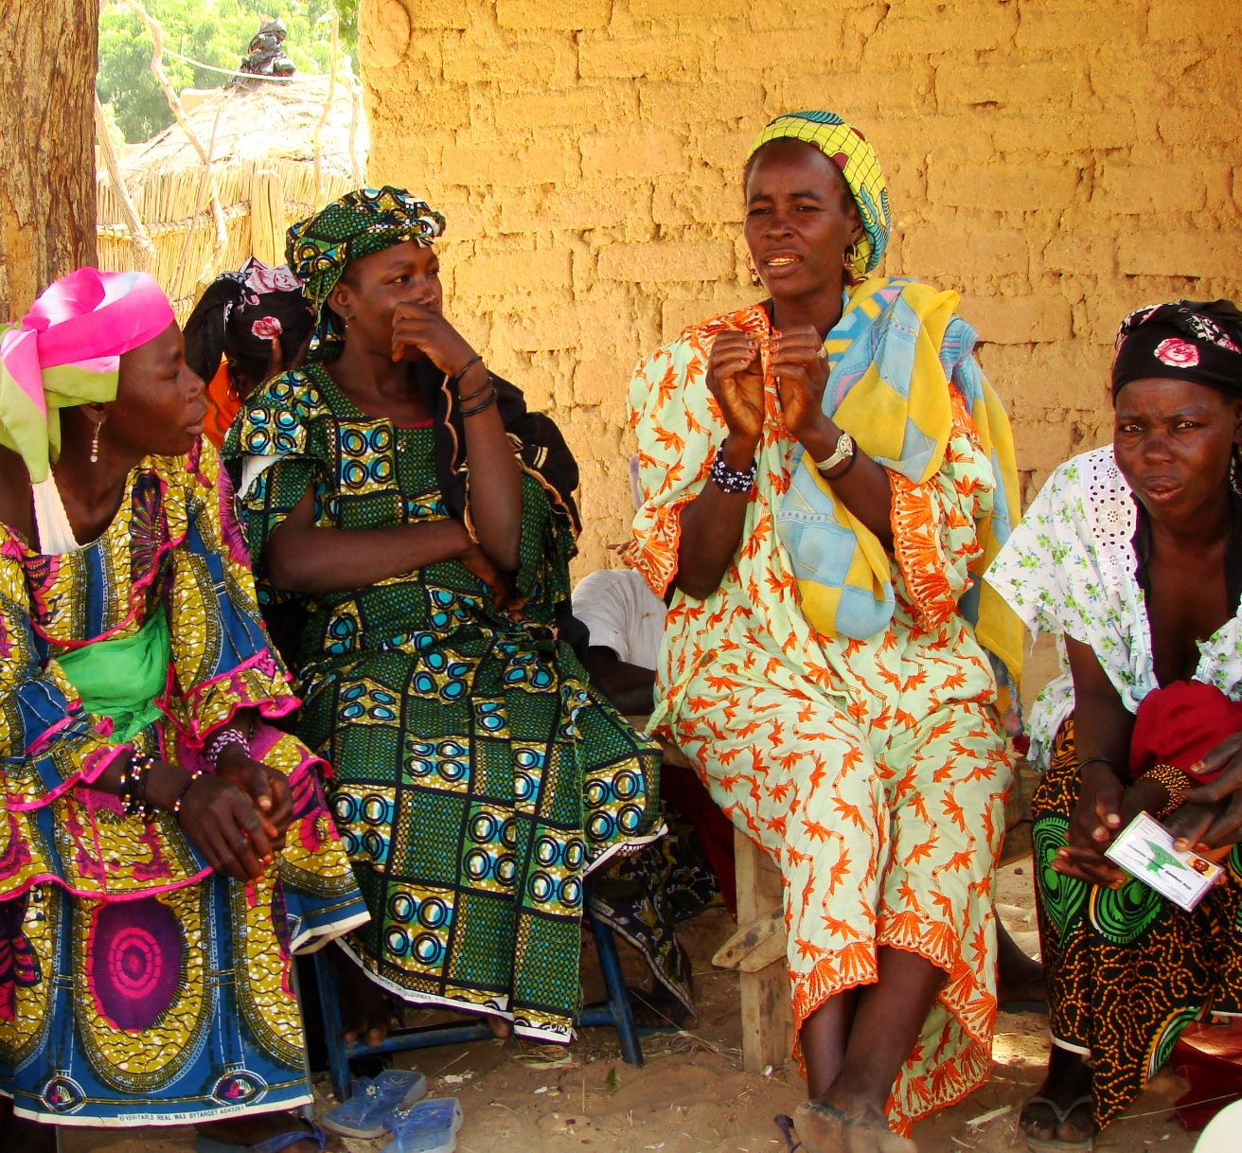
Strategic gender research
  Gender is fully integrated into priority setting, research design and implementation, and final evaluations such that interventions do no harm or worsen existing gender inequities and also empower women
  Topic addressing quality standards for quantitative sex-disaggregated data collection and qualitative sex-disaggregated data collection (scoping studies)

Slide 10
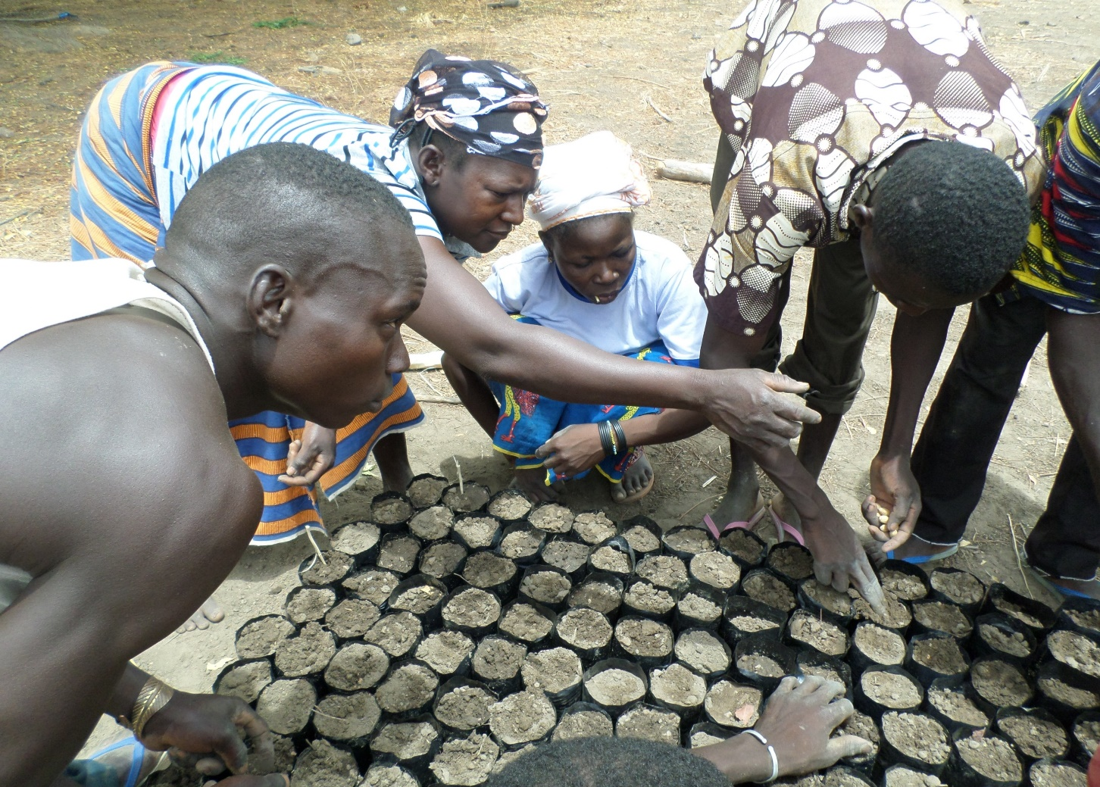
Capacity development : Knowledge-sharing
Strategic gender research
Undertake shared research design, sites, data collection methods and analysis, expanding the cross countries/transects scope and relevance of gender research to:
    Equitable access to improved technologies for women and men
    Development and testing of transformative gender approaches
    Methods for gender analysis in value chains
Capacity building on leadership: minimum request of 3/10 participants been women per village
→ target 5/10 by 2016

Slide 11

Current and past experiences in WAS&DS
Fodder crops and trees in cereal based systems targeting men and women, young people, rich and poor
R4D platforms built from the existing networks of existing farmers’ rural enterprises, developers and policy makers
Rural Resource Centres (RRC) focusing on options for sustainable intensification and income generation for women, youth and other resource-poor farmers
Functional multi-stakeholders Innovation Platforms
  Basis and indicators of success (Ghana, 2014)
  Key partners selection taking into account gender representativeness
  Definition of key activities within a system approach
  Defining gender sensitive communication and data sharing strategies

Slide 12
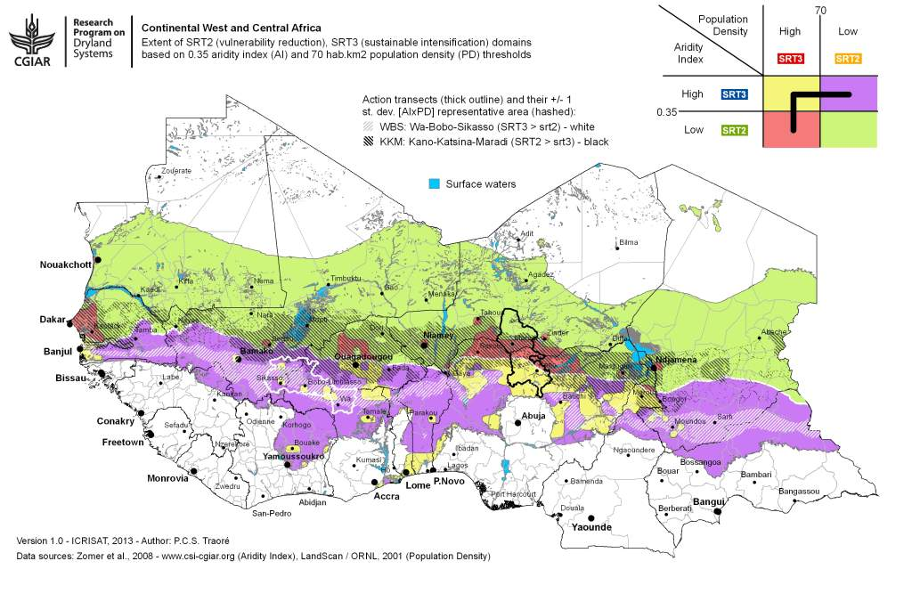
520 Households
6089 individuals:
1866 from 2 Mali sites
3448 from 4 Nigeria sites
336 from 2 Niger sites
439 from 2 Ghana sites
+ Focus group discussions

Slide 13
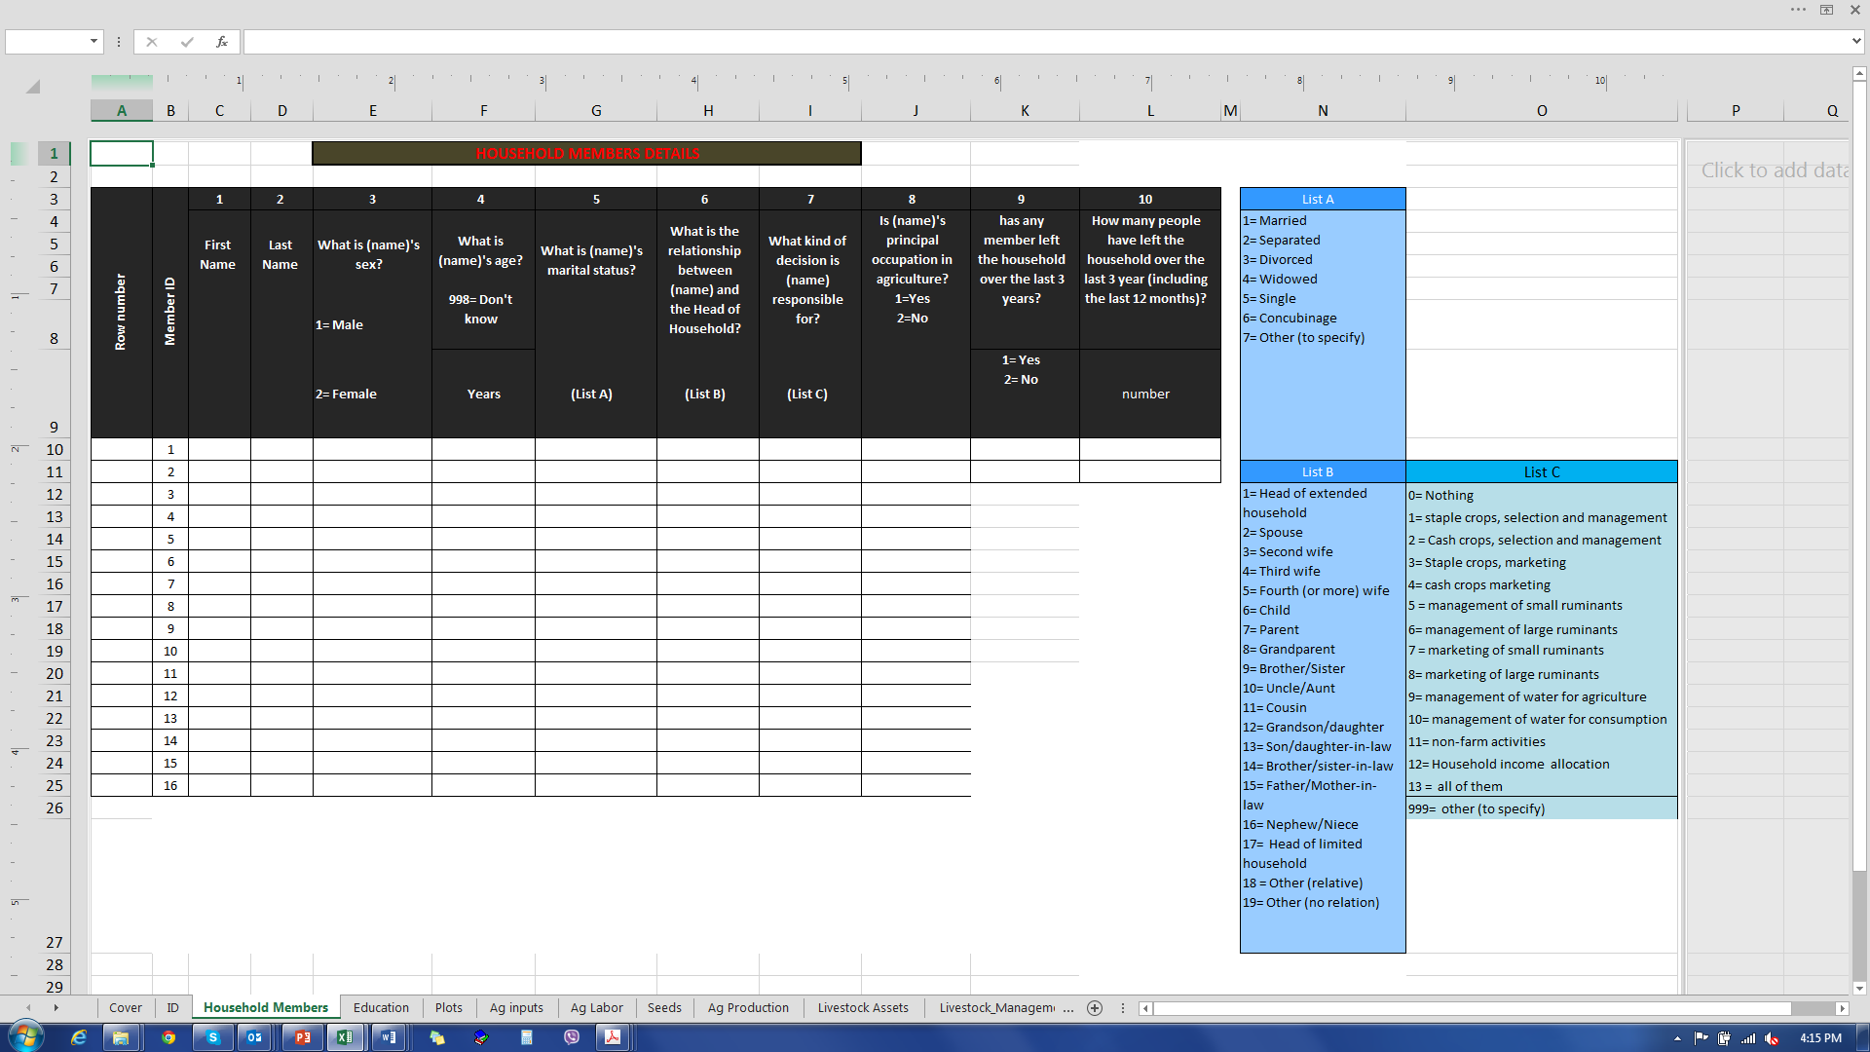
Baseline Household survey instrument with gender loop

Slide 14
Preliminary results : Marketing and management decision in the households: Does women voice count?

Slide 15
THANKS FOR
YOUR ATTENTION

