Slide 1

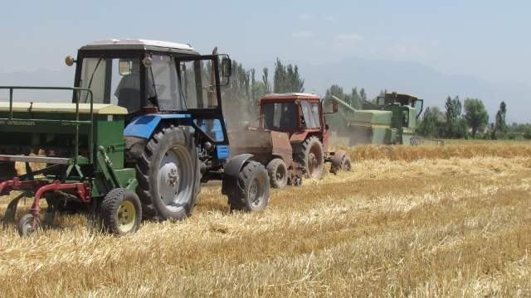
Integrated Crop-Livestock Conservation Agriculture for Sustainable Intensification of Cereal-based Systems in Central and West Asia and North Africa
Activity 1. 3. Site-specific CA technology packages fine-tuned and disseminated for enhanced farm productivity, resource use efficiency and profitability
April 5th 2016
Amman, Jordan

Slide 2
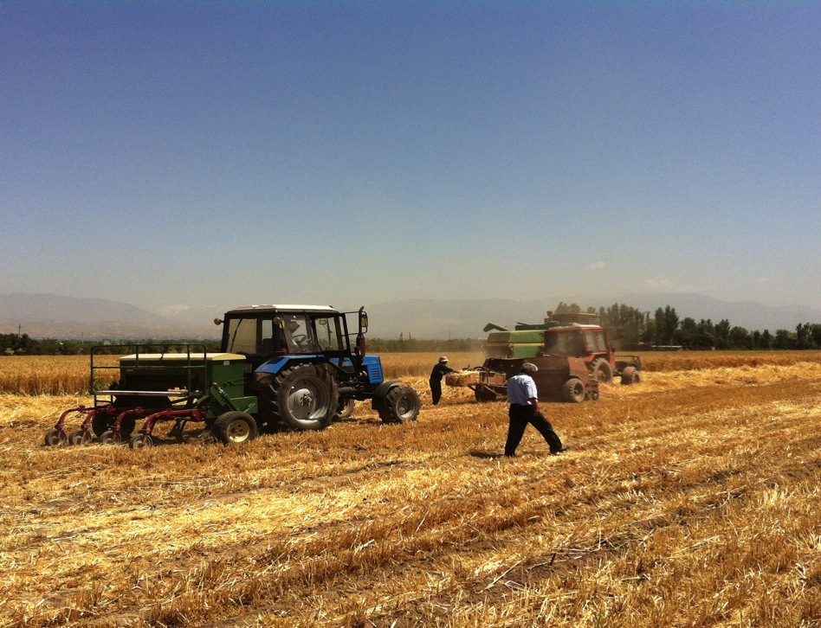
Stubble management
The more the better, or critical threshold?
Timing of seeding
Early or late ?
Seeders availability
Where to buy? Affordability? Parts? Tine vs. Disk?
Weed management
Herbicides? Grazing? Biodiversity? Fallow management?
Legumes
Which legumes? Seed availability? Cultivation knowhow? Markets? Subsidies for grains?
Alley Cropping
Species, methods and effect?
Strategic tillage
Evolution or devolution of CA principles?

Slide 3
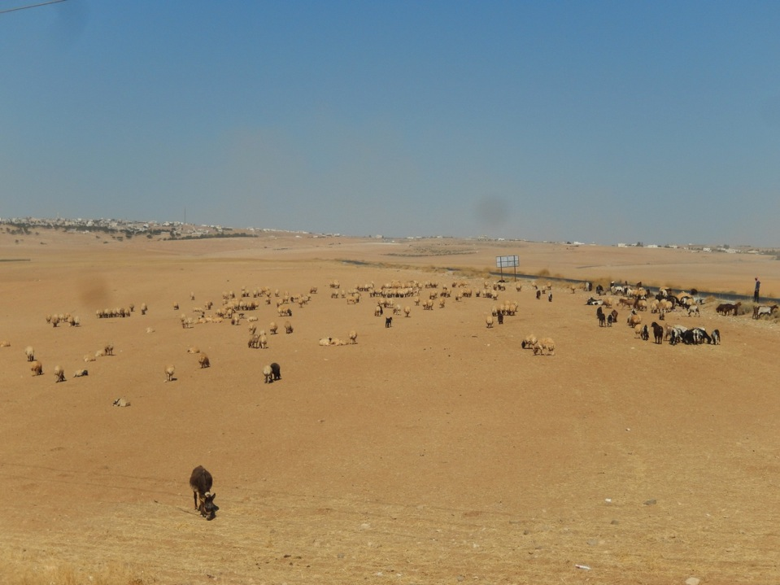
Current state of stubble management
Notes:
Karak Jordan

Slide 4
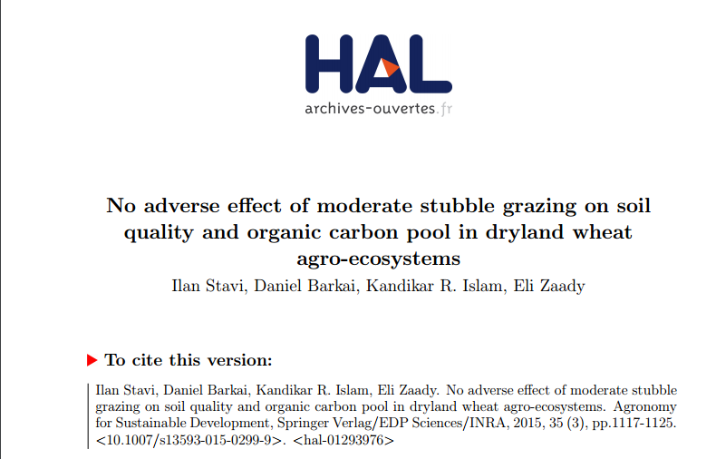
A conceptual model of the effects of stubble grazing rate on soil
Notes:
Stavi et al. (2015)

Slide 5
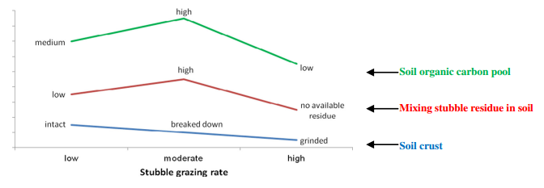
A conceptual model of the effects of stubble grazing rate on soil
0.3 Mg/ha
Stavi et al. (2015)
Notes:
Stavi et al. (2015)

Slide 6
What agronomic activities were undertaken?
Algeria
  Weed control with herbicides
  Rotation trials
  Seeding date trials
  Introduction to direct seeding
Tunisia
  Determination of optimal wheat seeding rate under CA (on-farm trial)
  Determination of optimal N fertilizer rate for wheat under CA (on-farm trial)
  Determination of optimal N fertilizer rate for wheat under CA (on-station trial)
  Disease assessment (Tan spot) on wheat under ConvA and CA (on-station trial)
Tajikistan
  Irrigated winter wheat and double cropped mung bean
  Rainfed winter chickpea trial
  Planting methods and winter wheat varieties (Irrigated) trial
  Forage legumes and cereal rotation trial
  Alley cropping trial
Notes:
ONLY AGRONOMY HERE!
You need to add forage trials etc….

Slide 7
Tajikistan CA trials
Irrigated winter wheat and double cropped mung bean
Repeated in 2014/15 and 2015/16 cropping seasons
Mung bean was successfully seeded after wheat harvest (sustainable intensification)
No difference between CA and tillage for mung bean yield
Rainfed winter chickpea trial
Repeated in 2014/15 and 2015/16 cropping seasons
Difficult to grow legumes under CA, therefore essential trial for demonstration as well
No yield penalty under CA
Planting methods and winter wheat varieties (Irrigated)
Repeated in 2014/15 and 2015/16 cropping seasons
Bed planting was compared to conventional seeding
Bed planting was superior
Notes:
Both years’ results are pretty much the same so I am just putting results from 2015

Slide 8
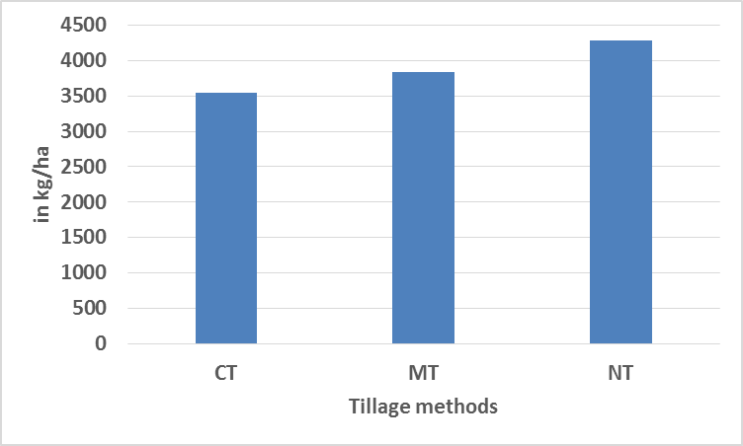
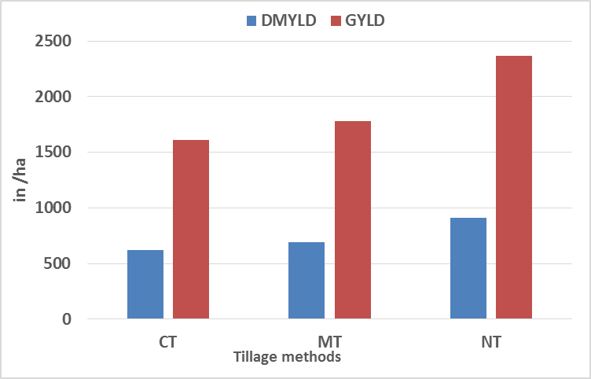
Irrigated winter wheat and double cropped mung bean
Wheat grain yield (kg/ha)
Mung bean grain and DM yield (kg/ha)
CT conventional, MT moldboard tillage and NT is no-till (CA)
No till cultivation did not negatively affect Mung bean production or the subsequent wheat grain yield. A small increase in productivity with NT was observed (3.5 vs. 4.2 kg/ha).
Notes:
Scale is kg/ha
mung bean drymatter yield (DMYLD) grain yield (GYLD)
CT conventional, MT moldboard tillage and NT is no-till (CA)
NT appears to be yielding better but ????

Slide 9
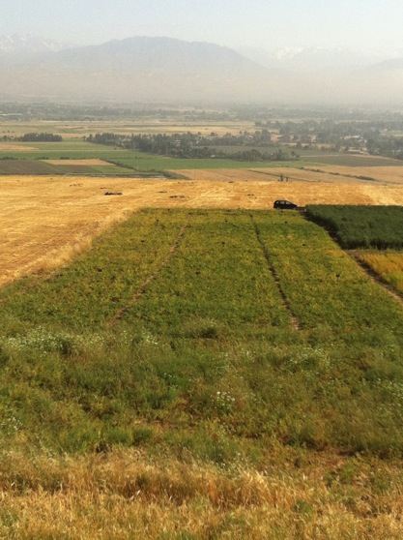
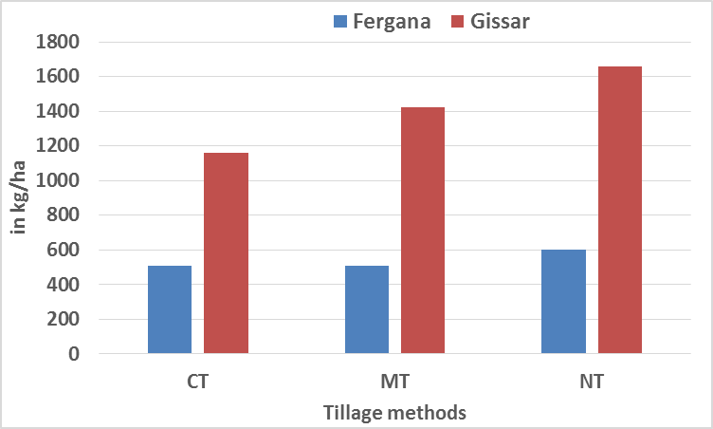
Rainfed winter chickpea trial
Chickpea grain yield (kg/ha)
CT conventional,
MT moldboard tillage and
NT no-till (CA)
A small positive affect of NT on chickpea production was observed

Slide 10
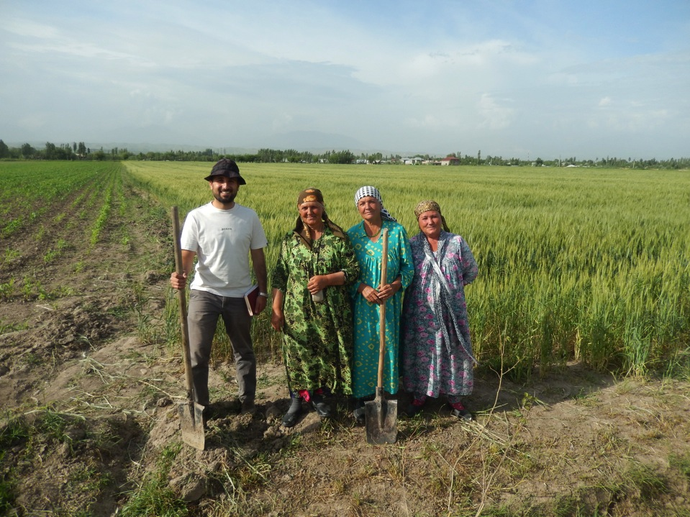
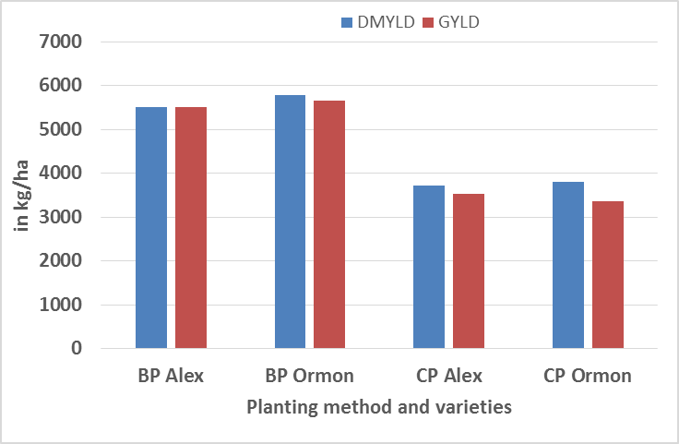
Trial 3 Planting methods and winter wheat varieties-irrigated
Grain yield ranged between 3.5 to 5.9 t/ha. Bed planting was superior to conventional planting method
Notes:
Picture shows the ladies working for this trial. I claim them to be my wives.
BP bed planting
CP conventional
Alex and ormon are variaties

Slide 11
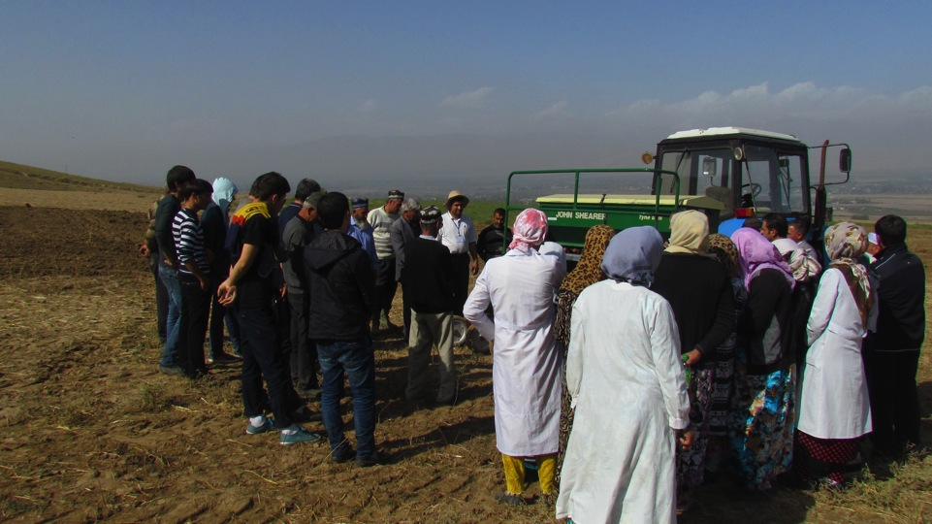
CA seeder demonstration in Tajikistan

Slide 12
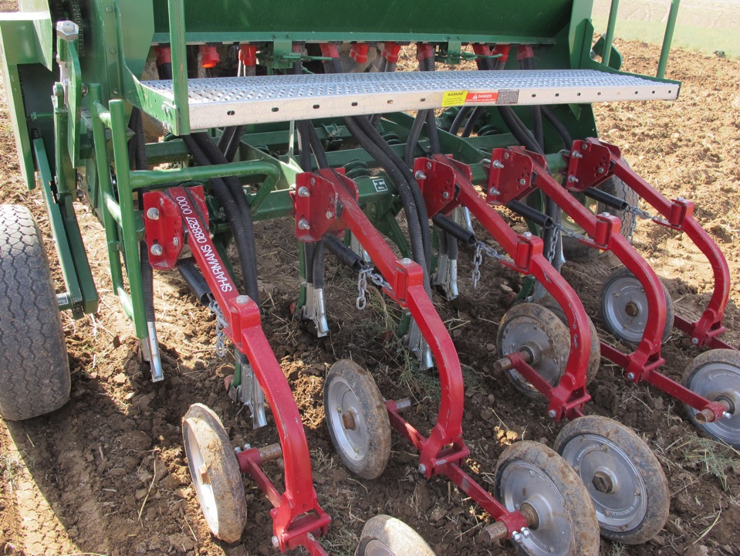
Notes:
Here I wanted to tell them the technicians in TJ had very little knowledge of CA machinery
They did not assemble the seeder properly and many parts were not functioning
Your choice whether you want to go into this or not.

Slide 13
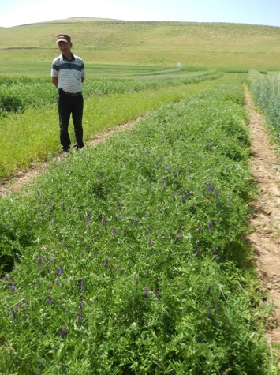
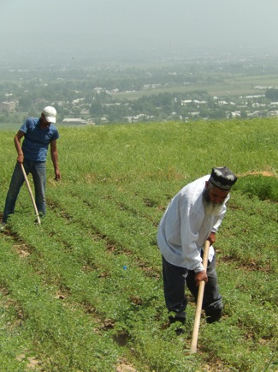
Food and forage legumes

Slide 14
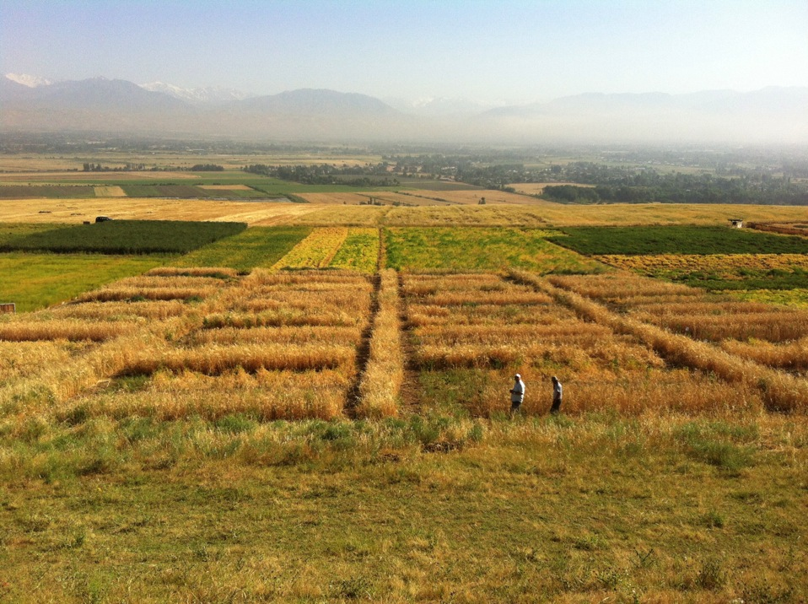
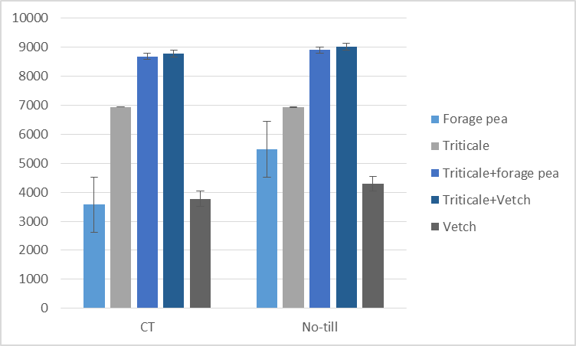
Legume-cereal mixtures under no till and conventional tillage
Forage dry matter (kg/ha)
Notes:
This is a forage data
Forage dry matter (kg/ha)

Slide 15
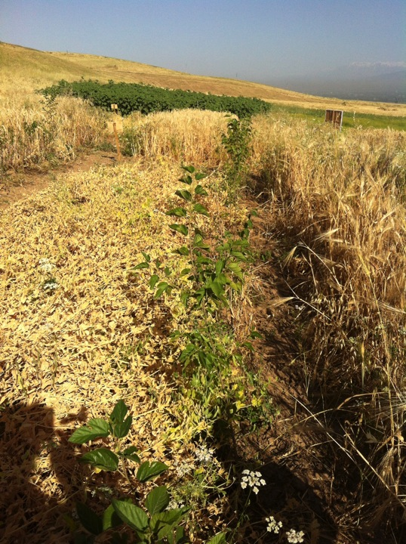
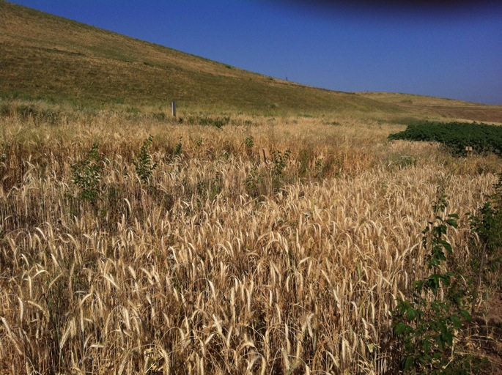
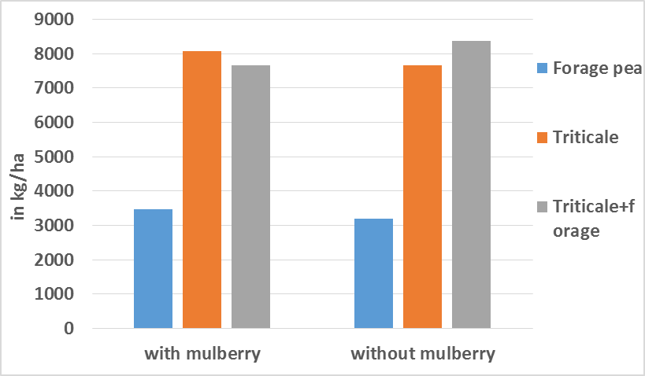
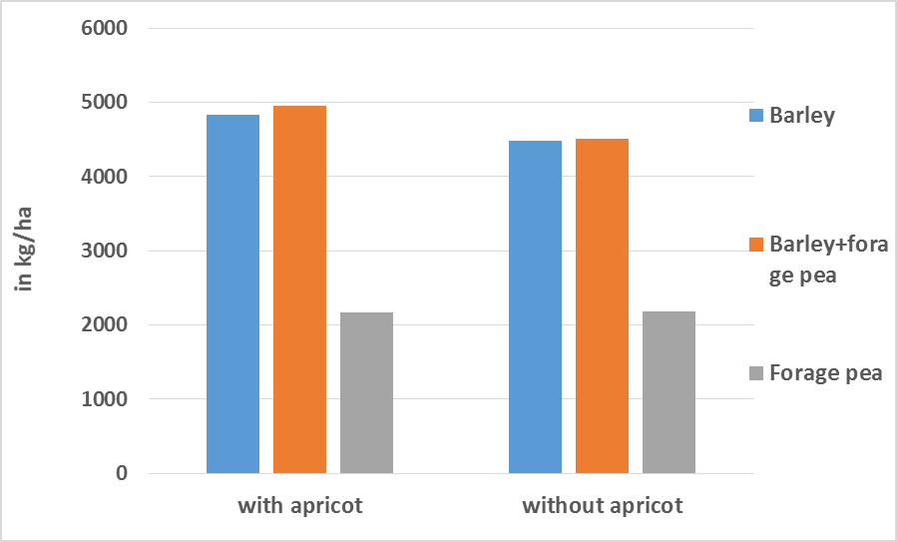
Alley cropping trials
Forage dry matter (kg/ha)
Forage dry matter (kg/ha)

Slide 16
Algeria CA on-farm demonstrations
Demonstrations | 2013/14 # of farms | 2014/15 # of farms | Total
Weed control with herbicides | 5 | 4 | 9
Rotation trials | 2 | 2 | 4
Seeding date trials | - | 3 | 3
Introduction to direct seeding | - | 17 | 17

Slide 17
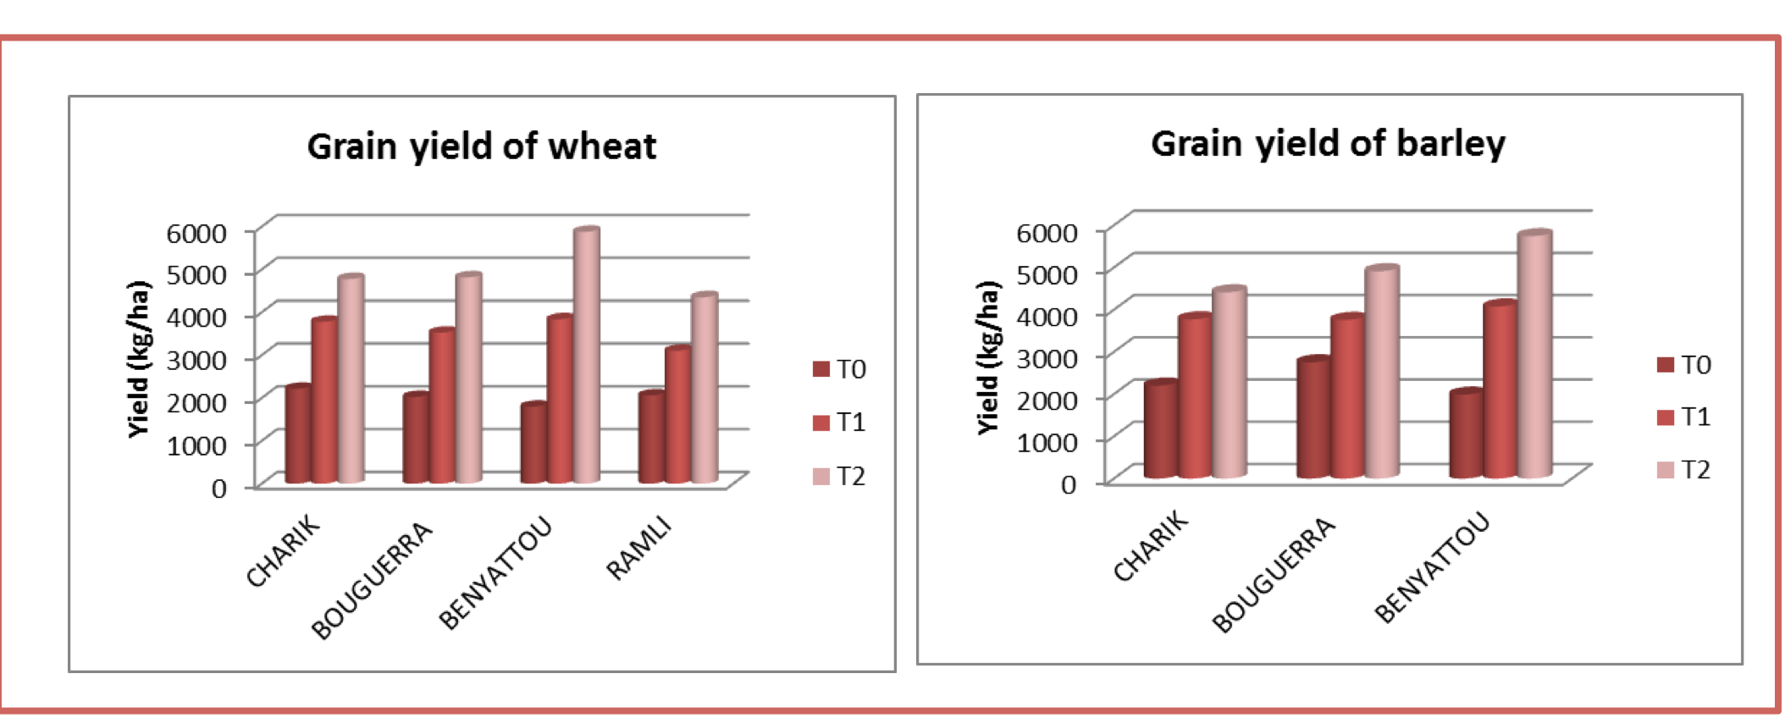
On Farm trials - Effect of chemical weeding on weed control in barley and wheat
T0 : Control (not weeded)
T1 : Weeding glyphosate only
T2 : Weeding glyphosate + early weed control at three-leaf stage.
Weeding glyphosate + early weed control at three-leaf stage resulted in greater cereal production for both wheat and barley.

Slide 18
On Farm trials -Sowing date trial under CA
Farmer | Time of Sowing | Straw yield (bales/ha) | Seedling number /m2 | Ears number /m2 | Grains number/ears | Thousand grain weight(g)
Kerfa Rabah | November | 205 | 226 | 309 | 35 | 42
 | December | 166 | 203 | 290 | 33 | 36
Belbey Aissa | November | 210 | 207 | 295 | 37 | 45
 | December | 190 | 194 | 255 | 35 | 43
Notes:
Activity 1.3.2: Effect of different types of rotation on improving crop yields of wheat and barley conducted under conservation agriculture.

Slide 19
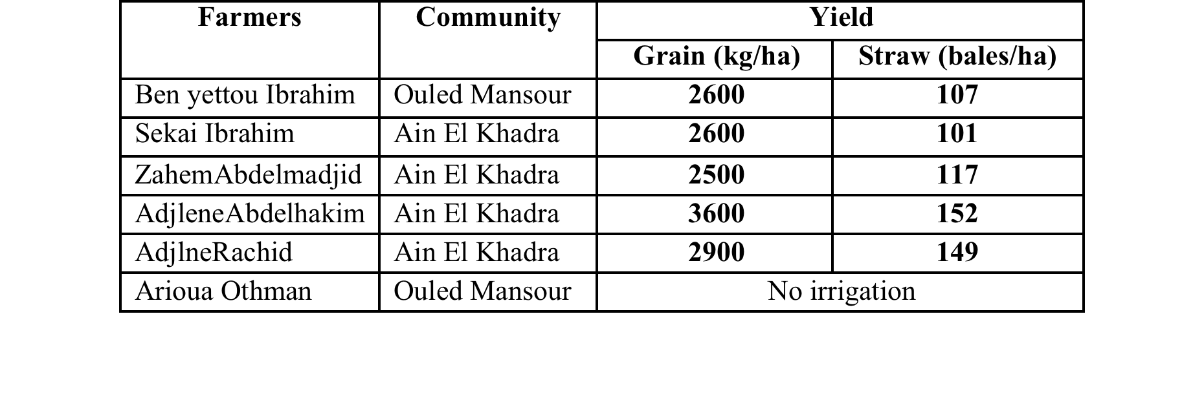
Farmers demonstrations
Bread wheat
Notes:
Farmers demonstrations Bread wheat

Slide 20
Farmers demonstrations

Slide 21
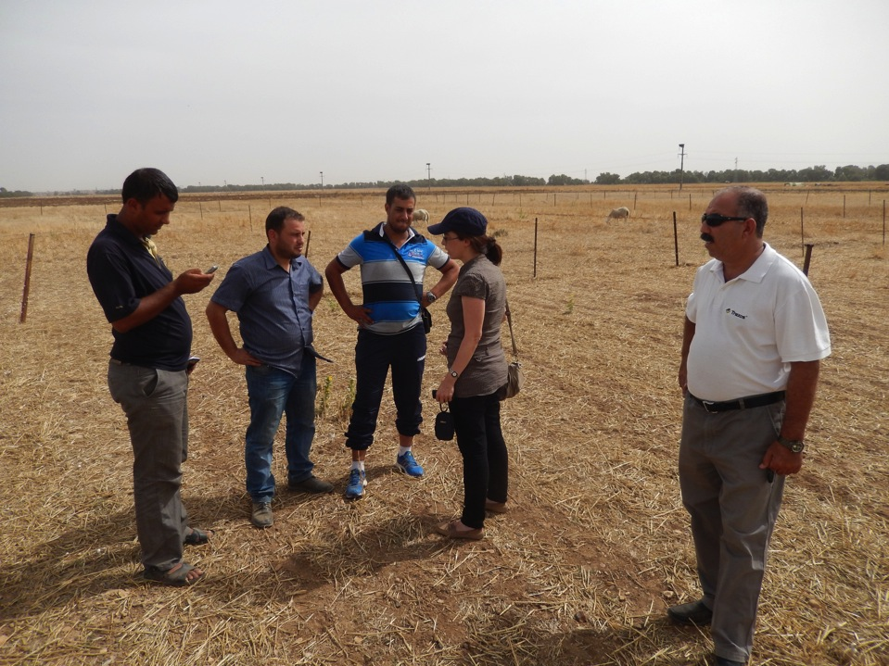
Algeria- Barley growth after barley stubble grazing
Residue level: 2 t/ha 0.45 t/ha 0.57 t/ha
Notes:
Residue level: 2 t/ha 1.2 t/ha 1.4 t/ha
Abi here forage trials start.
I hope you understand these. Call me if you have any problem.

Slide 22
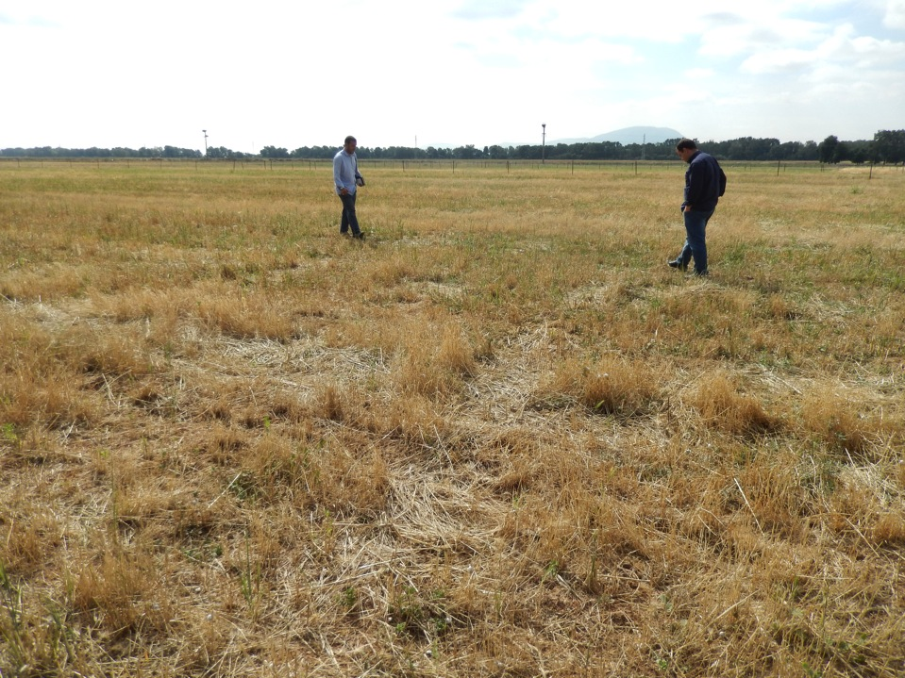
Effects of various stubble management options of pea/barley forage on soil quality and crop productivity (On Khababa Farm)
T1 : Stubble and tillage
T2 : Stubble grazing and tillage
T3 : Stubble grazing and no -till (next crop seeded with tine seeder)
T4 : Stubble grazing and no -till (next crop seeded with tine disc seeder)
T5 : Stubble and no -till (next crop seeded with tine seeder)
T6 : Stubble and no -till (next crop seeded with disc seeder)

Slide 23
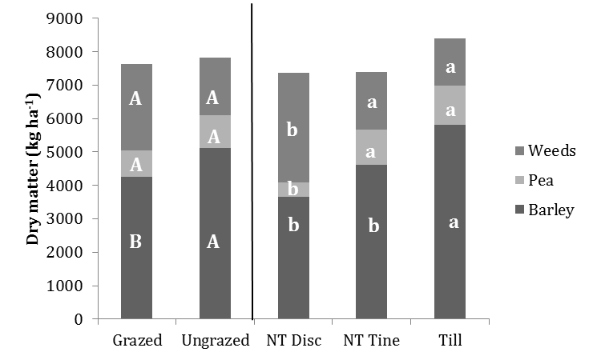
Pea/barley biomass after grazed and ungrazed pea/barley stubble
Ungrazed as compared grazed stubble lead to greater subsequent barley production.
Barley production was greater under CT.
Weed content was greater under cultivation with NT Disc seeder than the other cultivation methods.

Slide 24
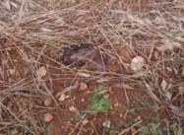
Results – Algeria Site
Species | No of rows | No of shrubs planted | No of shrubs survived | Survival rate %
Medicago arborea | 4 | 680 | 374 | 55%
Atriplex halimus | 7 | 1260 | 1050 | 84%
Atriplex nummularia | 7 | 1225 | 720 | 59%
O. ficus-indica (cactus) | 2 | 400 | 0 | 0%
Reasons for low survival rate:
Cactus: frost/snow
Medicago arborea: damage caused by wild rabbit (highly palatable)
Atriplex nummularia: grazing by livestock
Frost damage to cactus

Slide 25
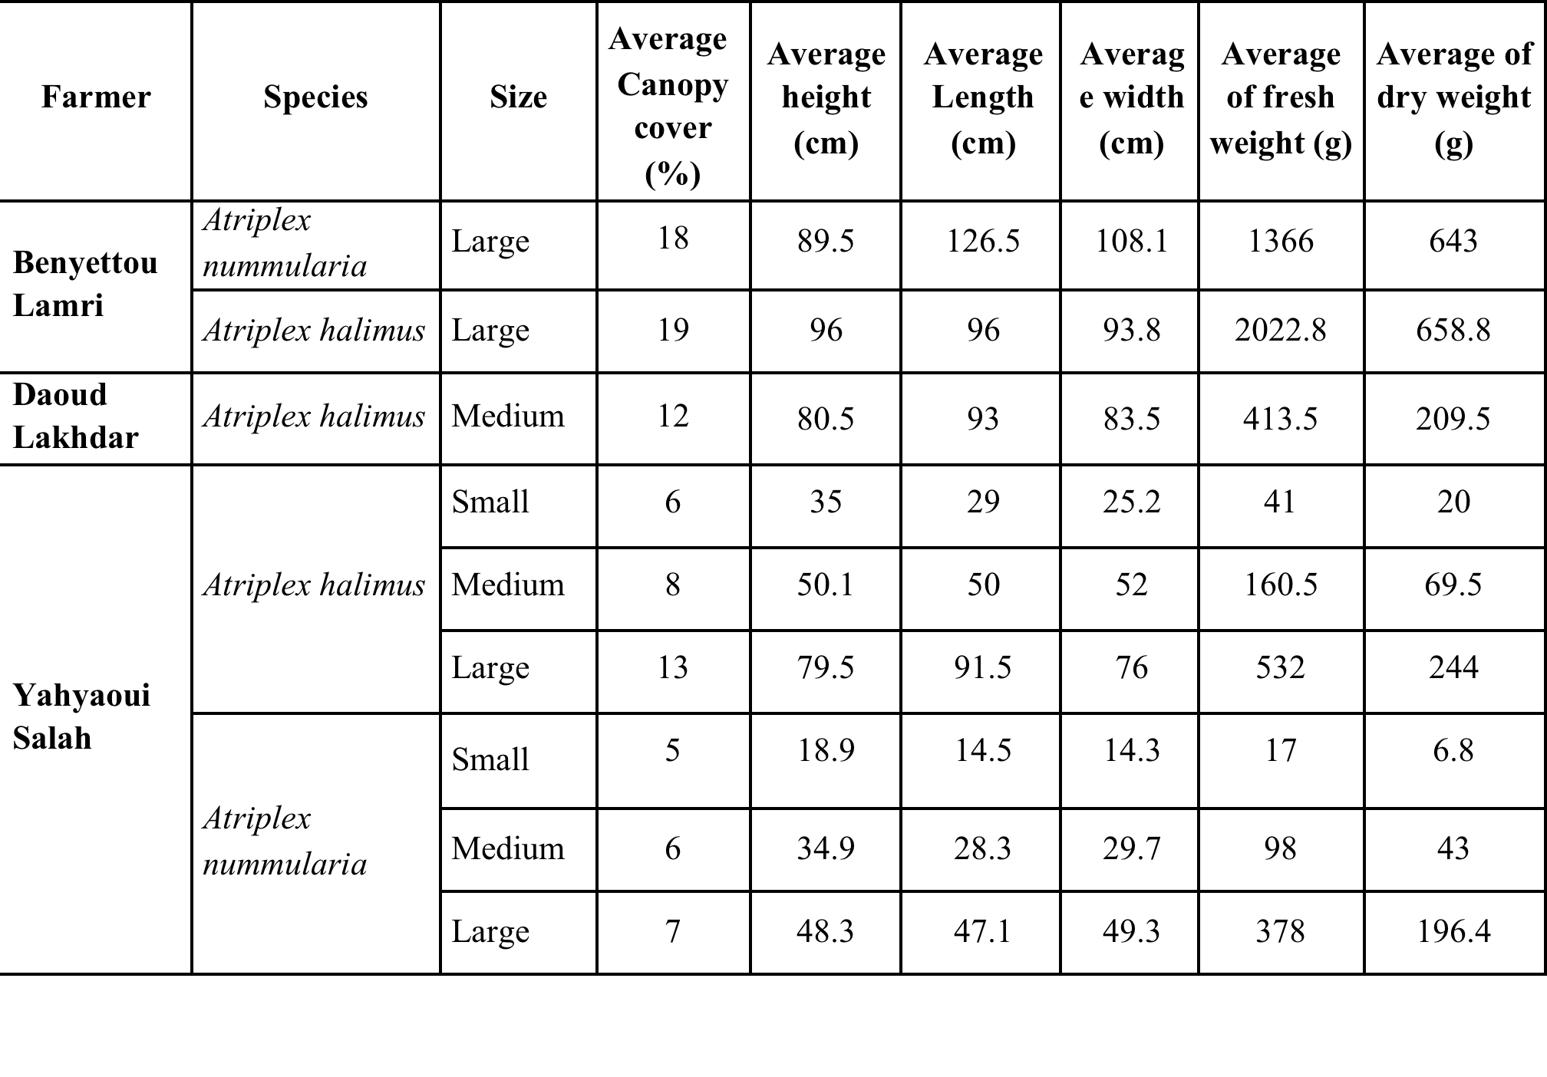
Productivity of pea-triticale and barley-pea mixtures and fodder shrubs as fallow replacement
Notes:
Shrubs as alternative forages

Slide 26
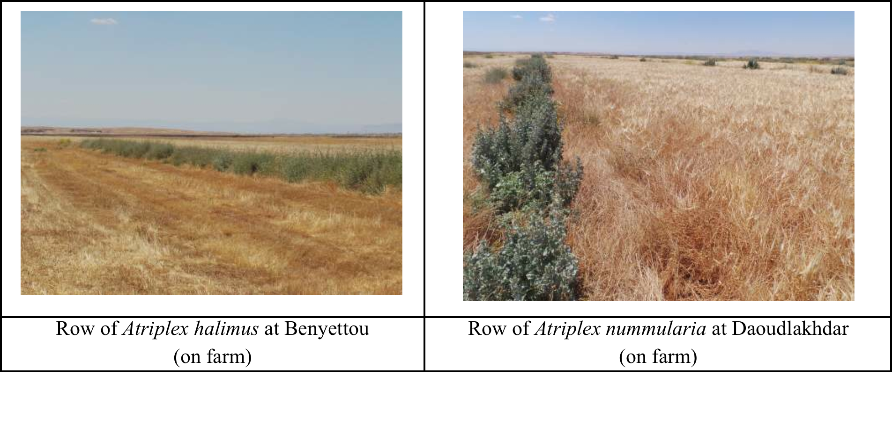
Productivity of pea-triticale and barley-pea mixtures and fodder shrubs as fallow replacement

Slide 27
Tunisia CA trials
Determination of optimal wheat seeding rate under CA (on-farm trial in Chouarina)
Determination of optimal N fertilizer rate for wheat under CA (on-farm trial in Chouarina)
Determination of optimal N fertilizer rate for wheat under CA (on-station trial in Bourbia)
Disease assessment (Tan spot) on wheat under ConvA and CA (on-station trial in Bourbia)
Notes:
In tunisia there are only experiments with CA
The on farm demonstrations are all related to forages but of course they are direct seeded (CA)
So here I only talk about CA trials (scientific experiments)

Slide 28
Determination of optimal wheat seeding rate under CA (on-farm trial in Chouarina)
Results indicated that increasing seeding rates DOES NOT increase yield or N concentration
Notes:
This shows that increasing seeding rates DOES NOT increase yield or N concentration.
So the recommendation is to go for low see rates, which in this experiment was 90 kg/ha
This experiment is REALLY flawed but we don’t have much else to show from Tunisia

Slide 29
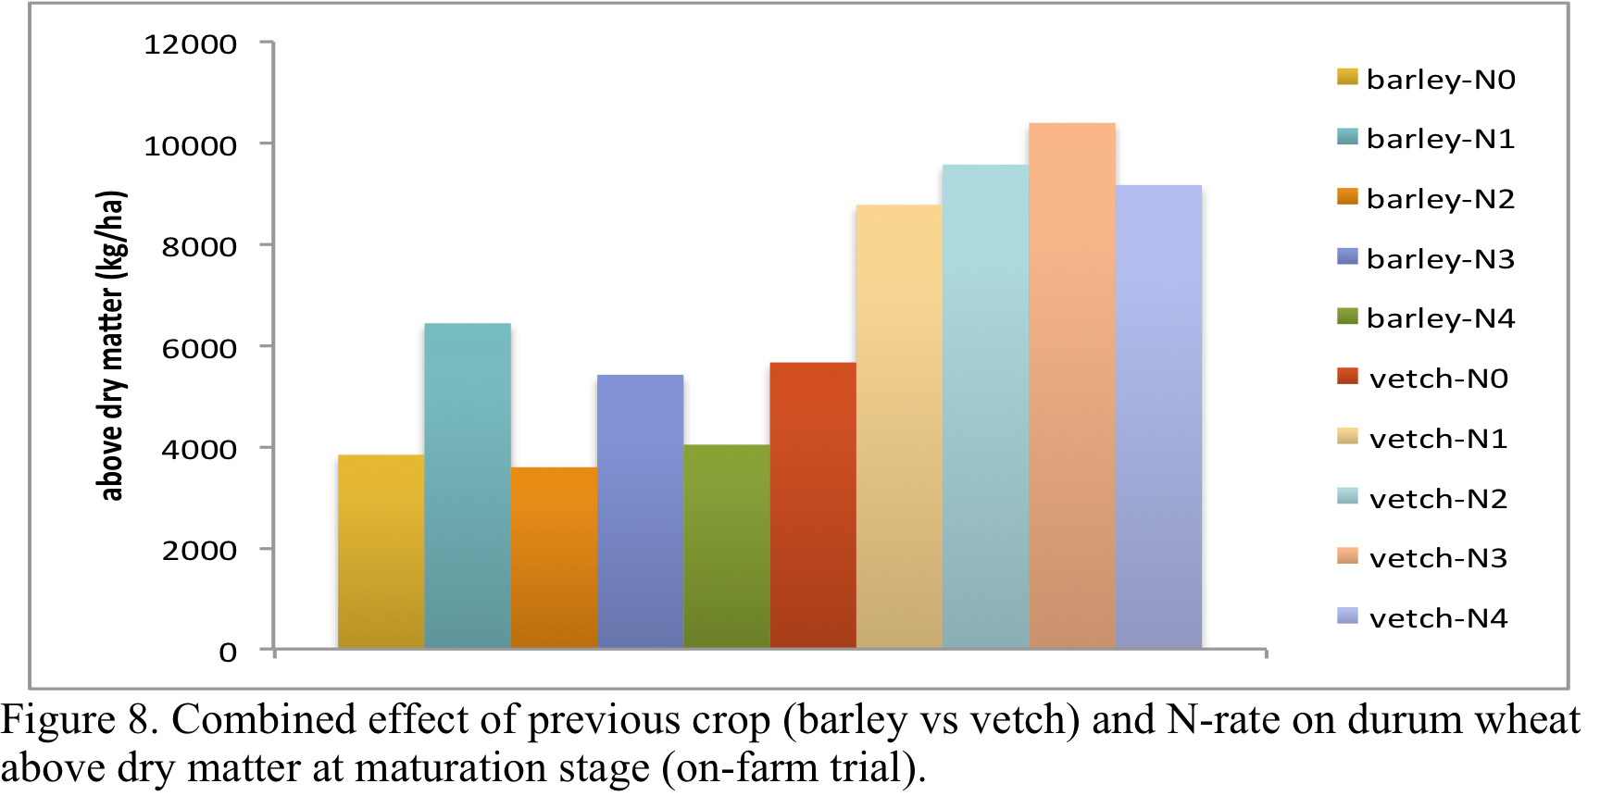
Determination of optimal N fertilizer rate for wheat under CA (on-station trial in Bourbia)
Notes:
Data shows that increase in N rate doesn’t translate into higher yields in monocultures
But including vetch into rotation increases yields. No N edffect

Slide 30
Disease control with CA rotations
There is no difference between cropping systems
Cereal legume rotation significantly decreased the incidence of Tan spot
Notes:
Disease control through rotations
The moral of the story is that monoculture increases disease incidence and rotation reduces diseases

Slide 31
Introducing forages in CA- Tunisia
Farmer | Area (ha) | Forage crop | Utilization
Tawfik B. Ammar | 1.5 | Small Faba bean | For seed and as break crop against high Bromus infestation of the land
Tawfik B Ammar | 1.5 | Vetch | For hay production and for seed production
Chaker B Ammar | 1 | Sulla | For spring grazing, alternative to spring grazed weedy fallow
Moez Ben Ammar | 1.5 | Oat saia | For hay production
HabibKharroubi | 2.5 | Oat (Saia) | For hay production
Khmaies Ben Ammar | 2 | Triticale | For grain production to feed animals with
JamelSahli | 1 | Mixture: Oat and Vetch | For hay production
Nabil Sahli | 1 | Oat (Meliane and Saia) | For hay production
M. Ali ESSID | 1 | Vetch | For spring grazing
Haj BelgacemMakhzoumi | 1,5 | Vetch-triticale mixture | For spring grazing and for hay.
AbdellatifSeddiq | 2 | Oat (variety Saia) | For hay production
Mahdi Seddiq | 1 | Vetch | For hay and in the aim to enhance its soil fertility
Mohamed Ajjel | 1.3 | Vetch pure stand and vetch-oat mixture | For spring grazing as alternative to weedy fallow
HoucineAaraari | 1.5 | ½ sulla + ½vetch | For spring grazing and as alternative to weedy fallow
Ali Houchi | 1 | Oat (variety Saia) | For hay production
M. H. Awaissi | 0.5 | Vetch pure stand | For hay production
Total | 20.3
Notes:
Introducing forages in CA

Slide 32
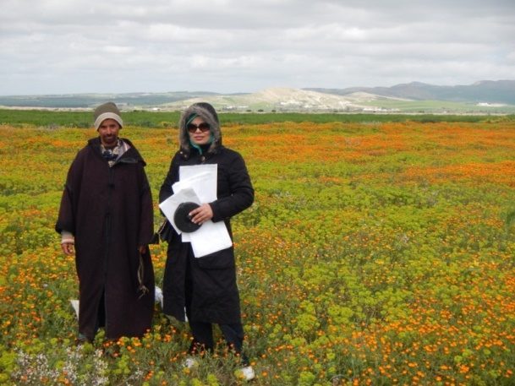
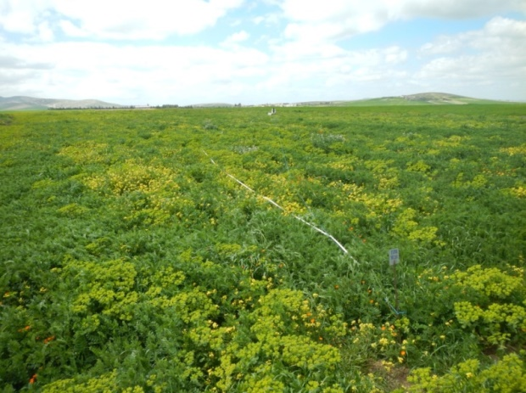
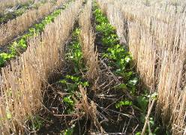
Winter cereals
Feed legumes
Yield of forage crops used as compared to weedy fallows under CA system.
Farmer | Forage type | Forage | Weedy fallow | Pr > t |  | SE
Biomass (t DM ha⁻¹)
T. Ben Ameur | Sulla | 6.2 | 2.2 | 0.001 | 0.67
T. Ben Ameur | Vetch | 3.5 | 1.4 | 0.05 | 0.61
M. Makhzoumi | Vetch-triticale mixture | 3.2 | 1.4 | 0.08 | 0.65
M. Makhzoumi | Vetch-triticale mixture | 2.9 | 1.4 | 0.05 | 0.45
J. Sahli | Oat-vetch mixture | 4.9 | 3.0 | 0.05 | 0.53
J. Sahli | Vetch | 4.3 | 4.0 | 0.10 | 0.80
Weedy fallows vs. Forage legumes
Notes:
As I mentioned that with the conservation ag gaining momentum in the region there is also a scope to re-introduce annual legumes into the cereal based crop-LS farming systems in the regions. Here is one of the very recent example of showing the increased productivity of the weedy fallows by replacing them with annual legumes in CA in Tunisia

Slide 33
Conclusions For Fallow Replacing Forages
Low cost replacement – no herbicide
Only vetch and sulla seeds are available
Direct seeding is a great option reducing cost
Need to apply phosphate and/or rhizobia because of degraded soils
Flexible options to utilize the forage (i.e., graze, hay, double purpose, soil amendment…)
Notes:
CONCLUSIONS FOR FALLOW REPLACING FORAGES

Slide 34
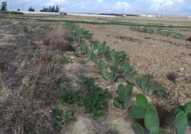
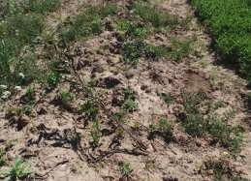
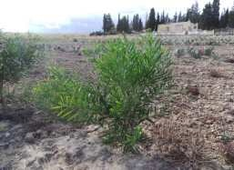
Alley cropping results – Tunisia Site
Species | Survival rate
Opuntia ficus-indica (cactus) | 100%
A. nummularia | 27%
A. cyanophylla | 62%
Cactus regrowth after summer rain of August. Photo taken in October 30th 2015.
Poor Acacia cyanophylla seedlings: over 2 years old and has not been thinned at early stage
Healthy stand of Acacia cyanophylla at Bourabia research station

