Slide 1
West African Sahel & Dry Savanna
Ongoing activities
Patrice Savadogo et al.
Joint Agroforestry System Scientist (ICRAF / ICRISAT)
CRP-DS Science and Implementation Workshop
30th June – 4th July, 2014
Holiday Inn Hotel - Amman, Jordan

Slide 2
Outline
Context of WAS & DS
Targeted Categories of production systems
On-going activities in WAS&DS
Research and development partners
Science and Impact highlights to date

Slide 3
Context of WAS & DS
Rainfall is becoming more erratic and extreme.
Temperatures are increasing, intensifying crop stress
Soil fertility is declining in many regions.
Inorganic fertilizers are increasingly expensive.
High population growth rates
Farming is expanding into more marginal lands.
Notes:
High population growth rates dwindle farm sizes and livestock assets and worsen the impacts of this food insecurity.

Slide 4
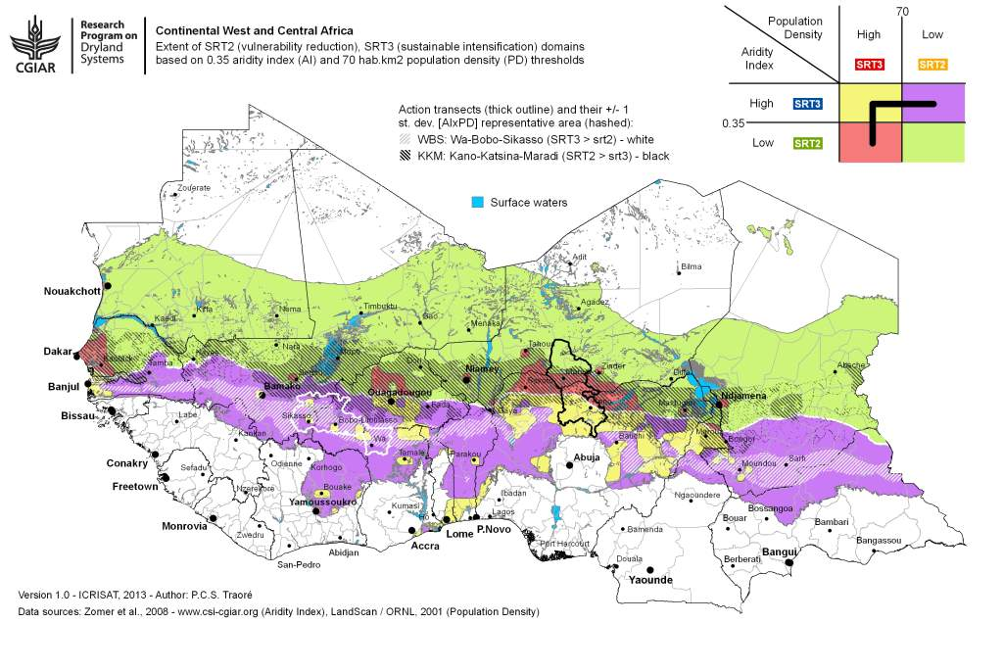

Slide 5
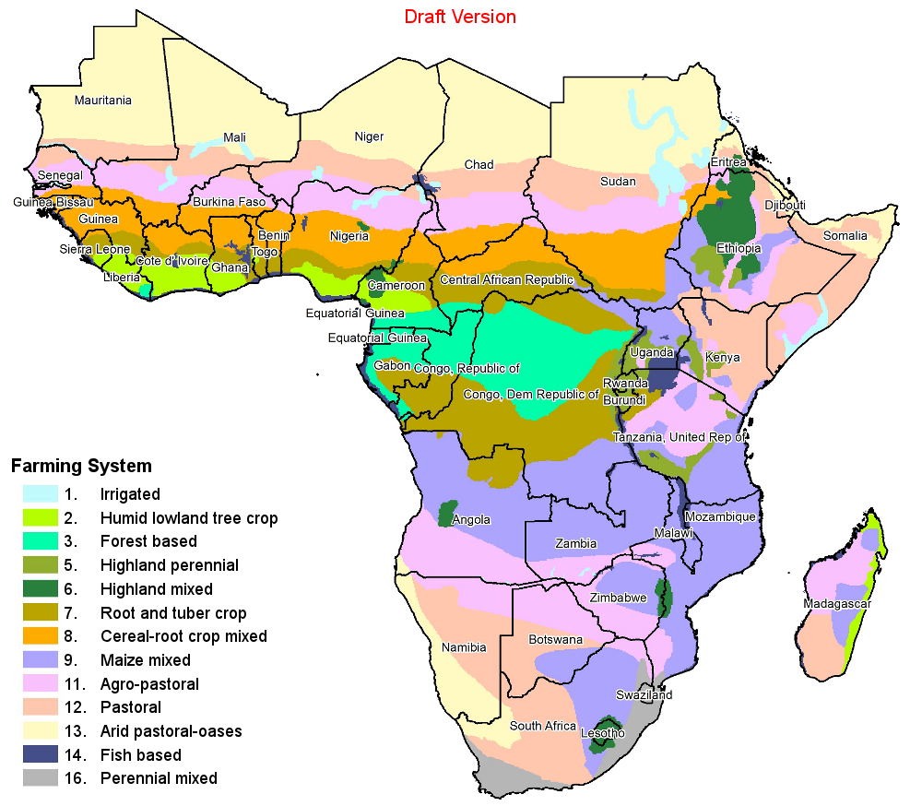
Targeted categories of production systems
Pastoral systems
Agro-pastoral systems
Intensive rain-fed systems
Tree-based systems
Extensive mixed crop-livestock systems

Slide 6
ICRISAT On-going activities in WAS&DS
CRP-DS Science and Implementation Workshop
30th June – 4th July, 2014
Holiday Inn Hotel - Amman, Jordan

Slide 7
Activity cluster | Progress towards outputs & IDOs, 2014
1. ESTABLISH REFERENCE SITUATION / BASELINES for the action sites to support systems approaches IDOs: 1-7 | Key activities: Establish and characterize watershed areas for integration of research activities. Use HH survey data to guide action research. Verity that HH survey data corroborates systems research hypotheses and site selection ; Advance our understanding of changes in land resources / capita as a key driver of change in systems Expected Outputs Appropriate and integrated technologies for watershed management are identified Instilling a sense of ownership in the community to manage the established watershed Report drafted testing the large-scale assumptions behind SRT2/3 distribution in action sites against HH level data. Area and Sites:- Kano-Katsina-Maradi (KKM), Wa-Bobo-Sikasso
CRP Dryland Systems – West Africa implementing CG Centre Activities
Notes:
Monitoring and evealuation

Slide 8
Activity cluster | Progress towards outputs & IDOs, 2014
2. Assess and MONITOR BIOMASS AND RESOURCE FLOW in the action sites IDO: 1-7 | Key activities: Biomass assessment of annual and perennial crops including woody vegetation, assessment of soil and land health conditions, and mapping of resource flows in the farm systems. This output includes assessment of ecological metrics and variability across action sites and information on soil health constraints Development of remote sensing methods for automatic quantification of seasonal biomass production Expected Outputs Administration of 2014 cropping season full biomass assessments (annuals + perennials) in KKM and WBS transect Paper/report being drafted on agrobiodiversity management and conservation in major agroecosystems of in West African Sahel and Dry Savanna Two ground, UAV and satellite measurement campaigns in 150 farms with fertility trials Area and Sites:- Kano-Katsina-Maradi (KKM), Wa-Bobo-Sikasso
CRP Dryland Systems – West Africa implementing CG Centre Activities

Slide 9
Activity cluster | Progress towards outputs & IDOs, 2014
2. Assess and MONITOR BIOMASS AND RESOURCE FLOW in the action sites IDO: 4,5,6 | Key activities: Testing various tree crops interactions-and roles of agroforestry parklands on soil water balance and crop yield in Sahelian farming system Quantification of nutrient flows in the farming systems in the action sites, yield mapping and tradeoffs assessment of nutrient use in the defined systems. Expected Outputs Data generated and paper on effect of shading on yields of staple crop by common tree on farming land in Sahelian agroecosystem Effect of tree husbandry on cereal and legume grown in pure stand or intercropped and nutrient management on crop performance Simulation of nutrients flow at farm scale in the Fakara from three years corralling trial Area and Sites:- Kano-Katsina-Maradi (KKM), Wa-Bobo-Sikasso
CRP Dryland Systems – West Africa implementing CG Centre Activities

Slide 10
Activity cluster | Progress towards outputs & IDOs, 2014
3. Facilitation of INNOVATION PLATFORMS, monitoring and evaluation of innovation platforms IDOs: 1-7 | Key activities: Stakeholder consultation to fill gaps and prioritize technologies Exploration of best cultivars for dual purpose crops in the region for crop-livestock in KKM and WBS sites Addressing the issues non-adoption of technologies in tree- crop-livestock interaction in West Africa. Develop a sustainable, subscription based rural land information service supported by very high resolution satellite imagery Expected Outputs Enhanced capacity for innovation and effective participation in collaborative IAR4D processes A basket of low risk crop and livestock innovation with technical potential for SI developed and tested 50,000 farmers registered in the land information service Area and Sites:- Kano-Katsina-Maradi (KKM), Wa-Bobo-Sikasso
CRP Dryland Systems – West Africa implementing CG Centre Activities

Slide 11
Activity cluster | Progress towards outputs & IDOs, 2014
4. Induce intensification and improve resource use efficiency through ON-FARM TESTING AND EVALUATION of technologies IDOs:1-6 | Key activities: Introduction and evaluation of new technologies: germplasm, agricultural inputs, livestock management options, fodder, and options for mechanization. In addition, this activity includes testing and evaluating of gender-smart best fit options for improved livelihood, and water management Pre and post harvest small and medium scale machines for planting and other agronomic activities as well as for processing made available test across KKM locations Expected Outputs New germplasm introduced Reduced drudgery Area and Sites:- Kano-Katsina-Maradi (KKM), Wa-Bobo-Sikasso
CRP Dryland Systems – West Africa implementing CG Centre Activities

Slide 12
Activity cluster | Progress towards outputs & IDOs, 2014
4. Induce intensification and improve resource use efficiency through ON-FARM TESTING AND EVALUATION of technologies IDOs: 1-6 | Key activities: Evaluate biomass productivity and quality in various sorghum genotypes on station to assess potential for dual purpose usage in different agro-ecologies Establish P response in selected sorghum genotypes including dual-purpose, and improve crop models (DSSAT, SAMARA) with P-aware functionalities. Expected Outputs Improved crop models, with associated simulation outputs corresponding to data collected on station trial. Paper/report on testing the improved model against sorghum yield data collected under high and low P conditions, and run a sensitivity analysis for various soil P levels and low-P tolerant genotypes Area and Sites:- Kano-Katsina-Maradi (KKM), Wa-Bobo-Sikasso
CRP Dryland Systems – West Africa implementing CG Centre Activities

Slide 13
Activity cluster | Progress towards outputs & IDOs, 2014
5. Strengthen the CAPACITY OF THE PARTNERS, INCLUDING WOMEN FARMERS AND YOUTH to facilitate wider scaling up of CTL technologies and development approaches and strategies IDOs:3-6 | Key activities: Promotion of Farmers to farmers interaction for CAWT adoption taking into account the gender Training on Crop-livestock management in West Africa Follow-up scenario visioning workshops organized at the district level Expected Outputs Enhanced dialogue for co-learning and dialogue with innovators farmers for bottom-up scaling of technologies (FMNR) Enhance participants awareness on the different ways of making efficient use of crop-residues Workshops organized for each action district within WBS and KKM transect Area and Sites:- Kano-Katsina-Maradi (KKM), Wa-Bobo-Sikasso (WBS)
CRP Dryland Systems – West Africa implementing CG Centre Activities

Slide 14
Partnership in the region
NARS
Institut National de Recherche Agronomique du Niger (INRAN)
InInstitut de l'Environnement et de Recherches Agricoles (INERA)
Institut d'Economie Rurale (IER)
CSIR-SARI
AGRHYMET
CDA-BUK
University of Niamey and Bobo
NGOs
Care International au Niger
World Vision
Oxfam Novib
AMEDD
Sahel Eco
Private sector
MANOBI S.A.
Farmers Organization
ROPPA
Moriben-Niger
FNUGN-Burkina Faso

Slide 15
ILRI On-going activities in WAS&DS
CRP-DS Science and Implementation Workshop
30th June – 4th July, 2014
Holiday Inn Hotel - Amman, Jordan

Slide 16
On-going Activities 2014
Review and synthesis of ILRI long-term (1994 – 2008) systems research in Fakara action site, Niger: Learning from the past
Assessment of vulnerability and risk of smallholder farmers in WAS&DS in KKM and WBS
Assessment of feed resources using Feed Assessment Tool (FEAST) in action sites in KKM and WBS
Quantification of internal farm constraints and assessment of trade-offs in resources use in KKM
Characterization of ruminant value chains in KKM

Slide 17
On-going Activities 2014 - details
Review and synthesis of ILRI long-term (1994 – 2008) systems research in Fakara action site, Niger: Learning from the past
  synthesis of past research activities in agro-pastoral systems of Niger with the overall goal of drawing pertinent lessons for dryland system research in West Africa
Assessment of vulnerability and risk of smallholder farmers in WAS&DS
  Group and individual interviews to collect basic information on risk perceptions, variation in vulnerabilities to risks and strategies to reduce socioeconomic vulnerability

Slide 18
On-going Activities 2014 - details
Assessment of feed resources using Feed Assessment Tool (FEAST) in action sites in KKM and WBS
  PRA survey and individual interview of farmers to have an overview of farming system and livestock feed aspect, and collect quantitative and qualitative information on crop-livestock production, feed availability, feeding rations and perception on feed quality
Quantification of internal farm constraints and assessment of trade-offs in resource use in KKM
  Modeling of resource use at farm level in mixed crop-livestock systems using FARMSIM and LIVSIM models developed by University of Wageningen

Slide 19
Partnership
Activity | Partner
Review and synthesis of ILRI past farming system research in West Africa dryland | Consultant (Pierre Hiernaux, Géosciences Environnement Toulouse, Toulouse, France)
Assessment of vulnerability and risk of smallholder farmers | University of Wisconsin, Madison; INERA Burkina Faso; AMEDD, Mali
Assessment of feed resources | INERA Burkina Faso; AMEDD, Mali; Animal Research Institute, Ghana.
Quantification of internal farm constraints and assessment of trade-offs in resources use | University of Wageningen; CCAFS national coordinators (Burkina Faso, Ghana, Mali)
Characterization of ruminant value chains in KKM | INRAN, Niger; Consultant (Dr Kassali, Obafemi Awolowo University, Nigeria)

Slide 20
ICRAF On-going activities in WAS&DS
CRP-DS Science and Implementation Workshop
30th June – 4th July, 2014
Holiday Inn Hotel - Amman, Jordan

Slide 21
Project
IDO LEVEL 2
ICRAF ON-GOING PROJECTS TO THE DS CRP’S IDOS
1. Agro-ecological intensification of sorghum and pearl millet-based production systems in the Sahel through agroforestry: linking farmers’ knowledge to process-based science Agro-Ecological Intensification (McKnight)
IDO LEVEL 1
IDO 2: More stable and higher per capita income for intensifiable households
IDO 5: Better functioning markets underpinning intensification of rural livelihoods
IDO LEVEL 3
IDO 1: More resilient livelihoods for vulnerable households in marginal areas
2. Sustainable Intensification of Cereal-Based Farming Systems in the Sudano-Sahelian Zone (USAID)
IDO 7: Policy reform removing constraints and creating incentives for rural households to engage in more sustainable practices that improve resilience and intensify production
IDO 3: Women and children in vulnerable households have year round access to greater quantity and diversity of food sources
IDO 4: More sustainable and equitable management of land and water resources in pastoral and agropastoral Systems
3. Regional program on food and water in the Sahel and the horn of Africa: regenerating Dryland farming systems by creating an Evergreen Agriculture (The Netherlands)
IDO 8: Women and youth have better access to and control over productive assets, inputs, information, market opportunities and capture a more equitable share of increased income, food and other benefits
IDO 6: More integrated, effective and connected service delivery institutions underpinning resilience and system intensification
4. Fodder trees species for enhancing production of the Sahelian Agroforestry systems (IDRC-UL)

Slide 22
I. Agro-ecological intensification of sorghum and pearl millet-based production systems in the Sahel through agroforestry: linking farmers’ knowledge to process-based science Agro-Ecological Intensification (McKnight)
Rationale
Most production systems of the Sahelian region are mixed tree-crop-livestock
There is a wealth of local knowledge as farmers have being managing these systems for centuries and such knowledge need to be capitalized
This knowledge is geared towards application
Its explanatory power can be helped by science-based analyses of the socio-ecological systems and its component processes

Slide 23
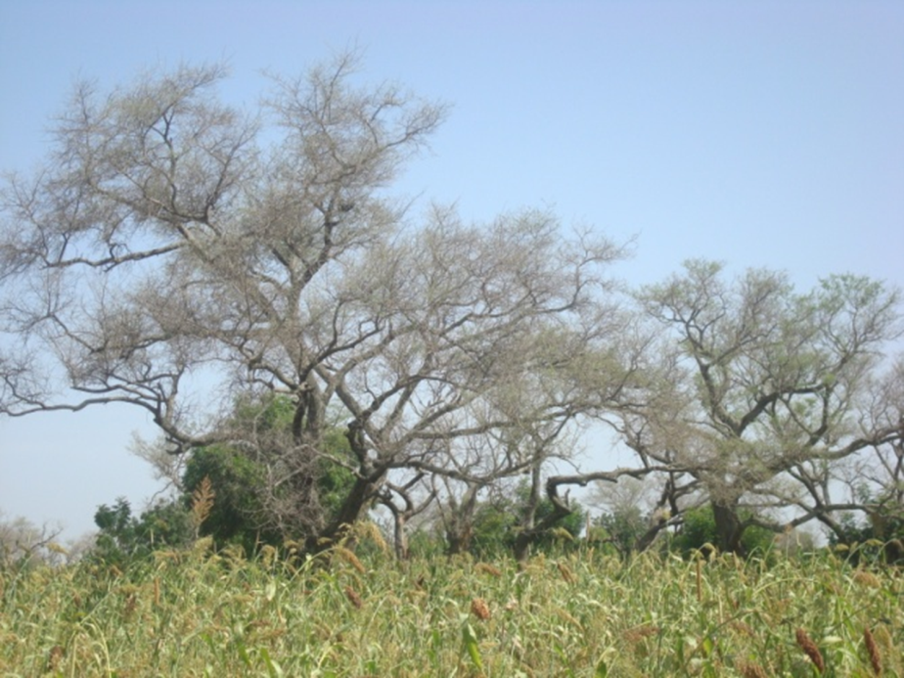
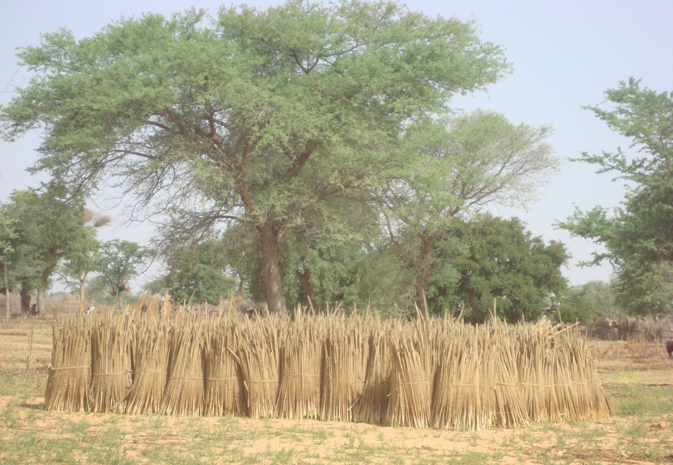
Objectives
Enhance the knowledge on the ecosystem functions provided by parkland agroforestry to sustain the production in sorghum and millet-based systems in the face of variable and uncertain rainfall
Assess, improve and support current development efforts to reduce human vulnerability in the Sahel through identification of current ‘best practices’ and promote the use of such approaches.

Slide 24
Inception phase
Output 1: Team of the project built and functional through mail exchanges, and face to face meetings and a workshop to fine tune the activities to be conducted
Output 2: Local knowledge on tree-crop-livestock interactions collected, synthesized and made available
a literature review tree-crop-livestock interactions and local knowledge as well as baseline surveys on local knowledge about tree-crop-livestock interactions
Key achievements
Local knowledge acquisition using the Agroecological Knowledge Toolkit (AKT) was conducted in Burkina Faso and Mali
11 researchers trained on AKT including McKnight project members from INERA and IER of Mali, and regional ICRAF staff working on DS CRP and ICRAF/MARS V4C Project
Technical report available

Slide 25
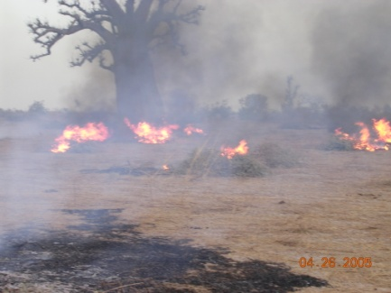
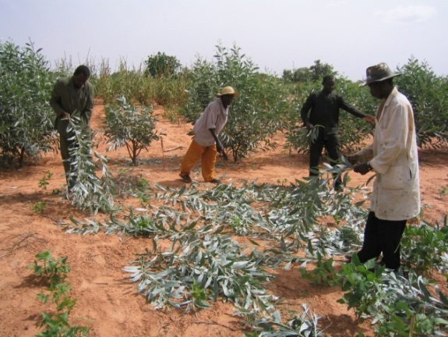
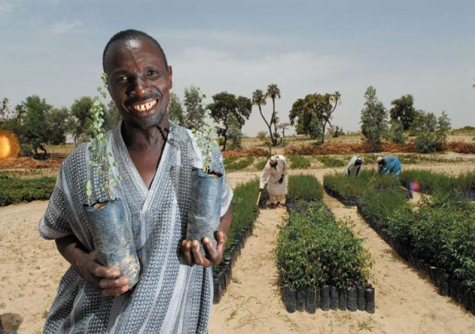
Implementation phase
Output 3: Tree-crop interactions evaluated on-farm using different tree species and cereal varieties
Output 4: Better management of the existing biomass is developed both for land reclamation and animal feeding
Output 5: New agroforestry technologies/practices aiming at improving biomass production evaluated
Output 6:Capacity of key stakeholders strengthened through collective action and co-learning.
Output 7: Finally, guidelines of best practices will be generated for the use of larger audience than the experimental site public.

Slide 26
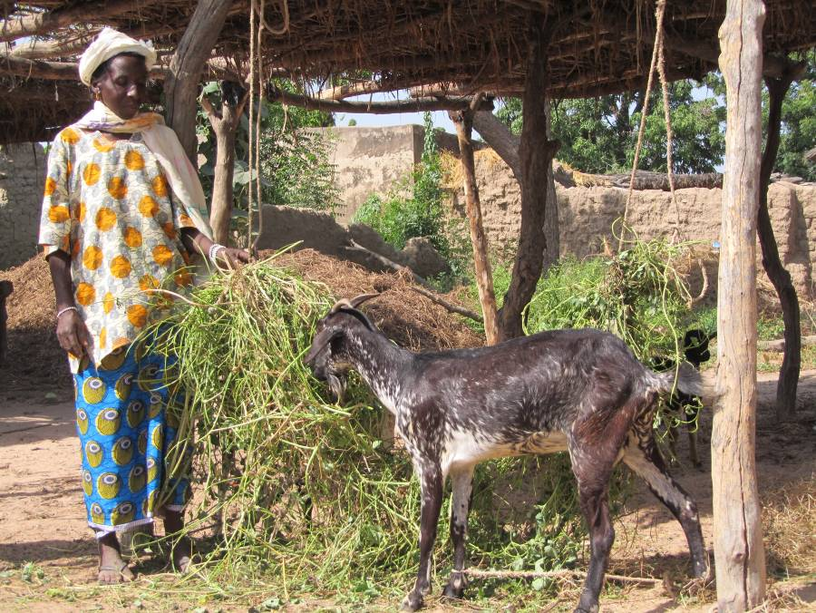
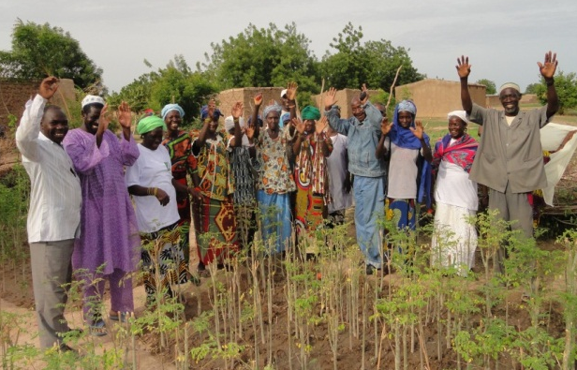
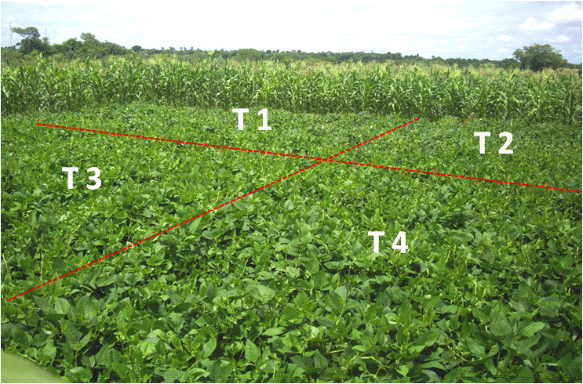
II. Sustainable intensification of cereal-based farming systems in the Sudano-Sahelian zone (AfricaRising project)
Aim: Transform Agricultural systems in Mali through Sustainable Intensification of key farming systems
Key research outputs (RO) are:
RO1: Situation Analysis and Program-wide Synthesis (IFPRI, WUR and partners)
RO2: Integrated Systems Improvement (CGIAR, AVRDC, WUR, national partners)
RO3: Scaling and Delivery of Integrated Innovation (CGIAR, AVRDC, WUR, national partners)
RO4: Integrated Monitoring and Evaluation (IFPRI with partners)

Slide 27
Community mobilization and establishment of innovation platform (1)
Diagnostic / planning meetings to identify the opportunity to introduce high yielding fodder and fruit tree species in 5 villages (Sirakele, Zanzoni, Mpessoba, Yorobougoula, Sibirila)
Platform established in Yorobougoula
20 innovator women farmers testing goat fattening and in combination with fodder cowpea trials
4-Participatory action planning
5-Participatory learning and implementation
6-Participatory monitoring and evaluation
2- Organize the community for action
3-Need assessment and priority setting
ICRAF
PARTNERS’ NGOS
Network of CBOs an
1- Prepare to mobilize
ICRAF community mobilization approach

Slide 28
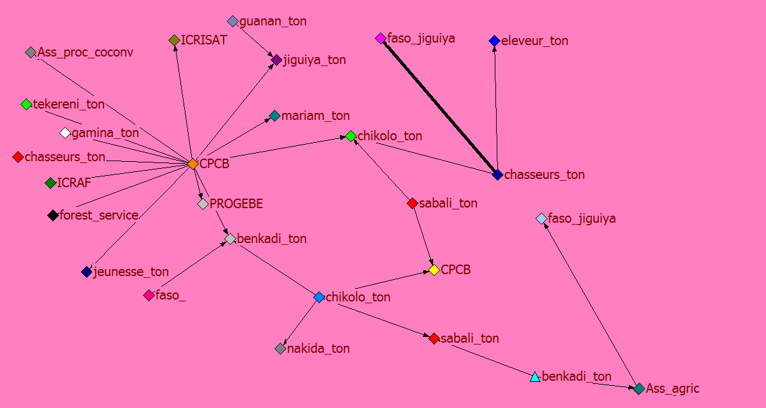
Innovation platform 1)- Networking mapping
The network map of Yorobougoula is dense with predominant CBOs and rural enterprises with a high level of centrality around one leader (Cooperative of Bio-cotton producers—CPCB)
The main channels for information sharing in Yorobougoula are trainings, formal and informal periodical meetings, etc.
There are three clusters with two of them connected through two women institutions which are a rotating saving and credit association (RSCA-Benkadi ton) and a shea butter processing association (Chikolo ton)
Cotton cooperative (OPCB) plays a central role reflected in the number links with other associations

Slide 29
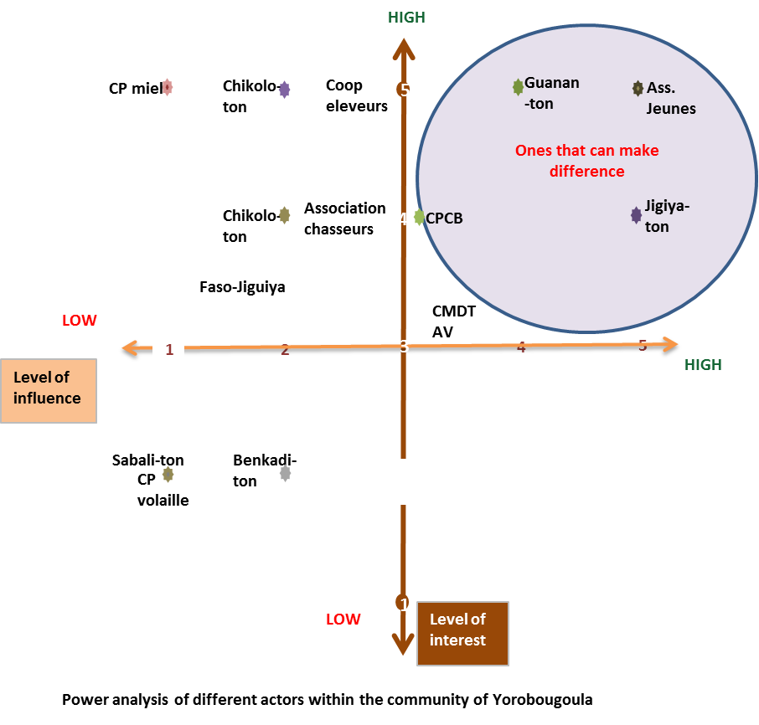
Innovation platform (2)- Institutional Power analysis
Youth associations, agroforestry farmers’ association (Guanan ton), tree products processing association as well as the cooperative of cotton producers (CPCB) among others are the most influential institutions through which the innovation platform can build to easily get the by-in from the other partners for the sustainability of actions in the platform.
Because the IP is an integrated and knowledge sharing framework inclusiveness is the guiding principle for the selection of different stakeholders/actors.
To increase inclusiveness, the IP should link the maximum number of farmer associations and groups (including those of the upper left quadrant) with other stakeholders from different domains including private sector, extension agents, development partners and policy makers to cater for the needs of different type of farmers.

Slide 30
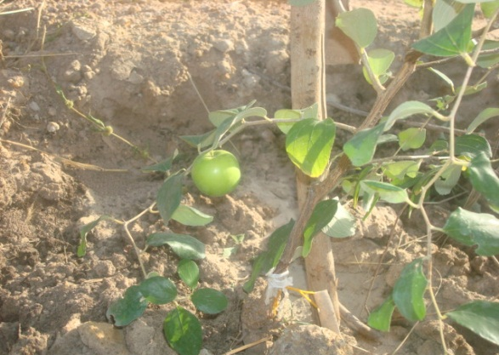
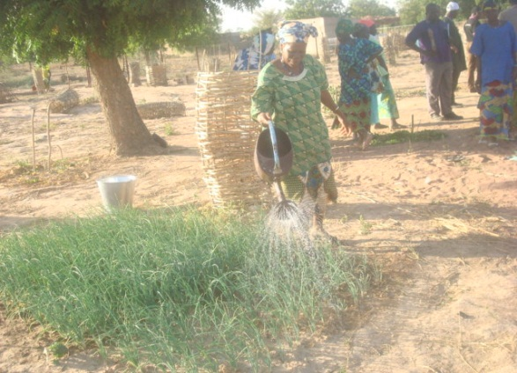
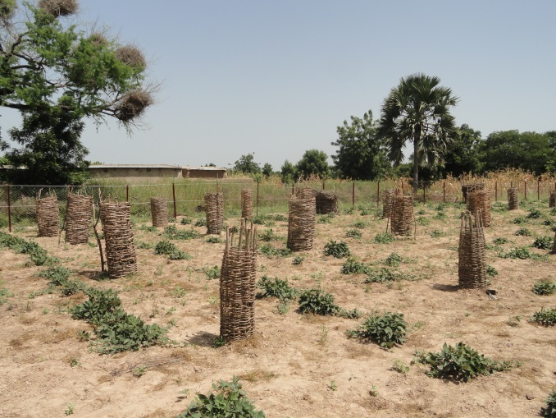
Establishment of diversified seed enterprise options
Increase availability and accessibility of improved seed (cereals, vegetables, fodder crops, etc.) and planting material (trees, shrubs) for rural cooperatives and their unions
A business plan developed by different producers with a defined target on seed/seedling production
Fruit tree establishment trials in five villages (Mpessoba, Sirakele, Zanzoni, Yorobougoula, Sibirila).
Off-season irrigated vegetable / seed production
Establishment of RRC
Capacity development training on tree propagation and planting techniques

Slide 31
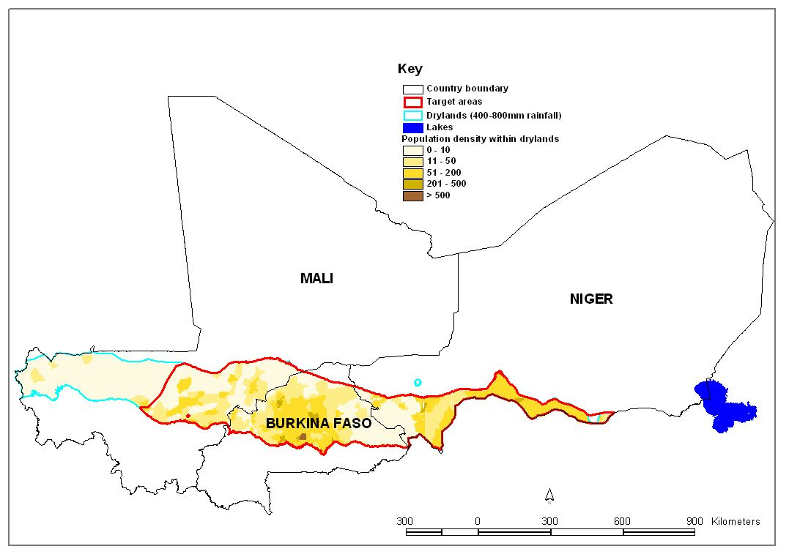
III. Regional program on food and water in the Sahel and the horn of Africa: regenerating dryland farming systems by creating an Evergreen Agriculture (DGIS The Netherlands)
Overview of main activity areas of the project
The programme is working in semi-arid areas of Mali, Burkina Faso, Niger
Priority areas are the ones with red limits

Slide 32
Overview of main activity areas of the project
Outcome 1: Improved water and food security
Integrated on-farm water and soil management practiced
Water availability in the watershed secured
Outcome 2: Commercialization of the rural economy
Increased participation of different categories of farmers in strengthened value chains of selected inputs and commodities
Access to credit and financial mechanisms by different categories of farmers improved
Outcome 3: Environment that enables increased water and food security and economic growth created
Policies adjusted to the interests of different categories of farmers
Institutional framework to upscale integrated water and soil management techniques and value chain development adapted to different categories of farmers
Inclusive and integrated approach developed and applied

Slide 33
Key long term impact indicators in the project
Increase in productivity of tradable crops (both women and men’s crops)
Increase in productivity of staple crops, (both women and men’s crops)
Improve water use efficiency
Improve on-farm profits
Decrease in dependency on food aid
Decrease of the different marginalized categories of people living under the poverty line
Increase in availability of nutritious food
Increase in consumption of nutritious food
Decrease the stunting levels of children

Slide 34
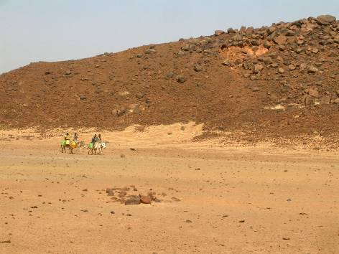
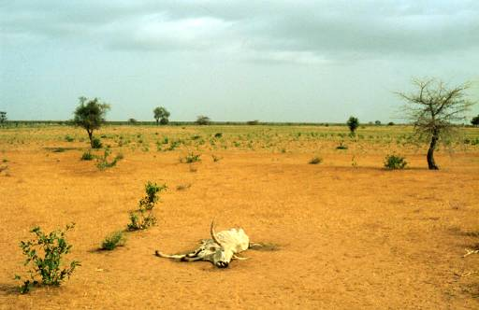
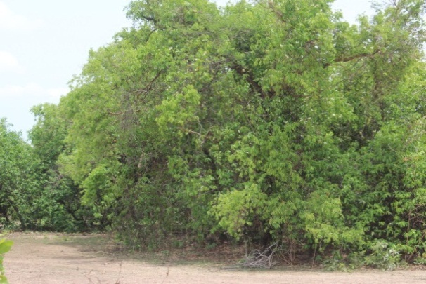
Provisionary targets
After 5 years, about 500,000 hectares will be rehabilitated.
Water productivity will be improved by 30% and the standard of living of about 70,000 farmers (male and female) will be improved.
These impacts will result from intervening in about 140 villages in each country

Slide 35
Key aspects of the project
Development oriented – An integrated approach with a broad soil and water component and commercialization component
The approach is a “bottom up, farmer driven” program that service providers will respond to.
An inclusive approach where the needs of all types of farmers including women, youth the poor can be addressed
Service providers are to be national organizations as much as possible with attention paid to building up capacity of farmer associations
Interventions are meant to be sustainable
International organizations playing mainly a capacity building role that is to lessen over time
A first year (inception phase) helps to learn how to make this work

Slide 36
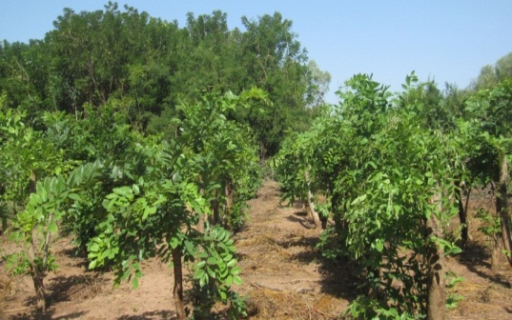
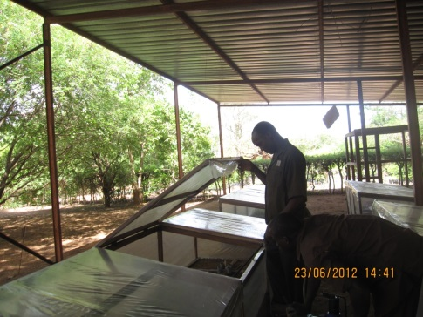
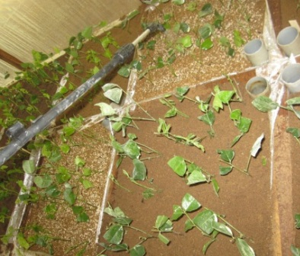
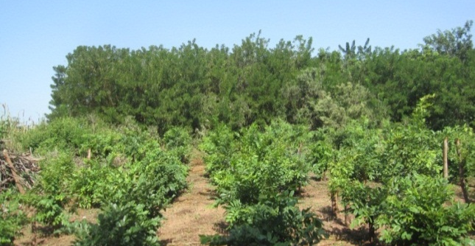
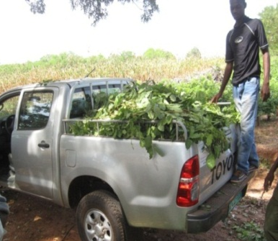
IV. Fodder trees species for enhancing production of the Sahelian Agroforestry systems
Literature review of animal feed systems in four Sahelian countries (Burkina Faso, Mali, Niger and Senegal): Bayala J., Ky-Dembélé C., Kalinganire A., Olivier A., Nantoumé H. 2014. A review of pasture and fodder production and productivity for small ruminants in the Sahel. Occasional Paper (ICRAF), ICRAF, Nairobi, Kenya
Valorization of data and experiments of previous trials on fodder species management
Development of vegetative propagation techniques for 12 local fodder tree species

Slide 37
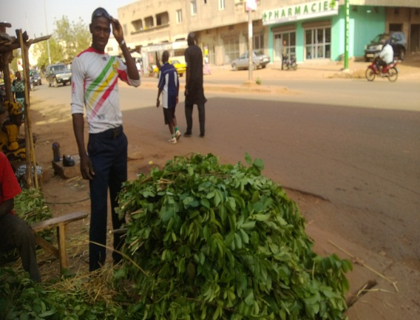
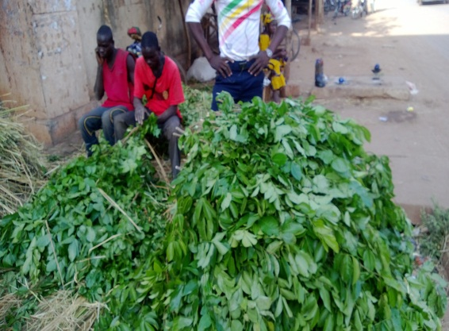
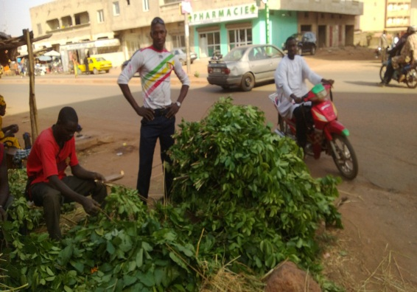
Survey on fodder trees and shrubs marketing
Key research questions to be addressed
Which value chain actors are involved and what are their respective roles (gender aspect)?
What are the profit generated from fodder trees and shrubs production and marketing, and how are theses profits distributed?
What are the farmers and breeders perceptions on fodder trees and shrubs availability and accessibility issues?

Slide 38
Partnership
NARS
Institut National de Recherche Agronomique du Niger (INRAN)
InInstitut de l'Environnement et de Recherches Agricoles
Institut d'Economie Rurale (IER)
CSIR-SARI
AGRHYMET
CDA-BUK
University of Niamey and Bobo
NGOs
Care International au Niger
World Vision
Oxfam Novib
AMEDD
Sahel Eco
Reseau Marp
Karkara
Farmers Organization
ROPPA
Moriben-Niger
FNUGN-Burkina Faso
Reseau Bilital Manore

Slide 39
ICARDA On-going activities in WAS&DS
CRP-DS Science and Implementation Workshop
30th June – 4th July, 2014
Holiday Inn Hotel - Amman, Jordan

Slide 40
CRP Dryland Systems – West Africa implementing CG Centre Activities ICARDA
No. | CRP WAS- DS Activity Title | CRP WAS - DS | Research Phase | Activity Leader | IDO | IDO Output
1 | Establishing innovative platforms at Kano for participatory wheat technology validation, demonstration and community based seed multiplication | KKM |  | S. Assefa | IDO 6 -1 | - Innovative partnership models for improved seed delivery and technology transfer to local circumstances across scaling domains
2 | Study of the effects of intensification on local agro-biodiversity in West Africa | KKM |  | A. Amri | IDO 1-2 | Information and Data on farming systems, - Threats to agro- biodiversity
3 | Land Use Land Cover change Mapping for Dryland Systems sites in the West African Sahel and Dry Savannas region | KKM, WBC |  | C. Biradar | IDO 1- 2 IDO 4- 2 | - Decadal dynamics of the land use and land cover baseline for action sites

Slide 41
Activity | Progress towards outputs & IDOs, 2014/15
1. Establishing innovative platforms for participatory wheat technology validation demonstration and community based seed multiplication | Key activities: Conduct R4D activities for technology validation, on-farm demonstration and dissemination ; Establish functional community-based farmers’ seed multiplication and supply (3 IP sites in Kano, 1 IP in Maradi) ; Organize training on IAR4D and innovation systems approaches for wheat value chain Organize training on quality seed production and management of certified seed for seed producing farmers and stakeholders Expected Outputs Establishing and operationalizing three innovative platforms (3 IP sites in Kano, 1 IP in Maradi) for wheat technology demonstration, seed production and promotion along the value chain Setting a functional and sustainable community based farmers’ seed multiplication and supply in the IP sites Area and Sites:- Kano-Katsina-Maradi (KKM)
CRP Dryland Systems – West Africa implementing CG Centre Activities

Slide 42
CRP Dryland Systems – West Africa implementing CG Centre Activities
Activity | Progress towards outputs & IDOs, 2014/15
2. Study of the effects of intensification on local agro-biodiversity in West Africa | Key activities: Undertake farming systems surveys for the aspects related to local agrobiodiversity in terms of extent, uses, threats; Organize workshop with key stakeholders to discuss technological, socio-economic, institutional and policy options for in situ conservation of dryland agrobiodiversity; Provide training on approaches for promoting in situ conservation. Write a report on status and threats to local agrobiodiversity Expected Outputs Report on status and threats to local agro-biodiversity Capacity building through training the trainers in the area of in situ conservation of dryland agrobiodiversity Area and Sites:- Kano-Katsina-Maradi (KKM)

Slide 43
Activity | Progress towards outputs & IDOs, 2014/15
3. Land Use Land Cover change Mapping for Dryland Systems sites in the West African Sahel and Dry Savannas region | Key activities: Collection of appropriate data (e.g., ground truth, statistical, ancillary info, etc.); Collection of appropriate satellites images (e.g., Landsat, CORONA, etc); definition of classes of land-use and land-cover (e.g., classification scheme); Definition of categories of land-use and land-cover change (e.g., major LULC types); Training of LULC surveyors (field data, geo-referenced field photos); Analysis of historical land-use and land-cover change; map accuracy assessment; Preparation of report based on analysis and methodologies. Expected Outputs Report with Map of land use land cover change survey, including an annex detailing data sources and methods used for pre-processing, data classification, and classification accuracy Area and Sites:- Kano-Katsina-Maradi (KKM) :- Kano-Katsina-Maradi (WBC)
CRP Dryland Systems – West Africa implementing CG Centre Activities

Slide 44
Partners & Stakeholders
Activity | Partners & Stakeholders
1. Establishing innovative platforms for participatory wheat technology validation demonstration and community based seed multiplication | - - LCRI, Nigeria: Contribute to establish IP sites and research center managed breeder and basic seed multiplication - Zaria Universitym Nigeria: contributes to establish and operationalize IP sites and community based farmers’ seed multiplication in Kano IP sites - SG-2000-Nigeria: Contributes to community based farmers’ seed production in Kano IP sites - IER-Mali: Contributes to participatory technology validation, on-farm and demonstration - INRAN-Niger: Contributes to participatory technology validation, on-farm and demonstration
2. Study of the effects of intensification on local agro-biodiversity in West Africa | Bioversity International: Contributes to workshop on options for in situ conservation - - Zaria University, Nigeria: Participate in the surveys
Land Use Land Cover change Mapping for Dryland Systems sites in the West African Sahel and Dry Savannas region | ICRISAT:– Coordinate the consultancy, and paper writing. Wageningen University: Provide inputs to paper writing and support for training event. AGRHYMET: Responsible for field survey administration, land use land cover change analyses and mapping, and final report production

Slide 45
CIP On-going activities in WAS&DS
CRP-DS Science and Implementation Workshop
30th June – 4th July, 2014
Holiday Inn Hotel - Amman, Jordan

Slide 46
CRP Dryland Systems – West Africa implementing CG Centre Activities CIP
No. | CRP WAS- DS Activity Title | CRP WAS - DS | Research Phase | Activity Leader | IDO | IDO Output
1 | Establish reference situation / baselines for the action sites to support systems approaches | KKM |  | E. Carey | IDO 6 -1 | Appropriate sweetpotato AR4D interventions
2 | Promote local and regional knowledge generation and exchange for scaling up and out of promising intensification options and strategies | KKM |  | E. Carey | IDO 1-2 | Information and Data on farming systems, - Threats to agro- biodiversity

Slide 47
CRP Dryland Systems – West Africa implementing CG Centre Activities CIP
No. | CRP WAS- DS Activity Title | CRP WAS - DS | Research Phase | Activity Leader | IDO | IDO Output
1 | Capacity building | KKM |  | E. Carey | IDO 6 -1 | Training of trainers from francophone benchmark sites and surrounding region on sweetpotato
2 | Gender oriented promotion of OFSPA | WBS, KKM |  | E. Carey | IDO 1-2 | - Engendered research and extension agenda implemented through innovation platform at local level - Action research priority planning at benchmark site level with gender perspective

Slide 48

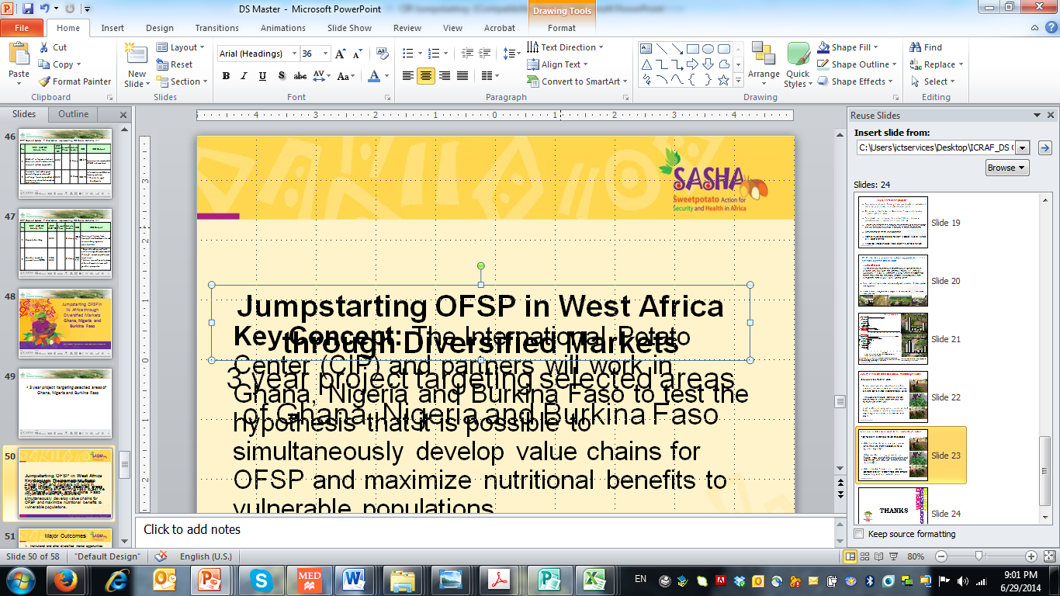
Jumpstarting OFSP in W. Africa through Diversified Markets
Ghana, Nigeria and Burkina Faso
SWEETPOTATO ACTION FOR SECURITY AND HEALTH IN AFRICA

Slide 49

Project targeting selected areas of Ghana, Nigeria and Burkina Faso
Key Concept: The International Potato Center (CIP) and partners will work in Ghana, Nigeria and Burkina Faso to test the hypothesis that it is possible to simultaneously develop value chains for OFSP and maximize nutritional benefits to vulnerable populations

Slide 50
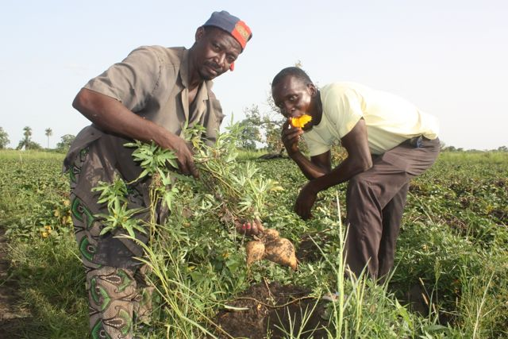
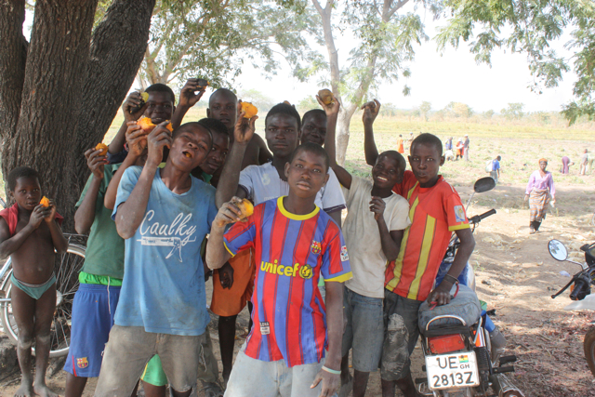
Major Outcomes
Institutional and other diversified market opportunities for OFSP developed in project pilot areas in Ghana, Nigeria, and Burkina Faso.
Commercial seed system functioning in target areas and capable of expanding in response to increased demand.
Most at-risk households and individuals in target areas have increased vitamin A intakes.
Commercial sweetpotato seed and root farmers are benefitting from participation in OFSP value chains

Slide 51
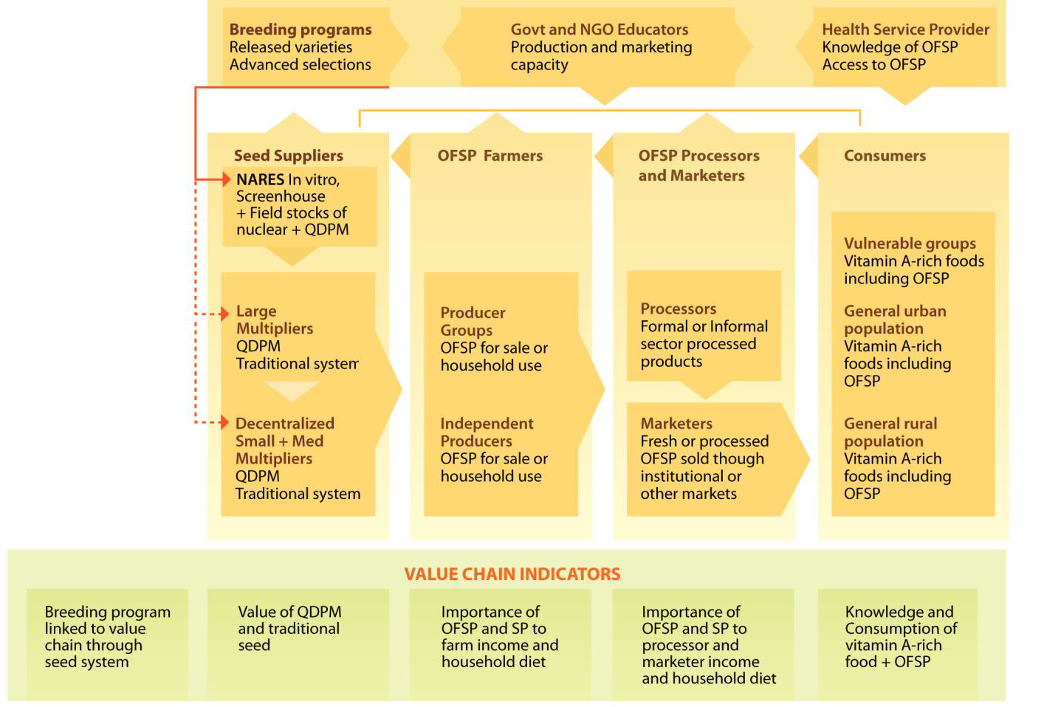
Interactions among value chain actors

Slide 52
Targets and Partners in Ghana
Region/State (District/Province) | Activity (Outcome) | Partner | Linked Projects/Program*
Upper East (Pusiga, Binduri, Bawku Municipal, Kassena-Nankana East, Kassena-Nankana West) | Market development, nutrition, and utilization training; production, storage, business skills, credit access (1, 3, 4); QDPM system and seed multiplication (2) | iDE-Ghana; MoFA | FRI; on-farm storage research project (CIP)
Northern (Tolon, Kumbungu) | Market development, nutrition, and utilization training; production, storage, business skills, credit access (1, 3, 4); QDPM system and seed multiplication (2) | Association of Church-based Development Projects (ACDEP); NGOs; MOFA | FRI; CGIAR Research Program on Dryland Systems benchmark site; SASHA

Slide 53
Targets and Partners in Ghana
Region/State (District/Province) | Activity (Outcome) | Partner | Linked Projects/Program*
Both regions | Product refinement (1) | UDS | SASHA
Both regions | Pathogen-free breeder and foundation seed; seed maintenance trials (2) | CSIR-SARI; CSIR-CRI | WAAPP; Ghana Grains Development Board; SASHA
Both regions | Integration of nutrition education into community health planning and services | Ghana Health Service | SASHA
Both regions | Capacity building (all) | iDE-Ghana, SARI, MOFA, Ghana Health Service | Reaching Agents of Change (RAC) sweetpotato course ARMTI, Ilorin, Nigeria
Both regions | Gender-sensitive monitoring & evaluation (M&E) (all) | CSIR-SARI; esoko | Dryland Systems

Slide 54
Targets and Partners in Burkina Faso
Region/State (District/Province) | Activity (Outcome) | Partner | Linked Projects/Program*
Hauts-Bassins (Kenedougou, Houet) | Market development, nutrition, and utilization training; production, storage, business skills, credit access (1, 3, 4); QDPM system, seed multiplication (2) | INERA; MOA; iDE-Burkina Faso | FRI; Dryland Systems benchmark site
Kenedougou | Links to Dafani S.A. juice factory, Orodada (1) | MOA; FGs | SASHA
Houet Province | Foundation seed multiplication and on-farm demonstrations (2) | INERA–Farako Ba; Nafaso | Alliance for a Green Revolution in Africa (AGRA)

Slide 55
Targets and Partners in Nigeria
Region/State (District/Province) | Activity (Outcome) | Partner | Linked Projects/Program*
Kwara State (Irepodun and Offa LGA) | Market development, nutrition, and utilization; production, storage, business skills (1, 3, 4); QDPM system and seed multiplication (2) | NRCRI, Agricultural Development Programme | FMARD, Rainbow Project + ??
Osun State (Odo-Otin, Osogbo+? LGA) | Linkages to school feeding program; nutrition and utilization training; production, storage, business skills, and credit access (1, 3, 4); QDPM system and seed multiplication (2) | Partnership for Child Development (PCD), NRCRI, ADP | FMARD Rainbow Project; QIIP; CGIAR Research Program on HumidTropics benchmark site

Slide 56
BIOVERSITY On-going activities in WAS&DS
CRP-DS Science and Implementation Workshop
30th June – 4th July, 2014
Holiday Inn Hotel - Amman, Jordan

Slide 57
CRP Dryland Systems – West Africa implementing CG Centre Activities BIOVERSITY
No. | CRP WAS- DS Activity Title | CRP WAS - DS | Research Phase | Activity Leader | IDO | IDO Output
1 | Agricultural biodiversity (ABD) assessment | WBS |  | Raymond Vodouhe, Mauricio Bellon | IDO 2 | Tested methodology to assess ABD applied and disseminated; understanding of the role of ABD in household livelihoods; entry points to apply interventions to improve livelihoods identified; increased capacity of local partners to carry out this type of work.

Slide 58
CRP Dryland Systems – West Africa implementing CG Centre Activities BIOVERSITY
No. | CRP WAS- DS Activity Title | CRP WAS - DS | Research Phase | Activity Leader | IDO | IDO Output
1 | Seed systems and community management of ABD | KKM WBS |  | Raymond Vodouhe, Mauricio Bellon | IDO 2 | Characterization of the seed system used by target farmers, farmers and farmers' organization trained in improved seed production techniques
2 | Dietary Diversity Assessment (West Africa) | KKM |  | Raymond Vodouhe, Mauricio Bellon | IDO 3 | Inventory of the foods available to households characterization of the dietary diversity consumed by women and children.

Slide 59
individual
Nutrition & Health status
Household & individual
Food security & dietary quality
Dietary diversity
Influencing factors
Self-consumption
Purchase
Influencing factors
Influencing factors
Household & community
On-farm diversity
Market diversity
Sale
Ecosystem & Evolutionary
Services
Income
Information flow

Slide 60
General objective
to characterize these three dimensions of ABD
  the elements and relationships involved
  the exogenous factors that influence them
  as the basis for analyzing the roles of ABD in the lives and livelihoods of rural populations
  to identify entry points for designing and implementing interventions that contribute to improve their well-being

Slide 61
Specific objective
To identify and quantify the number of all useful plant and animal species (including fish) at the household-level that are:
  grown on farm and home garden, or collected from the wild
  consumed as part of the diet by mothers and children
  purchased and sold
  Including both domesticated and wild species
  For each species the number of varieties/breeds
Notes:
Focus of the assessment
Annual domesticated plant species
Perennial plant species, including agro-forestry species
Wild and semi-domesticated plant species
Domesticated animal species
Wild animal species
Fish
Species and products bought and sold
Foods consumed
Markets

Slide 62
Methodology
Ethno-biological survey
Focus group discussion
    Elicit as much diversity as possible, particularly at the tail of the distribution
    Male and female groups
Questionnaire to a random sample of households in villages targeted by the CRP
Notes:
Focus of the assessment
Annual domesticated plant species
Perennial plant species, including agro-forestry species
Wild and semi-domesticated plant species
Domesticated animal species
Wild animal species
Fish
Species and products bought and sold
Foods consumed
Markets

Slide 63
Results FDG-Mali: village of N’Goutjina-male group
Village | Type | Total | Cell 1 | Cell 2 | Cell 3 | Cell 4
N’Goutjina | Annual plant species | 31 | 5 | 3 | 11 | 12
 | Perennial plant species-agro-forestry | 25 | 11 | 2 | 0 | 12
 | Wild and semi-domesticated plant species | 29 | 12 | 2 | 12 | 3
 | Varieties of Sweetpotatoe | 3 | 0 | 0 | 0 | 3
 | Domestic animals | 10 | 2 | 0 | 5 | 3
 | Wild Animals | 11 | 2 | 2 | 7 | 0
 | Fish | 6 | 0 | 1 | 2 | 0
 | Species and products sold | 30 | 6 | 5 | 4 | 15
 | Species and products bought | 32 | 13 | 0 | 2 | 17

Slide 64
Results FDG-Mali: village of N’Goutjina-Female group
Village | Type | Total | Cell 1 | Cell 2 | Cell 3 | Cell 4
N’Goutjina | Annual plant species | 31 | 8 | 2 | 9 | 14
 | Perennial plant species-agro-forestry | 15 | 0 | 2 | 2 | 12
 | Wild and semi-domesticated plant species | 11 | 7 | 1 | 1 | 2
 | Varieties of Sweetpotatoe | 2 | 0 | 0 | 0 | 2
 | Domestic animals | 10 | 0 | 1 | 6 | 4
 | Wild Animals | 8 | 0 | 2 | 0 | 6
 | Fish | 5 | 0 | 0 | 1 | 2
 | Species and products sold | 29 | 6 | 1 | 13 | 9
 | Species and products bought | 27 | 15 | 0 | 5 | 7

Slide 66
Seed systems and Community Management of Agricultural Biodiversity in Burkina Faso, Mali & Niger
An effective seed system is the basis for productive agricultural systems
Farmers need seeds (varieties and planting materials) that are adapted to their production systems, social and cultural environments, as well as existing market channels.
The sources of seed can be formal or informal.

Slide 67
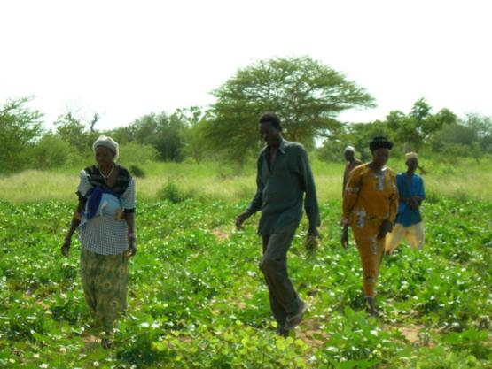
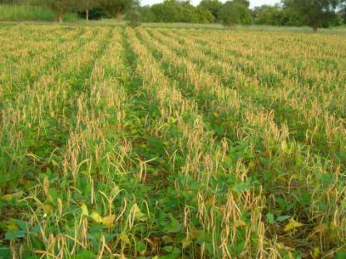
Burkina, Mali, Niger
Traditional Seed systems: meets 95 to 100% seed demand but is poorly correlated with production (r=0,269)
Formal seed systems covers only 1 to 5% of seed demand but is highly correlated with productivity/ production (r=0,931** & r=0,607**)

Slide 68
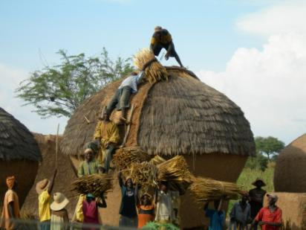
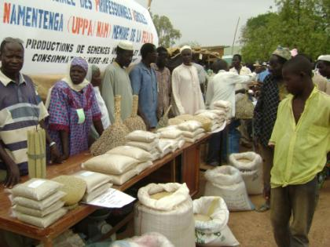
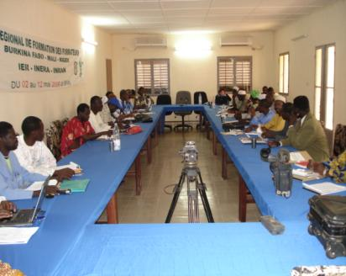
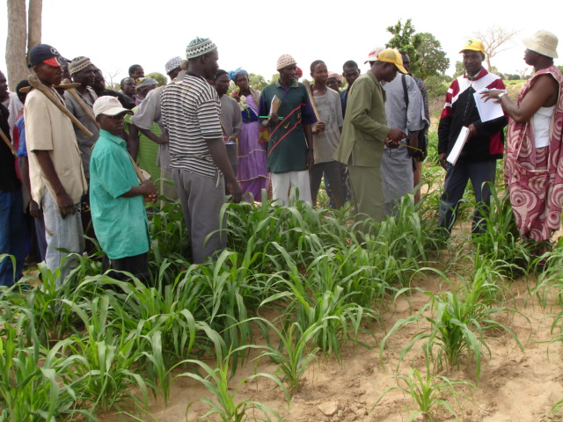
Empowering local communities
Initiate new partnership and platforms among actors
Adapting local and national legislations to existing context

Slide 69
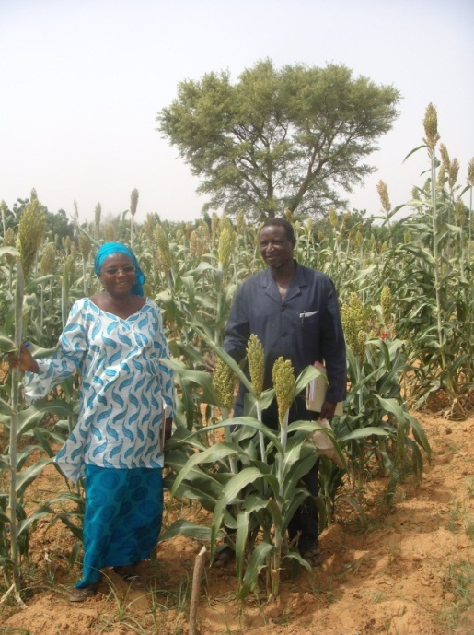
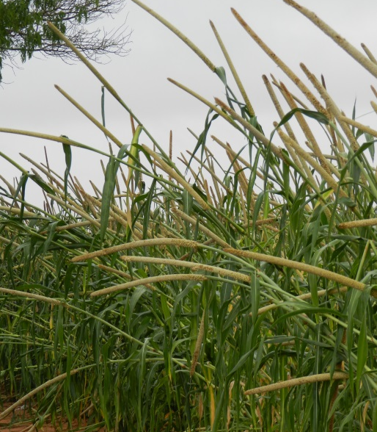
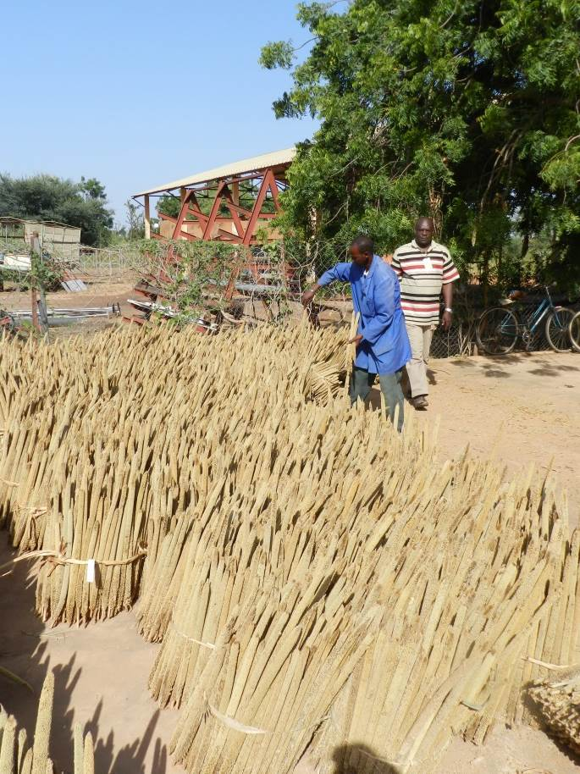
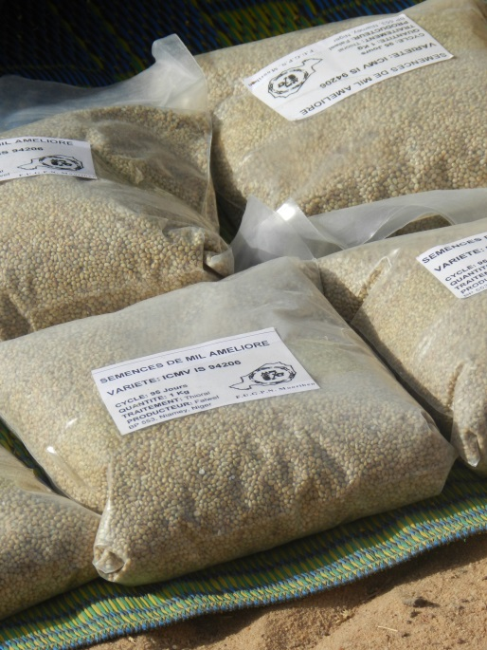
Achievements / Results
Farmers selected sorghum and millet varieties in Mali
Strengthened collaboration among seed actors
Major constraints to seed sector are examined.
  It was noted that formal and informal seed systems are complementary
  and should both benefit from government and development aids.
  Current laws are not conducive to local seeds
  Training of farmers on seed multiplication in Mali (46 farmers including 6 women
  farmers trained on seed multiplication, 20 other farmers including 9 women
  trained on seed conservation, packaging and on seed business plan development

Slide 70
Partnership
Activity | Partner
Agricultural biodiversity (ABD) assessment | Institut d’Economie Rurale (IER)-Mali, Plant Genetic Resources Institute-Ghana, Crop Research Institute Kumasi-Ghana
Seed systems and community management of ABD | IER-Mali INRAN-Niger INERA-Burkina Faso
Dietary Diversity Assessment (West Africa) | INERA Burkina Faso; AMEDD, Mali; Animal Research Institute, Ghana.

Slide 71
IWMI On-going activities in WAS&DS
CRP-DS Science and Implementation Workshop
30th June – 4th July, 2014
Holiday Inn Hotel - Amman, Jordan

Slide 72
Activity | Progress towards outputs & IDOs, 2014
1. ESTABLISH REFERENCE SITUATION / BASELINES for the action sites to support systems approaches IDOs: 1 | Key activities: Characterize farmer understanding, skills and aspirations in farm and business planning and meeting agronomic and financial objectives Expected Outputs Survey instrument designed and executed. Results submited for internal review. Area and Sites: (KKM), Wa-Bobo-Sikasso Partners CSIR-SARI University of Kumasi
CRP Dryland Systems – West Africa implementing CG Centre Activities

Slide 73
Activity | Progress towards outputs & IDOs, 2014
2. Assess and monitor biomass and resource flow in the action sites IDOs: 1 | Key activities: Understanding the role of trees in surface and subsurface carbon fluxes, hydrology, microclimate and soil fertility protection at hillslope to landscape scales Expected Outputs 1. Conceptual and empirical models of tree distribution in inland valleys and intervening ridges in agriculturally developed and virgin land submitted for review as conference paper. 2. Model (conceptual or otherwise) describing ridge, hillslope and inland valley processes as conference paper. 3. Spatio-temporal datasets and empirical relationships on tree-crop species combinations from field to catchment / lanscape scales developed and reviewed internally.. Area and Sites: Wa-Bobo-Sikasso
CRP Dryland Systems – West Africa implementing CG Centre Activities

Slide 74
Activity | Progress towards outputs & IDOs, 2014
2. Assess and monitor biomass and resource flow in the action sites IDOs: 1 | Key activities: Yield mapping of field crops to locate and help identifiy the causes of variability and capitalise on the causes of increases. Expected Outputs Characterization and reporting of main sources of variation published as a journal article Area and Sites: Wa-Bobo-Sikasso Partners CSIR-SARI University of Kumasi
CRP Dryland Systems – West Africa implementing CG Centre Activities

Slide 75
Activity | Progress towards outputs & IDOs, 2014
3. Induce intensification and improve resource use efficiency through on-farm testing and evaluation of technologies IDOs: 1 | Key activities: 1. Africa RISING farming systems experiments with the following treatments: 1) 'typical' or control; 2) best-bet options applied as informed by farmers and experts; 3) best-bet options applied from (2) that are economically viable 2. Mechanization options for human, animal and tractor propelled operations. New designs of simple and robust implements. Expected Outputs Farm scale experiments conducted 2. Prototype implements undergoing on-farm trials Area and Sites: Wa-Bobo-Sikasso Partners CSIR-SARI University of Kumasi
CRP Dryland Systems – West Africa implementing CG Centre Activities

Slide 76
Activity | Progress towards outputs & IDOs, 2014
4. Facilitate effective linkage and knowledge exchange among different actors for improved system productivity and better market access IDOs: 1-6 | Key activities: Smart phone apps for basic agronomy, basic water balance, forming market linkages and accessing market information Expected Outputs New apps beta tested Area and Sites: Wa-Bobo-Sikasso Partners CSIR-SARI University of Kumasi
CRP Dryland Systems – West Africa implementing CG Centre Activities

Slide 77
Activity | Progress towards outputs & IDOs, 2014
5. Promote local and regional knowledge generation and exchange for scaling up and out of promising intensification options and strategies IDOs: 1-6 | Key activities: Coodinated catchment, district, regional and farmer to farmer bus tours for familiarisation and exchange on local, catchment and landscape processes, ecosystem services and farming options and strategies. Expected Outputs Tours and field days conducted. Area and Sites: Wa-Bobo-Sikasso Partners CSIR-SARI University of Kumasi
CRP Dryland Systems – West Africa implementing CG Centre Activities

Slide 78
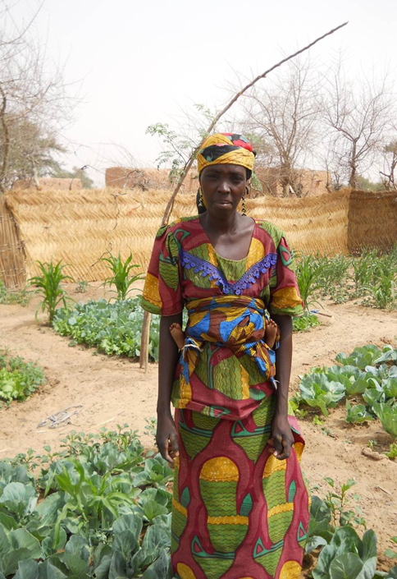
Thank you!

