Slide 1
Integrated mobilization of existing resources and innovative perception to improve livestock production and products in Jordan
Muhi El-Dine Hilali, Huthaifa Ababneh, Jumana Hijazi
Consortium Research Program on Dryland Systems (CRP DS)
ICARDA – NCARE Technical Meeting for Tafilah-Salamieh Action Site
(Jordan sites)
September 21-22, 2014
Ayass Hotel, Amman

Slide 2
The context – the Middle East
Climate change and drought is threatening small ruminant breeders and exposing animals to disease prevalence.
Sheep derived products (milk and meat) are important ingredients of the Middle Eastern cuisine
Sheep contribute substantially to farmers’ incomes and to family nutrition but have an important impact on natural resources
Population, urban areas and livestock product markets are expanding
Farmers are resorting to intensify their production systems to target the market demands
Notes:
Dairy sheep production is important in Syria as it affects the livelihood of at least 300,000 farmers.
Cheese and Yogurt, widely consumed directly or as a component of the local cuisine, are among the highly demanded products that dairy sheep farmers of the Middle East region

Slide 3
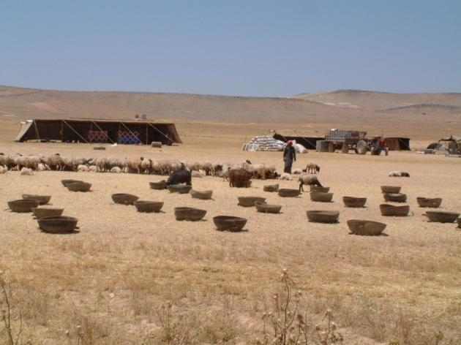
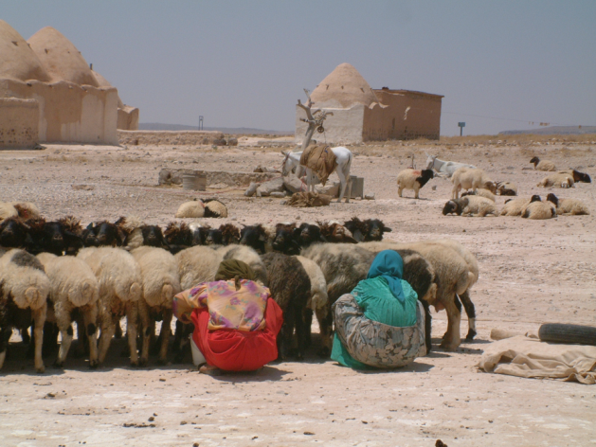
The context …
Rangelands are severely degraded due to overgrazing in combination with frequent droughts
Farmers are forced to purchase concentrates to fill the feed gap
Livestock farmers are facing high feed costs
  Milk production period
  Lamb fattening
Notes:
Most sheep are managed on a range-based semi-extensive basis, and also through different degrees of interaction with cropping areas. More intensive systems occur in areas where this integration is possible

Slide 4
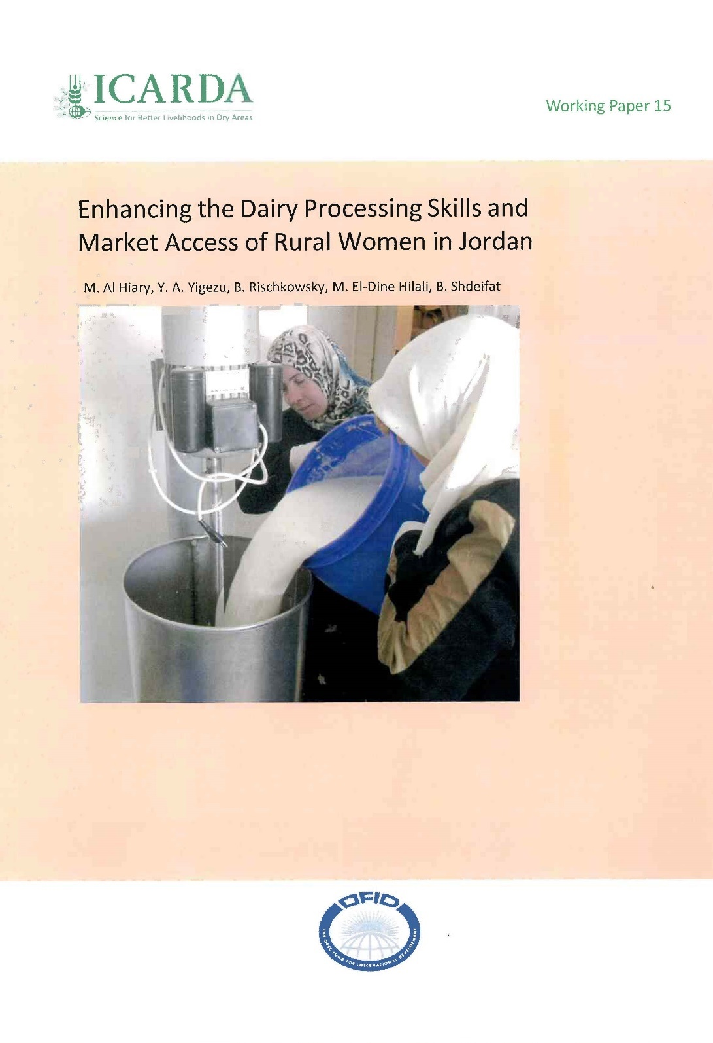
Sheep dairy products
Important products in the region
Jameed
Ghee
Labneh

Slide 5
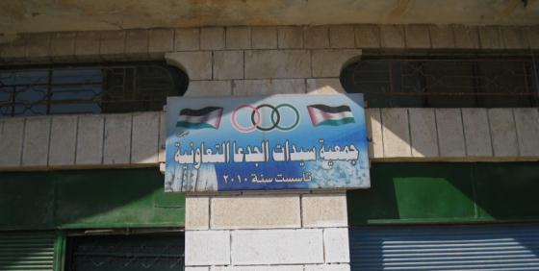
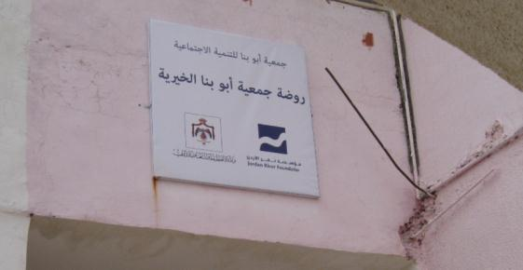
Preliminary study
Assessment of local knowledge
  El-Karak
  Tafila
  Maan
Collect information on constraints of the production systems
Validation of collected information
  Processing methods
  Constraints related to processing

Slide 6
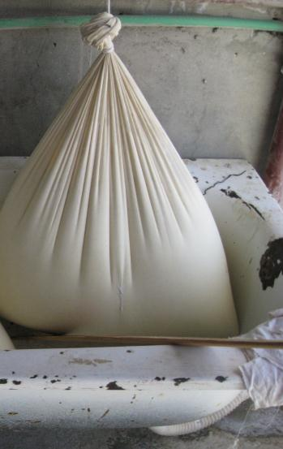
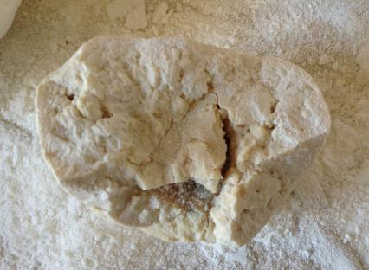
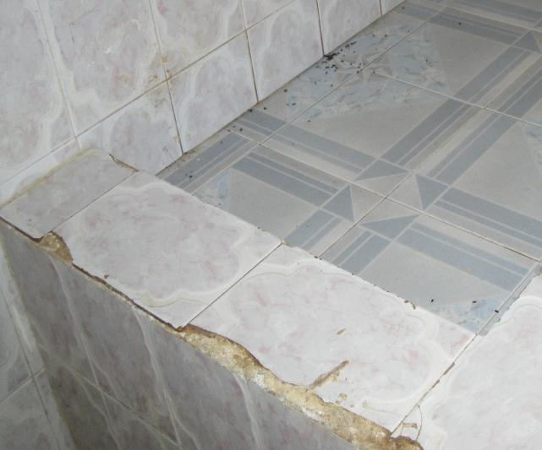
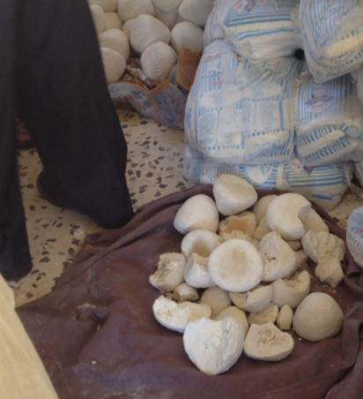
Observation
Notes:
Elevated acidity

Slide 7
Problems reported by producers
Lack of knowledge in milk handling and processing
Elevated milk acidity
Texture problems of the product
Foaming

Slide 8
Milk composition
 | Fat | SNF | Lactose | TS | Protein | Freezing Point | EC | SCC
Average | 6.71 | 10.15 | 5.63 | 16.53 | 3.66 | -0.706 | 4.78 | 939
Min | 3.51 | 7.78 | 4.29 | 12.89 | 2.86 | -0.783 | 2.86 | 289
Max | 12.93 | 17.12 | 9.44 | 20.20 | 6.46 | -0.529 | 7.47 | 3376

Slide 9
Comparison of jameed components (%)
 | Fat |  | Total Solids |  | Ash
 | Modified | Traditional | Modified | Traditional | Modified | Traditional
Average | 3.27 | 11.42 | 64.29 | 61.39 | 16.73 | 12.54
Min | 3.21 | 3.98 | 64.20 | 55.20 | 16.62 | 9.13
Max | 3.34 | 17.35 | 64.38 | 71.39 | 16.80 | 15.18

Slide 10
El-Khresha villages
20,000 Sheep
Milk
8000 L milk/day
Production
72 ton Jameed 36 ton ghee
Net income 400,000 JD

Slide 11
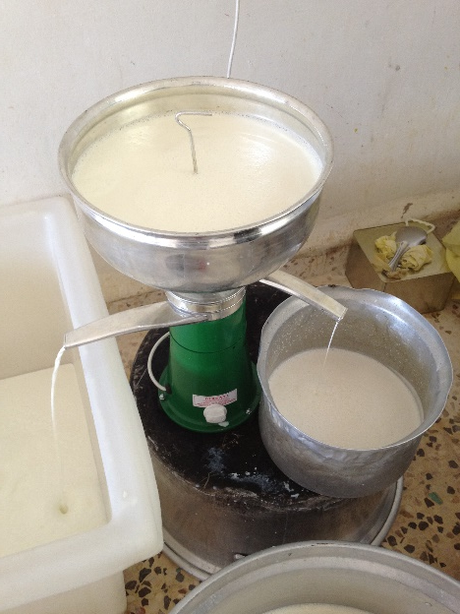
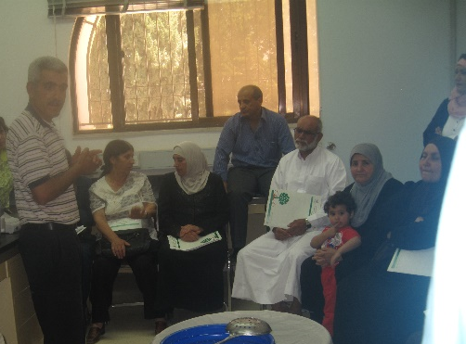
Benefit of using the improved processing method
Technology and improved processing method
Energy saving at least 60%
Reduce water consumption
Saving at least 216m³
Increase in net income 8%
Increase ghee yield 8.5 ton

Slide 12
S.W.O.T Analysis
Strength
Geographical indicator
Weaknesses
Need for training
Threats
Unavailability of processing equipment's
Opportunities
Increase the produced quantities
Lack of knowledge
Market demand
Notes:
Summary Overview
S.W.O.T. analysis identifies and lists the firm’s strengths and weaknesses and its opportunities and threats. A good S.W.O.T. analysis helps the manager focus on a strategy that takes advantage of opportunities and strengths while avoiding its weaknesses and threats. Strengths and weaknesses are internal to the company; opportunities and threats are external factors.
S.W.O.T. Analysis
Strengths. Strengths are those things a firm does well. It may be a process, a patent, or some other product-related activity. But it might also be extraordinary customer service, delivery, or channel support. Well developed strengths can lead to a distinct competitive advantage -- a way of doing business that distinguishes a firm from its competitors in some market-relevant way.
Weaknesses. Weaknesses are areas where the firm performs some activities less-well than competitive firms. These are areas where the firm needs to improve -- or at least not compete head-to-head with better performing organizations.
Discussion Note: Over the long-run, they may even be activities that match the competition but not the expectations for performance held by customers.
Opportunities. Opportunities are events, conditions, or situations in the external environment that are particularly well-suited or attractive to the way a firm does business or is planning to do business. The firm does not control the existence of opportunities, but it tries to match its strengths to opportunities that emerge, are emerging, or will emerge within the planning period.
Threats. Threats are events, conditions, or situations in the external environment that are NOT particularly well-suited or attractive to the way a firm does business or is planning to do business. Companies try to avoid threats or minimize their impact.
This slide relates to the material on pp. 597-600. See also Transparency 22 and Overhead 21.
Instructor’s Note: The lecture script provides extra-textual discussion material on S.W.O.T. for extended in-class discussion.

Slide 13
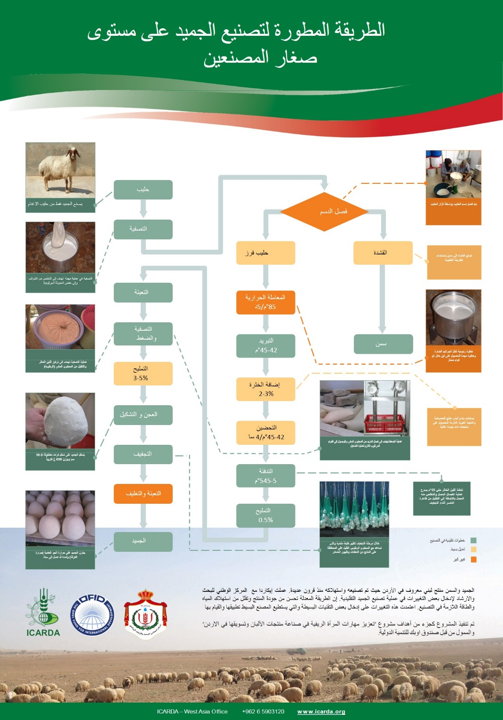
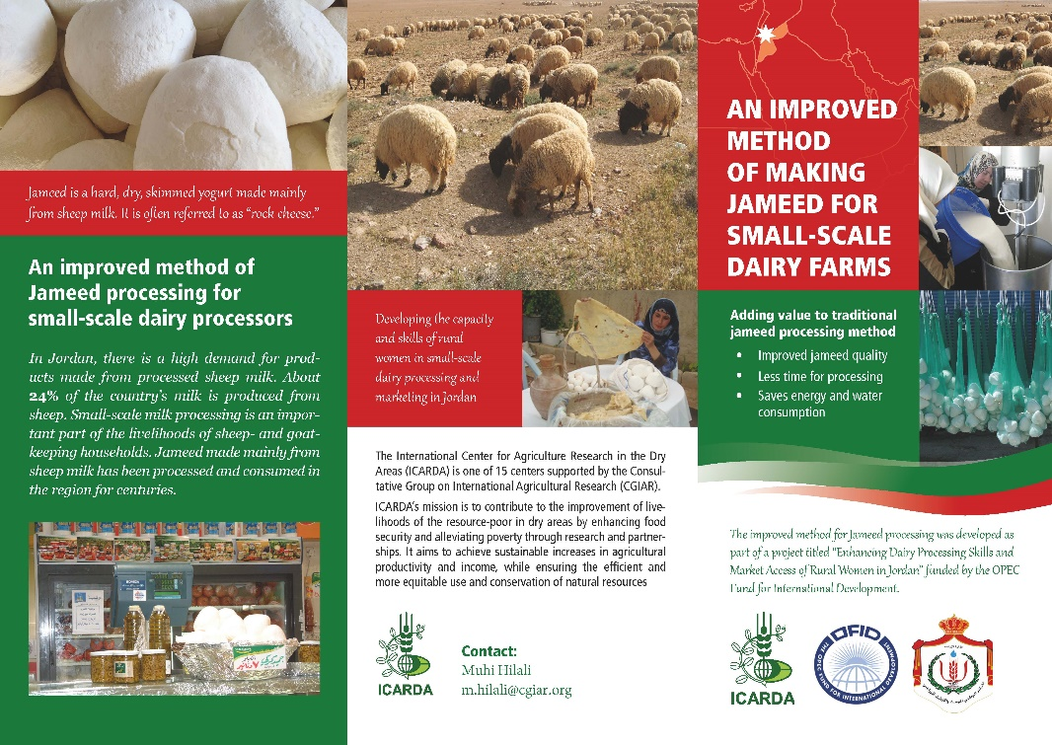
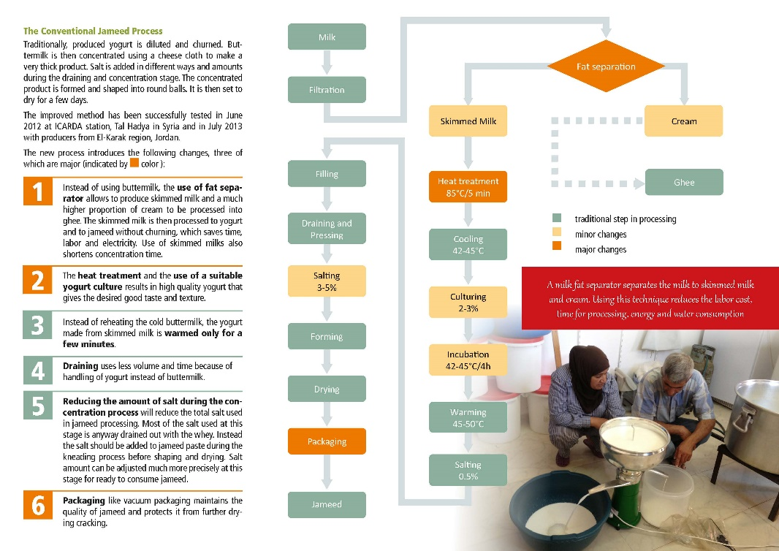
Out scaling

Slide 14
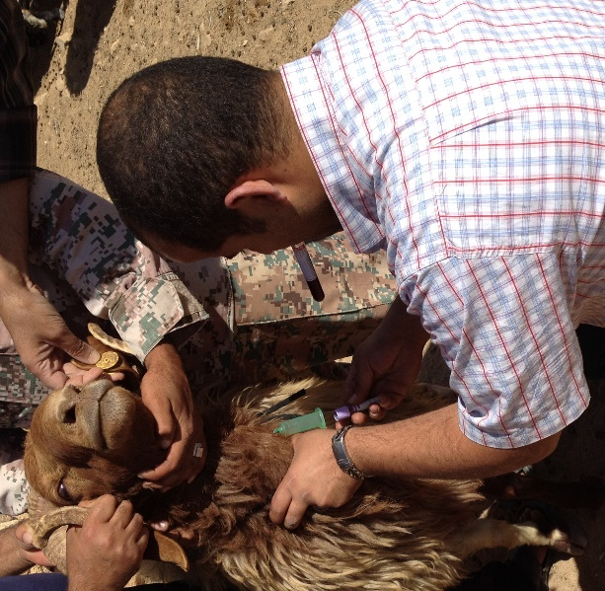
Sheep nutrient deficiency
Goal:
  To investigate nutritional deficiencies of sheep and goat
  To implement supplementation strategies
  To enhance the feeding balance of the flocks
Methodology
  Samples will be collected every 3 months from the same locations and farmers
  Serum and plasma were collected and stored at -20°C (260 samples)
    Minerals; Se, K, Na, etc.
    Blood metabolites
  Wool samples were collected and analyzed for minerals (100 samples).
  Soil, water, rangeland and feed samples were collected (100 different samples)
Notes:
Goal:
To enhance breeding values of the ram and conception rate of the ewes
To investigate nutritional deficiencies of sheep and goat such as Vit E-Se, minerals (Cu, Zn), blood chemistry (Protein, energy and fat) and etc.
Methodology
Serum and plasma were collected and stored at -20C°
Minerals and Vit E-Se will be measured using atomic absorption spectrophotometer
Blood metabolites
Soil, water, rangeland and feed samples were collected and will be analyzed for mineral, nutrient value
Wool samples were collected and analyzed for minerals.
Frequent samples every 3 months will be collected
Future recommendations
Enhance animal productivity through substitution of deficit ingredient during different physiological status of the animal
reduce the phenomena of eating their wool or foreign material by substitution of deficit minerals
Identify source of each ingredient

Slide 15
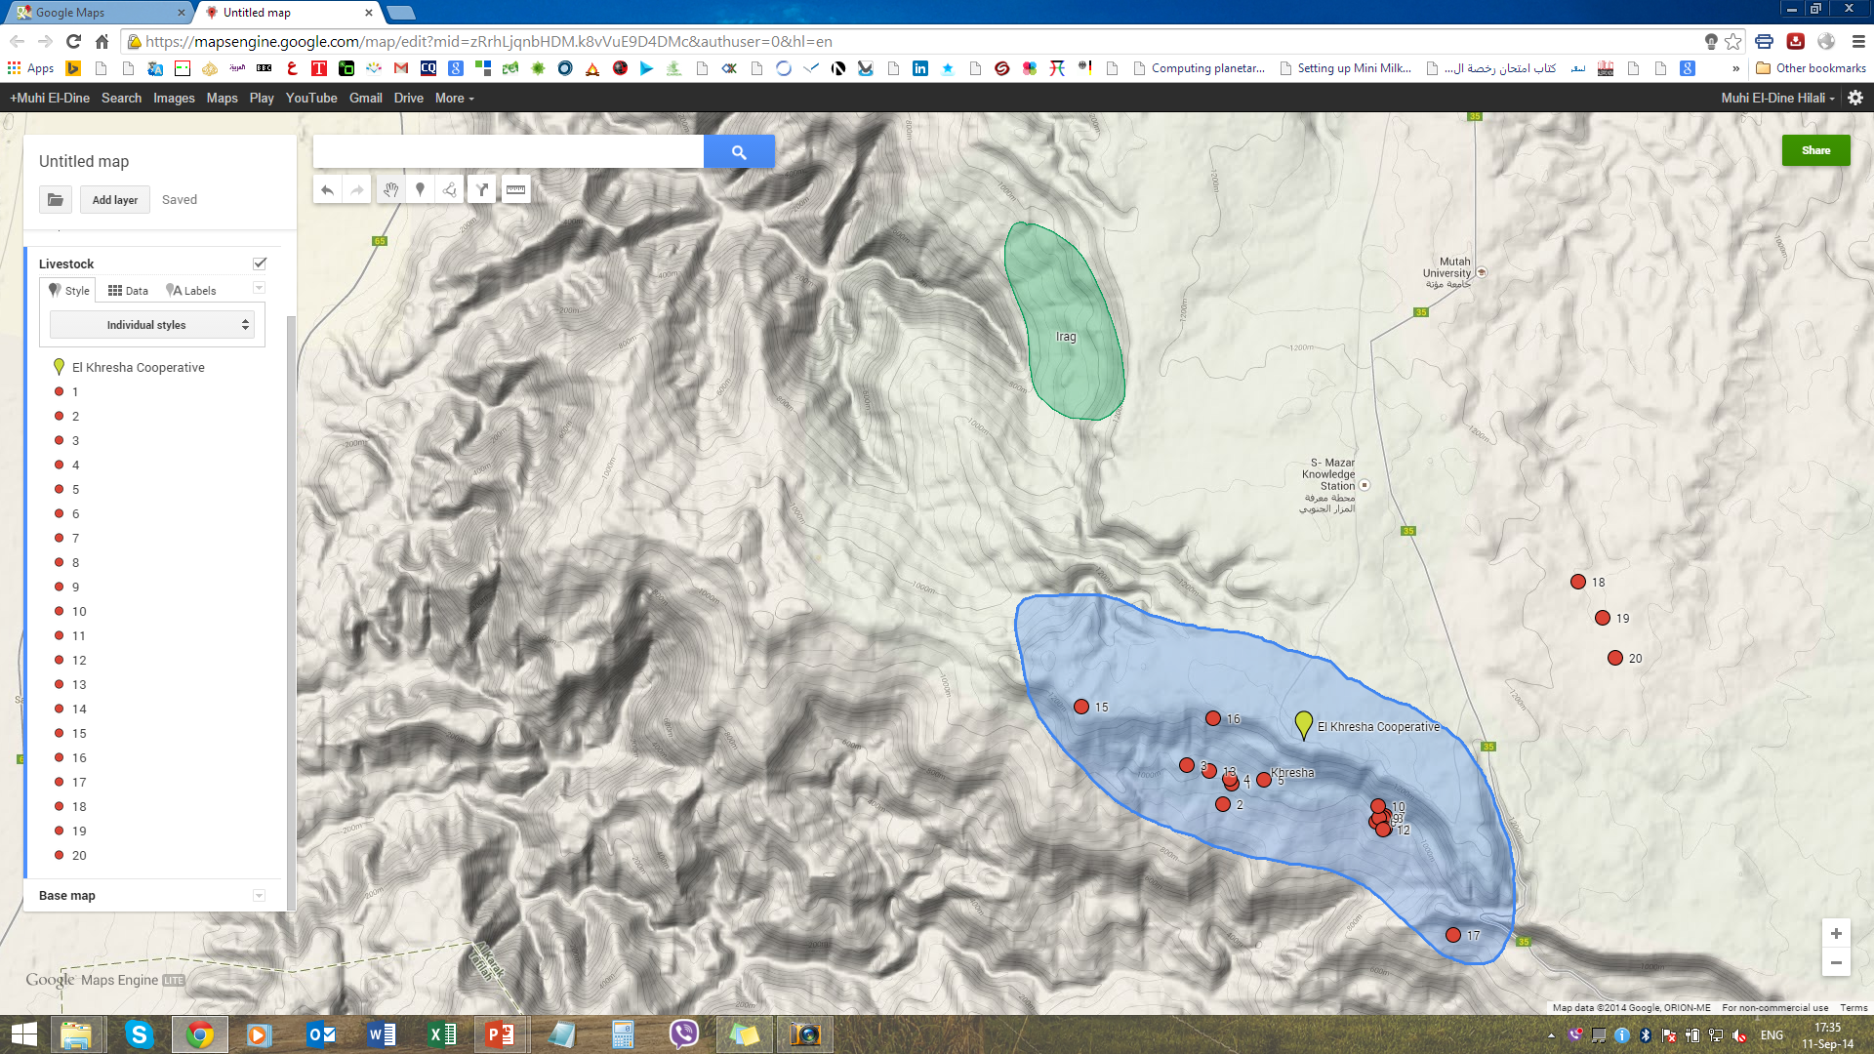
Sheep nutrient deficiency
Area covered by the sampling 53km²
Sheep population 40,000
Notes:
Goal:
To enhance breeding values of the ram and conception rate of the ewes
To investigate nutritional deficiencies of sheep and goat such as Vit E-Se, minerals (Cu, Zn), blood chemistry (Protein, energy and fat) and etc.
Methodology
Serum and plasma were collected and stored at -20C°
Minerals and Vit E-Se will be measured using atomic absorption spectrophotometer
Blood metabolites
Soil, water, rangeland and feed samples were collected and will be analyzed for mineral, nutrient value
Wool samples were collected and analyzed for minerals.
Frequent samples every 3 months will be collected
Future recommendations
Enhance animal productivity through substitution of deficit ingredient during different physiological status of the animal
reduce the phenomena of eating their wool or foreign material by substitution of deficit minerals
Identify source of each ingredient

Slide 16
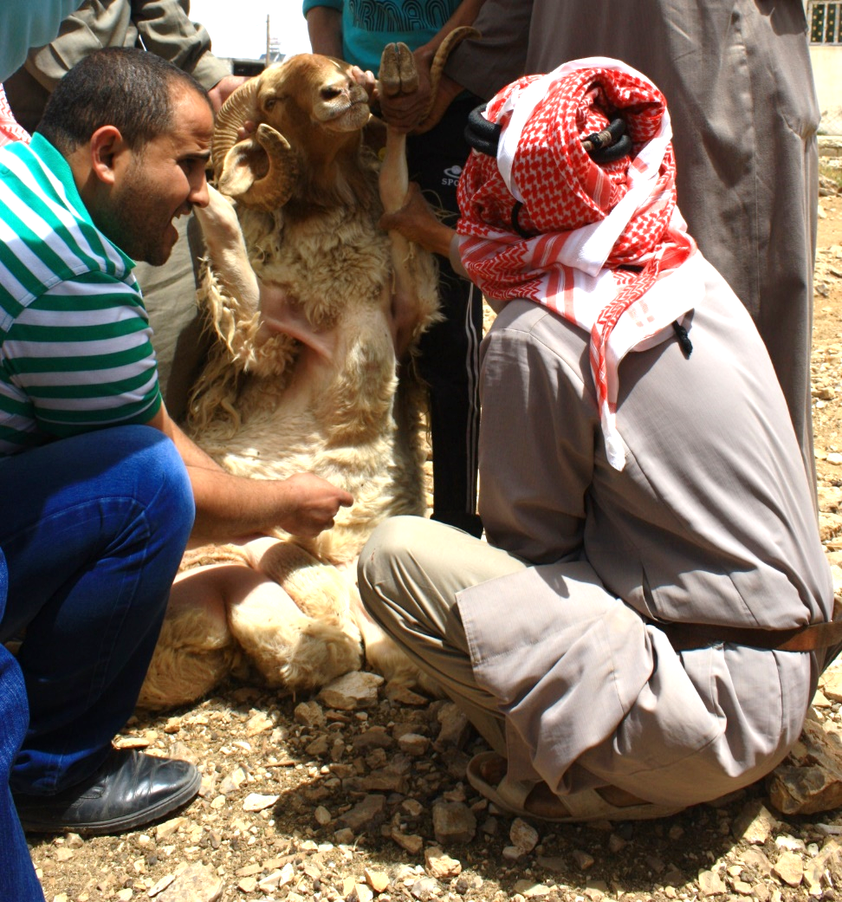
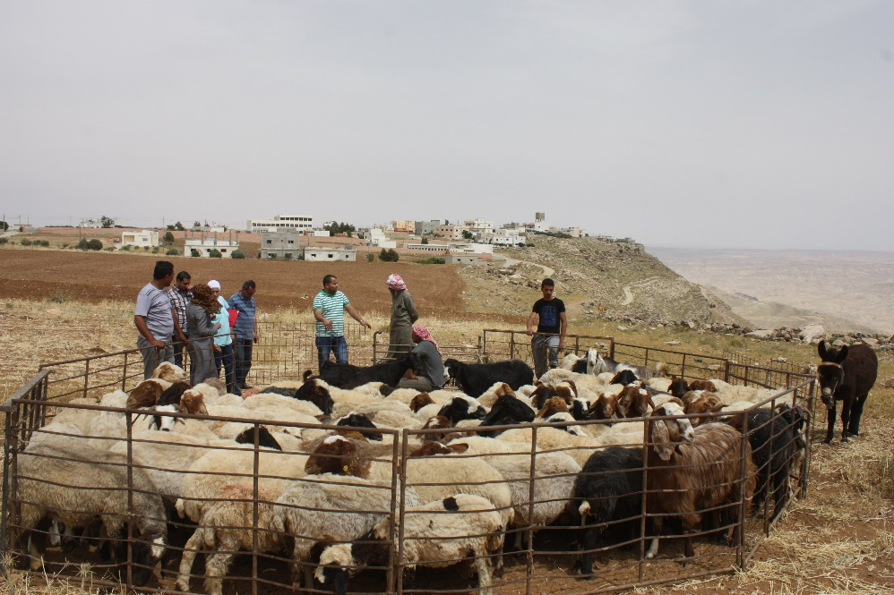
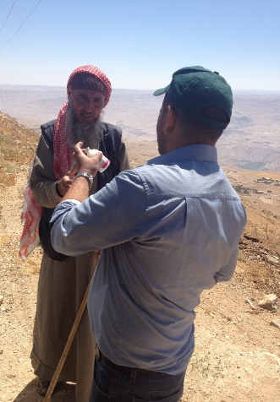
Breeding soundness examination
Improving flocks’ fertility

Slide 17
Increase of scrotal circumference with age in the examined population

Slide 18
Improving flocks’ fertility in Jordan field sites (≈ 40,000 sheep)
Over 35% of the examined rams have a likely background of being inbred
Over 85% of the rams have a body condition score under the recommended level prior to mating

Slide 19
Epidemiological survey in the action site
(Al-khraisha and Eraq)
Most common losses in small ruminants flocks are due to:
  Late Abortion
  Neonatal deaths and diarrhea
  Circling syndrome and parasite infestation

Slide 20
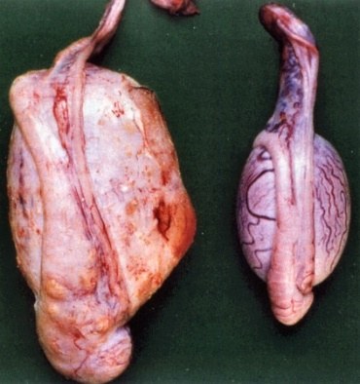
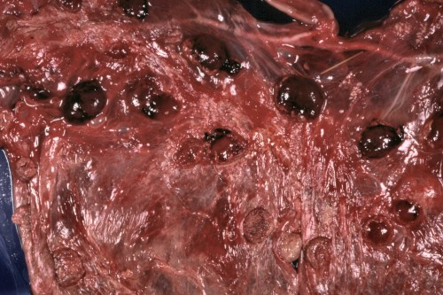
Overview of most common causes of infectious sporadic abortion globally
Disease | Causes | Vaccine Availability
Brucellosis | Bacteria | Available
Toxoplasmosis | Protozoa | !
Chlamydiosis | Bacteria | !
Campylobacteriosis | Bacteria | !
Q Fever | Bacteria | !

Slide 21
Sero-Prevalence of Chlamydophila abortus and Q. fever
Goal:
  To investigate the prevalence and risk factor associated with above mentioned diseases
  To study the requirement of the area to introduce a suitable vaccine
  To investigate the role of male in transmission of the disease
Methodology
  154 Serum sample were collected from 20 farm located in Khraisha area as presented in the map (5 ewes & 3 rams)
  Questionnaire were filled out individually consider the abortion history, percentage, age , repeated abortion, abnormality of the testicle and etc.
  Sample will be analyzed using ELISA technique
  risk factor associated with the infection will be determined
Notes:
Future Recommendation
Complete information about risk factor will be used to reduce transmission of the diseases
Introduction of the vaccine to the area or not establish economical introduction of vaccine in relation to risk factors

Slide 22
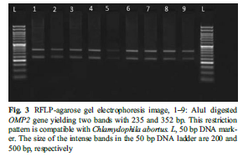
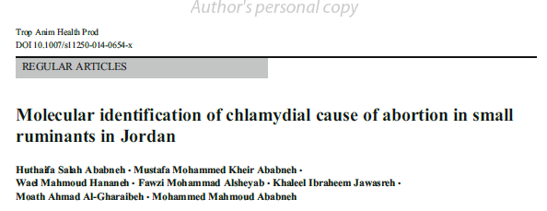
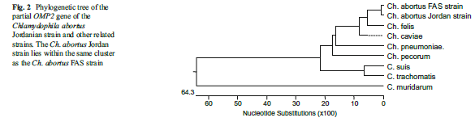
Molecular identification of the chlamydial cause of abortion: 1st step towards implementing a control program

Slide 23
Vaccine efficiency for commercially available vaccine against Ch. abortus
Goal:
  To measure Antibody titer post vaccination (PV) with available killed vaccine
  To study interval between vaccination doses
Methodology:
  This study will be conducted in Khanasry station.
  Lambs at 8 month of age will be vaccinated “twice 14 days apart” and serum sample will be collected before and after vaccination until 1 year PV
  ELISA will be used to measure antibody titer
Notes:
Future recommendation:
According to the results; vaccine can be advised to be used in khraisha or karak villages, poster dose is required or not

Slide 24
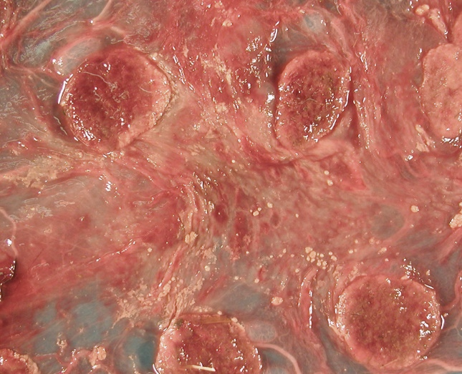
Molecular identification of Q. fever and Comylobacteriosis
Goal:
  To identify the strain responsible for the disease in Jordan
  To investigate the homology of our strain compared with gene bank strain
Methodology
  Placental, vaginal swab and fetal
  samples will be collected from aborted animal
  PCR analysis will be performed
  DNA sequencing will be performed
Notes:
Future recommendation
To show whether imported vaccine can protect our ewes and does against above mentioned diseases

Slide 25
Investigations of neonatal death and application of vaccine to pregnant ewes
Goal:
  Identify the cause of diarrhea in young animals less than 10 days of age
Methodology:
  Fecal and intestinal samples will be collected from sick animals
  E. coli, Rota and corona virus will be identified using PCR/RT-PCR technique
Notes:
Future recommendation:
Use of vaccine for above mentioned diseases to pregnant ewes to protect new animals from getting the disease

Slide 26
Pregnancy diagnosis
Goal:
  To calculate pregnancy and conception rate
  To diagnose ovarian and uterine abnormalities
  To diagnose pseudo-pregnancy
Methodology:
  Trans-abdominal scanning will be done for sheep and goat having reproductive abnormalities and representative samples to estimate pregnancy rate
Future Recommendation
  Each case will be treated according to its situation

Slide 27

Capacity building
Farmers
  Evaluation and selection of future rams
  Care of ewes during conception periods
  Common mistakes performed by small ruminants farmers
  Care of newly lambs

Slide 28
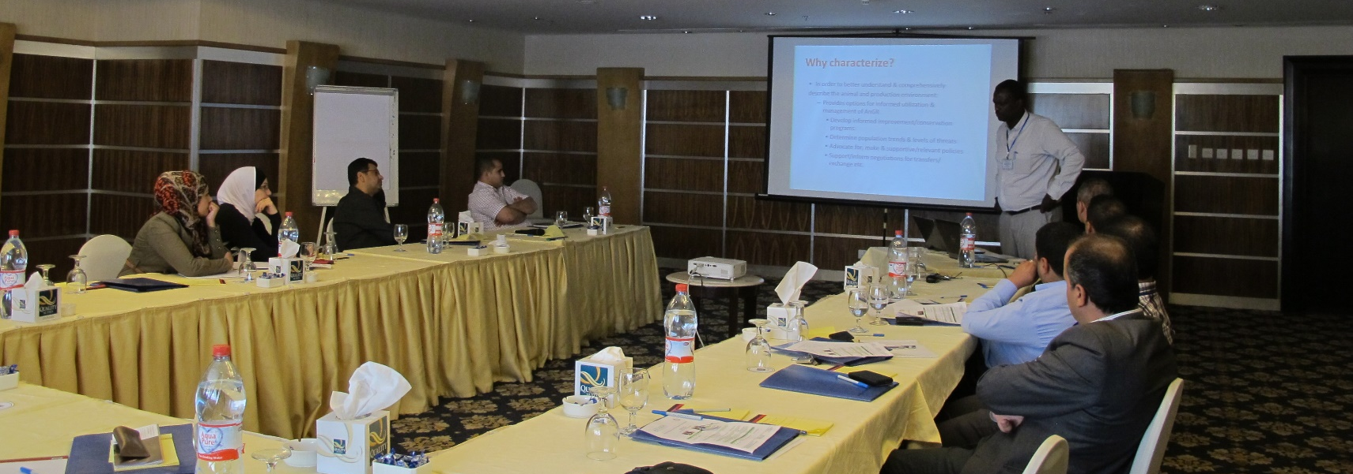
Capacity building
Specialists
Sheep breeding: data recording, management and valorization

Slide 29
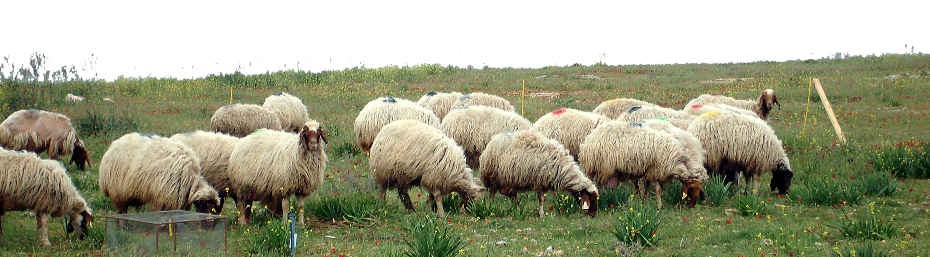
Thank you
Notes:
Future marketability of the products will be dictated by better quality

