Slide 1

Dryland Systems Program
Science and Implementation meeting
Amman, Jordan
June 29- July 4, 2014
Paul Vlek et al.
The global research partnership to improve agricultural productivity and income in the world's dry areas

Slide 2

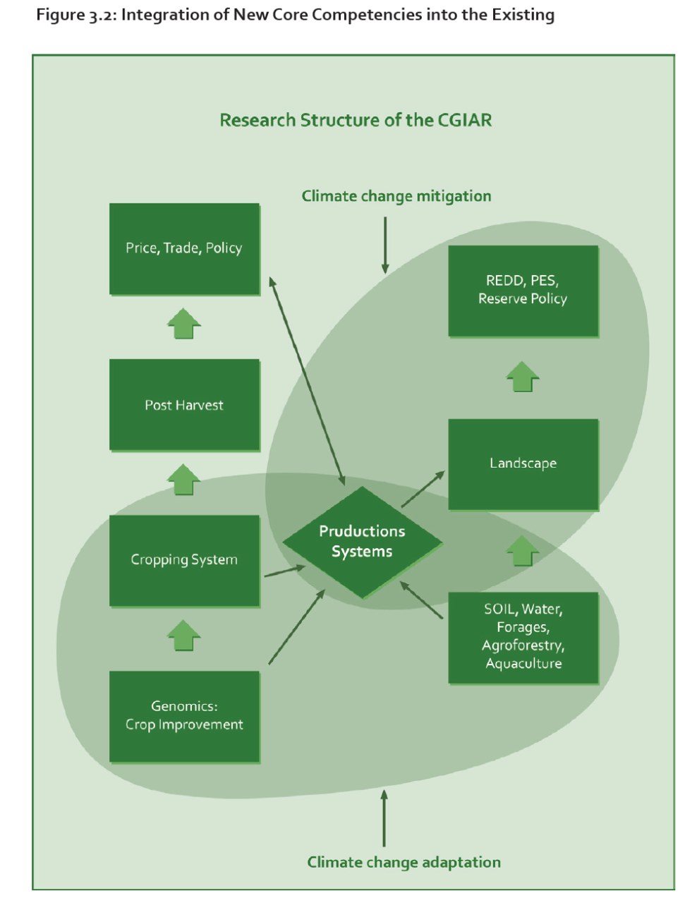
Title
Strategic and Results Framework (SRF)
The SRF (CGIAR 2011) advocates new areas of core competency to achieve impact in four SLOs
One is development of core competency in the area of “production systems”
This will test the ability of the system to undertake inter-center research
Systems research will integrate commodity, natural resource management and policy research to improve productivity and livelihoods in a sustainable manner at the national and regional level
SRF to be rewritten by Consortium Office Working Group, of which ICARDA is a member

Slide 3
Title
CGIAR System Level Outcomes
  • Reduced rural poverty;
  • Improved food security;
  • Better nutrition and health; and
  • Sustainable management of natural resources.
CGIAR Research Program on Dryland Agricultural Production Systems – Launch Meeting, Amman 21-23 May 2013

Slide 4
ON: Systems Program Development
Overall objectives: Sustainably improve wellbeing of dryland farming communities
Where are those communities: 5 corners of the world
What is the problem: Very diverse. System failure... Still looking for common ground
What is the approach to solve the problem: TOC with phases – SRTs
Who is involved: partnership
The global research partnership to improve agricultural productivity and income in the world's dry areas

Slide 5
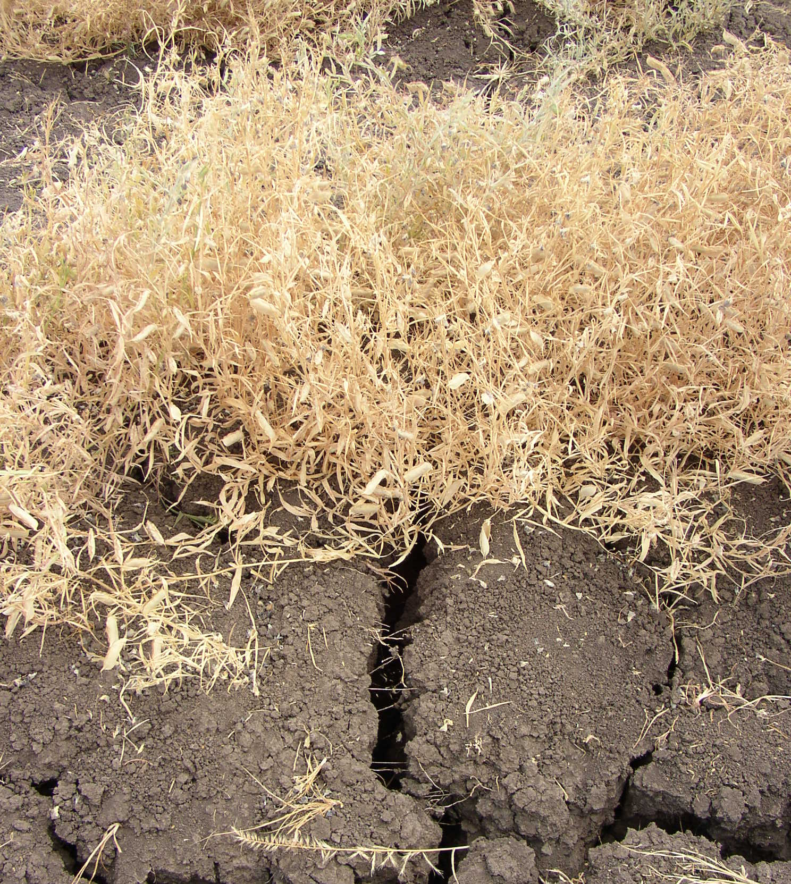
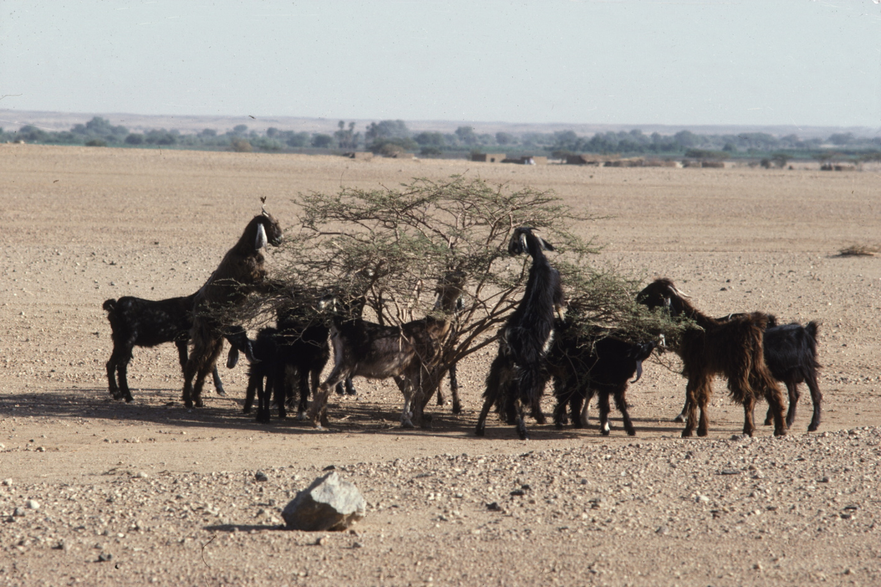
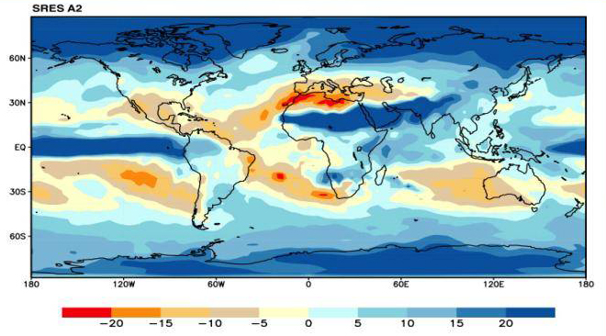
The Dry Areas = Fragile Eco-systems
Physical water scarcity
Rapid natural resource degradation and desertification
Groundwater depletion
Drought
Climate change will make it drier
-10
m
Decrease of the Souss aquifer level in Morocco
-20
-30
-40
-50
-60
-70
-80
1982
1985
1988
1991
1994
1997
2000
2003
2006
Or more eratic
Notes:
5
5

Slide 6
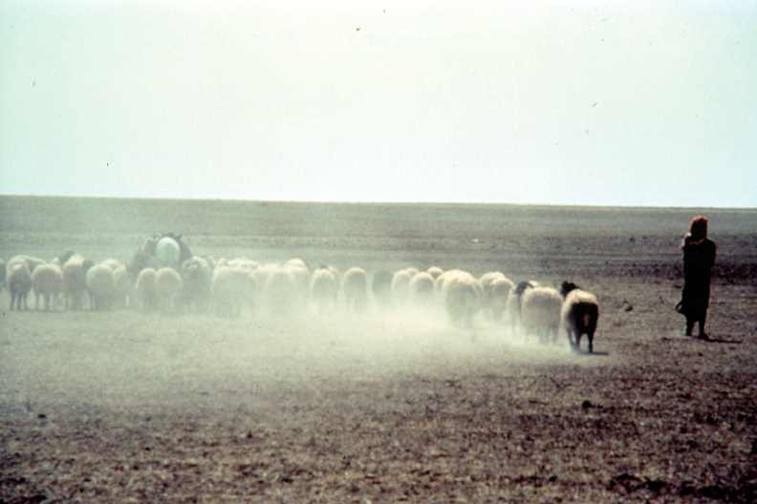
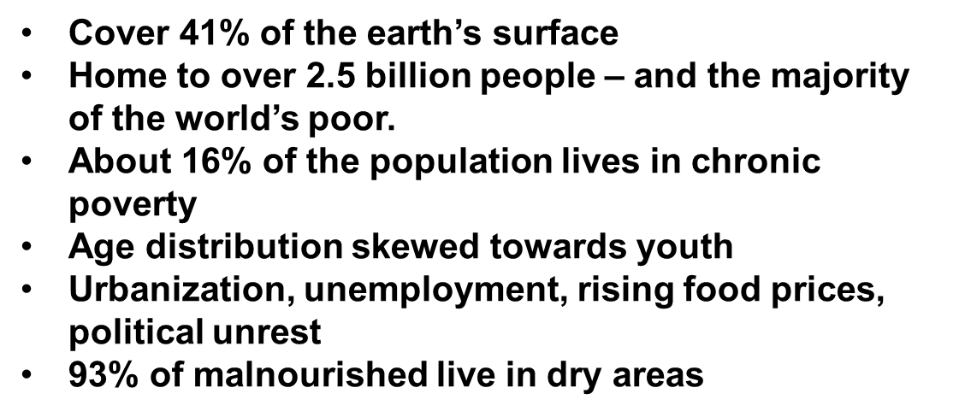
Title
Prominant Features of Drylands
Also disempowered women
CGIAR Research Program on Dryland Agricultural Production Systems – Launch Meeting, Amman 21-23 May 2013

Slide 7
Title
Drylands Systems
Dryland Systems targets the poor and highly vulnerable populations of dry areas in developing countries and the agricultural systems on which they depend
CGIAR Research Program on Dryland Agricultural Production Systems – Launch Meeting, Amman 21-23 May 2013
Notes:
The interpretation of agric. systems was
seen as too confining → Agric livelihood systems

Slide 8
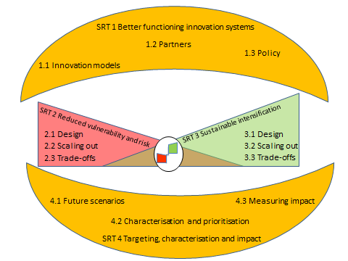
Title
Conceptual Research Framework
SRT1: Approaches and models for strengthening innovation systems, building stakeholder innovation capacity, and linking knowledge to
policy action
SRT2: Reducing vulnerability and managing risk
SRT3: Sustainable intensification for more productive, profitable and diversified dryland agriculture with well-established linkages to markets
SRT4: Measuring impacts and cross-regional synthesis
CGIAR Research Program on Dryland Agricultural Production Systems – Launch Meeting, Amman 21-23 May 2013

Slide 9
Strategic Research Theme | Output
Approaches and models for strengthening innovation systems, building stakeholder innovation capacity, and linking knowledge to policy action | Approaches and models for strengthening innovation systems, building stakeholder innovation capacity, and linking knowledge to policy action
 | Enhanced capacity for innovation and effective participation in collaborative “IAR4D” processes
 | Strategies for effectively linking research to policy action in a dryland context.
Reducing vulnerability and managing risk through increased resilience | Combinations of institutional, biophysical and management options for reducing vulnerability designed and developed
 | Options for reducing vulnerability and mitigating risk scaled-up and -out within regions
 | Trade-offs amongst options for reducing vulnerability and mitigating risk analyzed (within regions). Knowledge-based systems developed for customizing options to sites and circumstances
Sustainable intensification for more productive, profitable and diversified dryland agriculture with well-established linkages to markets | Sustainable intensification options designed and developed
 | Sustainable intensification options out-scaled
 | Trade-offs amongst sustainable intensification and diversification options analyzed and knowledge-based systems developed for customizing options to sites and circumstances
Measuring impacts and cross-regional synthesis | Future scenarios and priority setting
 | Livelihood and ecosystem characterization. Across-region synthesis of lessons learnt from SRTs 2 and 3
 | Program impacts measured.

Slide 10
Characterization of Target Areas and Action Sites
Criteria for Target Area Selection
Criteria | Limits for SRT 2 | Limits for SRT 3
Length of growing period | <90 days | 90-180 days
Distribution of poverty
Hunger and malnutrition (food security, no of people, % of people)
Aridity Index | 0.03 to 0.35 | 0.35-0.65
Environmental risk (Rainfall variability, access to irrigation, | CV>15% | CV<15%
Land degradation(soil salinity, soil erosion) | High | Low-medium
Market access | Travel time >2 hrs | Travel time <2 hrs
Population density

Slide 11
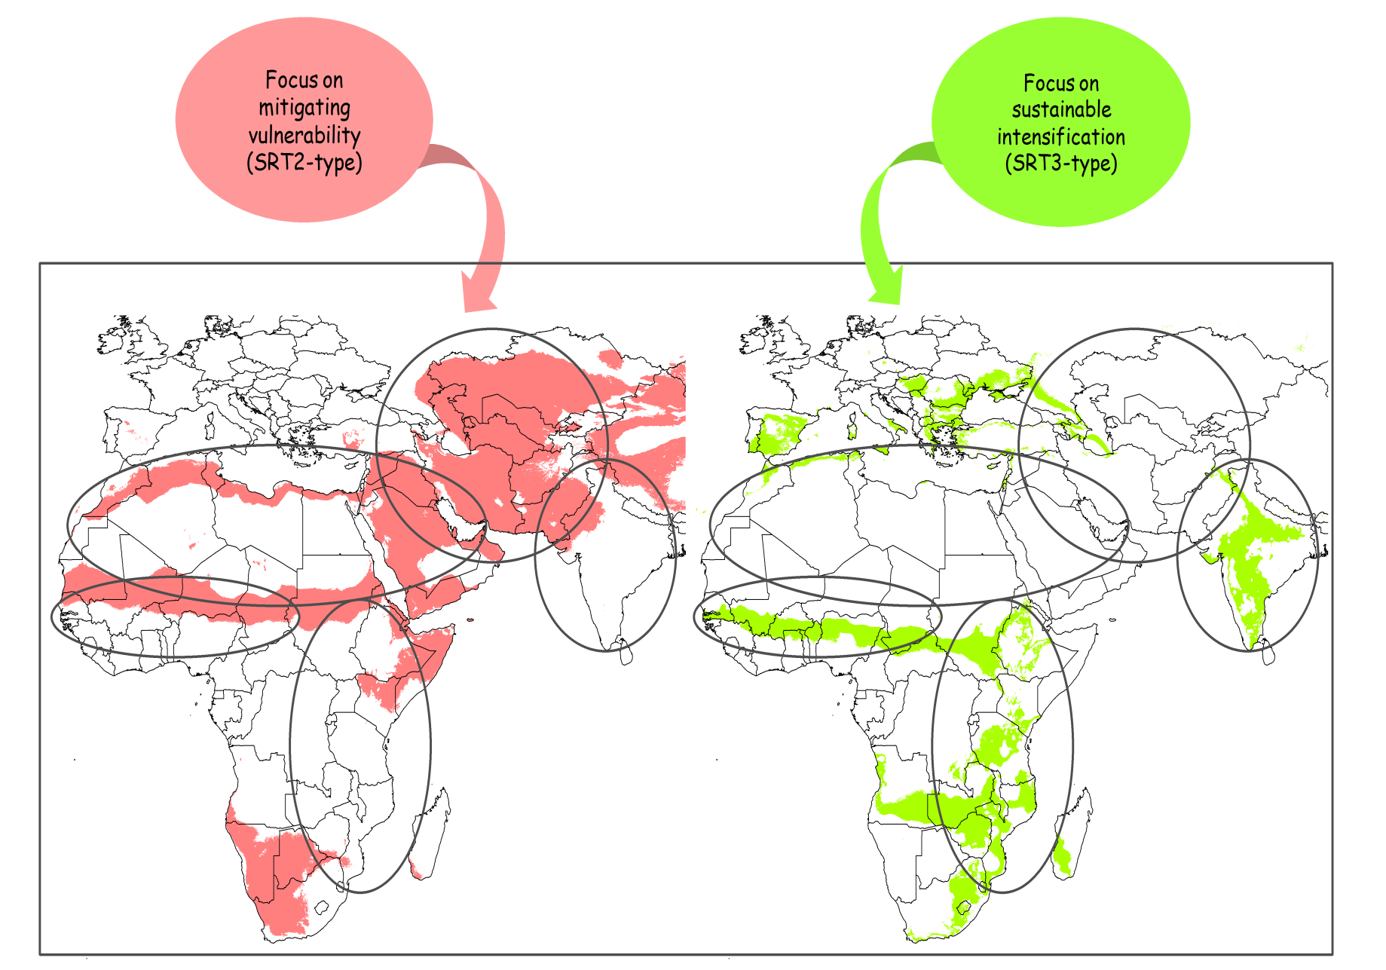
Dryland Systems focuses on two broad categories of agro-ecosystems
SRT2: Reduced vulnerability and increased resilience to shocks
SRT3: Sustainable intensification to reduce food security and generate income
Notes:
yellow = tropical drylands
pale and dark brown = non-tropical drylands with winter and summer rainfall respectively
The dry areas of the developing world occupy about 3 billion hectares (41% of the earth’s surface) and are home to some 2.5 billion people (more than one-third of the world population) – and the majority of the world’s poor.
In these areas, agriculture and pastoralism remain the main source of rural livelihoods. They are highly vulnerable, fragile ecosystems: and economic activities are constrained by persistent water scarcity, climatic variability and frequent droughts, rapid natural resource degradation and desertification and groundwater depletion
They are furthered threatened by climate change (decline in annual precipitation and increase in mean temperatures).
Dry lands, and particularly the most marginal lands (mountains, rangelands, and marginal arable areas), have suffered from underinvestment in research and development and supporting infrastructure
To ensure the future livelihoods of dryland farming communities, it is critical to
(1) manage risk more effectively in the most vulnerable systems, by building ecosystem resilience, and
(2) enhance production growth in higher potential areas through both the diversification and the sustainable intensification of production systems.
Thus, the complexity of challenges facing the dry areas requires an integrated agro-ecosystems approach to research for development. CRP1.1 will not be involved in basic research on single components of crop improvement and genetics, and other fields, but will take an integrated systems approach.

Slide 12
Criteria for selection of Action and Satellite Sites
Characteristics of potential action sites in Target Areas
Target Area | Potential Action Site 1 | Potential Satellite Site 1 | Potential Satellite Site 2
Country
Geographical location
Accessibility
Potential for hypothesis testing
Representativeness
Potential for out- scaling (impact)
Potential to attract funds
Potential to interact with CRPs

Slide 13
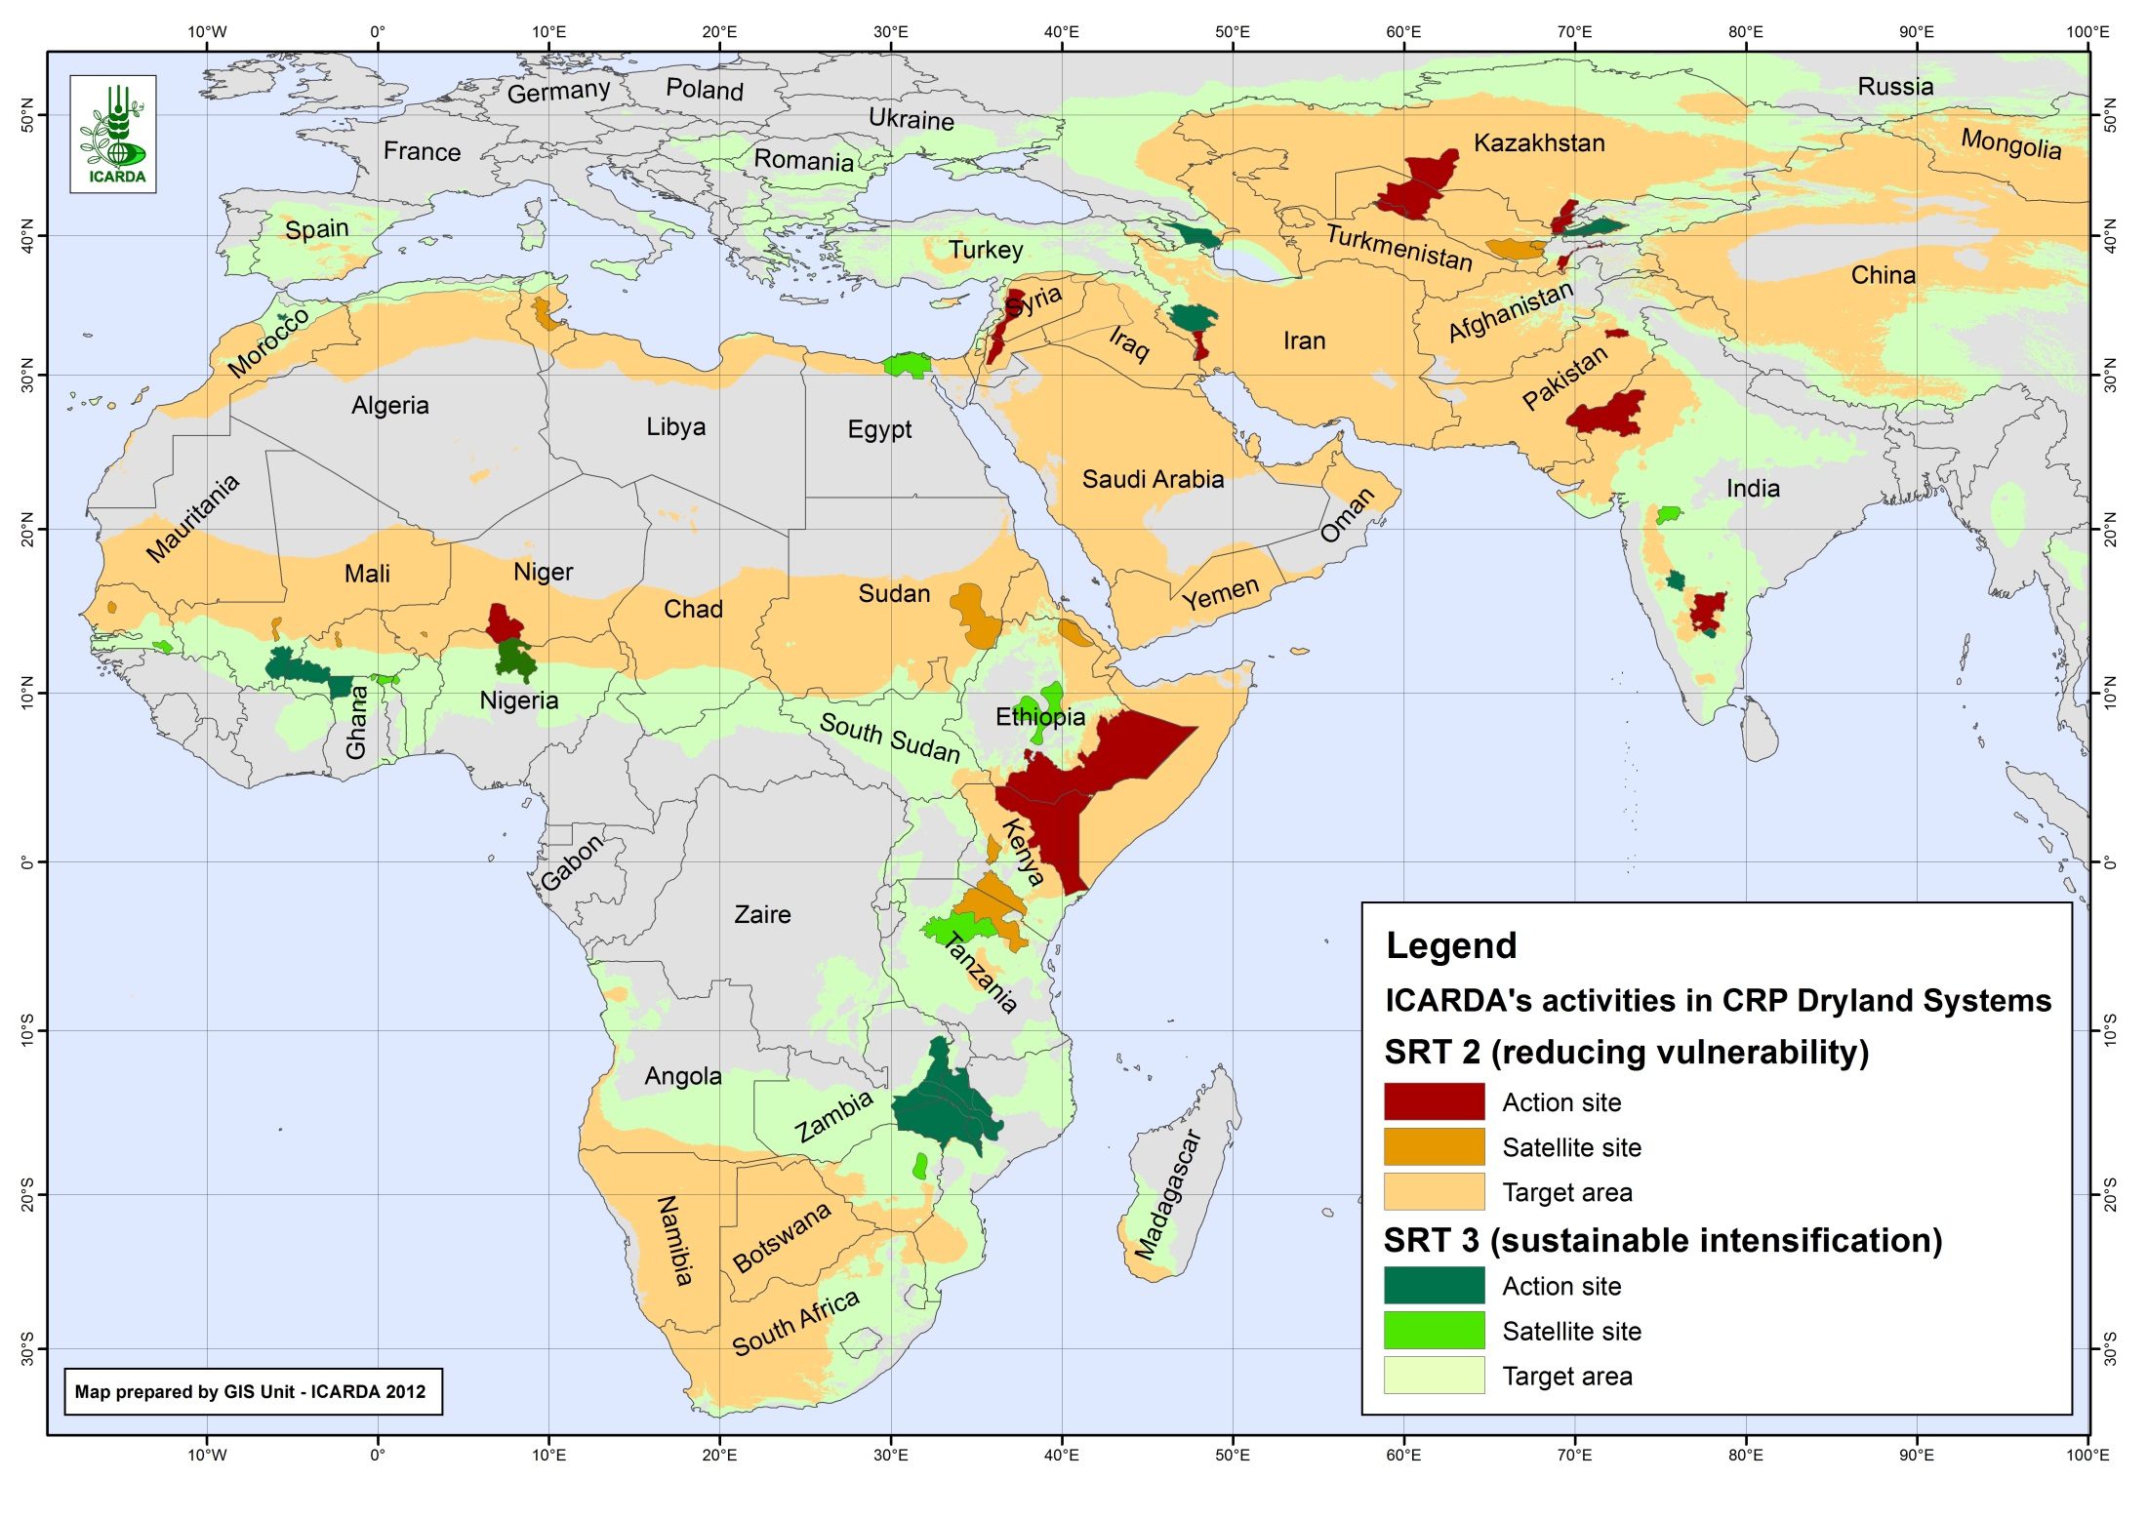
Notes:
Some problems with map—political sensibilities

Slide 14
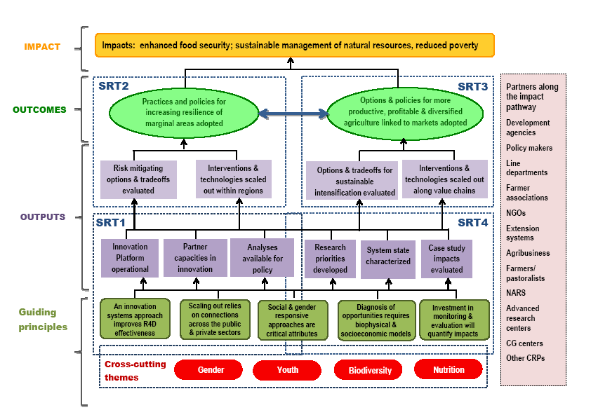

Slide 15
Title
Cross-Cutting Themes
    Gender
    Youth
    Biodiversity
    Nutrition
    Capacity building
CGIAR Research Program on Dryland Agricultural Production Systems – Launch Meeting, Amman 21-23 May 2013

Slide 16
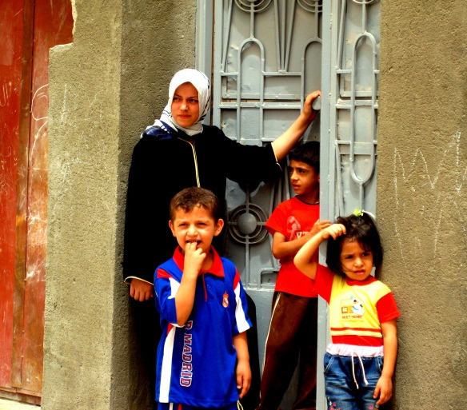
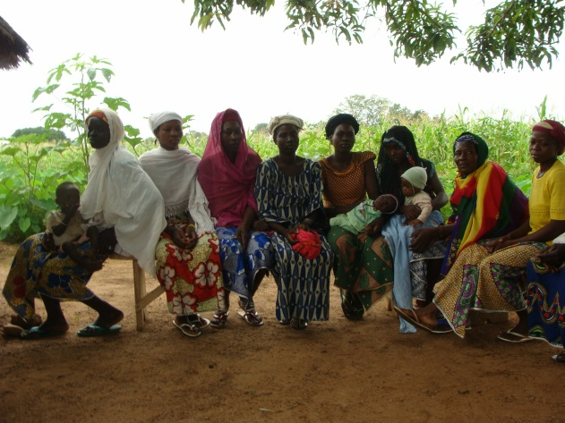
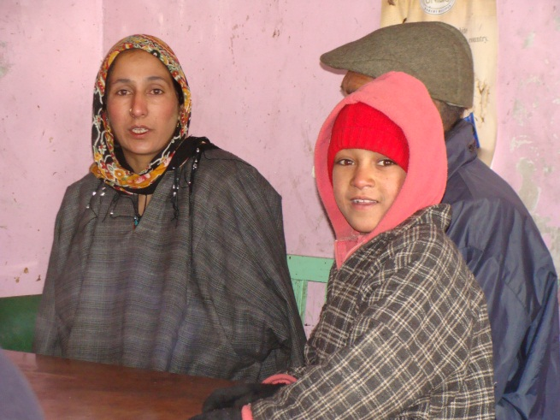
Gender Matters in Agroecosystems
No development if views and needs of women are not addressed
Land tenure
Natural resource access (trees, fields)
Food preparation and processing
Household nutrition
Varietal assessment
Use of disposable income
Landed and Landless labor
Culture- and agroecosystem-dependent

Slide 17
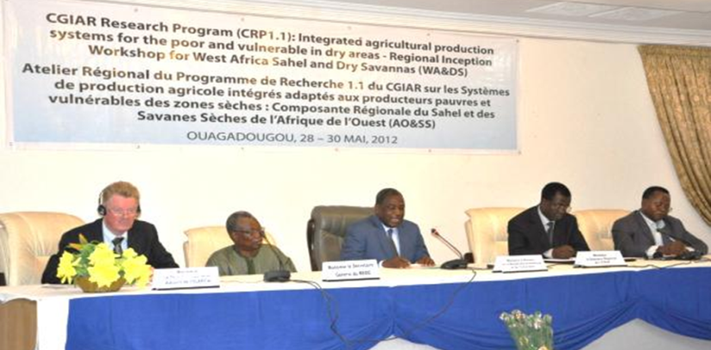
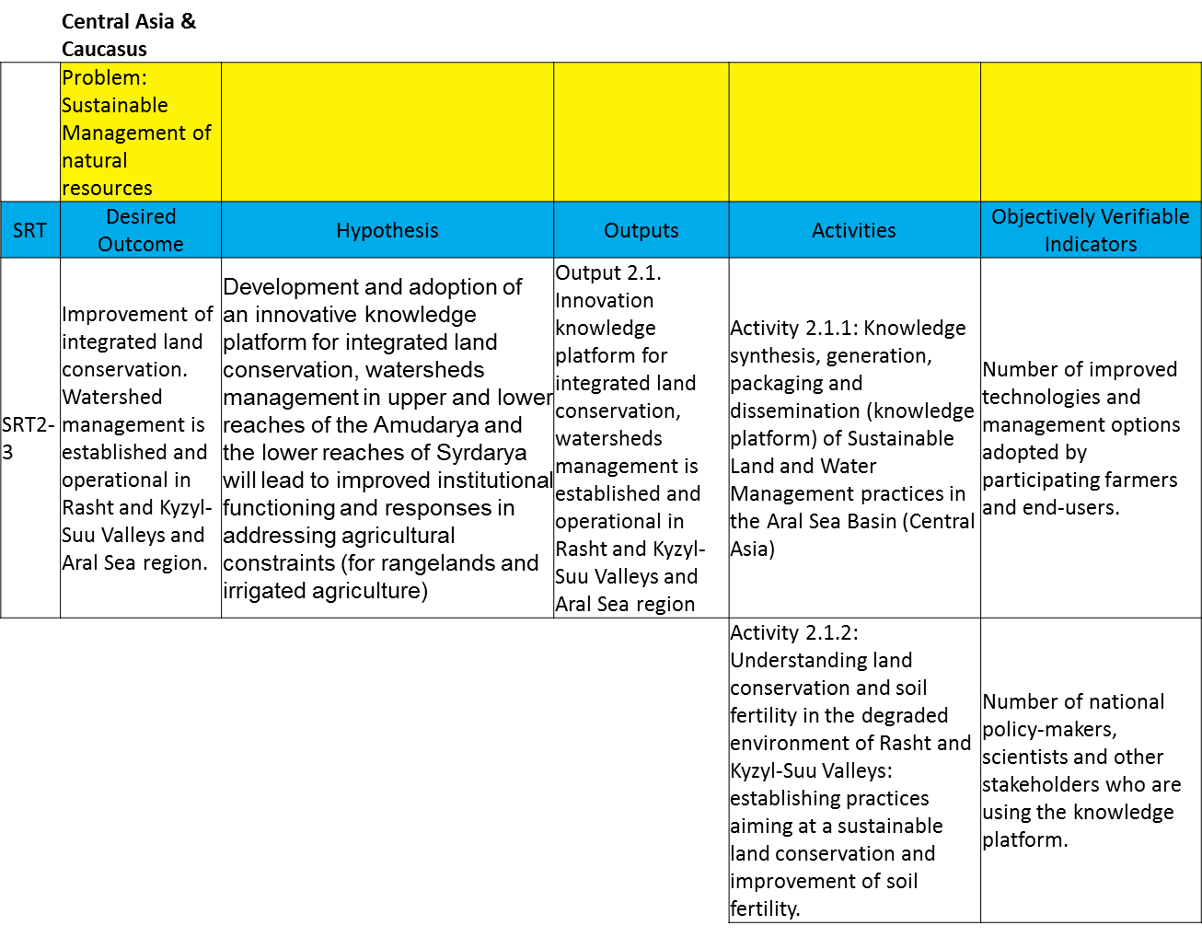
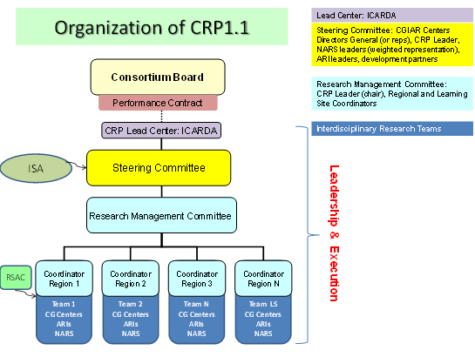
Partnership in Dryland Systems
Part of conceptual framework and one of four Strategic Research Themes
Critical to outscaling and therefore impact
Partners set research priorities and identified “Action Sites”
Partners are explicit part of governance

Slide 18
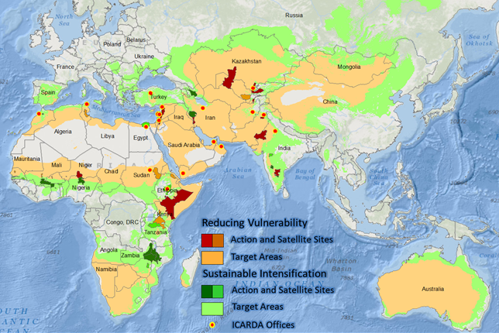
Title
Inception Phase
Groundwork for baseline characterization
Workshops to set Research Priorities
Common Ground
1) 21 Constraints
2) 20 Outputs
3) 16 Hypotheses
4) 20 Outcomes
CGIAR Research Program on Dryland Agricultural Production Systems – Launch Meeting, Amman 21-23 May 2013

Slide 19
Title
Intermediate Development Outcomes
CRP IDOs are meant to be:
Informed by and have buy in from key stakeholders
Integrated across CRPs to the extent possible
Fully aligned with system level IDOs (SLIDOs).
Completed by September 30, 2013 for as many CRPs as possible.
Composed of three 3-year cycles, i.e. they have ~10 year time lines

Slide 20
Intermediate Development Outcomes
(From 20 Common Outcomes!)
Title
The first 4 target direct impact on wellbeing and sustaining natural resource base:
More resilient livelihoods for vulnerable households in marginal areas.
More stable and higher per capita income for intensifiable households.
Women and children in vulnerable households have year round access to greater quantity and diversity of food sources.
More sustainable and equitable management of land and water resources in pastoral and agropastoral.
The rest relate to requirements for the first 4 to be realized:
Better functioning markets underpinning intensification of rural livelihoods.
More integrated, effective and connected service delivery institutions underpinning resilience and system intensification.
Policy reform removing constraints and creating incentives for rural households to engage in more sustainable practices that improve resilience and intensify production.

Slide 22
THEORY of CHANGE from Launch Meeting, May 2013
Key elements of the agricultural system interact to improve human welfare and management of natural resources
Title

Slide 23
Annual report version

Slide 24
Impacts from IDOs
More resilient livelihoods for vulnerable households in marginal areas.
More stable and higher per capita income for intensifiable households (those above an asset threshold that makes intensification a viable option).
Women and children in vulnerable households have year round access to greater quantity and diversity of food sources
More sustainable and equitable management of land and water resources in pastoral and agropastoral areas
Better functioning markets underpinning intensification of rural livelihoods
More integrated, effective and connected service delivery institutions underpinning resilience and system intensification
Policy reform removing constraints and incentivising rural households to engage in more sustainable practices that intensify and improve resilience and intensify production

Slide 25
Impact
More resilient livelihoods for vulnerable households in marginal areas
Indicators
Resilience index: contextualised multiscale assessment of resilience building strategies at household and community levels (see Marschke, and Berkes. 2006)
Outcome
NARES use tools, methods and processes to generate and customise improved resilience options for targeted groups of vulnerable households
Use of outputs: number and size of organisations using them and their areal and population domains; proportion of sector in targeted areas this represents
Customised options: number of options and number of hh targeted
Outputs
Improved resilience options (components, interactions and their management; explicit consideration of buffer functions, managing trade-offs between production and risk; nested scale risk mitigation, including incentives to adopt them)
Tools, methods, processes and capacity of NARES to create and customise improved resilience options to local circumstances across scaling domains

Slide 26
“Following the Impact pathway backwards”
CRP Objective / Operational level | Information needed | Performance targets
GOAL / IMPACT | Characterization of Action Sites in terms of the System Level Outcomes (SLO) | Performance Targets
 | System Level Outcomes: Reduce rural poverty: Number of poor and spatial distribution …. other indicators? Increase food security: Food Insecurity Index ….. other indicators? Improve nutrition and health: Number of undernourished children … other indicators? Ensure more sustainable management of natural resources: soil, water, agrobiodiversity, grasslands…….other indicators?
OUTCOMES | Defining Research Questions / Hypotheses, by SRT2 and SRT3 in each Target Region | Partners / Indicators
 | Examples:
 | Better integration of Fulani grazing with increased stover production from maize, sorghum, millet
OUTPUTS | Defining research deliverables, by Action site, within each SRT Target area | Partners/ Indicators
ACTIVITIES | Defining research activities, at each Action Site | Milestones

Slide 27
Montpellier meeting feedback
Observations made by IDO Working Group chair:
We needed to create new credible targets of impact for the new IDOs
We were cautioned about having too many sites (10 was seen as too many to implement at once)
Go slower and not try to be everywhere at once
We need more specifics on partnerships including their roles in impact pathway
Integration with other CRPs is not fleshed out as much as it could.

Slide 28
Regional Meeting Expectations
“Clustered” Activities in Prioritized Workplans to achieve Seven IDOs
Use of Standard Logframe Template
Specificity on:
  Sites
  Outputs
  Outcomes
  Deliverables
  Activity Leaders
  Partnerships
  Timelines
Better Impact Targets
Budget Principles

Slide 29


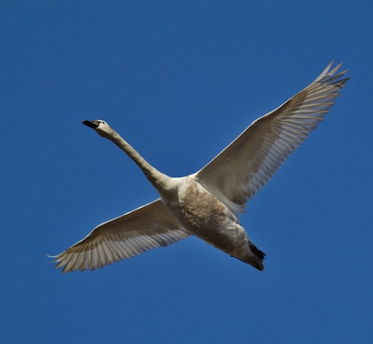


Effective Implementation of Dryland Systems CRP led by ICARDA
Overall presentation on this subject

Slide 30
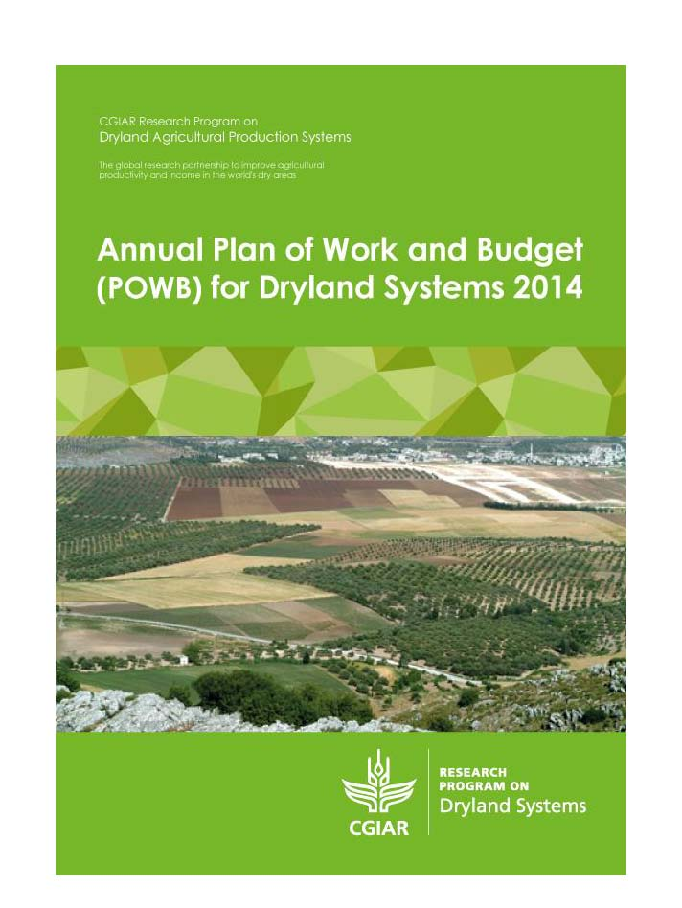
Title
Plan of Work and Budget 2014
November 2013 provision by CO of guidelines for:
    POWB2014 (December 15 – January 15, 2014)
    2013 Annual Report
POWB2014:
    Submitted on January 15
    Almost immediately rejected as it did not follow the format and did not provide all requested information. New deadline: February 22
    Submitted on February 22

Slide 31
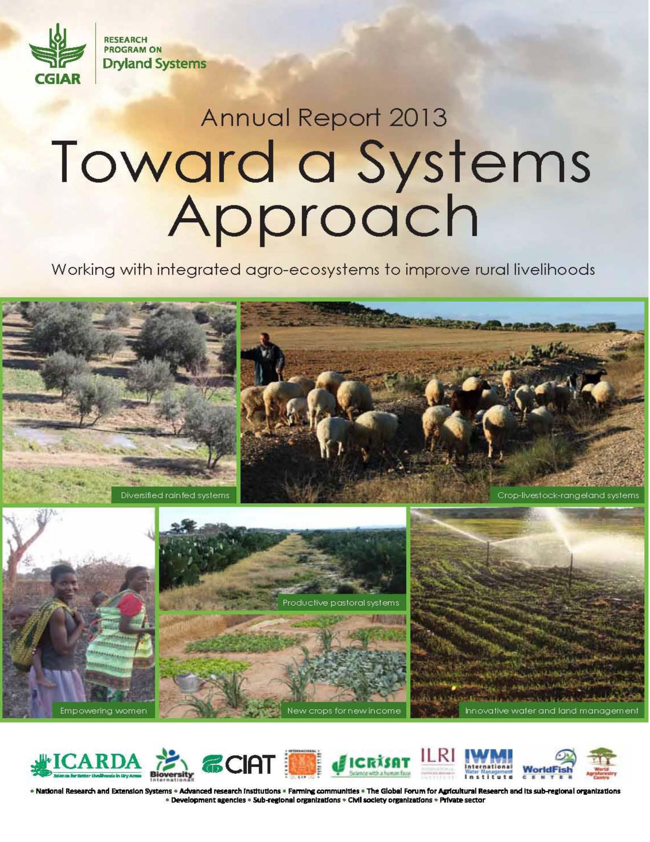
Title
2013 Annual Report
  First deadline: March 10
  Paul Vlek (ISAC): special guiding expert
  Submitted by first deadline: March 10
  Received positive, constructive feedback
  Final deadline: April 23
  Submitted by final deadline: April 23

Slide 33
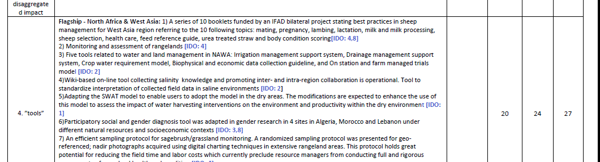

Slide 34
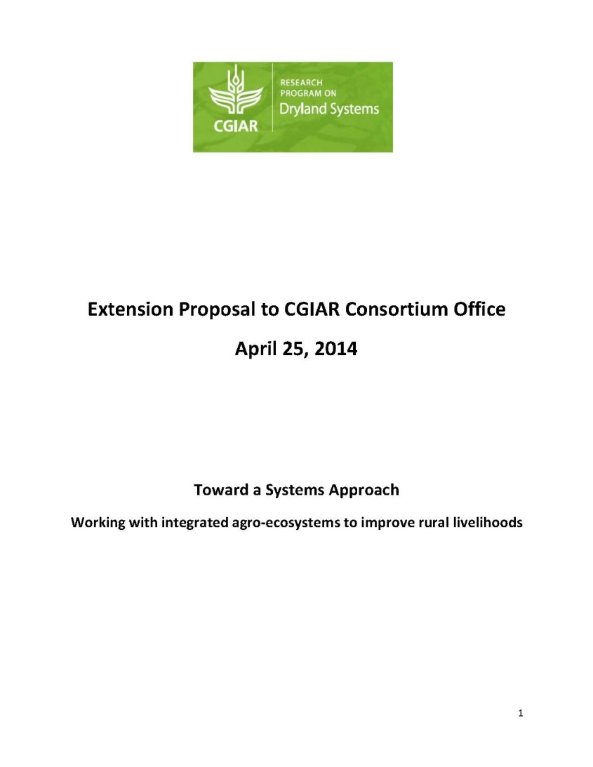
Title
Extension Proposal
Extension Proposal:
  2nd CRPs Phase starts 2017
  Gap filling till end 2016
Participatory development
  Deadline April 25
  Paul Vlek: special guiding expert
  Extension Proposal Writing Workshop:
          March 28-31 (Amman)
          Participants: 40 Dryland Systems Focal Points and Target Region Coordinators
  Submitted by final deadline: April 25

Slide 35
Title
Timeline for Extension Proposal
December 31, 2013: Final, approved templates and guidance for Extension Proposals.
April 25: CRPs submit Extension Proposals to CO.
April 30: CO shares Extension proposals, together with the 2013 Annual Reports, with FO/FC/ISPC for review.
June 30: ISPC provides reviews of Extension proposals to FO and CO;
July 14: CO combines all review and comments and shares with CRPs.
August 30: CRPs provide responses to ISPC/CO/peer review and questions.
September 15: CO prepares full package (proposal, ISPC review, CO review and funding recommendations) to CB and FC
October/November: CB and FC discuss and make decisions on Extension Proposals.
November/December: CRPs finalize proposals and contract amendments are processed.

Slide 36
Title
Flagship Target Regions and
Agricultural Livelihood Systems (ALS)
Agricultural Livelihood Systems
Pastoral systems
Agro-pastoral systems
Intensive rain-fed systems
Tree-based systems
Irrigated crop systems
Agricultural Livelihood Systems | West African Sahel & Dryland Savannas | North Africa & West Asia | East & Southern Africa | Central Asia | South Asia
Pastoral systems
Agro-pastoral systems
Intensive rain-fed systems
Tree-based systems
Irrigated crops systems
Home garden systems
Traditional Subsistence systems

Slide 40
Title
Newly-focused IDOs
(1st CRP leadership meeting)
IDO 1 RESILIENCE: More resilient livelihoods for vulnerable households in marginal areas
IDO 2 WEALTH AND WELLBEING: More sustainable and higher income and well-being of per capita for intensifiable households
IDO 3 FOOD ACCESS: Women and children in households have year-round access to greater quantity and diversity of food sources
IDO 4 NATURAL RESOURCES MANAGEMENT: More sustainable and equitable management of land, water resources, energy and biodiversity
IDO 5 GENDER EMPOWERMENT: Women and youth have better access to and control over productive assets, inputs, information, market opportunities and capture a more equitable share of increased income, food and other benefits
IDO 6 CAPACITY TO INNOVATE: Increased and sustainable capacity to innovate within and among low income and vulnerable rural community systems, allowing them to seize new opportunities and meet challenges to improve livelihoods, and bring solutions to scale.

Slide 41
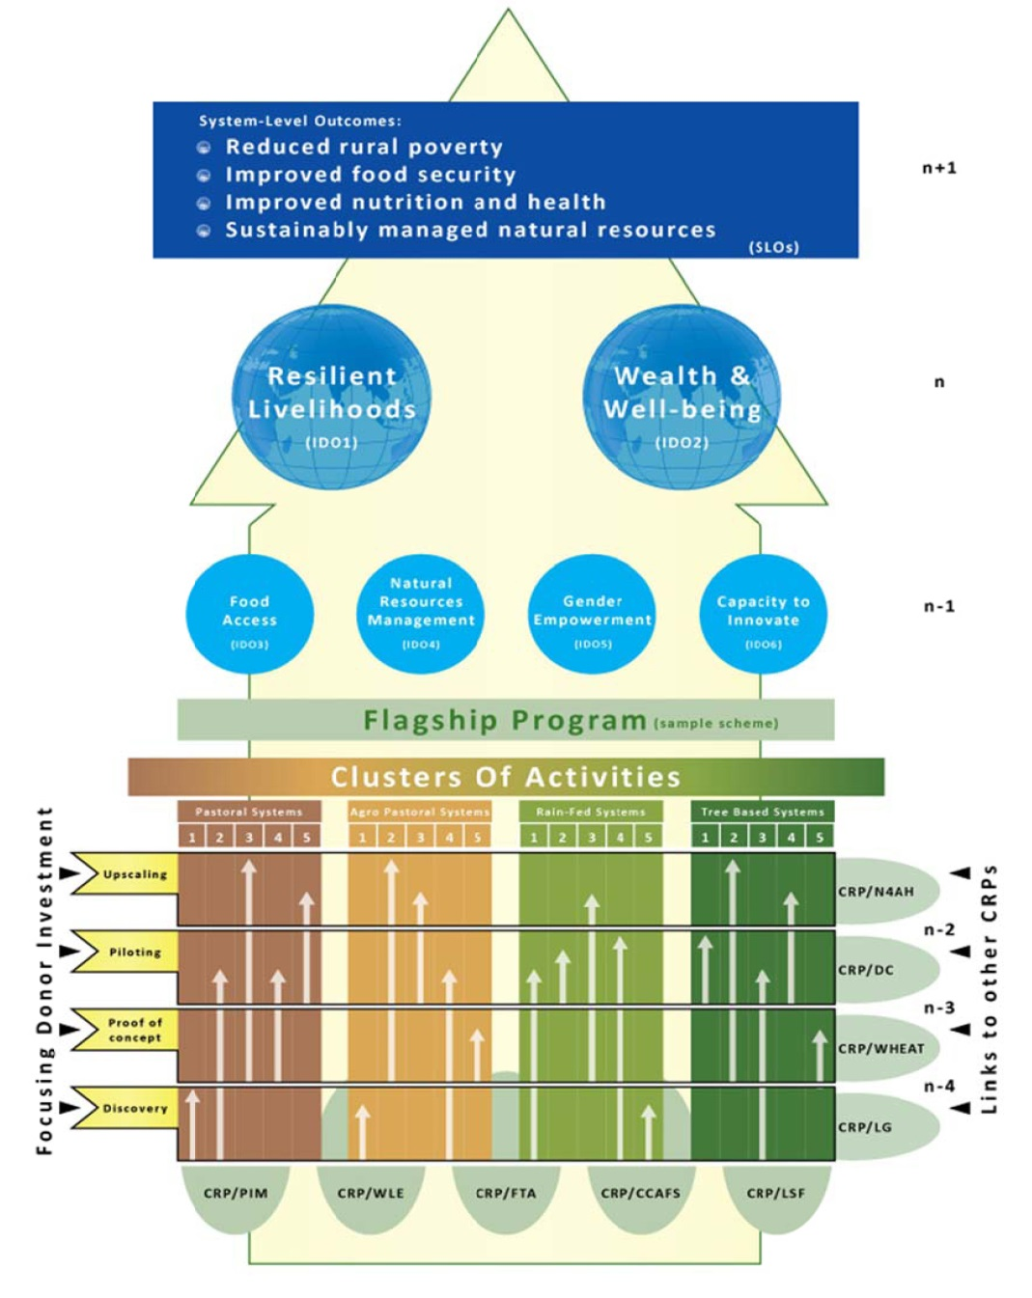
Title
Phased Activities, ALS, Flagships,
Intermediate Development Outcomes
Dryland Systems Results & Management Framework
Framework integrates Activities, Outputs and Outcomes
Follows 4-phased research pathway
Leads to 6 intermediate development outcomes (IDOs)
Delivers on 4 SLOs
Entry points at activity level with other CRPs
Donors can target investments on activities at specific phases

Slide 42
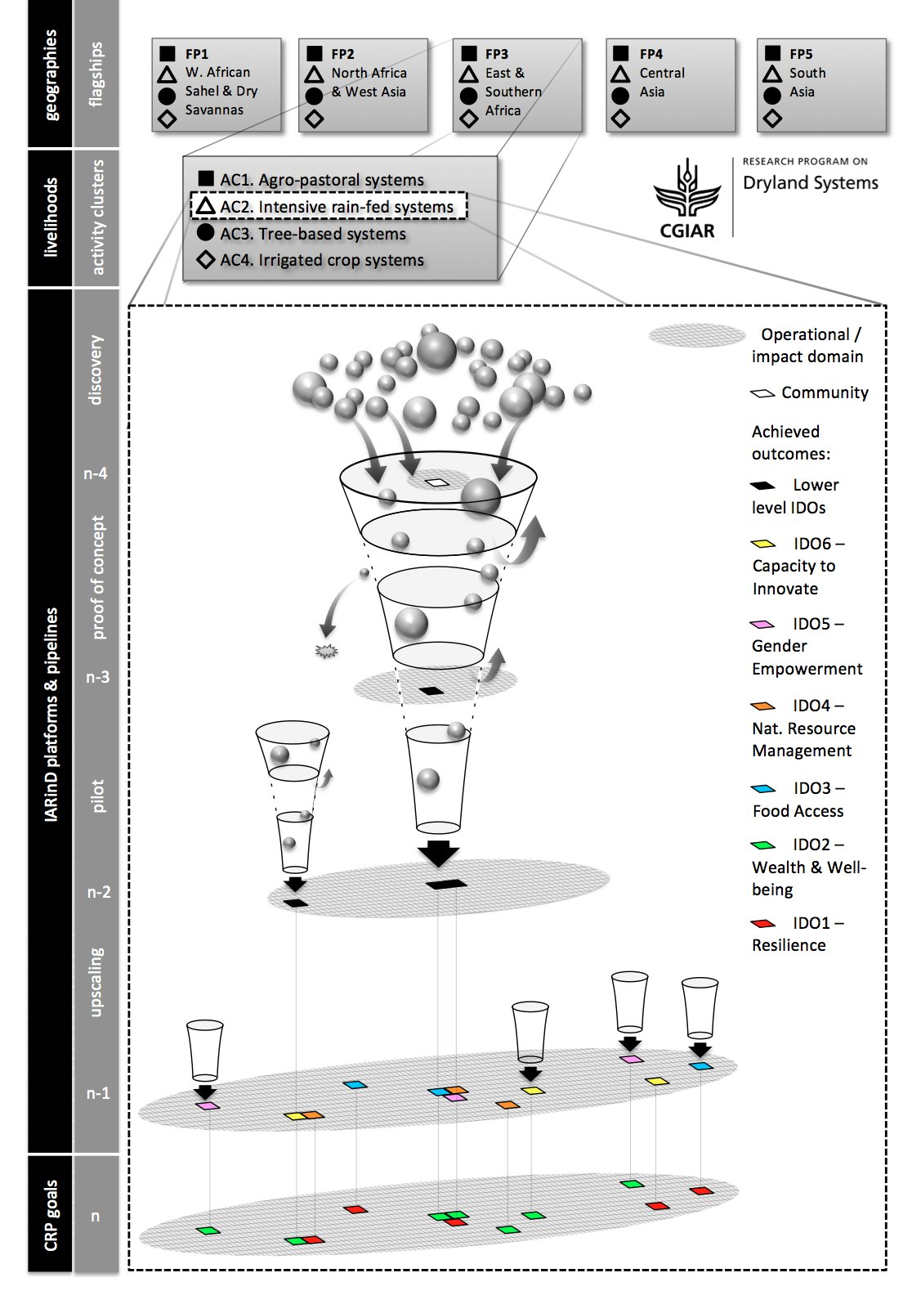
Title
“Same same, but for the Artistically Inclined”

Slide 43
From POWB

Slide 44
Title
Budget by IDO

Slide 45
Title
CG Center Focal Points,
Target Region Coordinators, Members and DGs

Slide 46
Title
2014 Total Budget
 | Budget
Activity Cluster | W1&2 | W3 | Bilateral | Total
Governance & Director's Office | 1,225 |  |  | 1,225
Regional Coordination | 1,075 |  |  | 1,075
Strategic Gender | 700 |  |  | 700
Total | 3,000 |  |  | 3,000
WAS&DS Flagship Project | 2,968 | 500 | 1,718 | 5,186
NA&WA Flagship Project | 3,952 | 2,037 | 10,800 | 16,789
E&SA Flagship Project | 2,831 | - | 7,141 | 9,972
CA Flagship Project | 1,452 | 799 | 587 | 2,838
SA Flagship Project | 2,797 | 138 | 5,608 | 8,543
Total | 14,000 | 3,474 | 25,853 | 43,327
Grand Total | 17,000 | 3,474 | 25,853 | 46,327

Slide 47
Title
Budget Allocation per
Agricultural Livelihood System

Slide 48
Title
Budget Allocation per
Research-for-Development Phases

Slide 49
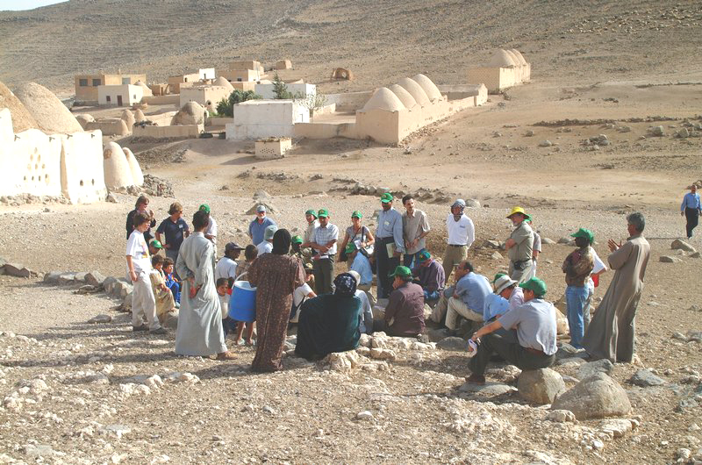
M&E framework, performance indicators
M&E system: To be developed and agreed upon with all partners = a key task at Regional Inception Workshops.
Approach: Impact pathways will be analyzed to ensure that annual plans include intermediate measurable indicators of progress and milestones along the R&D continuum.
M&E will include evaluation of economic, environmental and social indicators
Performance indicators:
agricultural productivity; production system stability
rural livelihoods: income, nutrition, welfare
bio-geophysical indicators: biodiversity, soil and water parameters
number/gender of users of products
participants in capacity strengthening
policy advisories and policy-makers reached, etc.
The development of International Public Goods at various scales will be an important performance indicator;
Participatory approach: M&E and performance assessment will use a participatory approach

Slide 50
Title
The way forward
Build on what we have:
IDOs
Flagship projects
Unit of Analysis (ALS)
Identify the threats and opportunities
Define the R4D agenda and ToC pathway
Identify or generate pipeline (phases)
Define research portfolio and compare with status quo
Look for common ground and synergies
Address cross cutting issues

Slide 51
Title
Why are we here
To see what science is on-going
To see how what issues it addresses
To see the R4D partnership
To see how it will deliver on IDOs
To identify research portfolio gaps
To see the common thread and cross
cutting issues among Flagships
To get a holistic view on where DS is
going and for whom

