Slide 1

Measuring resilience—Understanding trends in land cover changes and their potential impacts on pastoral communities
Mohammed Y Said, Leah Ng'ang'a, Gert Nyberg, Shem Kifugo, Ewa Wredle, Anna Hallmén, Regina Waiganjo, Peter Mwangi, Jan de Leeuw and Polly Ericksen
IFPRI 2020 Policy Consultation and Conference, Side Event on Measuring and Evaluating Resilience in Drylands of East Africa, Addis Ababa, 15-17 May 2014

Slide 2
Resilience framework
Future uncertainty
(Long term trends, climate change)
Adaptive capacity
Improving understanding of trends and local impacts
Ensuring access to relevant and timely information
Building confidence and flexibility to learn and experiment
Hazards and stresses
Disaster preparedness
Building capacity to analyse hazards and stresses
Improving hazard prevention and protection
Increase early warning and awareness
Establishing contingency and emergency planning
Livelihoods
Diversity and security
Strengthening community organization and voice
Supporting access to, and sustainable management of productive assets
Promoting access to technologies
Improving access to markets and employment
Ensuring secure living conditions
Resilience
Ability to manage risk
Ability to adapt to change
Ability to secure sufficient food
Governance
Enabling environment
Decentralized and participatory decision making
Strengthening links between local district and national levels
Promoting integrated approaches to livelihoods, disaster and climate change
Addressing underlying systematic issues
“ … measure of the persistence of systems and of their ability to absorb change and disturbance and still maintain the same relationships between populations or state variables (Holling, 173)
Source: Pasteur, K. 2012. From Vulnerability to Resilience A framework for analysis and action to build community resilience

Slide 3
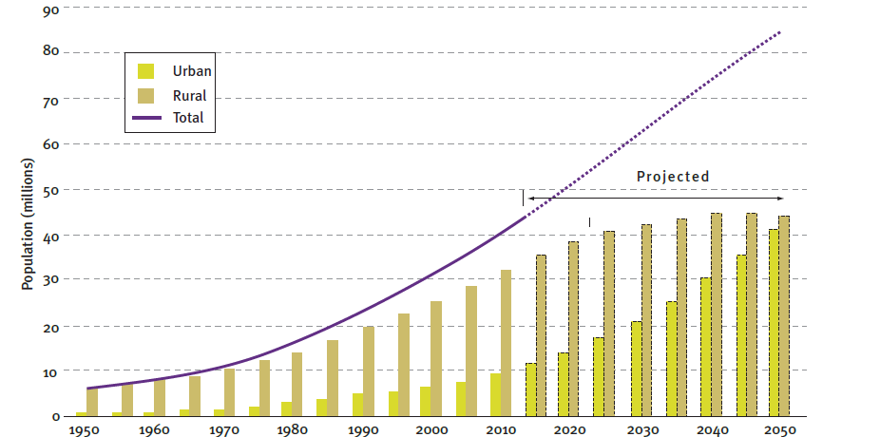
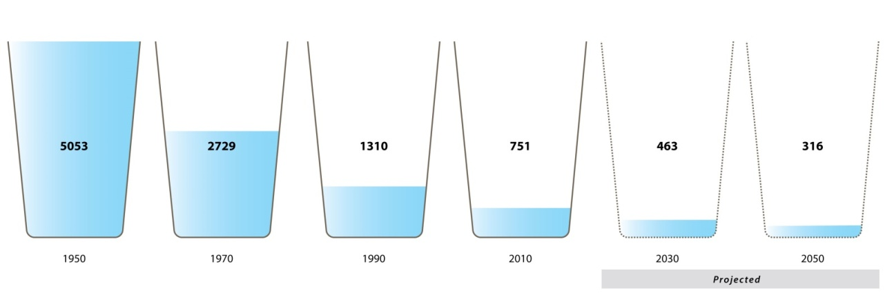
Projected population and water use
In 1960 Kenya population was less than 10 million by 2009 the had increased to 40 million. This population will double to 80 million by 2050
Growing human population and rise per capita use of resources is depleting water supply in Kenya. High conservation and management will be needed to deal with water shortages now and in the future.
Source: ACC 2014 Natural Capital Atlas

Slide 4
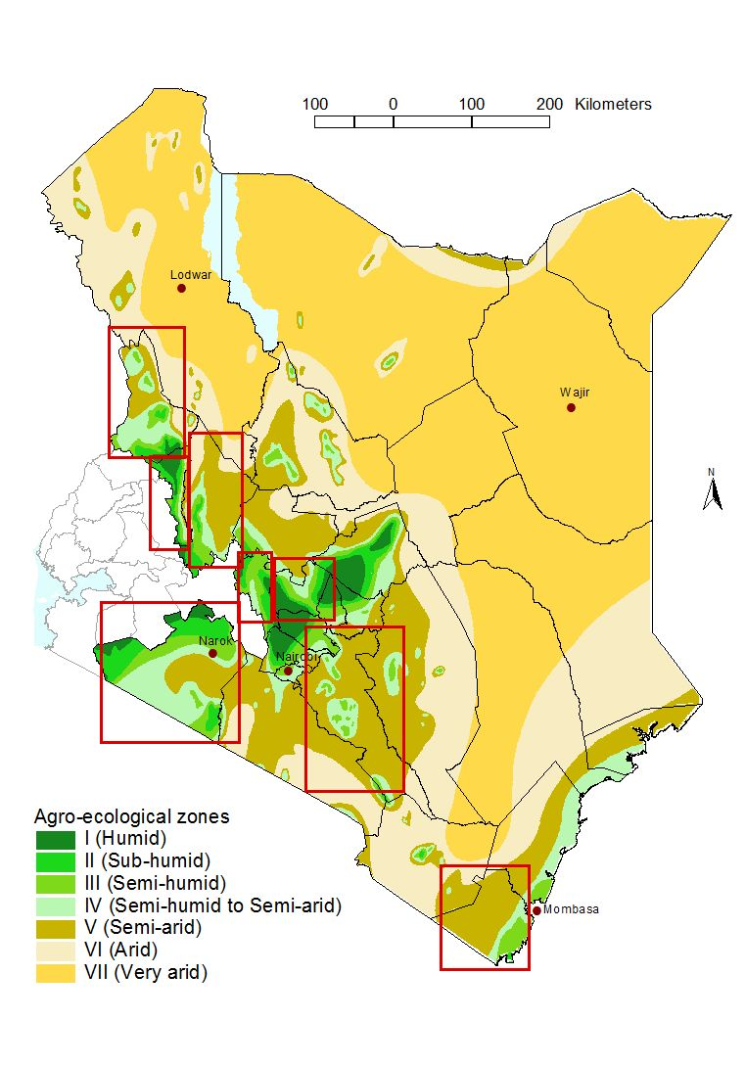
Study sites – agro ecological potential
Human Population
1962
1
2
3
4
5
6
7
2009
8
1 = West Pokot; 2 = Elgeyo Marakwet; 3 = Baringo; 4 = Nyandarua; 5: Nyeri
6 = Narok; 7 Machakos; 8 = Kwale
Source: KNBS, KSS, ILRI

Slide 5
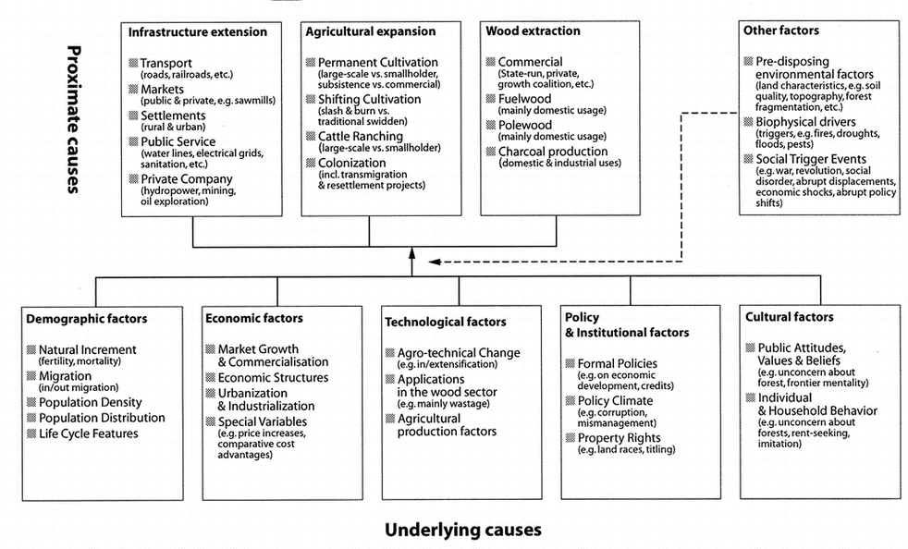
Causes of forest cover changes
Underlying cause
Source: Geist & Lambin 2002

Slide 6
Population dynamics
Source: Said et al. (in prep)

Slide 7

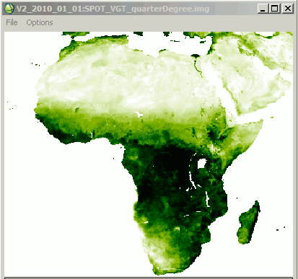
Monitoring Vegetation condition using satellite
Trends in NDVI for the period 1982 -2008. A 3 year smoothing interval used to clearly show the trends
Source: Said et al. (in prep)

Slide 8
Framework - Relationship between population growth and vegetation
C>D
D>C
Vegetation cover
Vegetation cover
Vegetation cover
D>C
C>D
D>C
C>D
Population density
Population density
Population density
C = Consuming Destruction Effect
D = Planting Construction Effect
Influence of population growth on vegetation cover can be considered as two effects – consuming constructive effect and constructive effect.
Source: Li et al. 2013, Modified

Slide 9
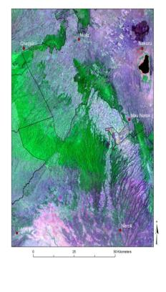
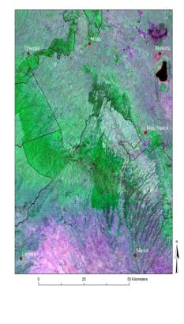
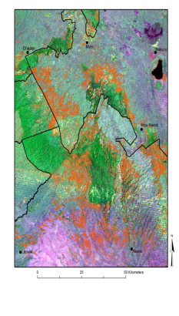
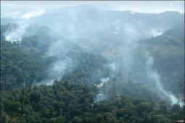
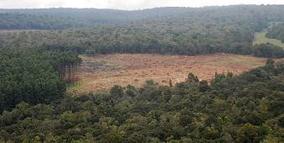
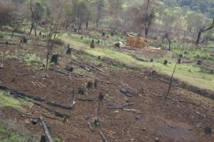
Land cover changes Mau - Narok
2001
2012
Change analysis 2001 -12
Source: Said et al. (in prep), Leah (in prep), Hansen et al. 2013)

Slide 10
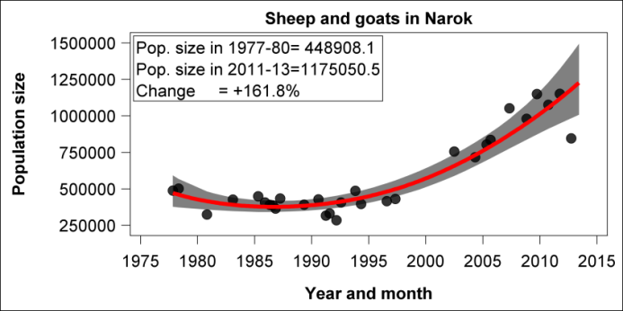
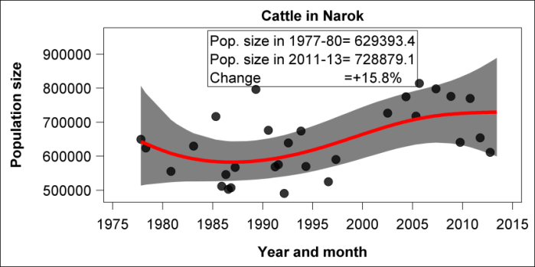
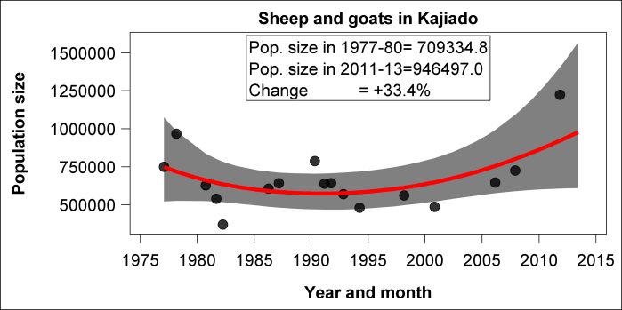
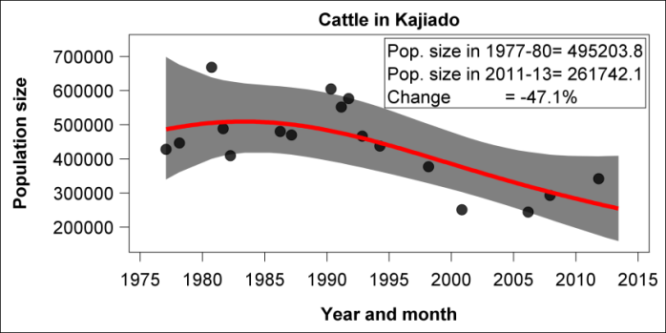
Impacts on livelihood and environment – southern Kenya rangelands
Ogutu, Said, Kifugo in press

Slide 11
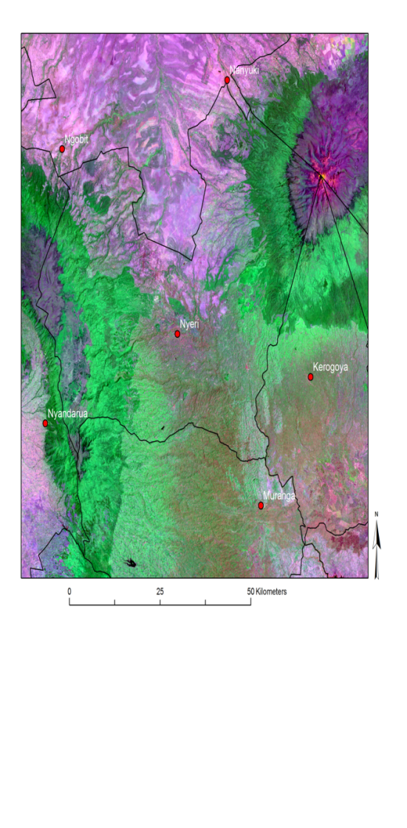
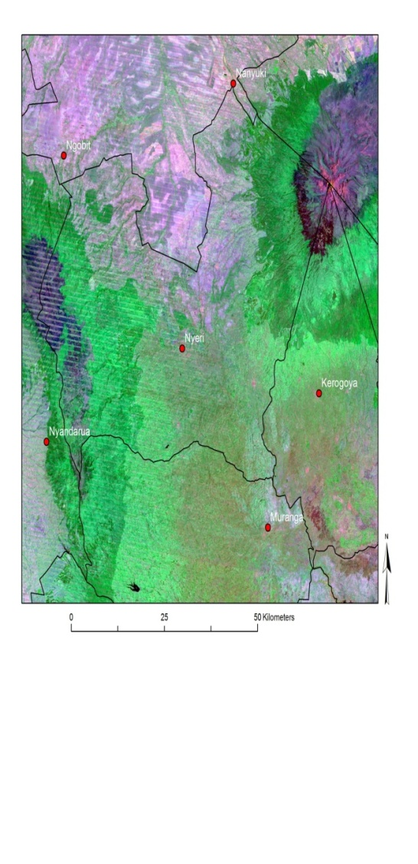
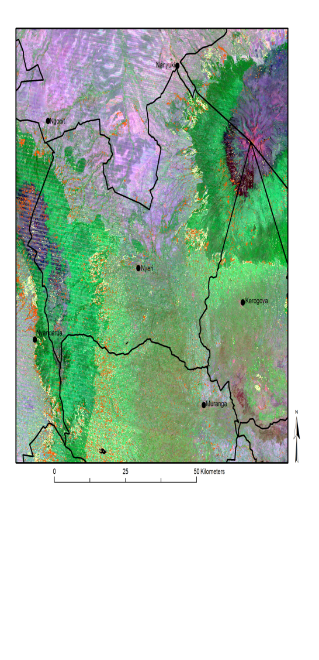
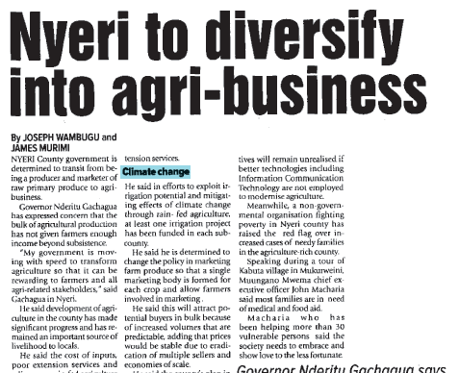
Land cover Mt Kenya - Nyeri
2001
2012
Change analysis 2001 -12
Source: Said et al. (in prep)

Slide 12
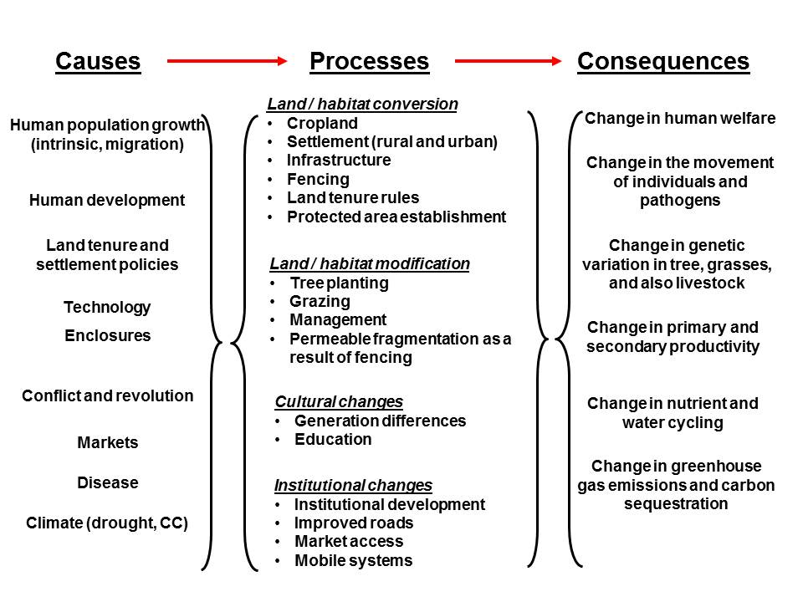
Framework - drylands

Slide 13
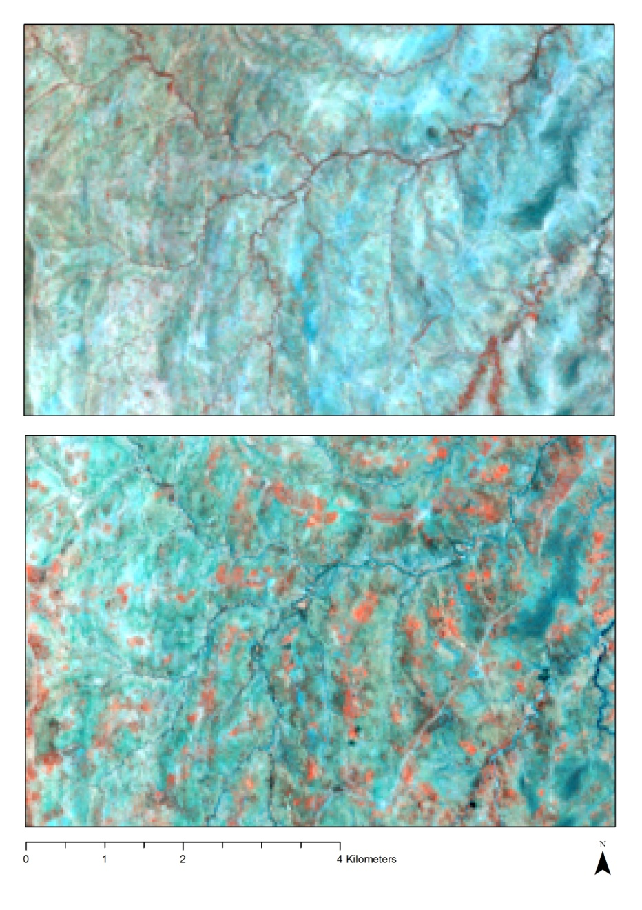
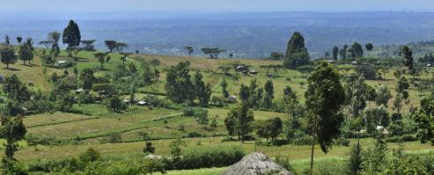
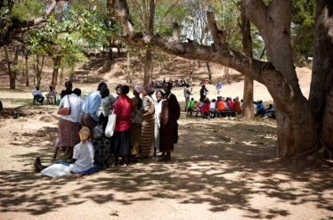
Land cover changes in West Pokot 1983 -2013
1983
2013
Photos: Vi
Efforts to increase tree cover started in the early 1980s by Vi Sweden in West Pokot. It started in schools and churches and later extended to communal and private lands.
Image showing changes in land cover – in 2013 the red tone colour indicates increase in tree cover
Source: Anna Hallmén, MSc Thesis 2014

Slide 14
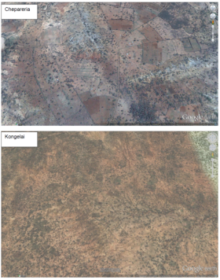
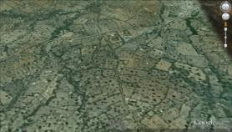
Impacts of enclosures on vegetation
Chepareria
Source: Regina Waiganjo, MSc Thesis 2014;
Said et al. (in prep)
Source: Google maps
Enclosures had more plant cover, biomass was four folds and species richness higher than the open grazing areas

Slide 15
Next steps
Socio - ecological changes
Livelihood challenges and opportunities
What are the land cover dynamics and trajectories in the drylands of EA?
What correlation can be established between climatic indicators and vegetation indexes?
What type land health can we detect
Potential for PES?
Does the number of livestock, stocking rate and composition differ between pastoralists using enclosures compared with traditional nomadic pastoralists?
Have a more sedentary lifestyle changed the roles in the family and the women’s economic empowerment?
What are the trades-offs between sedentary and non-sedentary population?

Slide 16
Acknowledgement
Projects or programs: CRP 1.1, BMZ (Developing the livelihood income diversification potential of carbon sequestration in African drylands), Triple L (Students and Scientists)
Data: Department of Resource Surveys and Remote Sensing (DRSRS), Kenya National Bureau of Statistics (KNBS), Kenya Agriculture Research Institute - Kenya Soils Surveys (KSS), Vi West Pokot, NOAA, and Google.

