Slide 1







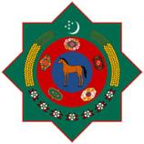

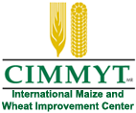



The CGIAR Collaborative Research & Capacity Building Program for the Development of Sustainable and Resilient Agricultural Production Systems in Central Asia under the Conditions of Changing Climate
17th Steering Committee Meeting of the CGIAR Regional Program for Central Asia and the Caucasus, 13-14 September, 2016

Slide 2

Russian Government Funded Activities:
Increase livestock productivity to improve availability of animal proteins to the households and increased revenues and wellbeing of livestock keepers
17th Steering Committee Meeting of the CGIAR Regional Program for Central Asia and the Caucasus
Makhmud Shaumarov
Moscow, Russia
13 September 2016
ICARDA team led by Barbara Rischkowsky: Makhmud Shaumarov, Kathryn Clifton, Jutta Werner, Mounir Louhaichi, Mourad Rekik, Muhi El-Dine Hilali, Chandra Biradar

Slide 3
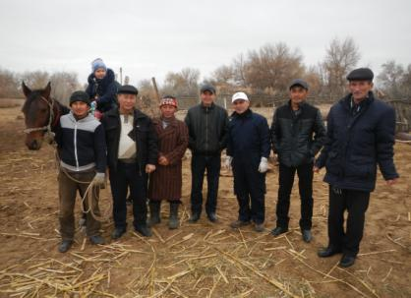
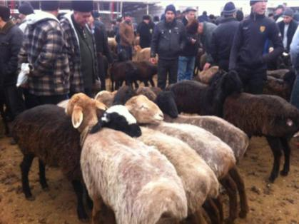
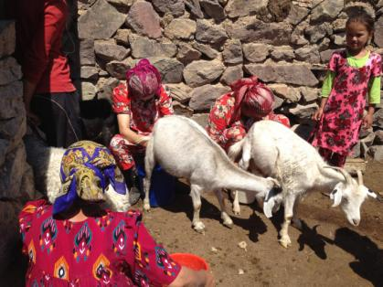
Enhancing livestock productivity for increased revenues and wellbeing of households of Karakalpakstan and Fergana Valley
Objective: to increase the returns from keeping sheep and goats on marginal lands in the Aral Sea basin and Fergana Valley through integrated livestock and rangeland management.
Targeted systems: Agropastoral ALS in Sogd Province, Tajikistan and Karakalpakstan, Uzbekistan
Major activities
Rangeland tenure and management
  Rangeland tenure
  Rangeland status
  Rangeland management
Sheep and goat management
  Rapid assessment of small ruminant value chains in Tajikistan and Karakalpakstan
  Genetic improvement of Tajik Angora goats and Karakul sheep (“Sur” pelt production)
  Reproductive technologies
  Improved milk processing
Notes:
Livestock and rangelands are important sources of income for agropastoral hhs in Central Asia.
Key Challenges: land degradation, water salinity, CC effects, unsufficient winter feeding, weak VCs

Slide 4
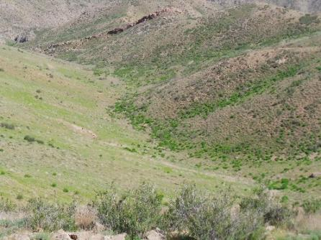
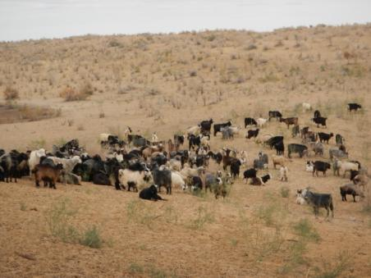
A systems approach for inclusive rangeland tenure practices in Uzbekistan and Tajikistan
Current rangeland tenure and access by pastoral communities were analyzed
Tajik Pasture Law allows land rights for traditional pastoral communities, but also favors elites
Obsolete water infrastructure and high transaction costs limit balanced rangeland utilization
Pastoral Tickets issued by Forestry Agencies open win-win opportunities: can be adopted by cooperatives
Uzbek and Tajik rangeland tenure systems do not reflect the tenure access and security needs of smallholders and large agro-pastoralists
This situation negatively affects the livelihoods of pastoralists and exacerbates rangeland degradation and high costs for communities and government
Community-based pasture management options are being discussed in Uzbek government
Summer pasture in Tajikistan
Winter pasture in Uzbekistan
Notes:
Rangelands cover more than 260 mln ha of land areas in Central Asia. Animal density increases near settlements and decreases in remote areas due to high transaction costs and lack of investments in water infrastructure and melioration.

Slide 5
Transition Period Challenges in Drylands of TJK & UZB
 | Former-Soviet Period | Present | Key Challenges
Political incentive | Ideological race: Socialism VS Capitalism | No ext. competition, weakly represented demand side | Lack of driving forces
Governance structure | Centrally planned command economy | De-concentration of administrative power | Still strong hierarchy
Land tenure | State ownership | Leasehold rights only | Gaps in legal frameworks, rangeland use conflicts
State intervention | Subsidized production, state quota orders | Lack of subsidy. Land tax, State quota remains | Little investment in land, shadow budgeting, leakage
Institutional capacity | Public services and incentives established | Shrunk structure. Services available by contract | Obsolete infrastructure, little incentives to invest
Science and technology | Strong support, used for polit.decision-making | Limited support, ignorance, kept on project funding | Brain drain, lack of capacity
Monitoring | Strongly controlled and prosecuted | Weak monit.in remote areas, elites’ interests prevail | Little funding for monitoring, increased rent-seeking
Rangeland management | Large-scale, centralized, chairman appointed | Influential groups, insecure positions, informal arrang’s | Lack of professional management capacities
4
Notes:
Key challenges: due to little investment returns from drylands > we have out-dated infrastructure and poor investments, underdeveloped value chains, lack of capacities and knowledge, and institutional gaps in legal frameworks

Slide 6
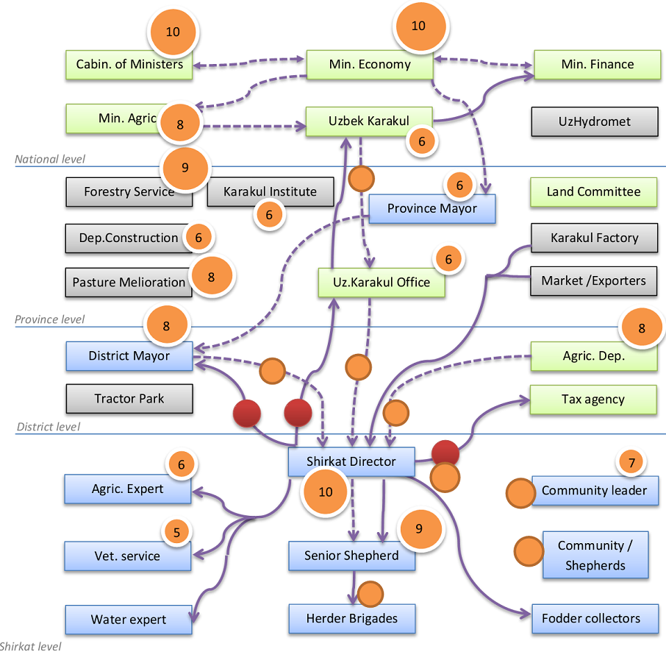





Institutional Mapping of Rangeland Management
5
Notes:
Map shows interaction between actors, organizations in rangeland system and ranks their influence towards the quality of pastures. It helps to identify target points of intervention for development transformation.

Slide 7
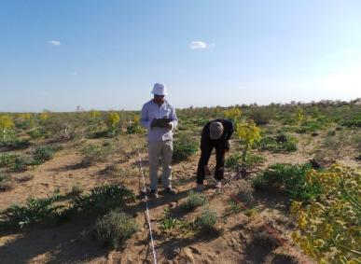
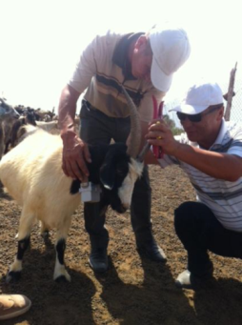
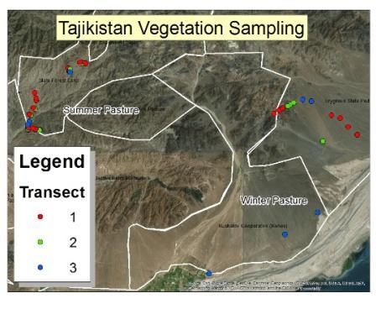
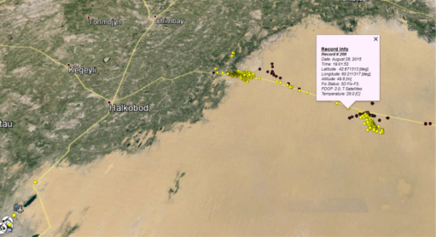
Understanding rangeland vegetation status and grazing patterns in Karakalpakstan and Fergana Valley
Vegetation inventory in spring and fall was conducted to understand the effect of grazing management on rangeland condition in Tajikistan an Karakalpakstan
Results are being used to create large scale vegetation maps to understand implications
under different management scenarios
GPS collars to measure
grazing patterns were
deployed in Aug. 2015 in
8 flocks in 2 target sites;
they record position, time,
speed, temp. every 15 mins
Vegetation monitoring
Fixing a GPS collar on a goat
The combined data will show feed availability, grazing patterns and help to identify management, input and services needs.
Data from GPS collars
Data collected with GPS collars
Notes:
Project works on understanding a rangeland productivity by analyzing inventory of rangeland vegetation aiming at mapping more productive pastoral areas for improved animal grazing management.

Slide 8
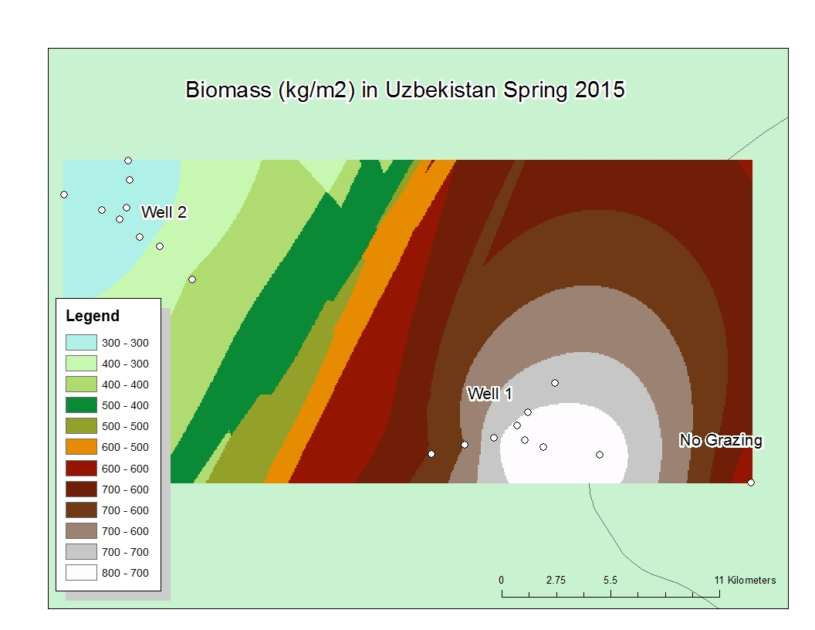
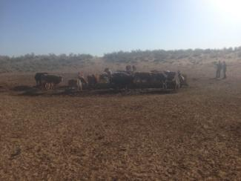
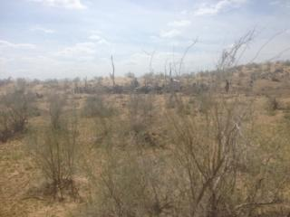
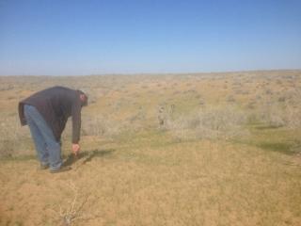
Results from vegetation inventory: Karakalpakstan - spring 2015
Notes:
The white points are areas that have been sampled in Uzbekistan during the spring of 2015. You will note that there are lines that look like a y. At the center is the well and three transects were placed around each well. Wells are central grazing areas that normally receive higher grazing intensity. One well is closter to the human settlement and the other well is farther away. There is also a point in an area that is not grazed. Vegetation samples were taken at each point as well as plant identification to understand how grazing intensity is effection stanging biomass and the types of vegetation that is growing. Historically herders would live in more remote areas of the community to utilize hard to reach pasture. However this practice has declined and there appears to be more intense grazing around the community. This study helps to understand how this is effecting vegetative areas that are receiving intense and no grazing. No grazing can be a problem as it can keep plants from regenerating and making more seed. In the map above the color differences represent changes in biomass (kg/m2). Notice that biomass reduces as you go to Well 2 and increases from left to right on the map. The left side is closer to the community. All of the biomass collected in this sampling period is palatable. The vegetation started growing around February 25th with peak vegetation growth from May 10-15th and the end of the growing season from Nov 15th-20th.

Slide 9
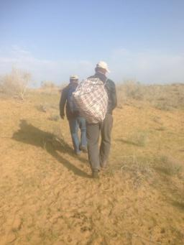
Results from vegetation inventory: Karakalpakstan - spring 2015
Well 2-Total Biomass
Well 2- Biomass of Artemesia Diffusa
Notes:
The radar graphs above show the differences in vegetation around the well center point. While the map of biomass that was shown prior is important the maps above show the difference in vegetation composition. On the left you see total biomass and on the right you see the biomass of Artemesia Diffusa. Note that more artemesia is available on the eastward transects on well 1 away from the human settlement and on the west side of the well toward the human settlement. This may be due to topography and further analysis is needed. Samples from the Fall are being processed and further information will be available by the end of the project

Slide 10
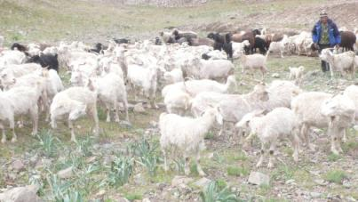
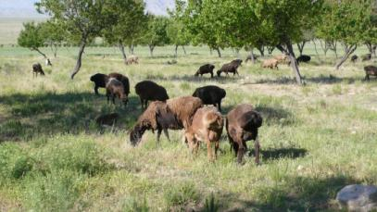
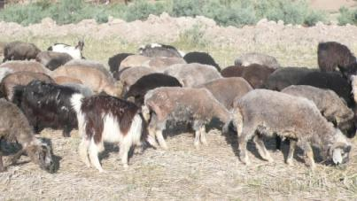
Rangeland utilization: effect of grazing patterns on the animals
Seasonal Nutritional Status of Grazing Animals
Determined through:
Repeated surveys of the flocks dynamic during the main production phases (winter, spring & summer grazing)
Seasonal monitoring of key blood-borne nutritional metabolites
  Glucose
  Proteins
  Cholesterol
  Creatinine
  Urea
Practical use:
Early metabolic markers of the nutritional status and prevention of metabolic disorders
Develop grazing strategies to meet nutritional requirements at demanding physiological stages
Strategic use of supplements for rangeland-grazing flocks
Notes:
We also collect animal blood samplings with analysis of animal metabolics to understand seasonal nutrition dynamics of animals in different rangeland conditions.

Slide 11
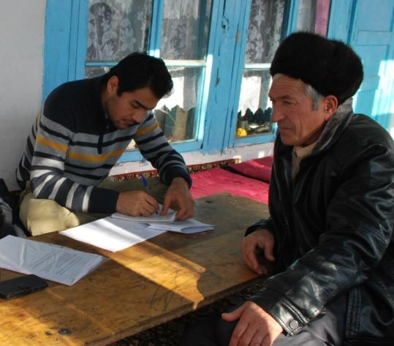
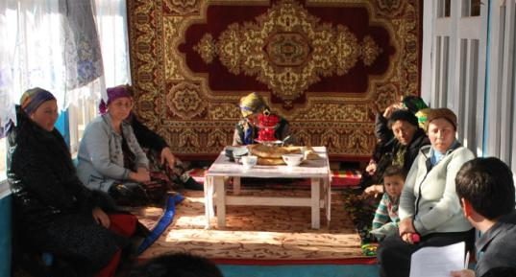
Sheep and goat management: rapid value chain assessments
  SR VCA toolkit developed for Ethiopia was adapted to Central Asian conditions (available in Russian and English)
  Tajikistan
  Training of research partners in Jan. 2015
  VCA in Asht and Gafurov districts (Sogd province)in spring 2015
  Identified challenges
  Inadequate skills in genetic improvement resulting in poor quality animals used for breeding
  Lack of vertical linkages between producers and traders
  Weak horizontal linkages: producers not organized
  Lack of public policy on livestock sector monitoring and development
  No fair system on certification for pasture lands
  Lack of livestock services (e.g. veterinary services, credit), market information and infrastructure
Key informant interview
Focus group discussion
Notes:
Value chain assessment identified that marginal income of traders are higher than have animal producers. Seasonal peaks in animal supply lead to price shocks both for producers and consumers.

Slide 12
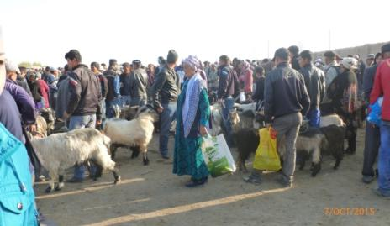
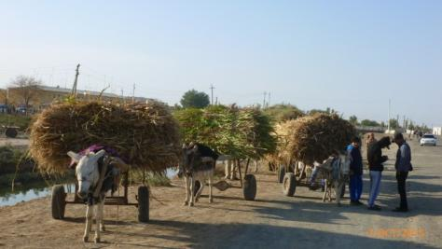
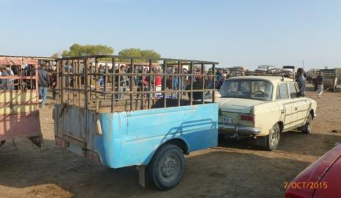
Sheep and goat management: rapid VCA in Karakalpakstan
  Sites: Karauzyak District; Village citizen Councils Koybak, Karabuga, and Karakul
  Challenges
  Lack of skills and knowledge of extension agents and livestock specialists
  Need for improved rangeland management and utilization
  Not enough land allocated for animal feeding crops
  Existing value chains for all livestock products are short, not well established, without stable, long-term relationships between households/sellers and consumers/buyers.
  Seasonal trade with peak sales during festivities in January, February, April and September.
  Market prices for live ruminants and meat determined by direct transaction influenced by the number of resellers and butchers in a given market day. absence of stable, long time clientele.
  International trends in demand for Karakul pelts
Notes:
Seasonal peaks in animal supply and price shocks both for producers and consumers

Slide 13
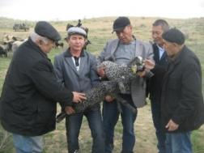
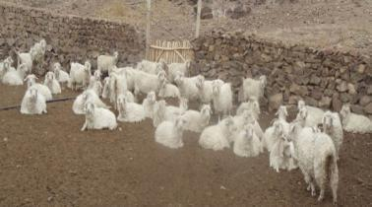
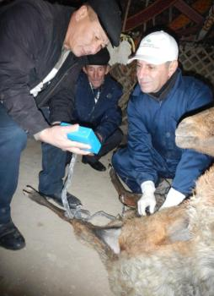
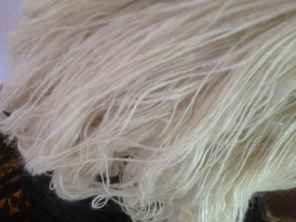
Sheep and goat management: improved management practices
Genetic improvement of Mohair quantitative and qualitative traits of Tajik Angora goats resulting in 20% increase in Mohair fiber traits and 80% reduction in kemp fibers
6 Angora nuclei flocks
Certification of newborn Karakul lambs for Sur pelt production
At scale development of artificial insemination and ultrasound pregnancy diagnosis to support genetic improvement and to manage herd fertility in Tajik Angora flocks resulting in 30% conception rate using frozen Texan semen
Reviving pelt production through establishment of elite flock of Karakul “Sur sheep elite flock” established in Karakalpakstan with nearly 200 elite newborns to be potentially used as improved rams
Ultrasound pregnancy diagnosis in at least 20 flocks
Kemp free Mohair fiber from Tajik goats

Slide 14
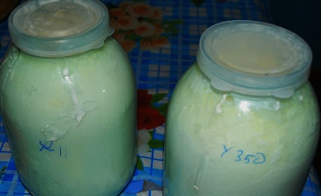
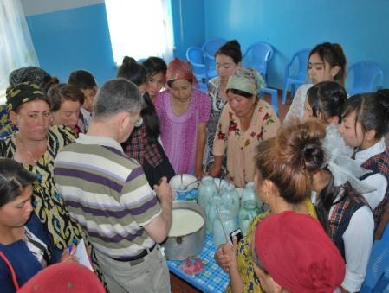
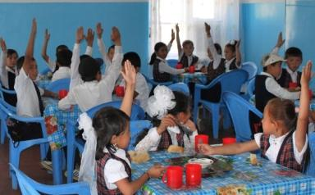
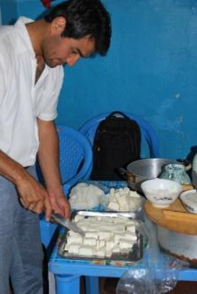
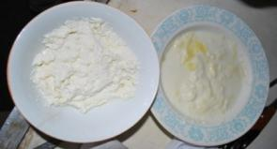
Improved dairy processing and product diversification to enhance revenues and livelihoods of the families in Tajikistan
Local Knowledge was assessed and constraints analyzed in Fergana valley
Options to produce traditional high quality dairy products developed and tested in Taboshar and Zartepa (Yogurt with sensorial properties meeting consumer preferences, better churning efficiency)
Options to diversify dairy processing to increase VC returns were investigated
  Processing of new products with potential (cheese and milk fat based products)
  Use of processing by-products (whey protein based products)
Capacity building and trainings on milk production and milk processing and hygiene were conducted (51 women and 12 men)

Slide 15
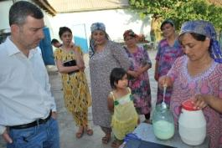
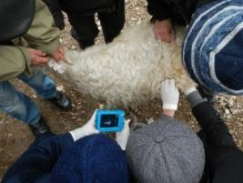
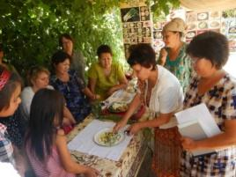
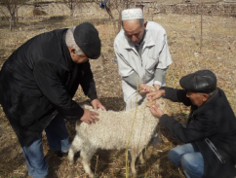
Capacity Building activities in 2015 and 2016
12 training events for at least 226 community leaders were conducted to build capacities of the project beneficiaries on:
  Artificial Insemination and improved SR reproduction (ultrasound)
  Improved milk processing for making quality cheese and yoghurt
  Conducting Rapid Value Chain Assessments
  Forage production in marginal areas
  Links between range productivity and SR grazing patterns
  Understanding seasonal animal metabolics.
114 women participated in the training sessions
Round-table with policy-makers was conducted and TV show and newspaper articles were communicated to raise people’s and decision-makers’ awareness on sustainable use of pastures in Tajikistan and Karakalpakstan.

Slide 16
Knowledge products and publications
ISI Publications
Mirzabaev, A., Ahmed, M., Werner, J., Pender, J., & Louhaichi, M. (2016). Rangelands of Central Asia: challenges and opportunities. Journal of Arid Land, 8(1), 93-108.
Mueller, J. P., Kosimov, M. A., Kosimov, F. F., Brent, L., Nishanov, N., & Rischkowsky, B. (2016). Do Texas Angora bucks improve mohair weight and quality traits of Tajik Angora goats? Small Ruminant Research, 134, 74-78.
Clifton, K, Louhaichi, M. (2015) Land tenure, climate change and livestock mobility in central and southern Asian grasslands. In P.K Ghosh, S.K. Mhanta, J.B. Singh, P.S. Pathak, Grasslands: A Global Resource Perspective (pgs. 347-362). New Delhi, India: International Grasslands Congress.
Technical Reports, Working Papers and Book Chapters
Louhaichi, M. (2015) Methodology for Assessing Rangeland Vegetation in the Action Sites (Karakalpakstan & Tajikistan). ICARDA: Amman, Jordan
Louhaichi, M. (2015) Using GPS collars at the Karakalpakstan site. Presentation of Work. ICARDA: Amman, Jordan.
Shaumarov M. & Birner R. (2015): Dryland Pastoral Systems in Transition: What are the Options for Institutional Change in Uzbekistan? Proceedings of the The 53rd Annual Conference of the German Society of Economic and Social Sciences in Agriculture (GEWISOLA) ‘How Much Market and How Much Regulation Does Sustainable Agricultural Development Need?’ Berlin, Sep, 2013.
Shaumarov M. & Birner R. (2015): Contribution of Scientific Knowledge to Dryland Pastoral System Development in Uzbekistan. Proceedings of the Academic Conference ‘Agricultural Knowledge and Knowledge Systems in Post-Soviet Societies’. Center for Development Research/ZEF, the University of Bonn, Sep, 2013.
Blogs
Werner, J. and Shaumarov, M. (2015). A systems approach for inclusive rangeland tenure practices in Uzbekistan. CGAIR Research on Dryland Systems.
Rekik, M. (2015) Breeding Angora Goats for finer mohair: the power of genetics and artificial insemination. CGIAR Research on Dryland Systems.
Khudaybergenova, S. (2016) Law on rangelands is an urgent necessity. CGIAR Research on Dryland Systems.
Datasets
Rajavov, T. (2015). Rangeland Vegetation Samples Datasets. ICARDA: Amman, Jordan.

Slide 17
Thanks for your attention!

