Slide 1
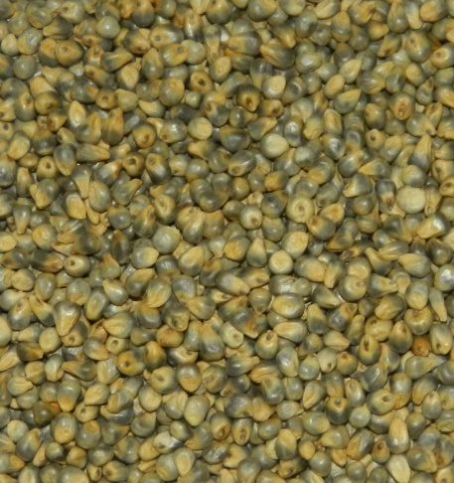
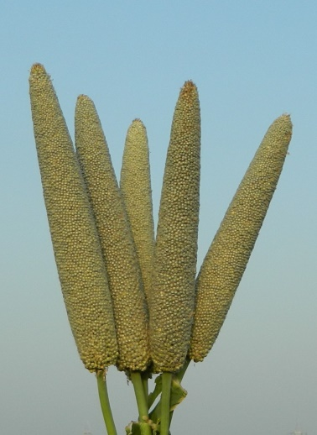
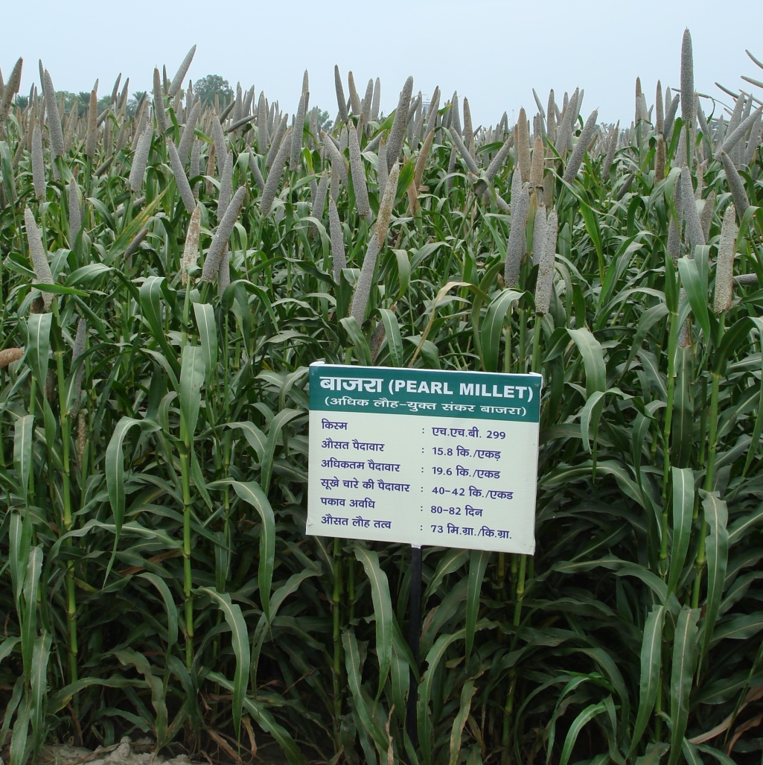
HHB 299
(ICMH 1203)
XRF Fe (ppm) | 73
XRF Zn (ppm) | 41
Grain yield (t/ha) | 3.3
Days to 50% flower | 50
Zone | Zone A1, A & B (High Fe & Zn) of Rajasthan, Gujarat, Haryana, Punjab, Delhi, Maharashtra, Tamil Nadu

Slide 2
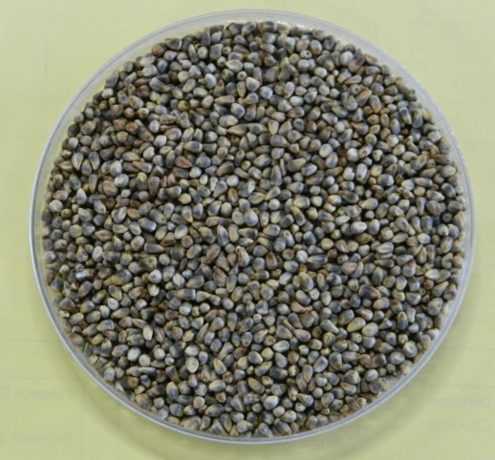
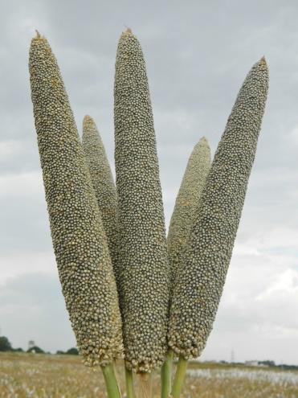
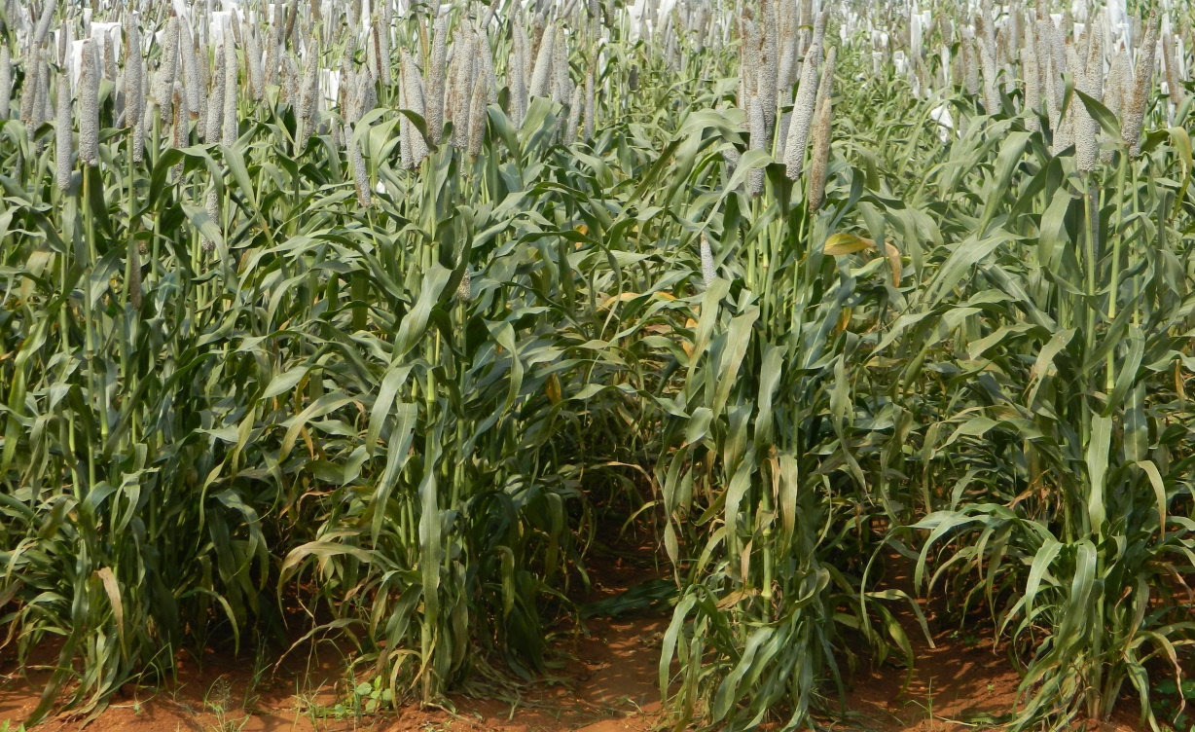
AHB 1200 (ICMH 1202)
XRF Fe (ppm) | 77
XRF Zn (ppm) | 39
Grain yield (t/ha) | 3.2
Days to 50% flower | 47
Zone | Zone A1, A & B (High Fe & Zn) of Rajasthan, Gujarat, Haryana, Punjab, Delhi, Maharashtra, Tamil Nadu

