Slide 1


IRAQ – Zero Hunger Strategic Review
Eliminating Hunger in Iraq and Meeting SDG 2 Targets
Presentation of Preliminary Results
WFP IRAQ - ICARDA Consultative Workshop Meeting
28 March 2018, Baghdad, Iraq
Boubaker Dhehibi (on behalf of ICARDA Team)
SIRPSP/AMMAN-JORDAN
b.dhehibi@cgiar.org
Baghdad, Iraq| 28/03/2018

Slide 2
Objectives of the Review – A Reminder
The overall objective of the Review are:
To prioritize actions that will be required to accelerate progress toward ensuring food security and enhanced nutrition and in-line with SDG 2.
Specific objectives will be as follows:
  Undertake a comprehensive analysis of current food security, nutrition situation, and agricultural sustainability against targets of SDG 2.
  Review current policies which are being considered and undertaken in Iraq for eradicating hunger;
  Identify the required policy and institutional gaps, as well as resources needed, to achievement SDG2 objectives

Slide 3
Food and Nutrition Security in Iraq: The current situation
HDI: 0.57 (1996) to 0.65 (2015) – Iraq: 121 (out of 188 countries)
GDP per capita: increase for an average of 4% per year: USD 4.098 (2007) to USD 5.695 (2016)
Average dietary supply: 110% ; Average protein supply: 65 gr/capita/day (2014-2016)
# Undernourished people: 6.5 M (2002) to 10.1 M (2016)
CFSVA (2016): 17% of children are stunned & Low birth weight: 13%
Nutritional Strategy: High level of illness among women and children:
  Anemia among childbearing women (15-49 years): 35.5%
  Anemia among children (<5 years): 26.2 %
  Vitamin A deficiency among pre-school children: 13.8 %
  Obesity: 20% of adults are obese (Females: 38%; Males: 23.4%; Adolescents: 8%)
  Between 1997-2016: Male obesity rate grew from 14 to 23% !!

Slide 4
Factors Driving Food and Nutrition Insecurity in Iraq
Poverty:
  22.5% Iraqis live below the national poverty line (IRD 105000 – USD84/month) / ISI-affected Governorates: Poverty rate is above 40%
  CFSVA(2016): 53% of the population is vulnerable to food insecurity
Low rural productivity and incomes:
  30% of population are living in rural areas (50% of the poor living in rural areas)
  Poor agriculture yield (Cereals: 2T/ha): Lack of infrastructure; decreasing water supplies; increasing land degradation and fragmentation; poor marketing channels, etc.
  Limited opportunities for off-farm employment (lack of processing, transport and storage activities)
  Widespread Government intervention: (private sector uncompetitive + subsidies – wheat sector)
Gender inequality and gender inequity:
  Low literacy rates for women / Lack of empowerment (Large family sizes)
  High economic dependency rates (1 working person is supporting 6 people)
High unemployment rates:
  High unemployment rates among youth: 35%
  Inefficient cash transfer programs for the poor (43% of beneficiaries are not poor) + Disparities in income distribution (Poorest quintile 7% of income – Richest quintile 39% of income)
  Lack of livelihoods and chronic poverty among IDP’s

Slide 5
KEY ACTION AREAS FOR THE ACHIEVING SDG2

Slide 6
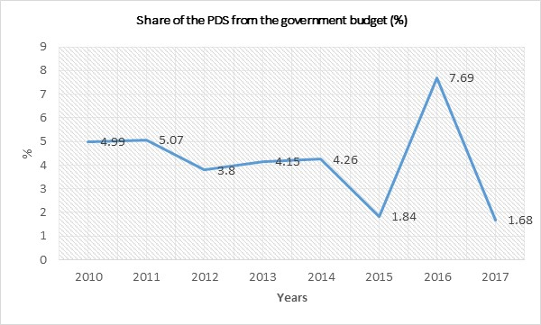
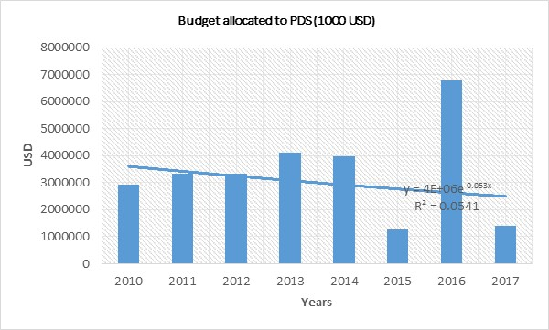
Action I: Improving Safety Net Instruments – The PDS System
Past Trends
PDS is covering almost the entire Iraqi Population (Fiscal cost is large)
The size of PDS is so large that it has major effects on Iraqi economy (allocation of resources within the country)
The PDS has distortionary effects on the structure of domestic food market prices
Large variations and decreases in funding (Share from the government budget: 4.99% in 2010 to 1.68%, in 2017)
Current Status and Issues
High costs of logistics
Inability to meet commitments. Inefficiently accomplished role because of the absence of targeting
Strong willingness to make the system more effective and efficient
Needs & Priorities
This programme need to be made:
  More effective and efficient with a much improved targeting (perfect targeting)
  Cost effectiveness and monitoring systems
  Leadership, accountability and setting priorities

Slide 7
Action I: Improving Safety Net Instruments – The PDS System
Proposed Interventions: Options For Reforming PDS
  OPTION I: Move from universal in-kind PDS to universal Coupon (ALL)
  OPTION II: Move from universal in-kind to targeted Coupon (ALL)
  OPTION III: The PDS delivery is changed from universal in-kind to universal cash (ALL)
  OPTION IV: Move from universal in-kind to universal targeted cash (ALL)
Note: For geographically Targeted: Possibilities to select to optimal combination between In-Kind, Coupon and Cash.
Proposed Interventions: Options For Reforming PDS - Perfect Targeted” (ONLY POOR – 22.5%)
Note: Estimated Cost value of the current food basket: USD 9 / Estimated Cost value for an improved (quantity & Quality) food basket: USD 15 (more items)
OPTION I: The poverty rate will decrease progressively in the coming 5 years: 22.5%; 20%; 17.5%; 15%; 12.5% for 2018, 2019, 2020, 2021, and 2022, respectively and the budget allocated to the PDS will remain unchangeable as for 2017 (1.6 Billion)
OPTION II: The poverty rate (22.5%) and the budget allocated to the PDS will remains the same for the coming 5 years(2018-2022)
OPTION III: Optimal PDS ration cost where we have all the poor population covered by the PDS budget (The poverty rate (22.5%) and the budget allocated to the PDS will remains the same for the coming 5 years)

Slide 8
Action I: Improving Safety Net Instruments – The PDS System
Financial Needs: Actions and their respective costs (ALL IRAQIS POPULATION)
Options/Years | 2018 | 2019 | 2020 | 2021 | 2022
Option 1: In-Kind PDS Distribution (All population with a PDS= USD 9/person/month)
Total | 4,723,488,000 | 4,843,936,944 | 4,967,457,337 | 5,094,127,498 | 5,224,027,750
Subsidy Reduction: 0-80-60-40-20 | 4,723,488,000 | 3,875,149,555 | 2,980,474,402 | 2,037,650,999 | 1,044,805,550
Option 2: Conversion to Universal Cash of USD 15/person/month
Total | 7,872,480,000 | 8,073,228,240 | 8,279,095,572 | 8,490,212,478 | 8,706,713,004
Option 3: Annual Reduction of coverage by 20% each year from 2019-2022
Subsidy Reduction: 0-20-20-20-20 | 7,872,480,000 | 6,458,582,592 | 4,967,457,343 | 3,396,084,991 | 1,741,342,601
Option 4: Annual Reduction of coverage by 40% in 2019, 20 % from 2020-2021 and 50% in 2022 Cash/coupons at USD 15/person/month
Subsidy Reduction: 0-40-20-0-50 | 7,872,480,000 | 4,843,936,944 | 3,311,638,229 | 3,396,084,991 | 1,741,342,601
Option 5: Annual Reduction of coverage by 30% in 2019, 30 % from 2020-2021 and 50% in 2022 Cash/coupons at USD 15/person/month
Subsidy Reduction: 0-30-30-0-50 | 7,872,480,000 | 5,651,259,768 | 3,311,638,229 | 3,396,084,991 | 1,741,342,601
Option 6: Annual Reduction of coverage by 20% in 2019, 40 % from 2020-2021 and 50% in 2022 Cash/coupons at USD 15/person/month
Subsidy Reduction: 0-20-40-0-50 | 7,872,480,000 | 6,458,582,592 | 3,311,638,229 | 3,396,084,991 | 1,741,342,601

Slide 9
Action I: Improving Safety Net Instruments – The PDS System
Financial Needs: Actions and their respective costs - Perfect Targeted” (ONLY POOR – 22.5%)
Years | 2018 |  | 2019 | 2020 | 2021 | 2022
OPTION I
Total cost needed to cover the poor population (USD) |  | 1,610,280,000 | 1,467,859,680 | 1,317,128,841 | 1,157,756,247 | 989,399,205
Coverage rate of PDS for poor population (%) |  | 89.42 | 98.101 | 109.32 | 124.38 | 145.54
Budget Needed /Exceeded to cover the full poor population (USD) |  | 170,280,000 | 27,859,680 | -122,871,159 | -282,243,753 | -450,600,795
OPTION II
Total cost needed to cover the poor population (USD) |  | 1,610,280,000 | 1,651,342,140 | 1,693,451,367 | 1,736,634,371 | 1,780,918,569
Coverage rate of PDS for poor population (%) |  | 89.42 | 87.20 | 85.03 | 82.92 | 80.85
Budget Needed /Exceeded to cover the full poor population (USD) |  | 170,280,000 | 211,342,140 | 253,451,367 | 296,634,371 | 340,918,569
OPTION III
In-kind cost of PDS food basket (Voucher/cash transfer)/poor capita/month (USD) |  | 13.41 | 13.08 | 12.75 | 12.43 | 12.13
Total cost needed to cover the poor population (USD) |  | 1,610,280,000 | 1,651,342,140 | 1,693,451,367 | 1,736,634,371 | 1,780,918,569
Coverage rate of PDS for poor population (%) |  | 100.00 | 100.00 | 100.00 | 100.00 | 100.00

Slide 10
Action I: Improving Safety Net Instruments – The SSN System
Past Trends
The national Social Safety Net was established to mitigate the effects of the economic reforms adopted by the Iraqi government, such as price liberalization and lifting subsidies on fuel for low-income households
SSN is assisting families with up to four kids.
The SSN, however, is around one-eighth of the PDS in terms of size
Current Status and Issues
Iraq Social Safety Net (SSN) is providing cash transfers to close to 1.1 million households (around 4 million people) based on a categorical targeting system
In recent years the SSN is underfunded: In 2017, the SSN cost is accounting for 0.2% of GDP as opposed to 0.95 for PDS, and has not been well targeted to reach the poorest.
The lack of flexibility in the design of the SSN and its relevant legislation is a significant obstacle to its ability to target poverty
Lack of Awareness about beneficiaries and lack of commitment when they receive the loan
Although there is a well-established monitoring system (1000 agents), people fraud because they feel the money is theirs and they wish to have a share.
Needs & Priorities
This programme need:
  Much improvement in terms of monitoring, leadership, accountability and setting priorities
  Improving targeting performance
  Strengthening SSN to become more effective in targeting reaching the poor and mitigating future risks associated with price increases

Slide 11
Action II – Enhancing Sustainable Agricultural Production
Background
Agricultural yields are primary drivers of domestic supply of agricultural commodities.
Yields can be expressed both in terms of levels and stability over time (especially for sensitive rain fed crops).
Yields and productivity levels of agricultural commodities currently produced in Iraq are being very low compared to world averages.
Low yields combined with low product prices result in small profit margins and marginal incomes for the farmers, and can also be translated into lower productivity of agricultural labour.
Agricultural and arable land is shrinking in Iraq, while good quality water resources are also getting scarce.
As a result, food production index in Iraq progressed with less than 10% during the last 10 years, with small advantage for the livestock activity compared to crop production.

Slide 12
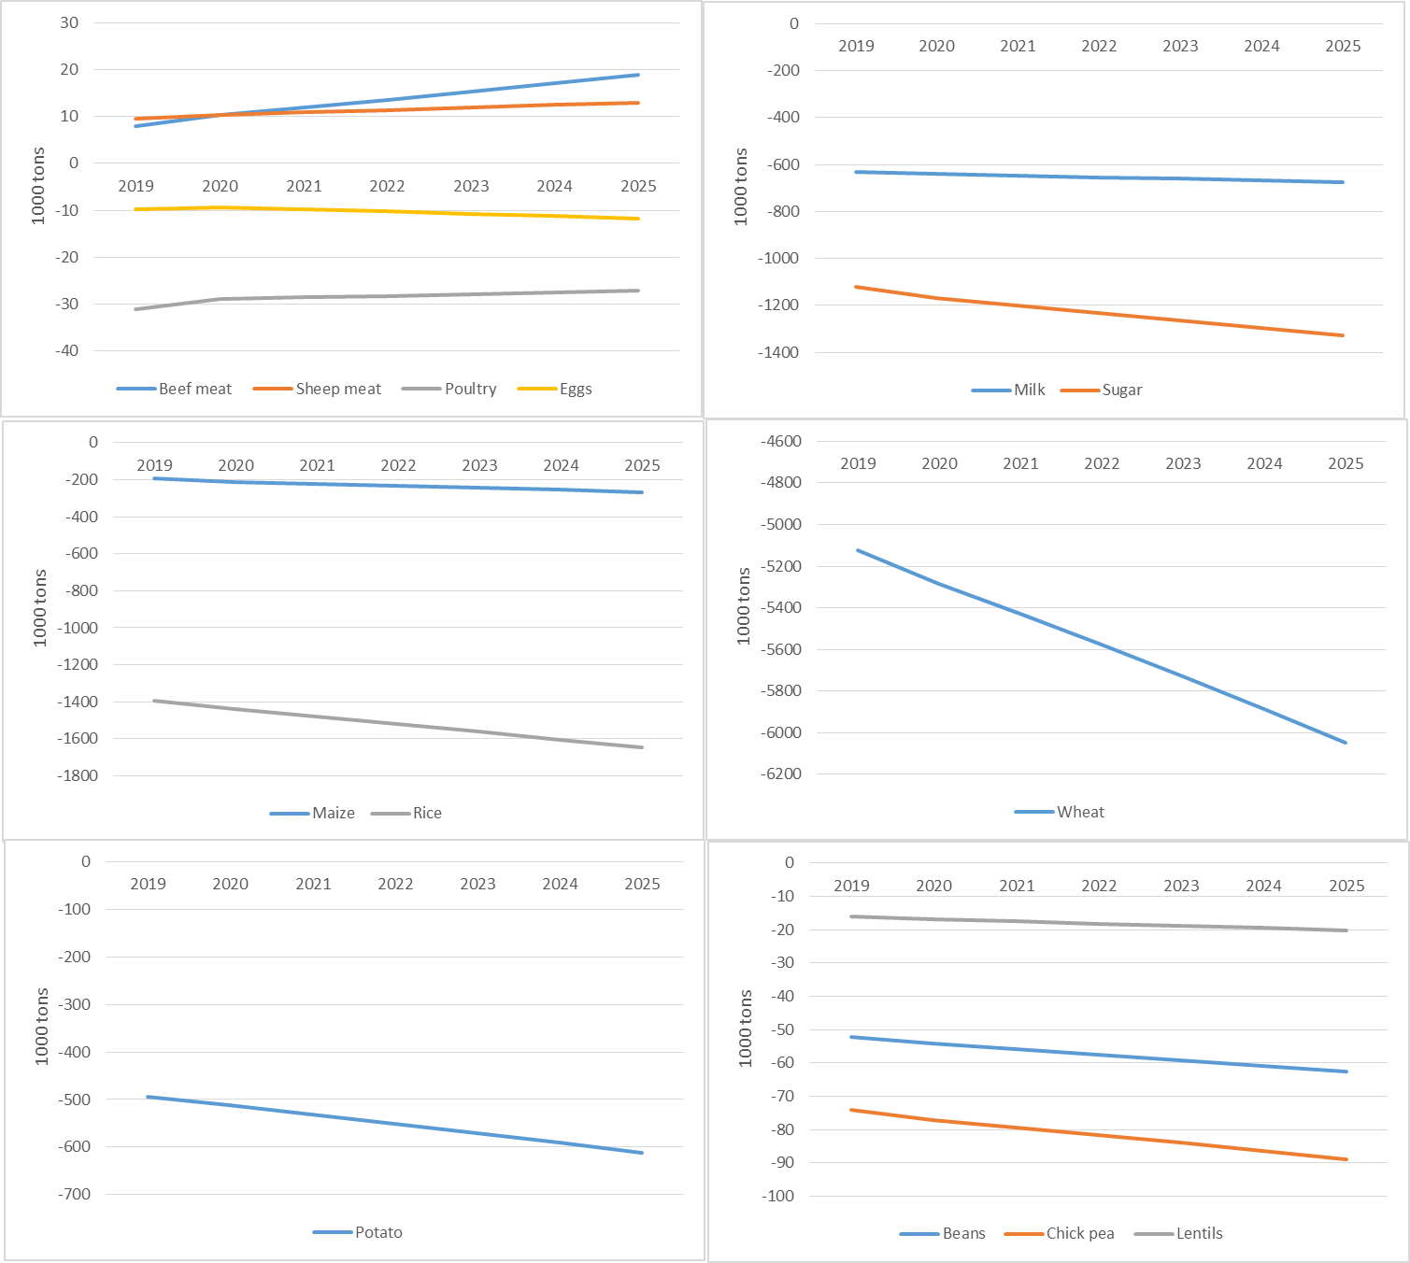
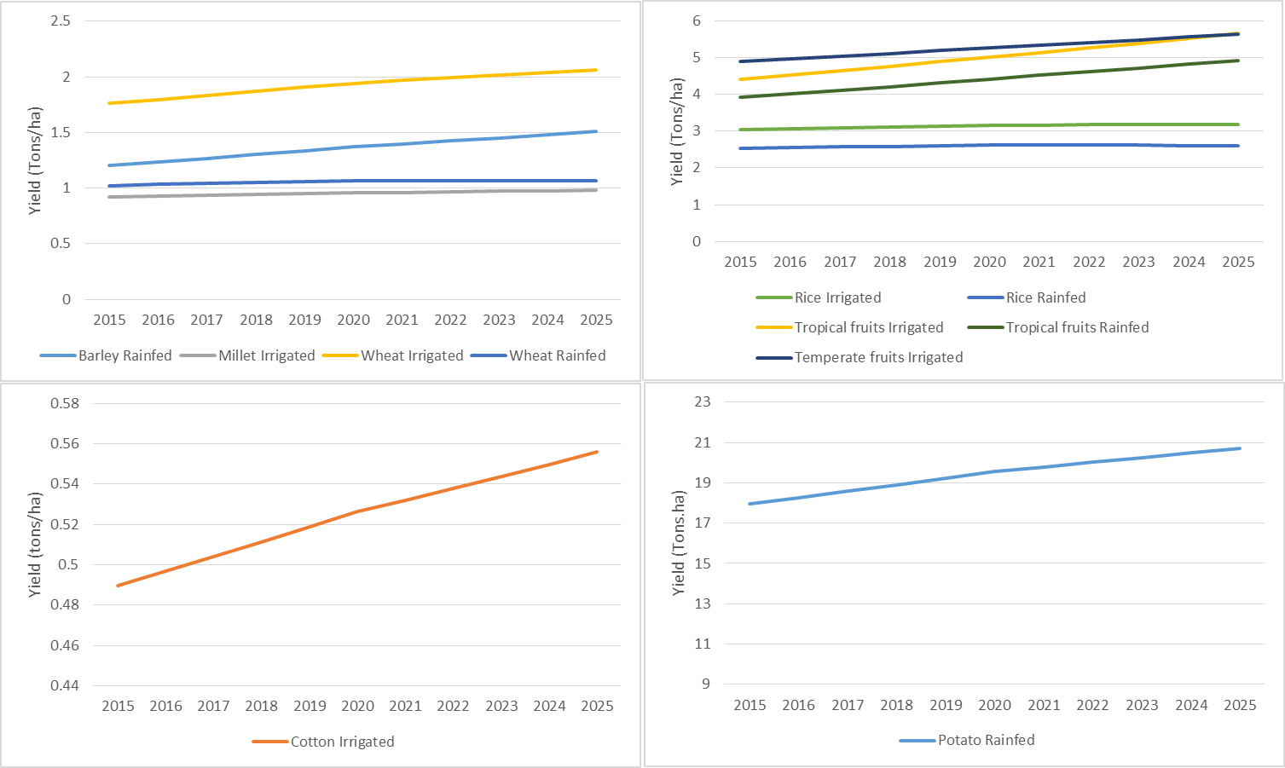
Action II – Enhancing Sustainable Agricultural Production
Background
Yields projections
Trade balance projections
Yield projections to 2025, under BAU scenarios, remain low which will be translated by a wider gap between supply and demand and thus more negative trade balance for most of the agricultural commodities (except red meat livestock products).

Slide 13
Action II – Enhancing Sustainable Agricultural Production
Proposed Interventions
1. Inputs provision. Ensuring continuous provision and availability of necessary inputs mainly agricultural machinery, improved seeds, fertilizers and pesticides. This can be done through appropriateinput market incentives and/or public-private partnerships.
2. Better integrating farmers to value chains and markets. This allows farmers selling at better prices and improves their adjustment and adaptation capacities to changing markets attributes and consumers preferences.
3. Enhanced institutional capacities. More effective institutions are needed at national and local levels. These include planning, implementing, monitoring and assessment institutions. Effective institutions also involves better coordinated policies among the involved agricultural (and nonagricultural) administrations. It also involves the development of appropriate farmers’ organization which can help small farmers better integrating value chains, reduce their transaction costs, and deal with low public provisions in some areas.
4. Land and irrigation (including drainage) development. There is a need to protect agricultural and especially fertile arable land in Iraq. This can be done through adoption and implementation of appropriate regulations and laws including regulation for better urban planning. Protection against erosion and desertification in highly vulnerable water basins, and valorizing fertile land areas through better public provisions and infrastructure development. There is also a need for encouraging farmers using enhanced irrigation practices and technologies, which are known to have a positive impact on both agricultural productivity and irrigation water efficiency.

Slide 14
Action II – Enhancing Sustainable Agricultural Production
Proposed Interventions
5. Protecting soil fertility. Soil fertility, and its organic matter content are crucial for long terms productivity enhancement and agricultural sustainability. These should be restored through appropriate farming practices including improved crop rotations, among others. Improved rotation can involve dry legumes and other vetch crops which might be used as food or feed. To ensure such integration, appropriate seed systems for these crops in addition to guaranteed prices should be considered as part of the food security strategy of Iraq.
6. Rationalize local production with trade policy. Becoming more food sovereign and achieving SDG2 through higher productivity levels, will also requires the development and implementation of a strategy to rationalize local production with trade policy in a manner which is sustainable, especially with regards to supply chains, natural resources as well as associated monetary and opportunity costs.

Slide 15
Action II – Enhancing Sustainable Agricultural Production
Financial Needs: Actions and their respective costs

Slide 16
Action III. Addressing the Double Burden of Poor Nutrition
Past trends
In 2008, the obesity prevalence in Iraq alarmingly reached 22% for men and 36.2% for women. Key causes associated with lifestyle factors, including poor dietary habits, inactivity and sedentary patterns among Iraqi adult age groups
The lack of access to the right balance of micronutrients leading to deteriorating health and diminished work and mental capacity for the most vulnerable groups in Iraq
Research showing that in children aged 0-60 months, one of the key consequences of nutritional deficiency is growth retardation, while in children older than five years it may seriously affect concentration span and learning capacity
Effects of bad nutrition negatively impact children’s physical and cognitive development. In addition, malnourished children are less likely to stay in school.
School feeding activities implemented in Iraq by the Ministry of Education and WFP until their suspension in 2014 because of shortage of funding, limited MOE institutional capacity and lack of an adequate hand-over strategy in place.

Slide 17
Action III. Addressing the Double Burden of Poor Nutrition
Current Status and Issues
Food insecure households face the negative effects of higher food prices on their real incomes. This contribute to alter quality of their diet and reduce the quantity of food consumed.
Children below the age of 18 represent on average 50 per cent of Iraq total population. Micronutrient deficiency among young children remains unacceptably high. This is a critical barrier to children’s learning for the following reasons:
Nutrition deficiency reduces children’s ability to focus and retain what they have learned at school.
Malnourished children are less likely to stay in school.
Total nutrient needs are higher during childhood and adolescence than any other time in the lifecycle.

Slide 18
Action III. Addressing the Double Burden of Poor Nutrition
Needs and Priority Actions
Proposed intervention: Healthy Food in Healthy School
Nutrition-sensitive agricultural intervention to address the underlying determinants of malnutrition and development (food security; adequate resources) at the individual household and community levels.
School feeding programmes to be: 1. reframed to incorporate longer-term perspective, 2. nationally established and maintained, 3. making community participation meaningful, 4. linked to local agricultural sector and 5. promoting gender equality (e.g. targeting vulnerable young girls and providing income opportunities for women).
Integrated, holistic approach to promote nutrition education and better eating habits, and make schools safer learning environments to encourage students’ enrolment and attendance (and increase adolescent girls’ retention).
More sustainable local market production by educating communities on the nutritional importance of eating seasonal products, encouraging links to local agricultural production and the use of local products in school menus

Slide 19
Action III. Addressing the Double Burden of Poor Nutrition
ACTION 1 - At School Level:
(Pilot) integrated school feeding programmes. The pilot phase will start with schools where the highest percentages of children will be eligible for free school meals. Primary schools selected through preliminary vulnerability framework at both rural and urban level.
Refurbishment of targeted primary school buildings, to be equipped with dining halls; school gardens; proper, gender-sensitive sanitation facilities and access to potable water.
Introduction of Nutrition Education, Food Pyramid Guide Approach and School Gardening topics adapted to age dynamics.
ACTION 2 - At Community Level (this section will be presented in the Theme 4 framework):
Construction and set up of equipped kitchen facilities run by targeted trained in schools catering management.
Strengthening local farmers’ production and establishing local supply chains for commodity procurement of school meal services.

Slide 20
Action III. Addressing the Double Burden of Poor Nutrition
ACTION 3 - At Ministry Level (both Ministry of Education and Ministry of Public Health in cooperation with WFP):
Launch of country awareness campaign involving national media on how good food improves health and school attainment.
M&E: set up and monitor the impact of the school feeding plan to ensure that progress is being made. Base-line measure at the beginning of the programme, regular inspections and data collection to assess nutritional quality of the food against children’s wellbeing and educational attainment.
ACTION 4 - At Policy Level
Integration of the nutrition education component in the national curriculum.
Launch of School Canteen Guidelines including requirements on healthy, age-tailored menu, and quality standards, such as staff health and hygiene, cleanliness, food preservation, delivery and storage and display and packaging.

Slide 21
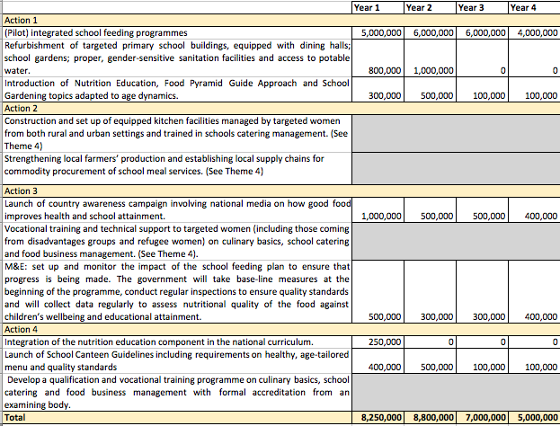
Action III. Addressing the Double Burden of Poor Nutrition
Financial Needs: Actions and their respective costs (USD)

Slide 22
Action IV. Increasing Employment Especially Among Youth and Women
30% population lives in rural areas and 50% of the poor lives in rural areas. Targeting rural areas to fast track SDG2 results.
Robust investment needed to strengthen technical education, vocational training, skills development and entrepreneurship opportunities
Promote gender equality: mobilize female agricultural outreach workers to impart knowledge and establish agricultural groups
Support cooperatives and business incubators to increase employment in rural areas, diversifying their services and the importance of integrated activities involving women.
The balance between rural and urban areas should be coherent with the infrastructural development planned by different ministries and governorates plans.
Job creation in processing, packaging, transportation and storage of agriculture products in rural areas targeting youth and women.
With much of the Iraqi population living in urban areas, employment creation programme in urban areas.

Slide 23
Action IV. Increasing Employment Especially Among Youth and Women
Background
30% population lives in rural areas and 50% of the poor lives in rural areas. Targeting rural areas to fast track SDG2 results.
The unemployment rate is 11% nationally (of whom 7% of males and 13% of females), with nearly half of Iraqi population being less than 21 years old
Iraq agricultural sector has been deeply affected by conflicts and consequent changes in leadership and land administration.
Iraq Technical and Vocational Education and Training (TVET) is often accorded low social status and regarded as last option when the general educational course is not available or has somehow failed. National TVET system is not adequately preparing individuals to perform in the labour market.
Iraqi girls and women are still experiencing limited access to quality education and labour market, especially those coming from disadvantaged rural communities and living in remote areas.

Slide 24
Action IV. Increasing Employment Especially Among Youth and Women
Research Question
How can agriculture become an attractive entrepreneurial undertaking, reducing unemployment, and getting people - women and youth in particular - decent and fulfilling work?
Proposed Interventions
Primary focus on resilience-building and strictly connected to the ‘Healthy food in healthy school’ initiative, as explained in Theme 3.
Nutrition-sensitive agricultural approach utilized as delivery platforms for tailored interventions to address the needs of adolescent boys and girls.
In collaboration with WFP, this initiative will help increase small-scale food producer capacities and strengthen young people and women skills in vocational training activities through the following actions:

Slide 25
Action IV. Increasing Employment Especially Among Youth and Women
Proposed intervention
Action 1 – At community level
Construction and set up of equipped kitchen facilities managed by targeted women from both rural and urban settings and trained in schools catering management.
Strengthening local farmers’ production and establishing local supply chains for commodity procurement of school meal services.
Action 2 – At Ministry level
Vocational training and technical support to targeted women (including those coming from disadvantages groups and refugee women) on culinary basics, school catering and food business management.
Vocational training and technical support to targeted smallholder farmers, including female agricultural outreach workers, on how to increase their agricultural production and sales.
Action 3 – At Policy level
Develop a qualification and vocational training programme on culinary basics, school catering and food business management with formal accreditation from an examining body.

Slide 26
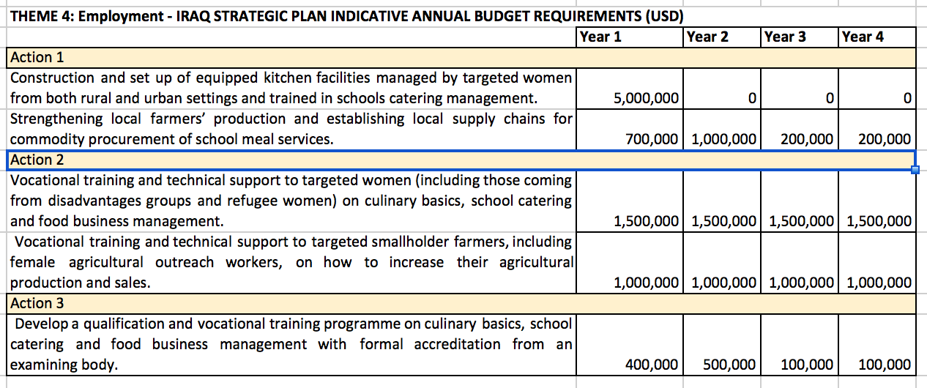
Action IV. Increasing Employment Especially Among Youth and Women
Financial needs (actions and their respective costs)

Slide 27
Action V. Reforming Marketing, Trade and Pricing Policies
Background
Level of food import in Iraq is very high and growing fast.
Agricultural Import Value Index increased from a value of 100 in 2004-2006 to 293 in 2013, indicating an increase of about 300% of the value of imported food commodities.
Import value based on 2005 prices increased from 2.6 billion $ in 2005 to 3.4 Billion $ in 2013. Import dependency remain high for most of the strategic agricultural commodities.
Despite relatively high production potential, actual agricultural production is limited with internal market mechanisms being inefficient due to market failures, import inflation, faulty value chains, and lack of employment opportunities.
Iraqi markets didn’t fully opened up to the benefit of free trade which has direct and indirect impacts on both producers and consumers. Consumer markets has been highly supported by the government which created a bias at the production level.

Slide 28
Action V. Reforming Marketing, Trade and Pricing Policies
Background
In the framework of the “national development plan” (2010-2014) the reform of the PDS resulted in a leverage of domestic prices thus offering more opportunities to the private sector. This reform had a significant impact on the wheat sector for example, where the semi irrigated wheat areas shifted from 70 k hectares to 170 k hectares, with increased productivity of over 40%.
Current trade policies in Iraq tends to subsidize food consumers by importing and subsidizing strategic commodities (cereals, rice, oil, and meat).
Import of many food commodities is also liberalized.
These policies would affect:
  Government expenditures and trade balances.
  Levels of national food production.

Slide 29
Action V. Reforming Marketing, Trade and Pricing Policies
Proposed Interventions
1. Enhance market integration of farms in their respective value chains. this would allow for higher producer prices of a wider basket of agricultural commodities will certainly be an effective incentive for higher private investments in productivity enhancements and will allow shifting to high value added crops.
2. Reduction and better targeting of consumer prices subsidies . This would result in higher involvement of private sector in food importation and better prices transmission between international and national market, which in turn can be a good incentive for agricultural production and trade liberalisation.
3. Mobilize resources and expertise to develop a comprehensive trade strategy with clear impact assessment of different market and non market policies. In fact, consumer subsidies, private involvement in food import, crops areas and land use, productivity levels, and distortions on producers’ prices, are all inter related items that need to be addressed in a single agricultural strategy. such a strategy will certainly add up to the ongoing technical investments for irrigation, land, and other infrastructure development.
4. Build on the “National development plan of 2010-2014”, which, to some extent, proved to be working before the terrorism events and helped closing parts of the yield gaps. The country should build on its experience in implementing these plans, and should coordinate its national programs to ensure harmonic co investments through market and non-market actions and policies.

Slide 30
Action V. Reforming Marketing, Trade and Pricing Policies
Cost of needed interventions. Most of the needed costs are related to prospective studies and impact assessment of free trade policies on both producers and consumers. These costs are insignificant compared to other actions and interventions.

Slide 31
Summary: Actions vs Financial Needs
# | Proposed Actions | Investments Over 4 Years (USD Millions) | Annual Recurrent Cost (USD Millions)
1 | Improving Safety Net Instruments (PDS) | - | 1600
2 | Enhancing Sustainable Agricultural Production | 5267.0 | 853.2
3 | Addressing the Double Burden of Poor Nutrition | 7.1 | 7.5
4 | Increasing Employment Especially Among Youth and Women | 10 | 2.6
5 | Reforming Marketing, Trade and Pricing Policies | 26 | 15
Total |  | 5310.1 | 2478.3

Slide 32
WAY FORWARD
Next Steps
Engage civil society in the strategic review
Engage more broadly with partners, including UN
Discuss how the ZHSR will be used in government planning
Share findings from ZHSR for discussion in order to finalize
Presentation of the final results and launching of the report by the end of April

Slide 33
Thank You
ICARDA – WFP Iraq – IRAQI PARTNERS
TOWARDS ZERO HUNGER IN IRAQ

