Slide 1

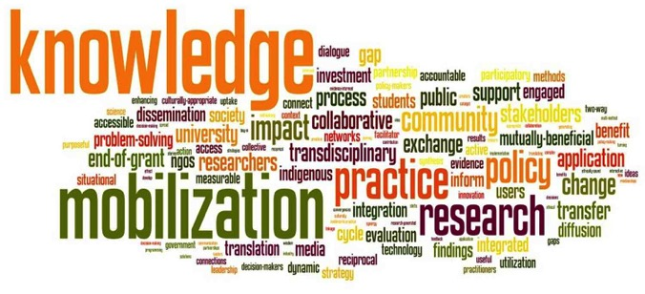



PROCASUR innovation-based
Knowledge management & empowerment
of rural actors for South-to-South Cooperation

Slide 2
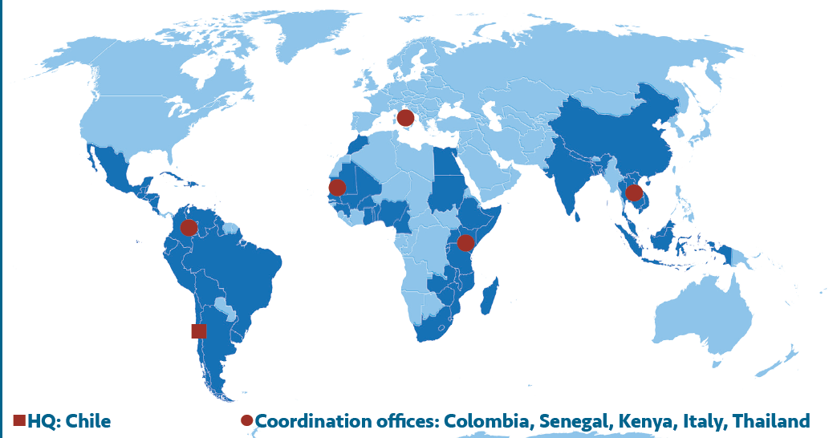
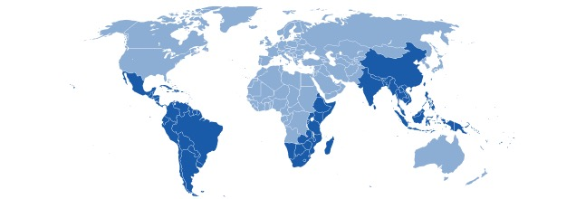
During the last 15 years PROCASUR worked especially with IFAD, FAO, Ford Foundation, in cooperation with Civil Society, National and Local Governments in more than 50 countries in Latin America, Africa, and Asia to identify, adapt and scale-up local knowledge-based innovations, valorizing Local Champions for Sustainable Development of Rural South

Slide 3
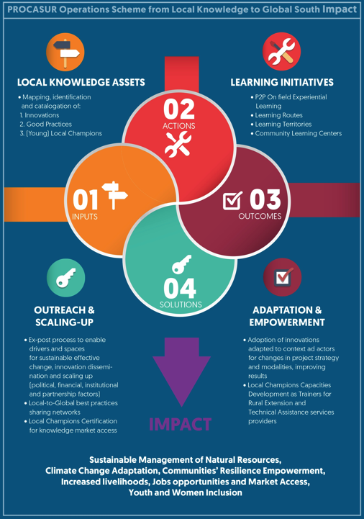

Slide 4
PROCASUR’s KM tools to scale up local solutions
THE BASE
THE INNOVATION SYSTEM
THE SCALE
Local Champion (LC) as acknowledged knowledge service providers. The LC are people with valuable practical knowledge in their territories and leading knowledge ex-change processes.
Learning Route. It’s an active capitalization tool that draws upon local knowledge and experiences to disseminate and scale up field-tested solutions and investigation results.
Learning Territories. Promotes LC association for private provision of extension services and advisory. Packages of diverse rural associations experiences are core knowledge products of practical and territorially specialized training.
Notes:
Local Champions: The Local Champions are people with valuable practical knowledge, which stand out within their organization or community for their ways of doing things and leading development initiatives that positively affect their territories. Local Champions hold a wide range of technical-empirical know-how as the result of years of experience. Their skills comprise “niche” areas of expertise that are complementary to the traditional extension services system, delivering culturally appropriate training and technical assistance. Local champions are members of women, youth, afro-descendant and indigenous people’s organizations, local governments, cooperatives, enterprises, producers and natural resources management groups. Excerpt from “Local Champions Toolkit” - PROCASUR, 2016
Learning Route. It’s an active capitalization tool that draws upon local knowledge and experiences to disseminate and scale up field-tested innovations and best practices in sustainable rural development. Built up as an innovation journey with specific learning objectives, it encourages active knowledge exchange between learners and their hosts. The final objective is to develop the ability of communities, practitioners and decision makers to scale up the solutions that work in favor of the livelihood of the rural people. over 300 Learning Routes in 40 countries have been organized in the last twelve years, supporting directly over 50,000 development workers, grassroots leaders, and policy makers of 50 different nationalities. Originally fostering farmer-to-farmer exchanges, the Learning Routes are increasingly engaging policy-makers
Learning Territories. A Learning Territory (LT) encourages Local Champions to associate for the private provision of extension services. It integrates diverse stakeholders’ successful experiences in sustainable development – with evidence of impact and learning significance – into of a range of practical and territorially specialized trainings, promoting new alternatives for grassroots´ organizations leaders and development workers. Over 30 Learning Territories training have been organized since 2013 in Chile, Colombia, Peru, El Salvador and the first one in Africa is under preparation.

Slide 5
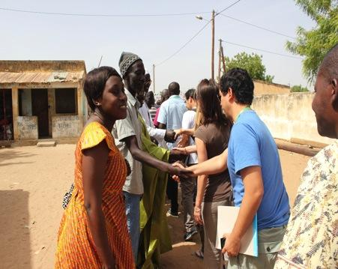
What is a Learning Route?
  Capacity building approach to promote experimental exchange and interaction
  Local actors become trainers to peers (peer-to-peer)
  Tailor-made to each client, and thematically structured around specific learning objectives
  Enables lesson learning and knowledge management based on concrete results
  A field-tested instrument to scaling-up of best practices and innovations across regions
  Intensify peer-to-peer networking through live and participatory knowledge sharing mechanisms
GOAL: participants are able to identify useful innovations to then adapt and apply these practices to their own organizations and contexts

Slide 6
Learning Route process
To Know To Know How To do To be able to
Mapping and Documentation of Good Practices and Innovation
Experimental Learning in the Field
Replication of good practices
Counting with knowledge products.
Design and preparation
Case studies &
KM training for local champions
Implementation of Learning Routes
Innovation Plan
Ex post assistance/
follow up

Slide 7
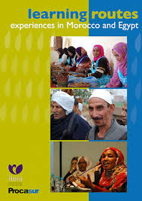

Slide 8

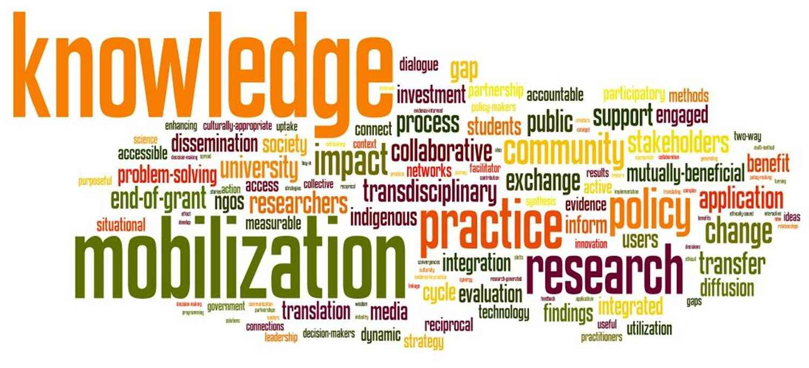
Learning Route Methodology
Learning Route Graphic Video

Slide 9

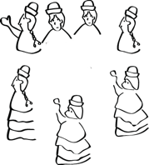
Local
Knowledge
Absorptive
Process
Sustainable
innovative
solutions
Contextualized
Knowledge
Local Champions:
Understand demand and context for change
Relate to, absorb, and contextualize local knowledge,
(3) Facilitate the transfer of good practices and innovative solutions,
(4) And reincorporate feedback for sustainable services.

Slide 10
Knowledge sharing of locally based innovations
https://www.youtube.com/watch?v=Z6EzAEg3gf8

Slide 11
PROCASUR.org

