Slide 1


STATE AGRARIAN UNIVERSITY OF MOLDOVA
Inception and Partnership Building Workshop
Morocco 9-10 October 2018

Slide 2

State Agrarian University of Moldova was founded in 1933 and it is the oldest and unique agricultural university in the country

Slide 3
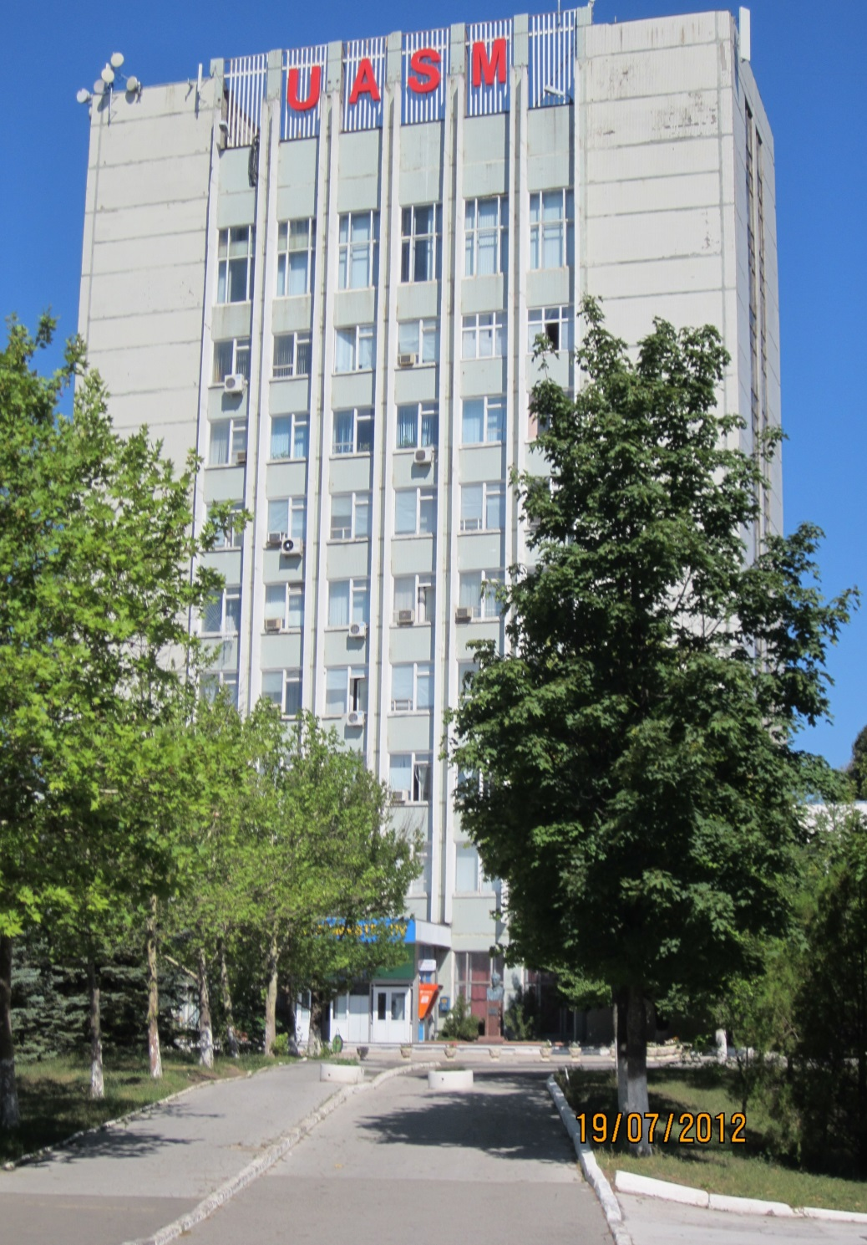
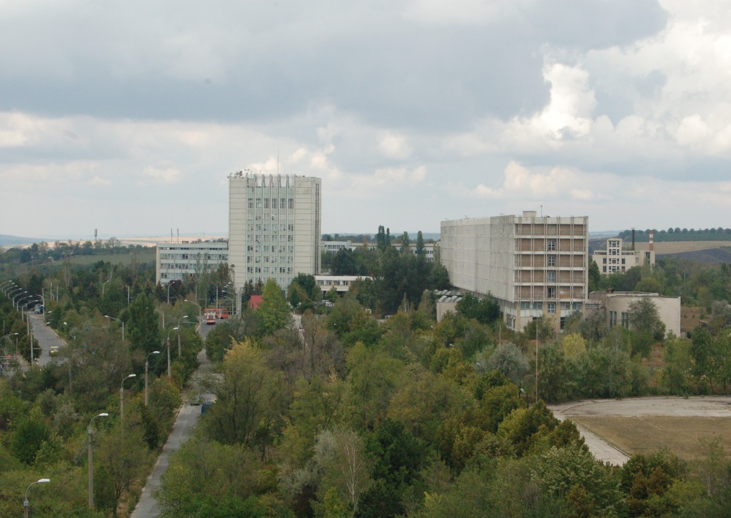
During its foundation, SAUM has made a particularly valuable contribution to the economic, social, political and cultural treasure of the society.
SAUM

Slide 4

In October, 2013,
State Agrarian University of Moldova was conferred the highest state distinction
"The Order of the Republic"

Slide 5
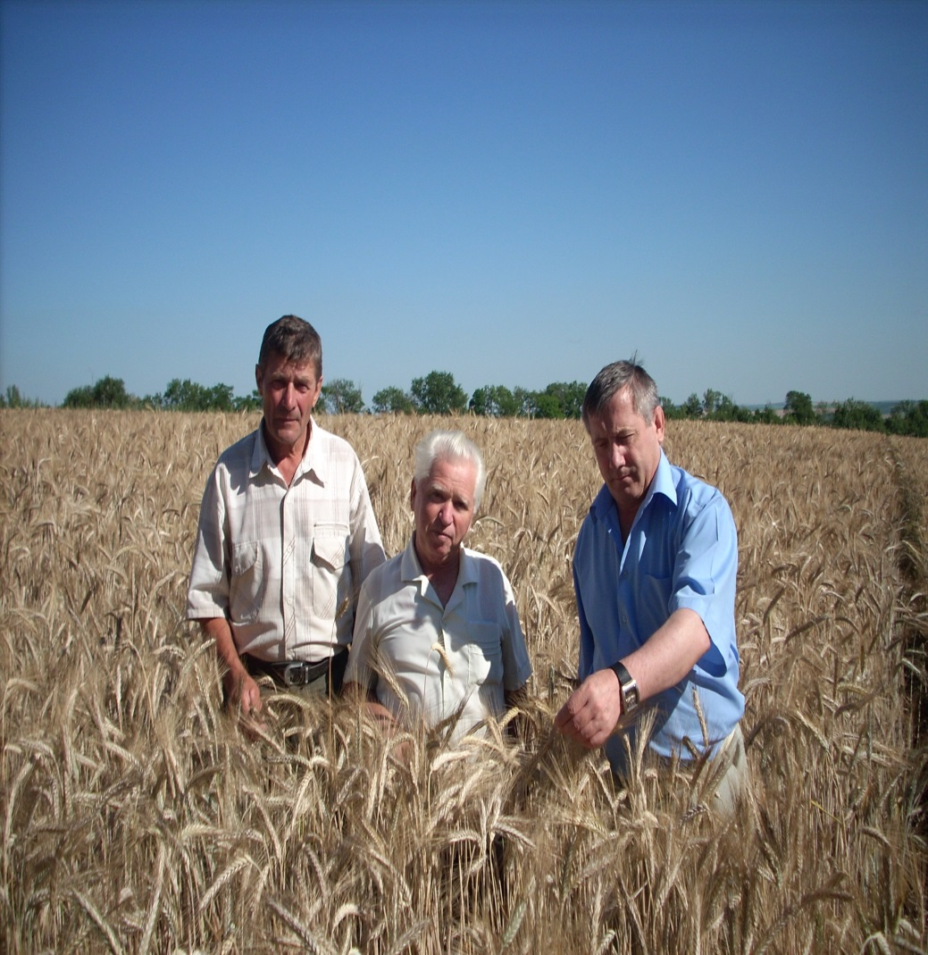
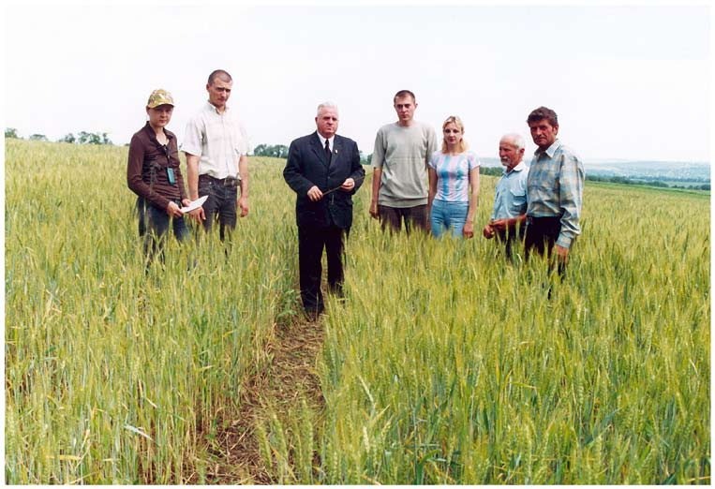
During its existence SAUM was also a spiritual center of agriculture. The academic staff developed a broad experience in propagating the results of scientific researches and new technologies among farmers.

Slide 6
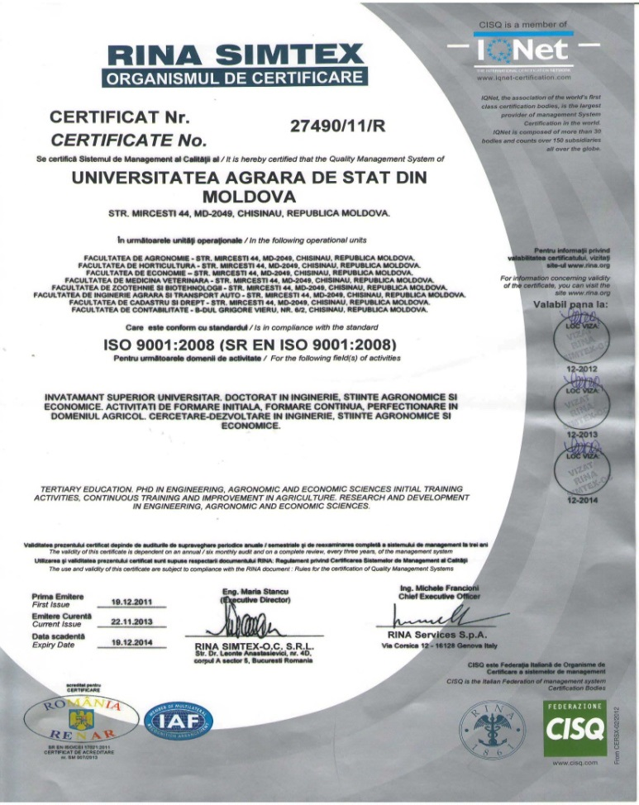
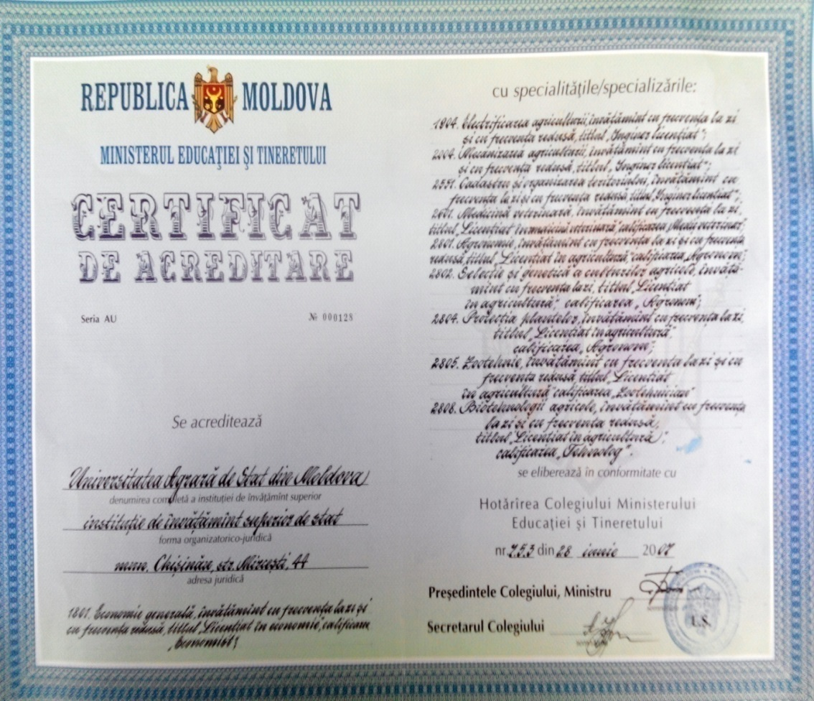
SAUM has implemented and maintains a Quality Management System that meets the requirements of ISO 2011-11-19 Standard.

Slide 7
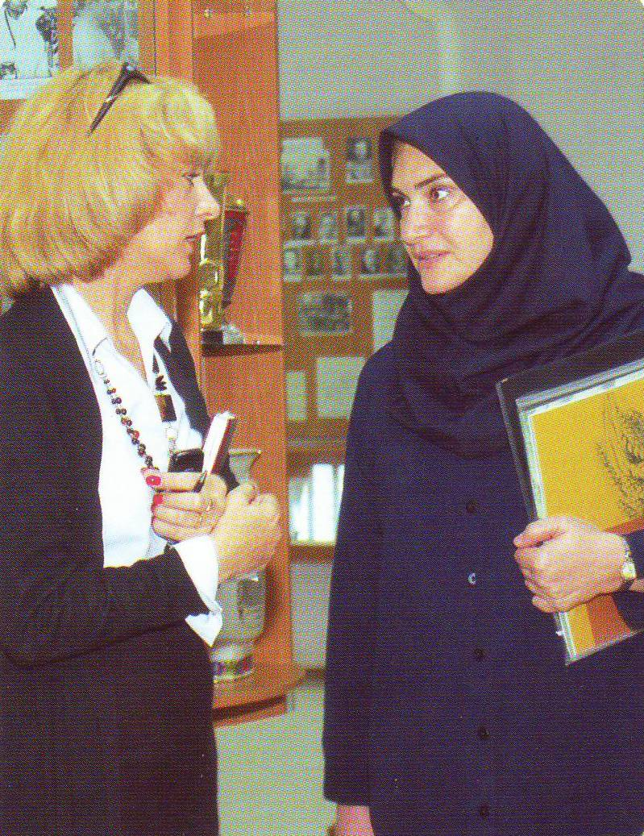
SAUM is the first university in the RM that became the member of the European University Association, the associate member of AUF, maintains relations of cooperation with universities and research institutes around the world based on more than 80 agreements and being totally open to international cooperation.

Slide 8
International Projects at SAUM
1. Project SMART “Fostering university enterprise cooperation and entrepreneurship of students via smart caffes -SMART” (nr. 585620-EPP-1-2017-1-EL-EPPKA2-CBHE-JP)
2. Project ReSTART“Reinforce entrepreneurial and digital skills of students and teachers to enhance the modernization of higher education in MOLDOVA” (nr. 585353-EPP-1-2017-1-RO-EPPKA2-CBHE-JP)
3. Project AGLAB“Improving skills in laboratory practice for agro-food specialists in eastern Europe” (nr. 586383-EPP-1-2017-1 – SI EPPKA2-CBHE-JP)
4. Project ELEVATE “Elevating the Internationalisation of Higher Education in Moldova-ELEVATE” (nr.573921-EPP-1-2016-1-MD-EPPKA2-CBHE-SP)
5. Project E-Drone „EDUCATIONAL FOR DRONE „(nr 574090-EPP-1-2016-1-IT-EPPKA2-CBHE-JP,
6. Project Teachme „Creating Moldovan E-Network For Promoting Innovative E-Teaching In The Continuing Professional Education”
8. Project „ Modern information services for improvement study quality”,CPEA-2015/10014
9. Project „Modernization and improving the teaching and research quality of the State Agrarian University of Moldova” Nr. 22/2016/05 Agency of Development, Czech Republic

Slide 9







All mentioned projects support the modernization of curricula, accessibility to the modern technologies and the internationalization of SAUM.
The main objectives are:
challenges in the management and governance of SAUM.
improving the quality of studies, developing new and innovative programmes.
providing and fostering cooperation between education, research and entrepreneur cooperation

Slide 10
ERASMUS KA1 ICM
UNIVERSITY OF APPLIED SCIENCES , Estonia
UNIVERSITY OF ALMERIA, Spain
SLOVAK UNIVERSITY OF AGRICULTURE FROM NITRA, Slovak Republic
PLOVDIV AGRARIAN UNIVERSITY, Bulgaria
UNIVERSITY FROM PORTO, Portugal
TECHNOLOGICAL INSTITUTE FROM CRETA, Greece
UNIVERSITY ALEXANDER STULGINSKIS, Lithuania
KINGSTON UNIVERSITY FROM LONDON, Great Britain
TRANSILVANIA UNIVERSITY FROM BRAȘOV, Romania
BOKU UNIVERSITY OF LIFE SCIENCES, Austria
UNIVERSITATEA OVIDIUS DIN CONSTANTA, Romania

Slide 11
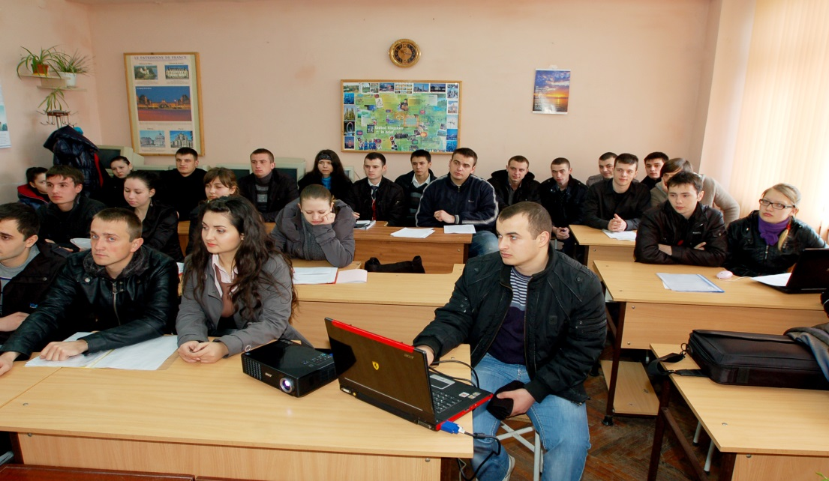
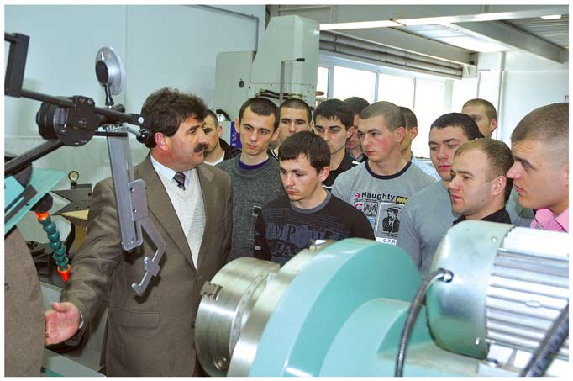
At present, within SAUM, more than 4000 undergraduate students and master’s degree studies at 23 specialties and 30 specializations.

Slide 12

The main goals of SAUM are:
reorganization of studies,
development of new research directions,
elaboration of a vast programs for infrastructure development.

Slide 13
There are six faculties at SAUM
Agronomy
Horticulture
Economy
Veterinary Medicine
Agricultural Engineering and Auto Transportation
Cadastre and Law
(23 specialties - on bachelor's degree, 30 specialties - on Master, and 16 specialties on doctoral programs).

Slide 14
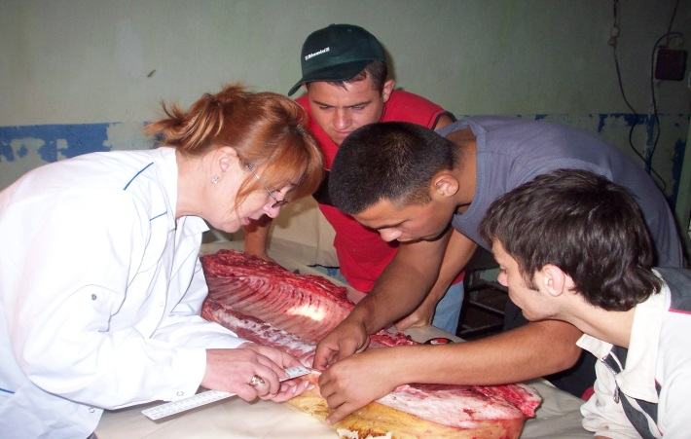
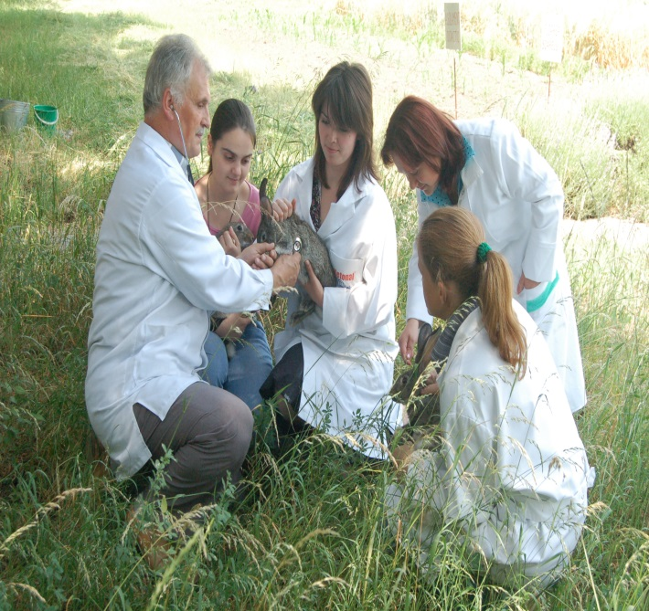
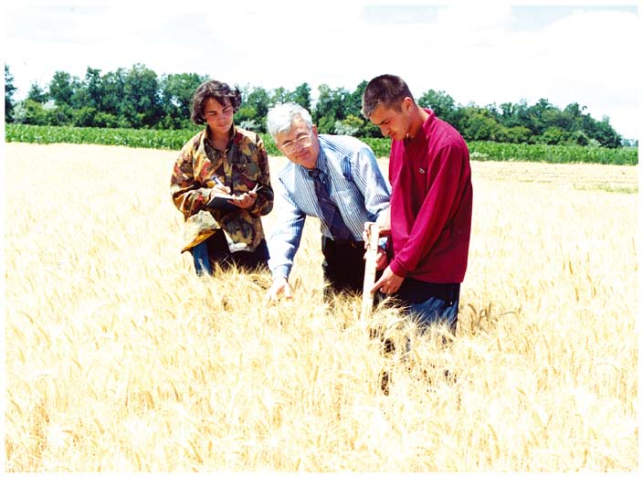
The teaching staff of the university includes about 300 highly qualified specialists who ensure qualified teaching and research activities, well-recognized both at national and international levels.

Slide 15
SCIENTIFIC RESEARCH AT SAUM
new plant varieties and hybrids,
local varieties,
animal and poultry cross breeds,
improved breeds of farm animals,
expanded intensive fruit growing plantations and vineyards
development of modern mechanization and automation technologies of the agricultural processes and of other related industries,
creation of new agricultural machinery, equipment, devices, composite materials, pharmaceutical products, etc.

Slide 16
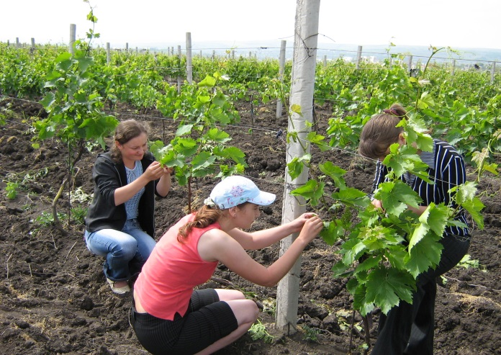
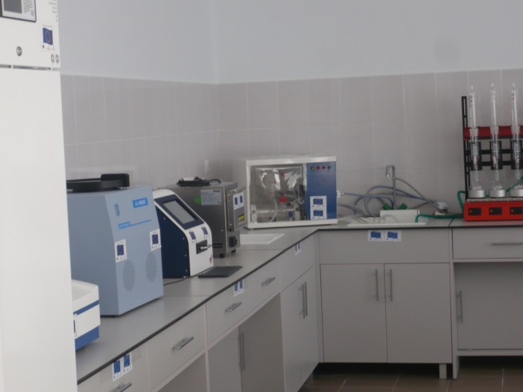
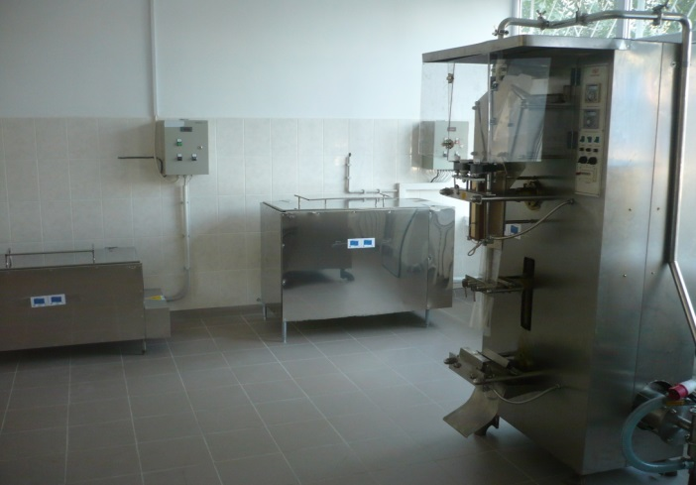
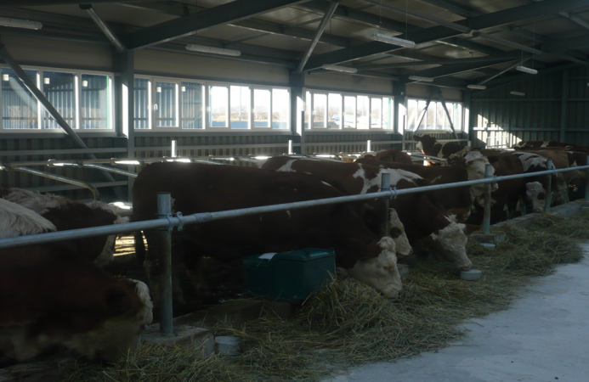
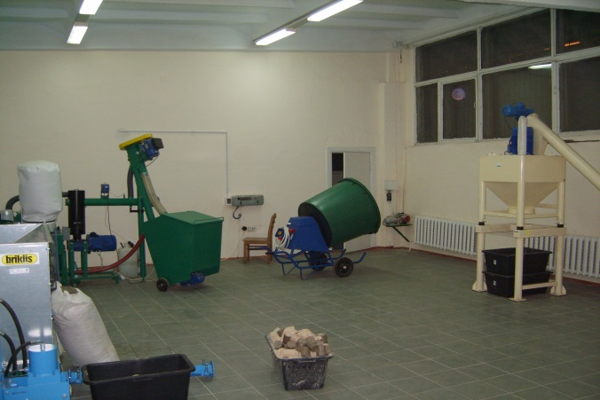
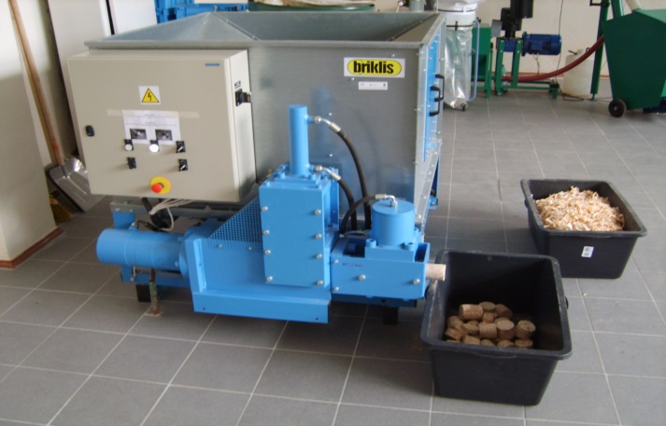
It was organized an innovation park with 8 specialized research centers and laboratories. Their aim is to carry out applied scientific researches ordered by different enterprises and related to specific research areas of SAUM

Slide 17
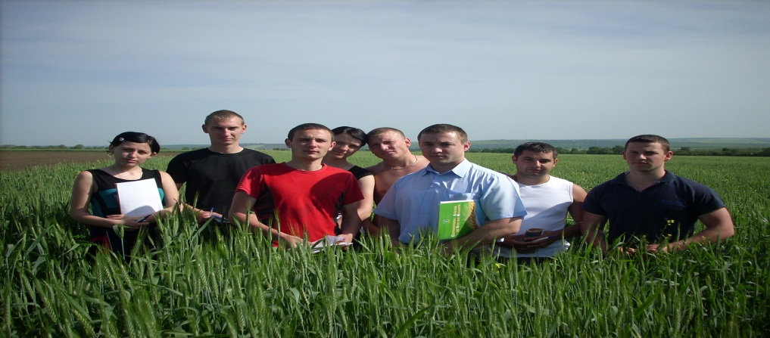
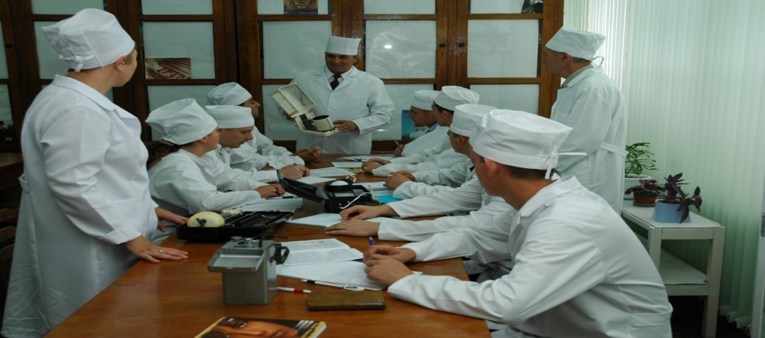

SAUM has at its disposal 9 teaching buildings, 14 student residences, 2 canteens, experimental didactic stations, the Republican Agricultural Scientific Library, a computer center, a publishing center, laboratories and sport facilities.

Slide 18
WELCOME TO
STATE AGRARIAN UNIVERSITY OF MOLDOVA
our addresses are:
www.uasm.md
or
44 Mircesti st., Chisinau, 2940 – MD,
Repubic of Moldova

Slide 19
THANK YOU FOR YOUR ATTENTION!
MERCI DE VOTRE ATTENTION!

