Slide 1



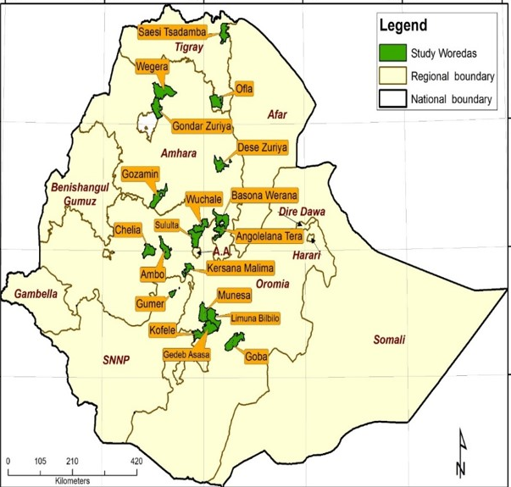


Faba bean Yield Gaps, Varietal Adoption and Seed Use in Ethiopia
ABSTRACT: The paper presents the varietal adoption and seed use of faba bean based on primary data collected from 370 faba bean producing farmers covering 19 districts in 13 major faba bean growing zones of Amhara, Oromia, SNNPR and Tigray regions. The adoption rate at household level indicate that 25.9% of the farmers are full adopters, 1.6% partial adopters and the remaining 72.4% were non-adopters based on plot level use of improved varieties. This has partly resulted in the productivity gaps between research estimated at 3.6 ton/ha, adopters (3.2 ton/ha) and national level (1.8 ton/ha). The current status calls for the need to strengthen the promotion of available improved varieties and for enhanced engagement of the formal seed system in faba bean to ensure better adoption.
DISCUSSIONS
The findings indicate that there is huge potential of expanding the production of faba bean linked with the revealed increased demand for export and domestic consumption. However, the low levels of productivity, which is on average 1.8 tons/ha compared to 3.2 tons/ha achieved at farmers’ field with research recommended practice, is the reflection of the low adoption of available improved varieties and management practices (see table below). This is associated with the limited engagement of the formal sector in availing certified seed of available varieties, which has resulted in considerable gap between demand and supply. This is further reflected in the low proportion of adopters who purchased certified seed. Only 6.28% of the adopted were able to buy certified seed. These trends require due attention in:
the strengthening demonstration and popularization of available improved faba bean varieties for enhanced demand creation in the target agro-ecologies;
Engaging with all relevant actors to promote integrated seed system development, where the formal, intermediate, and informal seed sectors will play their role; and
narrowing the gap between the demand and supply for certified seed.
INTRODUCTION
In Ethiopia, pulse crops play crucial role in agriculture with a share of 12.4% from the total land cultivated and 9.88% from the total grain production. Faba bean is the most important pulse crop and stands first in terms of area allocation (31%), production (35%) and number of farmers (52%) among all pulse crops. Over the years, there has been an increase in the number of farmers, area allocated, the productivity levels, and export. This paper presents the overall adoption of faba bean improved varieties, availability of certified seed and varietal composition.
RESULTS
Yield gaps in faba bean production
  Clear yield gap due to variety use and application of recommended crop management practices
  The national average yield (1.8 ton/ha) is by 50% and 43.75% lower than the yield achieved at research stations and farmers’ fields with improved variety and recommended practices, respectively;
Varietal adoption
  The adoption rate of improved varieties based on number of plots allocated is estimated at 18.93% and based on the proportion of land allocated is estimated at 22.38% at national level;
  At household level, 25.90% farmers were full adopters, 1.60% partial adopters and 72.40% are non-adopters
Faba bean seed sources
  From 22.28% of land covered with seed of improved varieties, 6.3% used purchased certified seed, 6.45% purchased local seed, and 9.56% used saved seed of improved varieties
  From 77.62% of land covered with local varieties, 64.56% was covered by saved seed and the rest 13.06% purchased seed and
Demand and supply of certified faba bean seed
The revealed seed demand is estimated to cover only 7% of the total faba bean area (0.54 million ha)
  Of revealed faba bean seed demand, only 35.52% of was supplied
  In addition, there is mismatch between varietal choice and seed supply
METHODOLOGY AND LOCATION - The study was based on nationally representative sample of 370 faba bean growers selected from 19 districts in 13 zones of the four major regions of the country (Amhara, Oromia, SNNPR and Tigray) during the 2014 cropping season (see Figure).
The adoption rates were estimated based on two approaches at householder level: (i) estimation based number of plot and varietal use, and (ii) based on plot size (area) allocated for improved varieties. In both cases, we identify full adopters, partial adopters and non-adopters of improved faba bean varieties. The average number of faba bean plots/farmer was 1.12.
REFERENCES
CSA (Central Statistical Agency). 2015. Area and Production of Major Crops. Agricultural Sample Survey 2014 / 2015 (2007 E.C.). Statistical Bulletin 578. Central Statistical Agency. Addis Ababa. Ethiopia
Alemu, D and Z. Bishaw. 2015. Commercial behaviours of small-holder farmers in wheat seed and its implication for seed demand assessment in Ethiopia. Development in Practice 26(6): 798-814
Zewdie Bishaw¹ and Dawit Alemu²
ICARDA, Addis Abeba, Ethiopia; EIAR, Addis Abeba, Ethiopia
Acknowledgements: CRP GL and CRP DS
Leveraging legumes to combat poverty, hunger, malnutrition and environmental degradation

