Slide 1

Livestock Productivity Improvement research activities and results in Central Asia
Makhmud Shaumarov
Tashkent, July 2016

Slide 2
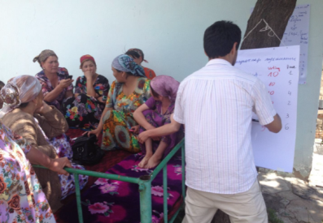
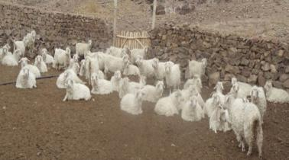
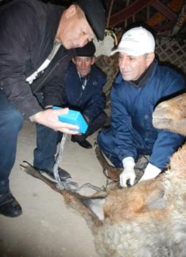
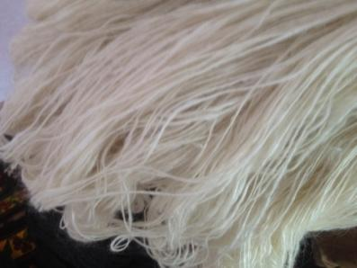
Enhancing livestock productivity for increased revenues and wellbeing of households of Karakalpakstan and Fergana Valley
Rapid assessment of small ruminant value chains (meat, milk, wool/pelt) completed in Tajikistan and Karakalpakstan
Traditional milk processing methods analyzed including entry points for low-cost improvements towards safer household nutrition
6 Angora nucleus flock
Capacitation of women interest groups in milk processing
Genetic improvement of Mohair quantitative and qualitative traits of Tajik Angora goats and “Sur” pelt production of Karakul sheep
At scale development of artificial insemination and ultrasound pregnancy diagnosis to support genetic improvement and to manage herd fertility
Ultrasound pregnancy diagnosis in at least 20 flocks
20% increase in Mohair fiber traits and 80% reduction in kemp fibers

Slide 3
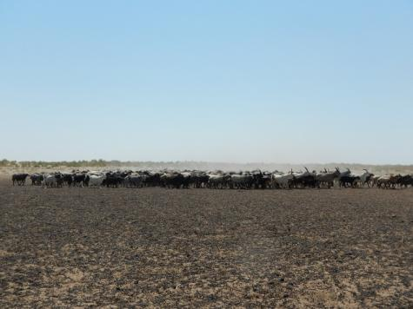
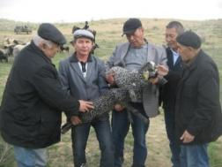
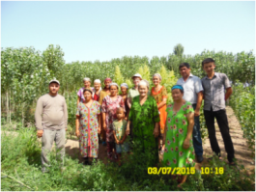
Improved Agro-pastoral Livelihoods and Rangeland Governance in Karakalpakstan and Fergana Valley
Elite flock of Karakul Sur sheep established in Karakalpakstan with nearly 200 elite newborns
Alternative biosaline forage crops were introduced to increase winter feeding for agro-pastoral households in Karakalpakstan
Institutional transformation of rangeland tenure in Uzbekistan and Tajikistan were documented
Round-table with policy-makers on sustainable rangeland management policy options were conducted in March, 2015
12 capacity building events for at least 226 community leaders were conducted to improve quality of SR dairy production, processing and agro-pastoral practices at both action sites.

Slide 4
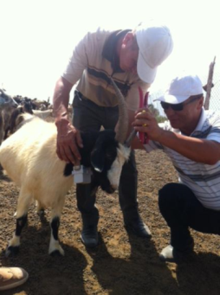
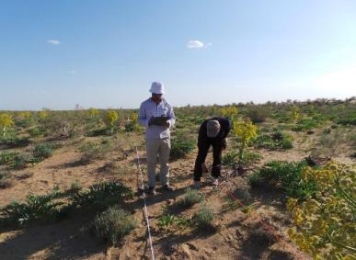
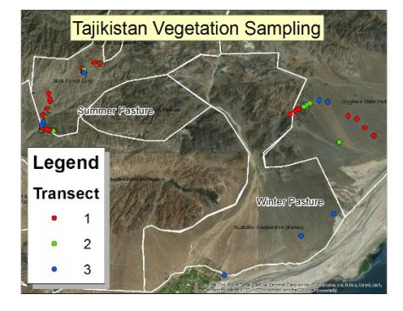
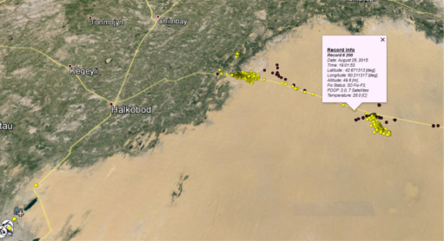
Understanding rangeland vegetation status and grazing patterns in Karakalpakstan and Fergana Valley
Vegetation inventory in spring and fall was conducted to understand the effect of grazing management on rangeland condition
Results are being used to create large scale vegetation maps to understand implications
under different management scenarios
GPS collars to measure
grazing patterns were
deployed in Aug. 2015,
they record position, time,
speed, temp. every 15 mins
Seasonal nutritional status
of grazing animals (blood
metabolites) is monitored
Vegetation monitoring
Fixing the GPS collars on a goat
Data from GPS collars
Data collected with GPS collars
The combined data will show feed availability, grazing patterns and help to identify management, input and services needs.

Slide 5
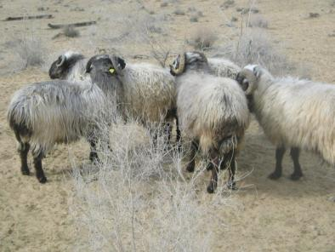
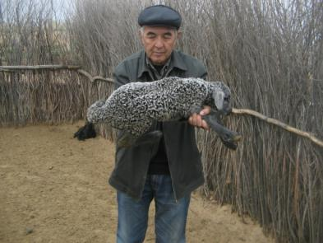
Thanks for your attention!

