Slide 1

Research on CLCA systems – opportunities for a second phase
Steering Committee Meeting (CPCM)
IFAD - ICARDA CLCA Grant Project 1393
CLCA Team (SIRPS-ICARDA)
Amman – Jordan
06th April, 2016

Slide 2
Steps to full project completion
Full documentation of the final WS available to participants
The third annual report needs to be cleared by internal review process – within the next week
Financial report for 2016 (Jan to March 2016)
Compilation and printing of final technical report including clarification of CapDev activities due within six months after project end
Communication strategy for the major achievements and results to be planned with IFAD communication team
  Presentation on major findings either for presentation at IFAD or to be posted on website
  Communication materials
ICARDA-NARS Fact sheets about major findings

Slide 3
Relevance of a follow-up project
Policy makers in the concerned countries became more convinced by CA and are designing specific strategies to promote it
Challenges are significant, but opportunities to significantly increase economic production of smallholder farmers through development and implementation of CLCA systems
Systems built under the core elements of CLCA (including ZT sown crops & strategic grazing of stubble residues) have potential for NRM benefits
Opportunities for increasing crops yields, enhancing capacity, capability, and resilience of farmers and rural communities
High willingness and motivation of small farmers related to the environmental benefits as one of the main source of motivation for the CLCA systems
Commitment to continue the support to the farmers !!!!
Opportunities to establish long-term experiments
Continuity required to fully capitalize on CLCA findings

Slide 4
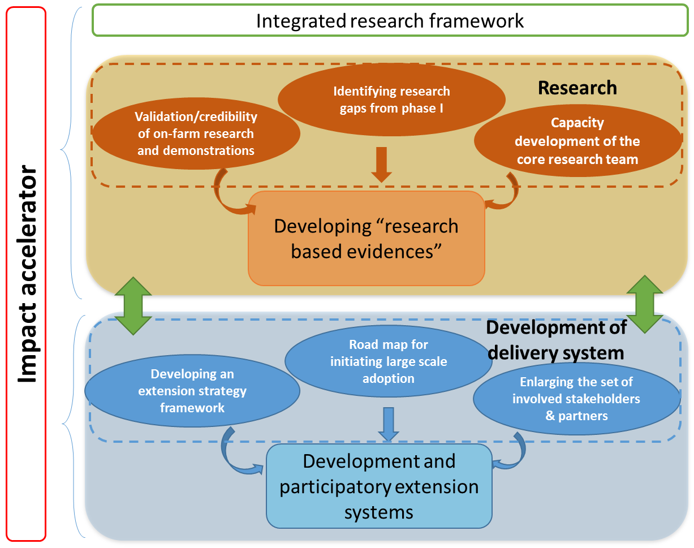
Conception of a new phase: Further research and delivery strategy

Slide 5
Steps towards second phase proposal
(Preliminary) farm typology based on baseline study to be used in CN for targeting and focused integrated research
Analysis of information material available through IFAD investment countries for delivery systems related to
  Farmer organizations
  Existing Extension services provided through different institutions (NGOs!)
  Rural financing
  Agri-businesses
Design of participatory Monitoring and evaluation system (incl. training)
In-kind support for NARS for continuation of activities and data analysis
CN to be submitted by August 2016 to IFAD

