Slide 1
AfricaRISING in Mali:
Concept note and work plans for 2013
T.A. van Mourik
with inputs from partners
Africa RISING West Africa Stakeholder Meeting, Accra, Ghana, 23 January 2013

Slide 2
Presentation outline
Introduction
Objectives AfricaRISING for Southern Mali
Description of Mali sites and “a system”
Workplans: System components and activities
Project implementation strategy

Slide 3
Introduction: AfricaRISING 2012
2012 “Quickwin” phase, initiate the project in on large scale (presented Eva Weltzien)
Some activities proposed have already been realised in Quickwin sites
Several review & planning meetings have led to the writing of concept notes for system components and workplans and budgets for 2013

Slide 4
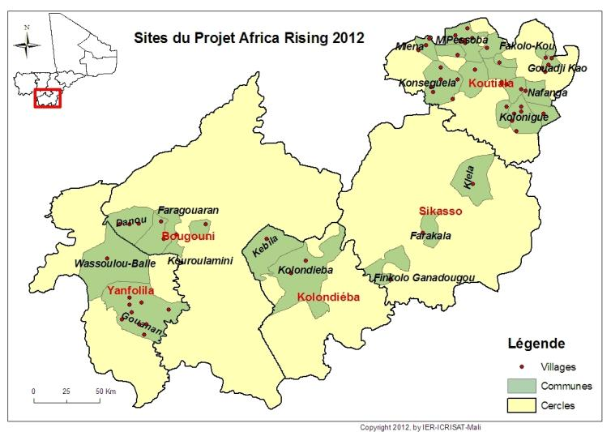
Southern Mali, Sikasso region

Slide 5
Objectives for southern Mali
Provide pathways of sustainable agro-ecological intensification for cereal-cotton-legume based systems and their components
(livestock, pasture, vegetables and agroforestry trees)
Develop integrated innovations for specific household types that are both productive and profitable and disseminate through farmer-to-farmer extension and commercialization
Achieve intensification through combining integrated innovations (technical and institutional) at the houshehold and landscape level while conserving or improving the natural resource base

Slide 6
Guinea Savanna and Sudanean zones of Mali
Annual rainfall between 900 and 1200 mm
Cotton-Maize-Sorghum/millet-legume rotations
Cotton cash crop driver of access to inputs
Opportunities for small scale irrigation for off-season vegetables, fruits, fruit-nut trees and rice
High degree of crop livestock integration, but still a lot of roaming cattle and transhumance

Slide 7
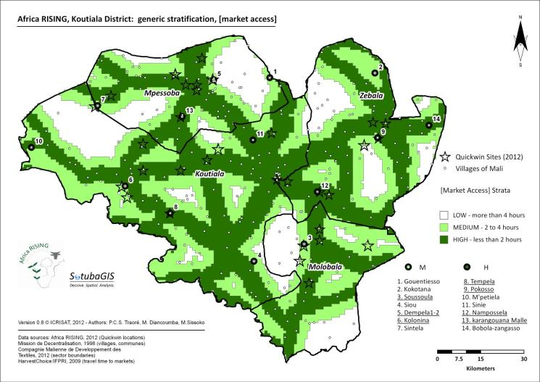
Koutiala district (20-50 hab/km)

Slide 8
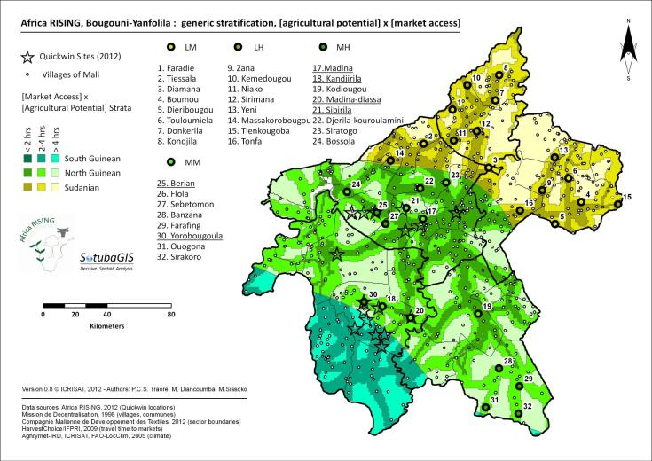
Bougouni/Yanfolila districts (5-25 hab/km)

Slide 9
A system?
“landscape or village territory”
NPK
NPK
NPK
FIELD
FARM
Notes:
4

Slide 10
Proposed system components for AfricaRISING in Mali
2.1 Cereal-cotton-legume systems (ICRISAT lead)
2.2 Vegetable systems (AVRDC lead)
2.3 Agroforestry systems (ICRAF lead)
2.4-5 Livestock, land and fodder systems
(ILRI & CIAT lead)
2.6 (Post)harvest technologies and markets
(ICRISAT & AVRDC lead)
2.7 Improved household nutrition (abandoned)

Slide 11
2.1 Cereal-cotton-legume systems
Activities
1.Establish R4D platforms with all partnes in Bougouni and Koutiala district
2.Develop and test combinations of component technologies for integrated innovations
3.Test and model (ex-ante) options for crop-livestock integration and intensification options
4.Test options for local seed production and marketing
5. Build capacity of farmers, extension and research staff for R4D, testing INVs and seed production
6. Develop and use media based tools for large scale dissemination and farmer-to-farmer training

Slide 12
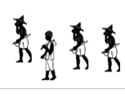




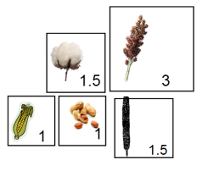
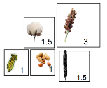

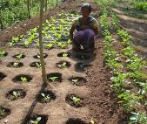

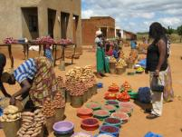
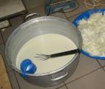
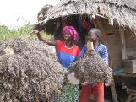
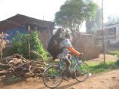
Ex-ante modeling of integration at farm scale using FARMSIM:
What-if analysis
NPK
NPK
NPK
Zai
MARKETS
Notes:
4

Slide 13
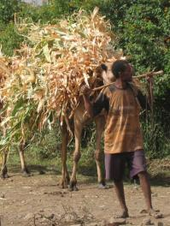
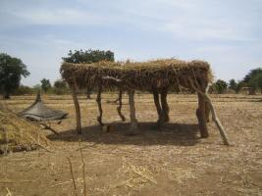

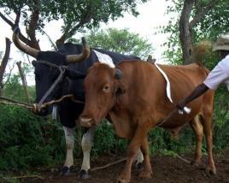
Trade-off analysis, sell crop residues or feed to animals?
Notes:
4

Slide 14
Trade-off analysis, sell crop residues or feed to animals?
Trade-off analysis, sell crop residues or feed to animals
Notes:
4

Slide 15
2.2 Vegetable systems:
Activities
1. Organise household, cropping system and market surveys focusing on production, consumption and sales of vegetables
2. Promote and disseminate new improved vegetable varieties
3. Develop best production practices for cereal-legume-vegetable crop integration
4. Strengthen the capacities of farmers, extension and research staff for vegetable production and seed multiplication

Slide 16
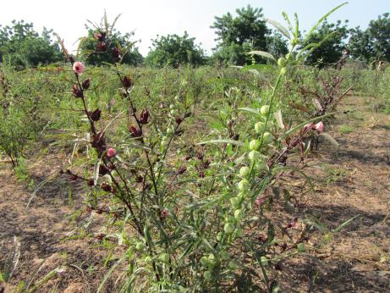
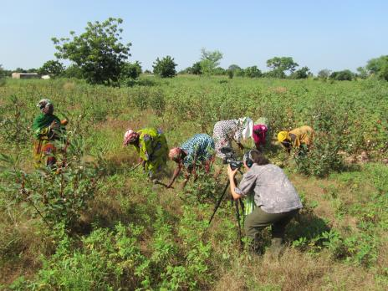
Vegetable-legume intercrops (hibiscus-groundnut),
vegetable-cereal intercrops (sorghum/maize-okra)
Especially performed by women:
Can we improve/optimize land/labour productivity??

Slide 17
2.3 Agro-forestry systems
Activities
1. Set up and monitor functional agricultural agricultural R4D platforms
2. Identify factors affecting adoption or dis-adoption of component options for integrated agro-forestry management
3. Adapt, test and disseminate best-bet propagation techniques for agro-forestry species
4. Development of decision support tools for selection of best-fit and appropriate livestock-tree-crop management options
5. Development and promotion of rural seeds/seedlings entrepreneurships
6. Develop guidelines and policy briefs related to on-farm tree and land management, institutional innovations to reduce vulnerability of rural poor and conflicts (from 2015 onwards)

Slide 18
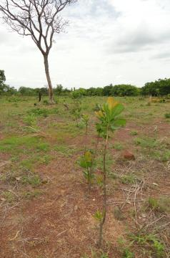
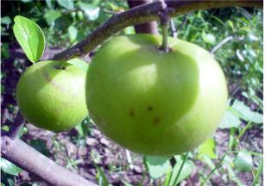
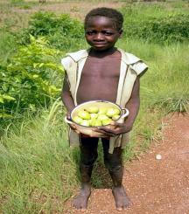
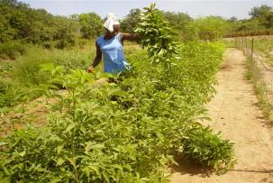
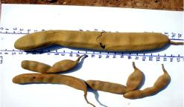
Best-bet/fit options:
Selecting/Grafting fruit trees, farmer managed natural regeneration (FMNR) etc.

Slide 19
2.4-5 Livestock, land and fodder Activities
1. Analyze strengths and weaknesses of existing local conventions (starts 2014)
2. Test the introduction of very high resolution (VHR) imageries in support of local land use planning
3. Monitor biomass production and destruction at landscape scale with in situ and remote sensing measurements
4. Integrated assessment of soil and ecosystem health, identify priority areas for land management interventions

Slide 20
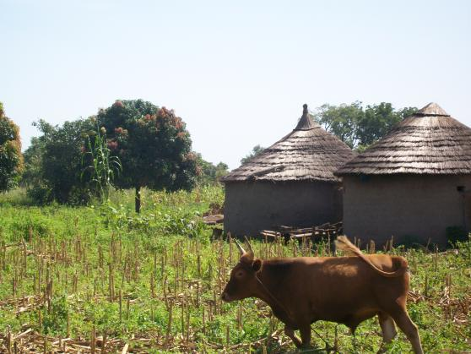
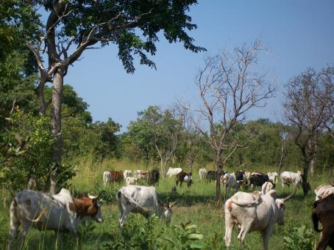
Monitor biomass production and destruction by regular assessments within and outside exclosures

Slide 21
2.4-5 Livestock, land and fodder Activities
5. Assessment of dairy and small ruminant value chains to identify constraints and opportunities
6. Evaluation of existing and potential feed resources, current use and costs and assess gaps
7. Test and design technical, institutional and organizational innovations for the upgrading of cattle and small value chains

Slide 22
2.6 Harvest, postharvest & markets activities
1. Synthesize information on harvesting, processing and storage methods at project sites
2. Test best-bet harvesting, handling, storage and pest and aflatoxin control methods
3. Train farmers in improved harvest, storage and processing of selected local crops to increase value and food safety
4. Inventory current markets and expand markets through market prospecting research and link farmers to identified markets (starting 2015)
5. Train farmers, processors and traders on agribusiness and entrepreneurial skills, aggregated by gender

Slide 23
Project implementation steps (1)
Build R4D platforms with all stakeholders and partners in the sites
(regroup villages from 1-2 strata in Koutiala / Bougouni)
Determine farm type & gender specific demand for technologies for each of the system components
(Farm typology performed for Koutiala and planned for Bougouni)
Plan activities and participatory research in each of the action villages and identify volunteer test farmers (gender, farm type specific)
Implement activities of at least 2, but preferably 3 or more components in any action village

Slide 24
Project implementation steps (2)
Organize meetings with test farmers to plan for tests, trials and training related to components and combine between components where possible
(fodder crops→livestock feeding, stable feeding→composting)
Involve IITA in Mali for obtaining seeds of new varieties/hybrids of maize, cowpea and soyabean and developing protocols
Plan village and R4D platform level evaluations of trials and activities at appropriate times (before, at and after harvest)
Take into account labor and economic aspects in the evaluation of component technologies and integrated innovations at farm level

Slide 25
Project implementation steps (3)
Develop for each component, a calendar explaining the key moments in and –off season for each activity and coordinate research activities accordingly
Study different workplans, identify the synergies between these and integrate planning accordingly

Slide 26
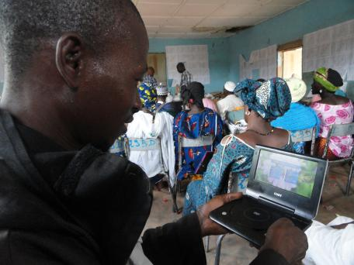
Adaptive research & extension can lead to “unsupervised experimentation by farmers” a good result (adoption)!
How to measure?

