Slide 1
How to report Clusters
Learn how to report clusters in MEL
in 1 minute

Slide 2
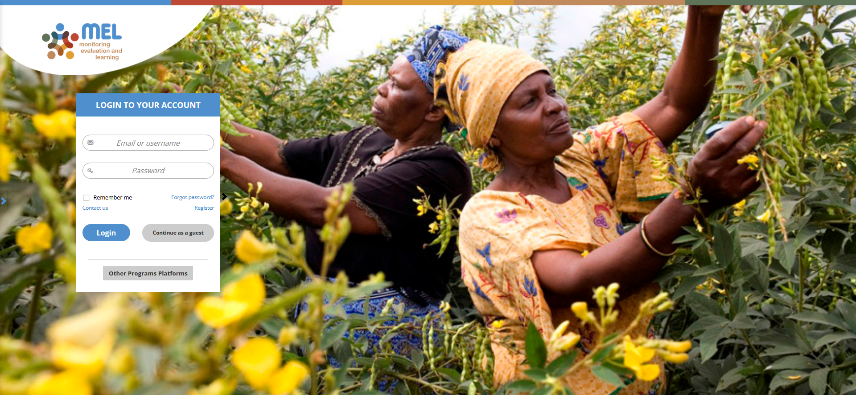
Go to mel.cgiar.org and login to your account
Use your email and password to login
Click on «Forgot password?» if you need to change your credentials

Slide 3
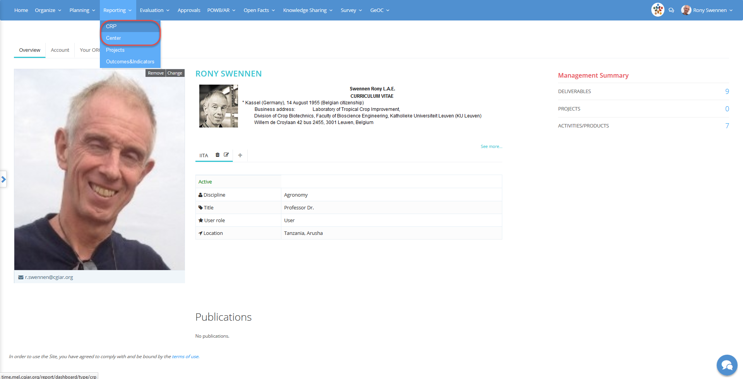
Click on the Reporting menu and select the reporting framework
You may select CRP or Center depending on the framework under which your cluster has been defined

Slide 4
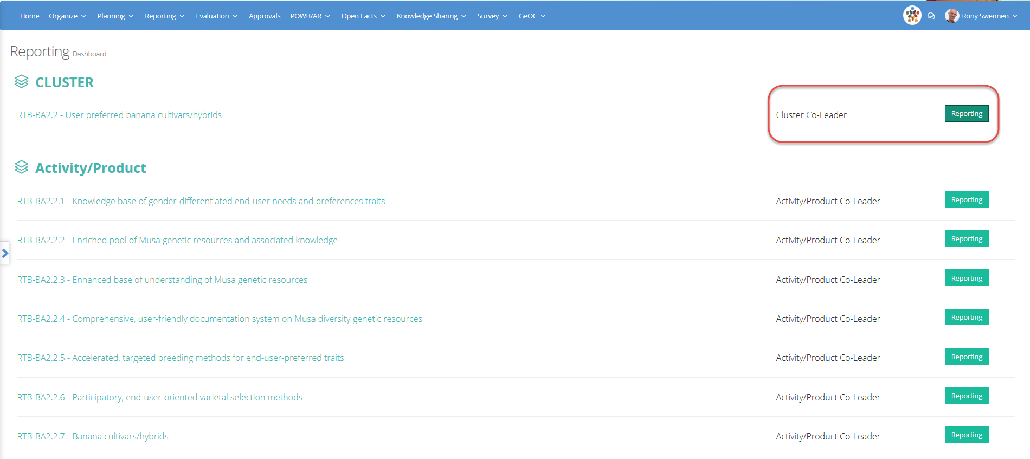
Identify the cluster that is under your responsibility or co-responsibility
Click on «Reporting» to open the Cluster page
Remember that the Cluster reporting is prepared and submitted by the Cluster leader in collaboration with the co-leader

Slide 5
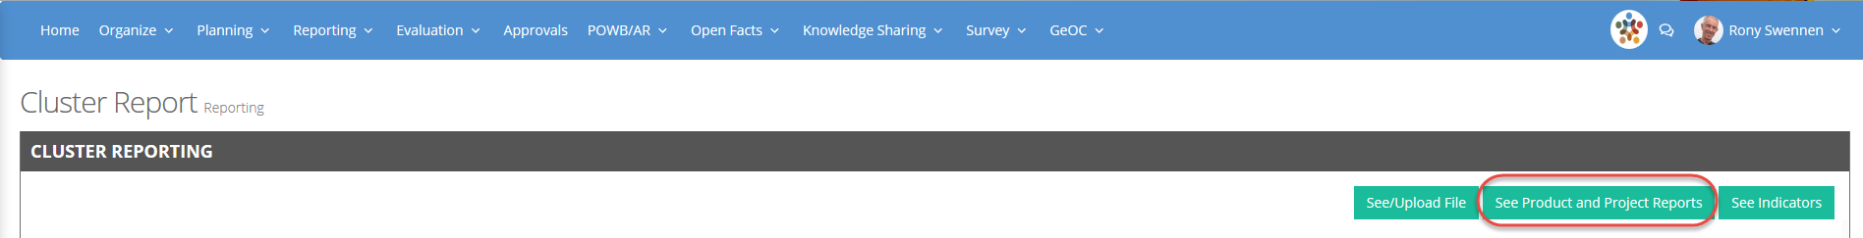
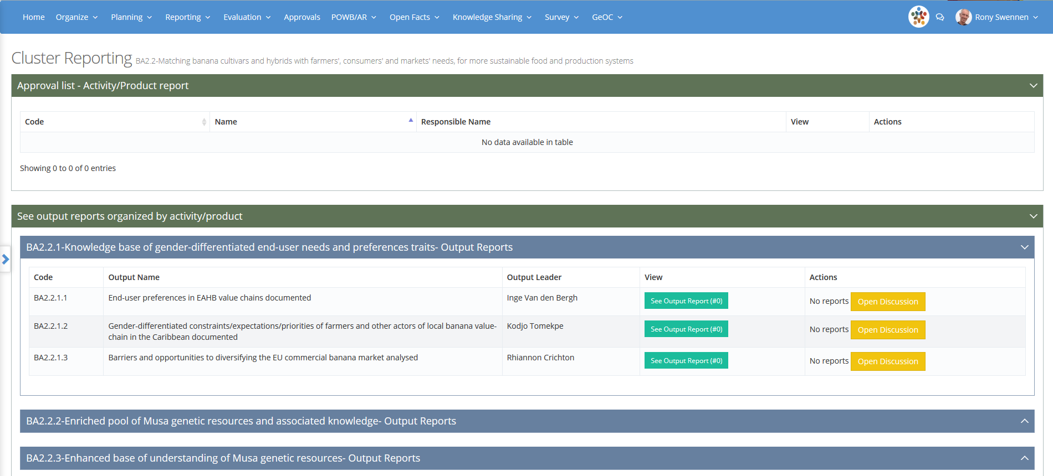
Make sure that products and outputs have been reported
Click on the button «See Product and Project Reports»
If Product reports have been submitted you will see them here
Click and expand the product tabs to see the output reports

Slide 6
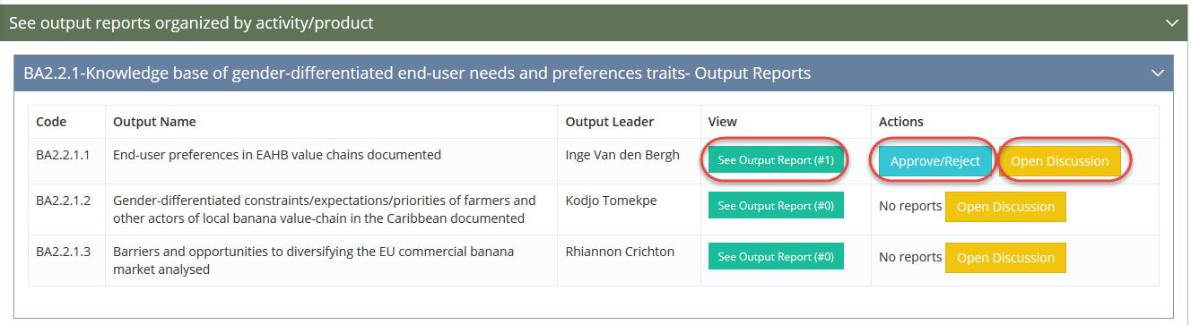
If Product leaders have not been defined
Click on the button «See Output Report» to see details about outputs and deliverables
Click on «Approve/Reject» to share your feedback with the output leader
«Open a discussion» if you have questions or if you need additional information

Slide 7
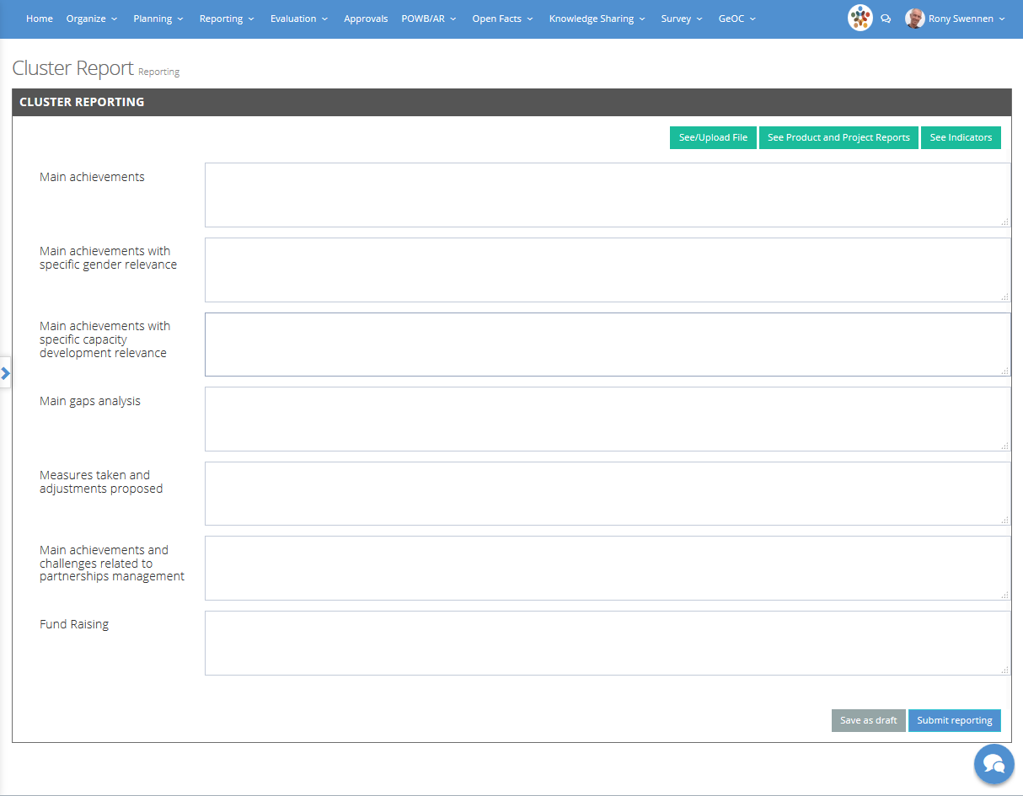
Go back to the main reporting page
Consolidate the information, complete the template and submit your report
If you are not ready to submit or if you want the cluster co-leader to contribute, save the report as draft. You will be able to resume the reporting and finalize it later

Slide 8



For more detailed information on how to use MEL please use the online guide
You need support?
Chat with us or send us and email
Thanks for using MEL

